Slide 1
LOWER LIMB VENOUS ASSESSMENT
Fundamentals of Vascular Ultrasound
28th February – 1st March 2022
Michael Davis AVS (University Hospital, Coventry)

Slide 2
Overview
Venous Anatomy and Physiology
Reasons to Scan Lower Limb Veins
DVT Scanning
Positioning, protocol, interpretation, reporting
Venous Insufficiency Scanning
Positioning, protocol, interpretation, reporting
Incidental Findings

Slide 3
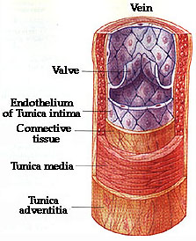
Anatomy and Physiology
Transport deoxygenated blood
Thin walled with 3 layers and bicuspid valves
Classified into 2 groups
Deep
Superficial
Notes:
Transport Deox blood = organs and tissue – IVC/SVC – Rt Atrium – Rt Ventricle – Pul Art – Lungs
Venous valves – prevent reflux/backflow

Slide 4
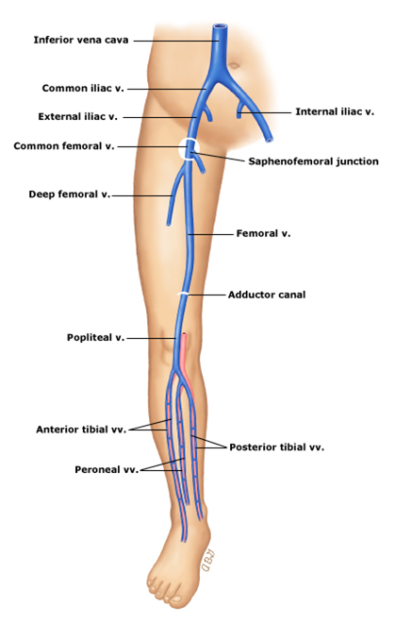
Anatomy and Physiology Cont.
DEEP VEINS
Below fascia and within or between muscle compartments
Below knee – paired veins, lie parallel to named artery
‘Superficial’ Femoral Vein (SFV) - AKA Femoral Vein
Gastrocnemius (GV) and Soleal veins
Notes:
Gastroc veins – can be 2 or more
supplies med and lat heads of gastroc muscle
single junc with POP V
Soleal sinuses – receive blood from soleus muscle
drain into PTV and PERV

Slide 5
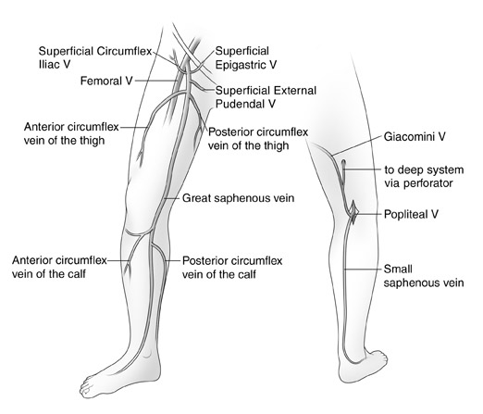

Anatomy and Physiology Cont.
SUPERFICIAL VEINS
Lie between skin and deep fascia
Two main systems:
Long/Greater Saphenous Vein (LSV/GSV)
Short/Lesser Saphenous Vein (SSV)
Anterior Lateral Thigh Vein (ALTV)
Communication between Deep and Superficial systems:
Sapheno-Femoral Junction (SFJ)
Sapheno-Popliteal Junction (SPJ)
SFJ

Slide 6
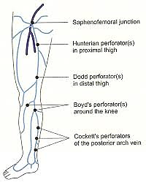
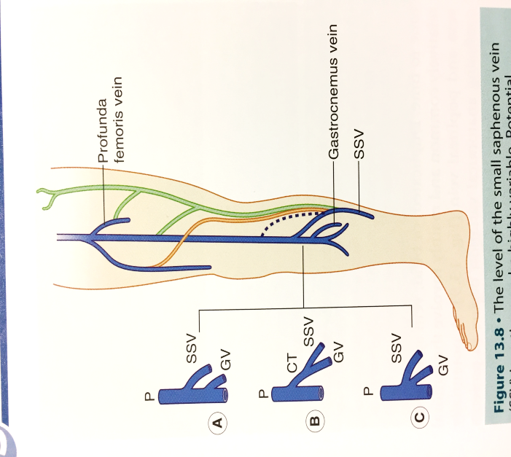
Anatomy and Physiology Cont.
SPJ position variable
Most commonly 0-4cm above knee
Common trunk or shared junction with GV
Drains to Proximal POP/SFV
Drains to LSV = Giacomini vein
Drains to SFV/PFV/Internal Iliac V (thigh extension vein)
Perforators – join superficial and deep veins
Notes:
SPJ - sometimes high junction with POPV (dashed line)
Green lines – thigh extension vein
Orange line – drains to LSV = Giacomini vein

Slide 7
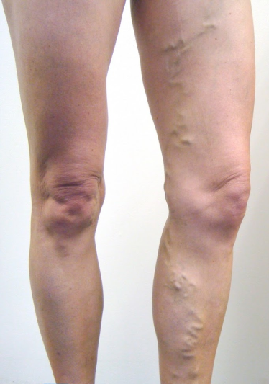
Why Scan Lower Limb Veins?
Deep vein thrombosis (DVT)
Pain, swelling, tenderness, reddening, heavy ache, and warm skin
Deep or superficial venous insufficiency (DVI/SVI)
Varicose veins
Primary, secondary, and recurrent
Primary 4-5 x more common than secondary
LSV involved 5-6 x more often than SSV

Slide 8
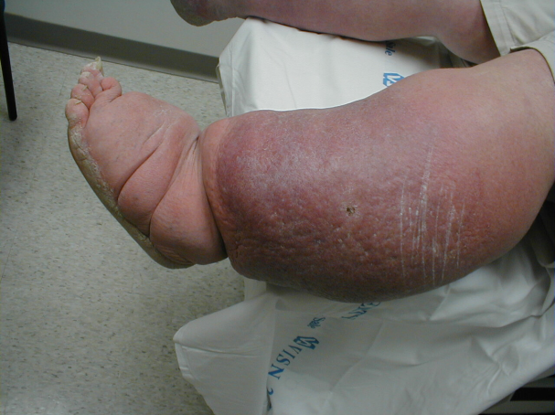
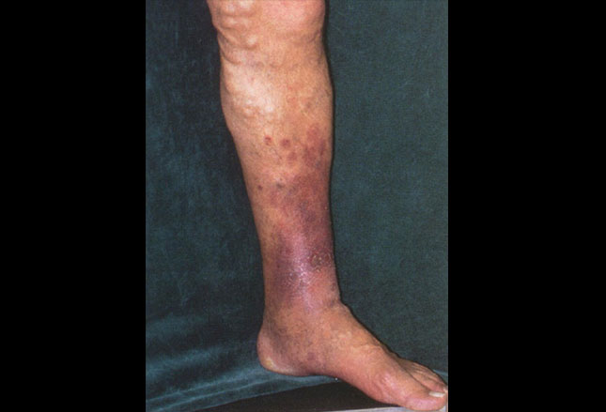
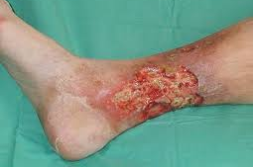
Why Scan Lower Limb Veins?
Oedema
Skin Changes
Lipodermatosclerosis
Varicose eczema
Ulceration
Notes:
Oedema – the trapping of tissue fluid in the interstitial spaces, No. reasons for this e.g. venous HTN due to DVT or CVI, cardiac or renal failure, extrinsic compression (pregnancy), systemic HTN.
Skin changes
LDS – noted particularly in medial aspect of lower calf,
- symptoms include pain, hardening of skin, change in skin colour, and swelling
Varicose eczema – classically associated with gaiter area of calf and may cause symptoms of itching or discomfort
Ulceration – 90% of ulcers are venous, situated in medial aspect of lower calf just above medial malleolus, usually associated with chronic skin changes (mentioned above)
Often painless, but can be extensive, involving large areas of tissue.

Slide 9
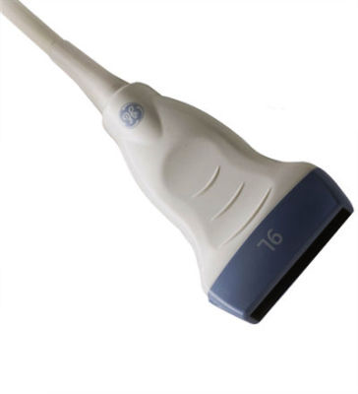
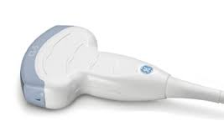
Equipment
Transducers
high frequency linear transducer for majority of work (5 MHz)
low frequency curvilinear probe for very large limbs or abdominal work (3-3.5MHz)

Slide 10
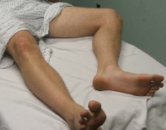
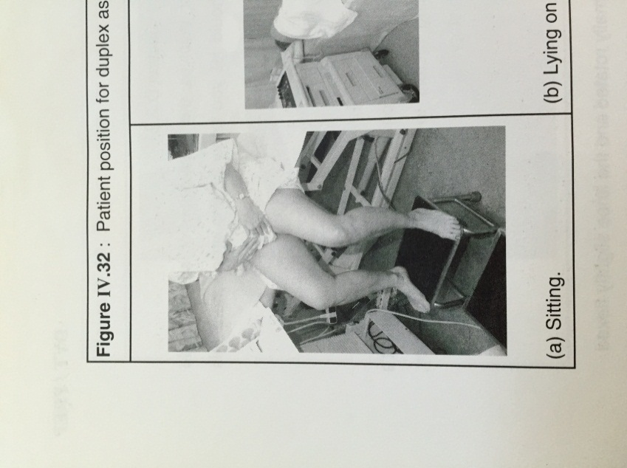
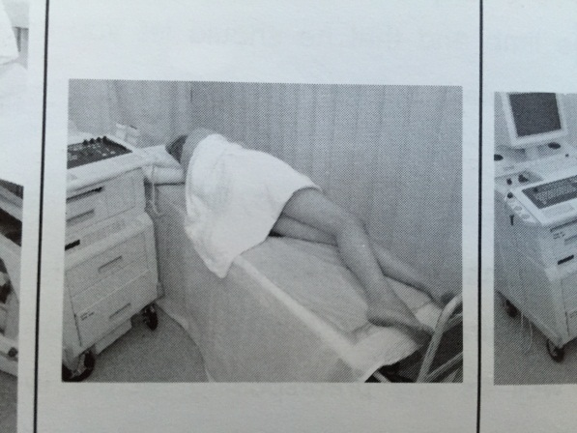
Duplex Scanning for DVT
Patient positioning
Pelvic and thigh veins
Lie patient supine, leg externally rotated, knee slightly flexed
Raise head and lower feet to aid venous distension
Popliteal Vein
Mobile patient – sit on edge of raised couch, ensure:
thigh is not compressed by couch
thigh sloped downward, knees lower than hips
calf hangs freely, muscles relaxed, and foot on stool
Immobile patient – lie on side with knees slightly flexed
Calf veins
Mobile patient – as above for popliteal
Immobile patient:
lie on side to assess Peroneal veins,
lie supine for PTV’s and ATV’s

Slide 11
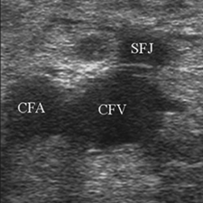
DVT Protocol
Explanation of protocol
Manual compression (moderate discomfort)
Starting at groin (intimate area)
Begin at groin in transverse, locate CFV, CFA, and SFJ in B-mode ‘Mickey Mouse view’
Apply gentle, slow, smooth pressure with transducer to examine compressibility
Into longitudinal projection use colour and spectral Doppler to assess flow (spontaneous and phasic with respiration).

Slide 12
DVT Protocol Cont.
Move distally to SFV in transverse (B-mode) examine compressibility at proximal, mid, and distal thigh level
Examine around SFA for duplicate/triplicate SFV (duplicated in 20-30%)
Distal thigh can be difficult to compress, place hand directly under thigh and apply pressure from behind

Slide 13
DVT Protocol Cont.
Reposition patient to assess popliteal, then repeat same process
Distal SFV (adductor canal) better visualised in this position
Above knee popliteal may require more pressure to demonstrate compressibility
When compression not possible (e.g. painful, poor imaging), use colour Doppler to demonstrate patency.

Slide 14
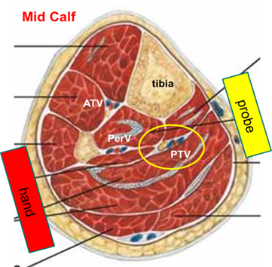
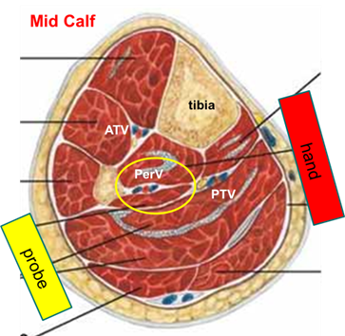
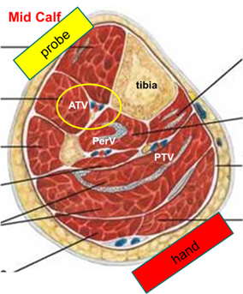
DVT Protocol Cont.
PTV and Peroneal veins compress from lateral and medial sides
ATV place probe anteriorly and brace knee with hand posteriorly

Slide 15
DVT Interpretation
Compressibility
Luminal diameter
Echogenicity
Colour and Spectral Doppler

Slide 16
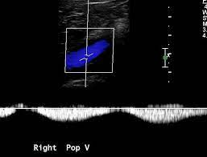
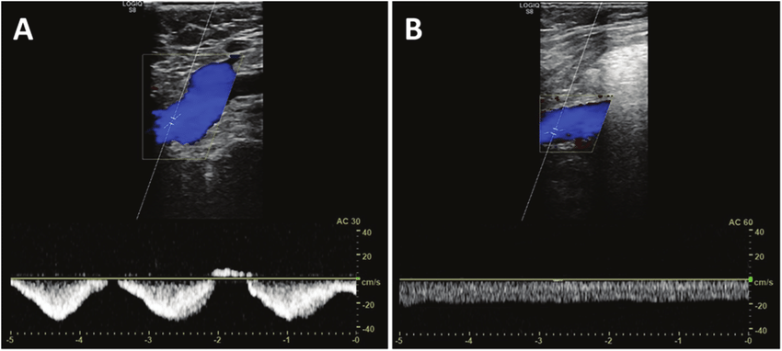
DVT Interpretation
Venous flow = Spontaneous and Phasic
Phasic flow (normal) Continuous flow (abnormal)
Notes:
Spontaneity – normal veins spontaneous phasic flow changes with respiration, without augmentation
- loss of spontaneity suggest DVT e.g. continuous flow in LSV = DVT in SFV
Phasicity - CFV, normally phasic with respiration, loss of this may indicate compromised venous outflow e.g. proximal iliac/IVC DVT

Slide 17
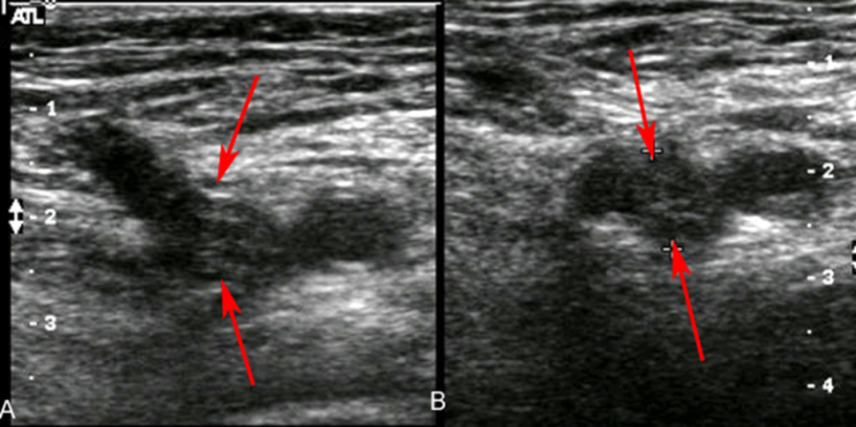
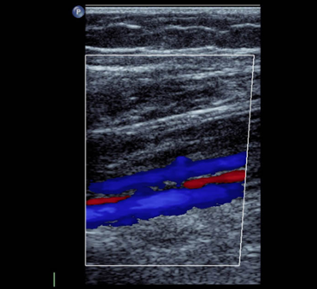
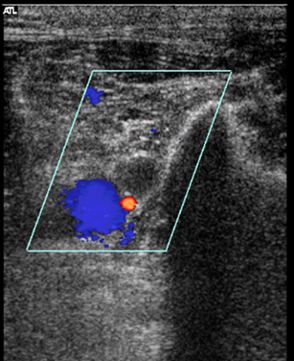
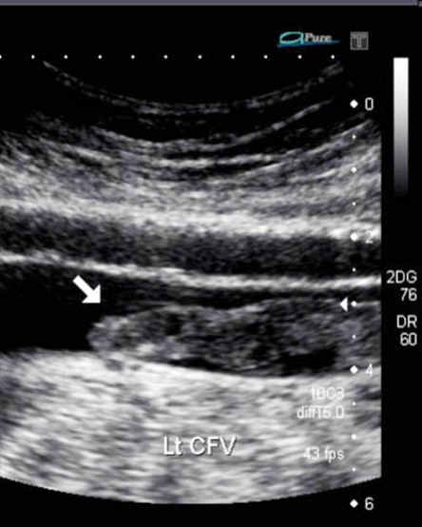
DVT Interpretation Cont.
CFV DVT
Free floating ‘tongue’ of clot
PTV and PERV DVT
Notes:
NOTE – establish proximal extent of clot (if possible)

Slide 18
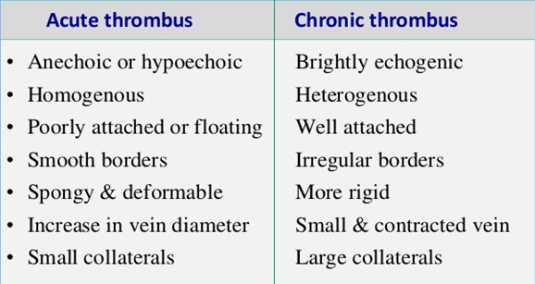
DVT Interpretation Cont.

Slide 19
Reporting DVT
Written report, including:
Leg scanned
Technique used e.g. compression, colour Doppler, flow interpretation
Any sections could not image
If positive, the extent of the DVT and appearance (e.g. acute or chronic)
Example normal report:
Normal flow seen in the CFV suggesting no occlusive proximal obstruction. Femoral Vein - patent and compressible throughout. Popliteal Vein - patent and compressible throughout. Conclusion: No obvious current DVT seen.

Slide 20
Reporting DVT Cont.
Example positive DVT report (femoral vein):
Normal flow seen in the CFV suggesting no occlusive proximal obstruction.
CFV and Popliteal vein - patent and compressible throughout.
Femoral vein - Incompressible occluding thrombus seen throughout.
NOTE - thrombus is echolucent giving the impression of an acute thrombus with a free floating tongue of clot seen proximally.
Conclusion: Femoral vein DVT demonstrated.

Slide 21
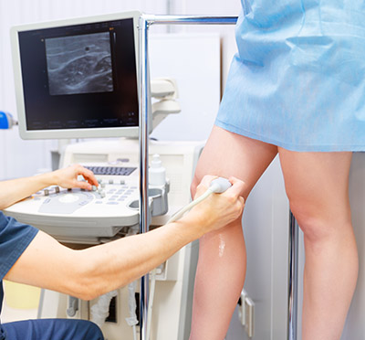
Duplex Scanning for Venous Insufficiency
Patient positioning
Different method’s, find what works for you!
Suggested method (patient able to stand)
Stand patient on stool/small step facing you
Externally rotate leg while flexing the knee
Weight onto contralateral leg, minimal weight on flexed leg
Examining POP, patient faces away in same posture

Slide 22
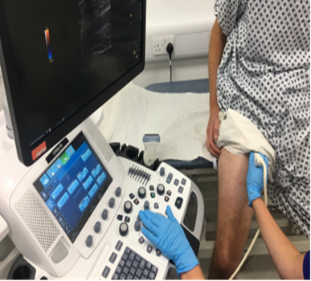
Duplex Scanning for Venous Insufficiency Cont.
Alternative method (patient unable to stand)
Thigh veins:
Patient stood with back to raised couch, sit on very edge with feet flat on floor
Position leg in same posture as previous

Slide 23
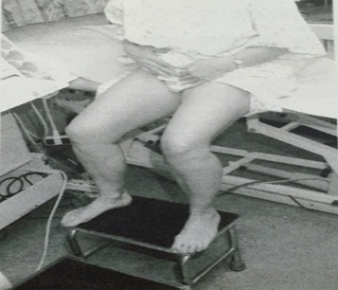
Duplex Scanning for Venous Insufficiency Cont.
Below knee veins:
Sat on edge of raised couch, feet on stool
(as per mobile DVT patient - POP and calf veins)
Externally rotate to examine medial calf region (LSV and deep calf veins)
Knee square on for examination of POP and SSV, ensure patient far enough forward to examine behind knee

Slide 24
Venous Insufficiency Protocol
Before start
Look at request card
Primary or recurrent VV’s
?LSV, SSV, or other e.g. ATV
Previous DVT
Look and speak to patient
Obvious varicosities, skin changes, ulceration
Brief history (symptoms, previous treatment)
Problem as they see it
Explanation of protocol
Starting at groin (intimate area)
Distal compression (calf/foot squeezes)
Occasional light headedness (males <40 yrs.)

Slide 25
Venous Insufficiency Protocol Cont.
Assess patency (colour and spectral Doppler) and competency (distal compression)
Map any large varices/perforators
Thigh veins
CFV /SFJ – transverse B-mode ‘Mickey Mouse view’
SFV – proximal, mid, and distal thigh level
LSV – most commonly tracks along medial thigh
Check for ALTV
If LSV incompetence ?origin e.g. SFJ/pelvic branch/perforators
Notes:
Longitudinal projection for checking patency and competency

Slide 26
Venous Insufficiency Protocol Cont.
Below knee veins
LSV - medial calf, ensure overlap with above knee
Deep calf veins - mid calf level (spot check)
POP - behind knee, check above and below knee joint
SSV - start proximal posterior calf, trace proximally to look for SPJ (not always present), then trace distally
SPJ - level of and ?communication with Giacomini and GV

Slide 27
Venous Insufficiency Interpretation
Competent/Normal
Incompetence/Reflux
Notes:
Competent/Normal – compress limb distal to TX, Cessation of flow during compression and phasic flow returns in normal direction upon release.
Incompetence/Reflux – retrograde flow (reflux) upon release

Slide 28
Venous Insufficiency Interpretation Cont.
Diagnostic criteria for reflux (as defined by SVT)
NORMAL:
valve closure <0.5secs
MILD:
0.5secs to ≤1.0secs and max velocity ≥10 cm/s
Sustained low volume reflux (max velocity <10cm/s)
MODERATE/SEVERE:
>1secs and max velocity ≥10cm/s
Notes:
As per SVT Vascular Lab Practise guide for Lower limb Venous Assessment

Slide 29
Venous Insufficiency Interpretation Cont.
Any reflux trace the origin:
Thigh to perineum
Thigh to buttock
Abdomen
Giacomini origin
Segmental reflux
Recurrent variations
LSV
Collaterals at SFJ, pelvic branches, perforators
SSV
Perforator above-knee, Giacomini to SSV, common junction SSV and Gastrocnemius vein, branch from LSV

Slide 30
Reporting Venous Insufficiency
Ideally diagrammatic
Directed to answering what the surgeon needs
If written use bullet points, avoid extraneous detail
Note key points and highlight non-obvious points, e.g. incompetent perforators
Information to guide treatment
suitability for RFA/laser (diameter, depth, tortuosity)
level of SPJ (may be marked before surgery)

Slide 31
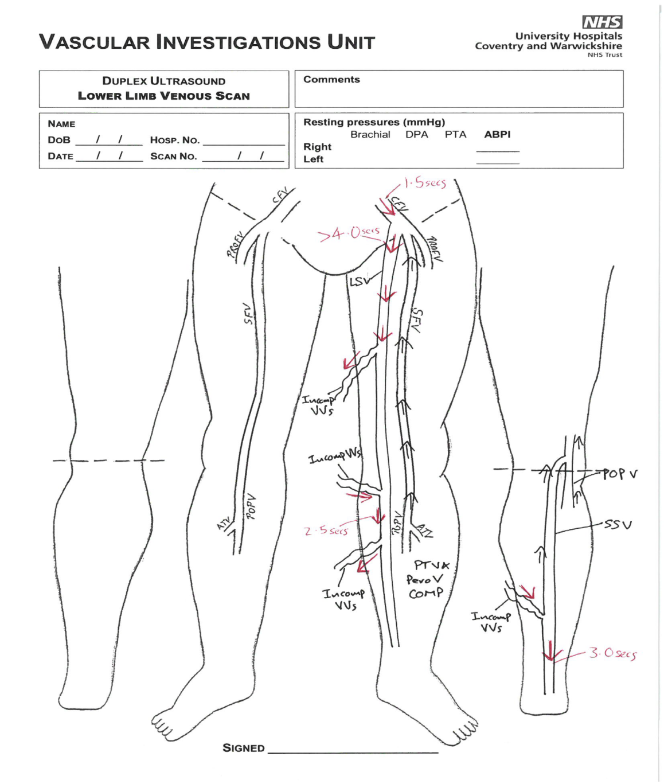
Reporting Venous Insufficiency Cont.

Slide 32
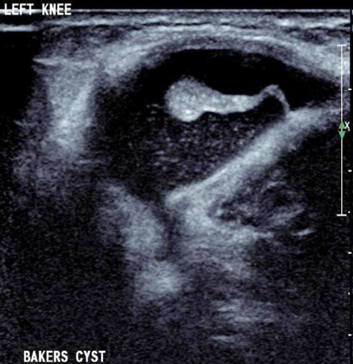
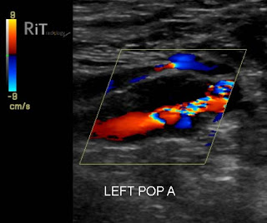
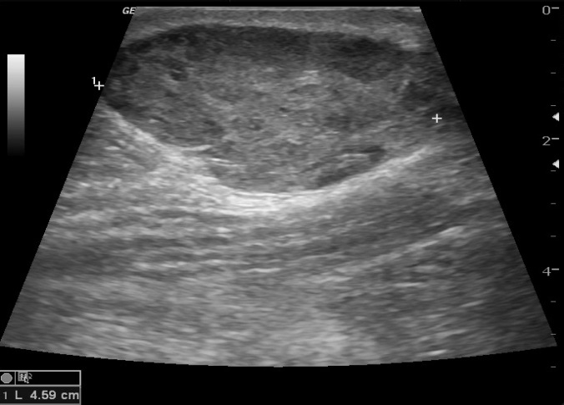
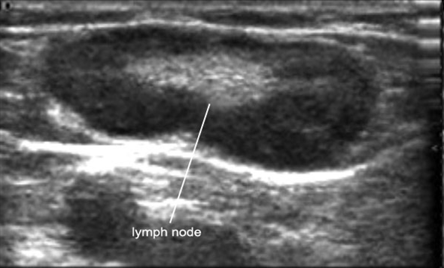
Incidental findings
Bakers cyst
Haematoma
Popliteal aneurysm
Enlarged lymph node
Notes:
Bakers cyst – accumulation of synovial fluid from knee joint,
Large echolucent oval structures in POP fossa, lie some distance medial to vein and artery.
Haematoma – large echolucent areas with muscle, often associated with muscle fibre rupture from blunt trauma or vigorous exercise
Popliteal aneurysm – large one can occasionally obstruct adjacent deep vein > DVT, should be able to define arterial walls.
Enlarged lymph node – can occur due to infection or malignancy
Mainly echolucent, containing stronger echoes in centre of node
Can be mistaken for thrombosed vein
Most commonly seen around groin
Can become so large that they compress adjacent vein

Slide 33
Any Questions?

