Slide 1
Lower limb arterial study day
Part 3
The role of Duplex ultrasound in surveillance

Slide 2
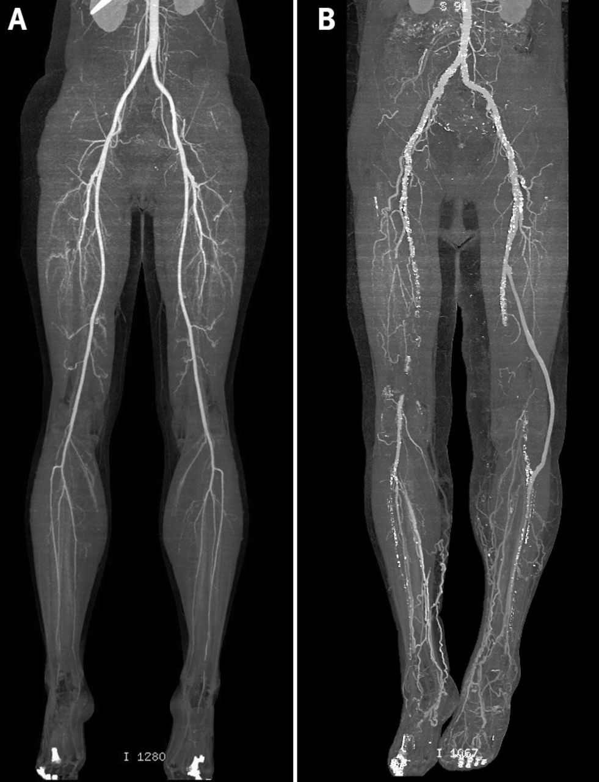
Lower limb bypass
Follow up surveillance is usually carried out after lower limb bypass surgery.
Visit will include full scan of the graft and an ABPI.
Patients will be followed up for 1 year and discharged if no problems are found.

Slide 3

Preparing for the scan..
Where is the proximal anastomosis and distal anastomosis?
Is the bypass vein or material?
Where does it lie?
Operation note

Slide 4

Performing the scan
Stenosis
Graft occlusion
In PTFE graft – intimal hyperplasia
Unusual findings – valve cusp, false aneurysm, AVF, kinking, graft infection, dilatation of vein graft.

Slide 5
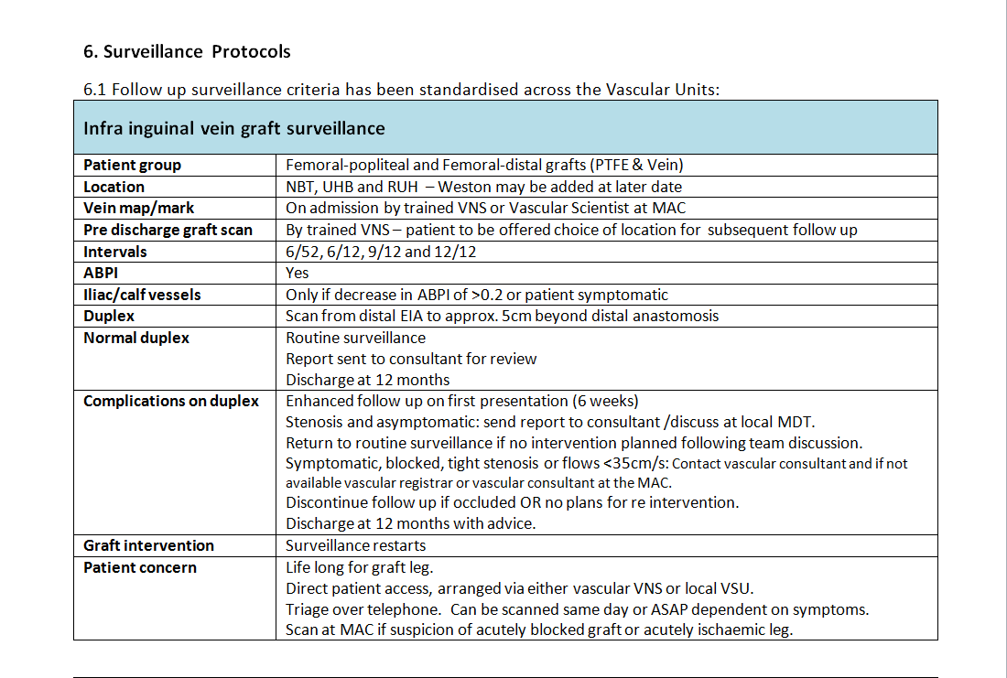
Lower limb bypass surveillance

Slide 6
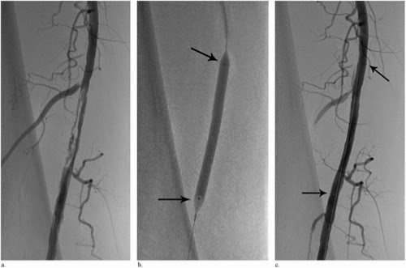
SFA stent surveillance
Follow up surveillance is usually arranged for SFA or popliteal stents.
Visit will include full scan of the stented area and an ABPI.
Patients will be followed up for 1 year and discharged if no problems are found.

Slide 7
Performing the scan..
Radiology report – tell you where the stent is.
Check for re-stenosis or occlusion
Intimal hyperplasia
Extrinsic compression

Slide 8
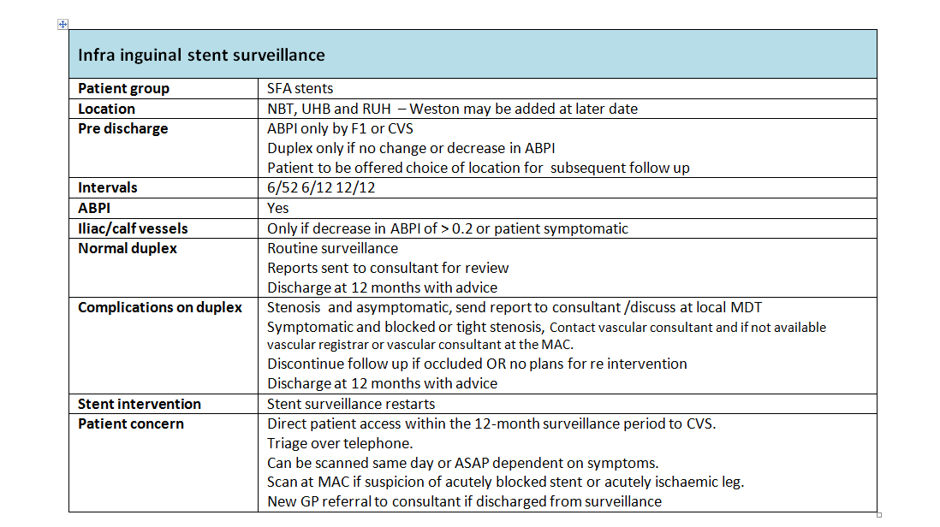
SFA Stent surveillance

Slide 9

Abdominal Aortic Aneurysm
Abdominal Aortic Aneurysm (AAA) is an enlarging of the aorta greater than 3cm.
Risk factors include, age, being male, family history, smoking.

Slide 10
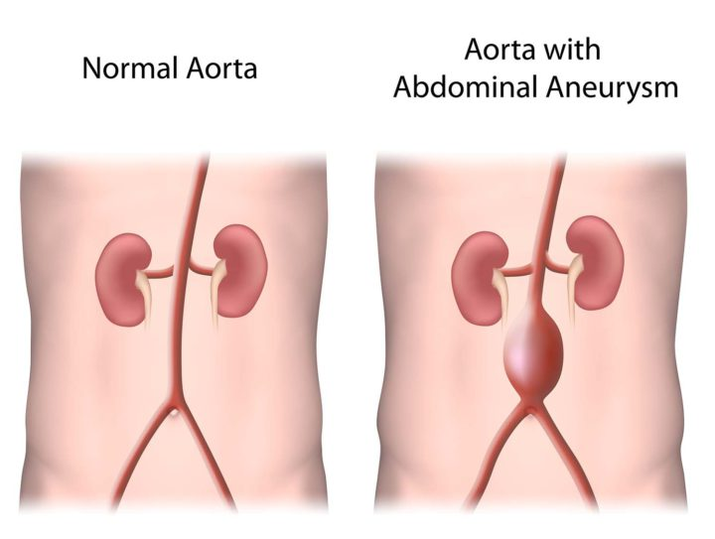
AAA screening programme
In England, screening for AAA is offered to men during the year they turn 65.
An AAA will often cause few or no obvious symptoms, but if it's left to get bigger it could burst and cause life-threatening bleeding.
Other than screening AAA are usually an incidental finding.

Slide 11
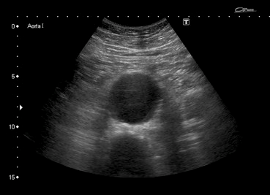
Performing the scan
Inner to inner measurement.
Type of aneurysm.
Report any thrombus or evidence of dissection.
Identify proximal end.
First AAA scan also includes an assessment of the iliac arteries, common femoral and popliteal arteries.

Slide 12
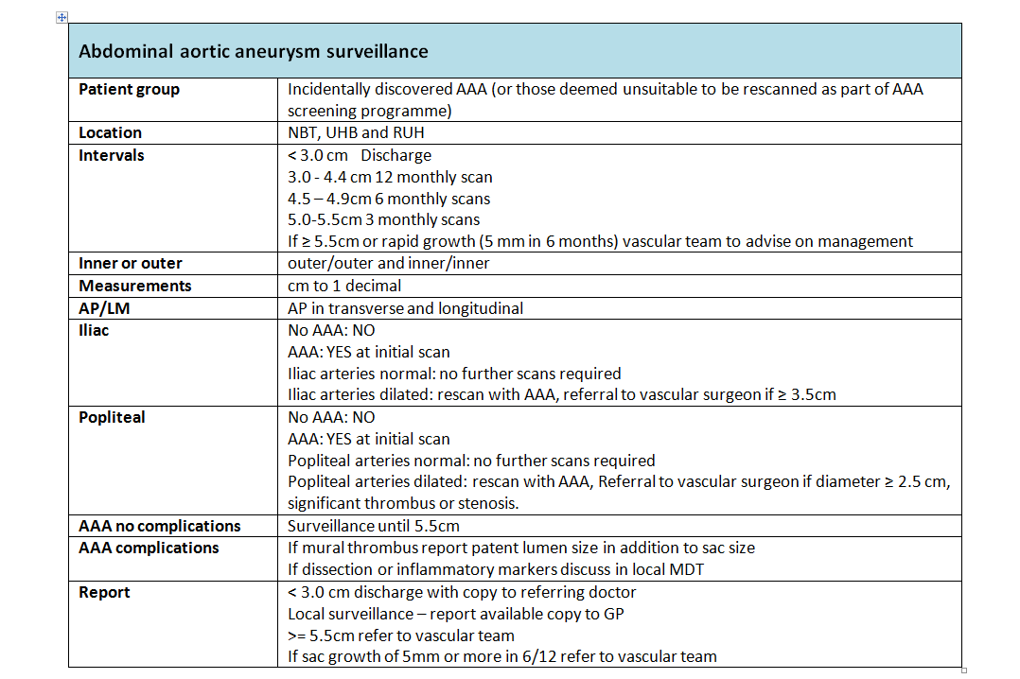
AAA surveillance

