Slide 1
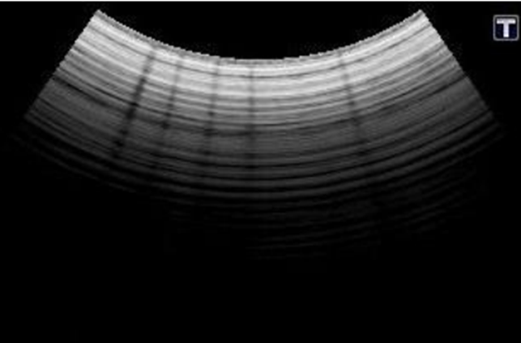
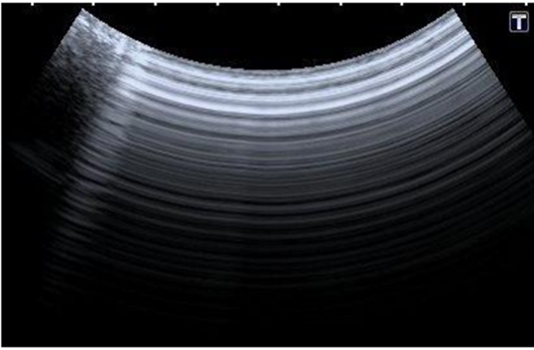
TRANSDUCER FAULTS
CABLE FAULT
ARRAY FAULT

Slide 2
Coupling Gel
A thin colloidal suspension used as a conductive medium for ultrasound.
Two of the largest changes in acoustic impedance in the body is when ultrasound encounters air or bone.
Coupling gel eradicates air from the face of the transducer.
Formulated to match the predicated speed of sound in soft tissue (1540 m/s).

Slide 3
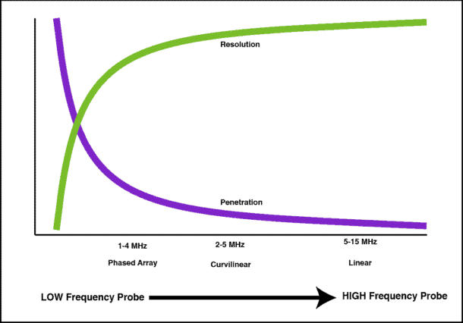
TRANSDUCER SELECTION

Slide 4
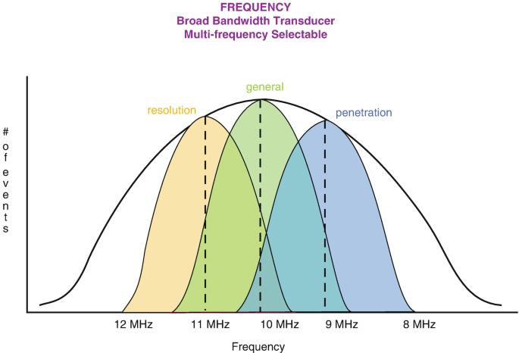
TRANSDUCER SELECTION

Slide 5
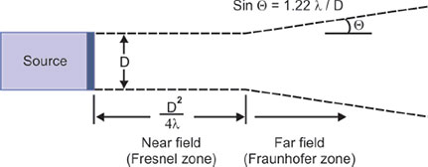
TRANSDUCER SELECTION

Slide 6
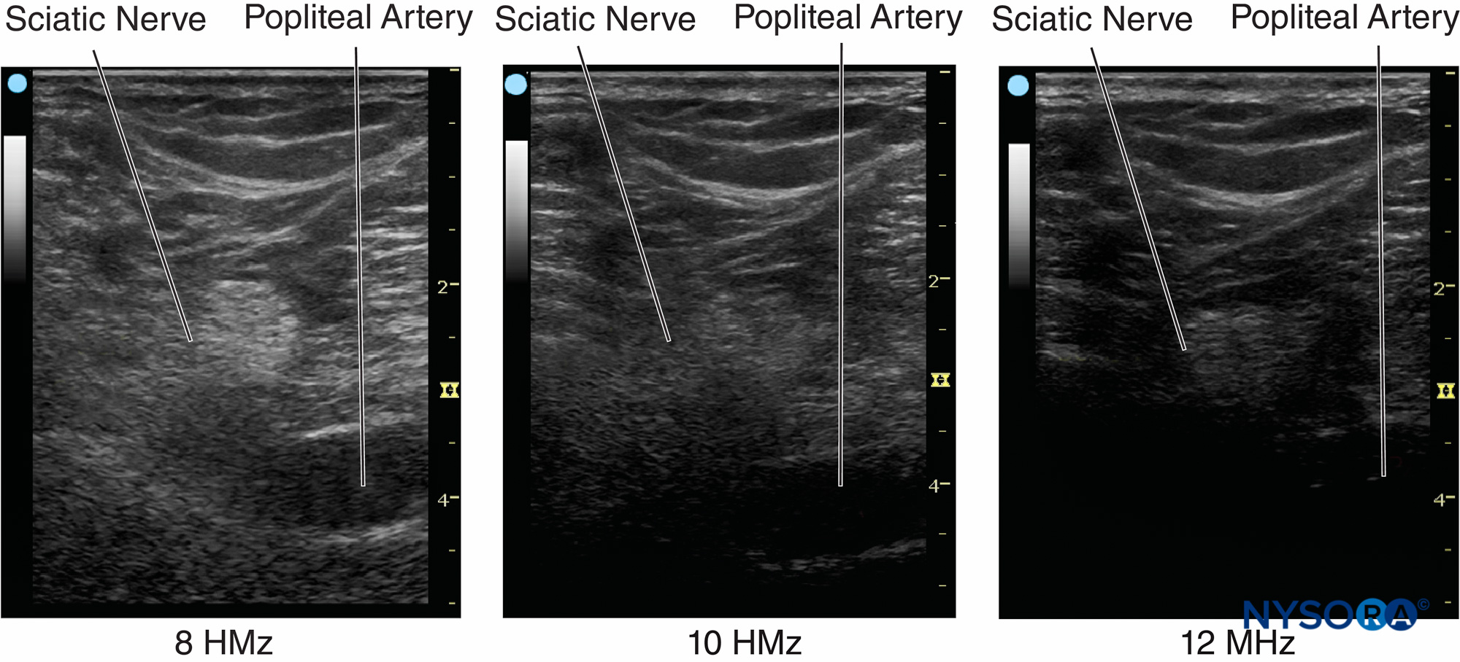
ATTENUATION

Slide 7
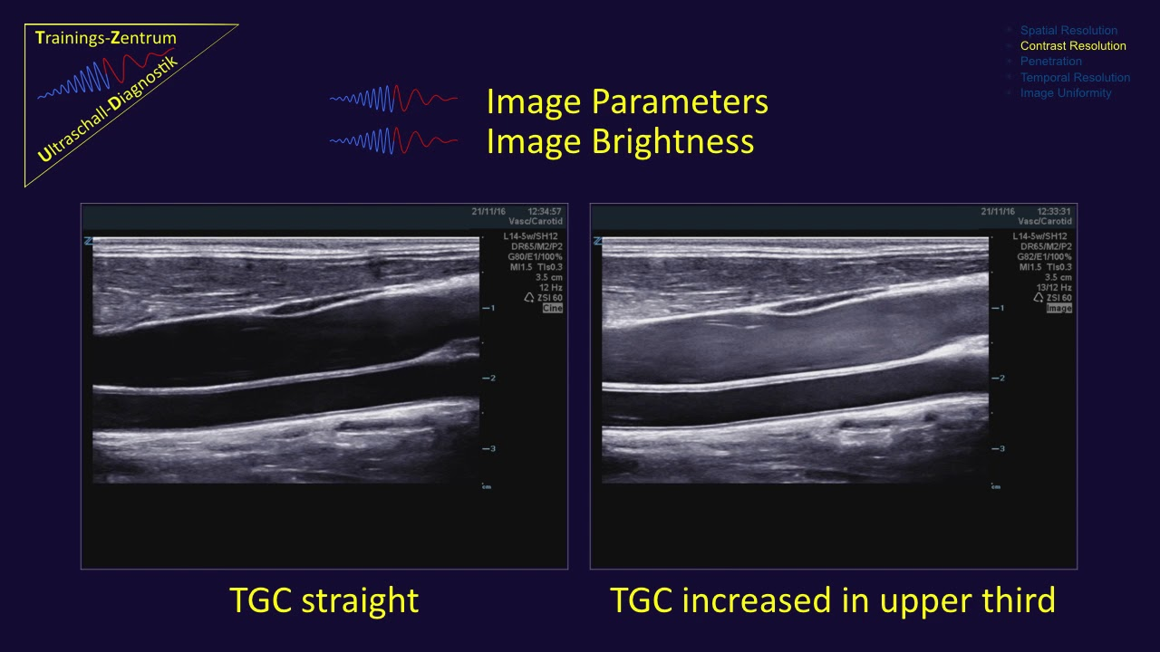
TIME GAIN COMPENSATION

Slide 8
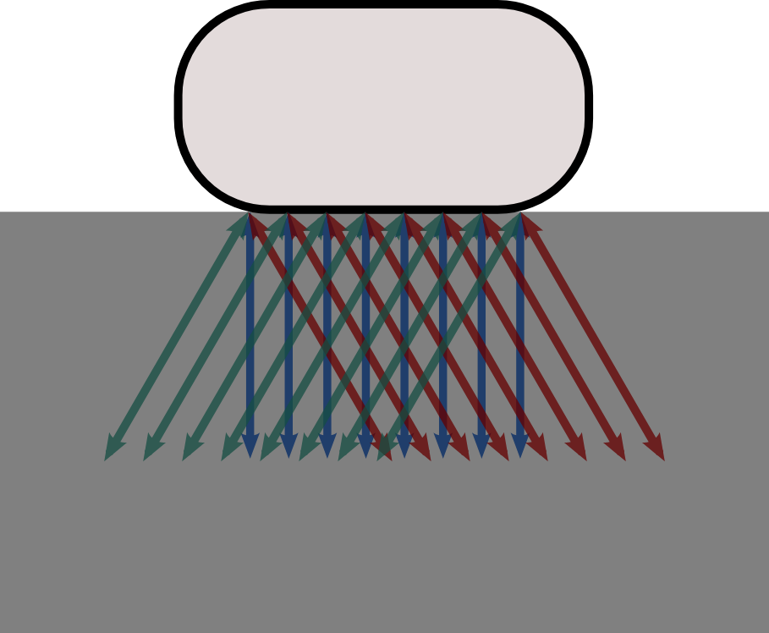
COMPOUND IMAGING

Slide 9
DYNAMIC RANGE
Dynamic Range - Ratio of the largest to the smallest signals that an instrument or component of an instrument can respond to without distortion. It controls the contrast on the ultrasound image making an image look either very grey or very black and white
Can be considered as “free” gain. If adjusted correctly weak echo will be selectively amplified without amplifying artefact.

Slide 10
Harmonic Imaging
decreased reverberation and side lobe artifacts
increased lateral resolution (but decreased axial resolution)
increased signal to noise ratio
improved resolution in patients with large body habitus

Slide 11
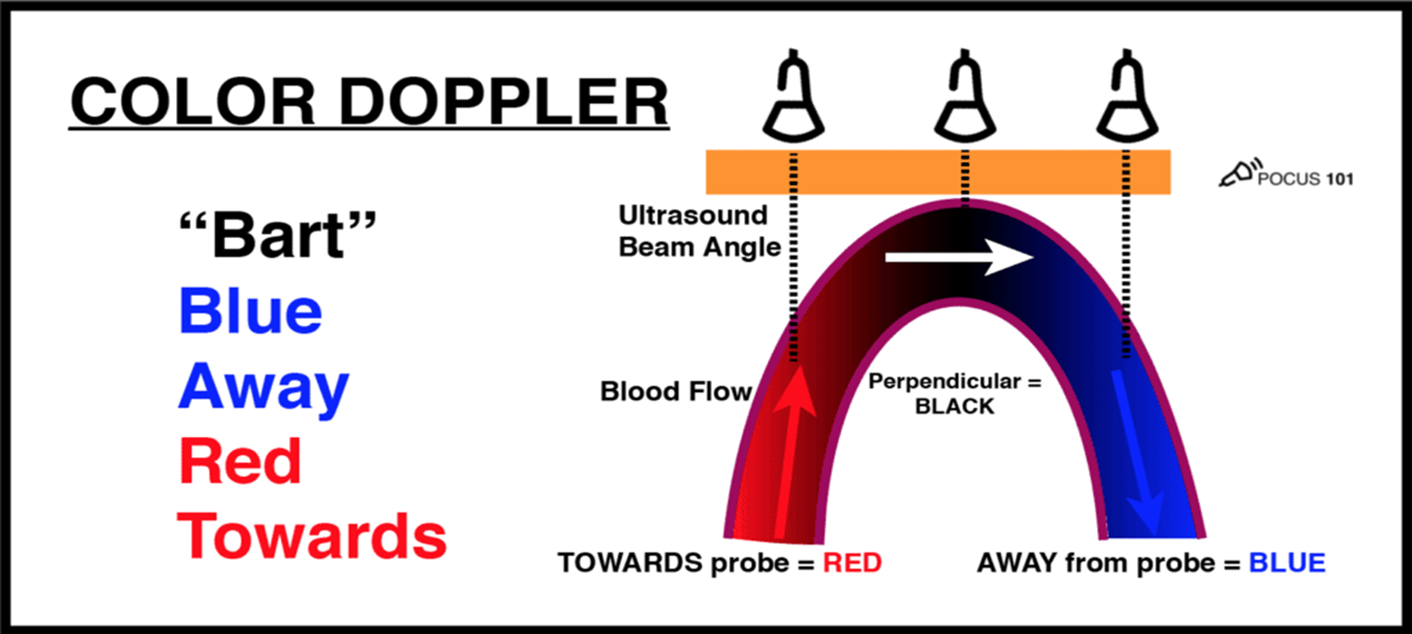
Colour Doppler

Slide 12
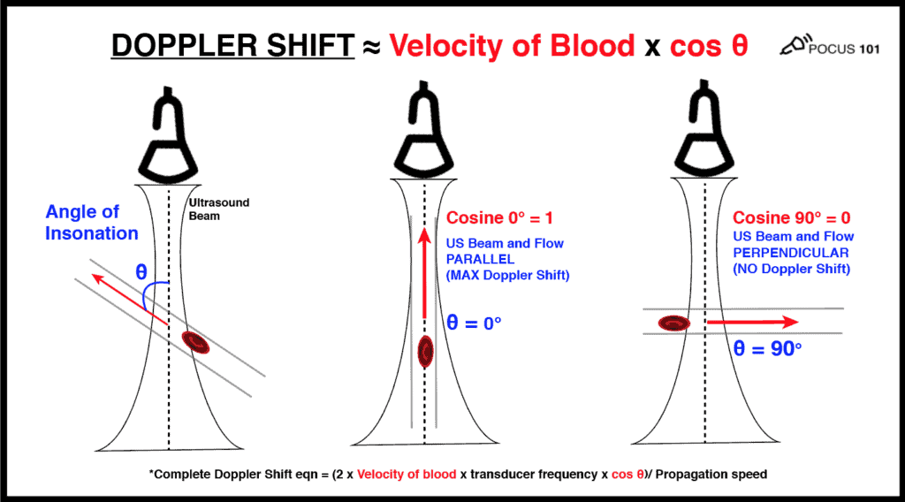
DOPPLER SHIFT

Slide 13
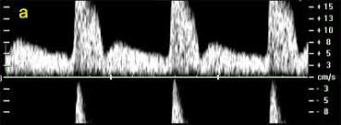
Pulse Repetition Frequency

