Slide 1
1. Plasma Desmosine in Acute Aortic Syndrome (AAS) 2. Health Literacy and Inequality
ASM 2021
Notes:
ID=d924773e-9a16-4d6d-9803-8cb819e99682 Recipe=text_billboard Type=TextOnly Variant=0 FamilyID=AccentBoxWalbaum_Zero

Slide 2
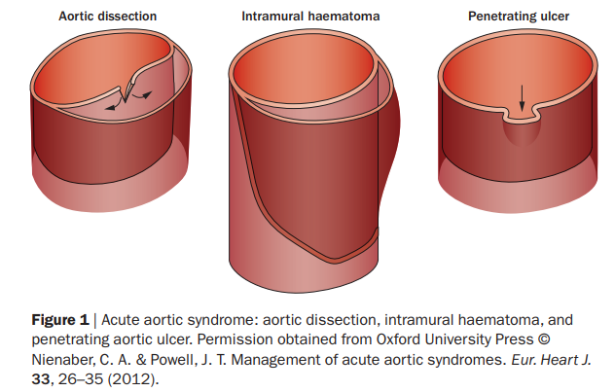
Plasma Desmosine as Biomarker for AAS
Acute Aortic Syndrome
- aortic dissection
- intramural haematoma
- penetrating ulcer
Clinical Presentation
- abrupt ’aortic pain’
Diagnosis and treatment

Slide 3
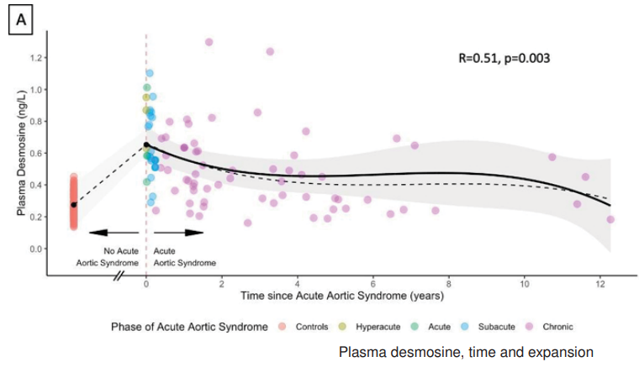
Plasma Desmosine as Biomarker?
Cross-link component of elastin
53 patients - radiologically confirmed AAS
106 controls
Demographic details, AAS subcategory, time from AAS event and pDES
pDES elevated in AAS
Highest at presentation

Slide 4

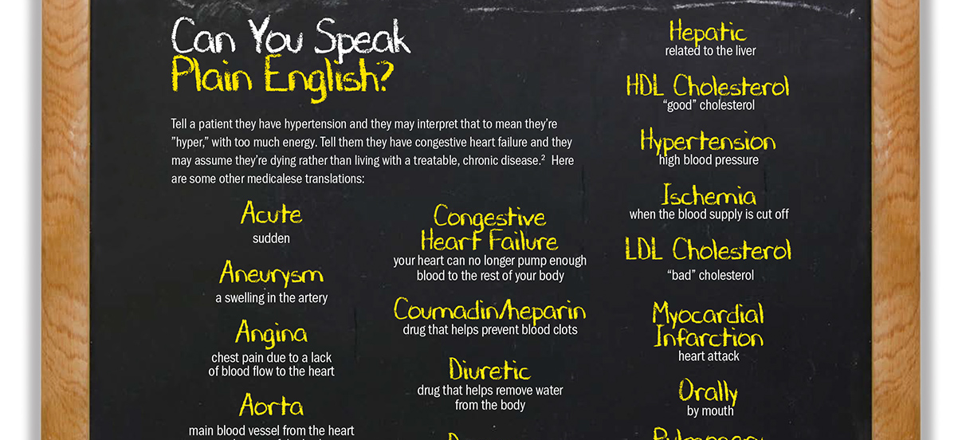
Health Literacy and Inequality
What is health literacy (HL)?
Poor outcomes associated with inadequate HL
Vascular patients – how do they fare?
HeaLTHI study

Slide 5
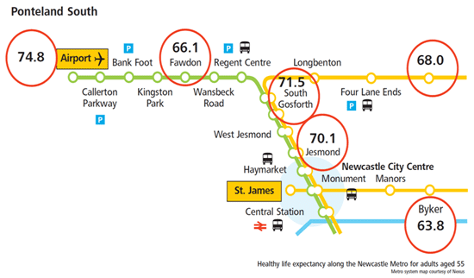
Mind the gap!
Only 8 miles apart, yet 11 years difference in healthy life expectancy

Slide 6

What about Gloucestershire?

Slide 7
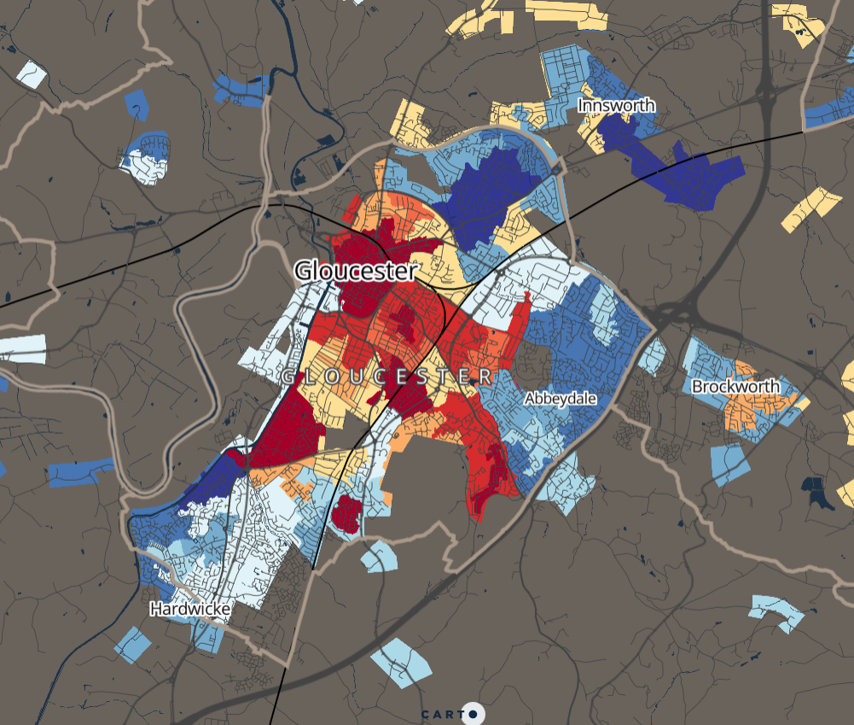
13.5yrs (M) and 9.5yrs (F) difference in life expectancy

Slide 8
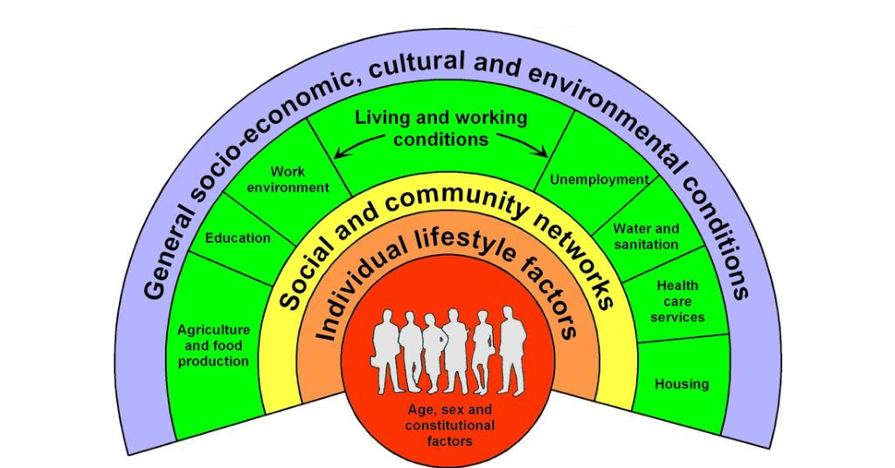
Why?
Dahlgren and Whitehead (1991) Policies and strategies to promote social equity in health.

Slide 9
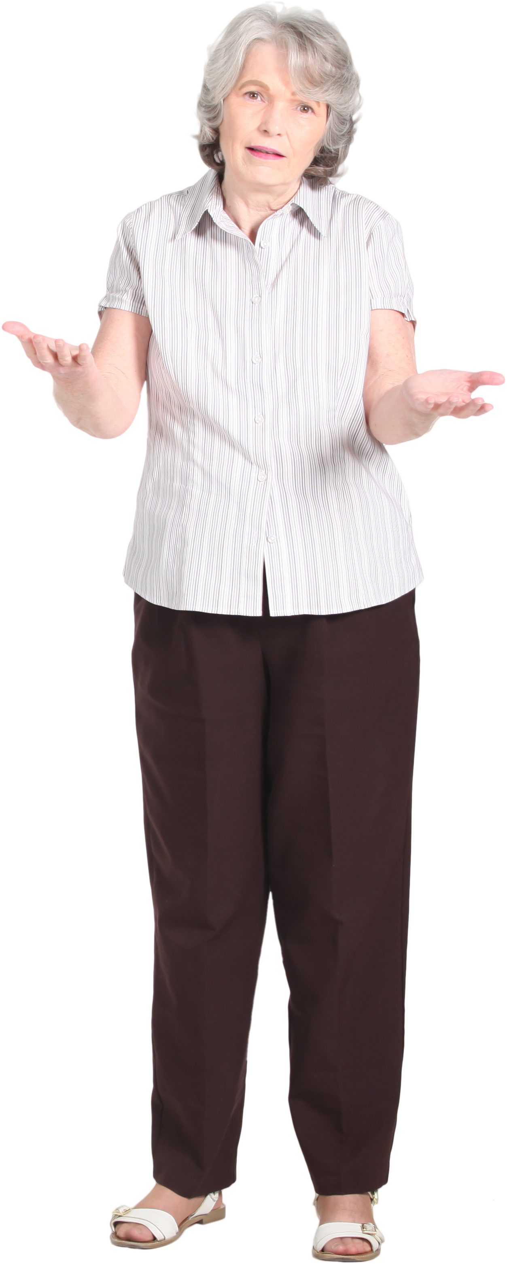
What does this mean for us?
People who live in more deprived areas less likely to attend (REF).
However, they have the poorest health outcomes.
Need to question why they might not be attending and what we can do to support better attendance.
Michael Marmot (2010) Fair Society, Healthy Lives. Proportionate Universalism.

Slide 10
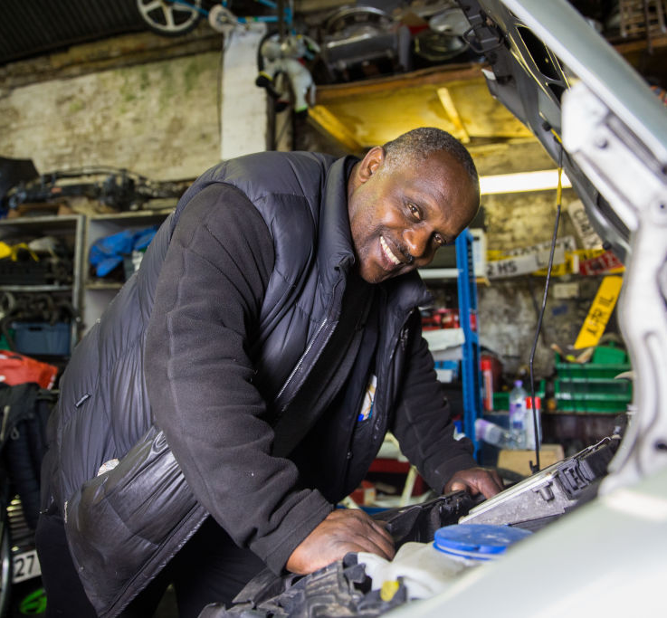
Andy
Works in the Forest of Dean
Doesn’t have a car
Has 4 children, one has a severe disability
We book him an appointment for 1.30
He doesn’t show up

Slide 11
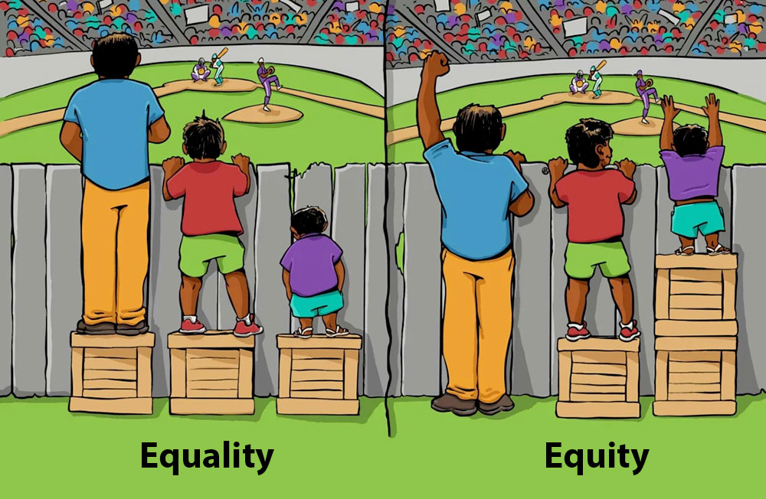
What could we do?
Michael Marmot (2010) Fair Society, Healthy Lives. Proportionate Universalism.

Slide 12
What might this look like?
Routine assessment and questioning of data
Clinic hours (evening and weekends)
Remote clinics (being in the areas where need greatest)
More contact points prior to appointments (reminders – chaotic lives)

Slide 13
Potential role of research
Let’s have a look at our data – who turns up, who doesn’t?
Understand more about these people based on the data we hold.
Qualitative work to explore barriers to accessing our service.
Link in with a research team who have expertise.

Slide 14
What can we do to ensure that we don’t widen inequality? https://vascularnews.com/collaborative-effort-key-to-investigating-potential-biomarker-of-acute-aortic-syndrome/ http://www.healthscotland.com/uploads/documents/24296-ProportionateUniversalismBriefing.pdf https://www.ejves.com/action/showPdf?pii=S1078-5884%2818%2930258-2 https://www.acc.org/latest-in-cardiology/articles/2019/10/06/24/42/cover-story-recognizing-and-addressing-health-literacy-in-your-patients http://psnc.org.uk/gloucestershire-lpc/wp-content/uploads/sites/64/2015/01/HealthProfile2015Cheltenham23UB.pdf https://www.gloucester.gov.uk/media/4495/gloucester-district-health-profile-march-2020.pdf https://www.ncl.ac.uk/press/articles/archive/2013/09/closingthegapinhealthinequalitypioneeringsimulation.html https://assets.publishing.service.gov.uk/government/uploads/system/uploads/attachment_data/file/460710/4b_Health_Literacy-Briefing.pdf

