Slide 1


Fundamentals of Vascular Ultrasound Peripheral Arterial Duplex Scanning
Jacqui George
Vascular Scientist
Plymouth Hospital NHS Trust

Slide 2
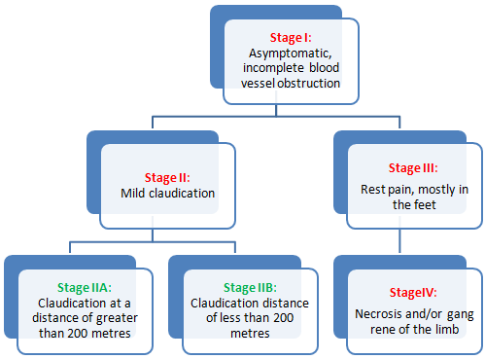
Symptoms of Peripheral Arterial Disease
Asymptomatic due to:
Mild disease
Reduced mobility
Neuropathy
Distal disease

Slide 3
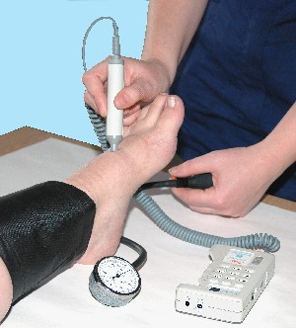
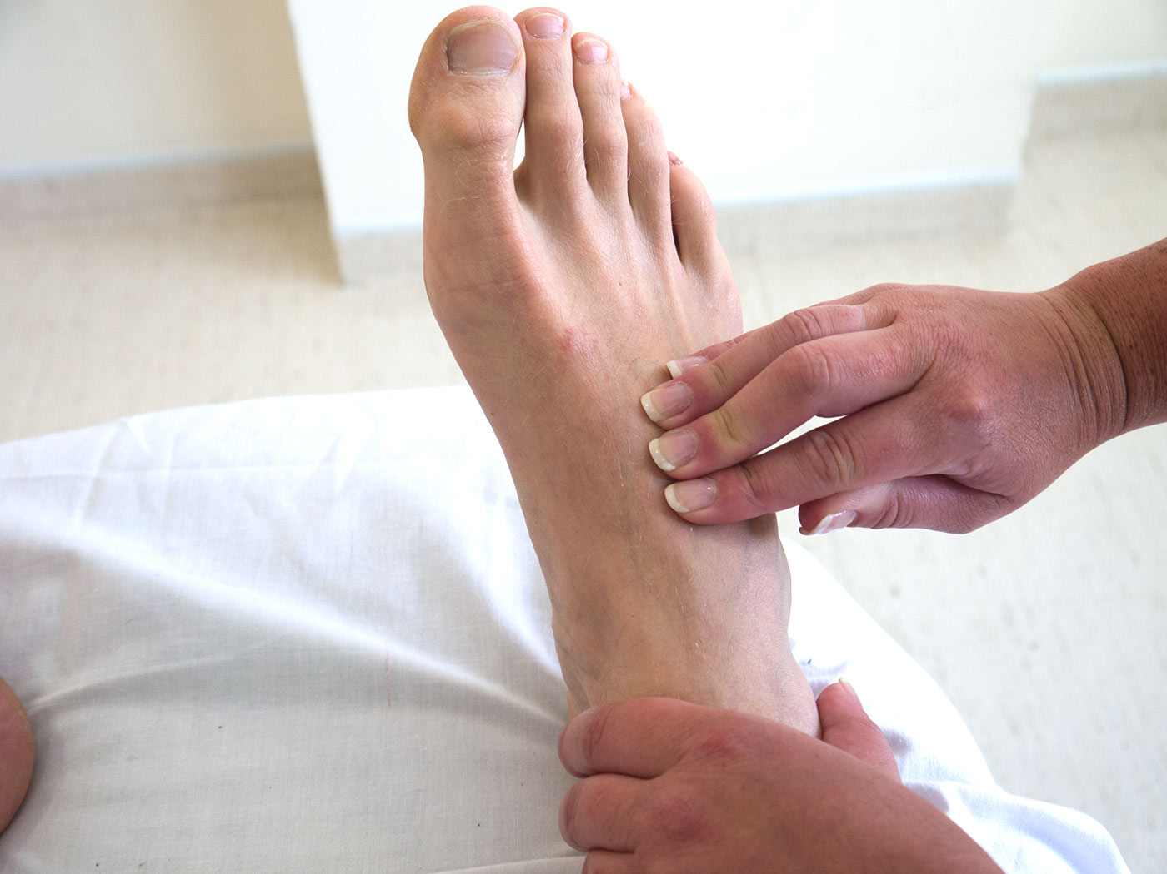
Nice guideline (CG147)-Peripheral Arterial Disease: Diagnosis and management
Assess people with suspected peripheral arterial disease by:
asking about the presence and severity of possible symptoms of intermittent claudication and critical limb ischaemia
examining the legs and feet for evidence of critical limb ischaemia, for example ulceration
examining the femoral, popliteal and foot pulses
measuring the ankle brachial pressure index

Slide 4
Nice guideline (CG147)-Peripheral Arterial Disease: Diagnosis and management
Imaging for revascularisation
Offer duplex ultrasound as first‑line imaging to all people with peripheral arterial disease for whom revascularisation is being considered.
Offer contrast‑enhanced magnetic resonance angiography to people with peripheral arterial disease who need further imaging (after duplex ultrasound) before considering revascularisation.
Offer computed tomography angiography to people with peripheral arterial disease who need further imaging (after duplex ultrasound) if contrast‑enhanced magnetic resonance angiography is contraindicated or not tolerated.

Slide 5
Main indications for Peripheral Arterial Duplex
Symptomatic Vascular disease being considered for revascularisation
Prominent popliteal pulses -?aneurysm
Post treatment scans –angioplasty or graft surveillance
ABPIs not measurable (ie calcification/ ulceration) and being considered for compression or leg surgery
Diabetic foot

Slide 6
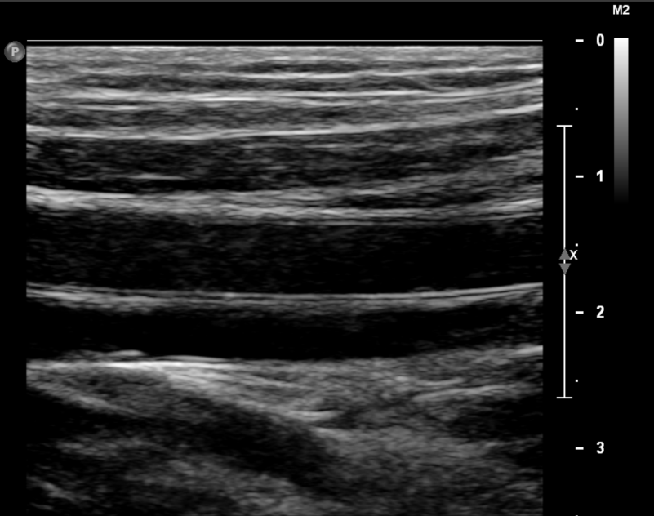
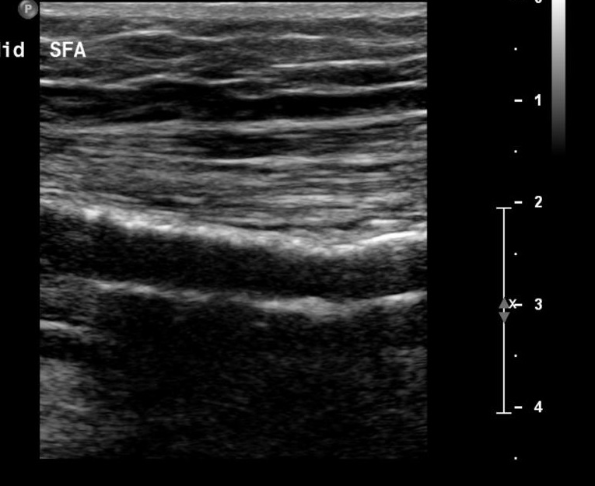
Features of B Mode Image Vessel Wall
Normal
Calcified

Slide 7
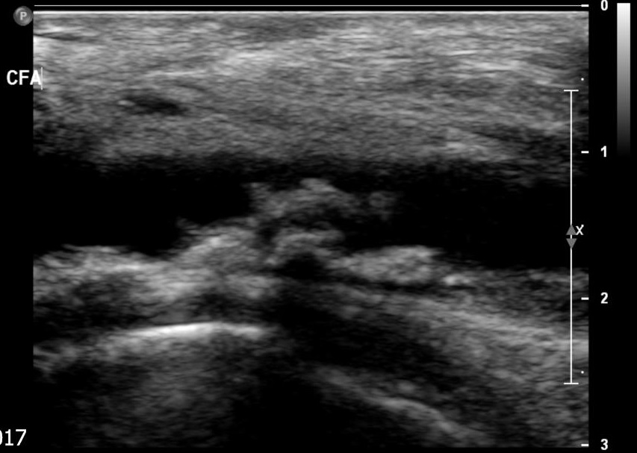
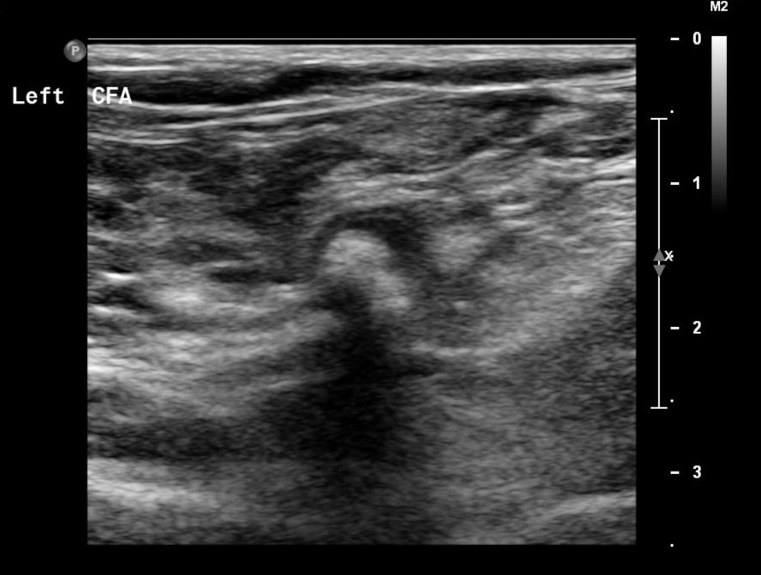
Features of B Mode Image Atheroma
Longitudinal
Transverse
Note :Eccentric plaque may not be accurately represented on longitudinal image
1
2
1
2

Slide 8
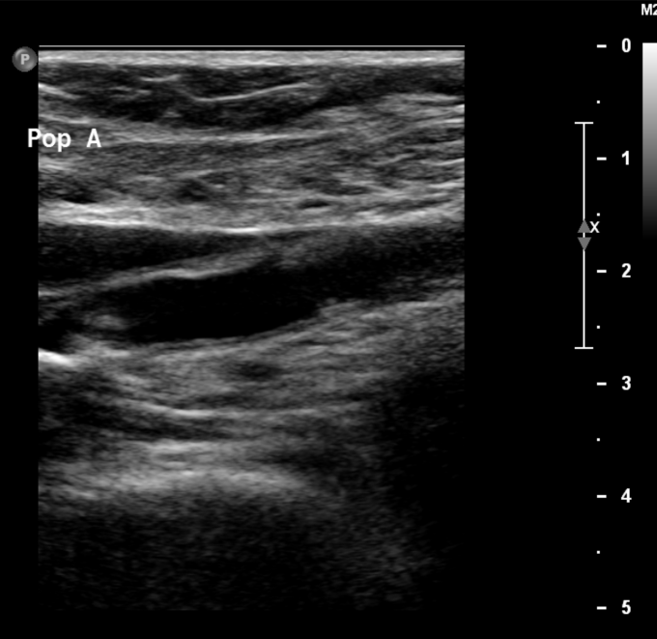
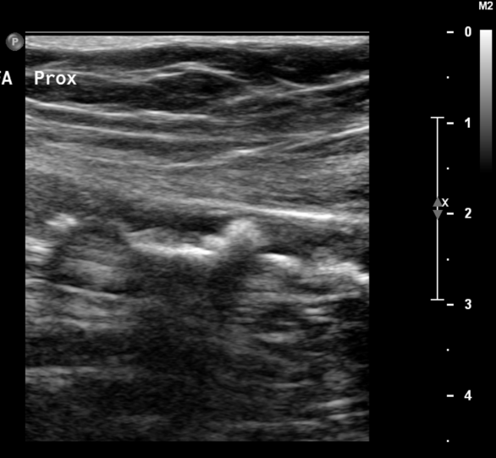
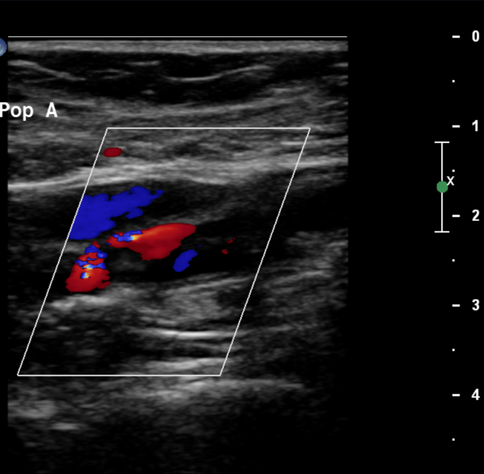
Features of B Mode Image Nature of Occlusion
Chronic Occlusion
Acute Occlusion
Patient history – sudden onset of symptoms, any history of claudication, in atrial fibrillation

Slide 9
Features of B Mode Image Vessel size
Artery | External diameter (mm)
Infra renal aorta | 17 -20
Common iliac | 10-12
External iliac | 8-10
Common femoral | 7-9
SFA | 6-8
Popliteal | 4-8
Definition of aneurysm: Increase by more than 50% of normal calibre
Aorta most common site (1.7% males at 65),
followed by popliteal artery (<1% males 65-80)

Slide 10
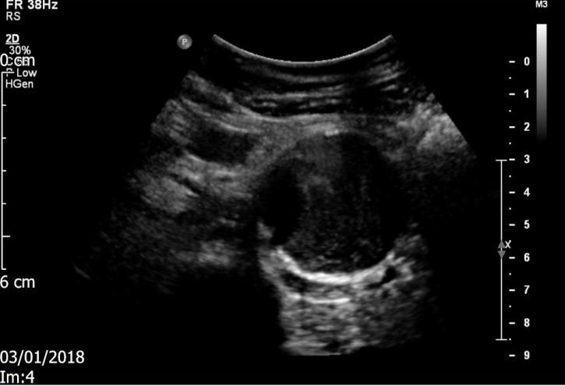
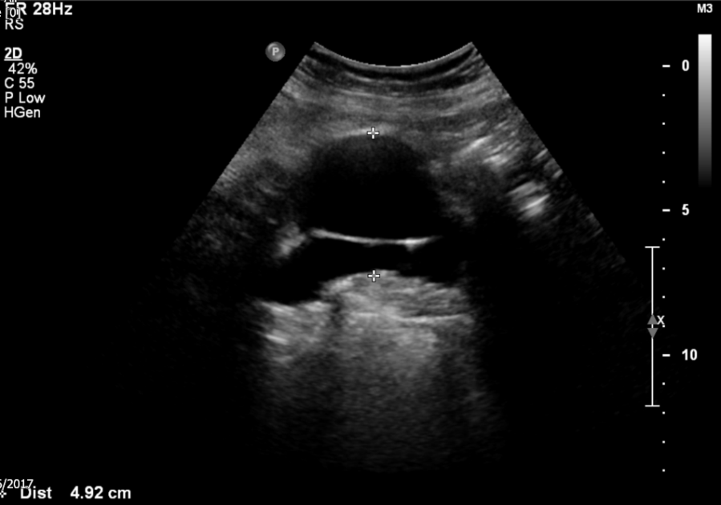
B Mode Image –Types of Aneurysm
True Aneurysm –dilation of all 3 layers of arterial wall
Fusiform -transverse
Saccular -longitudinal
False Aneurysm/ Pseudoaneurysm
Usually iatrogenic or related to IVDU
Does not have arterial wall layers

Slide 11
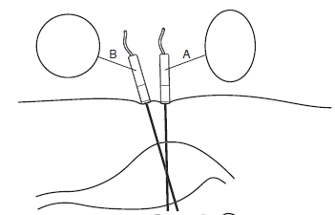
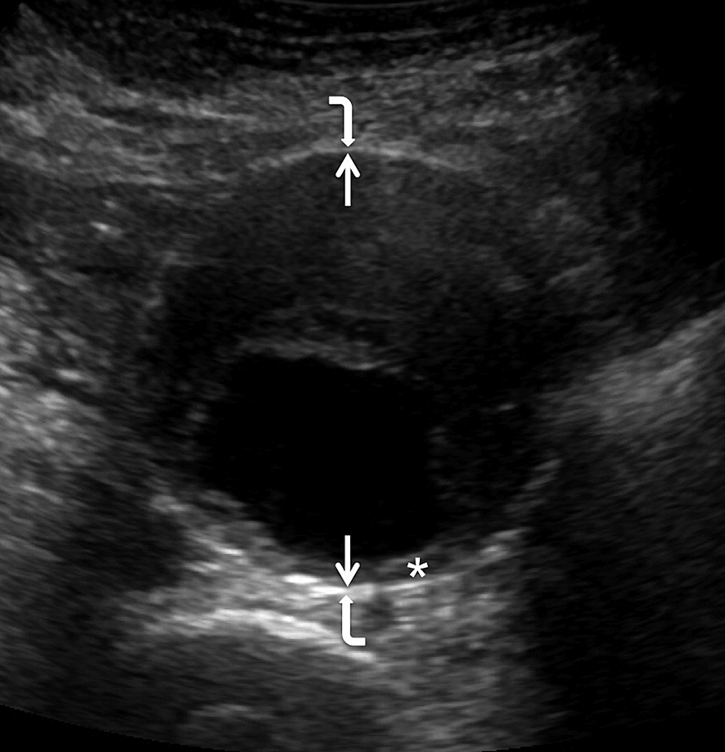
B mode Aneurysm diameter measurement
Measurements perpendicular to vessel wall –difficult if tortuous
Inner to Inner or Outer to Outer (3-4mm difference on average)
Measure in transverse and longitudinal
Assess extent

Slide 12
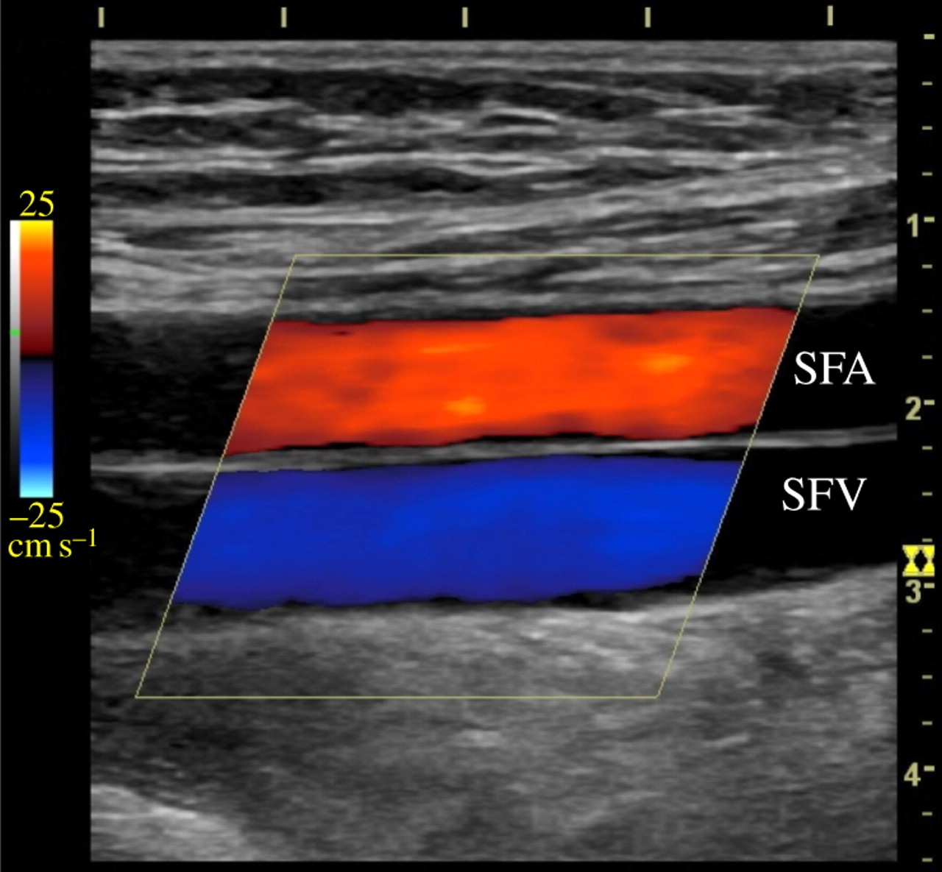
Colour Duplex
Image features:
Presence / absence of flow
Direction of flow
Complete colour filling
Flow disturbance

Slide 13
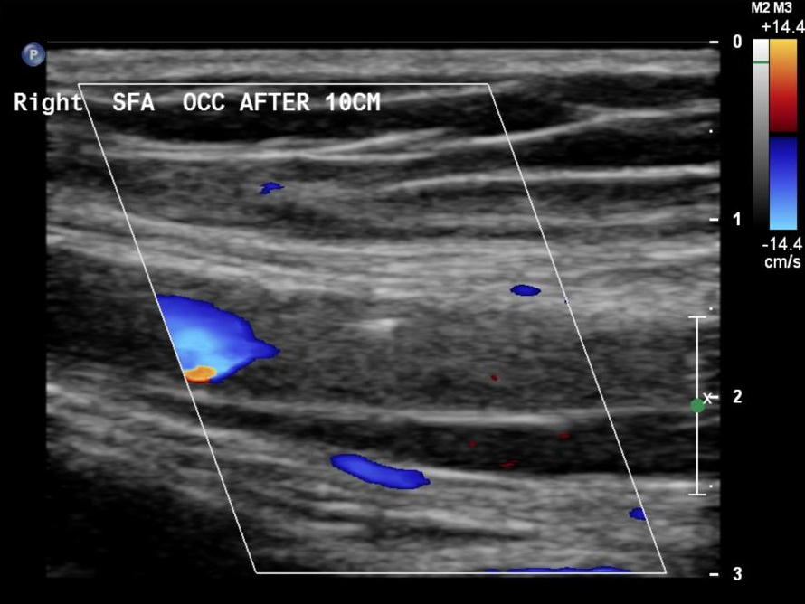
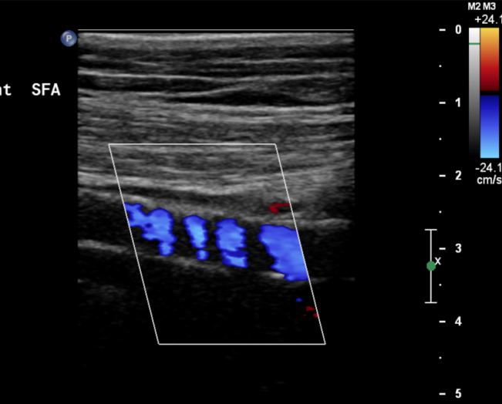
Colour Duplex Occlusion-absence of colour
Ensure velocity scale and wall filters reduced are reduced
Gain adequate
Check with spectral Doppler
Beware calcified vessels

Slide 14
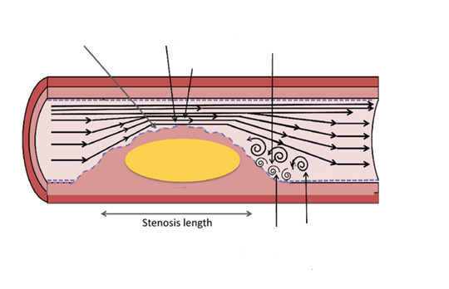
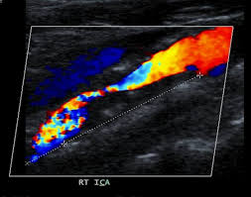
Colour Duplex Appearance of Stenosis
Plaque
Stenosis
Increase velocity
Reduced velocities
turbulence

Slide 15
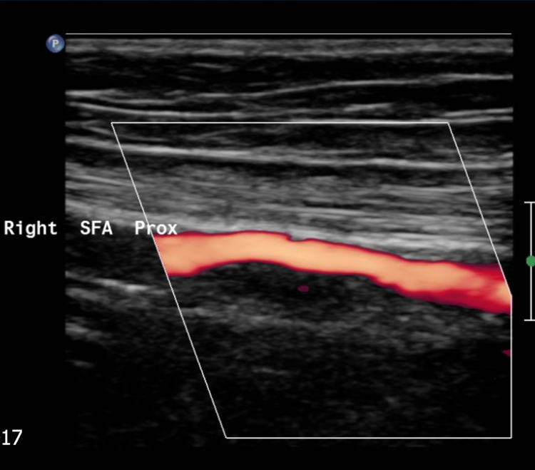
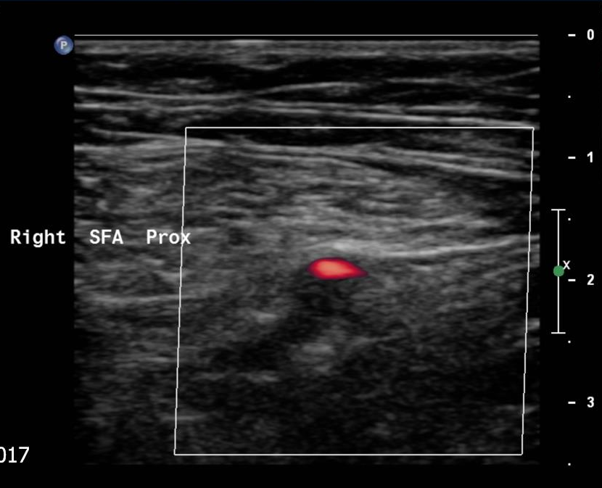
Power Doppler
Advantages over Colour Doppler Ultrasound:
Less sensitive to Doppler angle
Less overspill, better delineates patent lumen

Slide 16
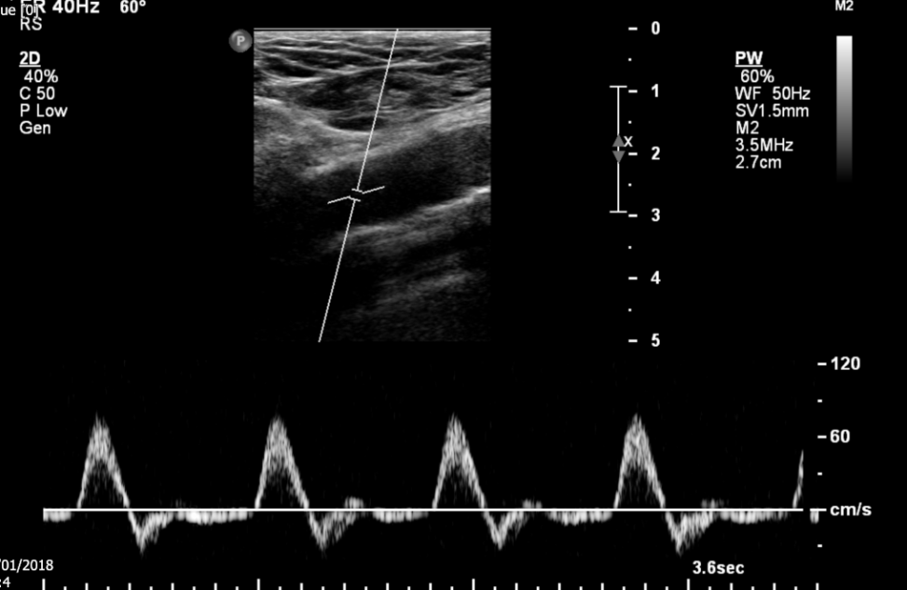
Spectral (Pulsed) Doppler
Optimisation
Centre of lumen
Small sample volume
Angle correct (<60º)
Scale
Adjust gain

Slide 17
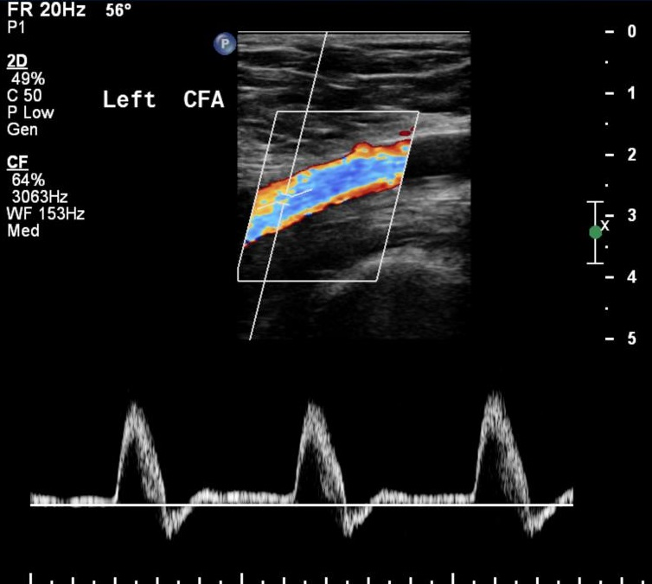
Features of Spectral Doppler Trace Normal
Triphasic:
Sharp upstroke /rise time
Clear systolic window
Reverse flow
Forward flow
Upstroke relates to proximal vessel
Diastolic flow affected by distal resistance

Slide 18
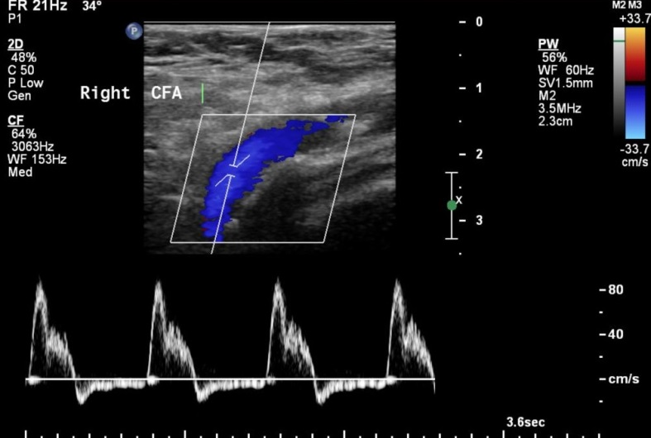
Features of Spectral Doppler trace Biphasic
Possible causes:
mild proximal disease
calcified vessels
poor cardiac output

Slide 19
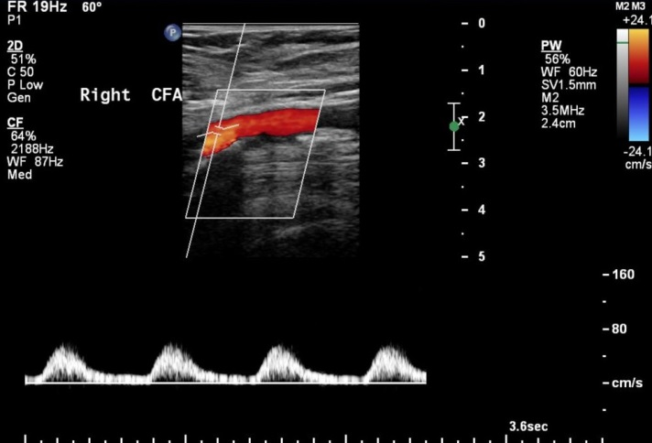
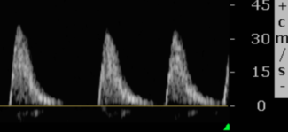
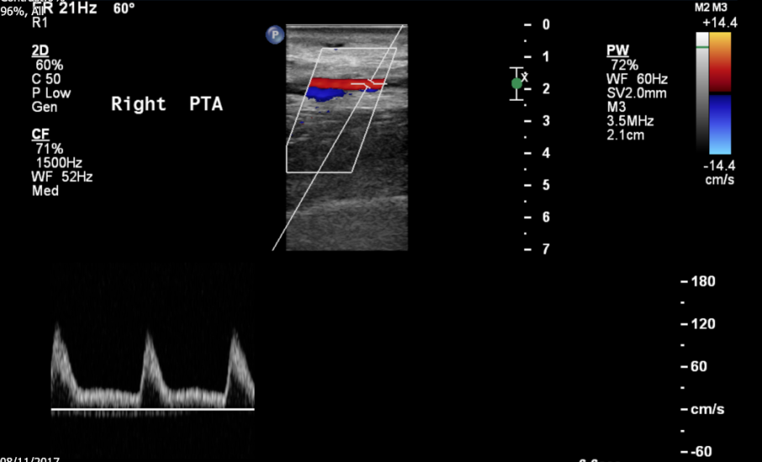
Abnormal Spectral Doppler -Monophasic
Monophasic due to proximal disease
increased upstroke
reduced PSV
Flow in diastole
Monophasic due to distal disease
Sharp upstroke
PSV either normal or reduced
Low diastolic flow
Monophasic due to hyperaemia
Sharp upstroke
Increased PSV
Increased flow in diastole

Slide 20
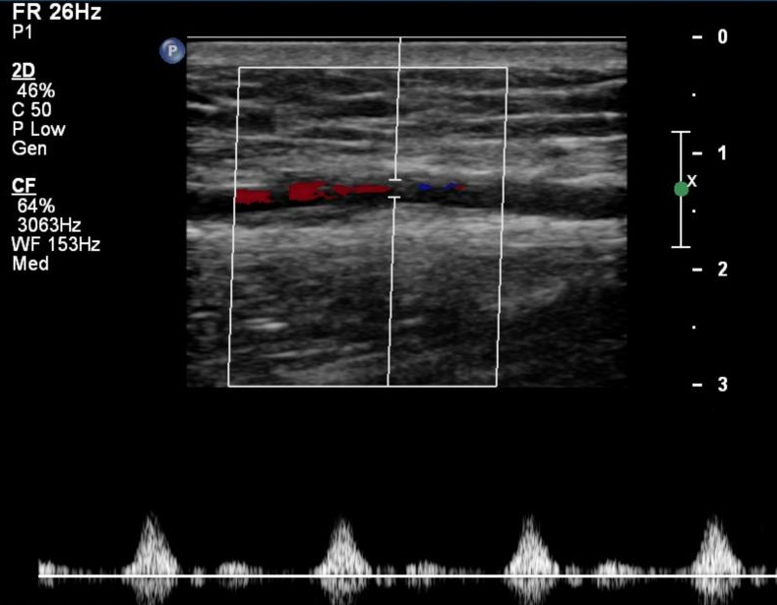
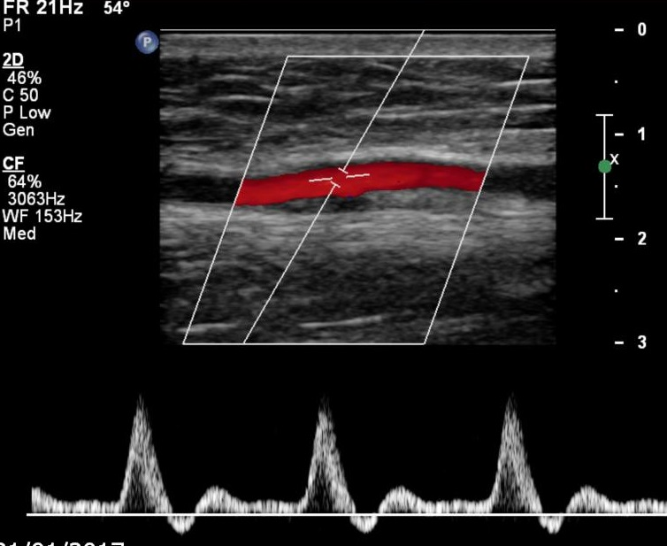
Spectral Doppler
Effect of angle

Slide 21
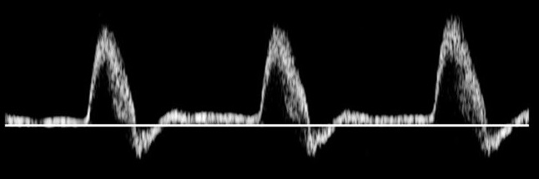

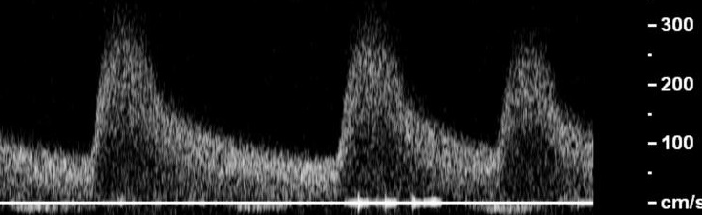
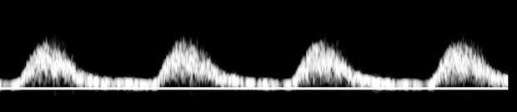
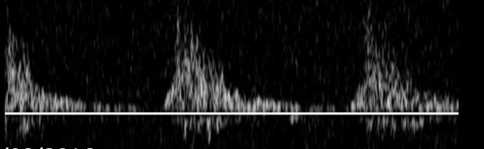
Spectral Doppler -Stenosis

Slide 22

Velocity ratio criteria
Vs =maximum PSV within stenosis
Vp=peak systolic velocity in normal area of artery just proximal to stenosis
Diameter reduction | Velocity ratio Vs/ Vp
0-49% | <2
50-74% | 2-3
75-99% | >3
Assumptions

Slide 23


Vd= 110cm/s
Vs=200cm/s
Vp =50cm/s
Vp =80cm/s
Vp =160cm/s
Vd= 40cm/s

Slide 24
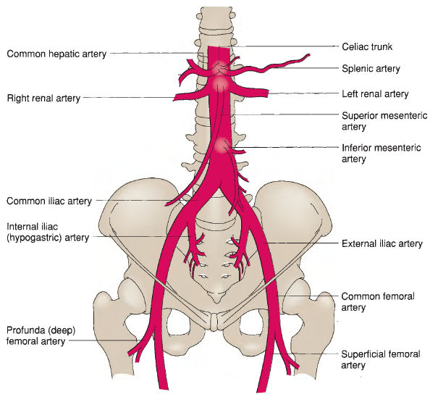
Aorto-Iliac Anatomy
Symptoms:
Buttock and thigh claudication
Weak/absent femoral pulses

Slide 25
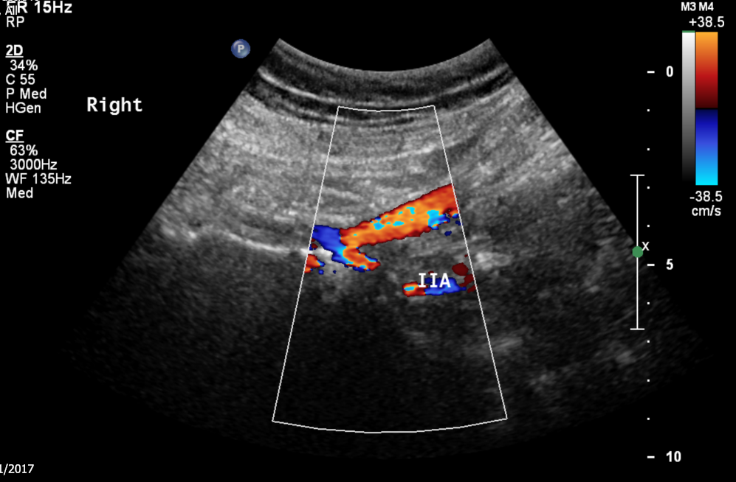
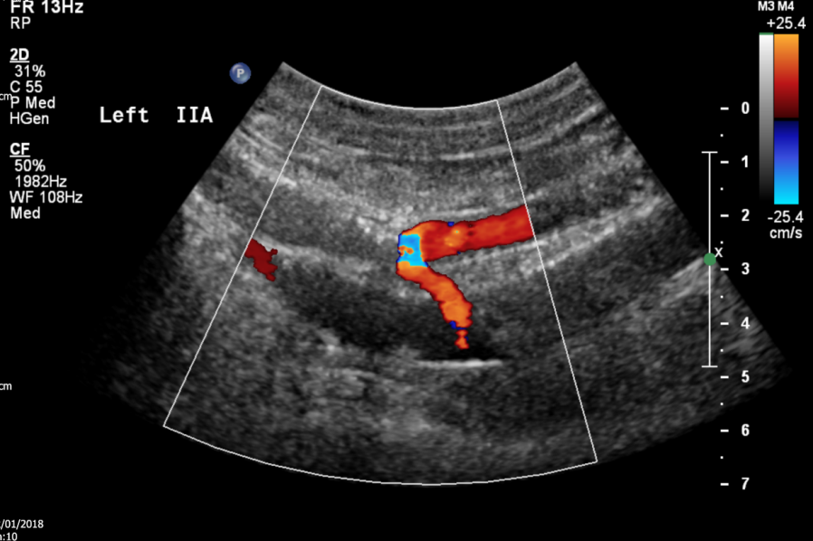
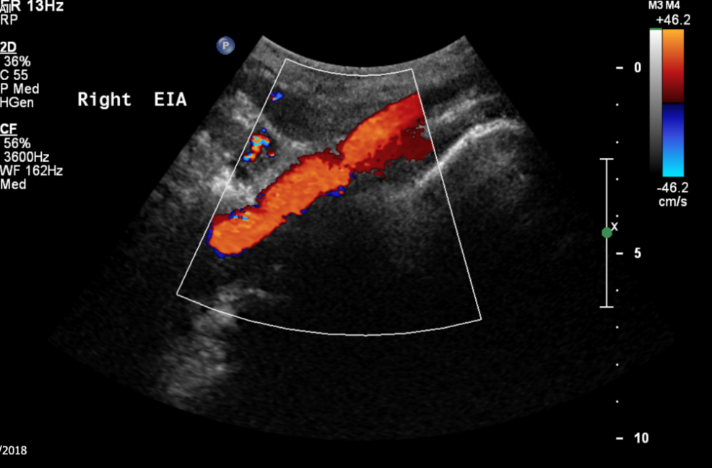
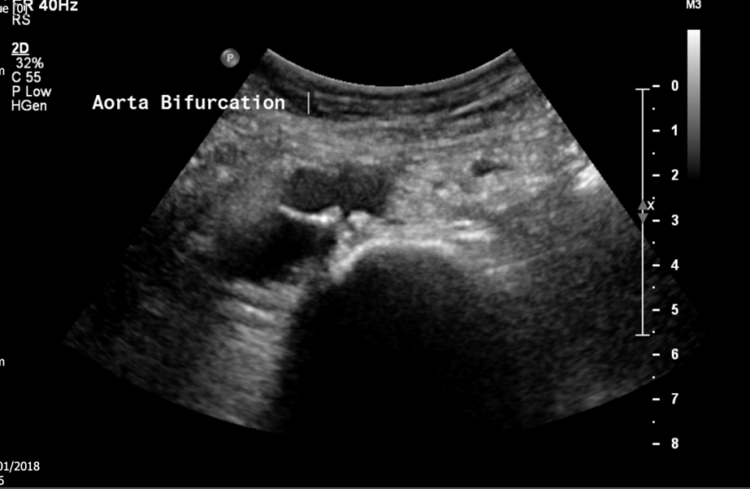
Aorto-Iliac Duplex Method
Lower frequency curvilinear probe
Patient usually supine but remember lateral decubitus position

Slide 26
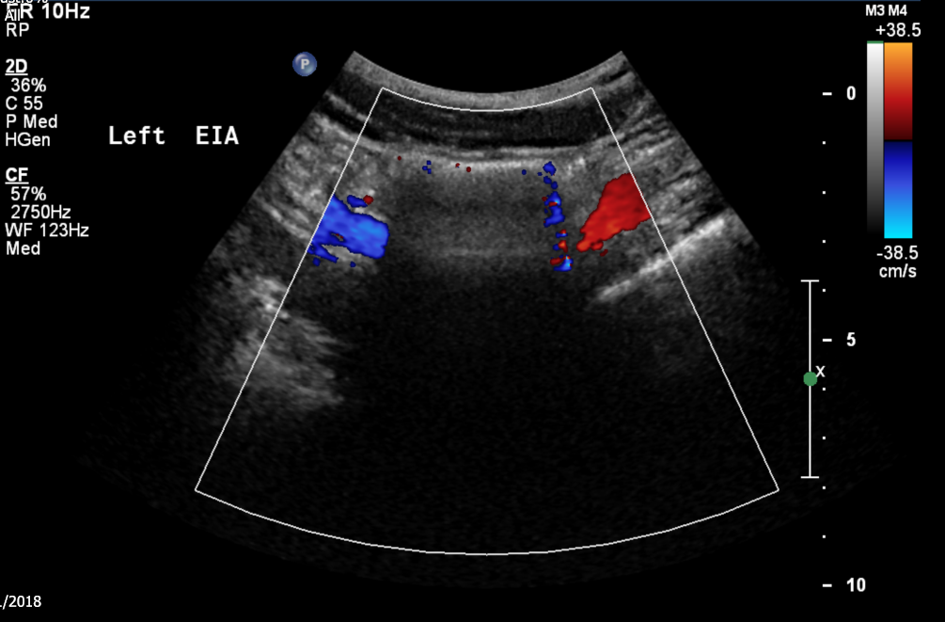
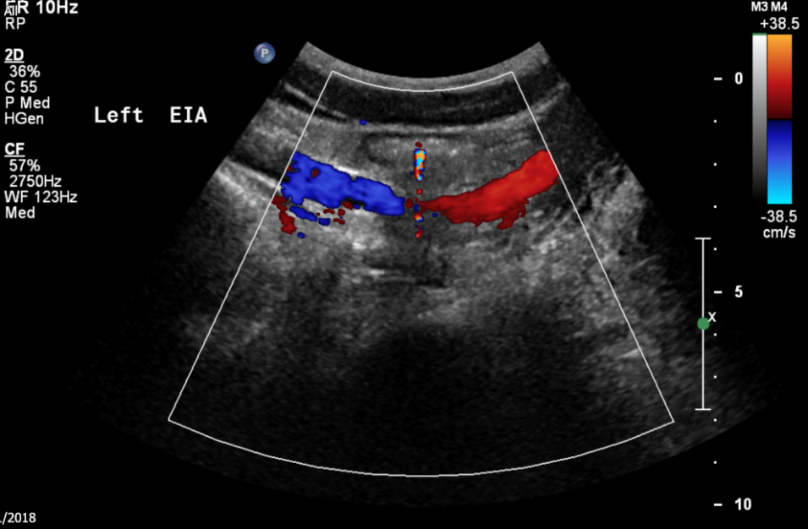
Aorto-Iliac Duplex Difficulties
Obesity
Bowel gas
fasting may help
apply pressure
Vessel calcification
Surgical scars/stomas
Vessel tortuousity (Angle correction)

Slide 27
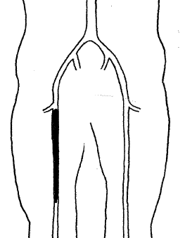
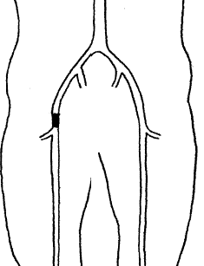
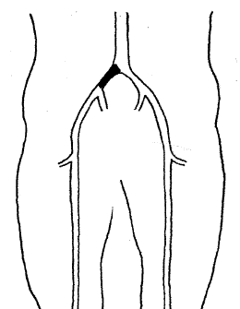



Analysis of CFA waveform
A
B
C

Slide 28
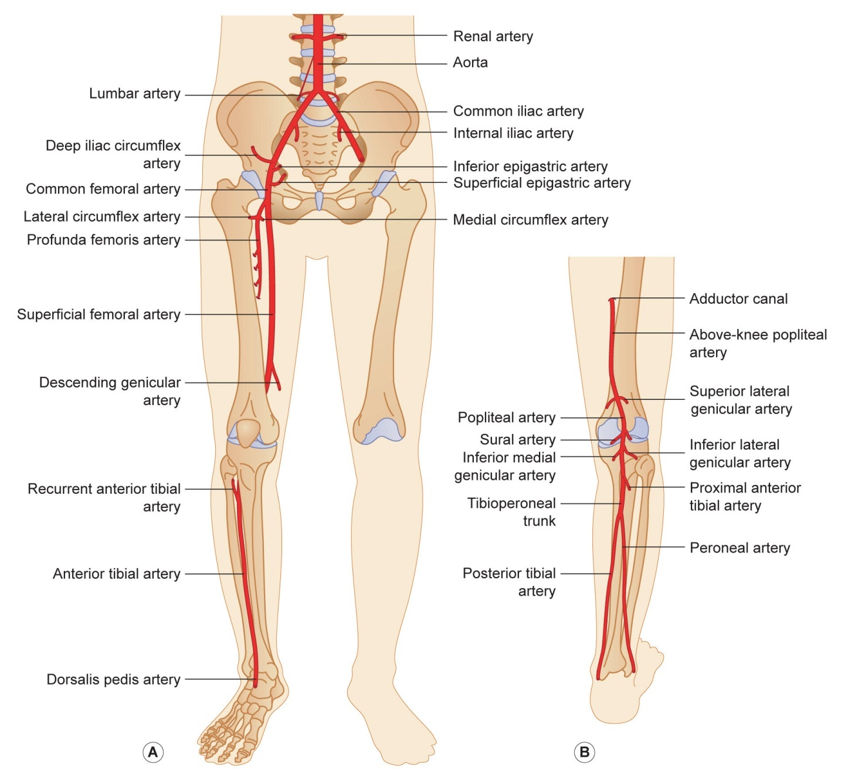
Femoro-popliteal and Crural Vessels Anatomy
Note:
10% have different anatomy at trifurcation ie high origin of anterior tibial

Slide 29
Femoro-popliteal Duplex Method
Patient position
CFA/SFA–supine, leg relaxed and external rotated
Popliteal – supine, knee slightly bent and internally rotated
OR patient on side
Higher frequency linear probe
Assess from CFA to distal popliteal using all 3 modalities

Slide 30
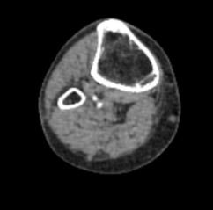
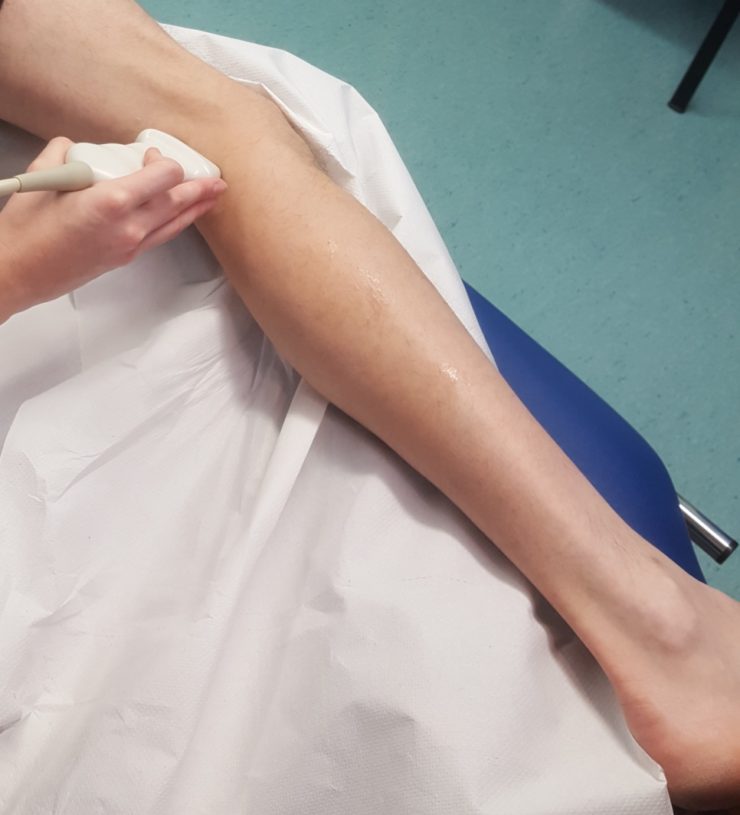
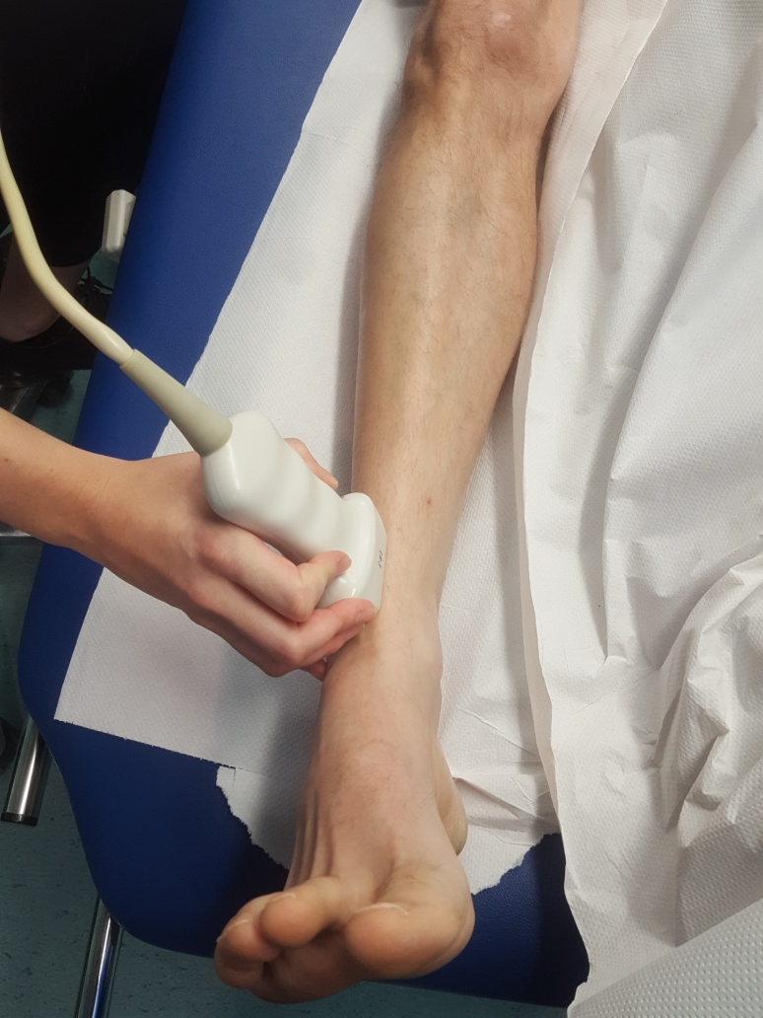
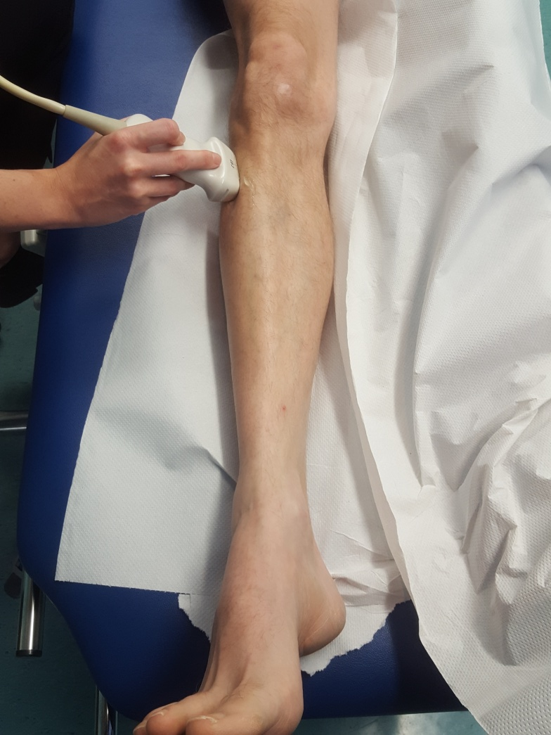
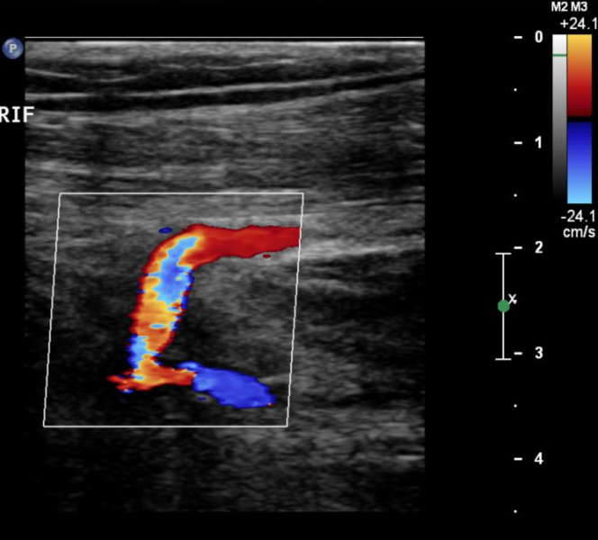
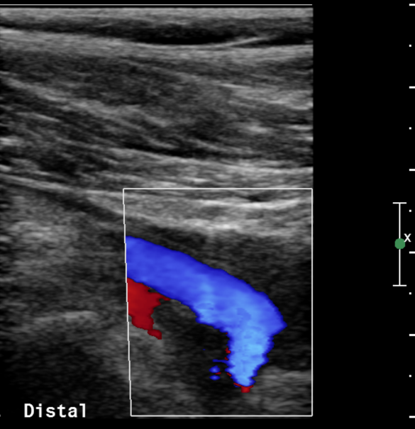

Duplex Scan - Anterior tibial

Slide 31



Duplex Scan –posterior tibial

Slide 32


Duplex Scan -Peroneal

Slide 33
Crural Vessels Considerations
Flow may be severely reduced in patent vessels due to proximal disease
Alter controls to be sensitive to low flow conditions
Do scan with leg dependent
Vessel calcification
Use waveform analysis
May be inconclusive

Slide 34



Pseudoaneurysms
Usually iatrogenic or IVDU
Arterial punctures
Graft anastomosis
Trauma/ surgery
Features:
Presence/absence of flow in sac
Size of sac
Size of wall defect
Length of neck
Characteristic flow in neck

Slide 35


Popliteal Artery Entrapment Syndrome (PAES)
Young (<30 years), athletic, mainly male
Compression / occlusion of the popliteal artery during exercise
Abnormal anatomy
Functional PAES
Duplex scan of popliteal artery (prone or standing) with forced plantar and dorsiflexion

Slide 36



Popliteal Artery Entrapment Syndrome (PAES)
Transverse images of popliteal artery may show abnormal anatomy or compression
Normal flow changing to very reduced, high resistance flow or absence of flow with foot manoeuvres.

Slide 37


Cystic Advential disease
Cyst develops in tunica adventitia
Most common in popliteal artery (85%)
Mainly young (<50 years old) men
Smooth echopoor lesion in otherwise normal arteries

Slide 38

Thromboangitis Obliterans (Buergers disease)
Non atherosclerotic thrombotic vasculitis
Young male, heavy smokers
Normal proximal vessels
Occlusion of distal vessels (calf or forearm)
Characteristic corkscrew collaterals

Slide 39


Upper Limb Anatomy
Common variants:
High bifurcation into RA and UA -12%

Slide 40
Upper limb Duplex scan
Right brachiocephalic and proximal left subclavian arteries are usually obscured by clavicle/sternum
Waveform interpretation
Axillary, brachial, ulnar and radial arteries are superficial and easily seen, assess with B mode, colour and spectral Doppler.
Doppler waveforms very dependent on temperature/ exercise etc

Slide 41
Upper limb
Atheroslerosis
often asymptomatic due to collaterals.
Reduced BP
Arm claudication
Embolism
Subclavian Steal
Thoracic Outlet syndrome

Slide 42

Thoracic Outlet Syndrome
Bordered by scalene muscle, first rib and clavicle.
TOS caused by compression of nerves and/or blood vessels
Only 2% TOS are due to arterial compression

Slide 43



TOS –provocation manoeuvres
Variable
Roos Test
Adsons manoeuvre
Hyperabduction
Symptomatic position
Monitor changes in colour and spectral trace in distal subclavian/axillary artery
Take care not to move off the vessel

Slide 44

AND FINALLY!
REPORTING
Concise and clear
Include a diagram if possible
Know what the relevant information is
Find out what information the surgeons require

