Slide 1

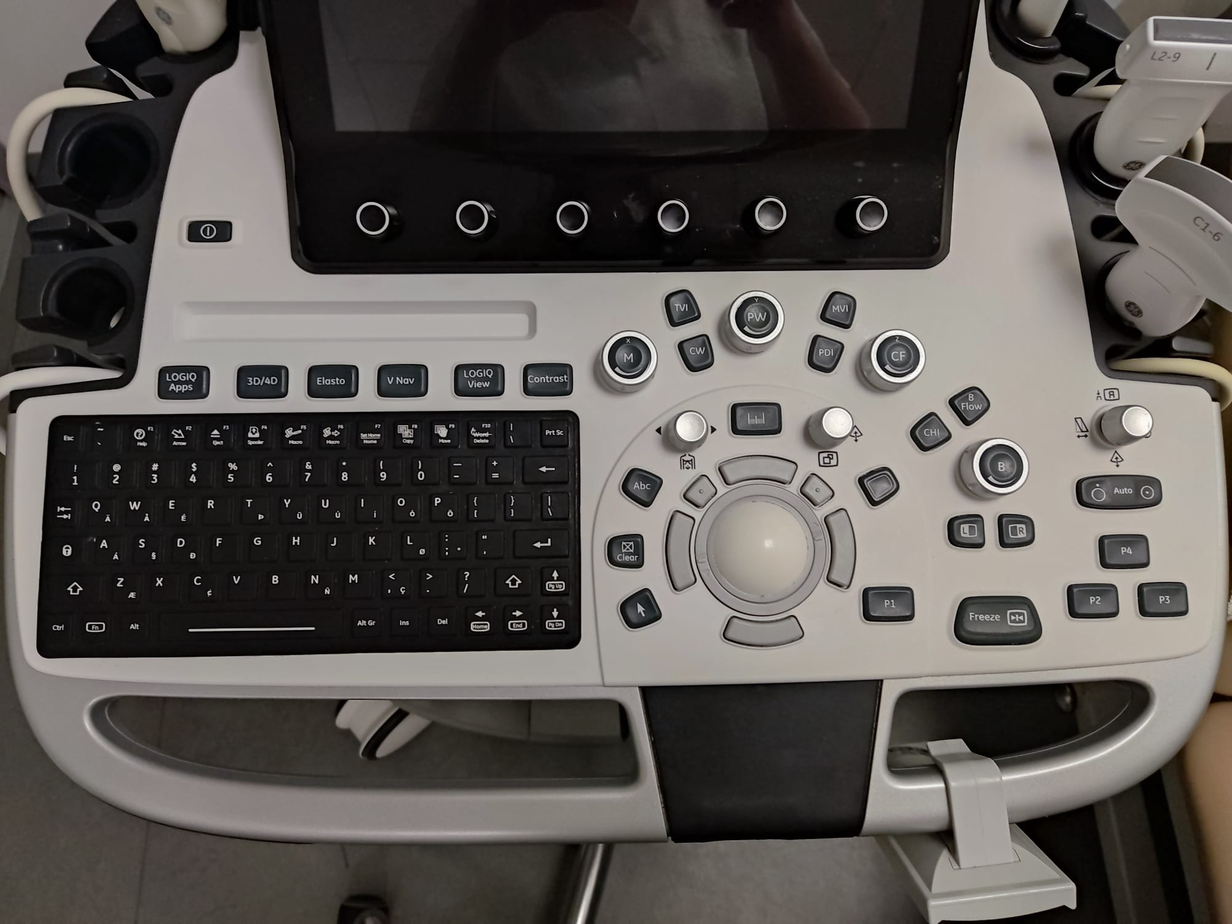

Machine Controls

Slide 2
Aim
Put the physics of imaging into practice
Provide a basis for understanding how to use an ultrasound machine
Give an understanding of the functions of different buttons – ‘knobology’
Provide an understanding of factors affecting image quality in B mode

Slide 3
Gain and TGC

Slide 4
B-mode
Gain effectively changes the brightness of the image. It is a pre-processing function amplifying the received transducer signals
TGC function changes the gain at varying depths in the field of view
Utilised to increase the receive amplification for weak echoes from depth, and reduce those from strong unwanted echoes that are usually from superficial structures or strong reflectors.
It can also be used to reduce posterior acoustic enhancement deep to fluid filled structures

Slide 5
Depth

Slide 6
Depth
Shown on a scale on the side of the image and can be adjusted to visualise deeper structures accordingly
Increasing the depth decreases the Pulse Repetition Frequency (PRF) which slows down the frame rate as it takes longer to acquire the images.
Maximum depth is dependent on the frequency of the ultrasound transducer, with lower frequencies penetrating much further but with reduced resolution.

Slide 7
Focus
Usually is indicated by an arrow or triangle marker on the left of the screen
Some machines have auto focus whilst others will allow the user to manipulate the focal depth
Placed at the depth of interest in the image, or just deep to it:
spatial resolution will be maximised (narrowest Beam)
improved image clarity
more accurate calliper measurements
If the focus is too superficial then rapid divergence of the ultrasound beam will occur beyond the focal zone, resulting in poor image resolution at depth

Slide 8
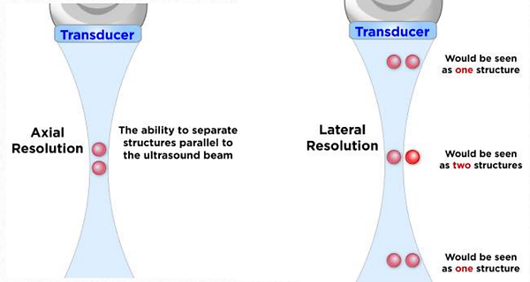
Remember Resolution
Frequency is inversely proportional to pulse duration
Higher frequency = shorter pulse duration = better axial resolution
Lower Frequency = longer pulse duration =
poorer axial resolution

Slide 9


Resolution
Determined by the width of the beam
The narrower the beam the better the lateral resolution
Higher frequency = narrower the beam
Higher frequency of the wave
Penetration

Slide 10
Harmonic imaging

Slide 11
Harmonic Imaging
Helps to reduce artefacts and increase resolution in the image: achieves this by sending and receiving signals at different ultrasound frequencies, with the returning frequency being a harmonic of the initial one
Uses the fact tissues distort due to the sound wave across them during imaging
This expansion and contraction produces a echo signal of its own – a harmonic - Selective detection of harmonic
Improved signal-to-noise for deeper structures
Shows enhanced contrast at tissue interfaces

Slide 12
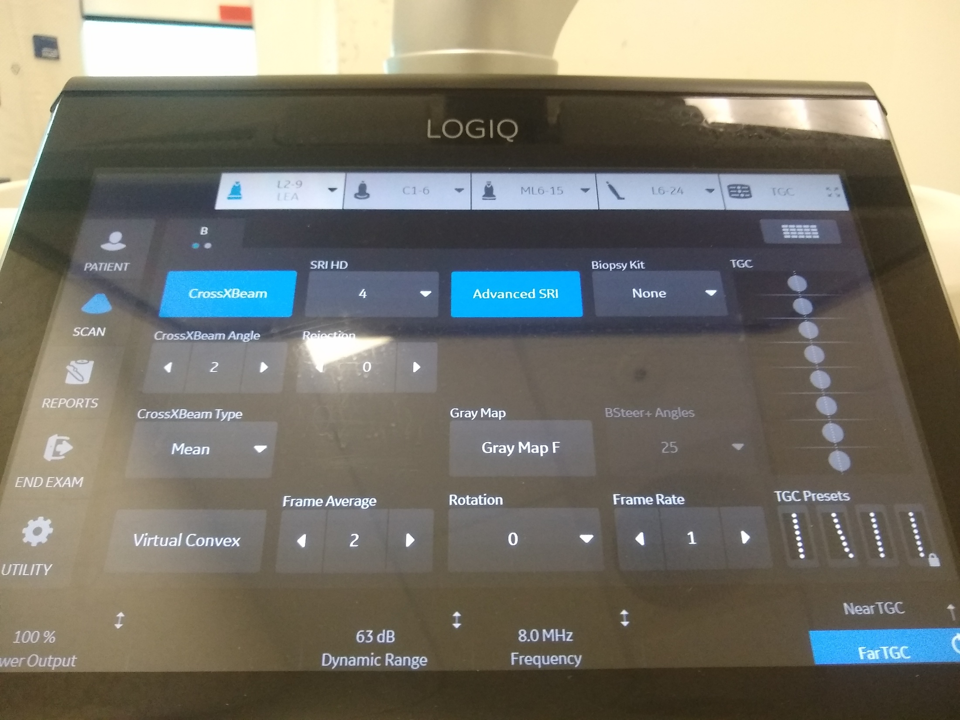

Compound Imaging

Slide 13
Compound Imaging
Combines three or more images acquired from different angles into a single view
Ultrasound transducer sends signals at multiple angles, which helps to eliminate artefact (including speckle) and increase edge detail
Available only on linear and convex transducers.
Different names according to manufacturer; CrossXBeam (GE), SonoMB (Sonosite), SonoCT (Philips) and ApliPure (Toshiba)
Notes:
However can reduce helpful artifact and reduce frame rate

Slide 14
Speckle Reduction (SRI) Imaging
Improved contrast resolution
Smooths image and improves clarity
Maintains or enhances edges or borders
Increased signal to noise ratio
Can adjust to different levels

Slide 15
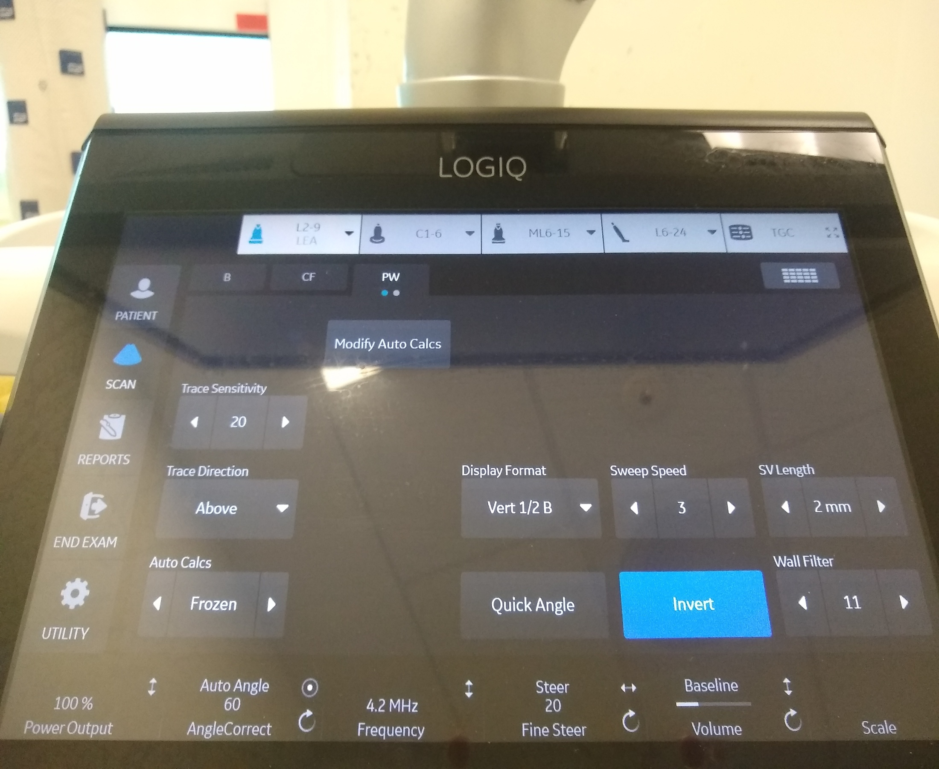
Wall Filter

Slide 16
Wall Filter
High-pass filters to eliminate the lowest Doppler shifts from the display
These Doppler shifts originate from motion of the vessel wall and solid tissue and are referred to as clutter or motion artefacts.
The wall filters may eliminate signals from low velocity flow as the filters separate by frequency alone.
The PRF and wall filter are linked controls—the lowest possible wall filter is lower for a low PRF than a high. Filter allows adjustment of the signal so that lower velocities up to a certain number will not be displayed.
A higher filter will reduce artefact but may limit visualisation of lower flow.

Slide 17
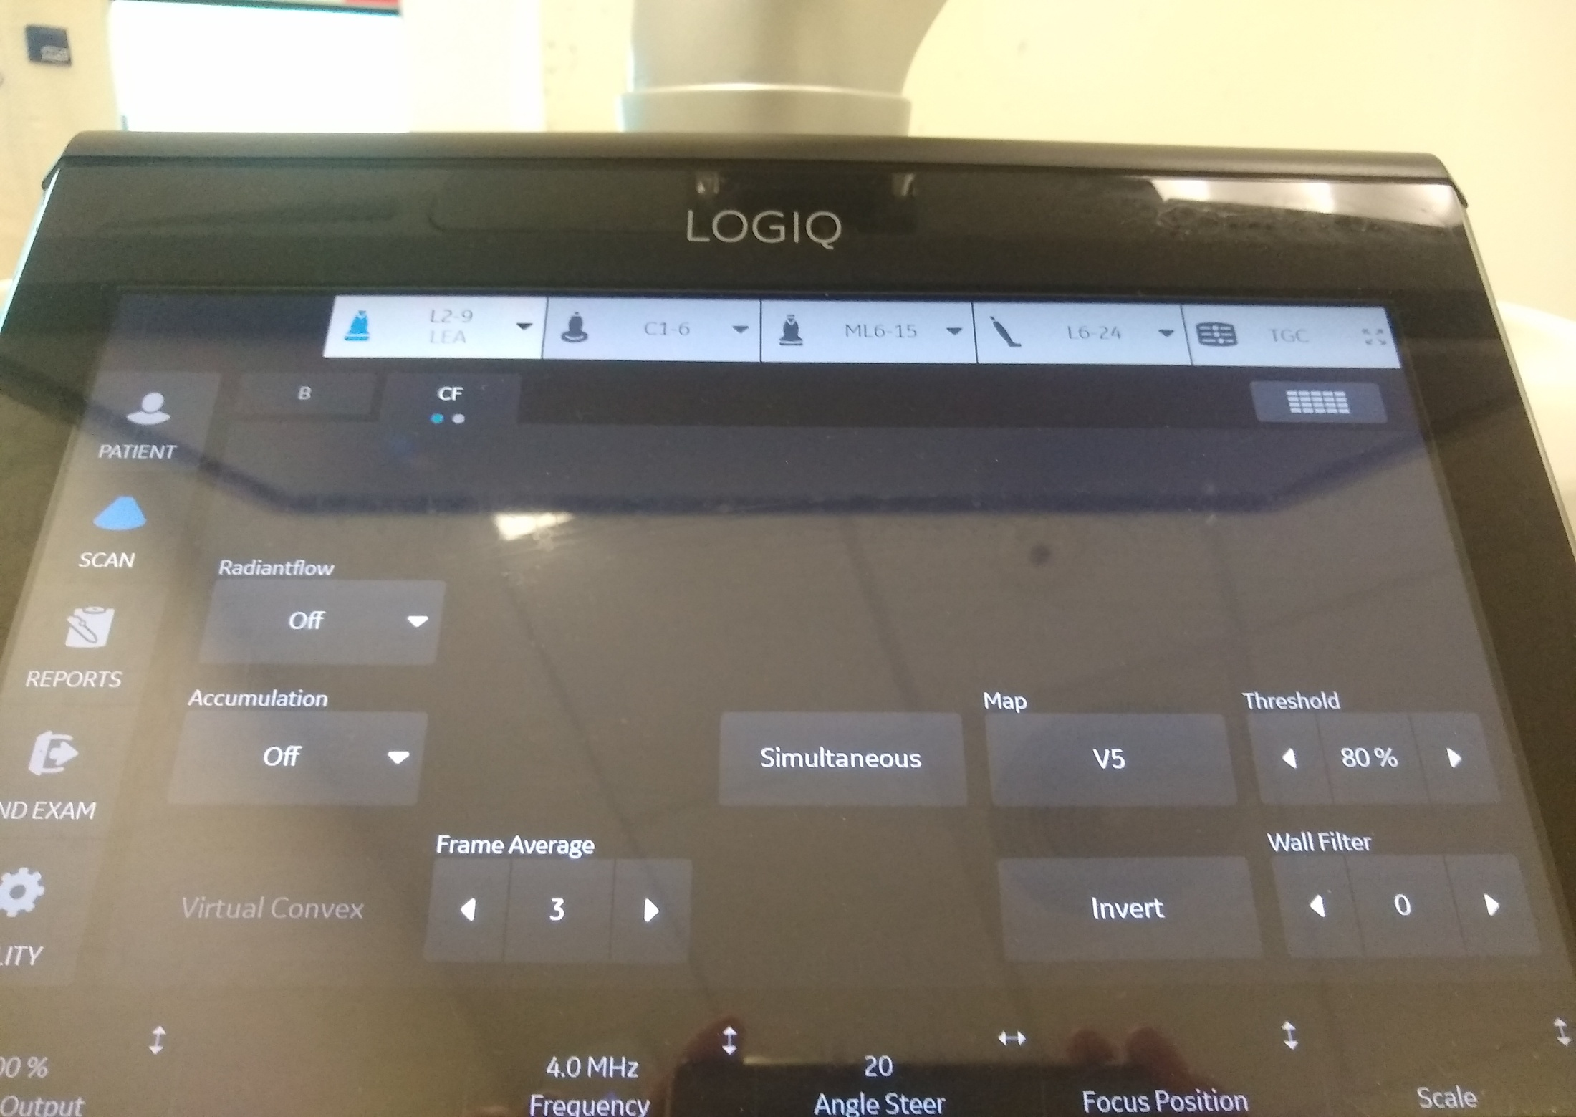
Frame Averaging

Slide 18
Frame Averaging/Persistence
Temporal smoothing function in which multiple image frames are combined, or “averaged” into a single image
The effect is similar to that of speckle reduction, in that the image appears smoother with reduced noise
Decreasing persistence - a more pixelated/speckled image, with a higher frame rate lower persistence for rapidly moving structures
Increasing persistence - smooth out image but sacrifices crispness of moving structure higher persistence more desirable for slow moving structures

Slide 19
Colour-Write Priority
Determines whether a particular pixel on the image displays colour or greyscale B-mode information
Low priority - allows B-mode to override colour information, helping to suppress motion artefact in the relatively hyperechoic tissue surrounding a pulsating artery
High priority - allows colour information to override grey-scale e.g. reverberation artefacts inside vessels
Increasing priority can significantly improve flow detection in small calibre vessels

Slide 20
Optimisation of B Mode Image
Select the most suitable transducer and preset
Do a survey scan
Adjust the image depth
Adjust the gain and TGC
Adjust the focal zone
Notes:
The colour box marks the area of interest within the b-mode image where we can apply colour Doppler signals to examine blood flow patterns.
It displays flow direction (red: to the transducer; blue: away from the transducer), flow velocity (colour tone or colour brightness), and distribution of velocities within the vessel (represented by different colours within the vessel).
Doppler controls of particular importance; the colour box size and angle, colour gain, and the PRF.

Slide 21
Optimisation of Colour Doppler Image
Activate the colour sampling box
Adjust colour box size and angle
Adjust the colour gain
Adjust the velocity scale/PRF
Notes:
The colour box marks the area of interest within the b-mode image where we can apply colour Doppler signals to examine blood flow patterns.
It displays flow direction (red: to the transducer; blue: away from the transducer), flow velocity (colour tone or colour brightness), and distribution of velocities within the vessel (represented by different colours within the vessel).
Doppler controls of particular importance; the colour box size and angle, colour gain, and the PRF.

Slide 22
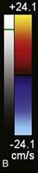
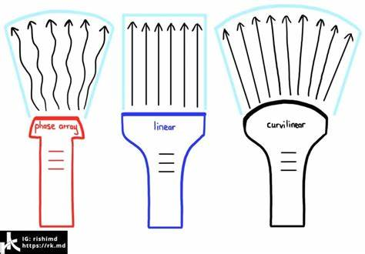
Colour Box Steer
60°
90°
60°
Notes:
The colour box marks the area of interest within the b-mode image where we can apply colour Doppler signals to examine blood flow patterns.
It displays flow direction (red: to the transducer; blue: away from the transducer), flow velocity (colour tone or colour brightness), and distribution of velocities within the vessel (represented by different colours within the vessel).
Doppler controls of particular importance; the colour box size and angle, colour gain, and the PRF.

Slide 23
Optimisation of Spectral Doppler Image
Activate the pulsed wave sample volume (SV) or gate
Position the depth of the gate
Adjust the size of the SV/gate
Optimise the Doppler angle
Adjust the gain
Adjust the velocity scale /PFR
Adjust the baseline

Slide 24
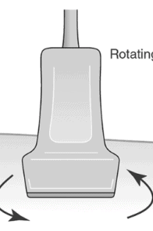
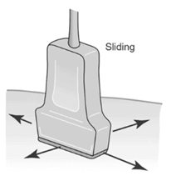
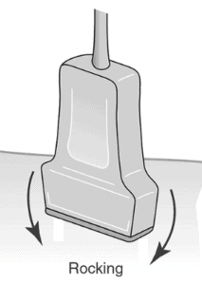
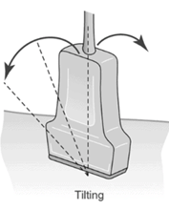
I’m having trouble finding…..
Try transducer movements;
Slide
Tilt (fanning)
Rotate e.g. change from long (LS) to transverse (TS)
Rocking
Try a new location/window
Apply more pressure, without making it too uncomfortable for the patient
Don’t be afraid to ask the patient to change position
If all else fails, more gel!
Notes:
https://www.pocus101.com/ultrasound-machine-basics-knobology-probes-and-modes/

