Slide 1
Doppler Waveforms

Slide 2
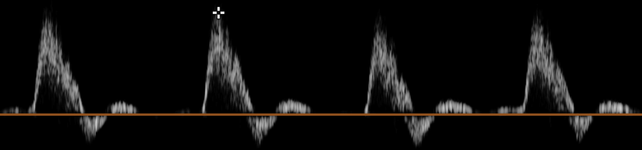
A normal lower extremity arterial Doppler velocity tracing is triphasic, with a sharp upstroke and peaked systolic component, an early diastolic component with reversal of flow, and a late diastolic component with forward flow

Slide 3
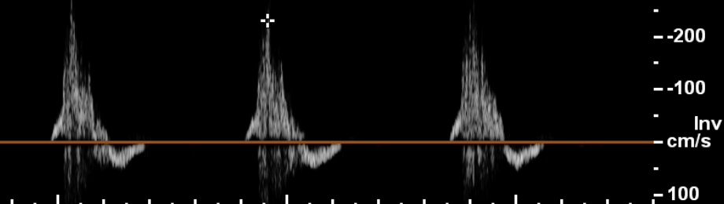
As atherosclerosis develops, the elastic and muscular recoil of the vessel wall is lost, resulting in loss of forward flow during late diastole, creating a biphasic waveform.

Slide 4
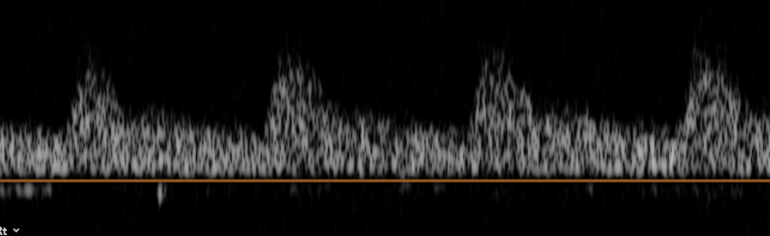
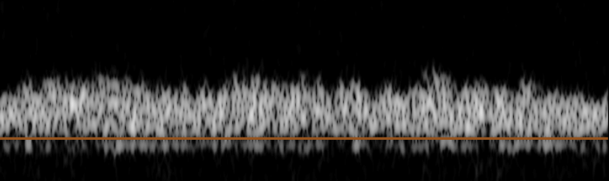
Monophasic waveforms are seen distal to severe stenoses or occlusions.

Slide 5
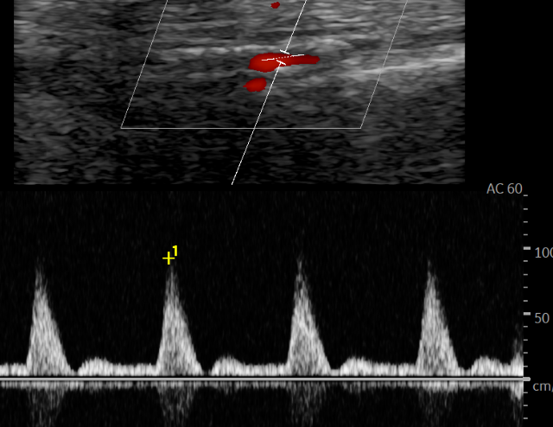
Hyperaemic waveform

Slide 6
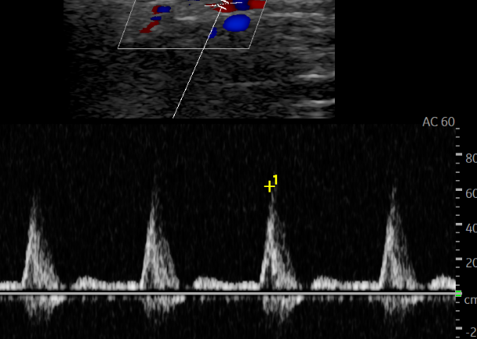
Hyperaemic waveform after foot squeeze

Slide 7
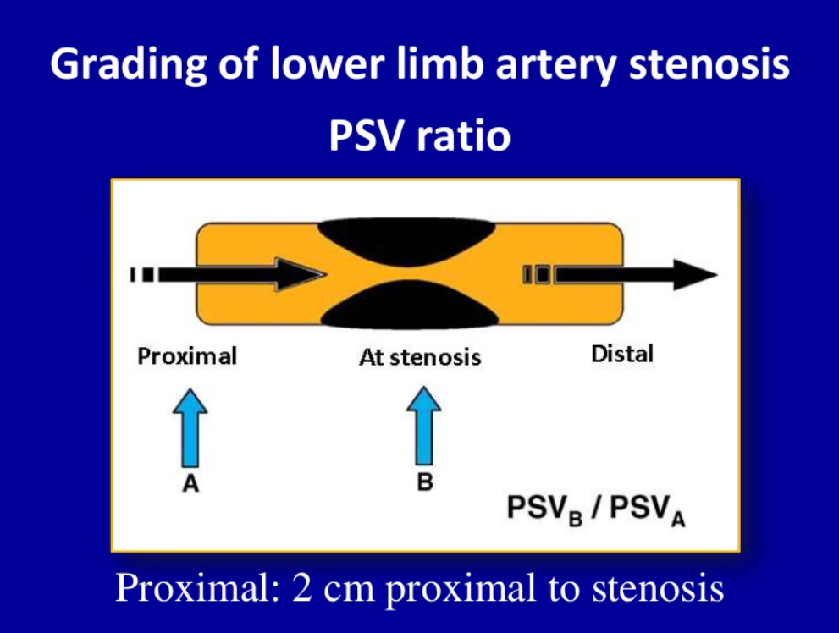

Slide 8
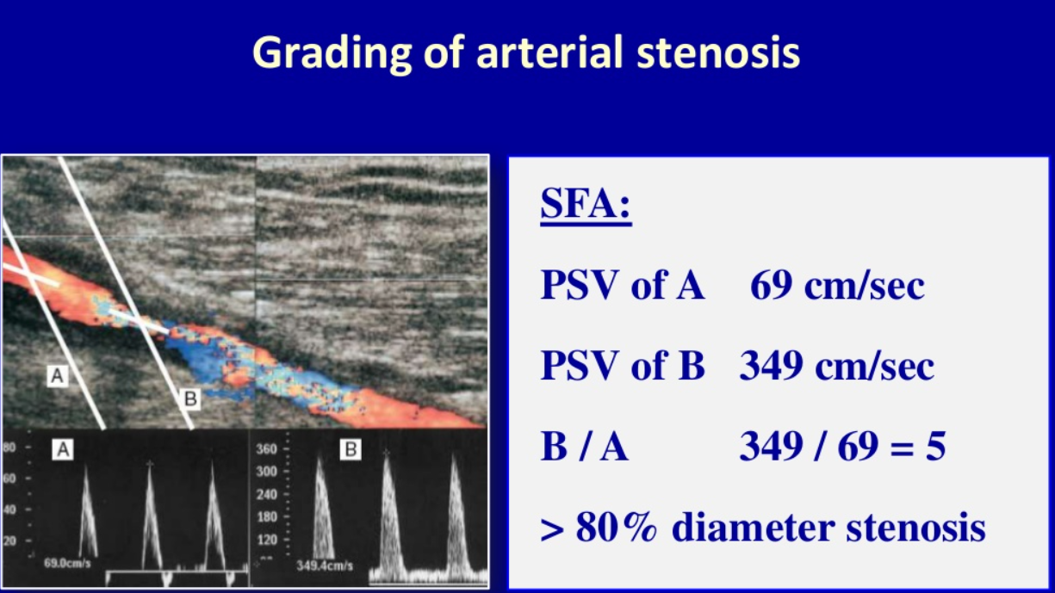

Slide 9
Limitations : Arterial/ bypass/ stent scans
Calcification
Body habitus
Patient compliance
Bowel gas
Oedma

Slide 10
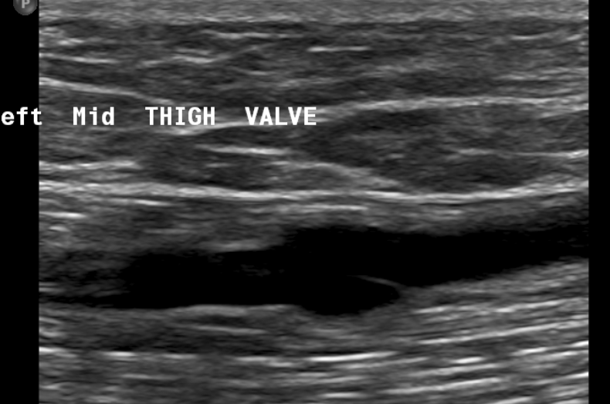
Arterial Bypass grafts

Slide 11
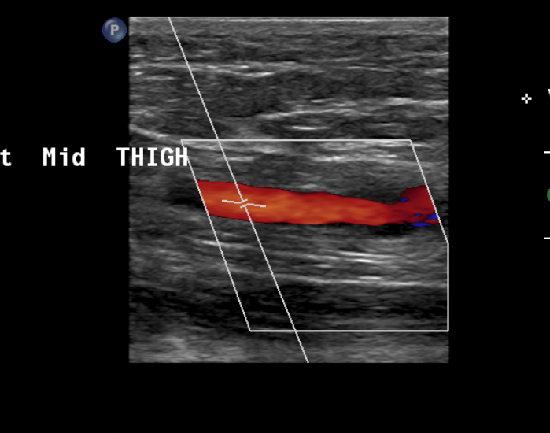
No stenosis at site of valve

Slide 12
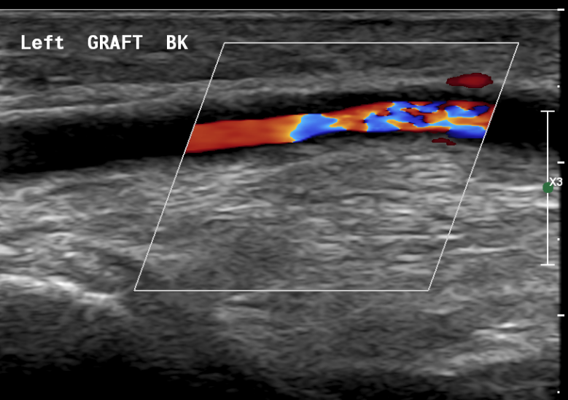
True graft stenosis

Slide 13
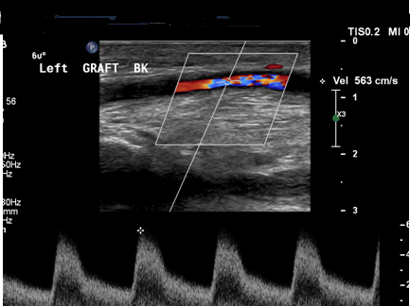

Slide 14
Current Graft Surveillance Programme
Surveillance Scan Type | Frequency | Referral Examination Detail on E-quest | CRIS Code
Arterial Grafts | Post op, 6 weeks, 3, 6, 9, 12, 18 months, then stop | US Graft Surveillance | UGRAF
Arterial Stents | 3, 6, 12, 18 months, then stop | US Graft Surveillance | UGRAF
Venous Stents | 6 weeks, 3, 6, 12, 18, 24 months, then stop. | US Venous Stent Surveillance | USRLY

Slide 15
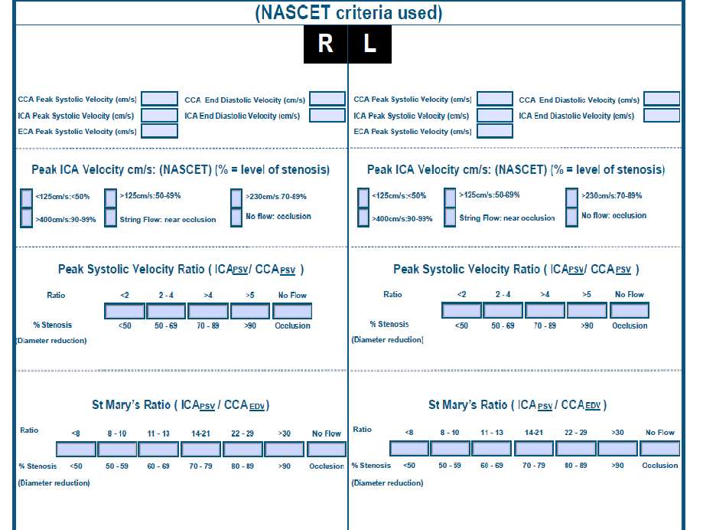
Carotid Stenosis Grading Criteria

Slide 16
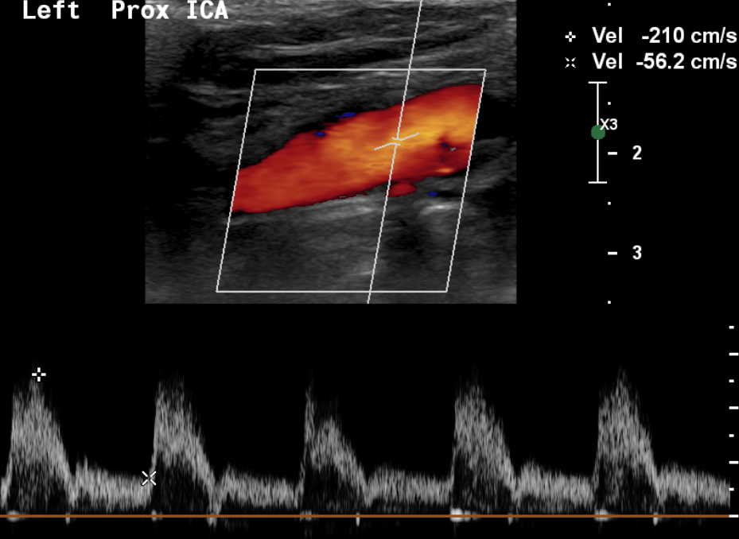

Slide 17
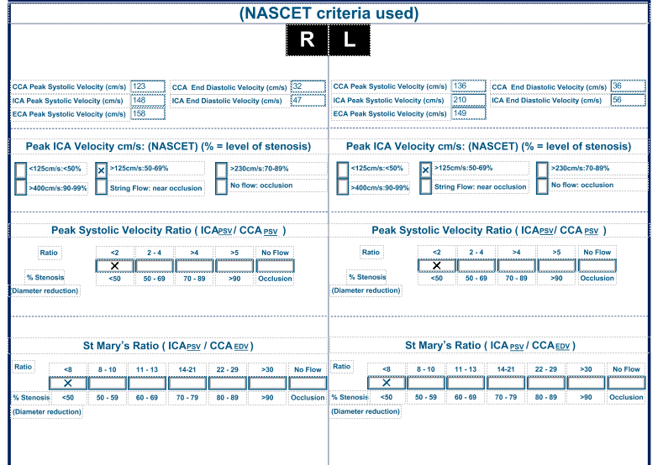

Slide 18
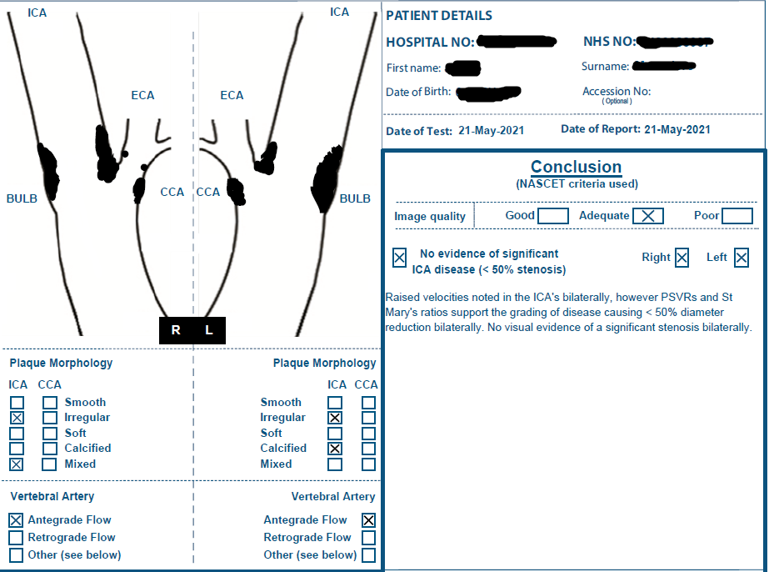

Slide 19
Limitations Carotid scanning
High Bifurcation
Misidentification of ICA and ECA
Tortuosity
Calcified plaque

