Slide 1
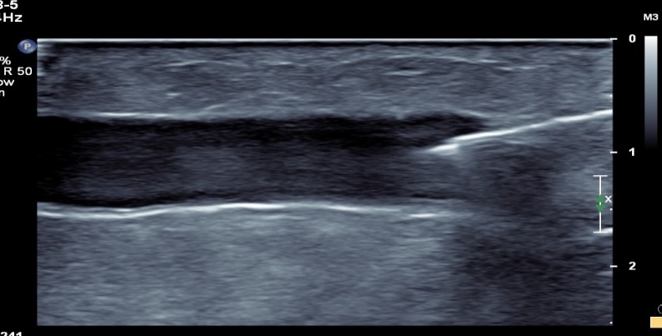
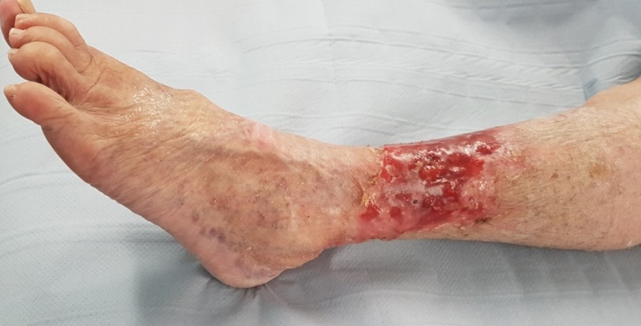
100 ulcerated limbs treated with Ultrasound Guided Foam Sclerotherapy:
Is long term recurrence related to recanalisation?
Howard JK, Slim FJA, Wakely MC, Davies CE, Kulkarni SR, Bulbulia RA,
Whyman MR, Poskitt KR
Cheltenham General Hospital
Notes:
Introduction: Chronic venous leg ulcers are unpleasant and costly with the chance of a recurrence being high. The ESCHAR study in 2004 demonstrated a significant reduction in venous ulcer recurrence when the underlying superficial venous reflux was correctly surgically alongside compression, versus compression alone. An attractive alternative to surgery is ultrasound guided foam sclerotherapy and, being quick and easy to perform and minimally invasive for the patient. However it has been reported that the rates of recanalisation following foam can be high and the aim of this study was to assess the effect of recanalisation on long term venous ulcer recurrence.

Slide 2
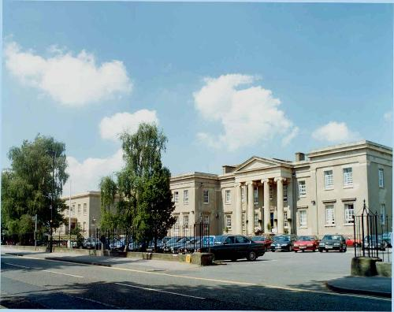
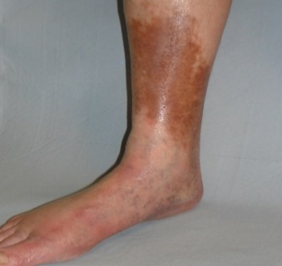
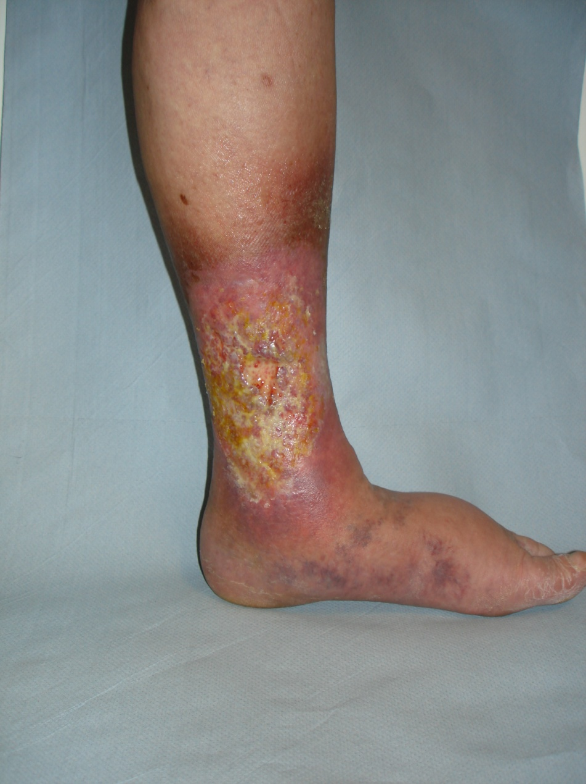
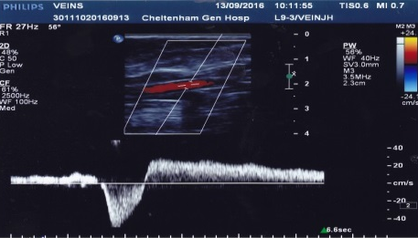

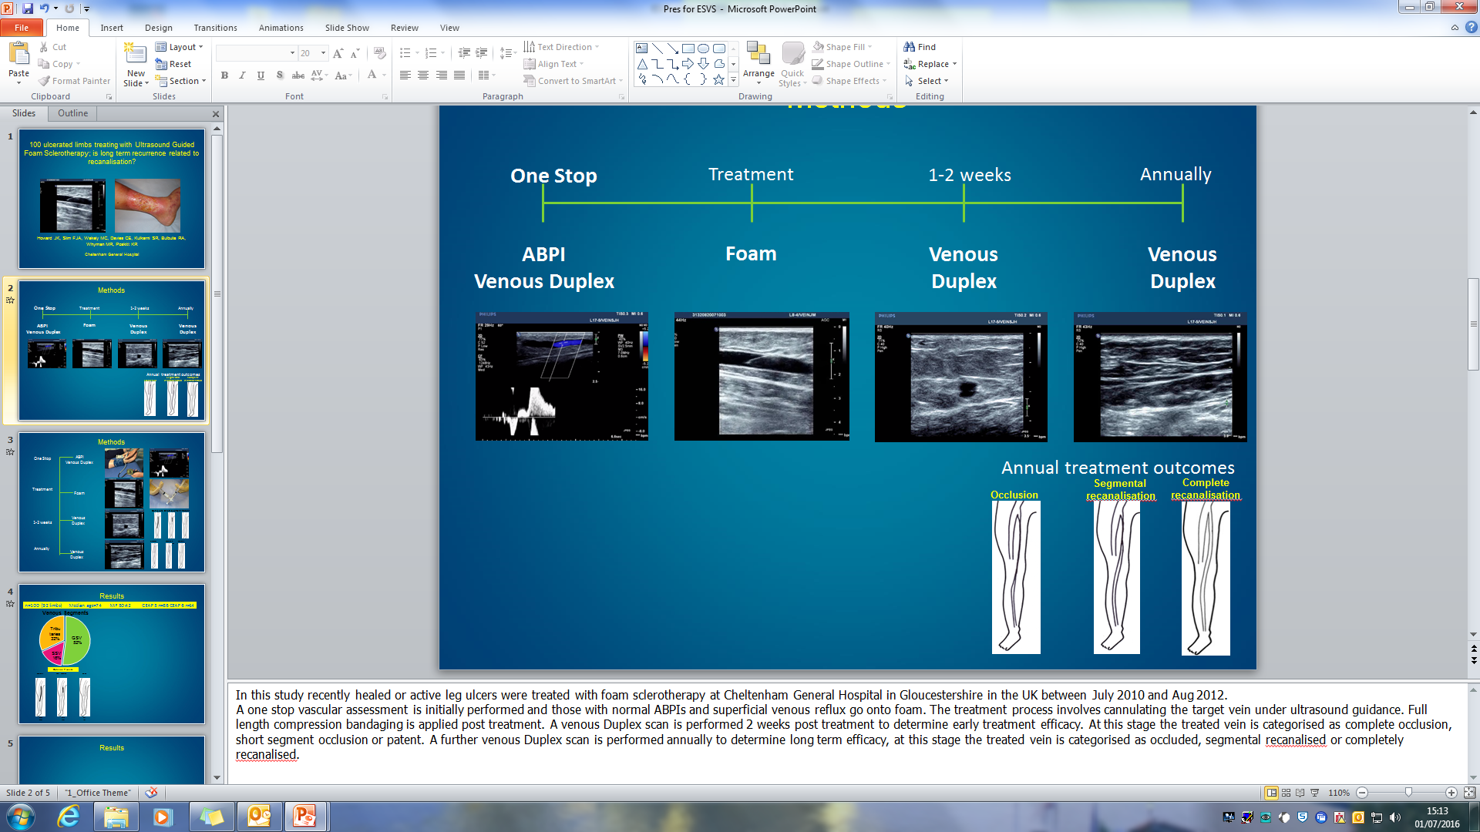
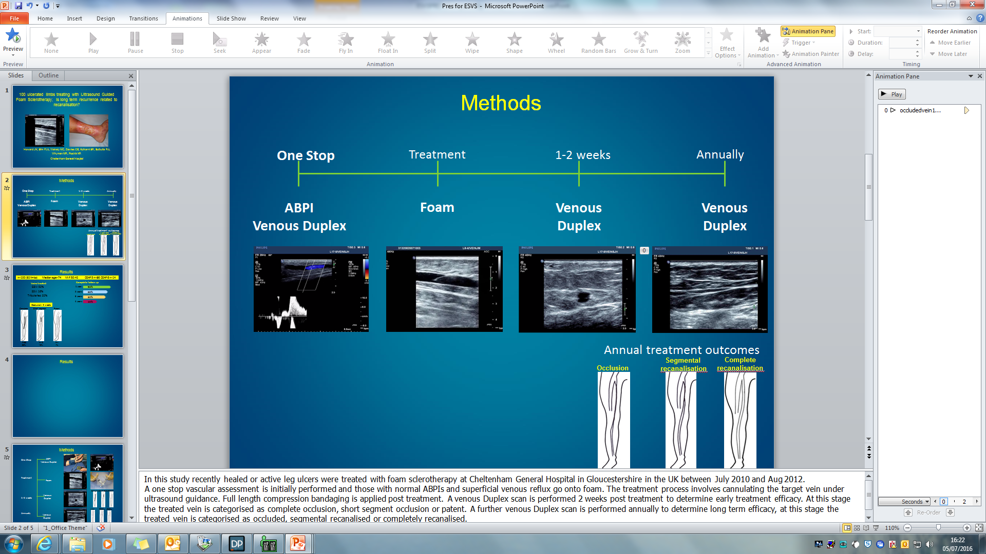
Methods
CEAP 5
CEAP 6
Cheltenham General Hospital, UK
Healed
Active
July 2010-August 2012
One Stop
Treatment
1-2 weeks
Annually
ABPI
Venous Duplex
Foam
Venous
Duplex
Venous
Duplex
Notes:
In this study recently healed or active leg ulcers were treated with foam sclerotherapy at Cheltenham General Hospital in Gloucestershire in the UK between July 2010 and Aug 2012.
A one stop vascular assessment is initially performed and those with normal ABPIs and superficial venous reflux go onto foam. The treatment process involves cannulating the target vein under ultrasound guidance. Full length compression bandaging is applied post treatment. A venous Duplex scan is performed 2 weeks post treatment to determine early treatment efficacy. At this stage the treated vein is categorised as complete occlusion, short segment occlusion or patent. A further venous Duplex scan is performed annually to determine long term efficacy, at this stage the treated vein is categorised as occluded, segmental recanalised or completely recanalised.

Slide 3
Results
n=100 (92 patients) Median age=74 M:F 50:42 CEAP 5 n=86 CEAP 6 n=14
Duplex 1-2 weeks
Duplex 4 years
Complete
occlusion
Short segment
occlusion
Segmental
recanalisation
Complete recanalisation
Patent
Occlusion
86%
n=86
13%
n=13
1%
n=1
43%
n=40
39%
n=36
18%
n=17
57% recanalisation with reflux
Notes:
100 limbs were treated in 92 patients, median age was 74 with 50 males and 42 females. 86 limbs were CEAP 5 with recently healed ulceration and 14 were CEAP 6 with active leg ulceration.
The majority of veins treated were great saphenous veins, with 16% short saphenous veins and 32% tributaries.
At two weeks, 86% demonstrated complete occlusion, 13% short segment occlusion and 1% were patent.
At 4 years, 43% remained occluded, with 39% demonstrating segmental recanalisation at some stage during the 4 years and 18% demonstrating complete recanalisation, which equates to a total of 53%recanalisation with reflux within 4 years.

Slide 4
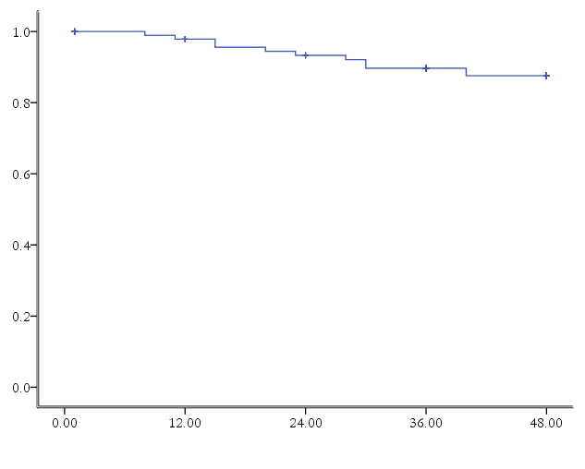
Results
Kaplan Meier Ulcer Recurrence
2.3%
5.1%
100
11.3%
12.4%
80
Chi Squared Tests:
No significant relationship with recanalisation and recurrence p=0.89
Healed legs not recurred%
60
40
20
0
0
1
2
3
4
Years
n=99
Numbers at risk
99 90 81 73 41
Notes:
At one year, ulcer recurrence rate was 2.3%, 5.1% at two years, 11.3% at three years and 12.4% at 4 years, there was no significant association between recanalisation and reflux and ulcer recurrence.
In conclusion-Mr Chairman, ladies and gentlemen, in the long term, recanalisation was demonstrated to be high in this group of patients.
However recanalisation does not lead to ulcer recurrence
As the severity of venous dysfunction cannot be quantified by venous Duplex, this cohort of patients may benefit from assessment of their venous function through non-invasive techniques and determine those who may be at greater risk of ulcer recurrence

