Slide 1
Intriguing referral: ‘Soft swelling and enlargement of left facial vein’
Ellie Walker
February 2015

Slide 2
Clinical History
Neurosurgery telephone referral for a duplex, 64 year old gentleman. Please look at a new soft swelling and enlargement of left facial vein; arterio-venous anastomosis?
Had a DBS procedure 1st March 2014
DBS procedure was to the contralateral side (however this was a redo and the previous device had been on the left)

Slide 3
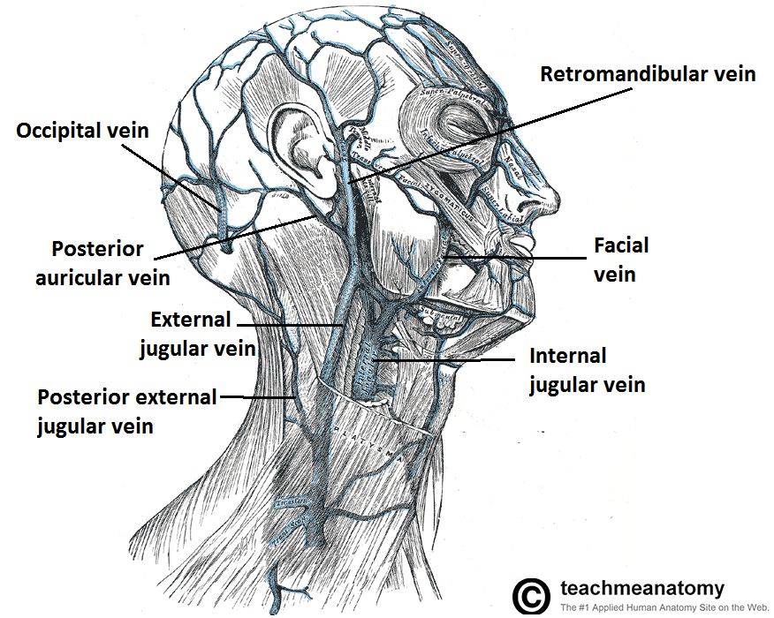
What is DBS?
Facial vein enlargement?
Procedure ~1 year ago why presenting now?

Slide 4
Deep Brain Stimulation - DBS
Deep brain stimulation (DBS) is a surgical procedure to implant a pacemaker-like device that sends electrical signals to brain areas responsible for body movement.
treatment for a number of neurologic disorders
movement disorders
Parkinson's disease, tremor and dystonia (Dystonia - medical term that describes a range of movement disorders that cause muscle spasms and contractions)

Slide 5
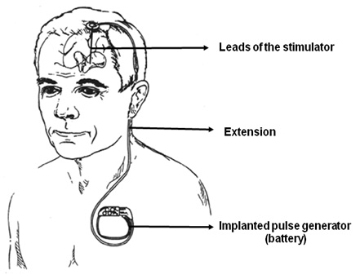
DBS system
Three components:
the lead
the extension
the implanted pulse generator (neurostimulator)

Slide 6
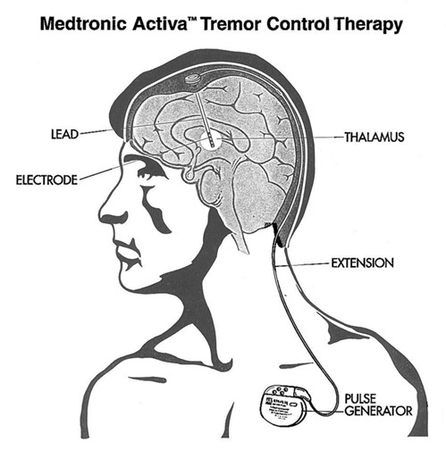
Extension lead placement
The DBS extension leads typically traverse subcutaneously from the subclavicular area to the lateral-posterior neck and then over the occipital area to penetrate the skull at variable sites in the parietal area
Lead insertion procedures can lead to iatrogenic AVF or false aneurysm

Slide 7
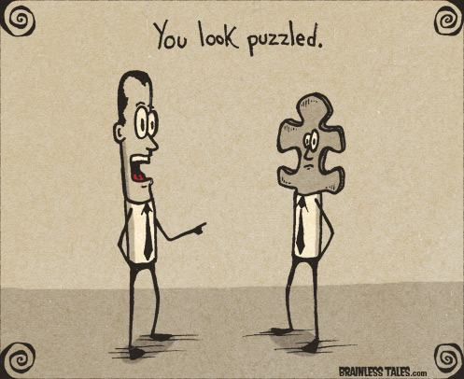
Duplex Findings
Lots of arterialised superficial veins in the supraclavicular region and extending up the neck. EJV enlarged with arterial flow.
Low resistance flow in the supraclavicular subclavian artery
High resistance Doppler signals below the clavicle

Slide 8
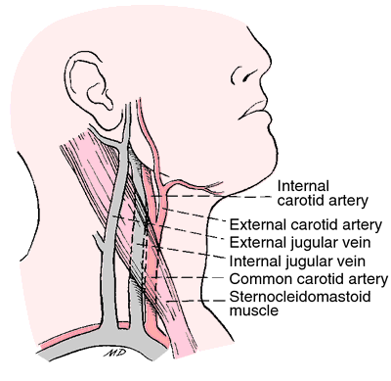
Duplex Report
Left neck US Venous/Arterial :
left common carotid, internal carotid and external carotid arteries are patent with normal Doppler signals.
left supraclavicular subclavian artery has low resistance Doppler signals, PSV 214cm/sec, with superficial overlying small veins with arterialised Doppler signals
infraclavicular subclavian artery has normal triphasic Doppler signals, PSV 130cm/s.
multiple superficial engorged veins in the neck appear to connect to the external jugular vein.
Patent internal jugular vein.

Slide 9
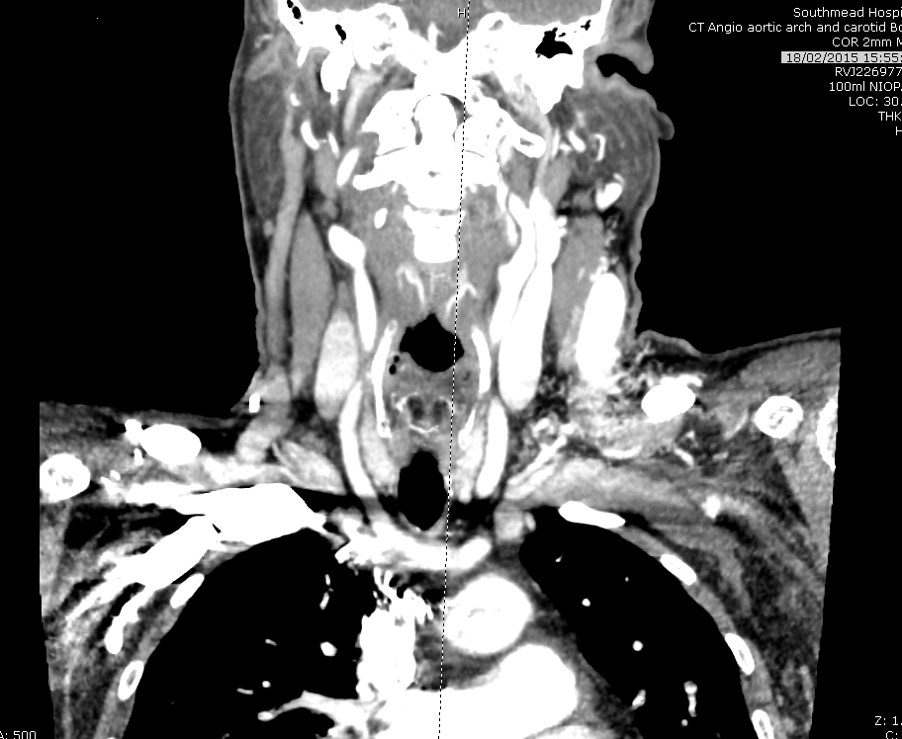
CT scan
Performed 18/2/15 and not reported yet.
However reviewing images there does appear to be a correlation with duplex
Briefly mentioned at MDT today, however CT still not reported and DM wants to see if suitable for stenting

Slide 10
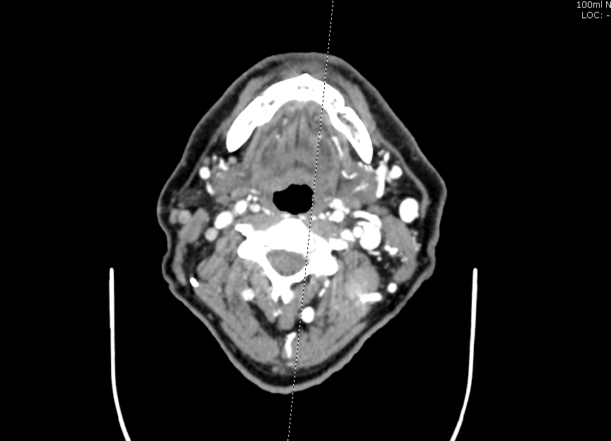
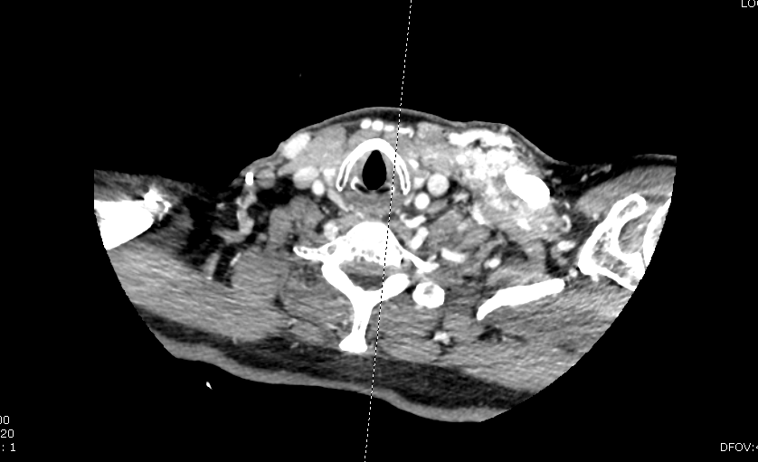
CT images

Slide 11
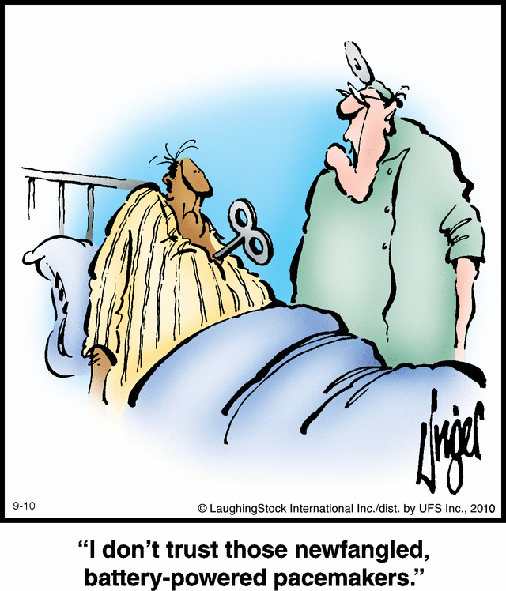
Review Papers? Iatrogenic Neck AVF
Uncommon- becoming more common complication due to the increase in device implantation techniques/ equipment
Only encountered as case studies in the medical literature
No article relating to DBS extension leads insertion or extraction arterial trauma
Several case studies relating to pacemaker leads, insertion and extraction
Additional papers central venous and IJV catheterisation (location differs)

Slide 12
Treatment options
Treat them - AVF located in the neck tend to increase in size and blood flow volume
Next step likely to be angiogram +/- coil embolisation or stent insertion depending on suitability.
Literature also suggest surgery is best option in certain cases, i.e. superficial lesion with simple AV communications, single artery with few draining vessels
Want to get it right first time to avoid complex collaterisation with more complex future treatment options.

Slide 13
References to be put on shared drive
Thyrocervical trunk and external jugular vein arteriovenous fistulas John Phair et al | Journal of Vascular Surgery Venous and Lymphatic Disorders 2014;2:77-8 | Case Study: Neck mass with palpable thrill, duplex thyrocervical trunk and EJV AVF, first documented case, no previous trauma or procedure. Surgical treatment performed due to superficial nature of fistula
Internal mammary arterial injury from extraction: A clinically subtle yet important complication of implantable device removal Cesar Cruz et al | Cardiology Research and Practice Volume 2011 (2011), Article ID 408640, 5 pages | Case Studies: 1. Removal of chronic atrial and ventricular leads, no apparent complication, then at follow-up murmur pre-pectoral region. CTA confirmed IMA- brachiocephalic vein fistula. Treatment coil embolization of IMA. 2. Technical difficult lead extraction, continuous murmur noted next morning and angiography confirmed AV fistula joining the LIMA to proximal subclavian vein and a false aneurysm. Closure achieved via coil embolization.

Slide 14
CT Result Update
Clinical History :
AVF in lower left neck said to originate from left subclavian artery, Contrast scan to delineate AVF with view to treatment.
Requested By: David Mitchell
CT Angio aortic arch and carotid Both : CT angiogram images from aortic arch and skull base
There is a right-sided deep brain stimulator box. I understand this is a repositioning from previous insertion on the left.
The aortic arch appears normal. Incidental note is made of bovine arch anatomy with, origins of the right brachiocephalic trunk and left common carotid artery. The right subclavian common, internal and external carotid appear normal. The right vertebral artery is hypoplastic which is a normal variant. The left common, internal and external carotid arteries are patent normal calibre. The left subclavian artery is patent normal calibre.
There is a high flow arteriovenous shunt with large network of distended draining veins in the left anterior chest wall/supraclavicular fossa/right side of neck. The exact dynamics the shunt difficult to ascertain on a static image but I think the arterial supply probably comes from a small superficial branch which has a common origin from left subclavian with left internal mammary artery. This is presumably a post-traumatic arteriovenous fistula and as such is likely to have a single point of arteriovenous communication. There are no features to suggest that this arteriovenous fistula has any intra cranial component.
Comment:–The next step would be to proceed to catheter angiogram with a view to embolisation if appropriate.

Slide 15
