Slide 1
Interesting cases Meeting
Vascular
09-02-22

Slide 2
Patient History
76 year old male with critical leg ischaemia Right leg
Previous operations right leg following RTC in 1977 -motorbike vs car

Slide 3
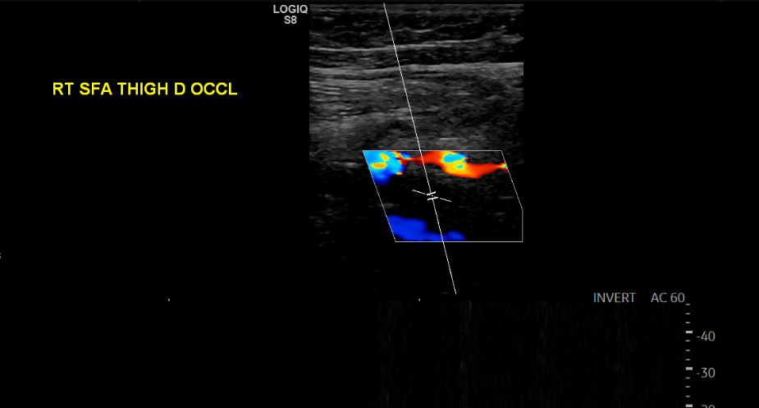

Slide 4
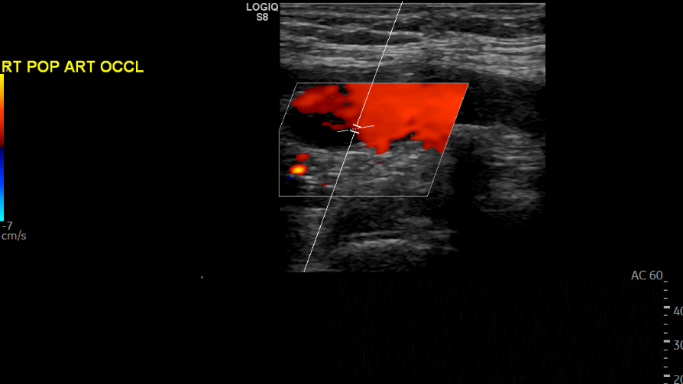

Slide 5
Ultrasound Findings
Arterial ultrasound findings 19/01/21
Occluded distal SFA, Popliteal and TPT
Vein map indicated a large calibre GSV.
Right Fem-PTA bypass-25/01/21
Notes:
rrdgfbfgs

Slide 6
Operation notes 25/0/21
Reversed Right GSV used.
Right knee unable to flex beyond 40 degrees- as per op-notes
Difficulty in accessing RIGHT PTA due to non-flexion of knee
Distal anastomosis re-done with 7/0 prolene. Awkward anastomosis.-as per op-notes
Haemostatic suture used at the distal anastomosis
Notes:
dfdfgfgfd

Slide 7
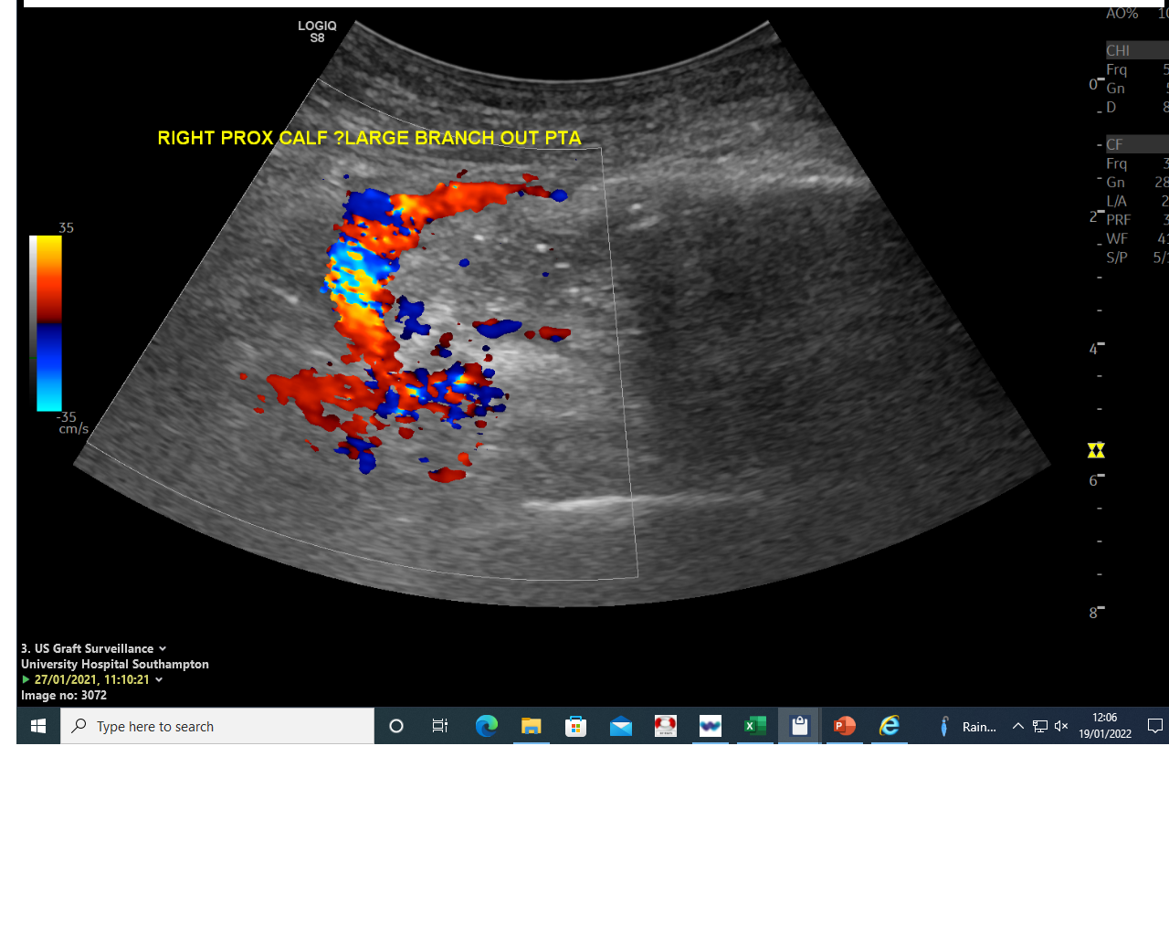
Post-op duplex
27/01/21

Slide 8
Post-op Graft Surveillance 27/01/21

Slide 9
Discussion with Radiologist Mr Wilson
Unlikely to be a bleed from the DA
Indicated to mention in report that arterial flow noted that could not be explained.

Slide 10
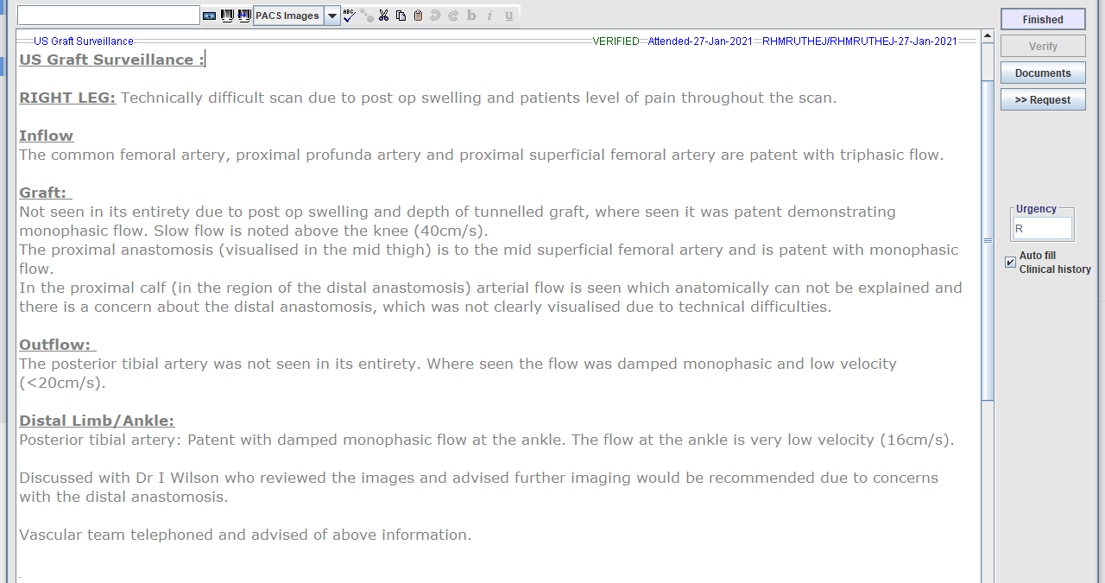

Slide 11
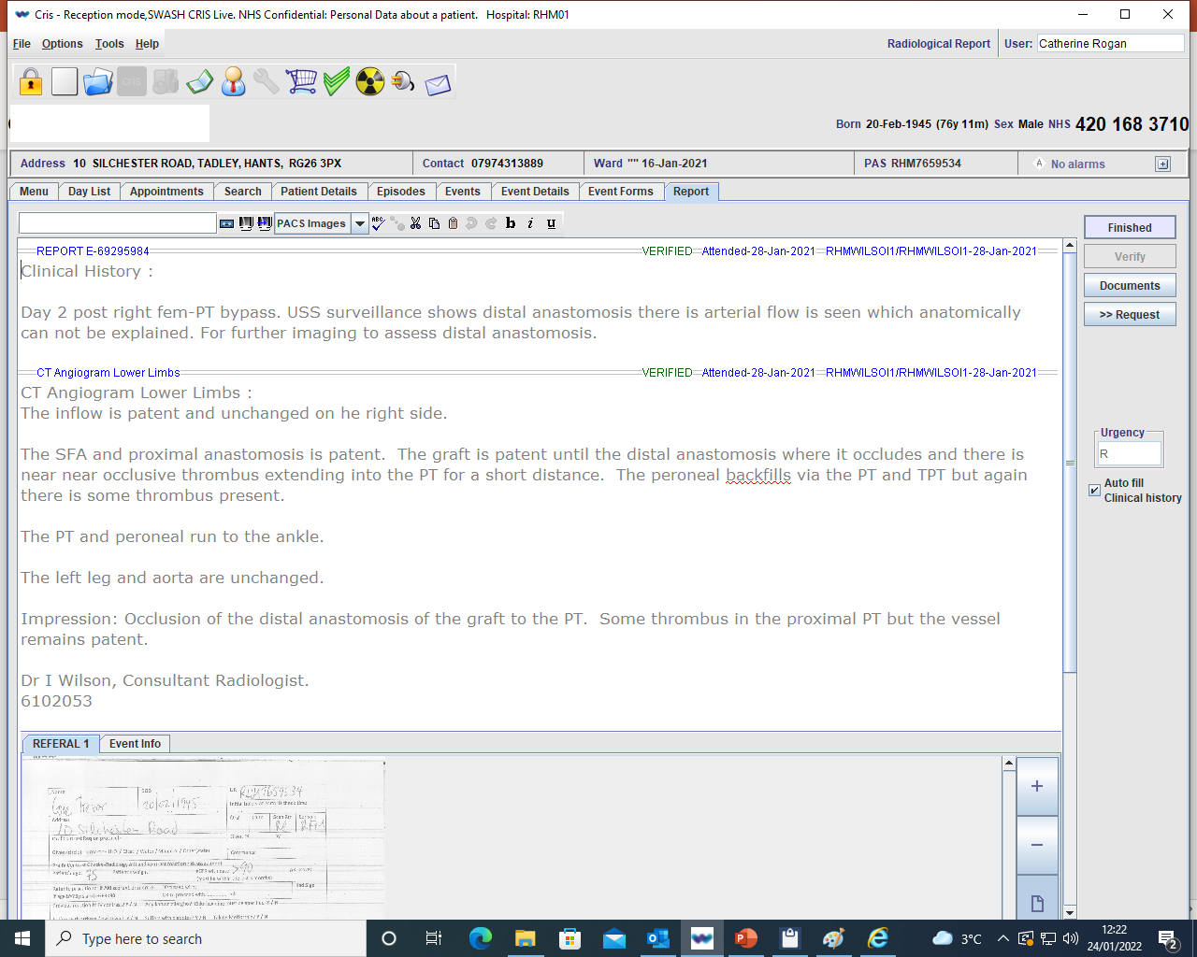
CT Report 28/01/21

Slide 12
Operation Notes 28/01/21
Graft thrombectomy performed
Bleeding on posteriolateral side of PT, distal to graft

Slide 13
Discussion

