Slide 1
Vascular Interesting Cases
June 2022

Slide 2
BACKGROUND
50-year-old male
Fit and Healthy
Type 1 Diabetes

Slide 3
Clinical History
10 Nov 2021 admitted to SGH with visual disturbance and 1-3 headache
Had CT head which showed acute infarct in the PCA territory and watershed Right MCA territory
Had CT aortic arch and carotids which showed no disease and normal circle of Willis anatomy.

Slide 4
Transthoracic Echocardiography Report
10/11/2021
No intracardiac thrombus observed throughout
No significant valvular abnormalities

Slide 5
2nd Hospital Admission
16 Nov 2021- woke up with Right sided weakness and expressive dysphasia
Second CT head now showed cortical necrosis within the Right occipito- temporal infarct.
ICAs, vertebrals and circle of Willis showed no evidence of stenosis
MRI- Acute Left MCA territory infarct.
Subacute Right PCA territory infarct with a focal area of haemorrhage

Slide 6
Stroke team refer patient for a CT chest/abdo/pelvis
X2 embolic strokes in 10 days in different vascular territories.
? Malignancy
18/11/2021
Report- No malignancy identified

Slide 7
Referral for Echo bubble study- ? Patent foramen ovale
22/11/2021
Small number of bubbles from R- L with 3 cardiac cycles.
With Valsalva passage of a large number of bubbles R-L noted.
Bubbles appear to arise from the interatrial septum.
Impression: Patent foramen ovale

Slide 8
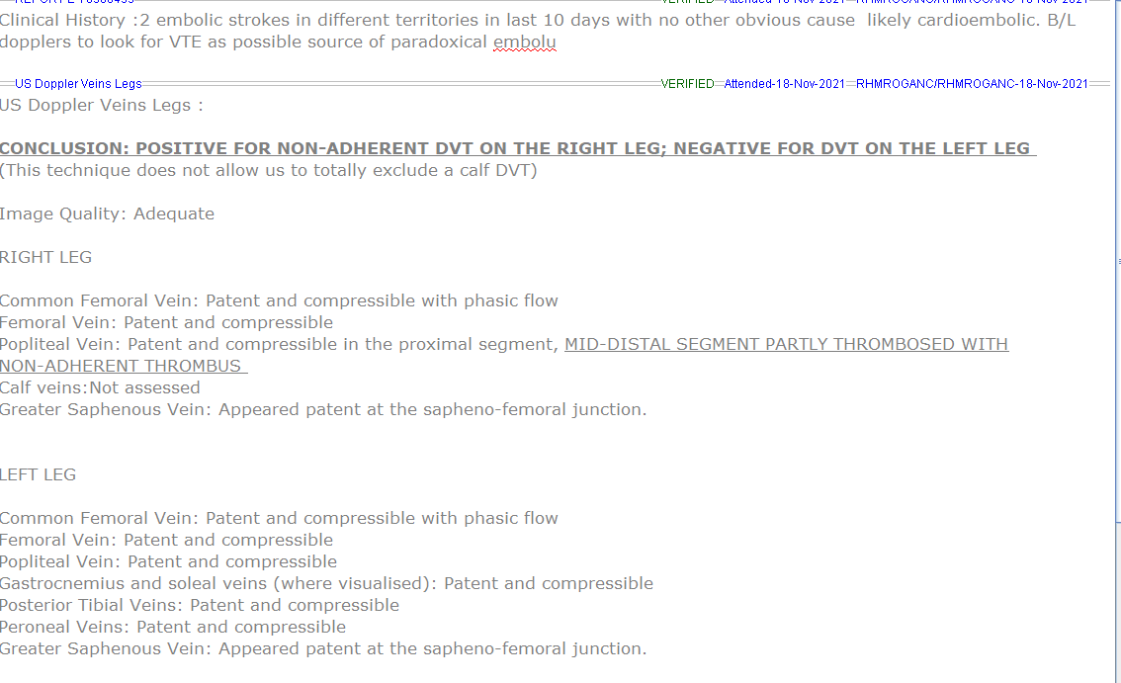
DVT Report

Slide 9
Diagnosis of Antiphospholipid syndrome
Disorder of the immune system that causes an increased risk of blood clots.
In APS, the immune system produces abnormal antibodies called antiphospholipid antibodies.
These target proteins attached to fat molecules (phospholipids), which makes the blood more likely to clot.
A diagnosis of APS can only be made after 2 abnormal blood test results, with at least a 12-week gap between them.
This is because harmless antiphospholipid antibodies can sometimes develop in the body for short periods of time.

Slide 10
Outcome
Patient on warfarin
APS, Unprovoked DVT and paradoxical embolism likely cause of stroke
Patient to be discussed at PFO MDT to discuss closure of PFO.
Studies do not show that co-existence of APS and PFO do not statistically increase the risk of recurrent strokes.

