Slide 1
Infection Control in Ultrasound
By Beth Stephens BSc, MSc

Slide 2
Why is this important?
Ultrasound has been recognised as a source of infection.
To prevent harm to patients from cross contamination.
I have reviewed the guidance and literature to determine if we need to change our practice.

Slide 3
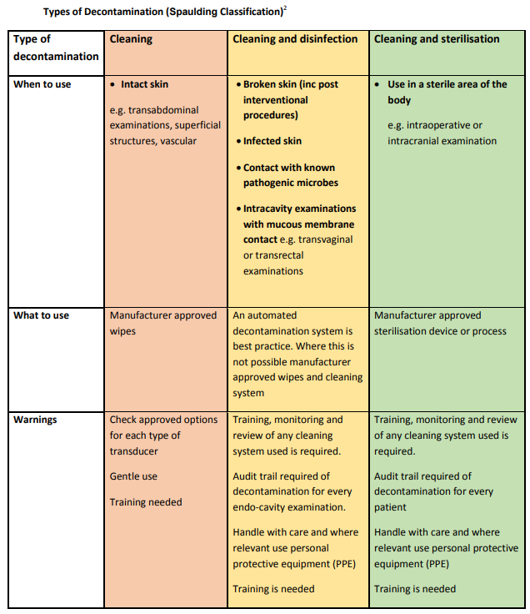
The Spaulding Classification
Best_Practice_Summary_-_probe_decontamination_-_FINAL_13_02_2020.pdf (bmus.org)

Slide 4
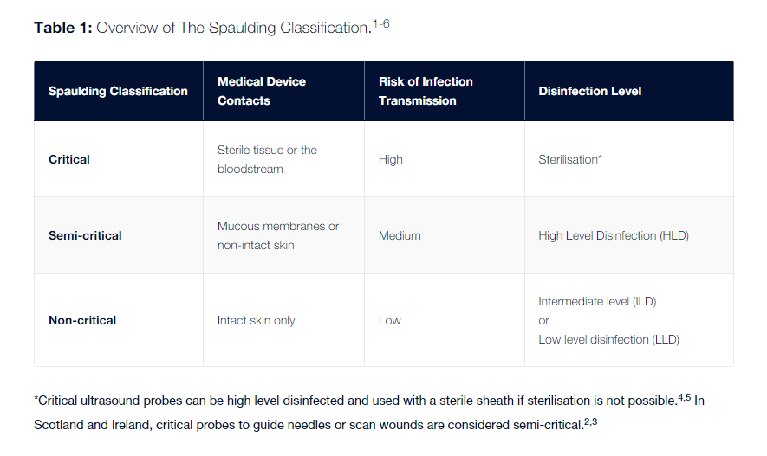
Notes:
Spaulding Classification | Nanosonics

Slide 5
What is High level Disinfection (HLD)?
Semi‐critical Probes must be manually cleaned prior to using a HLD method. There are four HLD methods available
Using Ultraviolet Light:
Semi‐critical Ultrasound Probe (Semi‐invasive and Non‐invasive) High Level Decontamination Procedure.
Using Hydrogen Peroxide (Trophon Cabinets):
Semi‐critical Ultrasound Probe (Semi‐invasive and Non‐invasive) High Level Decontamination Procedure
Endoscope Washer Disinfectors:
(EWD) can be modified to accommodate TOE Probes.
Using Manual Multi‐wipes (Tristell):
Semi‐critical Ultrasound Probe (Semi‐invasive and Non‐invasive) High Level Decontamination Procedure. This is the least preferred option for decontaminating SIUP’s. Chlorine dioxide.
9) Probe Guidance 26th January 2017 PM (hse.ie)

Slide 6
Cleaning - A process, which physically removes contamination but does not necessarily destroy microorganisms. The reduction of microbial contamination is not routinely measured and will depend upon many factors, including the efficiency of the cleaning process and the initial bioburden. Cleaning removes micro-organisms and the organic material on which they thrive.
Disinfection - A process used to reduce the number of viable microorganisms but which may not necessarily inactivate some microbial agents, such as certain viruses and bacterial spores. Disinfection may not achieve the same reduction in microbial contamination levels as sterilization.
Sterilization - A process used to render an object free from microorganisms including viruses and bacterial spores. Normal sterilization methods will not destroy prions.
Notes:
From trust decontamination policy.

Slide 7
The Guidance
There was a call for European guidance as this only existed for interventional procedures. Concerns were raised that there was risk of transmission of infection through conventional ultrasound, but in particular endo-cavity, near wounds and stomas (2).
It is very difficult to prove contamination, but it should not be assumed that the risk does not exist (2).
There is also risk associated with ultrasound gel, and the risk of probe cover perforations (2).
A large survey in 2016 by the European Society of Radiology showed a wide range of practices throughout Europe, and there are proven cases of outbreaks of infection (2).
Best practice recommendations from the European Society of Radiology Ultrasound Working Group were therefore published in 2017 (1).
Health Service Executive (HSE) also published their own guidance in 2017 for the Decontamination of Semi‐critical Ultrasound Probes; Semi‐invasive and Non‐invasive Ultrasound Probes.
Health Protection Scotland (HPS) Website - Guidance for Decontamination of Semi-Critical Ultrasound Probes
BMUS have used this guidance and summarised their own best practice summary (4).
SDMS released revised guidance in 2022.
Notes:
- best practice recommendations from the European Society of Radiology Ultrasound Working Group.
2) Nyhsen, C.M., Humphreys, H., Nicolau, C., Mostbeck, G., and Claudon, M. (2016). Infection prevention and ultrasound probe decontamination practices in Europe: a survey of the European Society of Radiology. Insights Imaging 7, 841–847.
4) Best_Practice_Summary_-_probe_decontamination_-_FINAL_13_02_2020.pdf (bmus.org)
Probe Guidance 26th January 2017 PM (hse.ie)

Slide 8
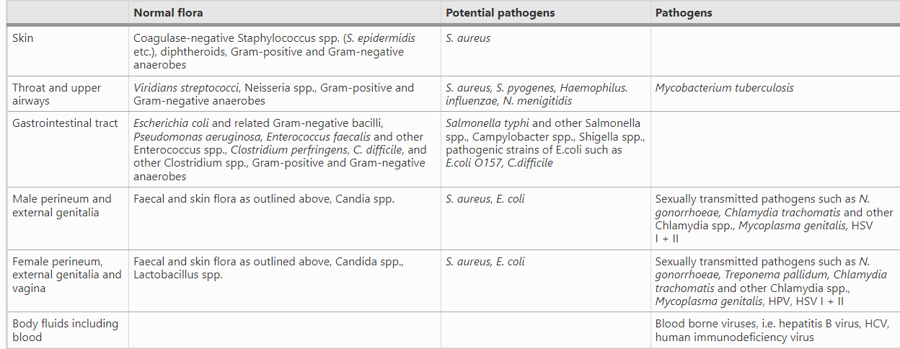
Physiological Flora and Potential Pathogens
Copied from the best practice recommendations from the European Society of Radiology Ultrasound Working Group 2017.
Notes:
Individuals who are asymptomatic carriers of potential pathogens may have developed a degree of immunity and be less susceptible to develop an infection caused by their endogenous flora. However, if these organisms are transmitted to another patient, through a contaminated US transducer or by other means, they may cause an infection, and are therefore classified as “potential pathogens”
1) Nyhsen, C.M., Humphreys, H., Koerner, R.J., Grenier, N., Brady, A., Sidhu, P., Nicolau, C., Mostbeck, G., Mirko D’onofrio, &, Gangi, A., et al. Infection prevention and control in ultrasound - best practice recommendations from the European Society of Radiology Ultrasound Working Group

Slide 9
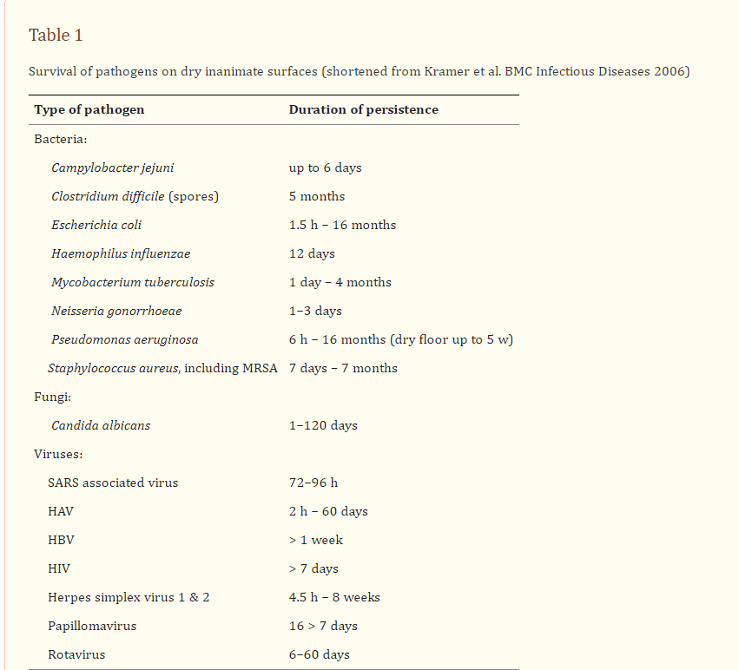
Survival of Pathogens on Inanimate Surfaces
Copied from (1) Nyhsen, et al. Infection prevention and control in ultrasound - best practice recommendations from the European Society of Radiology Ultrasound Working Group 2017.
Notes:
1) Nyhsen, C.M., Humphreys, H., Koerner, R.J., Grenier, N., Brady, A., Sidhu, P., Nicolau, C., Mostbeck, G., Mirko D’onofrio, &, Gangi, A., et al. Infection prevention and control in ultrasound - best practice recommendations from the European Society of Radiology Ultrasound Working Group.

Slide 10
Cases of Ultrasound being linked to Infections
The Medicines and Healthcare Products Regulatory Agency (MHRA) released a Medical Device Alert on the 28th June 2012 in relation to the decontamination of reusable TOE, TV and TR Ultrasound Probes (transducers) in response to the death of a patient from Hepatitis B which may have been associated with a failure to appropriately decontaminate a TOE probe (9).
A review in 2022 (11) described several outbreaks associated with TOE probes including Pseudomonas Aeruginosa (12), Legionella pneumophila (13) and E.coli (14) to name a few.
Cases of Hepatitis C transmission have also been recorded during prostate biopsy and assisted conception procedures associated with endocavitary ultrasound (16,17) as well as other infections via these routes.
A large metanalysis in 2012 estimated the pooled prevalence of infected patients after transrectal ultrasound and guided biopsies to be 3.1% (18).
There is very little/no literature on vascular ultrasound, wound infections linked to ultrasound but the theoretical risk is strong. A 1988 study investigated ultrasound as a cause of post-operative wound infections and found that 66% of swabs taken from machines in constant use and 33% of the total number of swabs taken were contaminated with Staphyloccocus aureus, Enterobacteriaceae and Pseudomonas species, all potential sources for wound infection (10).
Notes:
Reusable transoesophageal echocardiography, transvaginal and transrectal ultrasound probes (transducers) – failure to appropriately decontaminate - GOV.UK (www.gov.uk)
10) Spencer P, Spencer RC. Ultrasound scanning of post-operative wounds--the risks of cross-infection. Clin Radiol. 1988 May;39(3):245-6. doi: 10.1016/s0009-9260(88)80517-8. PMID: 3293884.
11) Infection Transmission Associated With Contaminated Ultrasound Probes: A Systematic Review - Souza Hajar - 2022 - AORN Journal - Wiley Online Library
12) Seki M, Machida N, Yamagishi Y, Yoshida H, Tomono K. Nosocomial outbreak of multidrug-resistant Pseudomonas aeruginosa caused by damaged transesophageal echocardiogram probe used in cardiovascular surgical operations. J Infect Chemother. 2013; 19(4): 677-681.
13) Levy PY, Teysseire N, Etienne J, Raoult D. A nosocomial outbreak of Legionella pneumophila caused by contaminated transesophageal echocardiography probes. Infect Control Hosp Epidemiol. 2003; 24(8): 619-622.
14) Bancroft EA, English L, Terashita D, Yasuda L. Outbreak of Escherichia coli infections associated with a contaminated transesophageal echocardiography probe. Infect Control Hosp Epidemiol. 2013; 34(10): 1121-1123.
15) Odeh Z, Abatli S, Qadi M. Radiology Department: A Potential Source of Multidrug-Resistant Microorganisms: A Cross-Sectional Study at Tertiary Hospital, Palestine. Can J Infect Dis Med Microbiol. 2023 Dec 18;2023:4441338. doi: 10.1155/2023/4441338. PMID: 38146333; PMCID: PMC10749721.
16) Ferhi K, Roupret M, Mozer P, Ploussard G, Haertig A, de La Taille A. Hepatitis C transmission after prostate biopsy. Case Rep Urol. 2013; 2013:797248. (doi: 10.1155/2013/797248).
17) Lesourd F, Izopet J, Mervan C, Payen JL, Sandres K, Monrozies X, et al. Transmissions of hepatitis C virus during the ancillary procedures for assisted conception. Hum Reprod 2000; 15 (5): 1083–85.
18) Leroy S. Infectious risk of endovaginal and transrectal ultrasonography: systematic review and meta-analysis. J Hosp Infect. 2013 Feb;83(2):99-106. doi: 10.1016/j.jhin.2012.07.014. Epub 2012 Sep 13. PMID: 22981638.
Probe Guidance 26th January 2017 PM (hse.ie)

Slide 11
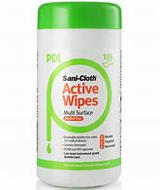
Efficacy of LLD and Probe Covers
A 2012 French study observed a 2.2% rate of high-risk HPV contamination of 417 TV probes despite LLD (Sani-Cloth Active) and probe covers. This study caused there to be a change in French guidance to HLD (19).
A 2014 French study with 300 samples showed that despite using probe covers and LLD, TV probes remained contaminated by clinically significant microorganisms that were actively infectious including HPV (7%), Chlamydia trachomatis (2%), mycoplasmas (4%), Staphylococcus aureus (4%), and further gram-positive and gram-negative bacteria (6).
Unable to access full journal but in a UK 2007 study on 40 transducers after LLD, 26 positive cultures were isolated (65%). Seven transducers (17.5%) isolating methicillin-sensitive S. aureus or P. aeruginosa was considered clinically significant. S. aureus was isolated from four transducers (7).
In a French study using a computer simulated model, for endo-cavity scans the estimated risk of infection using LLD and probe cover was calculated at 1-6% (3).
Notes:
Interestingly, HPV 16 very resistant to chemical even used for sterilisation. The disinfectants tested in this study were 70% and 95% ethanol and isopropanol, 2.4% and 3.4% glutaraldehyde (GTA), 0.55% OPA, a triple phenolic, a 0.25% and 1.2% PAA-silver-based disinfectant and 0.525% hypochlorite In HPV16 authentic viruses, only hypochlorite (4.86 log₁₀ reduction) and the 1.2% PAA-silver-based disinfectant (5.15 log₁₀ reduction) were able to produce >99.99% reduction in infectivity. All other disinfectants showed slight or no reduction in infectivity. .
Meyers J, Ryndock E, Conway MJ, Meyers C, Robison R. Susceptibility of high-risk human papillomavirus type 16 to clinical disinfectants. J Antimicrob Chemother. 2014 Jun;69(6):1546-50. doi: 10.1093/jac/dku006. Epub 2014 Feb 4. PMID: 24500190; PMCID: PMC4019329.
2014 study. Mechanism unclear. It may have been due to micro-perforations, leakage around the cover, manual contamination, or inconsistent cleaning. However potential for bias as funded by a UV high level disinfection company!
3) Leroy S, M’Zali F, Kann M, Weber DJ, Smith DD. Impact of Vaginal-Rectal Ultrasound Examinations with Covered and Low-Level Disinfected Transducers on Infectious Transmissions in France. Infection Control & Hospital Epidemiology. 2014;35(12):1497-1504. doi:10.1086/678604
6) M'Zali F, Bounizra C, Leroy S, Mekki Y, Quentin-Noury C, Kann M. Persistence of microbial contamination on transvaginal ultrasound probes despite low-level disinfection procedure. PLoS One. 2014 Apr 2;9(4):e93368. doi: 10.1371/journal.pone.0093368. PMID: 24695371; PMCID: PMC3973690.
7) How clean is your probe? Microbiological assessment of ultrasound transducers in routine clinical use, and cost-effective ways to reduce contamination – ScienceDirect
19) Casalegno JS, Le Bail Carval K, Eibach D, Valdeyron ML, Lamblin G, Jacquemoud H, Mellier G, Lina B, Gaucherand P, Mathevet P, Mekki Y. High risk HPV contamination of endocavity vaginal ultrasound probes: an underestimated route of nosocomial infection? PLoS One. 2012;7(10):e48137. doi: 10.1371/journal.pone.0048137. Epub 2012 Oct 24. PMID: 23110191; PMCID: PMC3480505.

Slide 12
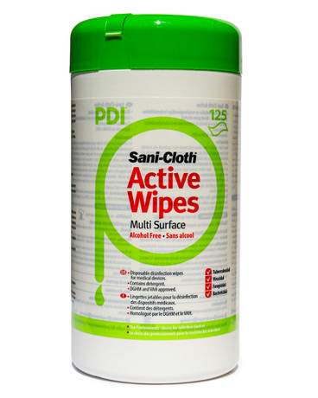
In the 2012 Study no probe covers were visibly damaged.
Sani-cloth active contains QAC and is reported to be “Bactericidal, Yeasticidal, Virucidal (Enveloped Viruses) and kills Norovirus (Non-enveloped Viruses)”.

Slide 13
Quaternary Ammonium Compounds (QACs)
Are the most commonly used disinfectant in ordinary environmental surfaces with a good cleaning and a broad spectrum of biocidal and sporostatic activity (lipid, enveloped viruses). Incorporation of quaternary ammonium moieties into polymers showed an effective antimicrobial effect against biofilm. Nowadays, QACs are the most used disinfectant in wipes.
However, they also have some drawbacks such as a susceptibility to high water hardness and low efficacy against gram-negative bacteria and non-enveloped viruses. Moreover, numerous studies showed that the adsorption of QACs onto the cotton substrate wiping material could lead to the failure of the disinfection process.
To summarise the information from a 2019 paper, the preferred disinfectants used for disinfectant -impregnated wipes in the market are quats-alcohol wipes, hydrogen peroxide wipes, hypochlorite wipes due to their user-friendly feature. Emphasis is drawn to the safety issue for the staff during their application. These DIWs are extensively approved to be employed in hospitals and healthcare centres.
Notes:
Song X, Vossebein L, Zille A. Efficacy of disinfectant-impregnated wipes used for surface disinfection in hospitals: a review. Antimicrob Resist Infect Control. 2019 Aug 19;8:139. doi: 10.1186/s13756-019-0595-2. PMID: 31452873; PMCID: PMC6701098.

Slide 14
Clinell Universal Wipes (from their website)
The efficacy of any given disinfectant wipe requires some healthy scientific scepticism. Standard efficacy tests for disinfectant wipes are inconsistent and may not reflect real-world usage. Manufacturer claims should always be interpreted with caution.
Good infection prevention is a mix of microbiology, formulation chemistry and behavioural science. Standard efficacy tests are designed, at best, to measure any one of these.

Slide 15
Conversely..
A large 2018 study showed that the average hospital acquisition rate of MRSA/ 100,000 patient bed days reduced by 6.3% per month after the introduction of the new Clinell universal wipe vs. two-step process of detergent and alcohol wipes. (20) ?Bias
A 2023 Australian Randomised Control Trial studied whether LLD or HLD is needed for percutaneous interventions using ultrasound (21).
Transducers were swabbed after scanning the forearms of 654 participants, using sterile gel, without probe covers. 20% of samples grew no microorganisms pre-disinfection. Overall, disinfection led to the elimination of all microorganisms in 99.0% (n = 500) of transducers following LLD (Clinell universal wipes, two wipes used) and 99.6% (n = 531) of transducers following HLD (Tristel wipes).
However.. Only healthy forearm skin was used. No resistant bugs were found. No percutaneous interventions occurred ie. no blood, pus etc. Also may not be realistic given not in clinical setting.
Notes:
20) Garvey MI, Wilkinson MAC, Bradley CW, Holden KL, Holden E. Wiping out MRSA: effect of introducing a universal disinfection wipe in a large UK teaching hospital. Antimicrob Resist Infect Control. 2018 Dec 19;7:155. doi: 10.1186/s13756-018-0445-7. PMID: 30574298; PMCID: PMC6299988.
21) Peters N, Williamson F, Bauer MJ, Llewellyn S, Snelling PJ, Marsh N, Harris PNA, Stewart AG, Rickard CM. Comparison of Low-Level to High-Level Disinfection in Eliminating Microorganisms From Ultrasound Transducers Used on Skin: A Noninferiority Randomized Controlled Trial. J Ultrasound Med. 2023 Nov;42(11):2525-2534. doi: 10.1002/jum.16286. Epub 2023 Jun 12. PMID: 37306253.

Slide 16
Microorganism type (n = 1669)
Acinetobacter baumanii | 1 (<0.1%)
Acinetobacter lwoffii | 2 (0.1%)
Actinomyces spp. | 2 (0.1%)
Aerococcus viridans | 1 (<0.1%)
Agrobacterium radiobacter | 1 (<0.1%)
Bacillus cereus group | 3 (0.2%)
Bacillus spp. | 62 (3.7%)
Brevibacterium casei | 1 (<0.1%)
Coagulase-negative Staphylococcus (CoNS) | 844 (51%)
Corynebacterium spp. | 4 (0.2%)
Dermacoccus nishinomiyaensis | 1 (<0.1%)
Enterococcus faecalis | 2 (0.1%)
Enterococcus faecium | 7 (0.4%)
Enterococcus spp. | 14 (0.8%)
Klebsiella spp. | 1 (<0.1%)
Micrococcus luteus | 478 (29%)
Moraxella spp. | 14 (0.8%)
Mold | 9 (0.5%)
Pseudomonas spp. | 1 (<0.1%)
Rhodococcus spp. | 1 (<0.1%)
Roseomonas mucosa | 5 (0.3%)
Rothia dentocariosa | 1 (<0.1%)
Serratia spp. | 11 (0.7%)
Staphylococcus aureus | 141 (8.4%)
Streptococcus spp. | 13 (0.8%)
Streptomyces griseus | 1 (<0.1%)
Tsukamurella spp. | 1 (<0.1%)
Yeast | 47 (2.8%)
Organisms grown pre-disinfection (21)
Notes:
21) Peters N, Williamson F, Bauer MJ, Llewellyn S, Snelling PJ, Marsh N, Harris PNA, Stewart AG, Rickard CM. Comparison of Low-Level to High-Level Disinfection in Eliminating Microorganisms From Ultrasound Transducers Used on Skin: A Noninferiority Randomized Controlled Trial. J Ultrasound Med. 2023 Nov;42(11):2525-2534. doi: 10.1002/jum.16286. Epub 2023 Jun 12. PMID: 37306253.

Slide 17
Regarding Percutaneous Vascular Interventions
An American 2021 paper (8) critiqued the SDMS recommendations, stating that physicians who perform ultrasound guided vascular procedures should have been included when writing these recommendations.
The SDMS contraindicated previous AUIM recommendations that LLD of probes is adequate for venous interventions.
They could not find any reports of infection caused by ultrasound guidance for superficial vein procedures or percutaneous deep vein procedures beyond those for venous catheter placement. Low numbers of infections were observed in all meta-analyses.
Higher likelihood of probe-cover tears in endo-cavity scans.
The paper only refers to HLD methods involving soaking, therefore more time-consuming than methods available here.
Notes:
Neither the AIUM nor the SDMS documents meet the level of scientific rigor of the Society for Vascular Surgery guideline.
Basseal J, Westerway S, Hyett J. Analysis of the integrity of ultrasound probe covers used for transvaginal examinations
8) Daugherty S, Blebea J. The need for participation in the development and critical review of recommendations for infection control policies involving vascular ultrasound.

Slide 18
Continued..
2021 intersocietal position on statement on Disinfection of Ultrasound Transducers Used for Percutaneous Procedures in which the AIUM participated supports the use of LLD
“Transducer covers for transcutaneous procedures are meant to protect the sterility of the procedure, not to make the transducer sterile. An analogous situation exists for human hands in surgical procedures. ”
“If contamination of covered transcutaneous transducers with blood or other bodily fluids occurs, it can be eliminated with low-level disinfectants that are effective against mycobacteria and bloodborne pathogens (including hepatitis B virus, hepatitis C virus, and HIV). Human hands are always cleaned LLD and covered with gloves.”
Notes:
Disinfection of Ultrasound Transducers Used for Percutaneous Procedures - 2021 - Journal of Ultrasound in Medicine - Wiley Online Library

Slide 19
Use of Probe Covers
HSE- “Use of a sheath/condom does not negate the need for Probes to undergo manual cleaning prior to HLD as there is limited evidence on their effectiveness as a barrier to reducing the risk of HCAI. A sheath should be used for diagnostic purposes in accordance with manufacturers’ instructions and should be the correct size for the Probe to be used. The sheath should be visually inspected for damage after use. Where damage is identified it should be recorded in the decontamination records/patient notes. “
HPS Health Protection Scotland (HPS) undertook a rapid review of the literature in 2014 regarding sheaths and concluded “there was no comprehensive assessment of the evidence for sheaths in relation to infection control and healthcare associated infection (HAI). Therefore if HLD is being undertaken between patients then a sheath is not required to reduce cross transmission risks. A sheath only requires to be used if clinically indicated to aid the diagnostic procedure. The CDC guidelines states “when probe covers are available, use a probe cover or condom to reduce the level of microbial contamination. Do not use a lower category of disinfection or cease to follow the appropriate disinfectant recommendations when using probe covers because sheaths and condoms can fail” (5).
Basseal et al tested 5000 probe covers of many different types with hydrostatic leak testing and found a leak in 0.4% to 13% of condoms and 0% to 5% of commercial probe covers.
The CDC and Prevention and the American Institute of Ultrasound in Medicine recommend the use of condoms rather than cover probes because they are less prone to perforations (1–9% and up to 81% in one study). However CE marked probe covers are preferred on the basis that condoms are not adapted to all types of transducers and may have a lower coverage of the heads. In the study of Kac et al. both types of covers performed similarly (6).
Notes:
J. Basseal, S. Westerway, J. Hyett Analysis of the integrity of ultrasound probe covers used for transvaginal examinations
Infect Dis Health, 25 (2020), pp. 77-81
Kac G, Podglajen I, Si-Mohamed A, Rodi A, Grataloup C, Meyer G (2010) Evaluation of ultraviolet C for disinfection of endocavitary ultrasound transducers persistently contaminated despite probe covers. Infect Control Hosp Epidemiol 31: 165–70

Slide 20
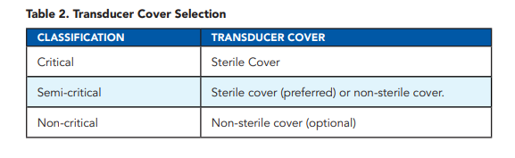
From SDMS Guidance
“Infection control The UK Health Security Agency has issued guidance on the use of ultrasound gel in relation to good infection control practice. The principles contained within this guidance should inform local infection control policies . BMUS advises users to refer to manufacturer’s instructions for cleaning and disinfecting transducers, and general equipment care. It should be noted ultrasound probes can be damaged by some cleaning agents, and so manufacturer’s specifications should always be followed. Sterile ultrasound gel and sheaths should be available and used in appropriate cases. Where there is open ulcers the ulcerated area should be covered with cling film to prevent contamination of equipment.”
From the SVT Professional Performance Guideline
Notes:
1 (svtgbi.org.uk)
8756479320933256.pdf (sdms.org)

Slide 21
Guidance for the decontamination of intracavity medical devices: the report of a working group of the Healthcare Infection Society 2019
There is a perception that Intra-cavity Medical Device (ICMD) covers in themselves constitute an effective infection prevention intervention. This is not reliably the case for the following reasons:
(i)ICMD covers may develop holes during use
(ii)Removing covers without contaminating the probe may sometimes be difficult
(iii)Staff-contaminated gloved hands can make contact with areas of the ICMD or associated equipment not protected by the cover .
Unless specifically risk-assessed as reliably providing high-quality assurance patient protection with respect to all these areas, decontamination conforming to the standards detailed in this guidance should occur.
There should be full decontamination after every ICMD use regardless of the use of a cover.
Notes:
Bradley CR, Hoffman PN, Egan K, Jacobson SK, Colville A, Spencer W, Larkin S, Jenks PJ. Guidance for the decontamination of intracavity medical devices: the report of a working group of the Healthcare Infection Society. J Hosp Infect. 2019 Jan;101(1):1-10. doi: 10.1016/j.jhin.2018.08.003. Epub 2018 Aug 7. PMID: 30092292.

Slide 22
From the 2022 review that looked at several serious outbreaks associated with TEE probes (11)
Findings from three of the included studies indicated that TEE probes had external structural damage, including cracks that could house microorganisms.
In addition, researchers identified reprocessing deficiencies, including:
using contaminated disinfectants
using the improper strength of disinfectant
failing to inspect TEE probes after cleaning
decontaminating TEE probes in the OR between patients rather than in a central sterile supply department (CSSD)
cleaning TEE probes adjacent to a waste sink
rinsing TEE probes in running tap water
storing TEE probes inappropriately.
Notes:
11) Infection Transmission Associated With Contaminated Ultrasound Probes: A Systematic Review - Souza Hajar - 2022 - AORN Journal - Wiley Online Library

Slide 23
HSE
“The standard of SIUP decontamination across the HSE and NHS Scotland is inconsistent, difficult to validate and does not give assurance of the recommended high level disinfection of SIUPs, meaning SIUPs remain a possible cross infection risk (9).
“High Level Disinfection (HLD) using the manual multi‐wipe system is the least preferred option for disinfecting Semi‐critical Ultrasound Probes. Internationally it is recognised that the use of an automated validated process for decontaminating RIMD will provide enhanced risk reduction of infection transmission.
It is recommended that a local risk assessment is performed if this option is to be used as an interim measure prior to implementation of an automated process. Semi‐critical Ultrasound Probes must be compatible with the detergents and decontamination methods that are used “ (9) Probe Guidance 26th January 2017 PM (hse.ie)

Slide 24
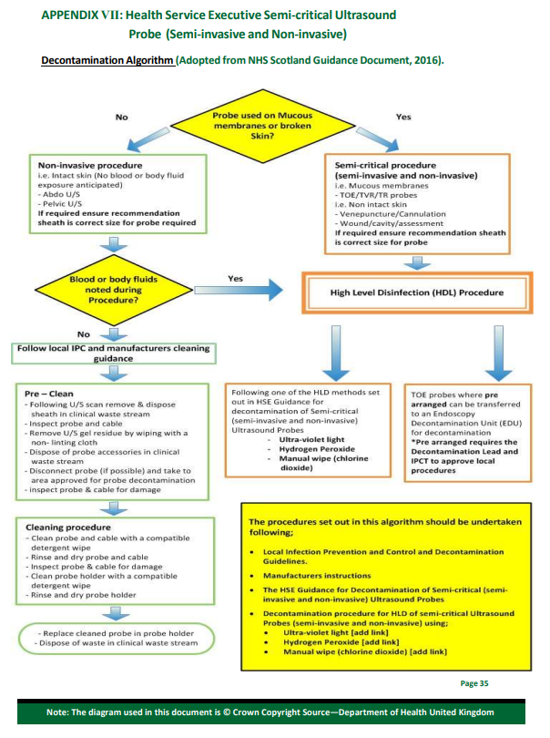
Probe Guidance 26th January 2017 PM (hse.ie)

Slide 25
Purchase of a Probe decontamination system should be based on the following criteria (HSE):
Evidence to support effectiveness of the decontamination system.
Training supports, to ensure effectiveness of the decontamination process
Safety of use (for healthcare workers and patients) of the decontamination system including any possible process residue.
Compatibility with the range of Ultrasound Probes.
Validation of disinfection process and suitability within the clinical setting.
Compatibility of wipes used for cleaning/disinfecting all surfaces of the decontamination equipment.
Costs(purchase and maintenance).
Environmental and energy impacts.
Notes:
Probe Guidance 26th January 2017 PM (hse.ie)

Slide 26
Trust Decontamination Policy
The choice of decontamination method may be related to the infection risk associated with the intended use of the equipment. Other factors that must be considered include:
1. The nature of the contamination.
2. The time required for processing.
3. The heat, pressure, moisture and chemical tolerance of the object.
4. The availability of the processing equipment.
5. The quality and risks associated with the decontamination method.
6. The manufacturer’s guidance.
Cleaning, disinfection and sterilization are all processes which remove or destroy micro- organisms. The method of decontamination will depends on the infection risk associated with the equipment/medical device. These risks can be classified as high, intermediate, low and minimal (Ayliff et al 2000).

Slide 27
Choice and Use of Disinfectant
Factors which affect the disinfectant activity:
1. The concentration of disinfectant – ensure that the dilution follows the manufacturer's instructions and is appropriate to the task.
2. The number and type of microbial contamination – the greater the number of microbes present the more difficult the surface to disinfect. Choosing the right disinfectant to kill the microbe, some microbes being more resistant than others.
3. The cleanliness of the surface – the presence of organic matter e.g. pus, blood.
Type of Ultrasound | Method of Decontamination | Frequency
Devices used in non- invasive procedures | Detergent wipe, dry thoroughly | After each use
Devices used in semi-critical procedures (semi-invasive and non-invasive) Probes used for TOE/TV/TR ultrasound/ venepuncture/ cannulation/wound assessments | High Level Disinfection using automated process or manual process | After each use
Notes:
All information taken from Trust Decontamination Policy

Slide 28
RISK ASSESSMENT (FROM TRUST POLICY)
How the item of equipment is decontaminated?
• Is the item intended for reuse? i.e. establish that it is not described as single use
• For what purpose is the device used? i.e. is it invasive? Is it used in contact with skin, body fluids or potentially infectious materials?
• How do manufacturers recommend it is cleaned, disinfected and sterilized?
• Can it be disassembled to facilitate cleaning?
• Is decontamination required at the point of use?
• Will it withstand an automated process?
• How soon will it be needed?
• Can it be wrapped to protect it from recontamination?
• How many times can it be reprocessed?
• Does processing constitute a hazard to patients and/or staff? If so, is COSHH hazard data and monitoring equipment available?
• Can it withstand cleaning with detergent and water?
• Can it withstand the high temperatures used for disinfection and sterilization?
• Can it withstand disinfectants e.g. chlorine releasing agents? NO
• If the manufacturers guidelines recommend the use of chemical disinfectants the following needs to be considered; •
Is the disinfectant recommended by infection control?
• Does the use and storage comply with COSHH?
• Will the product adequately decontaminate equipment?
• How cost effective is the disinfectant?
• Can it be adequately and safely stored?
• What is the availability of the disinfectant and is there an alternative

Slide 29
BMUS Best Practice Guidance
Disinfection is the term used to describe cleaning something, usually with a chemical, in order to destroy or prevent the growth of organisms, usually bacteria.
Cleaning includes the removal of gel, transducer covers, and other matter from the transducer. Cleaning should take place before disinfection or sterilisation.
Cleaning and disinfection is “a lower level than elimination of microbes but with quality assurance that ensures that an item is safe without necessarily being sterile”
Cleaning and sterilisation eliminates microbes from the transducer.
A clear and concise departmental and organisational guideline of practice / standard operating procedure is needed, using manufacturers guidance and in liaison with the infection control team.
Best practice is an automated system.
Keep a record of cleaning and disinfection for any transducer that has been in contact with anything other than intact skin i.e. for transducers that need disinfection or sterilisation.
Notes:
Best_Practice_Summary_-_probe_decontamination_-_FINAL_13_02_2020.pdf (bmus.org)
A clear and concise departmental and organisational guideline of practice / standard operating procedure is required and should be regularly reviewed and updated at a recommended interval of 12 months and maximum interval of 3 years. Manufacturer guidance on transducer decontamination should be reviewed each time a product or device is changed or when a new machine or transducer is purchased.
Disinfectant-impregnated wipes that contain an effective disinfectant are widely used but the assurance that all surfaces are in contact with liquid disinfectant for the required time is not as easy to achieve as a high-quality assurance standardised and automated process. Therefore, best practice is the use of an automated system. If an automated system is used in preference to a wipe system, as recommended by Bradley at al2 , an effective process which follows manufacturer’s guidance should be in place to ensure that the automated system in its own right is clean and a log of such cleaning is kept.
A record of cleaning and disinfection and / or sterilisation must be kept for any transducer that has been in contact with anything other than intact skin i.e. for transducers that need disinfection or sterilisation. This may take the form of a log-book or electronic database. The log should be able to identify that the transducer was cleaned after each examination.

Slide 30
Survey
King’s use green Clinell wipes for everything but probe cover and sterile gel for wounds.
Portsmouth- Tristel solo wipes and try to use probe covers and sterile gel.
Nottingham- Tristel solo £4.80/100 used since covid.

Slide 31


From: HAMDAN, Rashima (ROYAL CORNWALL HOSPITALS NHS TRUST) <rashima.hamdan@nhs.net> Sent: Tuesday, March 5, 2024 3:36 PM To: STEPHENS, Bethany (ROYAL CORNWALL HOSPITALS NHS TRUST) <bstephens1@nhs.net> Cc: KAYE, Graham (ROYAL CORNWALL HOSPITALS NHS TRUST) <graham.kaye@nhs.net>; DUNCANSON, Lauren (ROYAL CORNWALL HOSPITALS NHS TRUST) <lauren.duncanson@nhs.net> Subject: RE: Vascular Studies Infection prevention
Hi Beth,
I’ve done some digging and during the procurement of this equipment, it was discussed that you will use Tristel in place of Actichlor for high level disinfecting of these equipment. Not sure why this was not communicated back to you, but can you let your team know about this please? Tristel can be ordered through Unit 4. With regards to the rest of your questions:
So the main questions are:
When is a higher level of cleaning needed other than green Clinell wipes. Ie. Which infections? Before/after broken skin with or without infection or does this not matter?
All patient with known suspected/known infection and when use in non-intact skin.
2. Will using probe covers be beneficial for known covers and/or broken skin.
This will be an additional protection, so you can use this. But it is not a replacement for disinfection.
3. What products are recommended if needed?
Clinell and Tristel for high level disinfection
Kind regards
Rash 😊
Rashima Hamdan, RGN, MAN, PgCert IPC
Senior Infection Prevention and Control Nurse Specialist
Chief Nursing Officer Research Fellow
NHS Leadership Academy Awardee in Healthcare Leadership
Mobile: 07833287633

Slide 32
Standard efficacy tests for disinfectant wipes are inconsistent and may not reflect real-world usage. Manufacturer claims should always be interpreted with caution.
A 2022 study found ultraviolet technology to be more time efficient than the chlorine dioxide multistep wipe system allowing more essential tasks to be completed during disinfection. For a 4-h ultrasound list of 15 patients, the use of UV-C would save 55 min 45 s.
A 2023 study in Palestine showed a large amount of bacterial growth on areas such as ultrasound touchscreens and keyboards, meaning these areas were likely not being cleaned as frequently as the probes (15).
Notes:
Wiping out MRSA: effect of introducing a universal disinfection wipe in a large UK teaching hospital (biomedcentral.com)
Kyriacou C, Robinson E, Barcroft J, et al. Time-effectiveness and convenience of transvaginal ultrasound probe disinfection using ultraviolet vs chlorine dioxide multistep wipe system: prospective survey study. Ultrasound in Obstetrics & Gynecology. 2022;60(1):132-138. doi:10.1002/uog.24834

Slide 33
So What Should We Do?
1) Change nothing
2) Use probe covers but keep using Clinell wipes only.
3) Use probe covers and HLD Tristell wipes
3) Use probe covers and other HLD e.g. Trophon, UV
?Be extra careful around open wounds. ?Clear dressings.
Meeting with IPAC?
Confirm with Shane

Slide 34
References
4) Best_Practice_Summary_-_probe_decontamination_-_FINAL_13_02_2020.pdf (bmus.org)
Trust Decontamination Policy
9) Probe Guidance 26th January 2017 PM (hse.ie)
HPS Website - Guidance for Decontamination of Semi-Critical Ultrasound Probes https://www.hps.scot.nhs.uk/web-resources-container/guidance-for-decontamination-ofsemi-critical-ultrasound-probes/.
1) Nyhsen, C.M., Humphreys, H., Koerner, R.J., Grenier, N., Brady, A., Sidhu, P., Nicolau, C., Mostbeck, G., Mirko D’onofrio, &, Gangi, A., et al. Infection prevention and control in ultrasound - best practice recommendations from the European Society of Radiology Ultrasound Working Group.
2) Nyhsen, C.M., Humphreys, H., Nicolau, C., Mostbeck, G., and Claudon, M. (2016). Infection prevention and ultrasound probe decontamination practices in Europe: a survey of the European Society of Radiology. Insights Imaging 7, 841–847.
Joint Accreditation Scheme Committee of the College of Radiographers and the Royal College of Radiologists. (2019). The Quality Standard for Imaging: statements, rationales and criteria.
3) Leroy S, M’Zali F, Kann M, Weber DJ, Smith DD. Impact of Vaginal-Rectal Ultrasound Examinations with Covered and Low-Level Disinfected Transducers on Infectious Transmissions in France. Infection Control & Hospital Epidemiology. 2014;35(12):1497-1504. doi:10.1086/678604
Koibuchi H, Kotani K, Taniguchi N. Ultrasound probes as a possible vector of bacterial transmission. Med Ultrason. 2013 Mar;15(1):41-4. doi: 10.11152/mu.2013.2066.151.hk1upp2. PMID: 23486623
Gray RA, Williams PL, Dubbins PA, Jenks PJ (2012) Decontamination of transvaginal ultrasound probes: review of national practice and need for national guidelines. Clin Radiol 67(11):1069–1077
7) Mullaney PJ, Munthali P et al (2007) How clean is your probe? microbiological assessment of ultrasound transducers in routine clinical use, and cost-effective ways to reduce contamination. Clin Radiol 62(7):694–69 ** unable to access this one.
Ultrasound probes as a possible vector of bacterial transmission Harumi Koibuchi, Kazuhiko Kotani, Nobuyuki Taniguchi 2013.
Song X, Vossebein L, Zille A. Efficacy of disinfectant-impregnated wipes used for surface disinfection in hospitals: a review. Antimicrob Resist Infect Control. 2019 Aug 19;8:139. doi: 10.1186/s13756-019-0595-2. PMID: 31452873; PMCID: PMC6701098.
5) HPS Website - Guidance for Decontamination of Semi-Critical Ultrasound Probes https://www.hps.scot.nhs.uk/web-resources-container/guidance-for-decontamination-ofsemi-critical-ultrasound-pr

Slide 35
Bradley CR, Hoffman PN, Egan K, Jacobson SK, Colville A, Spencer W, Larkin S, Jenks PJ. Guidance for the decontamination of intracavity medical devices: the report of a working group of the Healthcare Infection Society. J Hosp Infect. 2019 Jan;101(1):1-10. doi: 10.1016/j.jhin.2018.08.003. Epub 2018 Aug 7. PMID: 30092292
Daugherty S, Blebea J. The need for participation in the development and critical review of recommendations for infection control policies involving vascular ultrasound
6) M'Zali F, Bounizra C, Leroy S, Mekki Y, Quentin-Noury C, Kann M. Persistence of microbial contamination on transvaginal ultrasound probes despite low-level disinfection procedure. PLoS One. 2014 Apr 2;9(4):e93368. doi: 10.1371/journal.pone.0093368. PMID: 24695371; PMCID: PMC3973690
Shokoohi H, Armstrong P, Tansek R. Emergency department ultrasound probe infection control: challenges and solutions. Open Access Emerg Med. 2015 Jan 5;7:1-9. doi: 10.2147/OAEM.S50360. PMID: 27147883; PMCID: PMC4806800.
8) Daugherty S, Blebea J. The need for participation in the development and critical review of recommendations for infection control policies involving vascular ultrasound.
Peters N, Williamson F, Bauer MJ, Llewellyn S, Snelling PJ, Marsh N, Harris PNA, Stewart AG, Rickard CM. Comparison of Low-Level to High-Level Disinfection in Eliminating Microorganisms From Ultrasound Transducers Used on Skin: A Noninferiority Randomized Controlled Trial. J Ultrasound Med. 2023 Nov;42(11):2525-2534. doi: 10.1002/jum.16286. Epub 2023 Jun 12. PMID: 37306253.
AIUM Official Statement: Guidelines for Cleaning and Preparing External- and Internal-Use Ultrasound Transducers and Equipment Between Patients as Well as Safe Handling and Use of Ultrasound Coupling Gel
J. Basseal, S. Westerway, J. Hyett Analysis of the integrity of ultrasound probe covers used for transvaginal examinations Infect Dis Health, 25 (2020), pp. 77-81
10) Spencer P, Spencer RC. Ultrasound scanning of post-operative wounds--the risks of cross-infection. Clin Radiol. 1988 May;39(3):245-6. doi: 10.1016/s0009-9260(88)80517-8. PMID: 3293884.
Kyriacou C, Robinson E, Barcroft J. Time-effectiveness and convenience of transvaginal ultrasound probe disinfection using ultraviolet vs chlorinedioxide multistep wipe system: prospective survey study.

Slide 36
11) ) Infection Transmission Associated With Contaminated Ultrasound Probes: A Systematic Review - Souza Hajar - 2022 - AORN Journal - Wiley Online Library
12) Seki M, Machida N, Yamagishi Y, Yoshida H, Tomono K. Nosocomial outbreak of multidrug-resistant Pseudomonas aeruginosa caused by damaged transesophageal echocardiogram probe used in cardiovascular surgical operations. J Infect Chemother. 2013; 19(4): 677-681.
13) Levy PY, Teysseire N, Etienne J, Raoult D. A nosocomial outbreak of Legionella pneumophila caused by contaminated transesophageal echocardiography probes. Infect Control Hosp Epidemiol. 2003; 24(8): 619-622.
14) Bancroft EA, English L, Terashita D, Yasuda L. Outbreak of Escherichia coli infections associated with a contaminated transesophageal echocardiography probe. Infect Control Hosp Epidemiol. 2013; 34(10): 1121-1123.
15) Odeh Z, Abatli S, Qadi M. Radiology Department: A Potential Source of Multidrug-Resistant Microorganisms: A Cross-Sectional Study at Tertiary Hospital, Palestine. Can J Infect Dis Med Microbiol. 2023 Dec 18;2023:4441338. doi: 10.1155/2023/4441338. PMID: 38146333; PMCID: PMC10749721.
18) Leroy S. Infectious risk of endovaginal and transrectal ultrasonography: systematic review and meta-analysis. J Hosp Infect. 2013 Feb;83(2):99-106. doi: 10.1016/j.jhin.2012.07.014. Epub 2012 Sep 13. PMID: 22981638.
19) Casalegno JS, Le Bail Carval K, Eibach D, Valdeyron ML, Lamblin G, Jacquemoud H, Mellier G, Lina B, Gaucherand P, Mathevet P, Mekki Y. High risk HPV contamination of endocavity vaginal ultrasound probes: an underestimated route of nosocomial infection? PLoS One. 2012;7(10):e48137. doi: 10.1371/journal.pone.0048137. Epub 2012 Oct 24. PMID: 23110191; PMCID: PMC3480505.
20) Garvey MI, Wilkinson MAC, Bradley CW, Holden KL, Holden E. Wiping out MRSA: effect of introducing a universal disinfection wipe in a large UK teaching hospital. Antimicrob Resist Infect Control. 2018 Dec 19;7:155. doi: 10.1186/s13756-018-0445-7. PMID: 30574298; PMCID: PMC6299988.
21) Meyers J, Ryndock E, Conway MJ, Meyers C, Robison R. Susceptibility of high-risk human papillomavirus type 16 to clinical disinfectants. J Antimicrob Chemother. 2014 Jun;69(6):1546-50. doi: 10.1093/jac/dku006. Epub 2014 Feb 4. PMID: 24500190; PMCID: PMC4019329.

