Slide 1
Internal carotid artery near-occlusion

Slide 2
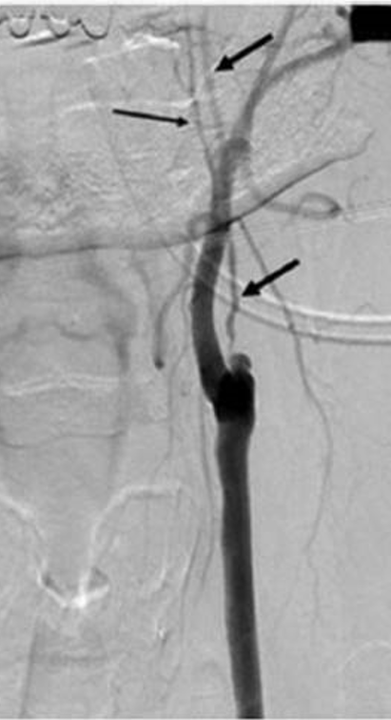
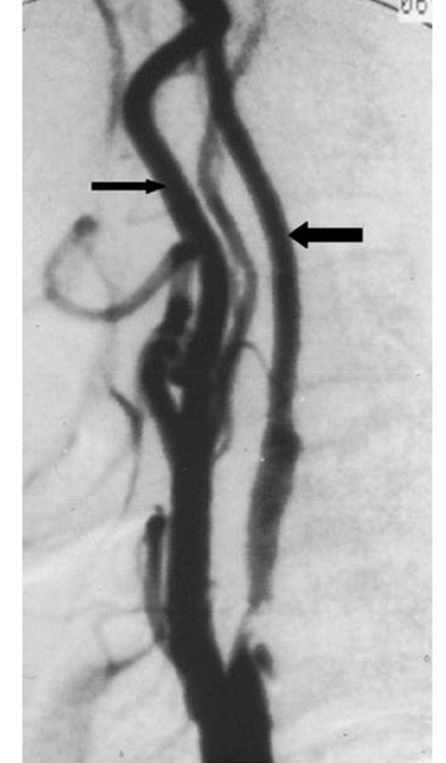
Near-occlusion
Prevalence - 0.5-23% of carotid cases
Tight atherosclerotic stenosis with
reduced distal lumen
Two types:
with and without full collapse
Alternative nomenclature:
Near-occlusion
Pseudo-occlusion
String sign
Slim sign
Critical stenosis
Preocclusive stenosis
Subtotal stenosis
Functional occlusion
Hypoplasia
99% stenosis
Hairline residual lumen
Incomplete occlusion

Slide 3
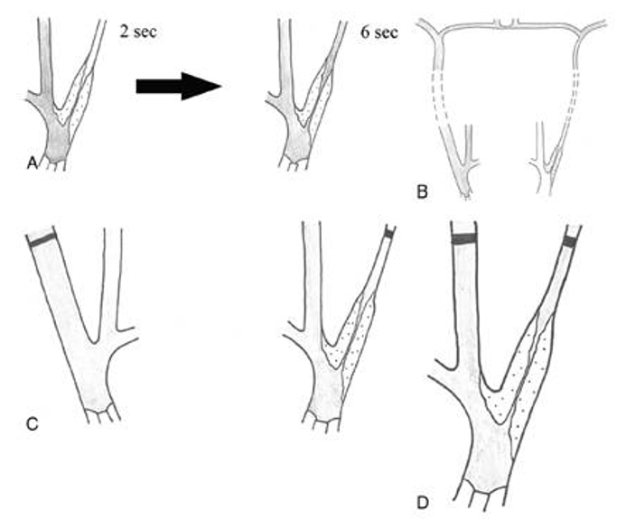
Diagnosis - CTA
NASCET and ECST criteria = 2 of the following 4;
- delayed filling
- intracranial collaterals
- ipsilateral distal ICA < contralateral distal ICA
- ipsilateral distal ICA ≤ ipsilateral ECA
However no differentiation between
near-occlusion with and without full collapse.
With collapse is easily apparent on CTA
but without collapse can be overlooked
 | Distal ICA and ipsilateral CCA | Stenosis diameter | Distal ICA to contralateral ICA | Distal ICA diameter | Distal ICA to ipsilateral ECA
ECST | Ratio ≤0.42
Bartlett et al. |  | ≤0.13cm | Ratio ≤0.87 | ≤0.35cm | ≤1.27

Slide 4
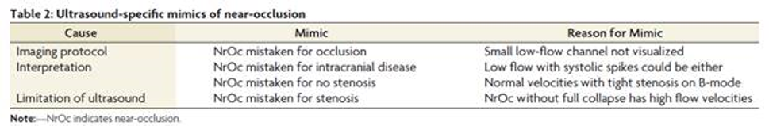
Diagnosis - ultrasound
Main function of US is to distinguish near-occlusion from occlusion
Pathology | Near occlusion with full collapse | Near occlusion without collapse
Features | Tight stenosis on B mode with narrow channel of flow Low flow velocity (<50cm/s) Pseudovenous or low diastolic flow distally | Tight stenosis on B mode with narrow channel of flow High velocity profile (>125cm/s) Subtle distal collapse
Considerations | Tight stenosis with low flow profile highly specific (93%) but sensitivity lower Low resistive flow can also indicate distal stenosis or occlusion Can also present with high velocities | Indistinguishable from tight stenosis on US alone

Slide 5
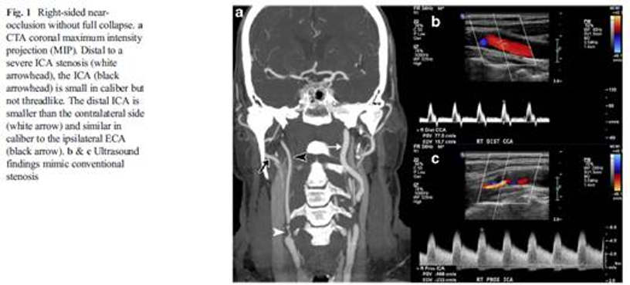
Examples

Slide 6
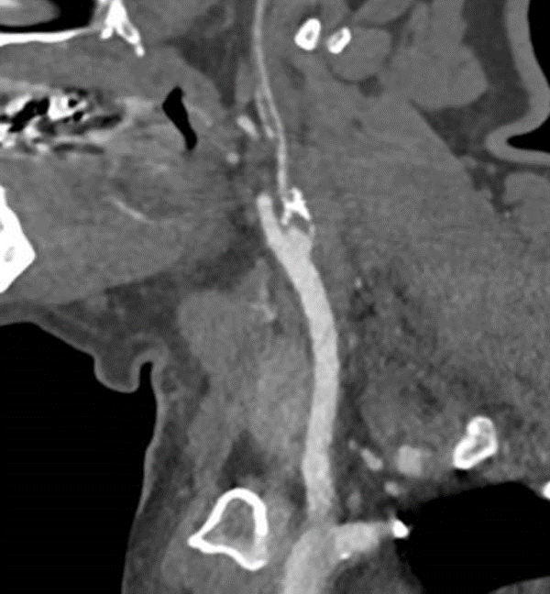
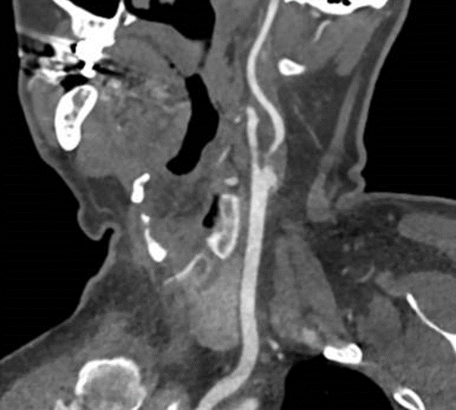
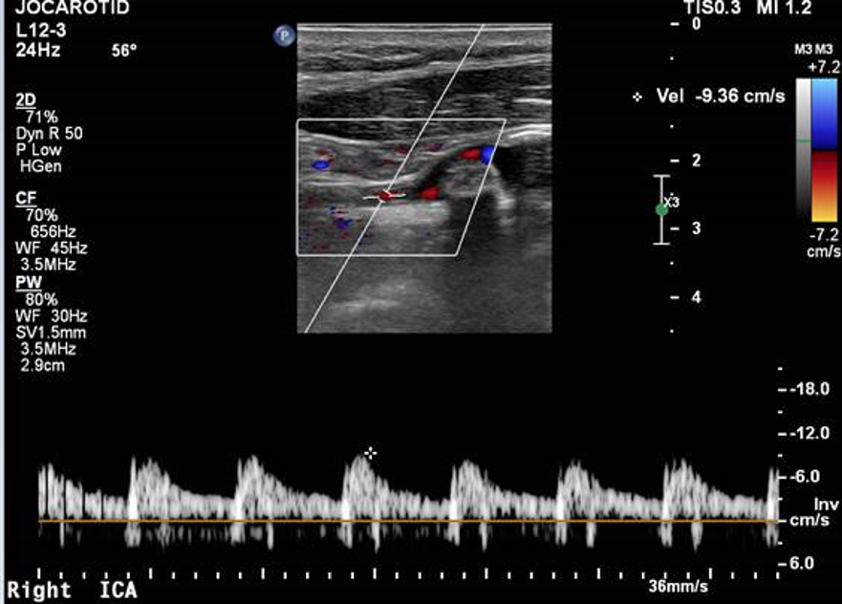
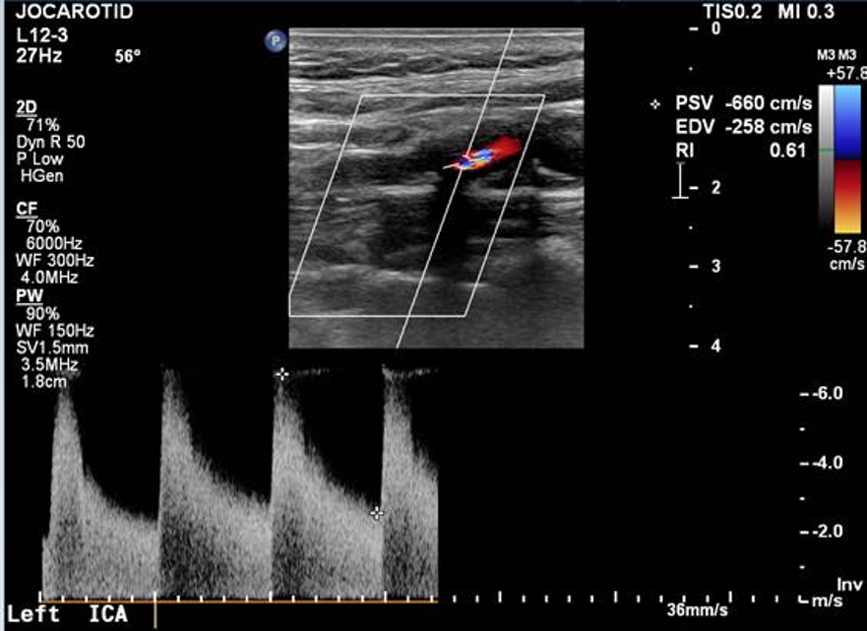
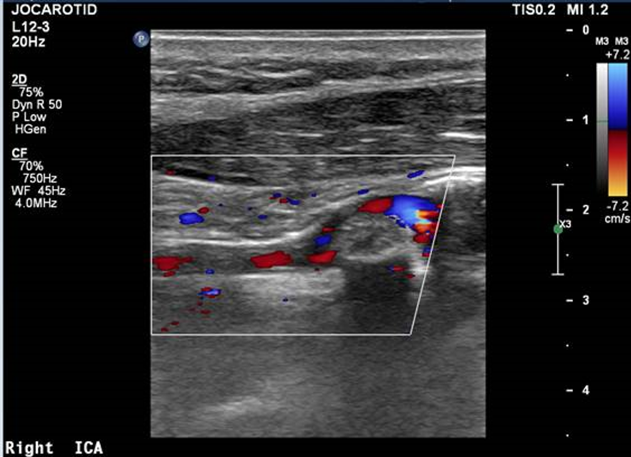
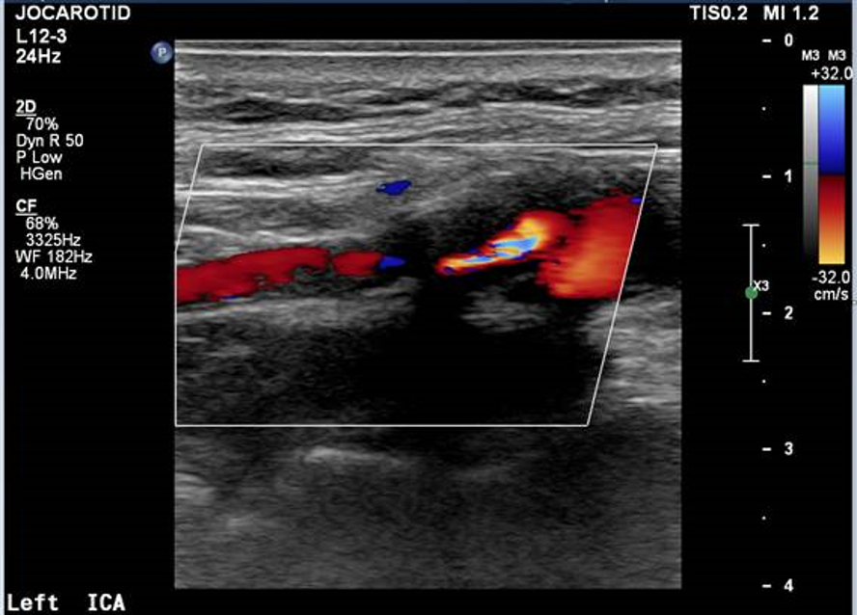
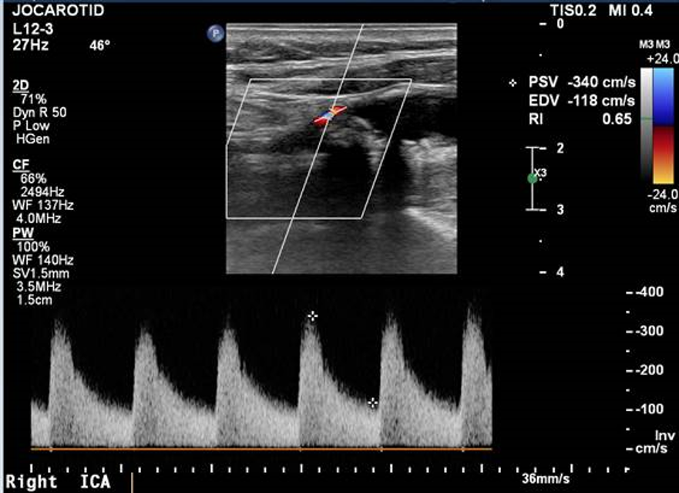

Slide 7
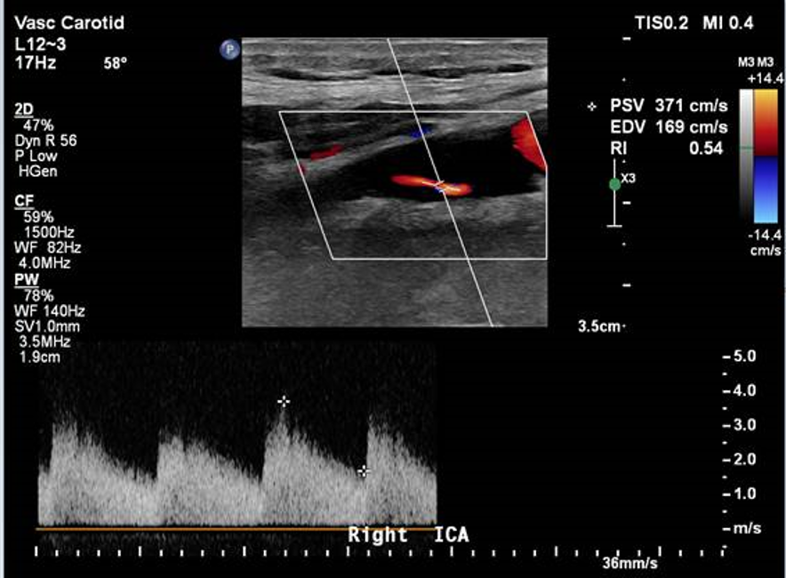
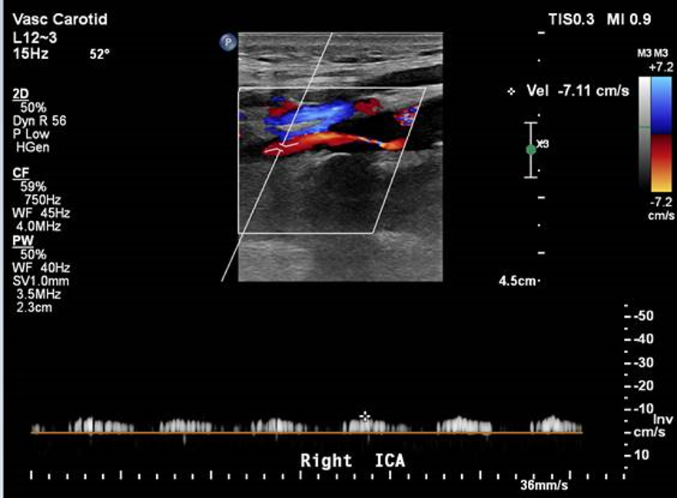

Slide 8
Outcomes
Before NASCET and ECST subgroup analysis, near-occlusion thought to have high short-term stroke risk that required intervention
Re-analysis showed 3 year risk of stroke lower than originally thought, possibility due to collaterals and reduced embolic risk
Possibly higher risk of 90 day stroke in full collapse vs. without, but small sample
Some benefit to intervention but guidelines suggest BMT alone
Perioperative surgical risk similar to that of severe stenosis
Asymptomatic near-occlusion not studied
 | BMT | Surgery | ARR
Near-occlusion | 15.1% | 10.9% | 4.2% (p=.33)
>70% stenosis | 26.0% | 8.2% | 17.8% (p<0.001)

Slide 9
Conclusion
Consider near-occlusion with and without full collapse when tight stenosis on B mode, and pay attention to distal vessel
Stroke risk lower than for tight stenosis, intervention may have some benefit
Many study limitations
Studies not designed to assess near-occlusion
Near-occlusion excluded in some large trials
Old studies with old BMT
Small samples with few stroke events
No RCTs

Slide 10
References
Fox. et al. (2005) ‘Identification, prognosis, and management of patients with carotid artery near occlusion’, American Journal of Neuroradiology, 26(8), pp. 2086–2094.
Antonopoulos, C. N. et al. (2020) ‘Management of internal carotid artery near-occlusion: the need for updated evidence’, Annals of Translational Medicine, 8(19), pp. 1263–1263.
Bowman, J. N. et al. (2009) ‘Carotid artery pseudo-occlusion: Does end-diastolic velocity suggest need for treatment?’, Vascular and Endovascular Surgery, 43(4), pp. 374–378.
Cay, F. et al. (2020) ‘Relevance of distal arterial collapse in stenting of atherosclerotic near-occlusion of the carotid artery’, American Journal of Neuroradiology, 41(6), pp. 1–7.
El-Saden, S. M. et al. (2001) ‘Imaging of the internal carotid artery: The dilemma of total versus near total occlusion’, Radiology, 221(2), pp. 301–308.
Fisch, U. et al. (2021) ‘Editor’s Choice – Risk of Stroke before Revascularisation in Patients with Symptomatic Carotid Stenosis: A Pooled Analysis of Randomised Controlled Trials’, European Journal of Vascular and Endovascular Surgery, 61(6), pp. 881–887.
Fox, E. J. and A. J. (2016) ‘Carotid Near-Occlusion : A Comprehensive Review , Part 2’, AJNR Am J Neuroradiol, 4, pp. 200–204.
Fujimoto, S. et al. (2006) ‘Accuracy of conventional plus transoral carotid ultrasonography in distinguishing pseudo-occlusion from total occlusion of the internal carotid artery’, Cerebrovascular Diseases, 22(2–3), pp. 170–176.
Giannoukas, A. D. et al. (2005) ‘Management of the near total internal carotid artery occlusion’, European Journal of Vascular and Endovascular Surgery, 29(3), pp. 250–255.
Gu, T. et al. (2020) ‘Symptomatic carotid near-occlusion causes a high risk of recurrent ipsilateral ischemic stroke’, Journal of Neurology, 267(2), pp. 522–530.

Slide 11
Johansson, E. and Fox, A. J. (2016) ‘Carotid near-occlusion: A comprehensive review, part 1 - Definition, terminology, and diagnosis’, American Journal of Neuroradiology, 37(1), pp. 2–10.
Johansson, E., Öhman, K. and Wester, P. (2015) ‘Symptomatic carotid near-occlusion with full collapse might cause a very high risk of stroke’, Journal of Internal Medicine, 277(5), pp. 615–623.
Khangure, S. R. et al. (2018) ‘Carotid near-occlusion frequently has high peak systolic velocity on Doppler ultrasound’, Neuroradiology, 60(1), pp. 17–25.
Kim, J. et al. (2019) ‘Comparison of carotid endarterectomy and stenting for symptomatic internal carotid artery near-occlusion’, American Journal of Neuroradiology, 40(7), pp. 1207–1212.
Leary, D. H. O., Mattle, H. and Potter, J. E. (1989) ‘Atheromatous Pseudo-occlusion of the Internal Carotid Artery’, pp. 1168–1173.
Lee, D. H. et al. (1996) ‘Duplex and color Doppler flow sonography of occlusion and near occlusion of the carotid artery’, American Journal of Neuroradiology, 17(7), pp. 1267–1274.
Lee, J., Phan, A. and Gao, J. (2020) ‘Multiparametric Ultrasound to Assess Adult Carotid Arteries’, Journal for Vascular Ultrasound, 44(3), pp. 144–149.
Mansour, M. et al. (1995) ‘Detection of total occlusion, string sign, and preocclusive stenosis of the internal carotid artery by color-flow duplex scanning’, The American Journal of Surgery, 170(2), pp. 154–158. doi: 10.1016/S0002-9610(99)80276-1.
Meershoek, A. J. A. et al. (2019) ‘Meta-analysis of the outcomes of treatment of internal carotid artery near occlusion’, British Journal of Surgery, 106(6), pp. 665–671.
Morgenstern, L. B. et al. (1997) ‘The risks and benefits of carotid endarterectomy in patients with near occlusion of the carotid artery’, Neurology, 48(4), pp. 911–915.
Morris-Stiff, G. et al. (2013) ‘Internal carotid artery occlusion: Its natural history including recanalization and subsequent neurological events’, Vascular and Endovascular Surgery, 47(8), pp. 603–607.
Paciaroni. et al. (2003) ‘Is ultrasound examination sufficient in the evaluation of patients with internal carotid artery severe stenosis or occlusion?’, Cerebrovascular Diseases, 15(3), pp. 173–176.
Rothwell, P. M. and Warlow, C. P. (2000) ‘Low risk of ischemic stroke in patients with reduced internal carotid artery lumen diameter distal to severe symptomatic carotid stenosis: Cerebral protection due to low poststenotic flow?’, Stroke, 31(3), pp. 622–630.
Spencer, M. P. and Reid, J. M. (1979) ‘Quantitation of carotid stenosis with continuous-wave (C-W) doppler ultrasound’, Stroke, 10(3), pp. 326–330.
Walters, T. D., Symons, S. P. and Fox, A. J. (2006) ‘Diagnosing Carotid Stenosis Near-Occlusion by’, AJNR. American Journal of Neuroradiology, March 2006, pp. 9–10.

