Slide 1


Celebrates 20 Years
18th January 2016
Chronic venous Leg Ulcers: Perspectives in Management
Notes:
So in January, Lila, Ellie and I attended the Gloucestershire Leg Ulcer Service study day which was organised to mark their 20th anniversary. It was held at the Cheltenham Chase hotel near Cheltenham and was a free event which was really well attended.

Slide 2
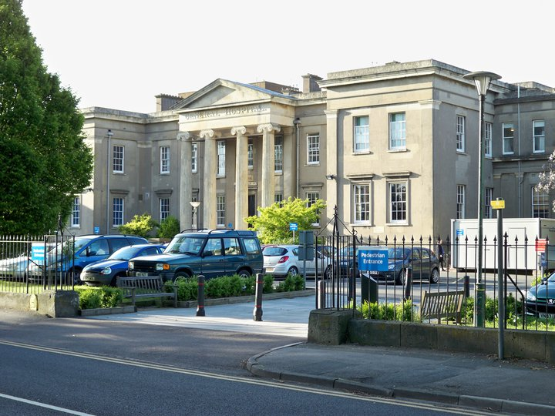

Cheltenham General Hospital
2007 - 2011
Notes:
The team are based at Cheltenham General Hospital and for those of you that don’t know, that is where I trained for four years between 2007 and 2011.

Slide 3

Aims
Gloucestershire Leg Ulcer service
History, the team, multidisciplinary working
Study Day
Attendee/speaker demographics
Interesting Presentations – Look at 6
Take Home messages
Notes:
So the aim of this presentation is to give you an insight into the Gloucestershire leg ulcer service, looking at it’s history, the team and it’s multidisciplinary working. I will then discuss study day itself, looking at the attendee and speaker demographics and the interesting presentations that I saw. There were 17 in total, so I won’t be sharing every single one. Notetaking and concentration flatlined briefly after the sit down three course lunch. I will share 6 that I found interesting. I will then discuss prominent take home messages from the day and any discussions.

Slide 4
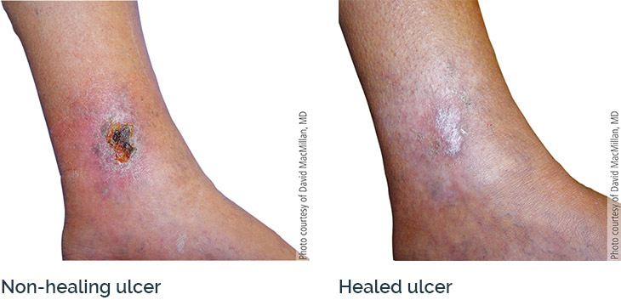
Gloucestershire leg ulcer Service
1995
2 Year Funded study
“East Vs West”
1998
Healing Rate at 24 weeks
29% to 68%
Specialist Leg Ulcer Nurse
Community Nursing staff
Open Access resource
One Stop clinic
G.P’s
Clinical Assessment
Hospital Departments
ABPI, Venous Duplex
Patients
Notes:
So the Gloucestershire Leg ulcer service was created in 1995, initially as a two year funded research study to evaluate the impact of a one stop service in the east of the county using the West of the county as a control. It was set up and run by specialist leg ulcer nurses and had an easy open access referral system whereby referrals were accepted from any department and even the patient themselves. The clinic worked along side the vascular laboratory and patients would all receive a clinical assessment, an ABPI and Venous Duplex scan. They looked at this data in 1998 and found that following the introduction of the leg ulcer service, ulcer healing rates at 24 weeks had increased from 29% to 68% when you compared the two sides of the counties.
They are dedicated to evidence based treatment and they have been going from strength to strength ever since.

Slide 5

The Team
6 nurse Specialists
2 research nurses
Admin Support
Vascular Lab
Vascular Surgeons
Surgical Practitioners
2000 – Expanded
Gloucester, Stroud, Cinderford,
Moreton
400 New Limbs/year
120 patients/week
in 10 clinics
Primary Care;
G.P’s
Community leg ulcer clinics
Notes:
So the team consists of Six leg Ulcer nurse specialists and two research nurses. They work very closely with the vascular scientists which they do the one stop clinic with but also the vascular surgeons and the vascular practitioners whom they refer many patients to for treatment of the underlying causes of the ulcers. They may refer the patients to a vascular consultant if the ABPI is less than 0.5, if they are healed and are suitable for venous intervention and also if they remain unhealed, typically for more than 12 weeks. They also have links with the surgical practitioners, a role developed by the surgeons at CGH. They aid the surgeons in theatre, perform foam sclerotherapy sessions and run their own follow-up clinics. They also have admin support and share a secretary with the vascular laboratory. They also have strong links with primary care, sharing the care with a clinic letter complied and sent to the patients G.P explaining the assessment and the course of treatment.
In 2000, they expanded their service to include a vascular assessment clinic at Gloucester Hospital and follow-up clinics in Stroud, Cinderford and Moreton-in Marsh.
They see approximately 400 new limbs each year and 120 patients are reviewed each week in the 10 follow up clinics they provide.
When I looked online, I found that they have their own facebook page which has a lot of useful information on it.

Slide 6
Attendee Demographics
Speakers
Notes:
So in total there were 193 attendees at the event. 59 were from a primary care setting and 126 were from secondary care. There were 8 others that I could not categorise from the information given. The speakers were primarily vascular surgeons with 14. There were 2 vascular scientists and 1 clinical nurse (which was Colin Davies who leads the leg ulcer team)

Slide 7

Primary Care
Notes:
The vast majority were nurses. These included practice nurses, community nurses, practitioners, student nurses etc. Four healthcare assistants and two managers. I was very surprised that there were no G.P’s at the event and this was even highlighted by a delegate at the event on the day.

Slide 8

Secondary Care
Notes:
So there were 36 nurses from a variety of backgrounds, including staff nurses, sisters and nurse practicioners. There were 33 Vascular specialist nurses. 23 Vascular surgeons/fellows/registrars. 19 Vascular scientists. 6 tissue viability nurses – I thought that there may be more TVN’s as they are involved in the prevention and treatment of wounds of differing aetiologies and can overlap with the leg ulcer nurses. There were 3 healthcare assistant, two managers and 5 that I could not easily categorise.

Slide 9
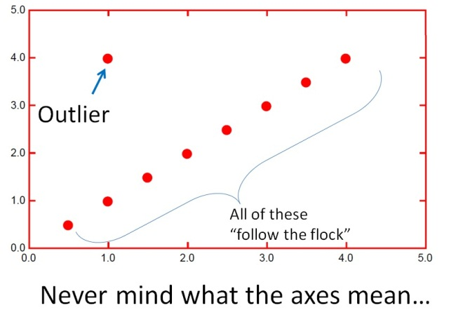
Outliers!
Anesthesiologist – Par Hospital, Iraq
Pharmacist
PhD researcher
“Director”
Notes:
There were a few that I termed as outliers, which had more unusual roles.

Slide 10
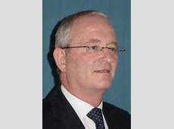

Mr Keith Poskitt
Welcome/ History and Scene Setting
100, 000 leg ulcers, 50% reoccur at 1 year
Financial burden - £500 million/year
Ulcer – “Vascular weed” – Treat Problematic roots
Influential research generated- ie ESCHAR
Notes:
So Mr Poskitt is a consultant vascular surgeon at Cheltenham General hospital and he gave a welcome and a history of the leg ulcer service. He highlighted the scale of the leg ulcer issue. There are around 100,000 patients with leg ulcers at any one time. They are common and often are poorly assessed. The financial burden is huge – approx £500 million per year.
to strength ever since.
He described the ulcer as part of a vascular weed system, which I thought was a good analogy. He discussed the need to treat the problematic roots (vascular systems), to effectively treat these ulcers.
He than discussed the milestone research produced by the team in the leg ulcer field; most notably and world renound is the ESCHAR study. Which was discussed in further detail later in the talk.

Slide 11
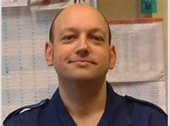
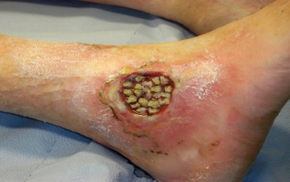
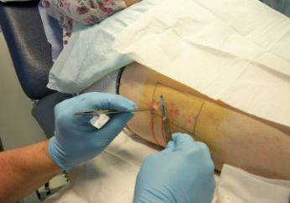
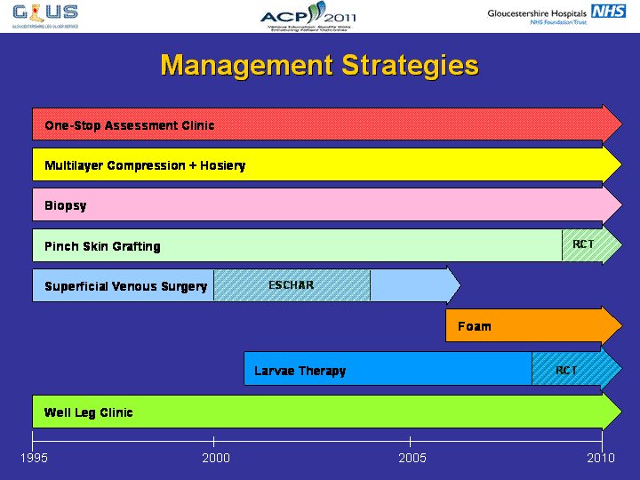
Colin Davis
Healing and recurrence (n= 5,396, prospective)
85% healed at 24 weeks (2014)
2010 - Recurrence at 12 months 13.5% (54 % before service)
Mean chronicity 1995 (18 months) to 2014 (6 months)
Proactive Management & One Stop Assessment
80% Venous nature Chronic Venous Hypertension - Venous Insufficiency
Compression - venous hypertension
Biopsy
Pinch Skin grafting
Treat VV’s – underlying cause – Surgery/Foam etc
Larvae therapy – remove devitalised tissue
Well leg clinic
Speed of referral improved (important
aspect)
Notes:
So Colin Davis is the lead manager for the leg ulcer service and gave us an interesting talk about the service. What really struck me was the success that they have had with ulcer healing and recurrence rates. State results. So they put this down to Proactive Management and evidence based treatment in their one stop assessment Clinic.
80% of ulcers are venous in nature and due to chronic venous hypertension resulting in venous stasis and oedema – this is often due to incompetent/damaged valves or calf pump failure. The one stop clinic would highlight a venous or arterial component or if fact both. If appropriate, patients would be put in compression, either 4 layer or modified compression to reduce pressure and venous hypertension. They would also suggest elevation and exercise.
1-2% of ulcers are due to an underlying malignancy so they might do a biopsy if there is a history of skin cancer or the ulcer has a sinister presentation.
They might offer pinch skin grafting where they use forceps to pinch and cut out small areas of the epidermis from another part of the body and transfer to ulcer site – to aid ulcer healing.
In many cases they treat the varicose veins – so treating the underlying cause of the ulcers.
They might use larvae therapy where sterlie maggots are put on the ulcer which remove devitalised tissue – effectivley cleaning the ulcer.
Once healed and wearing support hosiery, patients are offered routine surveillance follow-up after 3, 6 and 12 months and then annually thereafter in a well leg clinic.

Slide 12
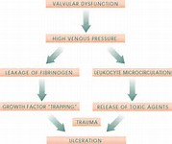
Mr Jamie Barwell
ECSHAR study - RCT, 3 Vascular Centres, n = 500
MS, Barwell JR, Taylor M, Chant T, Earnshaw JJ, Heather BP, Mitchell DC, Whyman MR, Poskitt KR. Randomised controlled trial of compression therapy alone versus compression plus superficial venous surgery in chronic venous ulceration (ESCHAR study): long-term results. BMJ. 2007 Jul 14; 335(7610):83.
Assess Effect of Superficial Venous Surgery with Compression Vs Compression alone
Results
Ulcer healing rates – no difference
Recurrence rates at 4 years:
31% Vs (56%)
Isolated superficial reflux: 27% Vs (51%)
Superficial + Segmental deep reflux : 24% Vs (52%)
Conclusions
Superficial reflux common in chronic ulceration Need to treat the underlying pathophysiology
20% never go on to heal – what can we do for these patients?
Ileofemoral therapies (duplex ileofem segment), immobility an issue (physio?)
Notes:
So Mr Barwell is a consultant Vascular and renal transplant surgeon at Derriford but was at Cheltenham General hospital when he undertook the ESCHAR study. The ESCHAR study was an RCT involving 3 vascular centres (one of which was Southmead Hospital) to assess the effect of superficial venous surgery with compression versus compression alone. Patients with open or recently healed leg ulcers were randomised to the study, with a total of 500 patients.
So here are their results.
When They looked at the 4 year recurrence rates and found that the surgery group had a recurrence rate of 31% compared to 56% in the compression alone group. Patients with isolated superficial reflux had 27% recurrence in the surgery group compared to 51% in the compression alone group. And patients with superficial and segmental deep reflux ahd 24% recurrence in the surgery group vs 52% in the compression alone group.
Mr Barwell concluded that superficial reflux is common in patients with chronic ulceration and this underlying pathophysiology needs to be treated to reduce the chances of recurrence – this is supported by the ESCHAR results.
He then talked about the fact that 20% of patients never go on to heal and what can we do for these patients? He suggested that there may be issues in the iliac veins – he asked the floor if we routinely scan this segment? May be able to offer therapies to patients that have disease at this level.
Immobility may also be an issue whereby immobile patients have a significant lack of calf muscle pump. He suggested that it may be worthwhile in this set of patients receiving physiotherapy to improve ankle movement.

Slide 13
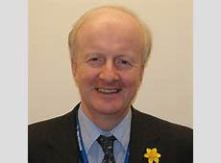
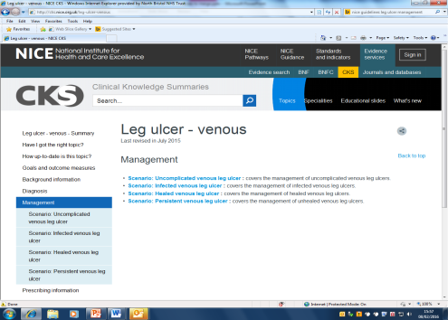
Prof Alun Davis
NICE Perspective – Chair Varicose Vein Guideline group
NICE Guidelines: Varicose Veins 2013
Leg Ulcers (Rev 2015)
Clinical Knowledge Summary
Refer to a vascular Service if have
“Use duplex ultrasound to confirm the diagnosis of varicose veins and extend of truncal reflux, and to plan treatment for people with suspected primary or recurrent varicose veins”
“symptomatic primary or symptomatic recurrent varicose veins…Lower limb skin changes..A venous leg ulcer (break in the skin below the knee that has not healed in 2 weeks..A healed venous leg ulcer.
“Doppler studies to exclude arterial insufficiency “ ……“Doppler studies should be carried out every 6 months, or sooner if clinically indicated” …. “A leg ulcer is defined as 'the loss of skin below the knee on the leg or foot, which takes more than 6 weeks to heal”'.
“An assessment should be carried out by a healthcare professional trained in leg ulcer management and should include”:
Conflicting Information/Confusion – Gaping holes in documentation – when do you refer to secondary care?
2 weeks or 6 weeks?
CKS – No mention of Venous investigation. ABPI – why every 6 months?
Notes:
Prof Alun Davis – Prof of Vascular Surgery Imperial College London. He is a world expert in the management of venous disorders. Editor in chief of phlebology.
So he gave a NICE perspective as he is chair of the varicose vein guideline group. He ran through the NICE Guidelines. So firstly the Varicose vein guidelines compiled in 2013. and then the Leg ulcer guidelines that were revised in 2015. The leg ulcer guidelines are a shortened version of NICE guidelines called Clinical Knowledge summaries which are supposed to simplify the information and make them more user friendly.
He picked out the relevant and useful information in the guidelines and I’ll run briefly through these. So the top guidelines suggest that you refer to a vascular service if the patient has
He highlights the fact that the NICE information is extremely confusing and contradictory. The top guidelines suggest that you should refer to the vascular service if an ulcer hasn’t healed in two weeks whereas the Clinical knowledge summary states that a referral to secondary care is often only necessary if there is an uncertain diagnosis or a person isn’t responding to treatment in primary care. Also if there is an arterial component or hard to heal ulcer (2-3) months.
The first guidelines state that an ulcer is a break in the skin that has not healed in 2 weeks, whereas the second guidelines state 6 weeks.
The clinical knowledge summary does not mention a venous investigation and suggests an ABPI only which should be repeated every 6 months - No justification for why.
All in all I think he seemed quite embarrassed about the guidelines and I think he will probably go back to NICE and highlight the issues – If anyone is going to do it I think he is the best person for it.

Slide 14
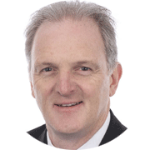
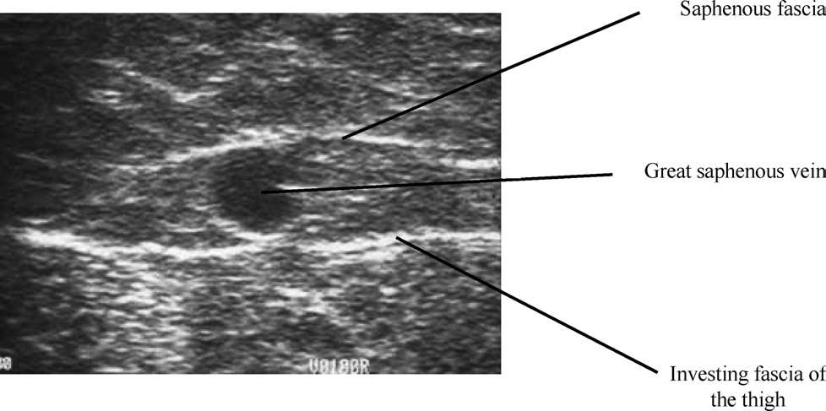
Mr Jonothan Earnshaw
CLASS Trial - RCT, 11 UK Vascular Centres
Comparison of laser, surgery and foam sclerotherapy (clinical + cost effectiveness)
n = 729 (Surgery 294, EVLA 212, Foam 292)
Primary outcome measures: Aberdeen VV questionnaire, Q-O-L measures at 6 months (Disease specific), QALY (cost effectiveness)
Secondary outcome measures: Q-O-L at 6 weeks, residual VV’s
Conclusions:
EVLA should be considered as the treatment of choice for suitable patients (6 months clinical outcomes + estimated 5 year cost effectiveness)
Ongoing : 5 year results being analysed for cost effectiveness and recurrence rates
Surgery still has its place (Intraoperative duplex to optimise surgery?)
Notes:
Jonothan Earnshaw is a consultant vascular surgeon at Gloucester Royal Hospital and he gave a talk about the CLASS trial which is ongoing at the moment. It is an RCT held in 11 UK vascular centres and is comparing the clinical and cost-effectiveness of laser, surgery and foam sclerothearpy in the treatment of superficial veins.
There are quite a few measures they are looking at, both primary and secondary outcome measures. Some of those they were looking at were the...
Quality adjusted life year.
When I looked into the study results in more detail, they were quite complex as so many things were being measured.
In essence, they suggest that EVLA should be considered as the treatment of choice for suitable patients and this is based on clinical outcomes and estimated 5 year cost effectiveness. So ongoing is to actually analyse this 5 year data for cost effectiveness and recurrence rates.
What was interesting is that Mr Earnshaw highlighted that he feels surgery still has a place in todays varicose vein treatments and in fact he still performs a lot of surgery. He suggested that intra operative duplex would be useful to optimise surgery.
Disease specific QOL questionaire. All effective.
EVLA has high chance of being cost effective.

Slide 15
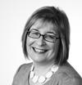

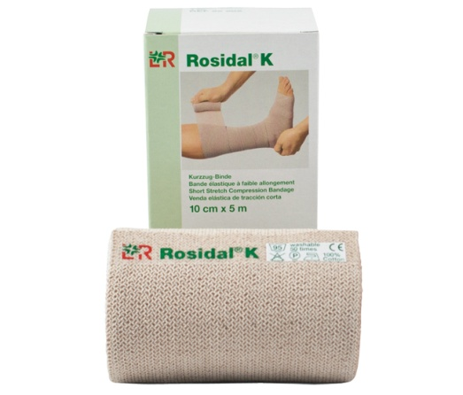
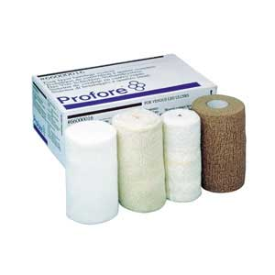
Andrea Nelson
48 RCT’s, 4321 participants, published 2012
How easy to perform? – not very! (Small RCT, bias, varying follow-up durations)
Analysis complex – unpooled analysis, pooled meta analysis (6RCT’s)
Conclusions?
Compression increases ulcer healing
Multi-component systems more effective than single (esp with elastic)
Two component = Four layer
Patients in 4 layer heal faster than short stretch bandaging
Take home messages
Compression that matters more, not type!
What will the patient realistically tolerate
Which system can be applied most effectively?
Does compression aid venous
leg ulcer healing?
Which system is most effective?
Notes:
So Andrea Nelson leads the school of healthcare in Leeds and has been co-author on a number of systematic reviews looking into the management of leg ulcers and chronic leg ulcers and clinical practice guidelines. The central question of her talk was “Does compression bandaging aid venous leg ulcer healing?” and also “which system is the most effective”. To do this she shared a cochrane review published in 2012 that she was co-author on.
48 RCTs included (4321 participants in total).
Highlight the issues in performing a systematic review (small RCTs, unclear, high risk of bias, varied follow-up duration). Results seem complex because so many studies cannot be pooled.
Overall, there is evidence that compression is better than no compression in the healing of ulcers. Multi component bandages more effective than single component systems (especially if they have an elastic component). Two-component systems perform as well as four layer. Four layer heal faster than those allocated short stretch bandage.
Andrea concluded on the difficulty to add evidence in such a review. Her take home message is that its not so much the type of compression that matters but the compression itself. What will the patient tolerate?
Conclusions: It seems important to undertake systematic reviews as they appear influence healthcare – Cochrane reviews recognised as the highest standard in evidence based healthcare

Slide 16
Take Home Messages
Leg ulcer Clinics work!
General feeling – all hospitals need one
National Strategic Framework
They need to be referred more quickly
How many are referred? Is NICE being implemented?
Alun Davis – Take guidelines to the commissioners
Notes:
Leg ulcer clinics work! – Their results speak for themselves. I think they have been so successful due to the speedy proactive management of these patients and also by treating the underlying causes of the ulcers.
There was a general feeling on the day that all hospitals need one and Richard Bulbulia CVS at Cheltenham gave a talk about the need for creating a national strategic framework like there is for strokes and cardiac diseases.
I think it is evident that these patients need to be referred more quickly. Indeed, I saw a patient in January that was referred to us by a G.P for an ABPI, I’m guessing to decide if they could use compression on the leg. This lady had had the ulcer for 3 months and had no compression to date. When I quizzed her, she had knew nothing about elevating the leg. Her ABPI was within normal limits and the ulcer looked venous in nature.
I wonder how many leg ulcer patients are referred as recommended by NICE. Alun Davis talked about taking the guidelines to the commissioners of the individual hospitals but in practice I wonder how easy this is to do?

Slide 17
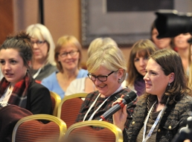
Audience Feedback
Notes:
So at the end of the day, Keith Poskitt held an audience feedback session, basically where people in the audience were picked out and asked to share what they are going to take away from the day. Put on the spot, where my mind when back, I suggested that my take home message would be the importance of compression in leg ulcer healing and also the fact that despite all the fancy and expensive dressings out there, there is no evidence to suggest these aid healing, best to stick to simple NA dressings which are a fraction of the price.
On reflection, I think my main take home message would be the fact that every hospital needs a clear and timely pathway for these patients and also what can we do for those poor 20% of patients who never go on to heal?

