Slide 1
“STP students MUST get AVS accreditation”
Notes:
Hello Everybody and welcome to the great debate.
STP students Must get AVS accreditation
Quick show of hands from STP students

Slide 2
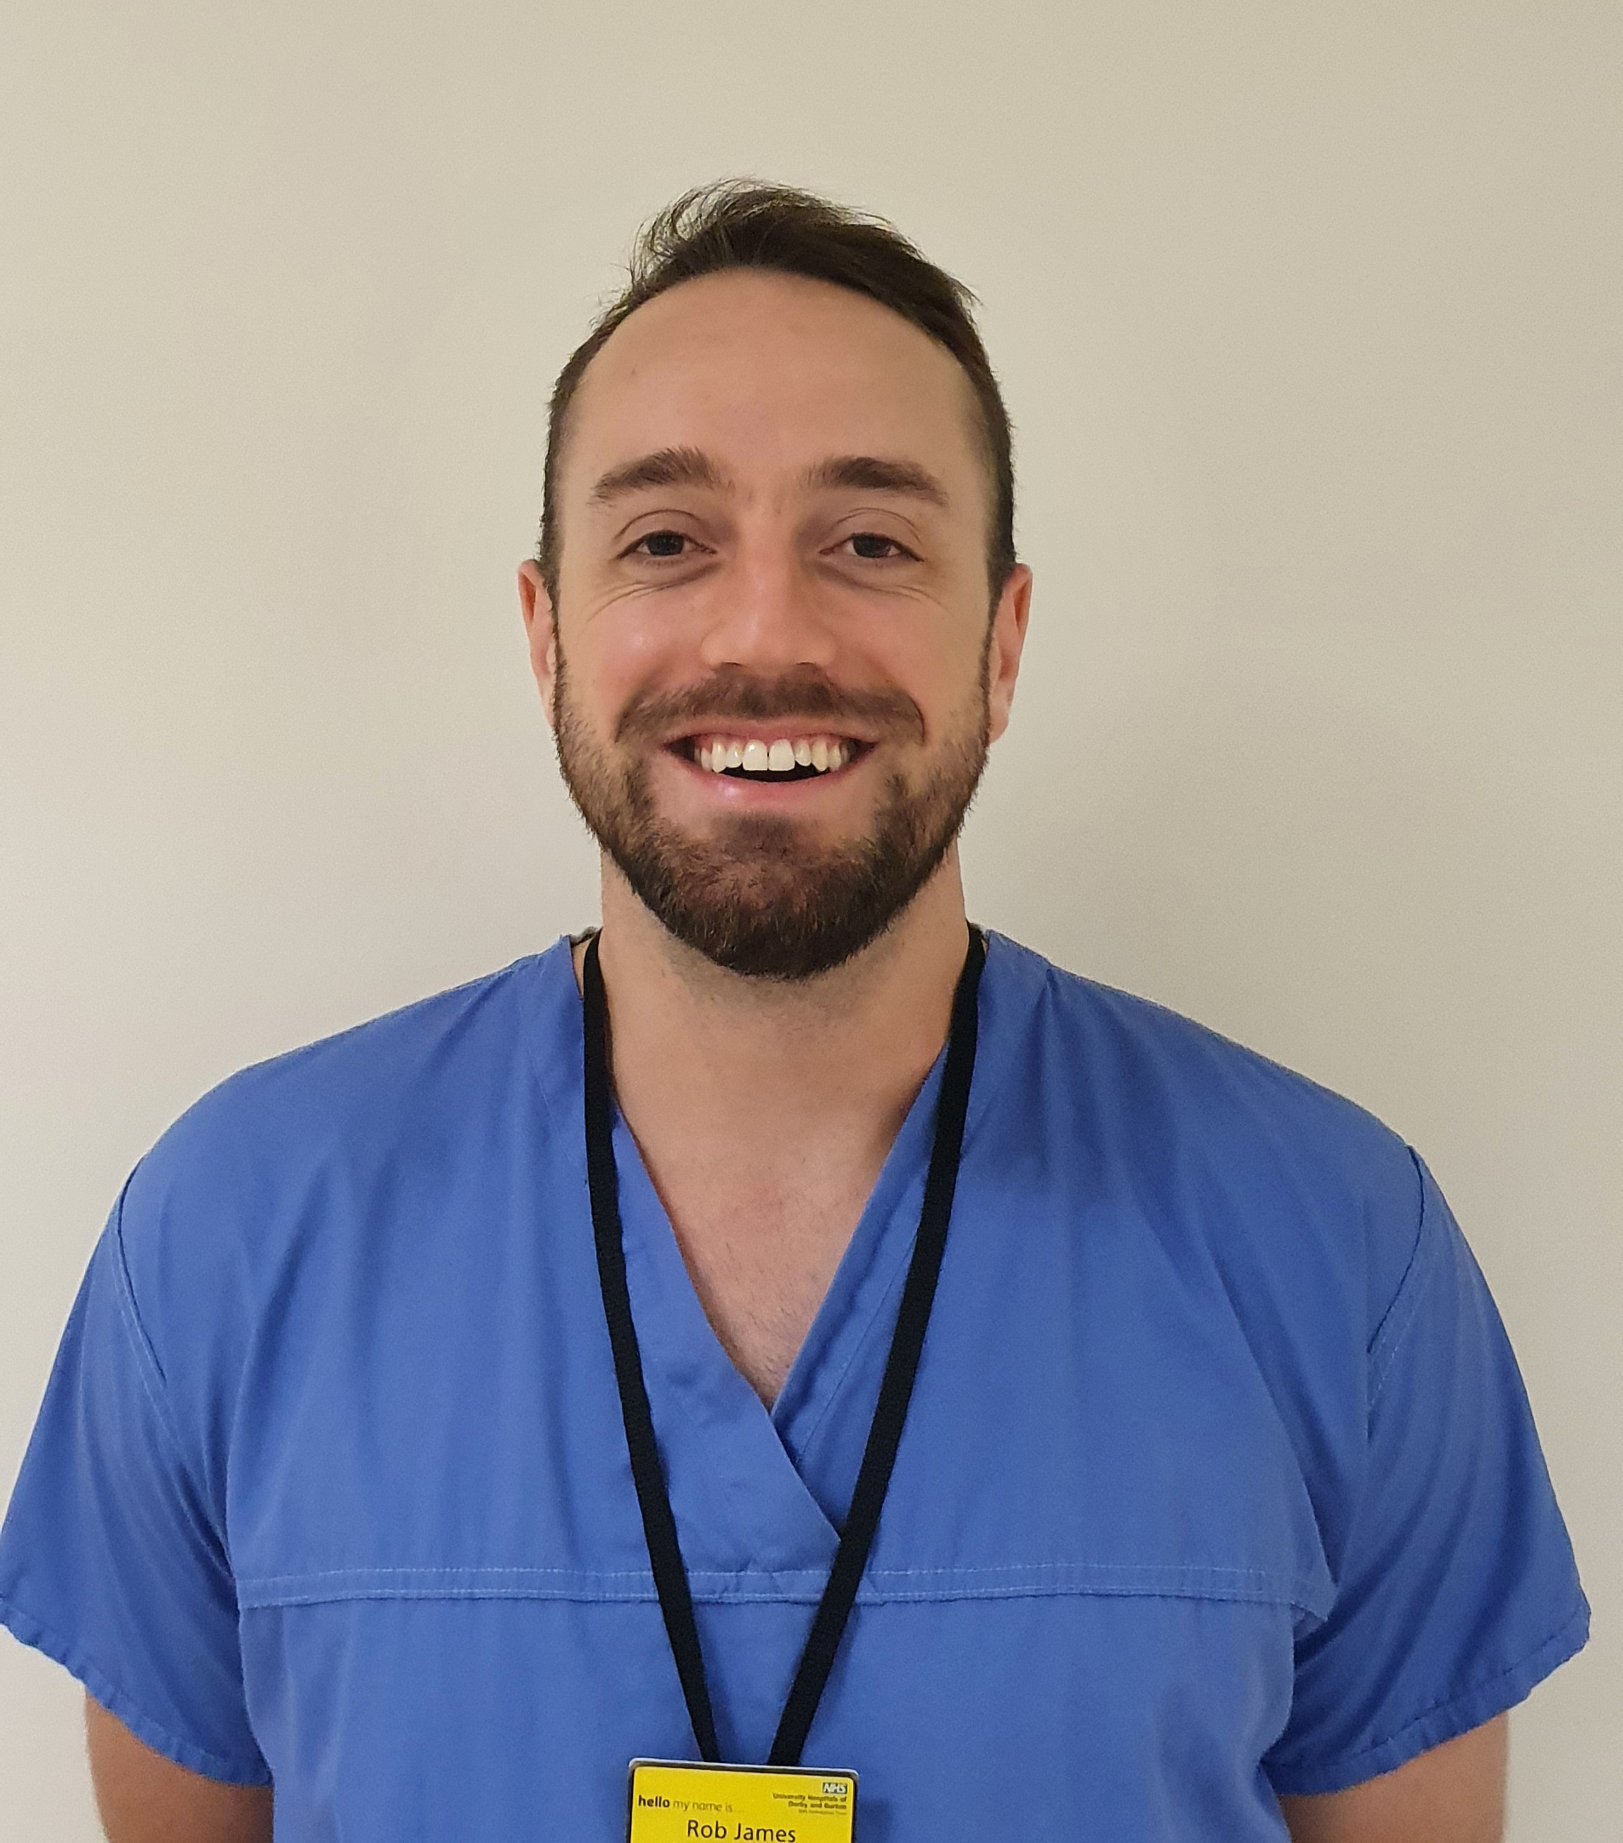
Robert James
STP graduate
Clinical Scientist (HCPC)
MSc Clinical Science (Vascular)
Accredited Vascular Scientist [AVS] (SVTGBI)
Zero conflicts of interest.
Notes:
Robert James
Graduated from the STP in 2019 and have all that comes along with it.
And I also now have my AVS which I got in 2020.
So zero conflicts of interest.

Slide 3
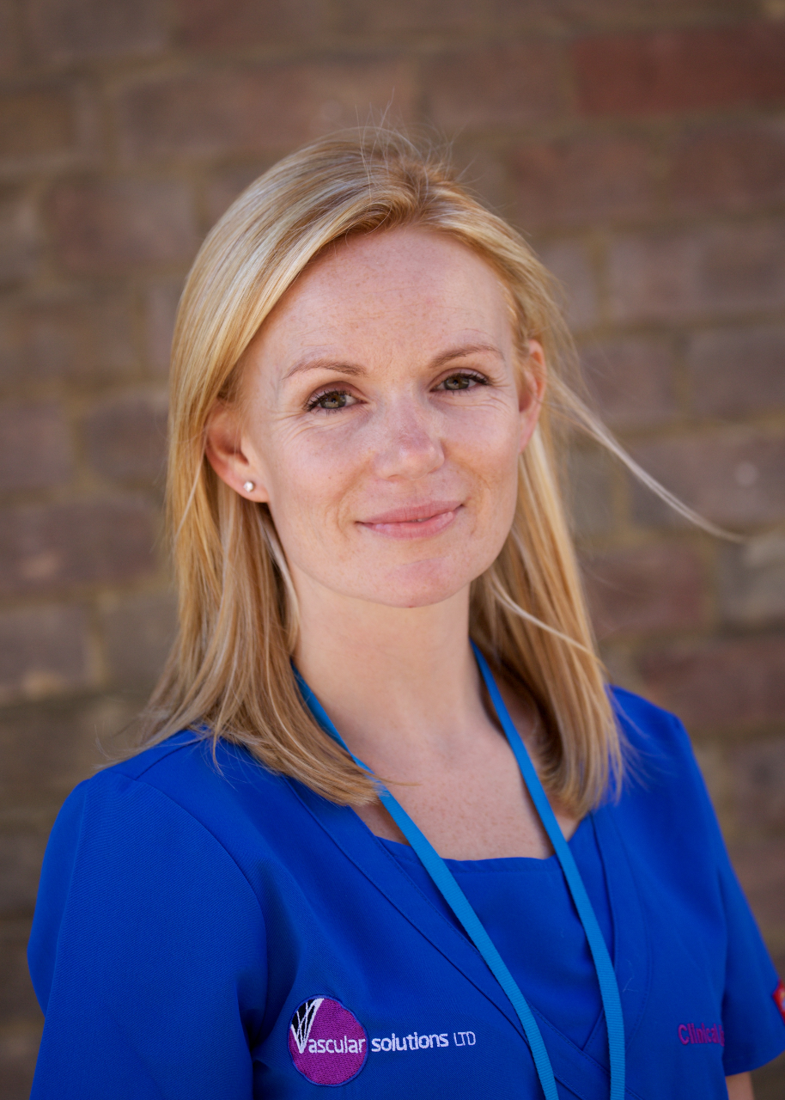
Emma Waldegrave
MSc Medical Ultrasound (Vascular)
Accredited Vascular Scientist [AVS] (SVTGBI)
SVTGBI – President
Many conflicts of interest.
Notes:
My Counter part for today is Emma.
Also has an Vascular MSc.
And is also AVS with many more years experience than myself.
She is also the SVT president so I need to tread carefully
But – Emma is not nationally registered with the HCPC.
So she is riddled with conflicts of interest.

Slide 4

“STP students MUST get AVS accreditation”
Terrible idea
Notes:
Now as the president of the SVT
Wouldn’t you assume that she would be a bastion of support for all trainees. Not least those that enrol into a national vascular training programmes like the STP.
However today she is not unfortunately. But don’t worry – I am, and I am here to tell you why this is an absolute load of rubbish.

Slide 5

Parameters for this debate
“STP students MUST get AVS accreditation”
“AVS MUST get HCPC
equivalence”
Disclaimer:
I am also not trying to talk anybody out of going for their AVS……
Notes:
And now again before I begin I want to make it very clear.
This is not a debate about experienced AVS getting or not getting their HCPC equivalence etc.
For today this is irrelevant and we are taking it off the table entirely.
My job is to strictly talk about STP students NEEDING AVS.
2) Big disclaimer, I am not trying to talk anybody out of going for their AVS.
What follows may or may not be my own views.
STPS with their HCPC against experienced AVS members. This discussion is not about HCPC equivalence. That is a can of worms for another day.
STP needing AVS and AVS needing HCPC registration are very different topics.
After this I am not even going to mention AVS equivalence. My hole is already perhaps deep enough.
2) I am most definitely not trying to talk anybody out of going for their AVS accreditation. Please do.

Slide 6
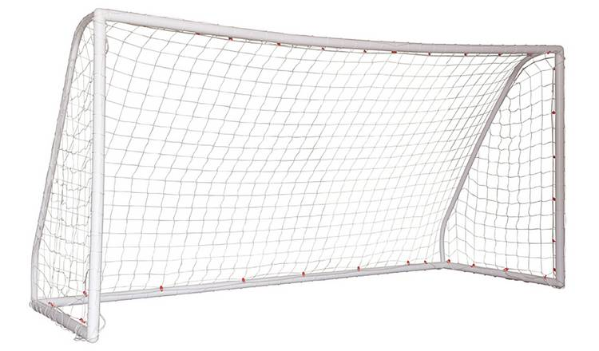

1 : 0
 | STP | AVS
Outcome | HCPC Registration (Clinical Scientist) | SVTGBI accreditation (AVS)
 | MSc Clinical Science | No formal academic qualification
Notes:
So, lets have a look.
It is world cup season so I’ve made this a quick head to head.
Green is a goal. Amber is neutral.
What actually are the differences.
Both are a recognised stature.
STP gives you an MSc.

Slide 7

 | STP | AVS
Outcome | HCPC Registration (Clinical Scientist) | SVTGBI accreditation (AVS)
 | MSc Clinical Science | No formal academic qualification
Academ. Practical | 3 years FT programme (in a centrally approved department) | 3 years minimum (No departmental approval required)
 | Multiple formative academic assessments (Coursework and exam based [essay and multiple choice q’s]) | Two formative academic assessments (multiple choice q’s)
 | Required research module | No research module required
 | Multiple DOPs and CBDs throughout | One final practical exam (only 3 scans)
 | No ‘arbitrary’ scan number requirement | ‘Arbitrary’ scan number requirement
 | Low range of scans | Wide range of scans ?? (LEA,LEV,Carotid,ABPI)
3 : 0
4 : 2
1 : 0
Notes:
Academically it’s a bit of a land slide.
STPS are assessed so many times in different formats. The AVS assessment is just MCQs.
STPS also do a research module.
This is shaping into an easy win.
But then the comeback is on. Practically its perhaps more controversial so ill focus on these.
STPs require more assessed scans throughout their training.
But AVS requires more scanning experience (which is possibly arbitrarily set)
And its supposed that AVS covers a wider range of practical scans.
So the final score is 4-2 and the world cup belongs to the STPs. But why doesn’t it feel like its come home yet.

Slide 8
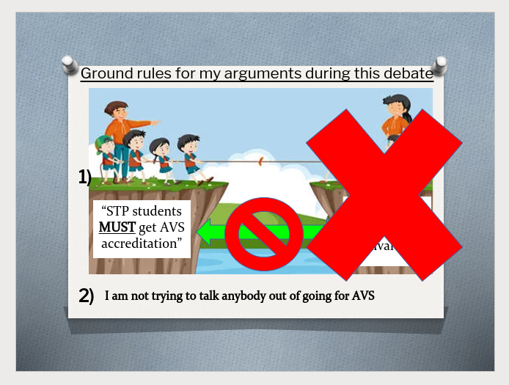
What are the perceptual differences?
But hold on…
STP
AVS
Great underpinning knowledge
? Not practically sound
? Lack of experience
vs
Seasoned veterans
Notes:
So to be clear, what are the perceptions
STP graduates are extremely knowledgeable but lack practical competence and experience.
But on the other hand
AVS holders are highly experienced candidates with decades of experience and have been there done that and got the bookmark.
BUT HOLD ON!!!!!! This isnt necessarily true. Remember the rules. We aren't talking about experienced AVS.

Slide 9

What actually is AVS?
The minimum standard required to achieve it.
3 years minimum
Vast underpinning knowledge
~2000 scans worth of experience
Notes:
So What actually is AVS.
By definition of any qualification – it simply is minimum standard that is required to achieve it. A baseline value.
So as we saw before, AVS is 3 years of experience and somebody with a degree of knowledge..
Guys, doesn’t this sound a little bit familiar.
There may be one or two other things – but lets not linger.

Slide 10


So what should we actually compare?
Individual 1
Individual 2
Newly graduated STP (3 years)
AVS in minimum time (3 years).
But how many AVS actually achieve this immediately after 3 years?
Individual 3
Individual 4
Graduated STP
Plus 1 year post STP experience
AVS in 4 years
But Why?
Notes:
SO what should we actually compare an STP to?
Newly graduated vs a AVS that’s done it in 3 years seems fair.
But how many AVS actually achieve this in 3 years? I would say a very very slim minority.
I would say the AVS would still be more looked favourably upon. But WHY?

Slide 11
~2000 scans worth of experience
No ‘arbitrary’ minimum required scan numbers | Minimum Scan numbers Requirement
WHY 2000?
Notes:
Is it because of the 2000 scan requirement?
This multi coloured row means were taking it to VAR.
Why is the bar set at 2000? We know that the RVT accreditation *The American equivalent for AVS* requires ~800 diagnostic cases?

Slide 12
2000 what?
2000 amazing scans
or
2000 terrible scans?
2000 independent
or
2000 supported?​
2000 technically challenging scans
or
2000 technically easy?
2000 boring scans
or
2000 exciting scans?
2000 scans worth of skill experience and skill acquisition?
2000 Complex scans
or
2000 Straight forward scans?
Notes:
So what does 2000 even mean?
Does it mean experience and skill acquisition?
Isn’t that a little bit speculative?

Slide 13
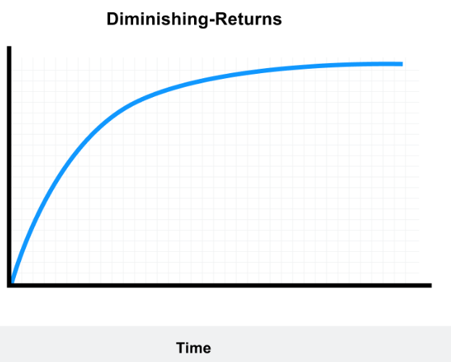
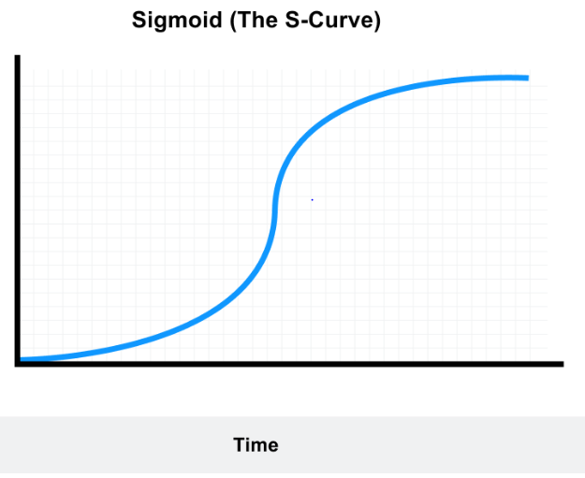
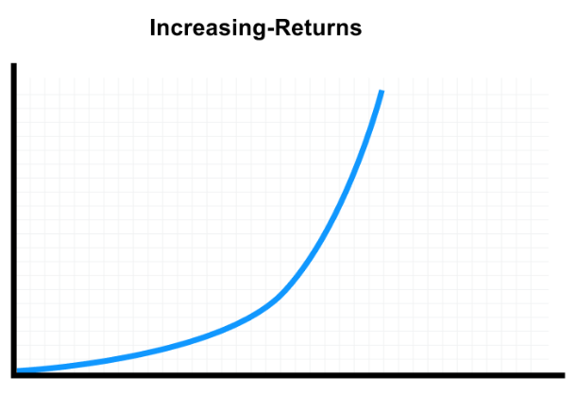
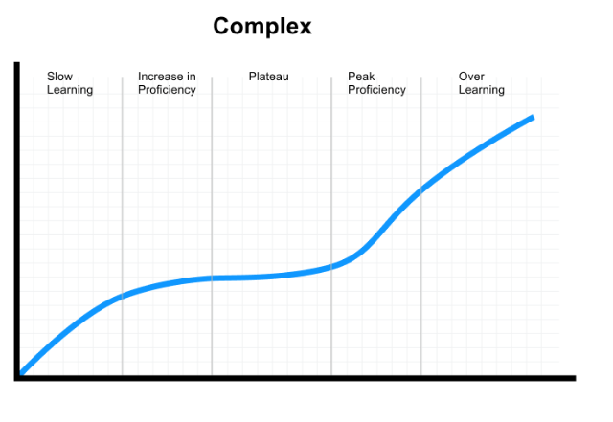
No ‘arbitrary’ minimum required scan numbers | Minimum Scan numbers Requirement
1)
?
?
Where should 2000 scans lie?
Where does 2000 scans lie?
Notes:
So if we are talking about skill acquisition we cant do that without learning curves.
Different people learn in different ways. And even the same people learn tasks in different ways.
So what is 2000 scans on here?
If an advanced AVS with decades of experience, perhaps an interventional vascular scientist, or performing advanced renal artery scans etc is going to be at the right of this,
Where should 2000 scans be?
Where does it actually lie? Is it all the way over here? Maybe its all the way to the other side? We don’t know.
But what we do know is that not all learning is equal learning.

Slide 14


Not all practice is equal!
Ensure that training centres are suitable
Ensure that training plans are in place
Ensure that training officers are suitable
Provide education and underpinning knowledge from leading academic centres, by specialists.
Notes:
And not all practice is equal practice.
For those of you that either play golf or have heard about my golf you will know that practice most certainly does not make perfect.
Only perfect practice makes perfect.
So how can we get as close to perfect practice for our trainees?

Slide 15
No ‘arbitrary’ minimum required scan numbers | Minimum Scan numbers Requirement
1)
Notes:
I am going to go out on a limb here
As close to perfect standardised practice as possible would squeeze these curves to the left.
That would leave this speculative 2000 level – wherever it may be - seem a little absurd wouldn’t you agree?

Slide 16

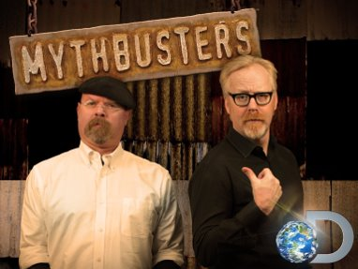


What else?
Low range of scans | Wide range scans
NSHCS
New STP syllabus

Slide 17
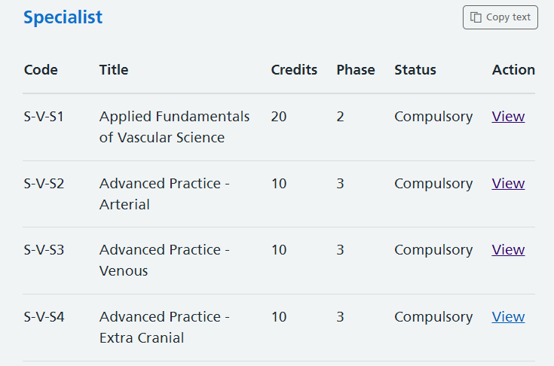
Low range of scans | Wide range scans

Slide 18
What else?
Practical assessment

Slide 19
“STP students MUST get AVS accreditation”
Immediately after graduation?
Automatically after graduation?
NEVER!
As soon as possible after graduation
Some time in the distant future after graduation
Early career
TIMELINE
Late career
EXTREME!
Moderate
EXTREME!
Notes:
Now before we get going, let me begin by asking the room for a raise of hands from whowever is either currently enrolled on the STP or are a graduate. Okay, now only leave your hands up if you are also AVS.
Right so – quite an equal spread and not very of you, so this may be a tricky sell. I have my work cut out for me.
Anyway. STP students MUST get AVS accreditation. Lets break down what this could mean.
That this could happen Immediately and Automatically after graduation?
As soon as possible after graduation
Some time in the distant future, but with elements of urgency.
And my favourite for today..... NEVER. Never in a month of sundays!
Now I have called the two on the edges as the more extreme side of the conversation. But I am going to delve into these. Particularly immedaitely after graduation.

Slide 20

STP

Slide 21

STP Finish line
A
V
S

Slide 22
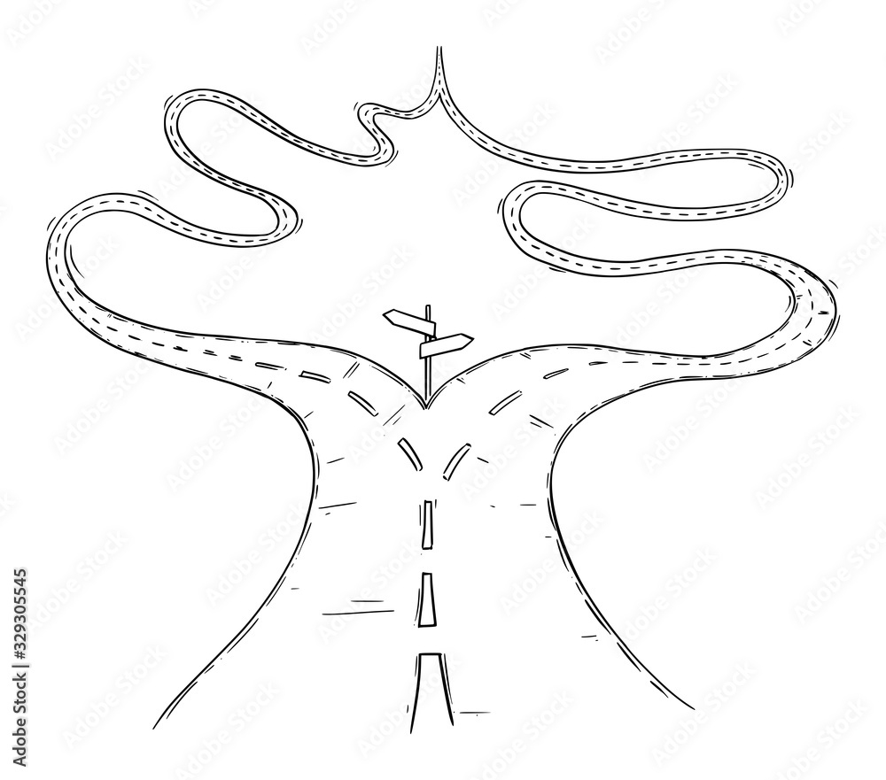
Competent Vascular Scientist
New Trainee

Slide 23
“STP students MUST get AVS accreditation”
Terrible idea

