Slide 1



Ultrasound - A Tool for Deep Venous Disease Assessment
Vikki Galgerud
Clinical Vascular Scientist – Independent Vascular Services (IVS)
Royal Oldham Hospital

Slide 2
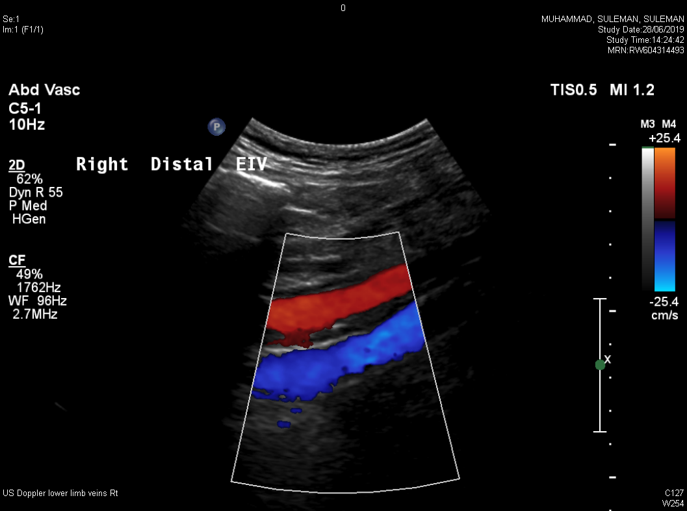
Imaging the Deep Venous system
Cross-sectional (CT\MRV)
Venography
Ultrasound Imaging
IVUS – Intravascular Ultrasound
Notes:
Various ways to image the deep venous system –
I’m here to talk about ultrasound as that’s my speciality.

Slide 3
Why is Ultrasound Useful?
Multiple planes & multiple
ways to assess
Non-invasive
Superficial and Deep Systems
Dynamic
Notes:
MULTIPLE PLANES – Able to assess the vessel in transactional and longitudinal planes giving a more complete picture and the ability to try and look around calcified plaques.
TOOLS - Greyscale/Colour/Power/Spectral Doppler
NON INVASIVE – No exposure to ionising radiation, needles or potentially harmful contrast.
SUPERFICIAL AND DEEP – Able to assess both superficial and deep systems with good accuracy – limitations in patients with large body habitus.
DYNAMIC – Able to assess flow as it moves passed the transducer in an almost real time image, wall to wall filling, nature of flow through a vessel, how it behaves around thrombus. And assess surround tissues to highlight potential issues; infections etc.

Slide 4
The four pillars of deep venous duplex scanning:
Anatomy and lesion location
Disease morphology
Competence & Flow
External compression

Slide 5
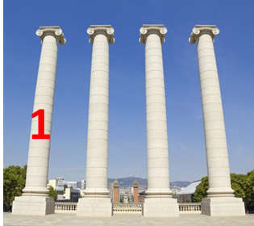
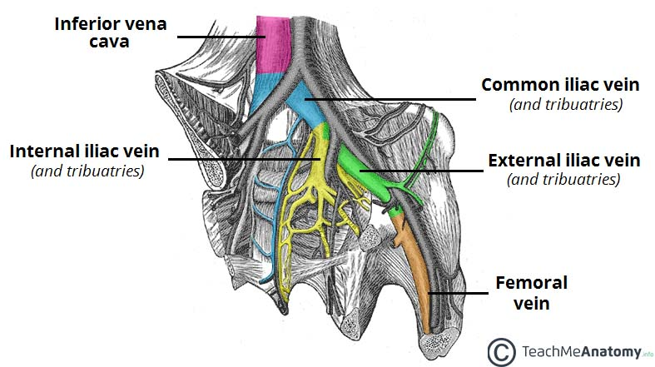
The Four Pillars of Duplex in Deep Venous Disease
Anatomy and thrombus/fibrosis location
Segments involved (e.g. IVC, CIV, EIV, CFV, FV)
Notes:
Pillar 1
WHAT ARE WE TRYING TO ACHIEVE? – WHAT DO WE WANT TO KNOW?
What vessels are involved?
What is the extent of the thrombus/ How many vessels are involved?
Does the number of vessels affect treatment? Below profunda managed by anti-coagulation
Above profunda consider lysis.

Slide 6
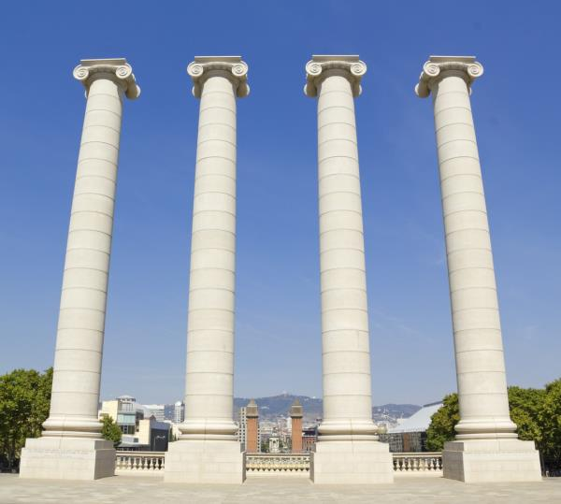
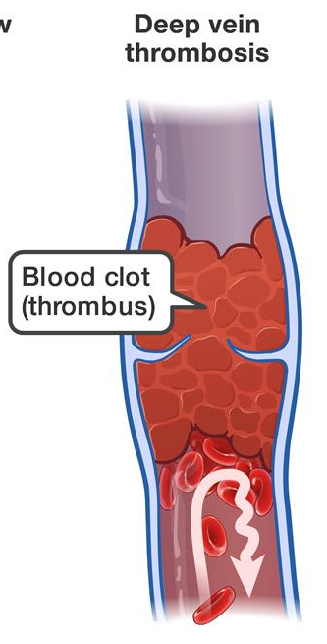
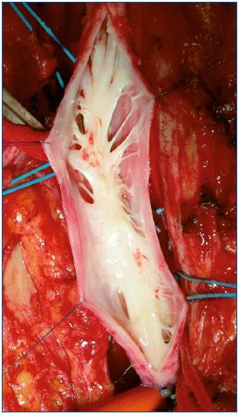
The Four Pillars of Duplex in Deep Venous Disease
2
Disease morphology
Thrombosis
Fibrosis
Thrombosis + fibrosis
Notes:
DISEASE MORPHOLOGY –
Ultrasound can determine chronic or fresh disease.
Is if fresh thrombus – Appears echolucent on US
Is there fibrosis – Chronic disease appears as a bright white echogenic area on US.
Are both present – has fresh thrombus formed on fibrotic lesions? This can be difficult but not impossible to assess.

Slide 7
The Four Pillars of Duplex in Deep Venous Disease
3
Flow + patency
Inflow: PFV + SFV
Flow through the diseased vessel
Outflow: IVC
Competence
Superficial venous flow
GSV
Collaterals
Notes:
Flow and Patency – Is there flow present – What is the inflow like in the PFV and SFV?
What is the flow like through the diseased sections?
What is the outflow like? IS the IVC patent?
Competency – Is there back filling of blood? Is there damage to the vein from disease?
Is there disease in the superficial system – Is the superficial system acting as a collateral route?

Slide 8
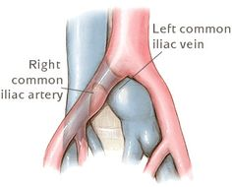
The Four Pillars of Duplex in Deep Venous Disease
4
External Compression
May-Thurner
Surrounding organs
e.g. fibroids
Notes:
May Thurner syndrome, where a vein is being compressed by an artery in various different locations as you can see on the diagram. Other forms of compression can come from surrounding tissues such ash Fibroids.

Slide 9
Documentation + Communication
Essential
Detailed
Accurate
Good Relationship
Notes:
ESSENTIAL - to extrapolate the information from the vascular scientist to the consultant.
DETAILED – To give the consultant the complete picture of the extent of disease. But at the same time being concise.
ACCURATE – Results must be accurate good images and cineloops demonstrating disease with an accurately written report.
GOOD RELATIONSHIP – Important to have a good working relationship between the CVA and the consultant trust what you are telling them.

Slide 10
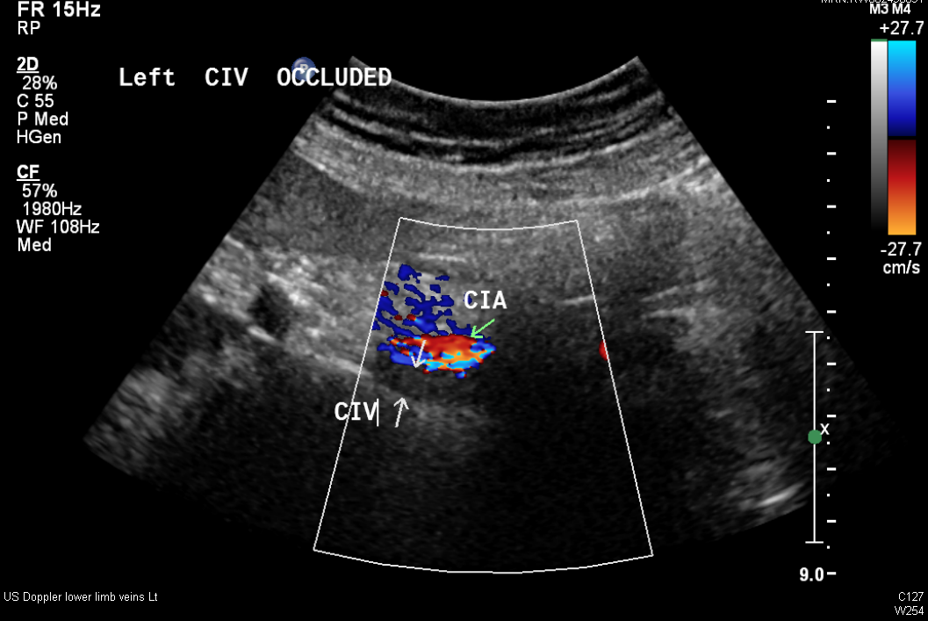
43yr F - 7th January 2019
Notes:
Admitted 7/1/19 ileo-femoral occlusion.
Flow seen in the Common iliac artery
No flow in the Common iliac vein
In the days following 10-11th Jan patient had Thrombolysis and Stent implantation.

Slide 11
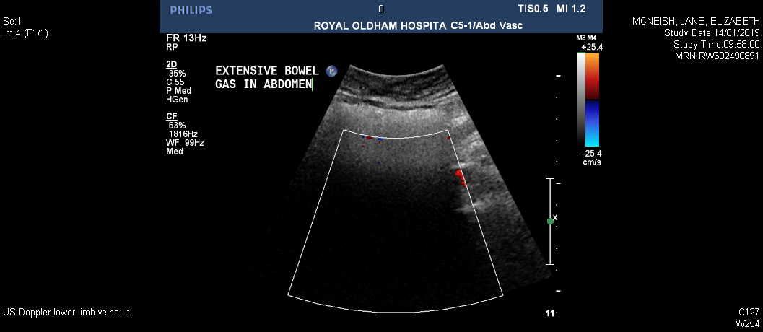
Day 3 Post-stent - 14th January 2019
Notes:
CIV stent was obscured.
This demonstrates one of the main limitations of ultrasound - BOWEL GAS. Soundwaves travel slowly in air (~340m/s) - the US machine assumes a speed of sound of 1540 meters per second and produces images based on this, the sound waves rerun so slowly back to the transducer that it assigns no shade of grey to the image – thus obscuring the vessels.
When this happens we need to use other tools at our disposal to make a diagnosis……

Slide 12
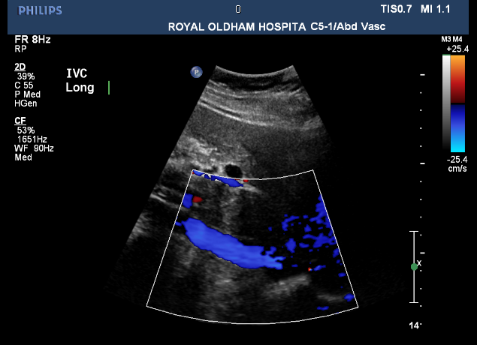
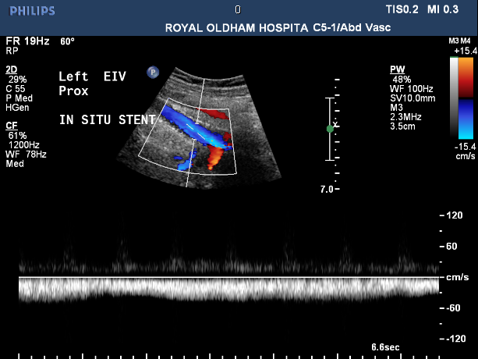
Day 3 Post-stent - 14th January 2019
Notes:
IVC – Patent we can see good wall to wall colour filling
The EIV is phasic with respiration suggesting proximal vein patency. Due to changes in thoracic pressure.- READ UP ON THIS
If this doesn’t give us the information we need We can suggest alternative imaging modality.

Slide 13
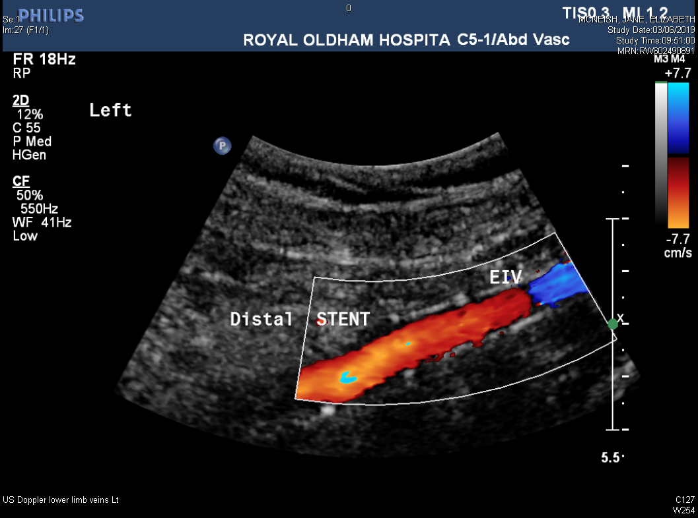
1 year post stent – 14th January 2020
Notes:
1 Year later ultrasound surveillance shows the stent is still widely patent – patient tells us each time she comes into the department how happy she is to have some relief from Post Thrombotic Syndrome.

Slide 14
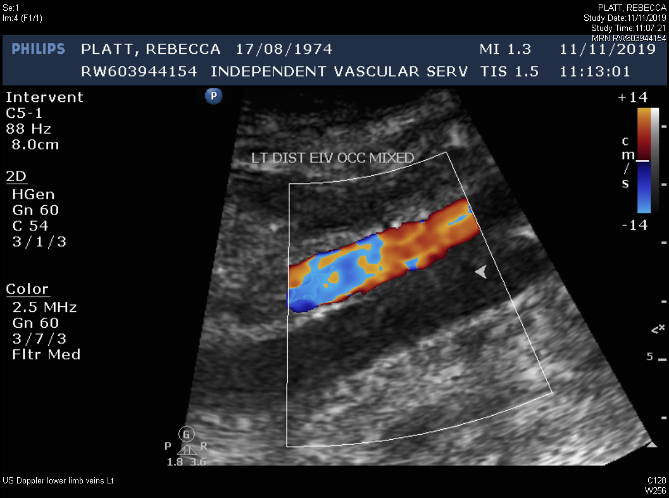
45y F – 11th November 2019
Notes:
45yr Old female presents 11 Jan 2019 - Victim of DV – assaulted by her husband presents to hospital - US diagnoses extensive ileo-femoral DVT.
Over the next few days patient had Thrombolysis and a stent implanted.

Slide 15
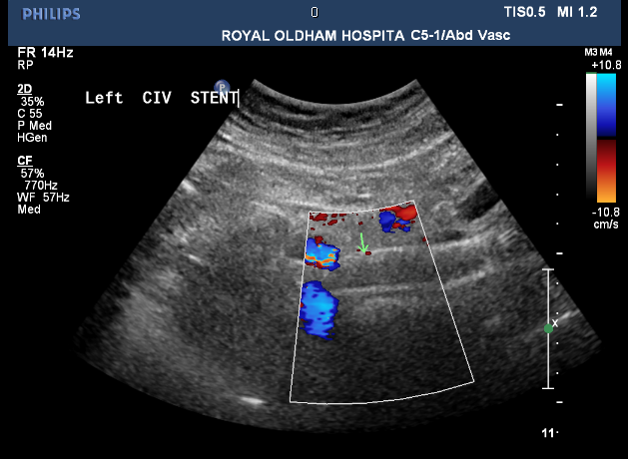
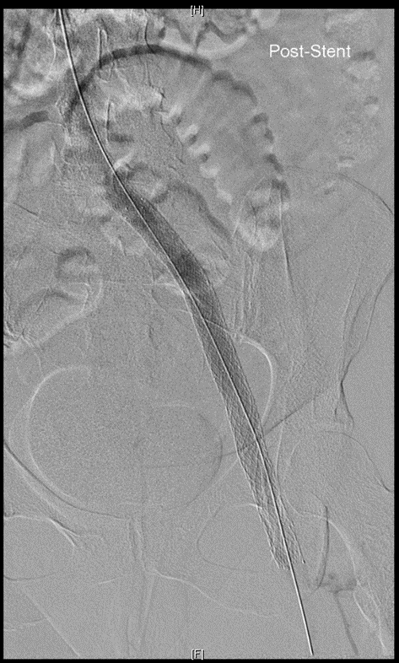
45y F – 25th November 2019
Notes:
Ultrasound queried if stent was occluded during routine surveillance. US suggested alternative imaging if appropriate.
Venogram showed stent was patent but with very low flow in the CIV region.
2 modalities working together – US highlighted a problem – Venogram confirmed flow and the next step was taken.

Slide 16
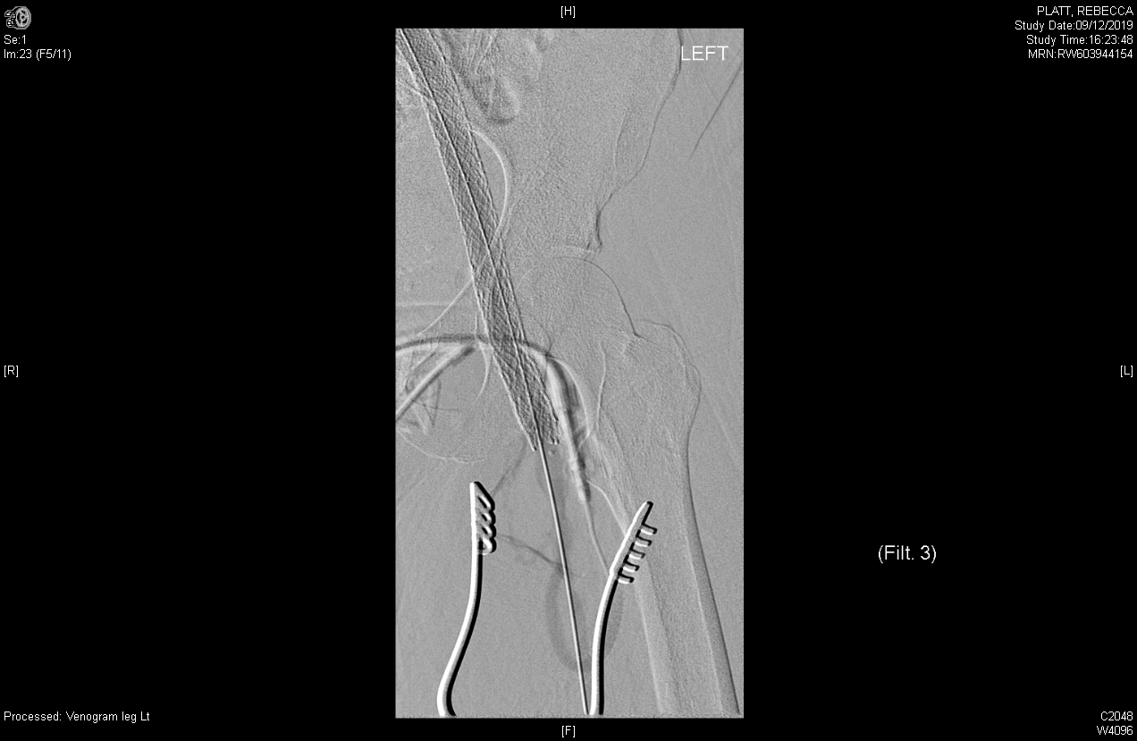
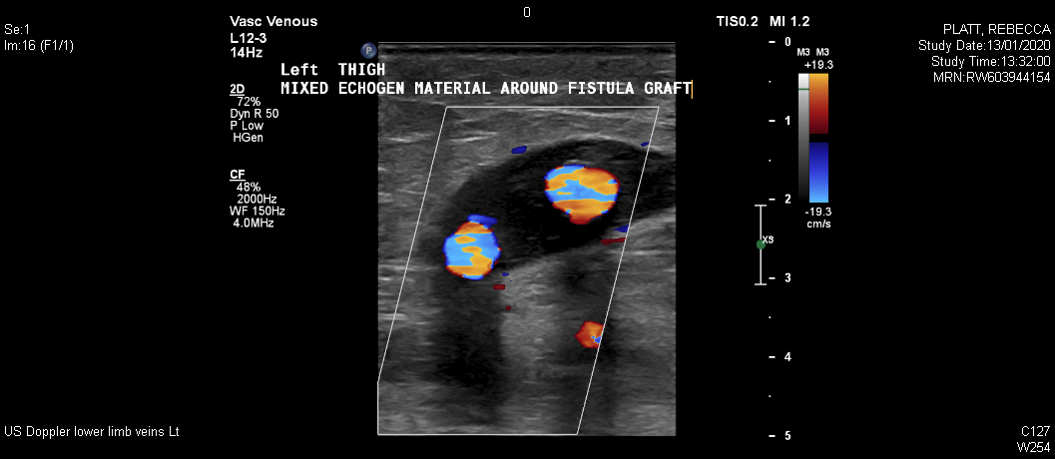
45y F – ????^{th} November 2019
Notes:
Patient had a fistula implanted connecting the Origin of the SFA to the SFV? Utilising arterial pressure to increase the outflow in the lower limb into the stent to prevent the risk of failure.
US image shows TS image of widely patent fistula.

Slide 17
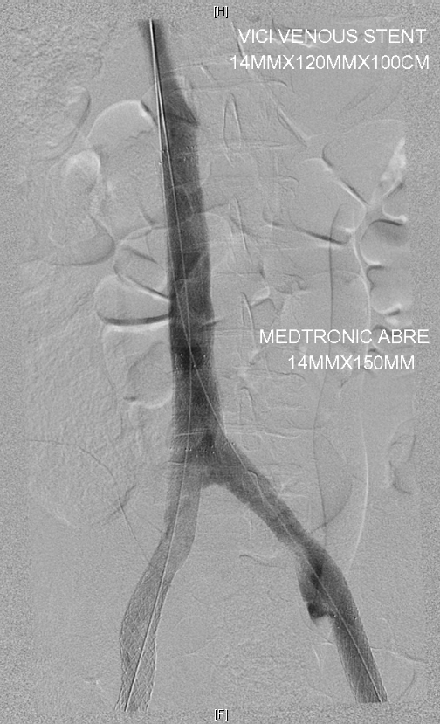
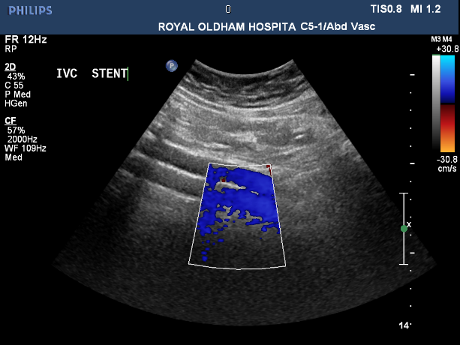
Challenges
Complicated anatomy/devices
Double-barrel IVC reconstruction
IVC
Bowel Gas
Scar tissue
Calcification
Notes:
For example – Double barrelled IVC reconstruction – can be tricky to see both limbs depending on the angle, depth and other limitations of abdominal ultrasound.
IVC & CIV bifurcation – tricky to see as anatomically lies behind the umbilicus.
Other things that make it difficult – Bowel Gas – Scar tissue – Calcification of overlying arteries – Acoustic shadowing from overlying structures.
Beware of RSI – amount of pressure required to scan the abdomen is huge in some patients.

Slide 18
IN CONCLUSION
No one modality is better than another
Each have their advantages and limitations
Important to understand each modality and use the most appropriate
Notes:
1 Not standing here saying you should only use US, its better than anything else – its not a competition.
2 Limitations
The most important thing is that each health professional involved in a patients care is able to make the most of the options open to them and understand the value of every type of imaging modality for best clinical practice.

Slide 19
QUESTIONS?

