Slide 1
Extracranial Arterial Duplex Imaging
Ben Warner-Michel
Your friendly neighbourhood vascular scientist

Slide 2
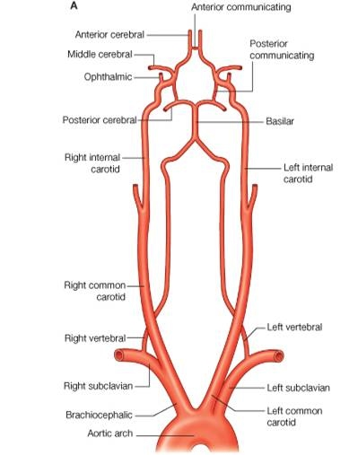
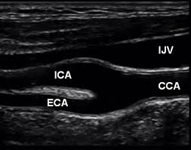
Anatomy
Main extracranial vessels
  Brachiocephalic trunk
  Subclavian artery
  Common carotid artery
  External carotid artery
  Internal carotid artery
  Vertebral artery

Slide 3
Anatomy
Main extracranial vessels
  Brachiocephalic trunk
  Subclavian artery
  Common carotid artery
  External carotid artery
  Internal carotid artery
  Vertebral artery

Slide 4
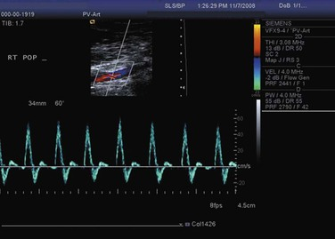
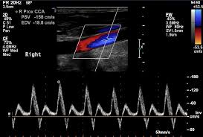
Haemodynamics – subclavian artery
Triphasic peripheral waveform – three phases characterised by crossing the zero flow baseline twice in each cardiac cycle
  Systolic antegrade flow
  Early diastolic flow reversal
  Late diastolic forward flow (may continue throughout diastolic into the next systolic pulse if distal resistance is low)
RT SCA
1
3
2
1
3
2

Slide 5
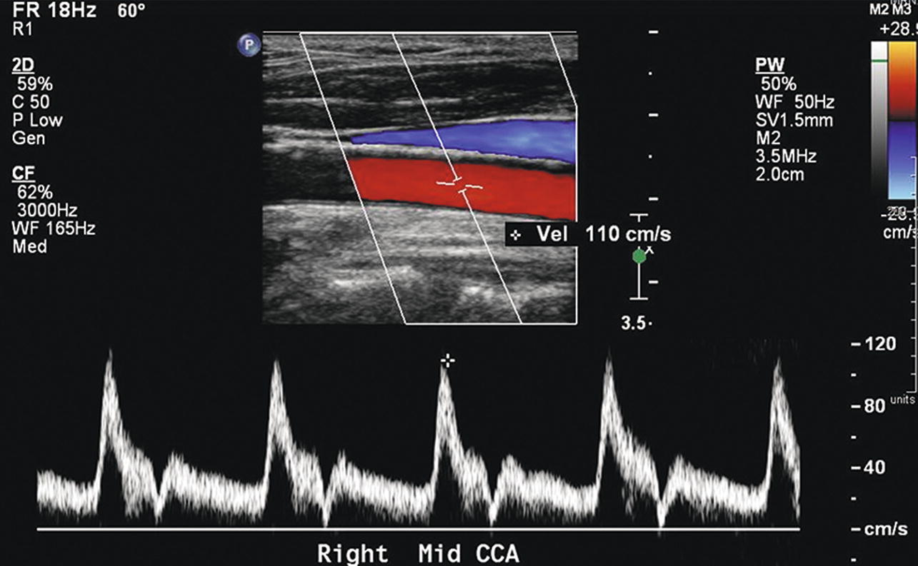
Haemodynamics – common carotid artery
Relatively low resistance waveform – ~70% of flow supplies the ICA and cerebral vascular bed
  Rapid systolic upstroke
  Continued forward flow throughout diastole
  Relatively high end-diastolic volume flow
  Window under peak indicates laminar flow

Slide 6
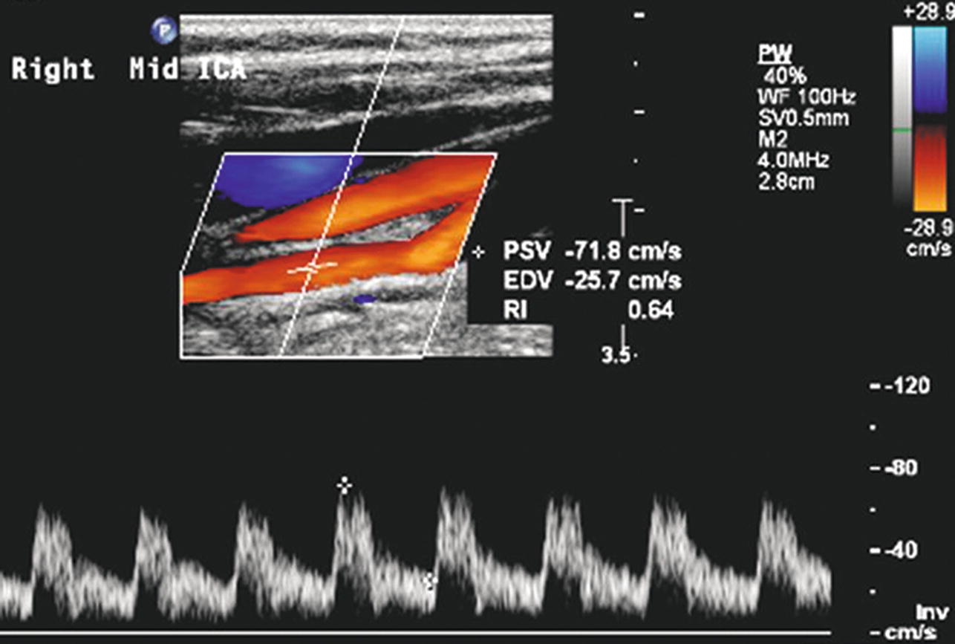
Haemodynamics – internal carotid artery
Typical damped, low resistance waveform - supplies a large, low-resistance cerebral vascular bed
Usually more damped than common carotid
  Rapid systolic upstroke
  Continued forward flow throughout diastole
  Less sharp peak than CCA/ECA
  High end-diastolic volume flow

Slide 7
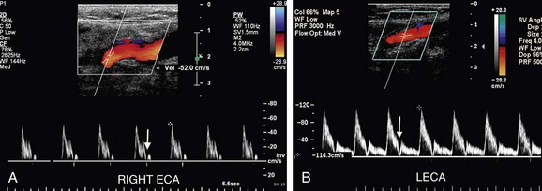
Haemodynamics – external carotid artery
Typical high resistance waveform – supplies smaller and more resistive vascular beds of the head and neck
  Rapid, sharp systolic upstroke
  Often flow reversal in early diastole
  Low or absent end-diastolic volume flow

Slide 8
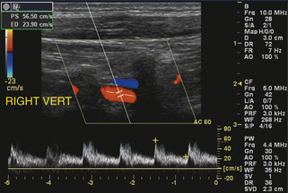
Haemodynamics – vertebral artery
Similar to internal carotid – low resistance waveform supplying a large cerebral vascular bed
  Rapid systolic upstroke
  Continued forward flow throughout diastole
  Rounded peak
  High end-diastolic volume flow

Slide 9
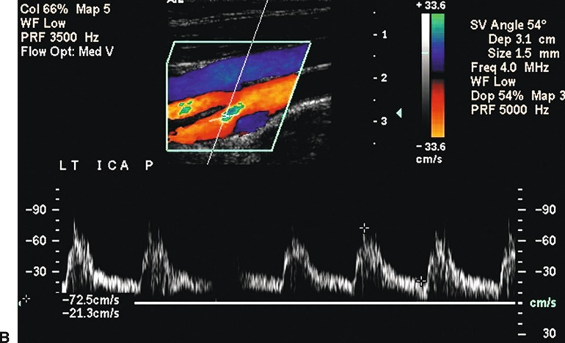
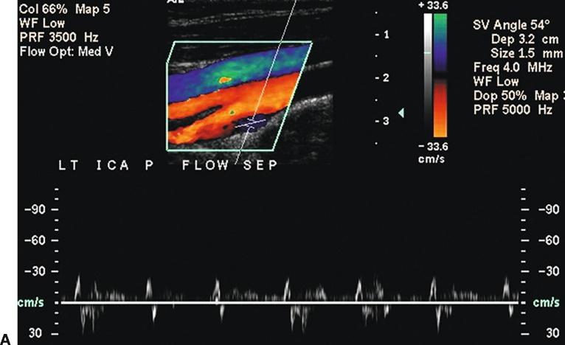
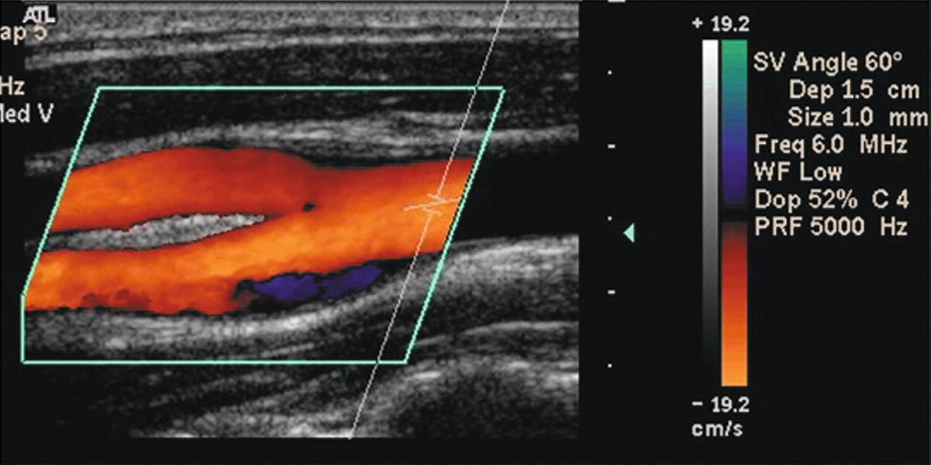
Haemodynamics – carotid bulb
The normal proximal ICA or bifurcation often includes a dilation or bulb of variable size that tapers gradually toward the mid-distal vessel
Transient reversal of flow occurs at peak systole near the centre stream and at the outer wall opposite the flow divider – boundary layer/flow separation
Sampling in this region will give an abnormally blunted waveform with antegrade and retrograde flow components
May be identified on the colour Doppler image by an area of blue at the far wall opposite the flow divider

Slide 10
Haemodynamics – carotid bulb
The carotid bulb is a fairly variable structure between patients and so flow division patterns will depend upon the shape, location and size of the carotid bulb
Haemodynamic changes caused by the changing calibre of the carotid bulb and flow division at the bifurcation strongly contribute towards carotid atherosclerosis

Slide 11
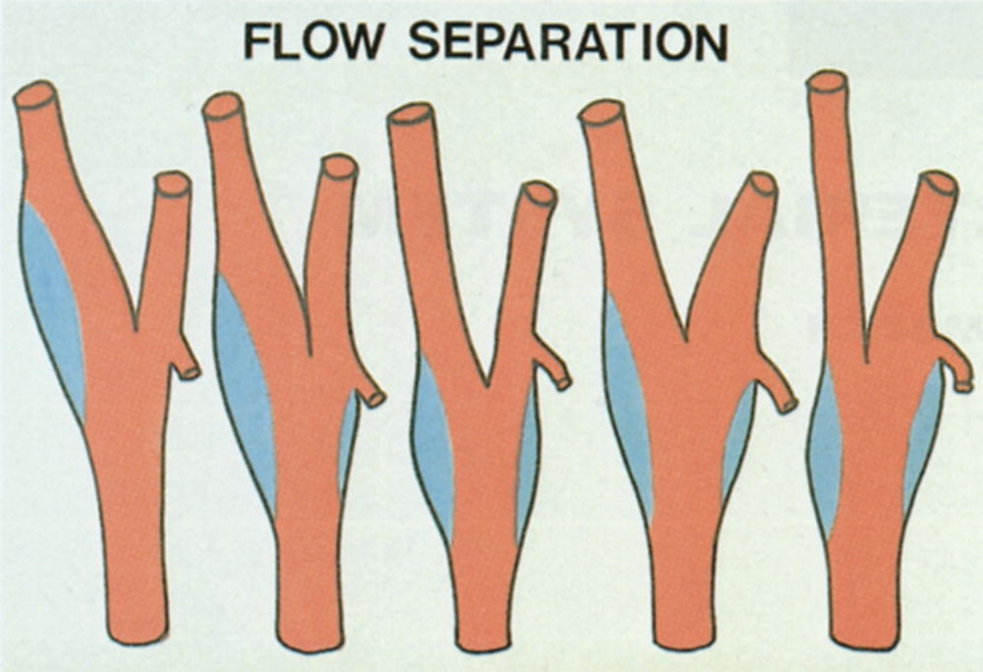
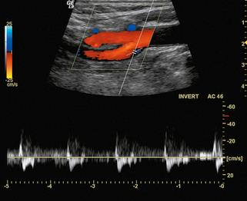
Haemodynamics – carotid bulb
1. Carotid bulb located at the ICA origin – flow reversal predominantly affects proximal ICA
2 & 4. Carotid bulb begins at bifurcation and extends into proximal ICA – flow reversal occurs at bifurcation extending into proximal ICA
3 & 5. Carotid bulb localised to bifurcation – flow reversal occurs at bifurcation
1 2 3 4 5

Slide 12
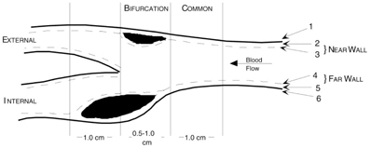
Dynamics of plaque formation
Ref: 10
The presence of atherosclerotic plaques is closely related to vessel geometry – carotid bifurcation, coronary arteries, infrarenal aorta & lower limb vessels
Positive correlation between plaque thickness and presence of low shear stress, departure of unidirectional flow and regions of low separation and recirculation
Comparison between flow velocity measurements and plaque distribution shows that the outer wall of the carotid sinus (shear stress/velocities = low) has maximal plaque thickness compared to inner wall

Slide 13
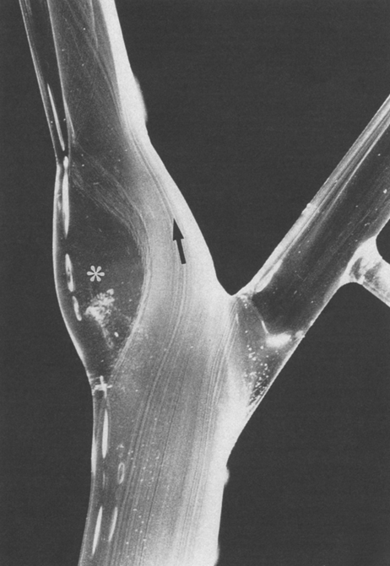
Dynamics of plaque formation
Ref: 4
“Hydrogen bubble flow visualization in a glass model carotid bifurcation. Flow is laminar along the inner wall of the internal carotid artery (arrow), where velocity and shear stress are high.”
“The cross-sectional diameter of the carotid bulb is twice that of the distal internal carotid artery, which results in a larger area of flow separation and stasis, low shear stress, increased particle residence time, and oscillation of shear stress direction (∗).”
“These hemodynamic features are associated with plaque deposition in this region of the carotid bifurcation.”

Slide 14
Extracranial US Imaging

Slide 15
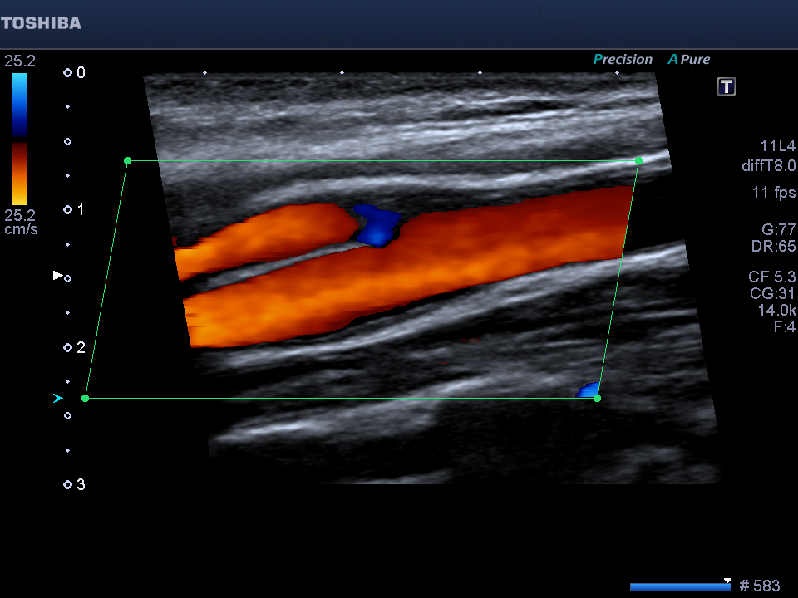
Where to sample?
Proximal ECA
(Beyond the origin to allow for normalisation of entry flow)
Distal CCA
(~1cm proximal to bifurcation)
Proximal ICA – no significant stenosis
(Beyond the origin to allow for normalisation of entry flow)

Slide 16
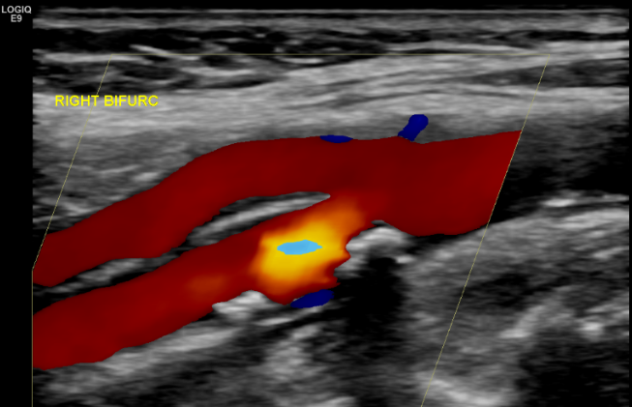
Where to sample?
Proximal ECA
(Beyond the origin to allow for normalisation of entry flow)
Distal CCA
(~1cm proximal to bifurcation)
Proximal ICA – haemodynamically significant stenosis
(Adjust colour gain + PRF to highlight the point of highest velocity)

Slide 17
Case study – normal carotid duplex

Slide 18
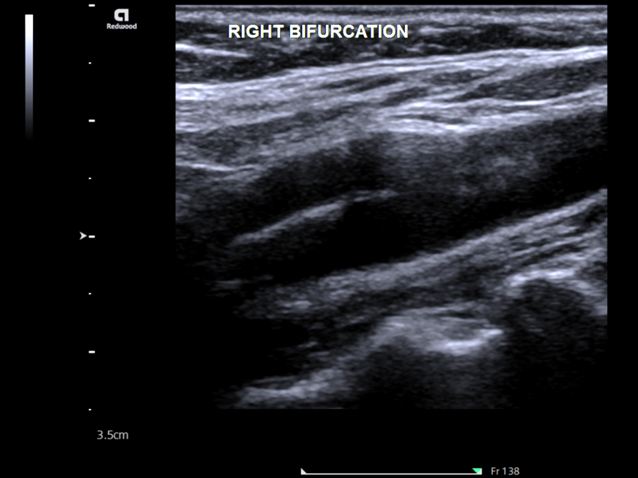
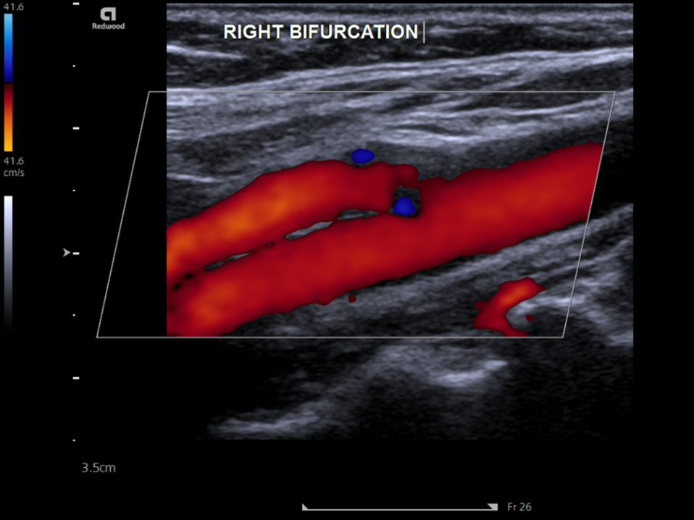
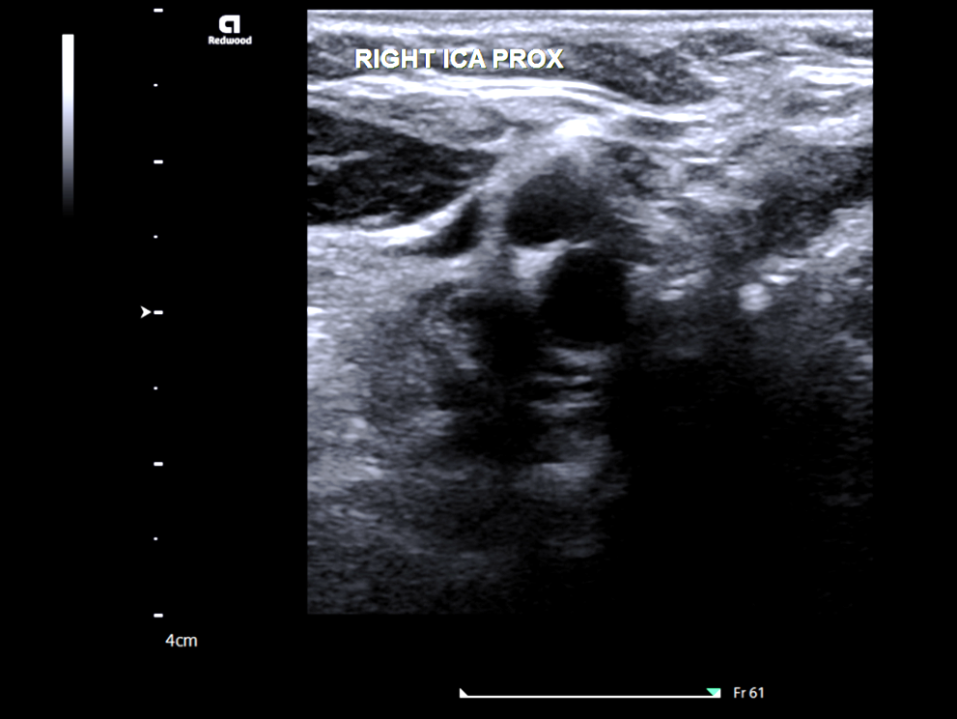
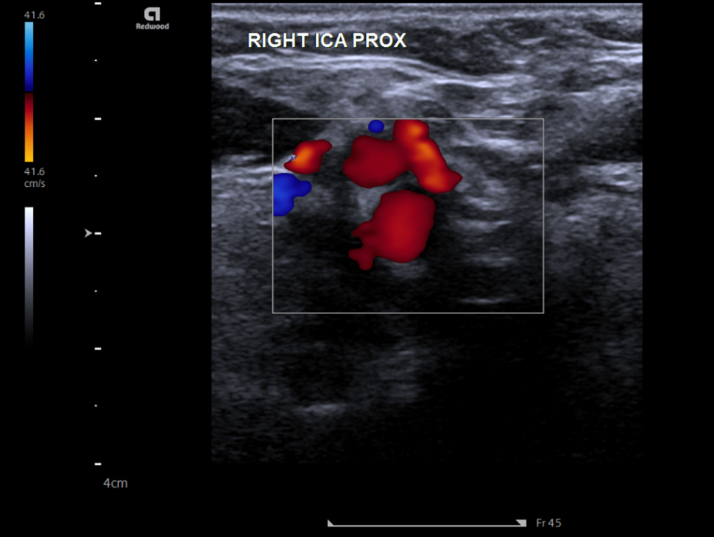

Slide 19
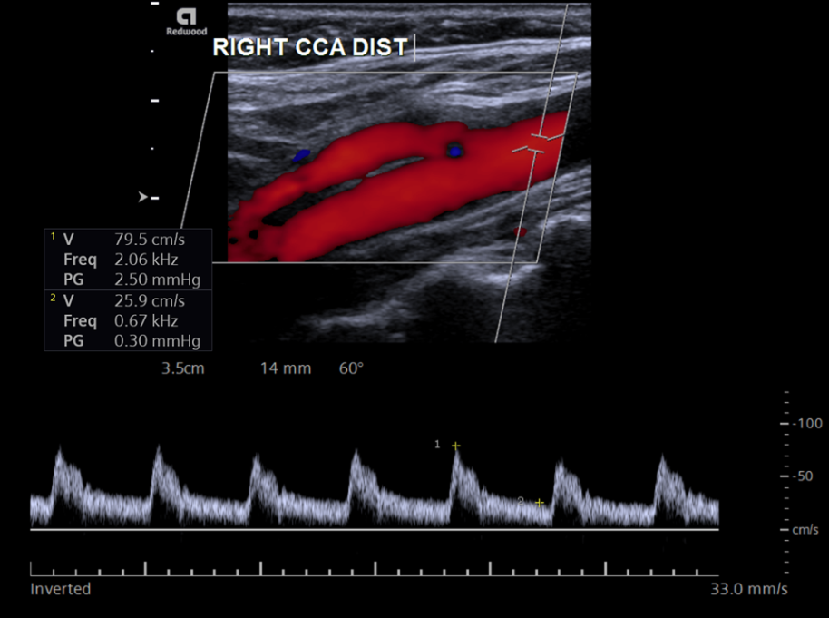
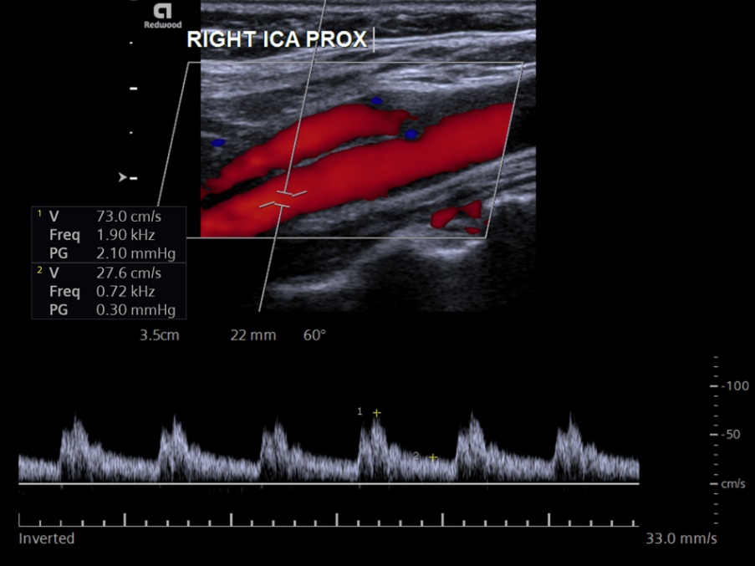
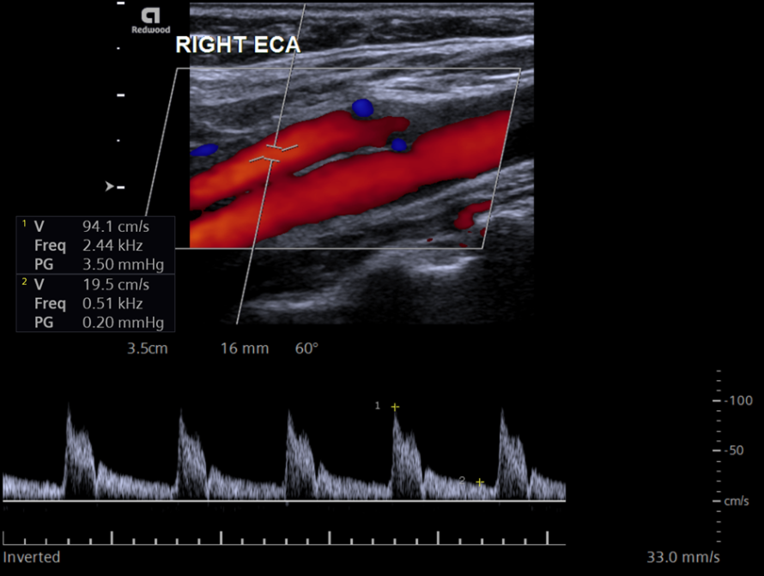
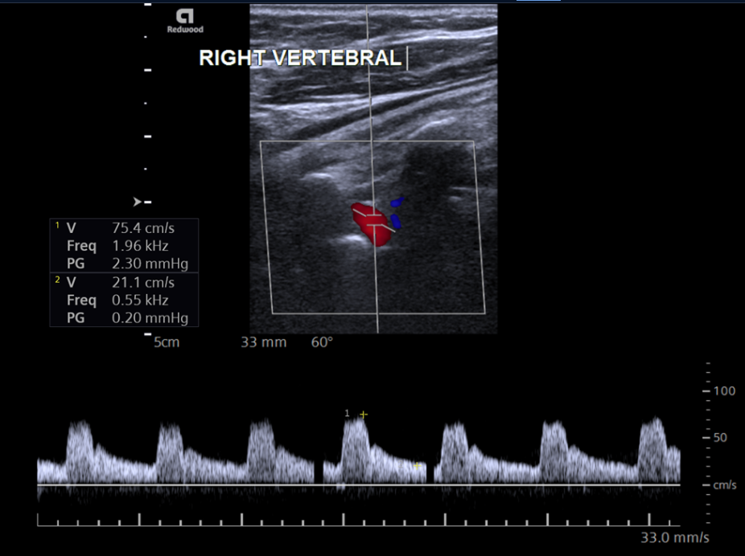

Slide 20
NASCET Trial, 1998
(North American Symptomatic Endarterectomy Trial)
Ref: 1
The first large, well-designed trial to study carotid endarterectomy in patients with low-moderate (<50%), high-moderate (50-69%) and severe (70-99%) stenosis
2,226 patients with symptomatic carotid stenosis
Outcomes (CEA vs medical management):
  Ipsilateral stroke at 5yrs (50-69% stenosis) – 15.7% vs 22.2%
  Ipsilateral stroke at 5yrs (<50% stenosis) – 14.9% vs 18.7%
  Death or stroke at 30 days (50-69% stenosis) – 33.2% vs 43.3%
  Death or stroke at 30 days (<50% stenosis) – 36.2% vs 37%
  Patients in the 70-99% stenosis subgroup received such a dramatic benefit that this study arm was prematurely stopped and all patients were subsequently referred for CEA

Slide 21
ECST Trial, 1998
(European Carotid Surgery Trial)
Ref: 7
3,024 patients with symptomatic carotid stenosis
CEA significantly reduced the rate of major stroke or death compared to usual medical care (14.9% vs 26.5%) in patients with 80-99% stenosis, but not in patients with <80% stenosis
This is a notably different finding to the NASCET study likely due to the differences in grading stenoses between the two studies
Subsequent analyses of patient-level data shows that CEA is of moderate benefit in patients with 50-69% symptomatic stenosis, and is highly beneficial in patients with 70-99% stenosis.

Slide 22
Grading Stenoses:
Velocity Criteria

Slide 23
v
A
Q = Av
  Volume flow = area x velocity
Q = volume flow
A = intraluminal area
v = blood velocity
E = total energy
P = pressure
ρ = blood density
h = height above heart
g = gravitational acceleration (9.81m²)
v = blood velocity

Slide 24
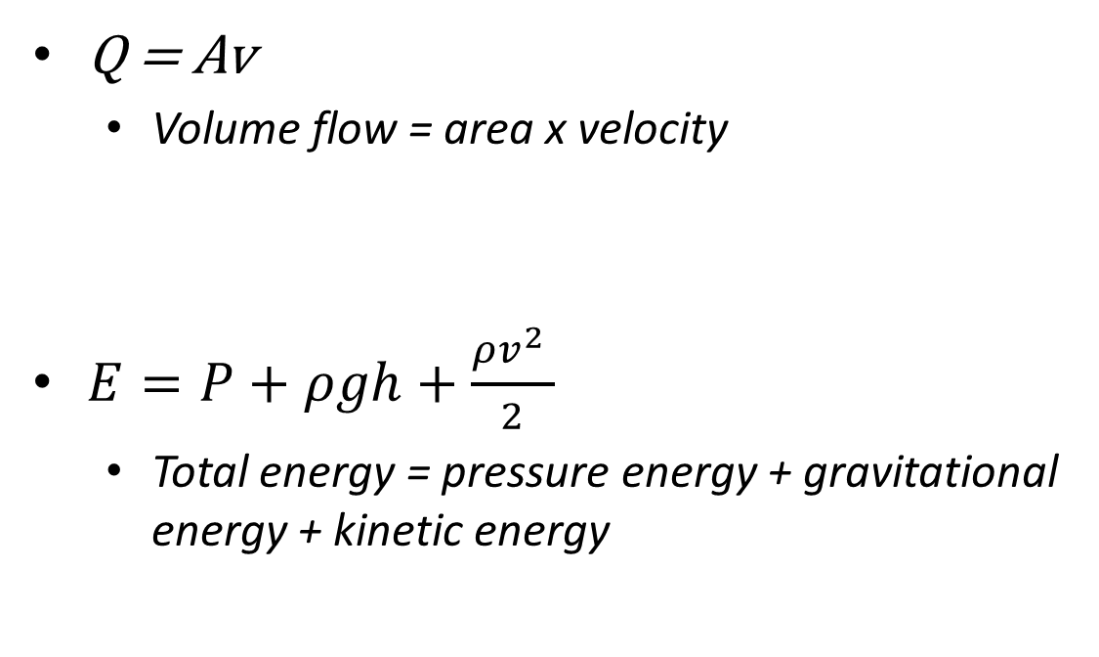
v
A
Q = Av
  Volume flow = area x velocity
$E=P+ρgh+\frac{{ρv^{2}}_{ }}{2}$
  Total energy = pressure energy + gravitational energy + kinetic energy
Q = volume flow
A = intraluminal area
v = blood velocity
E = total energy
P = pressure
ρ = blood density
h = height above heart
g = gravitational acceleration (9.81m²)
v = blood velocity

Slide 25
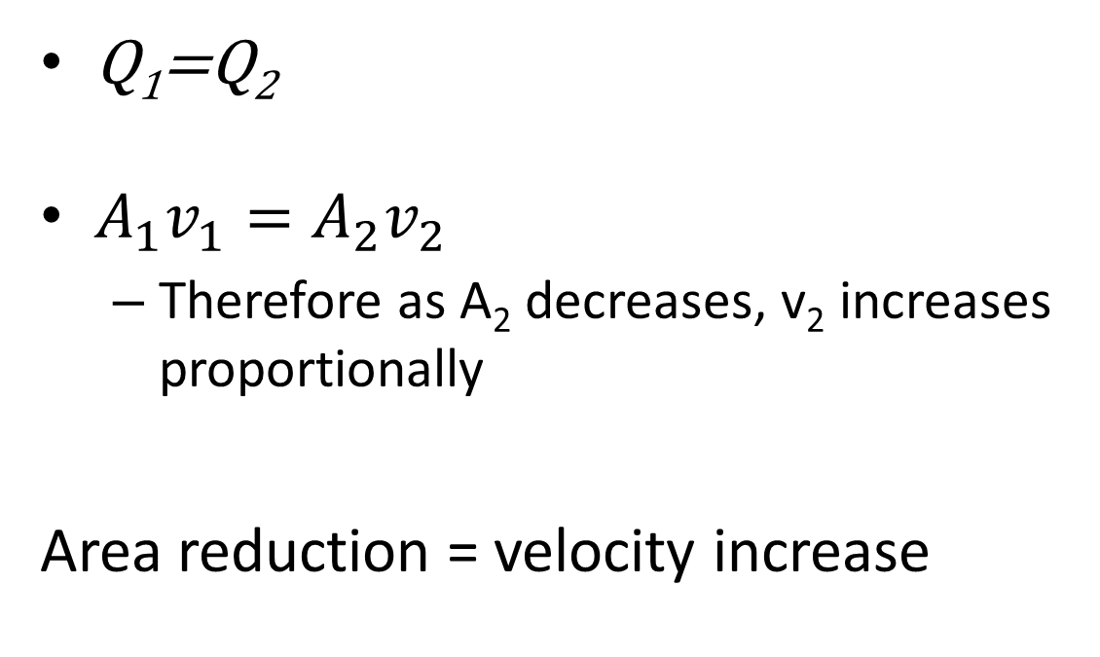
Q₁
Q₂
v₁
v₂
A₁
A₂
Q₁=Q₂
$A_{1}v_{1}=A_{2}v_{2}$
  Therefore as A₂ decreases, v₂ increases proportionally
Area reduction = velocity increase
Q = volume flow
A = intraluminal area
v = blood velocity
E = total energy
P = pressure
ρ = blood density
h = height above heart
g = gravitational acceleration (9.81m²)
v = blood velocity

Slide 26
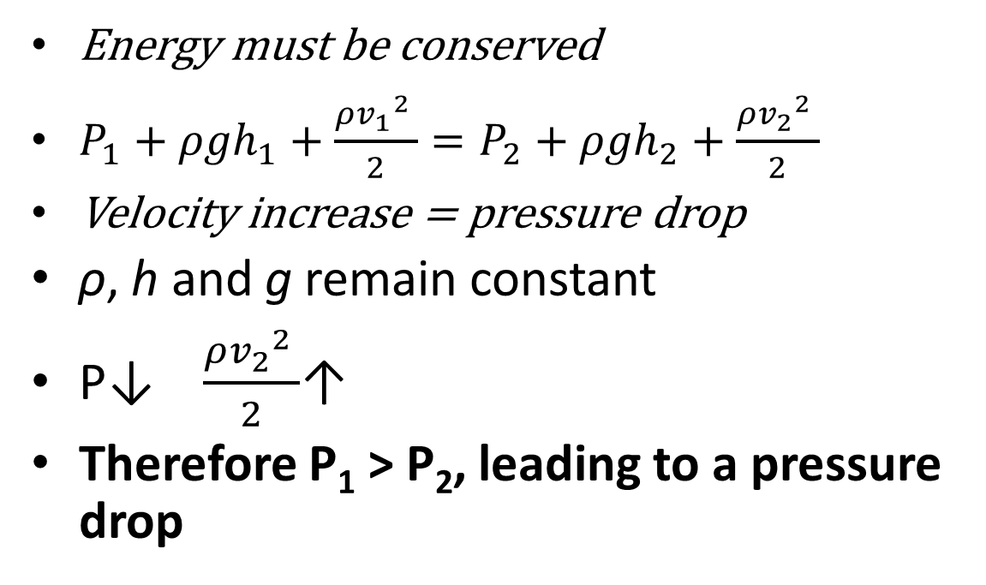
P₁
P₂
v₁
v₂
A₁
A₂
Energy must be conserved
$P_{1}+{ρgh}_{1}+\frac{{ρ{v_{1}}^{2}}_{ }}{2}=P_{2}+{ρgh}_{2}+\frac{{ρ{v_{2}}^{2}}_{ }}{2}$
Velocity increase = pressure drop
ρ, h and g remain constant
P↓ $\frac{{ρ{v_{2}}^{2}}_{ }}{2}$↑
Therefore P₁ > P₂, leading to a pressure drop
Q = volume flow
A = intraluminal area
v = blood velocity
E = total energy
P = pressure
ρ = blood density
h = height above heart
g = gravitational acceleration (9.81m²)
v = blood velocity

Slide 27
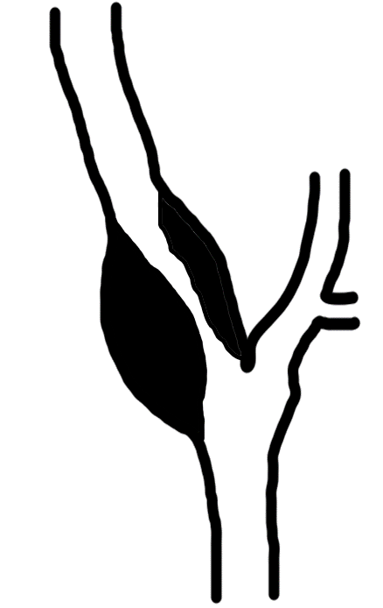
Simply put:
ICA
Diameter = 3.0mm
Velocity = 140cm/s
As intraluminal area decreases, velocity increases
As the velocity increase is proportional to the reduction in vessel diameter, the change in velocity can be used to grade the degree of stenosis
CCA
Diameter = 6.0mm
Velocity = 70cm/s

Slide 28
NASCET velocity criteria
Stenosis | ICA PSV (cm/s) | ICA EDV (cm/s) | PSV ratio (ICA_{PSV}/CCA_{PSV}) | St. Mary’s ratio (ICA_{PSV}/CCA_{EDV})
0-29% | <100 | <40 | <2.0 | <8
30-49% | <110-130 | <40 | <2.0 | <8
50-59% | >130 | <40 | ≥2.0 | 8 – 10
60-69% | >130 | 40-110 | 3.2 – 4.0 | 11 – 13
70-79% | ≥230 | 110-140 | >4.0 | 14 – 21
80-89% | ≥230 | >140 | >4.0 | 22 – 29
>90% | ≥400 | >140 | >5.0 | >30
Sub-occlusion | Trickle flow – likely damped waveforms with low flow
Total occlusion | No flow

Slide 29
NASCET velocity criteria
Stenosis | ICA PSV (cm/s) | ICA EDV (cm/s) | PSV ratio (ICA_{PSV}/CCA_{PSV}) | St. Mary’s ratio (ICA_{PSV}/CCA_{EDV})
0-29% | <100 | <40 | <2.0 | <8
30-49% | <110-130 | <40 | <2.0 | <8
50-59% | >130 | <40 | ≥2.0 | 8 – 10
60-69% | >130 | 40-110 | 3.2 – 4.0 | 11 – 13
70-79% | ≥230 | 110-140 | >4.0 | 14 – 21
80-89% | ≥230 | >140 | >4.0 | 22 – 29
>90% | ≥400 | >140 | >5.0 | >30
Sub-occlusion | Trickle flow – likely damped waveforms with low flow
Total occlusion | No flow

Slide 30
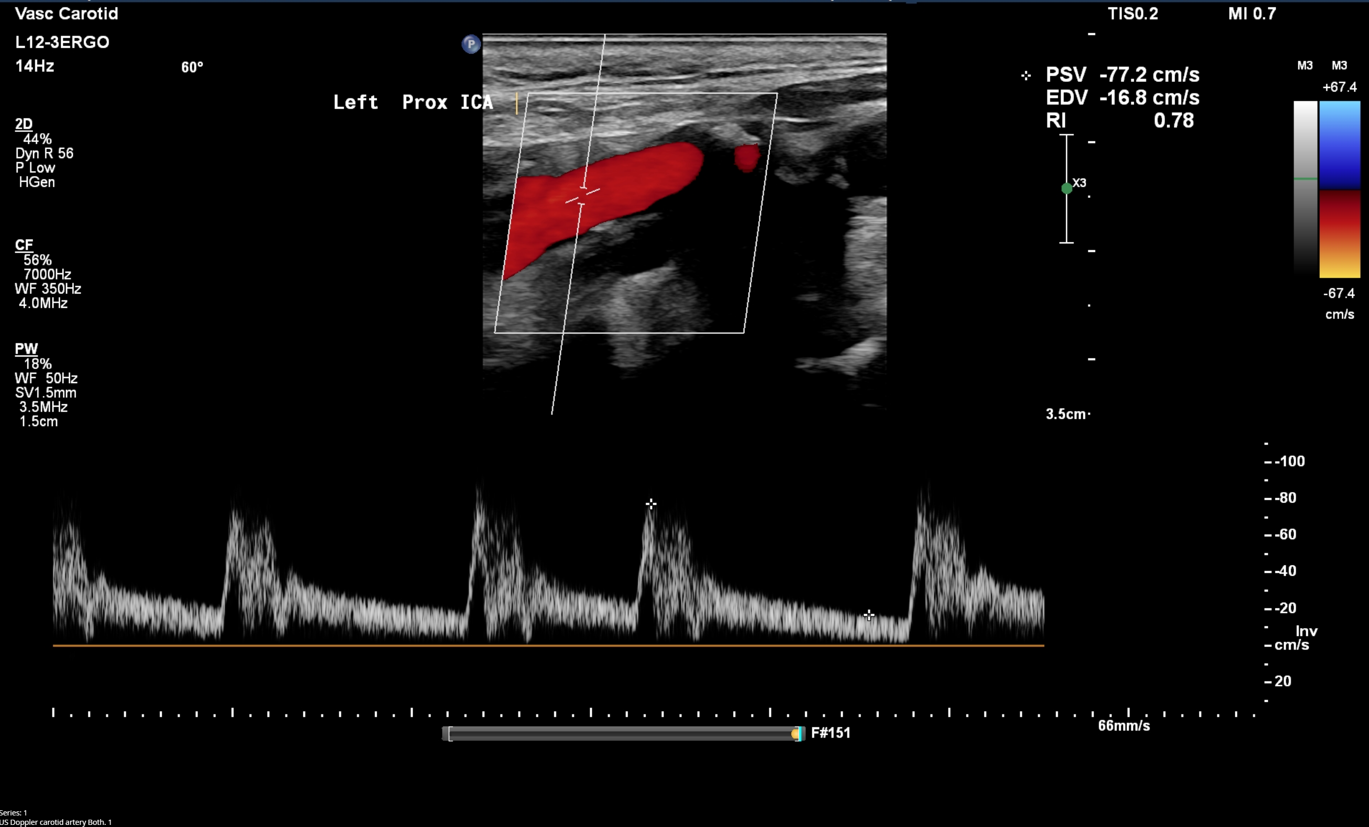
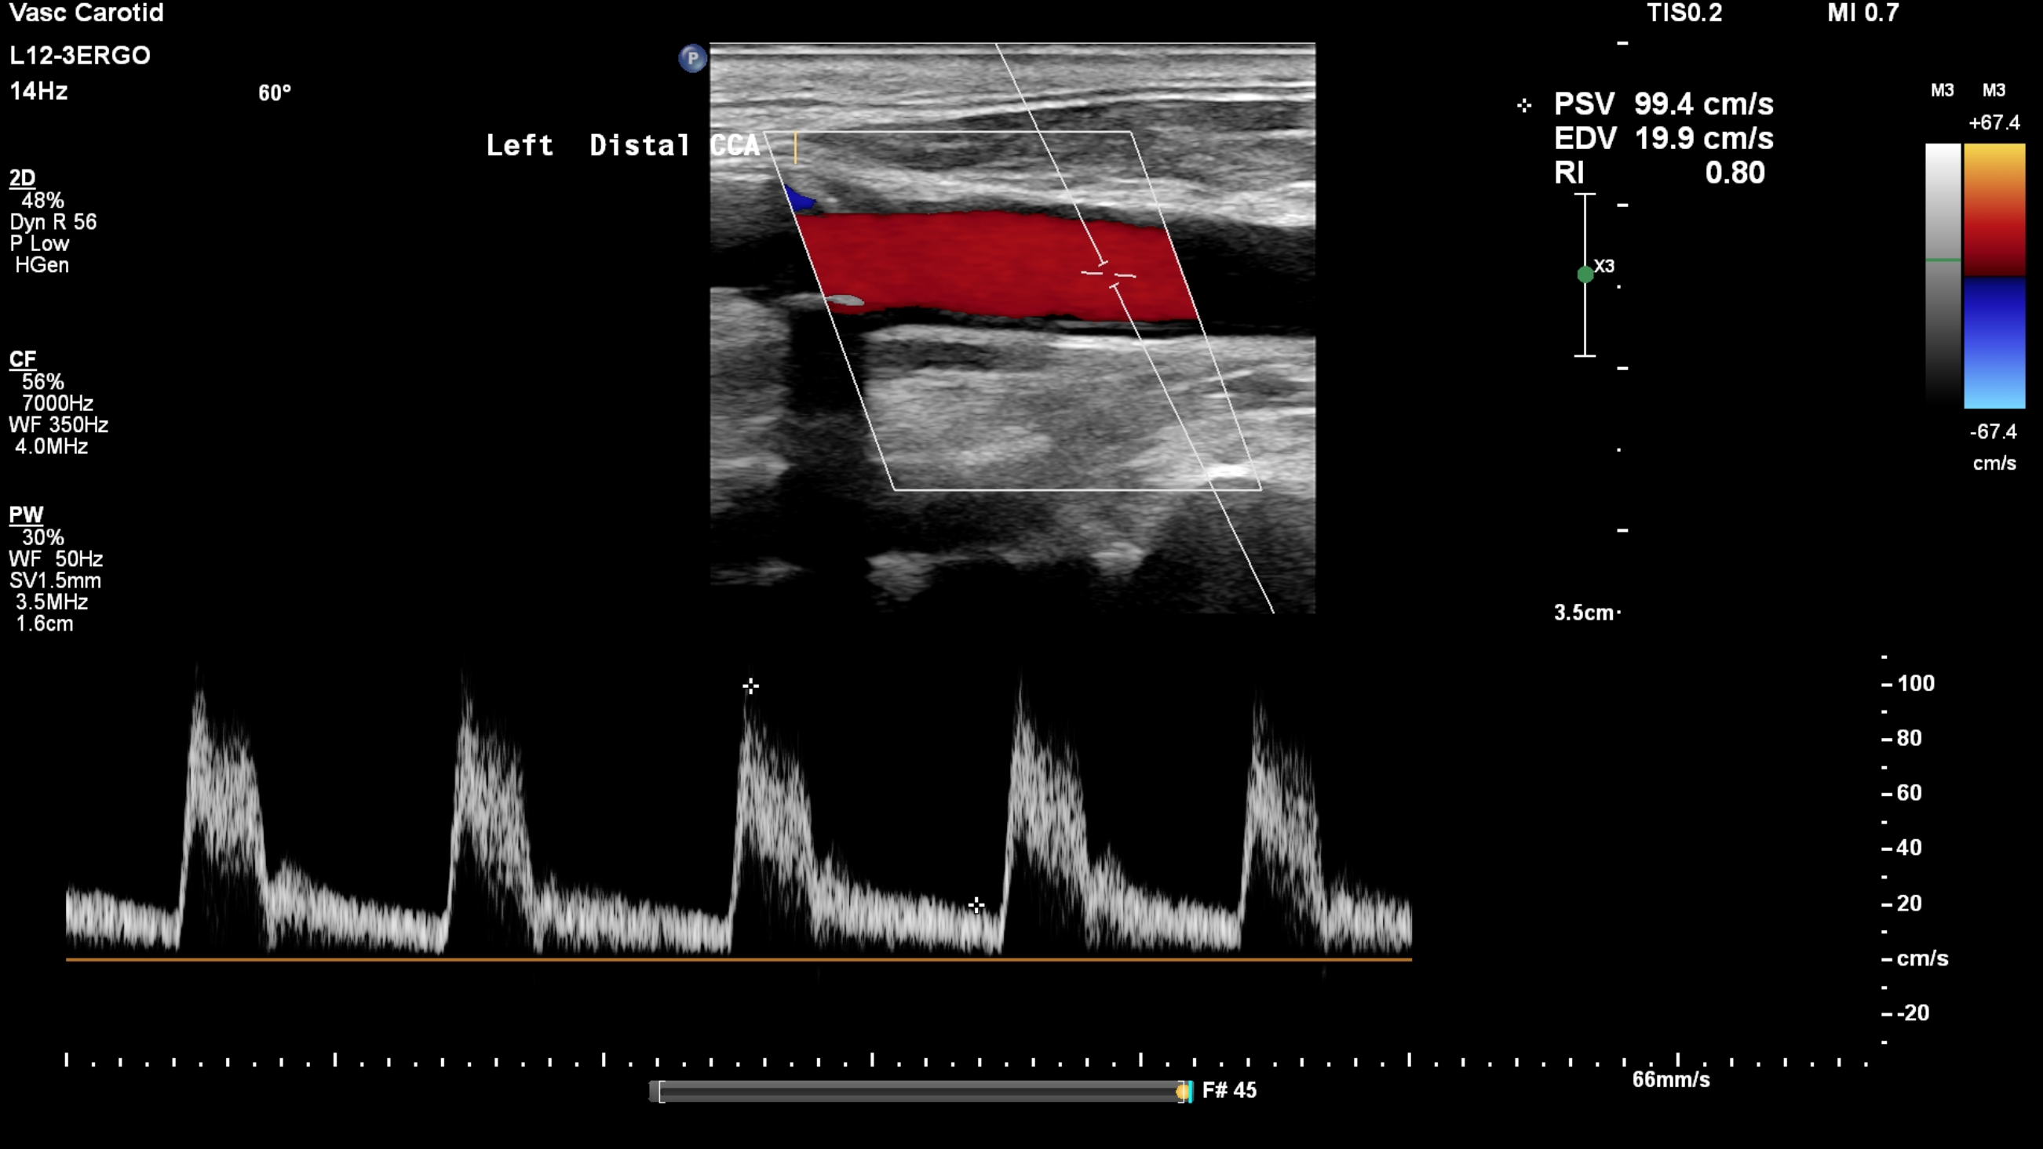
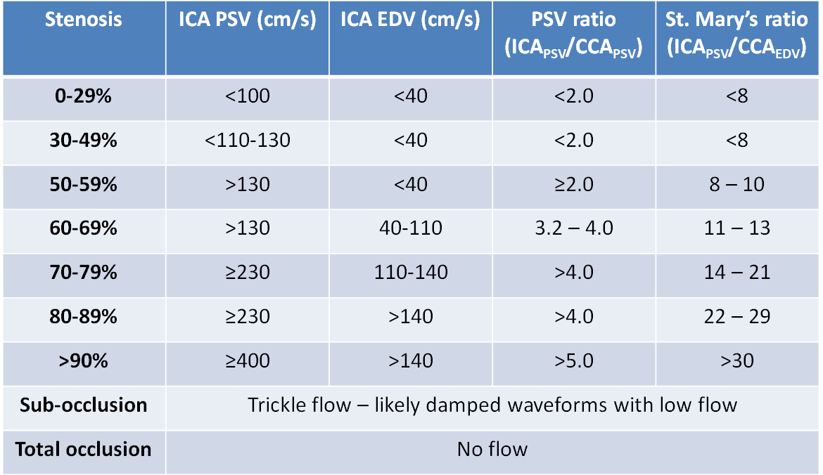
ICA_{PSV} – 73cm/s
ICA_{EDV} – 28cm/s
ICA_{PSV}/CCA_{PSV} – 0.9
ICA_{PSV}/CCA_{EDV} – 1.1

Slide 31
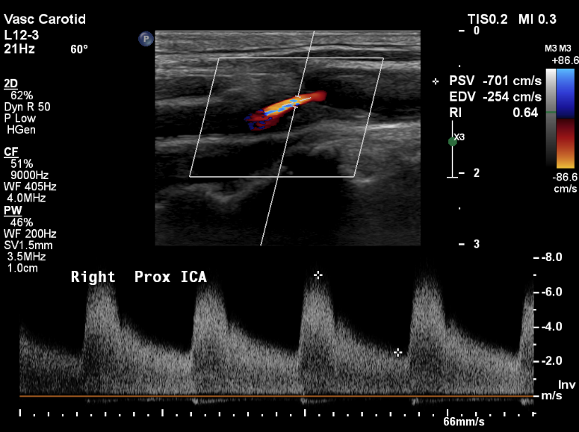
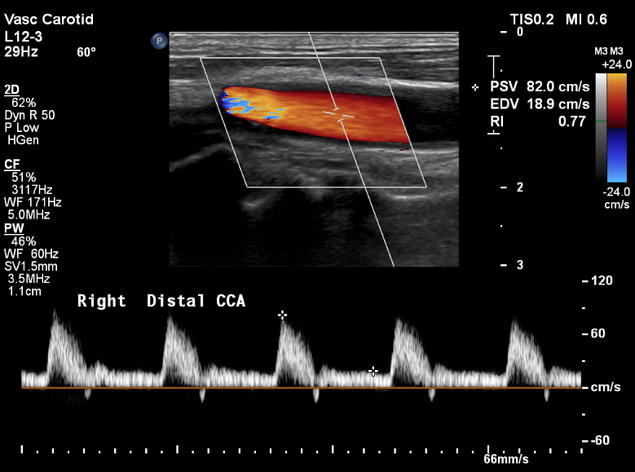
ICA_{PSV} – 701cm/s
ICA_{EDV} – 254cm/s
ICA_{PSV}/CCA_{PSV} – 8.5
ICA_{PSV}/CCA_{EDV} - 37
>90% stenosis

Slide 32
Grading Stenoses:
Luminal Reduction Criteria

Slide 33
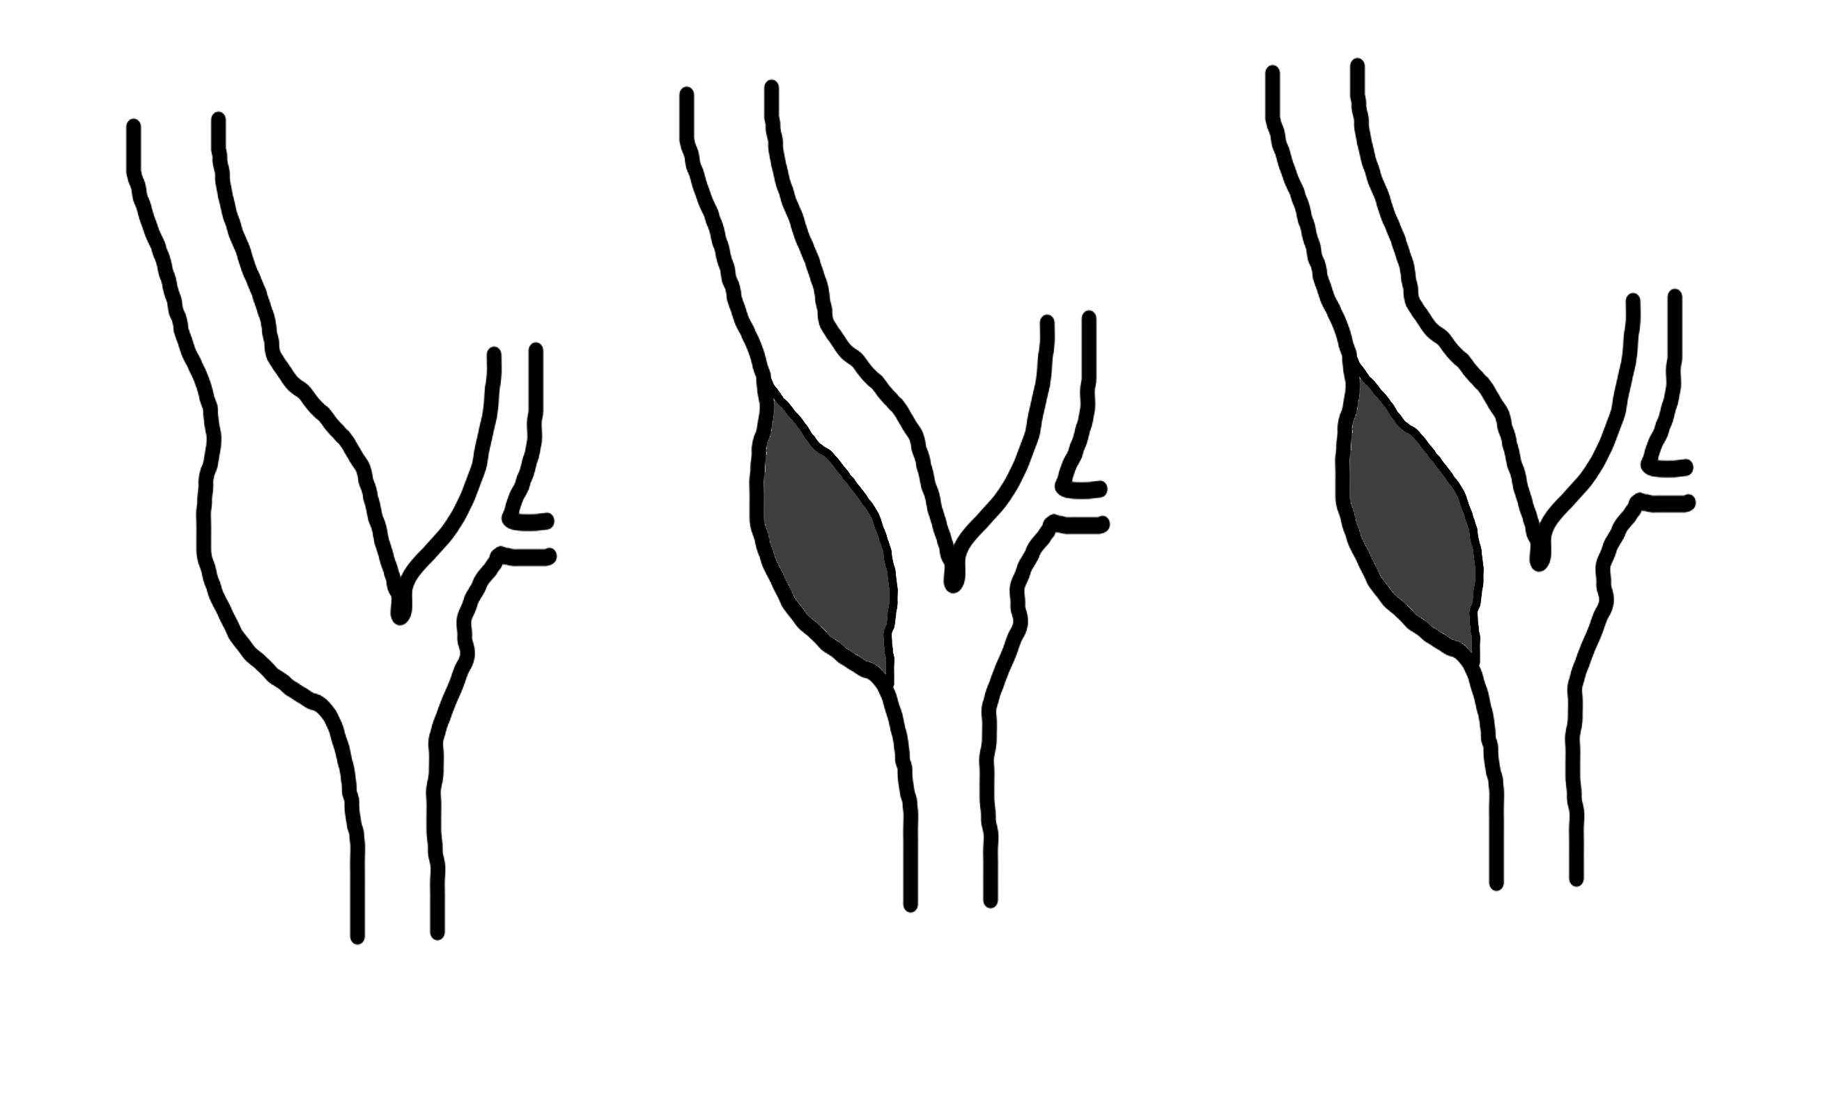
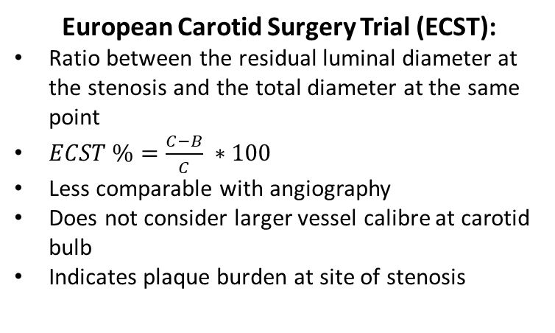
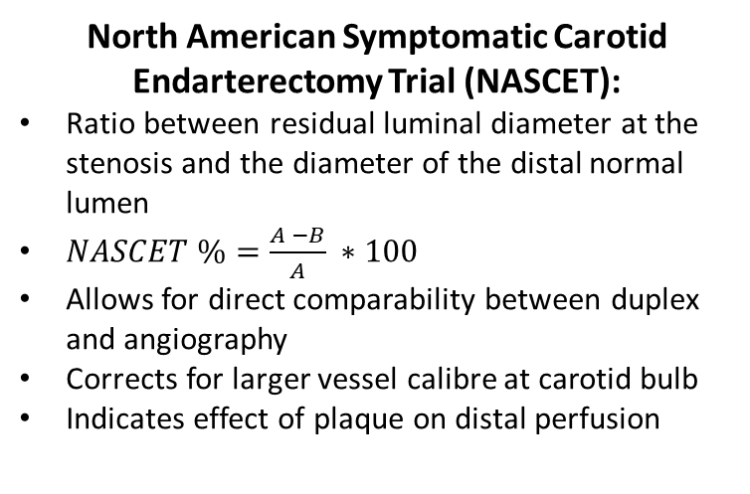
A
B
B
C
North American Symptomatic Carotid Endarterectomy Trial (NASCET):
Ratio between residual luminal diameter at the stenosis and the diameter of the distal normal lumen
$NASCET \%=\frac{A −B}{A} ∗100$
Allows for direct comparability between duplex and angiography
Corrects for larger vessel calibre at carotid bulb
Indicates effect of plaque on distal perfusion
European Carotid Surgery Trial (ECST):
Ratio between the residual luminal diameter at the stenosis and the total diameter at the same point
$ECST \%=\frac{C−B}{C} ∗100$
Less comparable with angiography
Does not consider larger vessel calibre at carotid bulb
Indicates plaque burden at site of stenosis

Slide 34
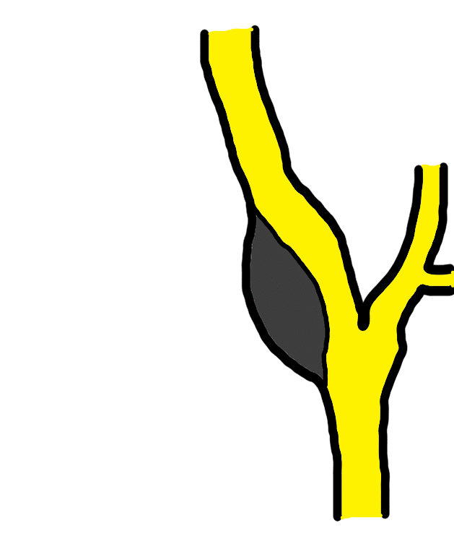
Comparison with CTA
Distal ICA
Contrast fills non-diseased distal ICA, allowing for measurement of distal lumen
Proximal ICA
Contrast fills residual lumen, allowing for measurement of patent segment at the stenosis
Contrast doesn’t fill diseased vessel due to plaque, making total vessel measurement less reliable

Slide 35
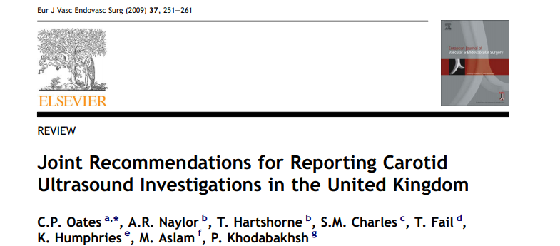
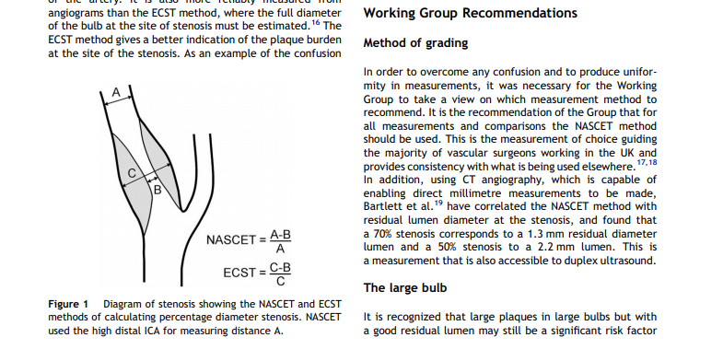
Ref: 11

Slide 36
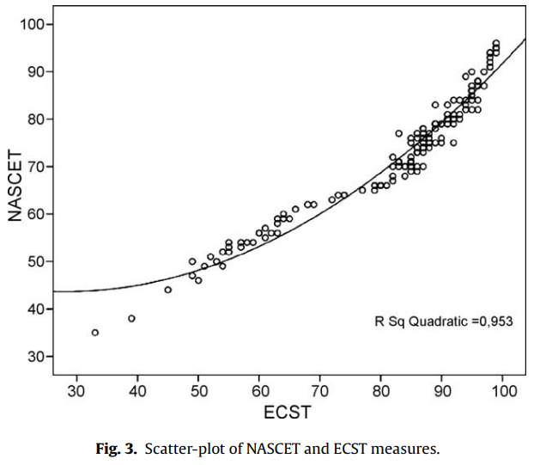
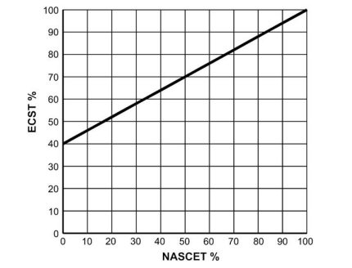
NASCET and ECST agreement depends upon degree of stenosis
Refs: 11, 13, 14
NASCET criteria: ratio between residual luminal surface at the stenosis and the surface of the distal normal lumen
ECST criteria: ratio between the residual luminal surface at the stenosis and the total surface
Pearson coefficient = 0.962 (p<0.00001)
NASCET stenosis of 50% ≈ ECST stenosis of 70%
NASCET stenosis of 70% ≈ ECST stenosis of 83%
Differences were larger in low-grade stenosis (<70%); high-grade stenosis (>70%) shows better agreement

Slide 37


NASCET and ECST agreement is highly dependent on carotid anatomy
4.0mm
4.0mm
3.0mm
3.0mm
8.0mm
8.0mm
Large carotid bulb – proximal ICA ~2x the diameter of the mid-distal ICA
NASCET stenosis calculation:
$$\frac{4.0mm −3.0mm}{4.0mm}=25\%$$
ESCT stenosis calculation:
$$\frac{8.0mm −3.0mm}{8.0mm}=62.5\%$$
Large bulb compared to distal ICA – ECST grading will be significantly higher than NASCET grading

Slide 38
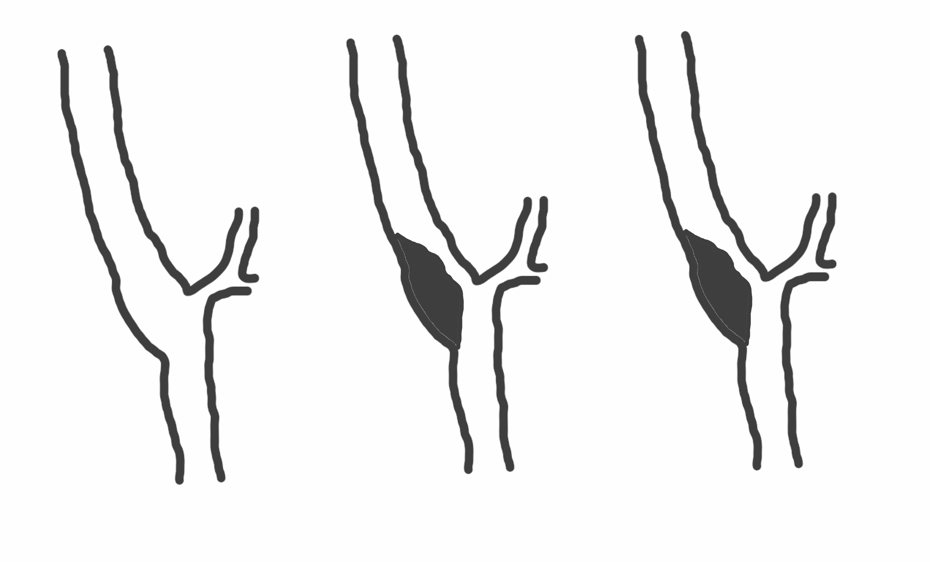


NASCET and ECST agreement is highly dependent on carotid anatomy
4.0mm
4.0mm
1.0mm
1.0mm
5.0mm
5.0mm
Small carotid bulb – ICA roughly the same size throughout
NASCET stenosis calculation:
$$\frac{4.0mm −1.5mm}{4.0}=75\%$$
ESCT stenosis calculation:
$$\frac{5.0mm −1.0mm}{5.0mm}=80\%$$
Small bulb compared to distal ICA – ECST and NASCET gradings are more likely to agree

Slide 39
Case study – diseased carotid duplex

Slide 40
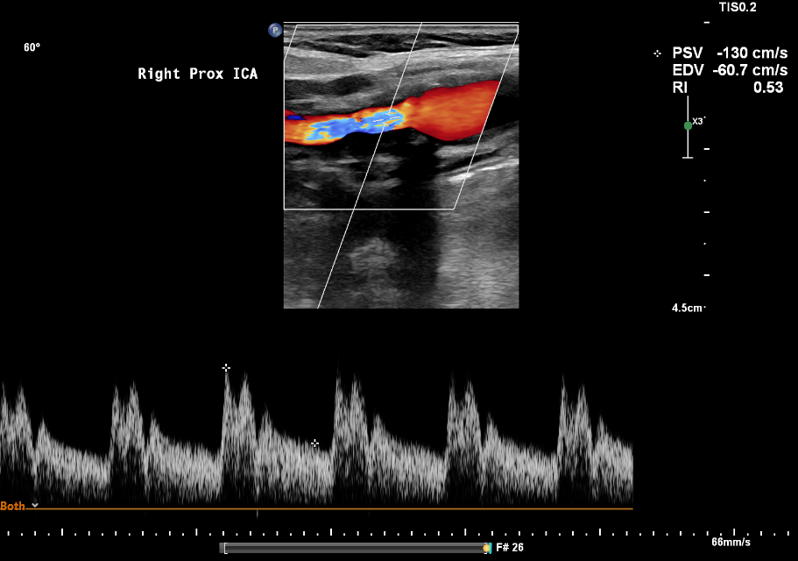
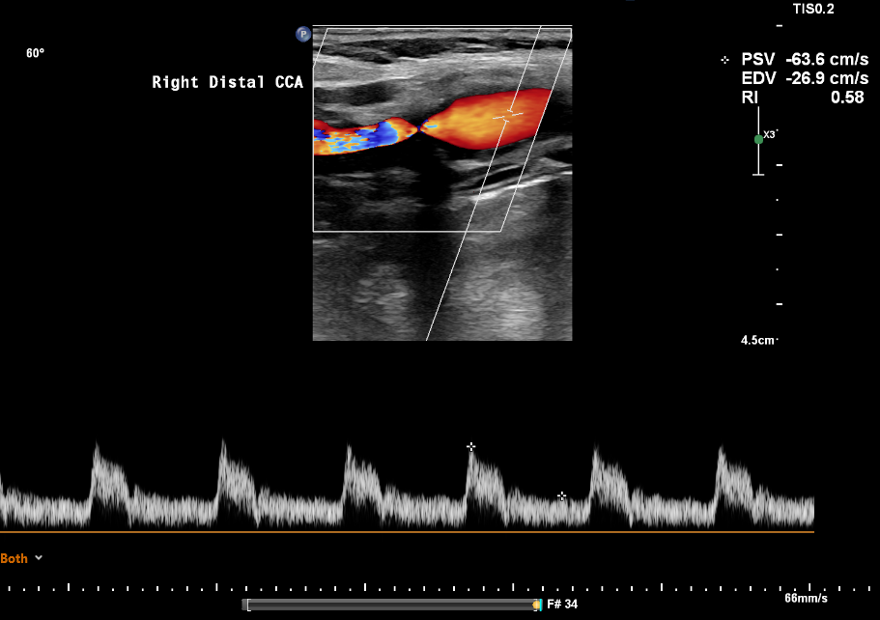
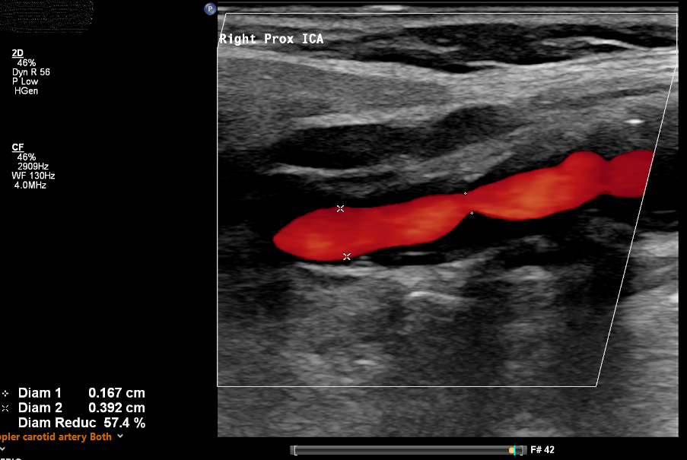

NASCET
ECST

Slide 41
ICA_{PSV} = 130cm/s
ICA_{EDV} = 61cm/s
ICA_{PSV}/CCA_{PSV} = 2.04
NASCET caliper reduction = 57%
Grading: 50-59% stenosis
NASCET
ECST

Slide 42
Carotid plaque morphology
Plaque descriptors:
  Surface – smooth, irregular, ulcerated
  Morphology – echogenic, echolucent, mixed, calcified
Echogenicity:
  Dense plaques tend to be harder and more fibrous/calcified
    These plaques generate stronger echo signals, and thus appear bright on US imaging (echogenic)
  Less dense plaques tend to be softer and contain intraplaque haemorrhage or a necrotic core
    These plaques generate weaker echo signals, and thus appear darker on US imaging (echolucent)

Slide 43

Plaque morphology
Echolucent / hypoechoic plaque

Slide 44

Plaque morphology
Mixed, predominantly echolucent plaque

Slide 45

Plaque morphology
Mixed, predominantly echogenic plaque

Slide 46

Plaque morphology
Echogenic plaque

Slide 47

Plaque morphology
Calcified plaque – causing acoustic shadowing

Slide 48
Pitfalls and limitations
Calcified plaque causes acoustic shadowing
  Adjust the scan plane to avoid the plaque
  Sample immediately proximal and distal to the plaque to investigate flow changes
  Use a lower frequency probe
Imaging complicated by tortuous vessels
  Use a curved-array probe to gain a wider field of view to follow the vessels more easily
Unable to differentiate between ICA and ECA
  Look for proximal branches (ECA)
  Follow distally to see if the artery dives deep (ICA)
  Tap the temple and look for percussive waves (ECA, but can transmit to the ICA if done too hard)

Slide 49




Pitfalls and limitations
Calcified plaque causes acoustic shadowing
  Adjust the scan plane to avoid the plaque
  Sample immediately proximal and distal to the plaque to investigate flow changes
  Use a lower frequency probe
Imaging complicated by tortuous vessels
  Use a curved-array probe to gain a wider field of view to follow the vessels more easily
Unable to differentiate between ICA and ECA
  Look for proximal branches (ECA)
  Follow distally to see if the artery dives deep (ICA)
  Tap the temple and look for percussive waves (ECA, but can transmit to the ICA if done too hard)

Slide 50
Case study – the importance of colour Doppler!

Slide 51




Slide 52



ICA occlusion – the importance of colour

Slide 53

Remember – never just rely on B-mode imaging alone
Hypoechoic plaque/thrombus may appear dark on US imaging and may not be immediately visible
Use B-mode, colour and spectral Doppler to assess patency of vessels

Slide 54
Case study – assess the whole vessel!

Slide 55







Slide 56





Slide 57

Remember – whilst the carotid bulb is the most common site for atherosclerotic disease, cerebrovascular events may arise as a result of lesions in the proximal or distal extracranial vessels also
Be sure to assess the proximal common carotid artery to investigate for central stenosis, and scan as distally as possible in the internal carotid artery to assess for distal disease

Slide 58
Additional pathology – subclavian steal
Transient or complete reversal of flow in the vertebral artery
Caused by proximal obstruction in the subclavian artery
Collateralisation of flow via the contralateral vertebral vessel
‘Steals’ from vertebrobasilar circulation to perfuse the upper limb

Slide 59

BA
VA
SCA
No subclavian disease – no steal
Orthograde flow in both vertebral arteries, converging at the basilar artery to perfuse the posterior cerebral circulation

Slide 60
No steal – normal vertebral waveform, continuous low-resistance orthograde flow throughout the cardiac cycle

Slide 61

BA
VA
SCA
Proximal subclavian occlusion – complete steal
Retrograde collateralisation of the left vertebral artery via the right side to perfuse the left upper limb

Slide 62

Complete steal waveform – retrograde flow throughout the cardiac cycle

Slide 63

Systole
Diastole
BA
VA
SCA
Proximal subclavian stenosis – transient steal
Orthograde flow in left vertebral artery during systole due to pressure of ventricular contraction
Retrograde flow in left vertebral artery during diastole as pressure decreases

Slide 64

Systole – orthograde flow
Diastole– retrograde flow
Transient steal waveform – orthograde flow during systole with retrograde flow during diastole

Slide 65

Pre-steal waveform – “the vertebral bunny”
Usually seen with mild-moderate subclavian stenosis
Characteristic mid-systolic deceleration indicative of proximal obstruction

Slide 66

Inflation and rapid deflation of a pressure cuff on the ipsilateral arm can generate a hyperaemic response in the limb, which will turn the transient steal waveform (A) into the total steal waveform (B)

Slide 67



Additional pathology – carotid dissection

Slide 68


Additional pathology – carotid body tumour
Identifiable by ‘splaying’ ICA and ECA around the tumour
May be highly vascularised – can be detected using colour Doppler

Slide 69
References
Barnett HJ.,Taylor DW., Eliasziw M., Fox AJ., Ferguson GG., Haynes RB., Rankin RN., Clagett GP., Hachinski VC., Sackett DL., Thorpe KE., Meldrum HE., Spence JD. Benefit of carotid endarterectomy in patients with symptomatic moderate or severe stenosis. The New England Journal of Medicine. 1998. 339(20):1415-25.
Borne RT., Aghel A., Patel AC., Rogers RK. Innominate Steal Syndrome: A Two Patient Case Report and Review. AIMS Medical Science. 2015. 2 (4), 360-370.
Boßelmann, C., Poli S. Sonographic features of carotid artery dissection due to extension of aortic dissection: a case report. Ultrasound Journal. 2019. 11, 32/
Botnar R., Rappitsch, G., Scheidegger, M.B., Liepsch, D., Perktold, K., Boesiger, P. Hemodynamics in the carotid artery bifurcation: a comparison between numerical simulations and in vitro MRI measurements. Journal of Biomechanics. 2000. 33, 137–144.
Charlton-Ouw KM., Sandhu HK., Burgess W., Vasquez M., Estrera AL., Azizzadeh A., Coogan SM., Safi HJ. Duplex Ultrasound Protocol and Findings in Common Carotid Artery Dissection Extending from the Aortic Arch. Journal for Vascular Ultrasound. 2018. 38 (2), 80-86.
Deng, F., Goel, A.. (2021). Doppler waveforms. Available: https://radiopaedia.org/articles/doppler-waveforms?lang=gb. Last accessed 28/04/2021.
ECST Writers. Randomised trial of endarterectomy for recently symptomatic carotid stenosis: Final results of the MRC European Carotid Surgery Trial (ECST). The Lancet. 1998. 351(9113):1379-1387.
Francolin P., Chierighini L., Romualdo A., Chammas M., Cerri G. Collateral circulation in carotid and vertebral territory: Color Doppler analysis. 2015. 10.1594/ecr2015/C-0069.
Gustavson S., Olin JW. Images in vascular ultrasound: A clue to the diagnosis of internal carotid artery occlusion. Vascular Medicine. 2002. 7, 333-335.
Kaufman JD., Adar SD., Barr RB., Budoff M., Burke GL., Curl CL., Daviglus ML., Diez Roux AV., Gassett AJ., Jacobs DR., Kronmal R., Larson TV., Navas-Acien A., Olives C., Sampson PD., Sheppard L., Siscovick DS., Stein JH., Szpiro AA., Watson KE. Association between air pollution and coronary artery calcification within six metropolitan areas in the USA (The Multi-Ethnic Study of Atherosclerosis and Air Pollution): a longitudinal cohort study. The Lancet. 2016.
Oates CP., Naylor AR., Hartshorne T., Fail T., Humphries K., Aslam M., Khodabakhsh P.. (2009). Joint recommendations for reporting carotid ultrasound investigations in the United Kingdom. European Journal of Vascular and Endovascular Surgery. 2009. 37 (3), 251-261.
RadiologyKey. (2016). Ultrasound Assessment of the Vertebral Arteries. Available: https://radiologykey.com/ultrasound-assessment-of-the-vertebral-arteries/. Last accessed 28/04/2021.
Rerkasem K., Rothwell PM. Carotid endarterectomy for symptomatic carotid stenosis. Cochrane Database of Systematic Reviews. 2011. Issue 4.
Saba L., Mallarini G. A comparison between NASCET and ECST methods in the study of carotids evaluation using Multi-Detector-Row CT angiography. European Journal of Radiology. 2009. 76 (2010) 42-47.
ThoracicKey. (2017). Extracranial Carotid and Vertebral Arteries. Available: https://thoracickey.com/extracranial-carotid-and-vertebral-arteries-2/. Last accessed 28/04/2021.
Thorup M. (2021). Subclavian Steal Syndrome. Available: http://ncus.org/subclavian.pdf. Last accessed 28/04/21.
Tong, Y. Role of duplex ultrasound in the diagnosis and assessment of carotid body tumour: A literature review. Intractable & rare diseases research. 2012. 1. 129-33. 10.5582/irdr.v1.3.129.
Vecera J., Vojtísek P., Varvarovsky I., Lojík M., Másová K., Kvasnicka J. Non-invasive diagnosis of coronary-subclavian steal: Role of the Doppler ultrasound. European journal of echocardiography : the journal of the Working Group on Echocardiography of the European Society of Cardiology. 2010. 11. E34. 10.1093/ejechocard/jeq068.
Zarins CK., Xu C. (2016). Pathology of Carotid Artery Atherosclerosis. Available: https://thoracickey.com/pathology-of-carotid-artery-atherosclerosis/. Last accessed 28/04/2021.
Zarins CK., Giddens DP., Bharadvaj BK., Sottiurai VS., Mabon RF., Glagov S. Carotid bifurcation atherosclerosis: quantitative correlation of plaque localization with flow velocity profiles and wall shear stress. Circ Res. 1983. 53:502–514,.
Zhou W., Huynh TT., Kougias P., El Sayed HF., Lin PH. Traumatic carotid artery dissection caused by bungee jumping. Journal of Vascular Surgery. 2007. 46 (5), 1044-1046.

