Slide 1
Endovascular Aortic Repair (EVAR)
Recap Workshop
Samuel Davis MSc. BSc. RVT. AVS.

Slide 2
What is EVAR?
A surgical procedure where a stent is placed in aorta and common iliac arteries.
This is to reduce pressure within the aneurysm sac, reducing risk of aneurysm rupture, while preserving flow through the artery.
Minimal access – less risky than open repair
Longevity of repair still up for discussion. Generally reserved for those with limiting comorbidities.
Not all aneurysms are suitable for EVAR.

Slide 3
EVAR surveillance?
We assess EVARs for endoleak.
Endoleaks are leaks that refill and possibly restore pressure within the aneurysm sac, leading to sac expansion.
We assess EVAR for stent narrowing/occlusion – an injury to the lumen of the vessel has been caused.
Stents may kink or move.

Slide 4
Types of stent
Many different brands
Two main types we see here:
Conventional – simple stent with limbs or extensions.
Nellix – has two bags that are filled with polymer resin to reduce type 2 leak. Very hard to scan day 1 post-op.
FEVER stands for fenestrated EVAR. Fenestrations are small stents inserted into the sides of the stent to perverse perfusion to renal arteries, SMA etc. Can be a sourse of leak.

Slide 5
Types of endoleak
Type 1 – coming from the proximal stent seal (1a) or distal stent seal (1b).
Type 2 – a branch of the aorta e.g. IMA, lumbar artery or internal iliac, back bleeding into the sac.
Type 3 – a leak from a joint in the stent or in the stent fabric (rare).
Type 4 – caused by porosity of certain graft materials (I’ve never seen this).
Type 5 – endotension – posh word for saying we don’t know.

Slide 6
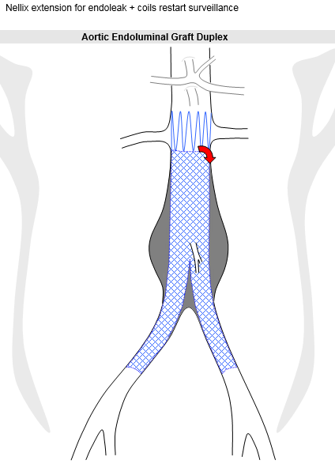
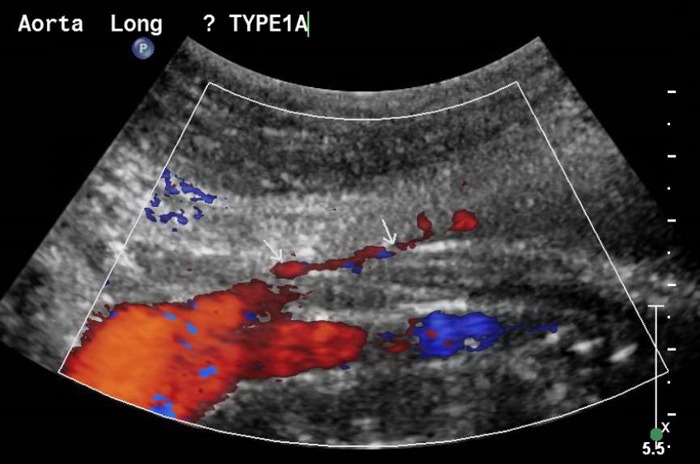
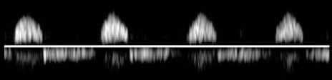
Type 1

Slide 7
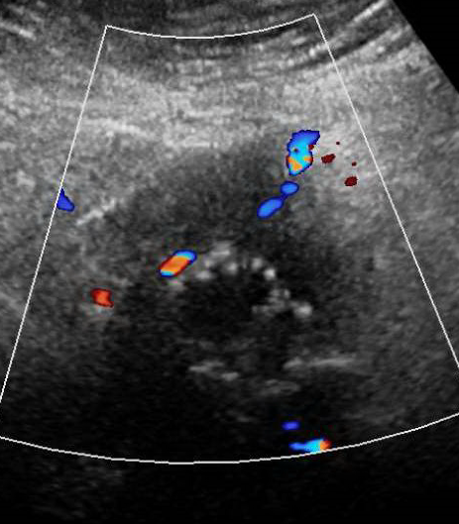
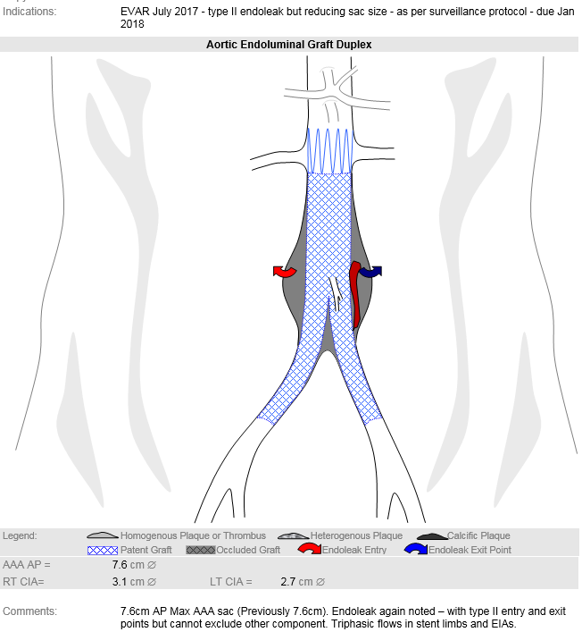
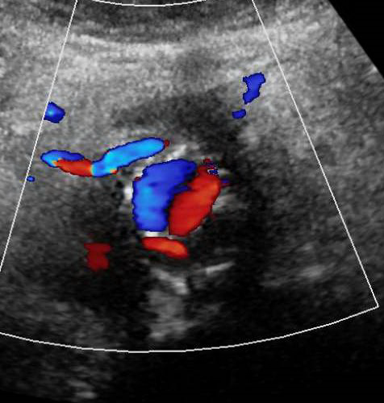
Type 2

Slide 8
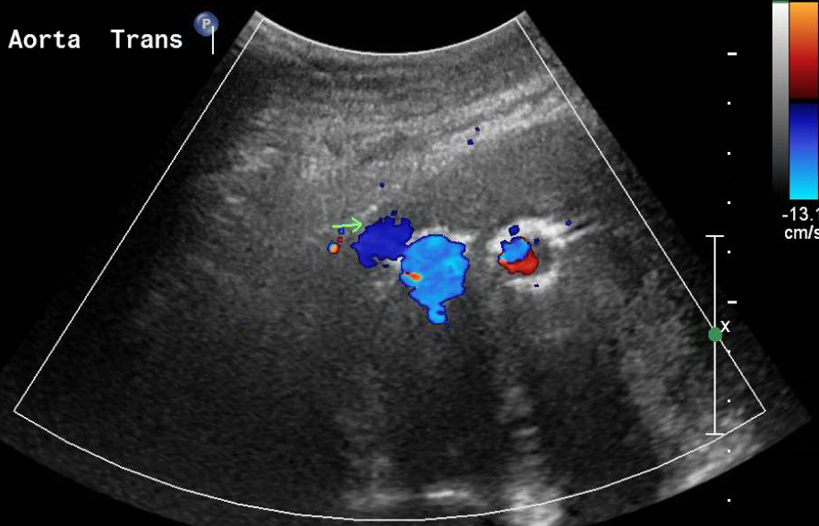
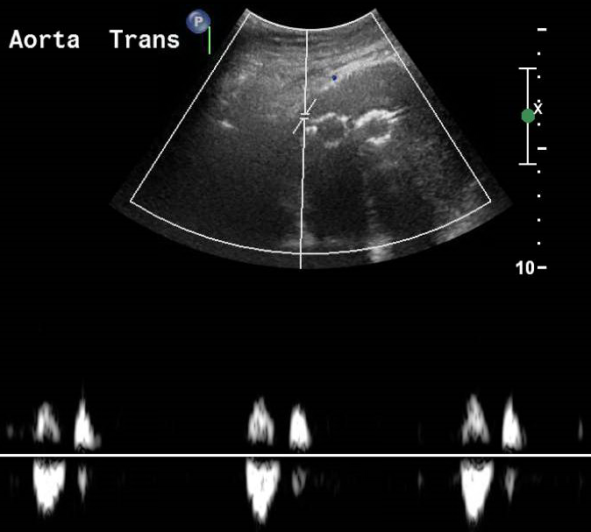
Type 3

Slide 9
Scanning protocol
Use 5-1Mhz curved probe
Patient lying flat with hand by their sides – helps relax abdo muscles.
Patient should be fasted.

Slide 10
Scanning protocol
Measure AP diameter of aneurysm sac in trans and long. Also measure CIAs, other previous aneurysms.
Assess flow through stent with colour and pulsed wave. Take measurements in aorta, left and right stent limbs and EIAs. Any sites of stenosis.
Assess for endoleak by SLOWLY moving through the aneurysm in transverse and long section, with colour and power Doppler. PRF should be set to low e.g. 10cm.s to identify endoleaks.
If a leak is found, try and find the source.

Slide 11
Reporting
Genesis sheet
Record diameters of repaired AAA sac, CIAs – any other aneurysms.
Document any stenoses or occlusion of stent limbs – waveforms in each EIA.
Presence of any leak and which type of leak if possible – recommend alternative imaging.
Email to radiologist, PACS and referring consultant, along with any recommendations or alerts.

