Slide 1
EVAR and Endoleaks
Josie Whitaker

Slide 2
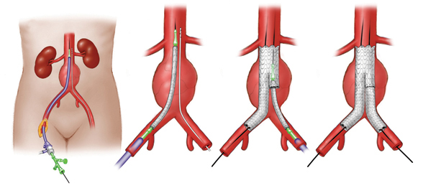
Endovascular Aortic Aneurysm Repair
EVAR
Through a needle puncture or small incision in one or both common femoral arteries and guided by X-ray images a catheter is inserted and advanced to the aneurysm site
A guidewire and expandable stent are advanced through the thin tube
When positioned correctly the stent is expanded within the artery. The wire frame pushes against the healthy portion of the aorta to seal the device in place
Once in place blood flows through the stent and cannot enter the aneurysm.
The procedure normally take 1.5-2.5 hours and has a hospital stay of 1-5days

Slide 3
EVAR vs Open Repair
EVAR
Open Repair
15-45% will need a secondary procedure
Majority of ruptures will occur in first 3 years following EVAR and have a mortality rate of 60%
More costly
No long term survival benefit over OR
Higher operative mortality
Substantially lower mid term aneurysm related mortality than EVAR
Cheaper than EVAR
Established procedure >40 yrs experience
Proven long-term results
Long hospital stay (5-7 days and 1-2 days ITU)

Slide 4
Different Types of EVAR
Unruptured
Ruptured
Uncomplicated- Infrarenal AAA with neck length >10mm and diameter <30mm
Trouser graft or uniliac with fem-fem cross-over graft
Complicated- Juxtarenal and suprarenal AAA and patients with a conical neck
Can only be offered to patients with favourable aortic anatomy
Has reduced in –hospital mortality compared to open repair
However tends to only be done on haemodynamically stable patient’s because of the need for CTA

Slide 5
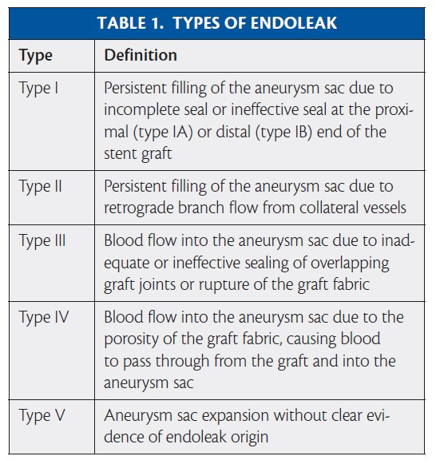
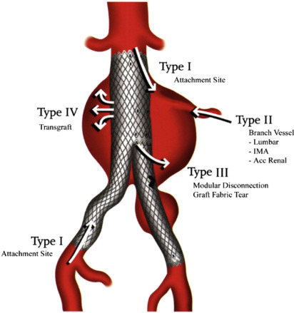
Types of Endoleak

Slide 6
Type 1 Endoleaks- Failure of proximal or distal anastomosis sites (2-12% )
Type 1 a- Proximal Anastomosis
Direct communication with systemic blood flow
For immediate repair when detected
Tend to occur as an early complication, insufficient seal
Graft can migrate so can present as a late complication
High risk if neck distance <10mm (Measured on CT)
Type 1 b- Failure of distal anastomosis
Direct communication with systemic blood flow
For immediate repair when detected
Early complication, usually seen on initial follow up CT
Less likely to present as a late complication
Type 1 c-Iliac occlude

Slide 7
Type 2 Endoleaks
Account for 40% of endoleaks, of which approx. 20% will require intervention.(Increase in sac size >10mm or present for >6months)
Can be split into type a) involving 1 vessel with waveform similar to false aneurysm. Type b) Involving two or more vessels and will have an arterial waveform. Type 2 a is much more likely to spontaneously resolve.
Typically involve the lumbar arteries or IMA, less common accessory renal or sacral
May or may not result in sac pressurisation and sac growth
Difficult to treat as involve secondary procedures either via
A) Puncturing groin and passing guidewire under arterial wall into residual sac
B) Retroperitoneal approach
Both can have serious consequences if cause more serious endoleaks such as type 1 or 3. Coils not demonstrated to be very successful on their own and glue is often used.

Slide 8
Type 3 Endoleaks
Secondary to structural failure of the graft
A) component disconnection
B) Stent fabric disturbance/tear due to angulation of the device
Can occur as either early or late complication
Direct communication with systemic blood flow
Requires immediate intervention
Commonly treated with a further stent to reline the graft

Slide 9
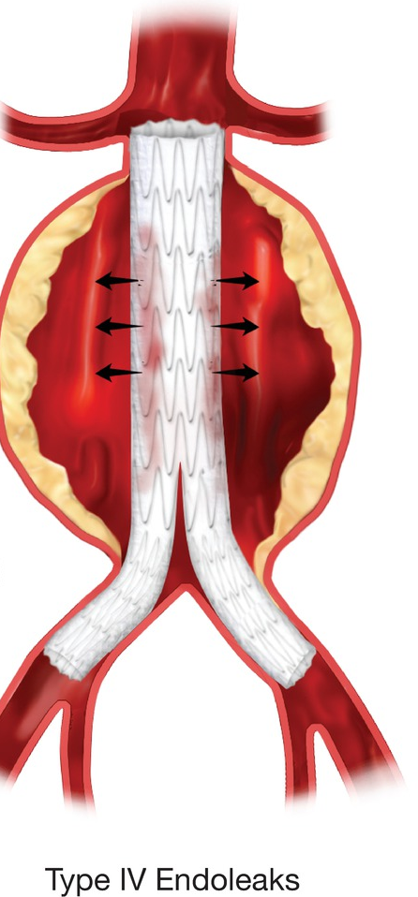
Type 4 Endoleaks
Occurs due to porosity of certain graft materials
Occurs <30 days after graft placement
Likely to resolve on its own once blood clotting has normalised
Now very rare due to improved endovascular stent grafts

Slide 10
Type 5 Endoleaks
Growth of the aneurysm sac size
No detectable endoleak on imaging
Thought to be transmitted pressure?

Slide 11
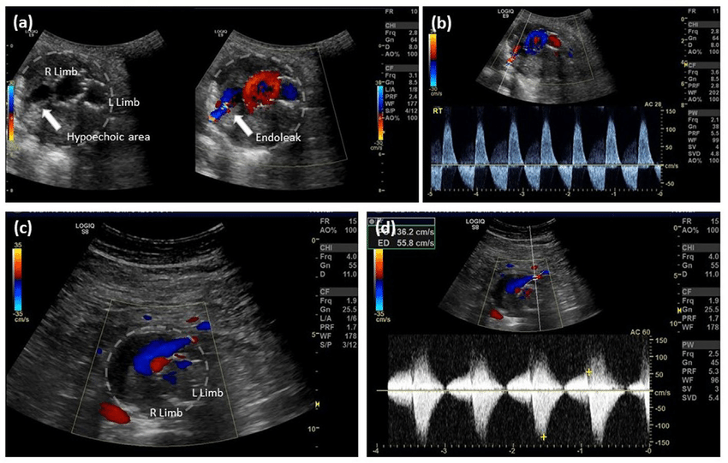
Getting the Ultrasound Right
Measure the sac size and ensure you are comparing the same measurement
Use caution when comparing your measurement to CT
Look for echo poor areas within the sac on grayscale
Use Colour Doppler to try and locate flow outside of the stent graft
Endoleaks can be high (Type 1)or low velocity flow (Type 2)
Take a Waveform to confirm flow outside the stent and this will help distinguish between type 2a and 2 b.
If you can demonstrate an endoleak and are unable to detect where it is coming from arrange CTA after discussion with a Radiologist
Check fem-fem cross over graft if uni-iliac
Check for significant iliac limb kinking

Slide 12
Different Make of EVAR
Different Makes OF EVAR

Slide 13
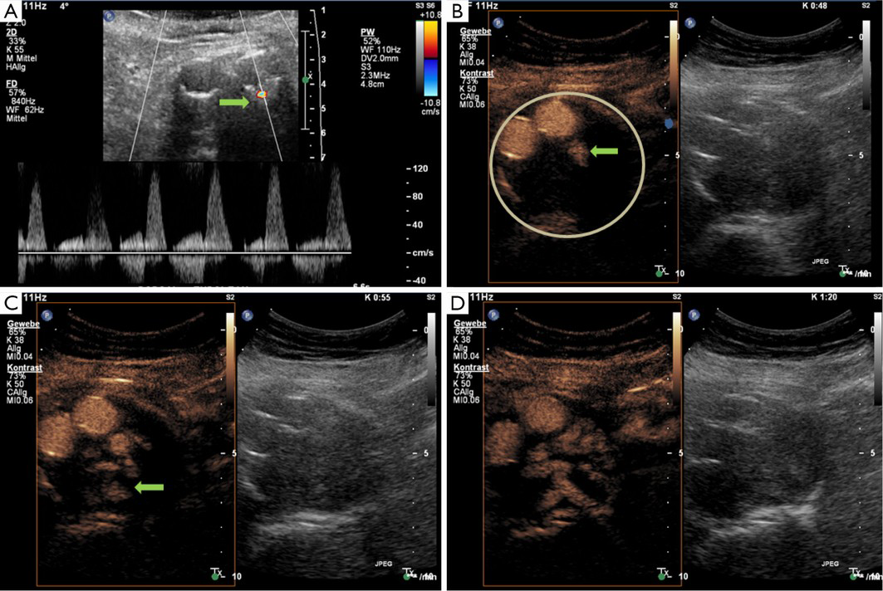
Contrast Ultrasound and EVAR
Contrast Enhanced Ultrasound
Cost effective
Minimally invasive
Cannot accurately show stent position
Able to detect slow flow leaks which may be missed on CTA

Slide 14
Current consensus on Follow-up
Aim to identify and treat potentially life threatening type 1 or 3 endoleaks
Lifelong surveillance indicated and initial follow-up at 30 days with CTA
How best to identify these before symptoms occur
Currently no consensus between yearly CT and CDUS, but CTA indicated in the first year.
Both have shown to be sufficiently accurate in early detection of type 1 and 3 endoleaks
Some studies report contrast ultrasound as the best imaging modality in detection of endoleaks
Measurements are NOT comparable between CT and Ultrasound.
Should x-ray be performed when we do CDUS to assess for stent migration? CEUS and CDUS unable to detect stent migration, need AXR as well
Future developments
Assess if there is sufficient seal on initial CTA (>10mm seal considered low risk to develop type 1 endoleak)
Sac shrinkage >5mm at 1 year suggests low risk to develop type 1 or 3 endoleaks
CTA and CEUS comparable in studies at detecting endoleaks

Slide 15
EVAR Clinical Trials
EVAR 1 – Compared open repair versus EVAR
EVAR2 – Compared EVAR versus conservative management in patients unsuitable for open repair
DREAM- Dutch Randomised Endovascular Aneurysm Management Trial

Slide 16
NICE Guidelines on EVAR
Do not offer EVAR for unruptured infrarenal AAA if open repair is suitable
Do not offer EVAR for unrupture infrarenal AAA if open repair is unsuitable because of their anaesthetic or medical condition
Do not offer complex EVAR for unruptured AAA if open repair is an option unless part of a randomised controlled trial comparing the two
Do not offer complex EVAR for unruptured AAA is open surgical repair is not an option because of their anaesthetic or medical condition
EVAR or open surgical repair be offered for ruptured AAA. (Evidence favours open surgery in younger men and women have better short term survival following EVAR)
Recommends further research into best methods/ modalities for surveillance protocols

Slide 17
NICE Guidelines AAA Surveillance
Offer surveillance with aortic ultrasound every 3 months if AAA is 4.5-5.4cm and every 2 years if AAA is 3.0-4.4cm
Report AP diameter measurement inner to inner and clearly document any additional measurements taken.
Offer screening to all men aged 66 years and over who have not previously had abdominal imaging
Offer screening to all women aged 70 years and over who have not previously had abdominal imaging who have any of the following risk factors COPD, CAD/CVD/PAD, European family origin, family history AAA, hyperlipidaemia, hypertension, smoking history

