Slide 1
Doppler Explained (hopefully!)
Ben Warner-Michel
Your friendly neighbourhood vascular scientist

Slide 2
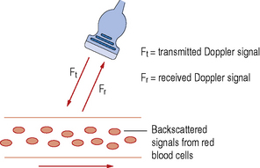
The Doppler Principle
The Doppler effect – the change in frequency of a wave in relation to an observer, who is moving relative to the wave source
When a sound wave of a certain frequency is reflected by a moving object (eg. red blood cell), it changes frequency as it travels back to the ultrasound probe
The change in frequency between transmitted and received wave is known as the ‘Doppler shift’

Slide 3
The Doppler frequency
The Doppler shift, also referred to as the Doppler frequency (f_{D}), is the difference between the received frequency (f_{R}) and the transmitted frequency (f_{T})
f_{D}= f_{R} - f_{T}
  Positive Doppler shift: f_{R} > f_{T}
    Received frequency increases if the target is moving towards the ultrasound probe
  Negative Doppler shift: f_{R} < f_{T}
    received frequency decreases if the target is moving away from the ultrasound probe

Slide 4
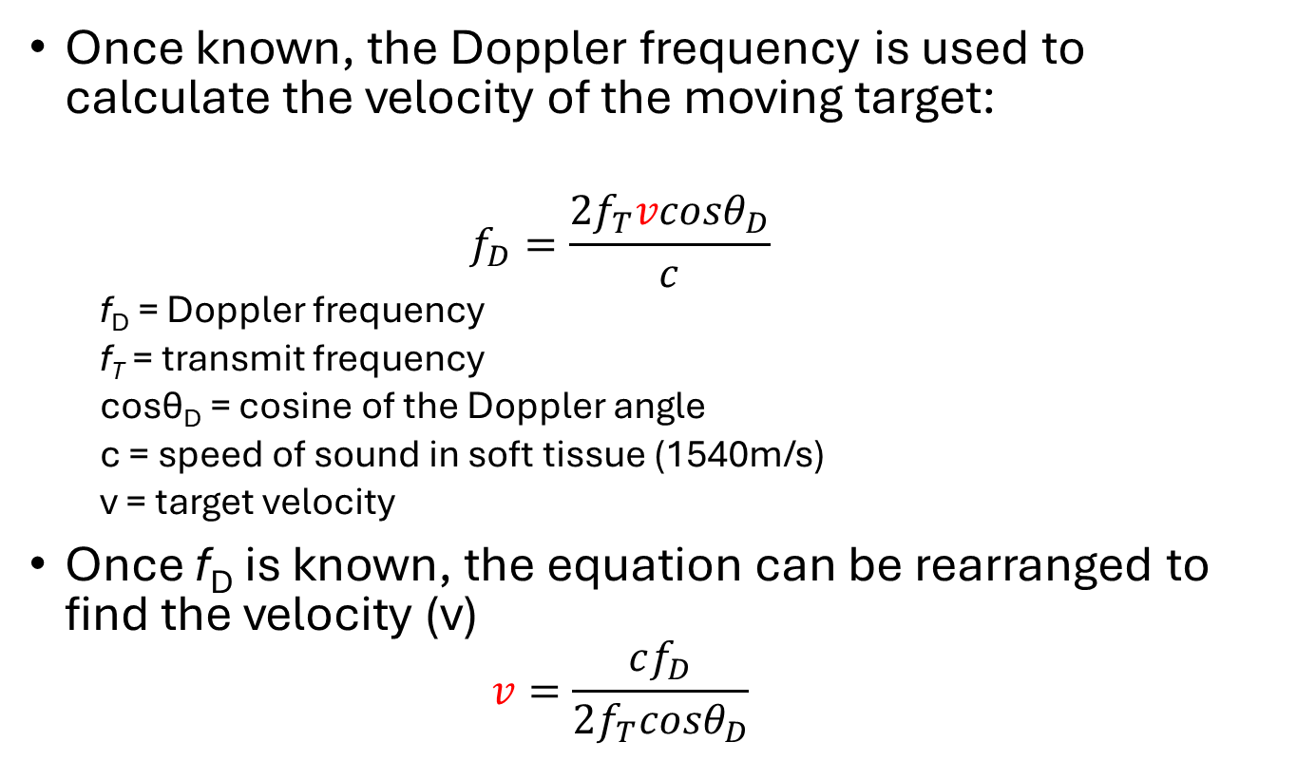
The Doppler equation
Once known, the Doppler frequency is used to calculate the velocity of the moving target:
  $$f_{D}=\frac{2f_{T}v{cosθ}_{D}}{c}$$
  f_{D} = Doppler frequency
  f_{T} = transmit frequency
  cosθ_{D} = cosine of the Doppler angle
  c = speed of sound in soft tissue (1540m/s)
  v = target velocity
Once f_{D} is known, the equation can be rearranged to find the velocity (v)
  $$v=\frac{cf_{D}}{2f_{T}{cosθ}_{D}}$$

Slide 5
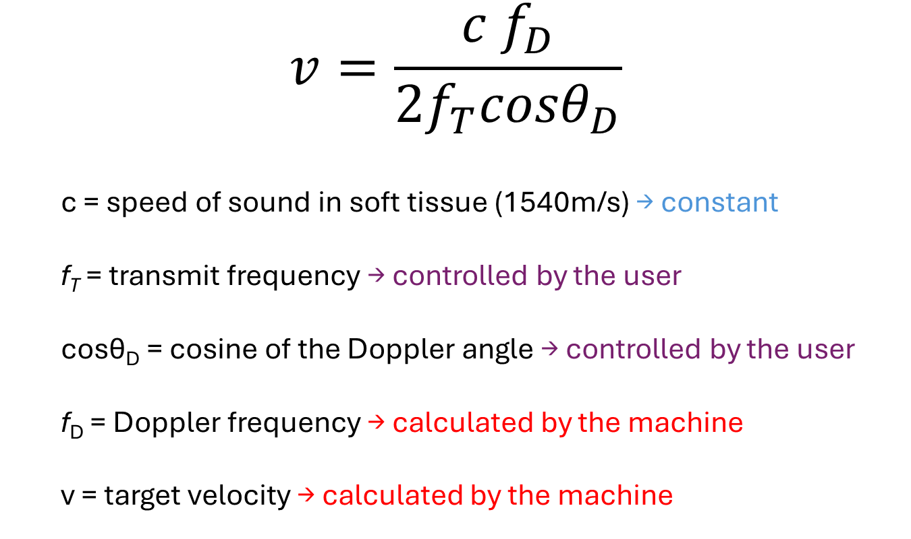
The Doppler equation
$$v=\frac{c{ f}_{D}}{2f_{T}{cosθ}_{D}}$$
  c = speed of sound in soft tissue (1540m/s) → constant
  f_{T} = transmit frequency → controlled by the user
  cosθ_{D} = cosine of the Doppler angle → controlled by the user
  f_{D} = Doppler frequency → calculated by the machine
  v = target velocity → calculated by the machine

Slide 6
The Doppler angle
The angle between the axis of the ultrasound beam and the direction of blood flow
Should be kept below 60°
As cos90° = 0, if the Doppler angle is 90° there will be no returning Doppler signal
ie. flow is perpendicular to the beam, not moving towards or away from the probe
Ultrasound beam axis
Blood vessel
θ_{D}
Direction of blood flow
Doppler angle

Slide 7
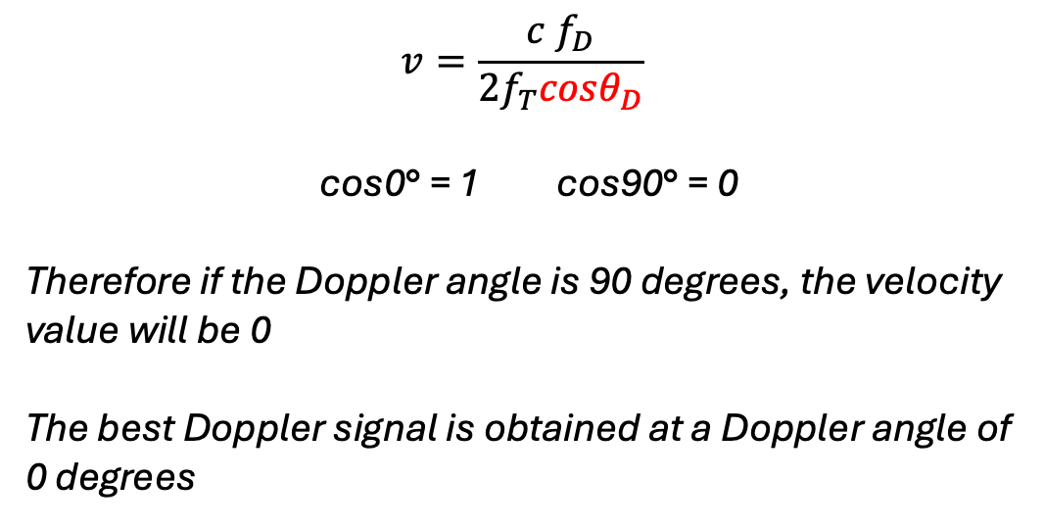
$$v=\frac{c{ f}_{D}}{2f_{T}{cosθ}_{D}}$$
cos0° = 1 cos90° = 0
Therefore if the Doppler angle is 90 degrees, the velocity value will be 0
The best Doppler signal is obtained at a Doppler angle of 0 degrees
θ_{D} = 0°
θ_{D} = 90°

Slide 8
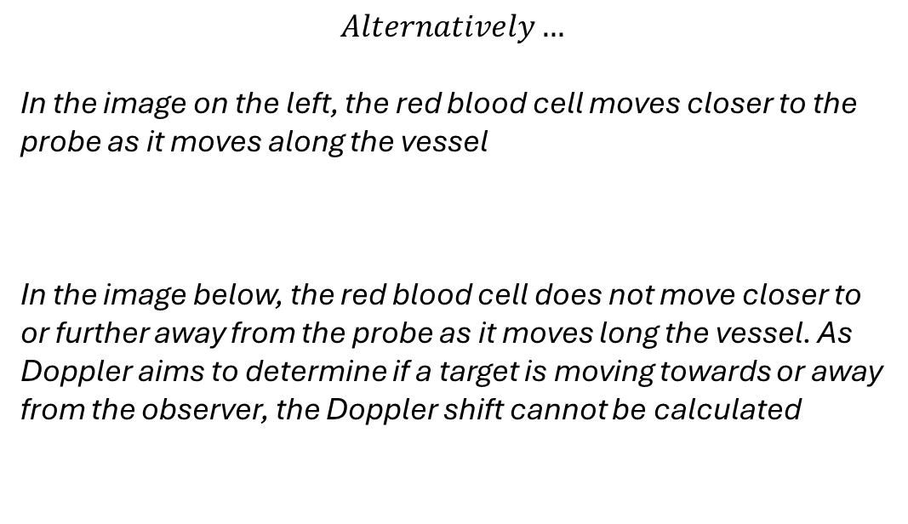
$$Alternatively…$$
In the image on the left, the red blood cell moves closer to the probe as it moves along the vessel
In the image below, the red blood cell does not move closer to or further away from the probe as it moves long the vessel. As Doppler aims to determine if a target is moving towards or away from the observer, the Doppler shift cannot be calculated
θ_{D}
θ_{D}

Slide 9
$$Alternatively…$$
In the image on the left, the red blood cell moves closer to the probe as it moves along the vessel
In the image below, the red blood cell does not move closer to or further away from the probe as it moves long the vessel. As Doppler aims to determine if a target is moving towards or away from the observer, the Doppler shift cannot be calculated

Slide 10
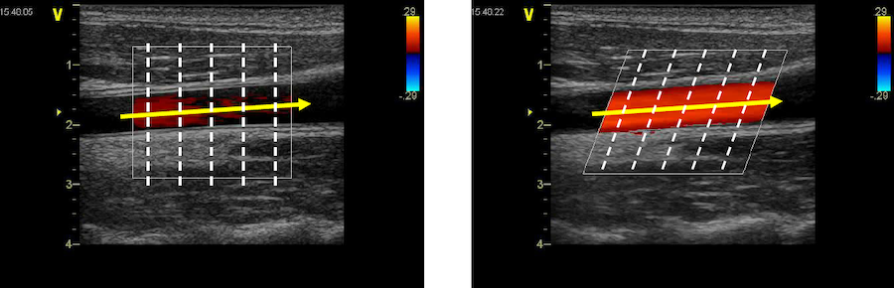
The Doppler angle
θ_{D} = ~90°
Blood flow perpendicular to beam axis
Poor signal
θ_{D} = ~60°
Blood flow not perpendicular to beam axis
Good signal

Slide 11
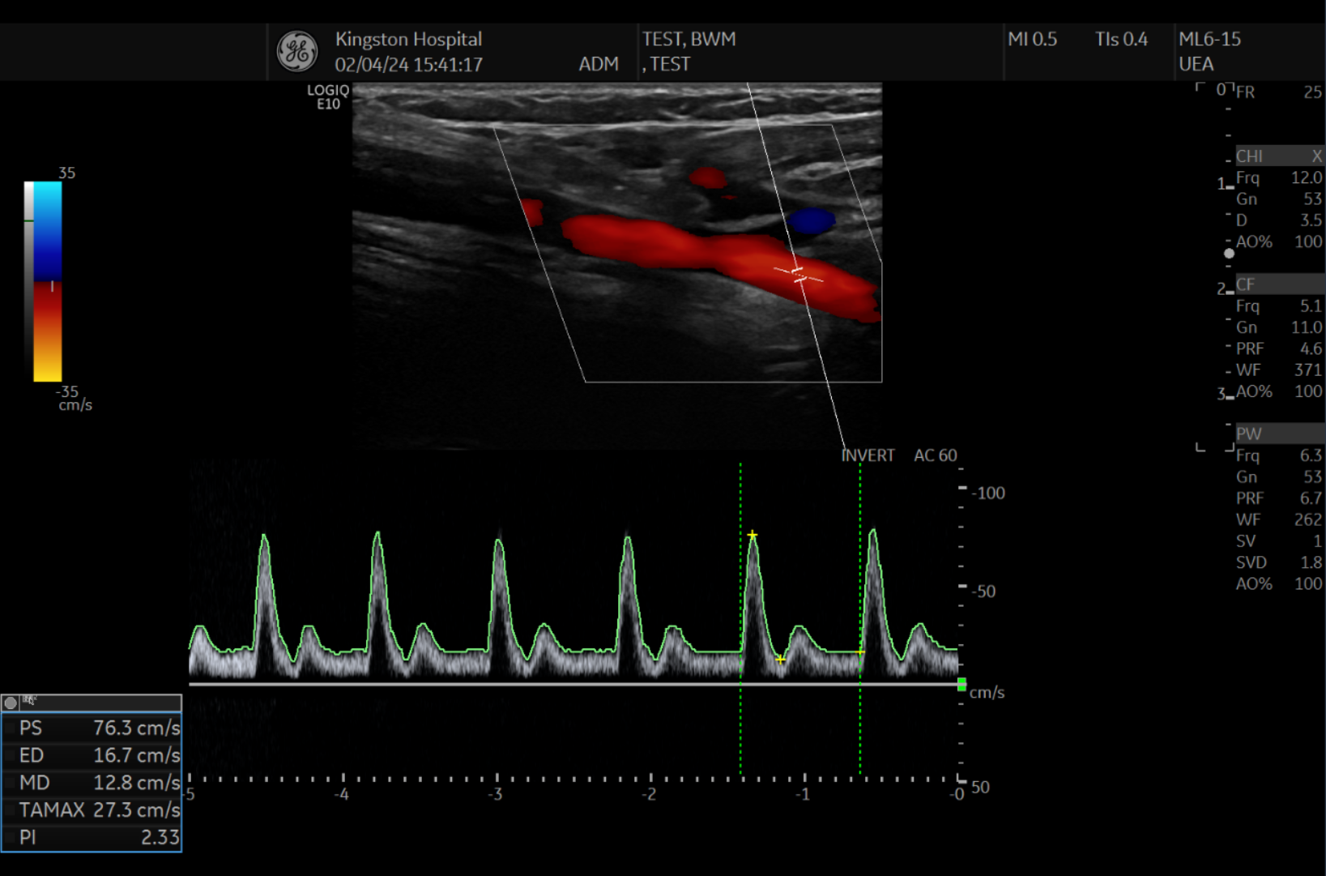




$$v=\frac{c{ f}_{D}}{2f_{T}{cosθ}_{D}}$$
$$θ_{D}$$
$f_{T}$
  $$v$$

Slide 12
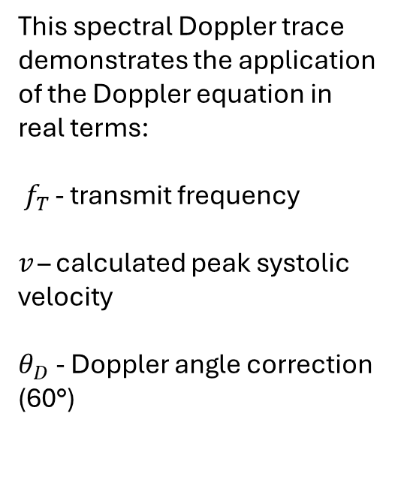
This spectral Doppler trace demonstrates the application of the Doppler equation in real terms:
$f_{T }$- transmit frequency
$v$ – calculated peak systolic velocity
$θ_{D}$ - Doppler angle correction (60°)
$$v=\frac{c{ f}_{D}}{2f_{T}{cosθ}_{D}}$$
$$θ_{D}$$
$f_{T}$
  $$v$$

Slide 13
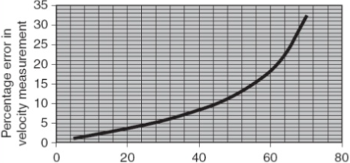
Doppler angle error
% Error in velocity measurement
Doppler angle (°)
Velocity measurement error increases exponentially above 60°
Keeping the Doppler angle at or below 60° allows for a consistent level of error that the machine can correct for

Slide 14
Duplex ultrasound
A combination of B-mode imaging and Doppler ultrasound
There are two main forms of Doppler imaging we use in duplex ultrasound:
  Colour Doppler – a colourised representation of all moving targets within the scan field
  Spectral Doppler – a graphical representation of all targets moving through a particular location over time

Slide 15
Colour Doppler
Colour mapping displays the following information about a moving target (RBC):
  Depth of target
  Direction of movement
  Velocity of movement
The target is assigned a colour – red or blue – depending on the direction of movement
The brightness of the colour increases with the velocity of the target – allowing for identification of the point of highest velocity in an artery, which is useful for identifying stenotic jets

Slide 16
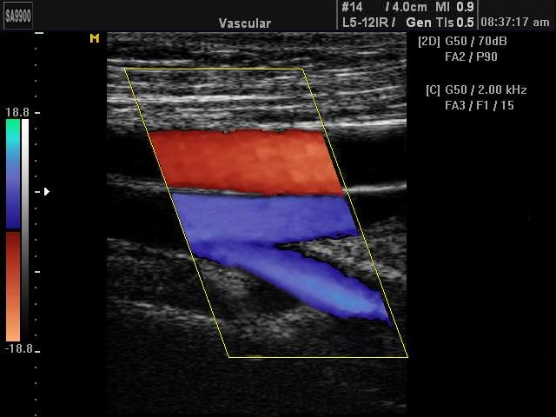
Colour Doppler
Displays all moving targets within the scan field
Assigned a red or blue colour depending on the Doppler shift (red away from probe – artery / blue towards probe – vein)*
  *these settings can be altered depending on probe location
SFA
CFV
SFV
PFV

Slide 17
Colour Doppler
Displays all moving targets within the scan field
Assigned a red or blue colour depending on the Doppler shift (red away from probe – artery / blue towards probe – vein)*
  *these settings can be altered depending on probe location
Colour scale (PRF):
Represents the sampling rate of the ultrasound machine.
Effectively shows the maximum velocity that can be displayed on the colour map. Higher velocities are given a brighter colour.
SFA
CFV
SFV
PFV

Slide 18
Colour Doppler
Displays all moving targets within the scan field
Assigned a red or blue colour depending on the Doppler shift (red away from probe – artery / blue towards probe – vein)*
  *these settings can be altered depending on probe location
θ_{D}
SFA
CFV
SFV
Colour box:
Represents the colour scan field and the Doppler angle of the ultrasound beam.
PFV

Slide 19
Spectral Doppler
Spectral Doppler tracing displays the following information about an area within tissue:
  Direction of targets (RBCs) moving through this point over time
  Velocity of targets (RBCs) moving through this point over time
This information is displayed graphically – flow away from the probe is displayed above the baseline (x-axis), and flow towards the probe is displayed below the baseline
The y-axis indicates the velocity of targets moving through this point – the scale increases in magnitude away from the baseline

Slide 20
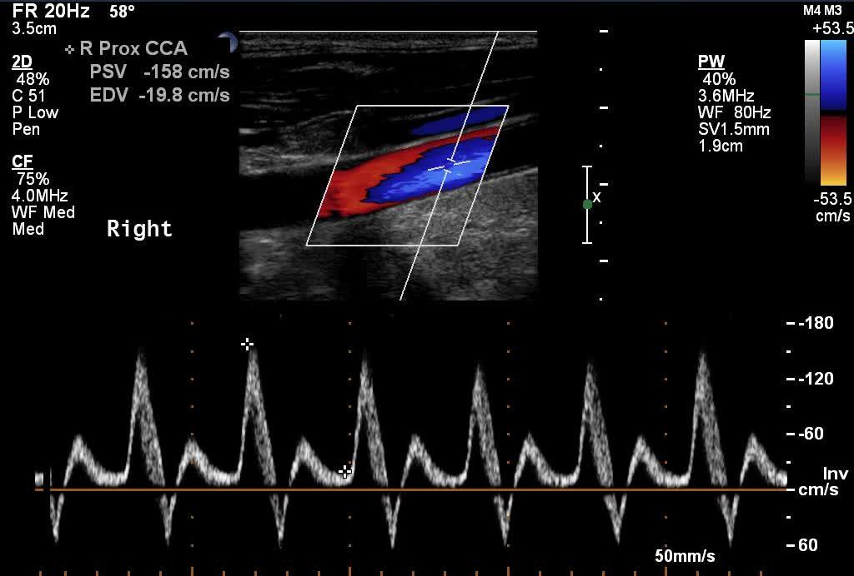

Slide 21
Sample volume:
The spectral Doppler trace is a graphical representation of velocity and direction of blood moving through this point over time.

Slide 22
Baseline:
Waveforms above the line indicate flow away from the probe.
Waveforms below the line indicate flow towards the probe.

Slide 23
Doppler waveform:
The graphical representation of blood velocity and direction through the sample volume. This waveform shows a sharp antegrade peak during systole, then a small retrograde peak followed by antegrade flow during diastole – indicating triphasic flow.
Antegrade
Systole
Diastole
Retrograde

Slide 24
Doppler angle:
Represents the angle difference between the beam axis and direction of blood flow.

Slide 25
Velocity scale:
Represents the velocity of moving blood at a given point in the cardiac cycle.

Slide 26
Velocity value:
Represents the exact velocity of a given point on the spectral trace
Systole
Diastole

Slide 27
Pulsatility and resistive indices
Calculated Doppler flow parameter derived from the maximum, minimum and mean Doppler frequency shifts during the cardiac cycle
Used to calculate resistance in a pulsatile vascular system (i.e. artery)
PI = (v_{max} - v_{min}) / (v_{mean})
RI = (v_{max} - v_{min}) / (v_{max})
Note – as PI and RI are ratios, they will remain constant even when the angle correction is changed, as the returning signal remains the same
The PI and RI will change if the probe position or returning signal changes

Slide 28
PI – clinical uses
Umbilical artery Doppler
  Varies with gestation
  Normal PI ≤95th centile
  Abnormal PI >95th centile or absent / reversed end diastolic flow
Middle cerebral artery Doppler
  Varies with gestation
  Normal PI ≥1.0
  Abnormal PI <1.0
Other uses include assessment of ovarian malignancy, transcranial Doppler, renal artery Doppler

Slide 29
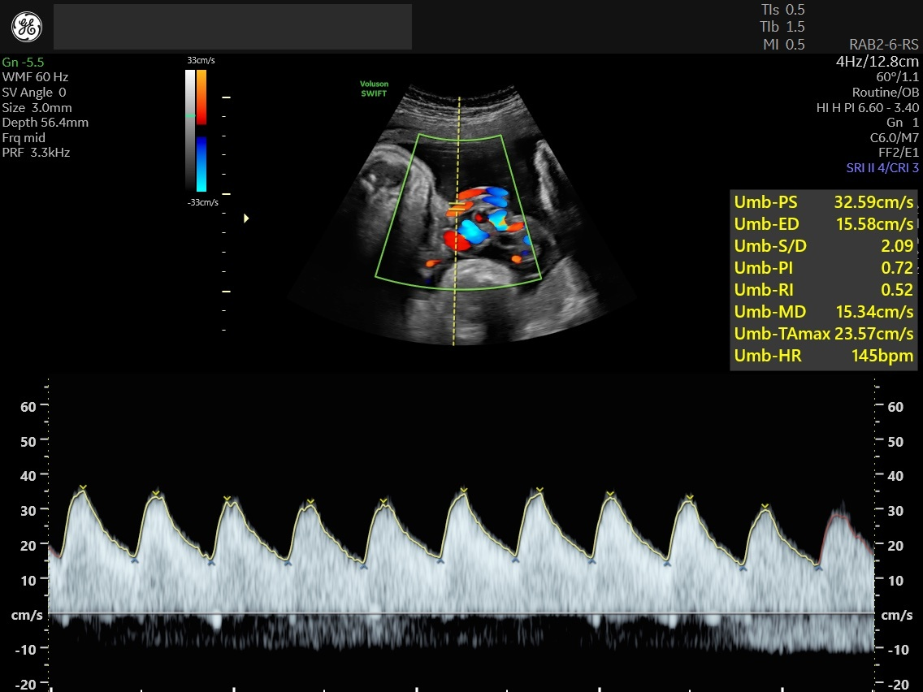

Slide 30
Pulse Repetition Frequency
Ultrasound machines alternate between transmission and reception of ultrasound waves (pulse-echo)
Once the ultrasound wave is transmitted, the machine ‘listens’ for the sound wave to return and registers any change in frequency (Doppler shift)
The frequency of this pulse-echo system is termed the ‘pulse repetition frequency (PRF)’
The magnitude of the Doppler shift in the returning echo is converted into a corresponding velocity value and displayed on the colour map / spectral trace

Slide 31
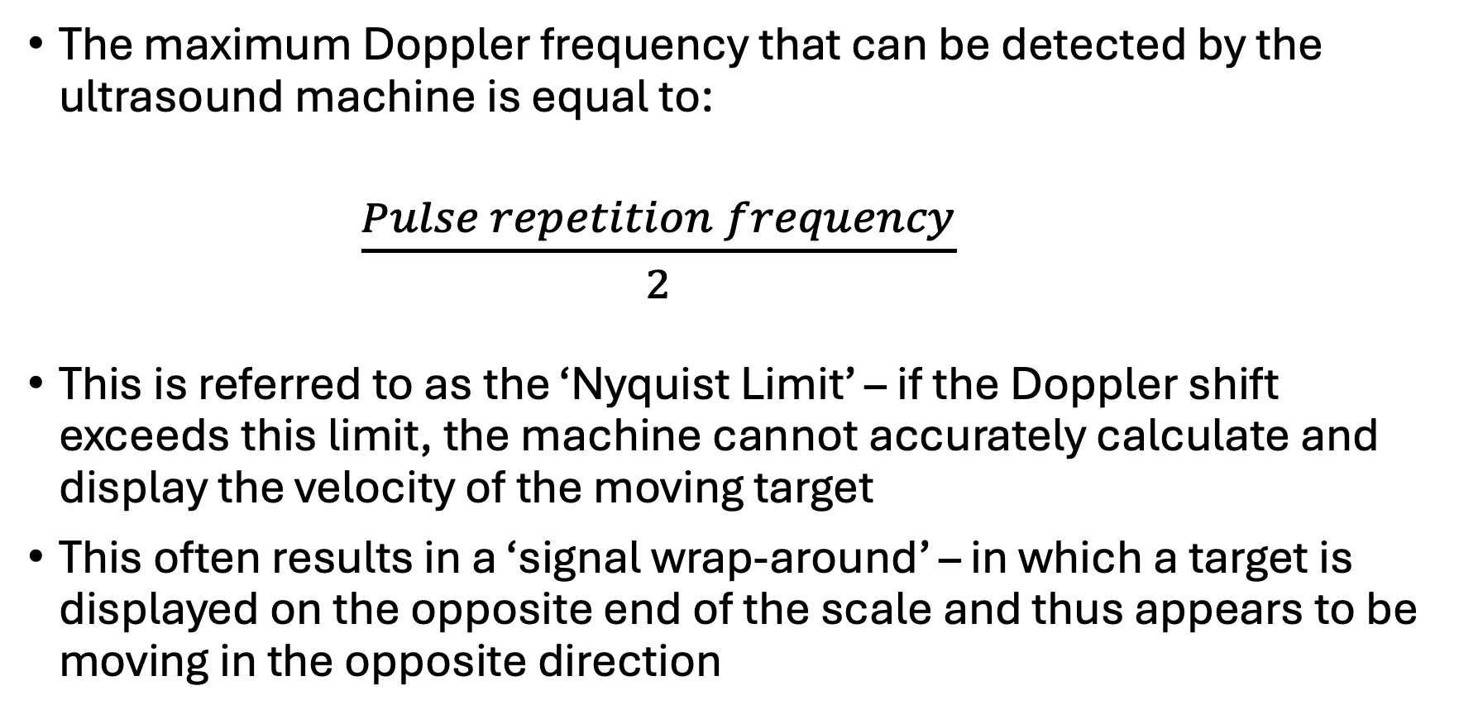
Aliasing
The maximum Doppler frequency that can be detected by the ultrasound machine is equal to:
    $\frac{Pulse repetition frequency}{2}$
This is referred to as the ‘Nyquist Limit’ – if the Doppler shift exceeds this limit, the machine cannot accurately calculate and display the velocity of the moving target
This often results in a ‘signal wrap-around’ – in which a target is displayed on the opposite end of the scale and thus appears to be moving in the opposite direction

Slide 32
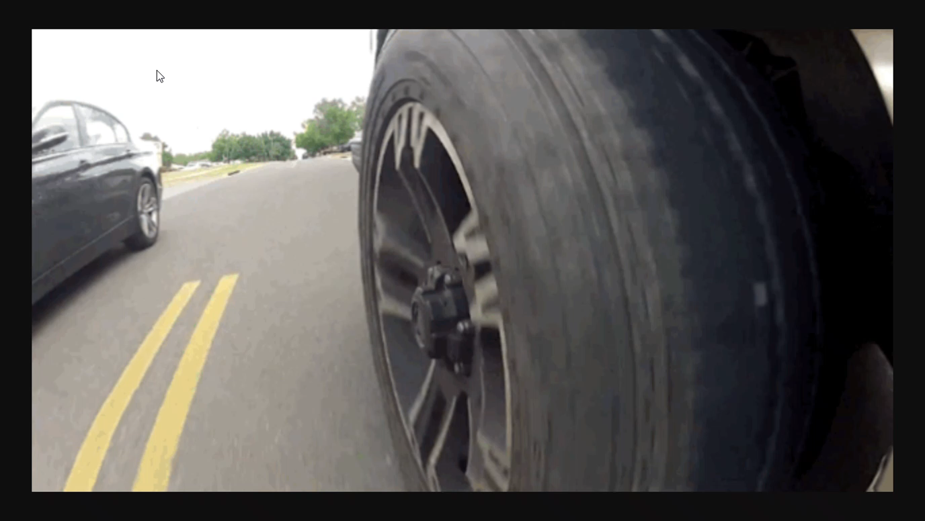
‘The Wagon Wheel Effect’ - Aliasing

Slide 33
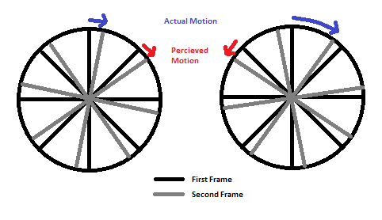
Slow movement – wheel movement falls within the camera’s maximal sample rate, therefore appears to move forward.
Fast movement – wheel movement exceeds the camera’s maximal sample rate, therefore appears to move backwards.

Slide 34
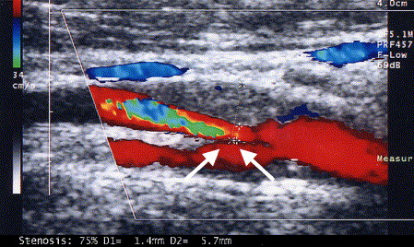
Colour Doppler aliasing
Aliasing
Stenosis
Plaque
ICA
CCA
ECA

Slide 35
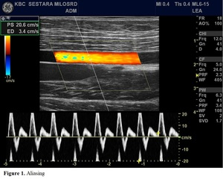
Spectral Doppler Aliasing
Spectral aliasing, indicating that the blood velocity has exceeded the PRF. ‘Wraparound’ results in the blood flow here being displayed below the baseline, where it’s registered as retrograde flow.

Slide 36
Spectral Doppler Aliasing
QUICK FIX
Increase the PRF
Spectral aliasing, indicating that the blood velocity has exceeded the PRF. ‘Wraparound’ results in the blood flow here being displayed below the baseline, where it’s registered as retrograde flow.

Slide 37
Power Doppler
Produces a blood flow map similar to colour Doppler, however does not utilise velocity or directional information, eliminating the issues of signal aliasing or Doppler angle dependency
Instead, converts the amplitude of the Doppler signal into ‘brightness’, similar to B-mode ultrasound
Elimination of Doppler angle increases sensitivity for lower velocities than colour Doppler, and can visualise blood flow at 90° to the beam
Useful for investigating perfusion, e.g. in the renal cortex, testis, ovarian cysts, liver masses etc.

Slide 38
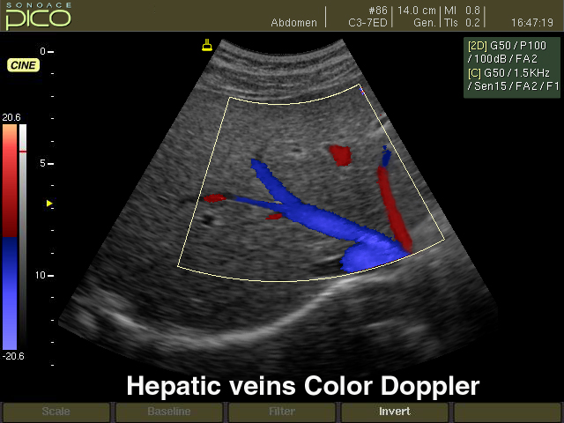
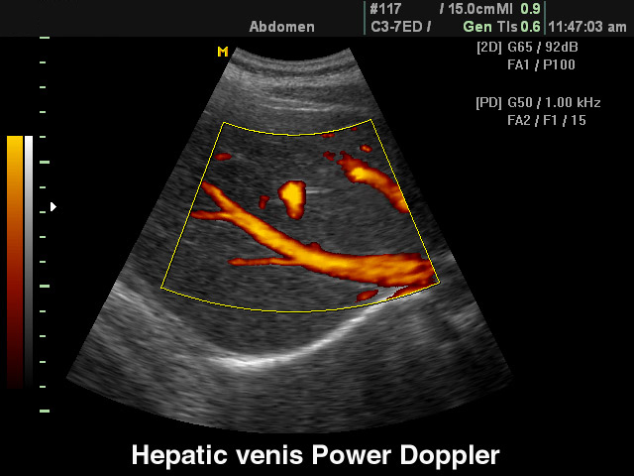
Colour Doppler
  Angle-dependent
  Provides directional information and velocity
  Susceptible to aliasing
  Poor signal at 90°
  Useful for investigating haemodynamics
Power Doppler
  Angle-independent
  Does not provide directional or velocity information
  No signal aliasing
  Useful for investigating perfusion

Slide 39
Colour Doppler optimisation

Slide 40
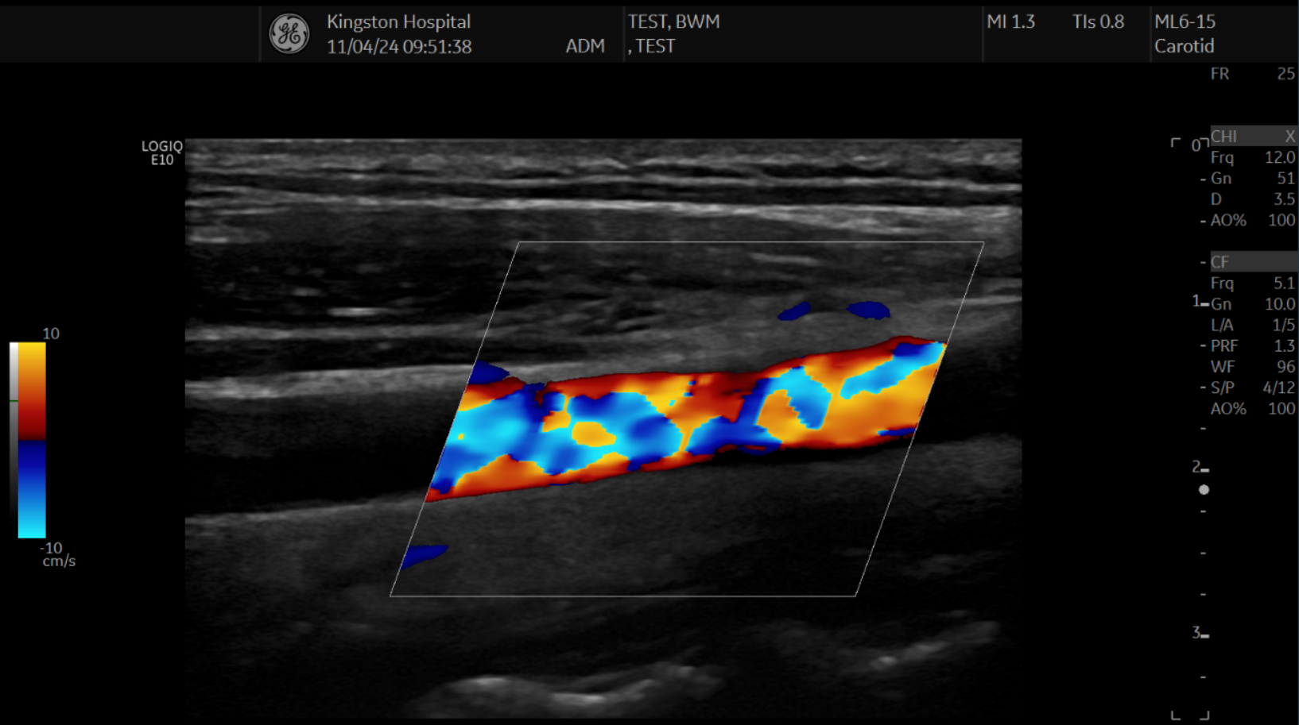
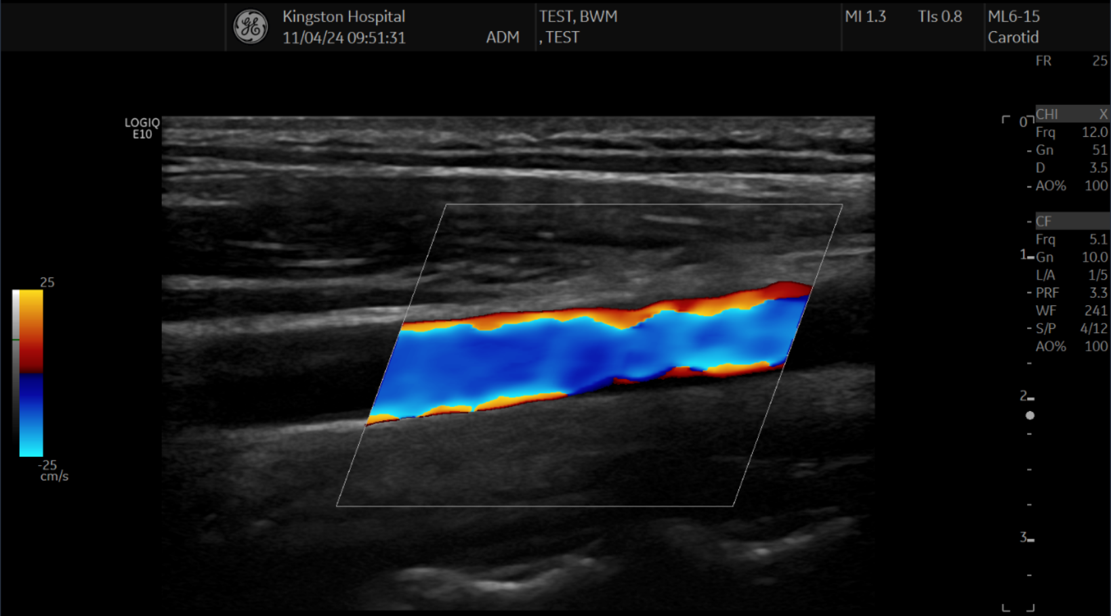
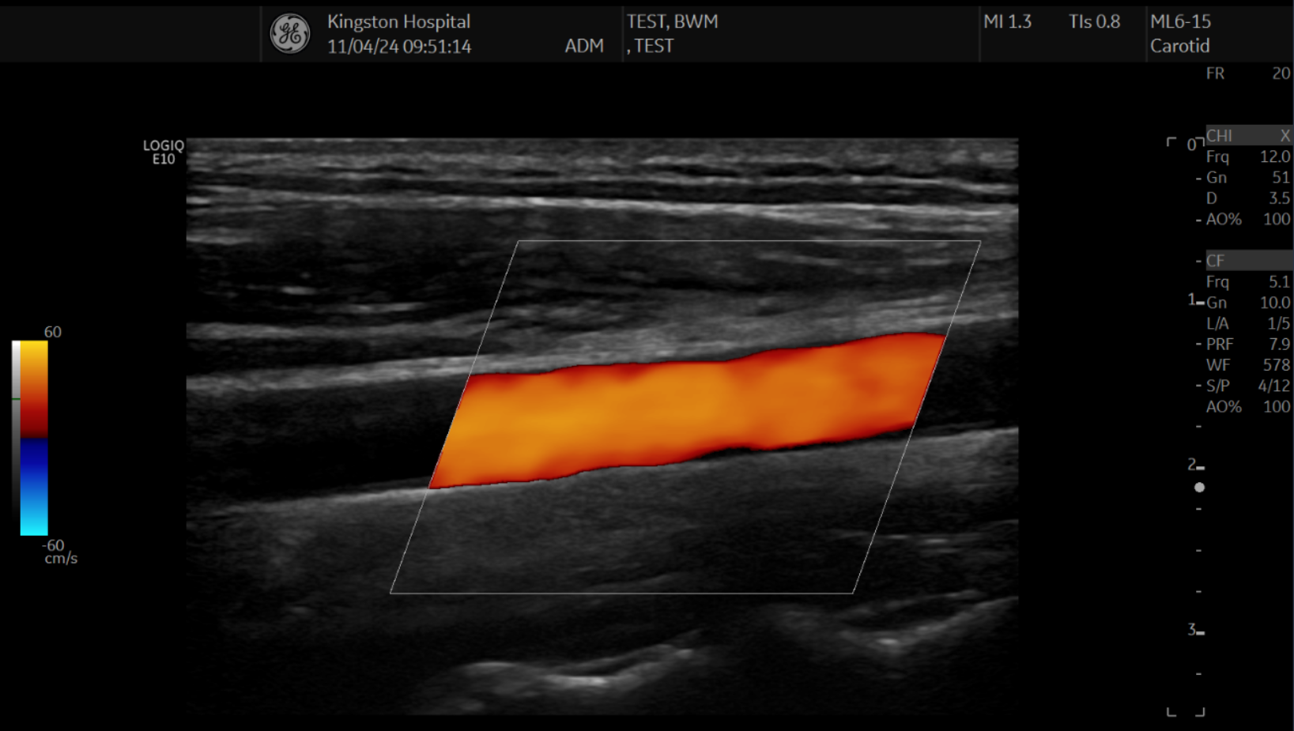
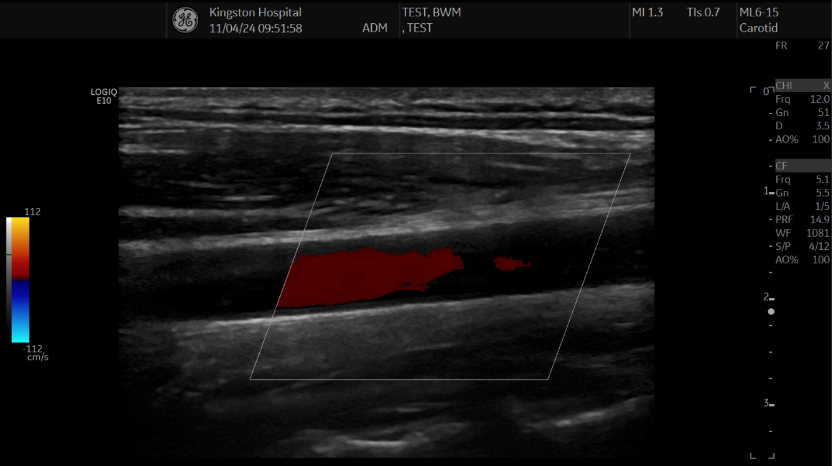
10cm/s
25cm/s
60cm/s
112cm/s

Slide 41
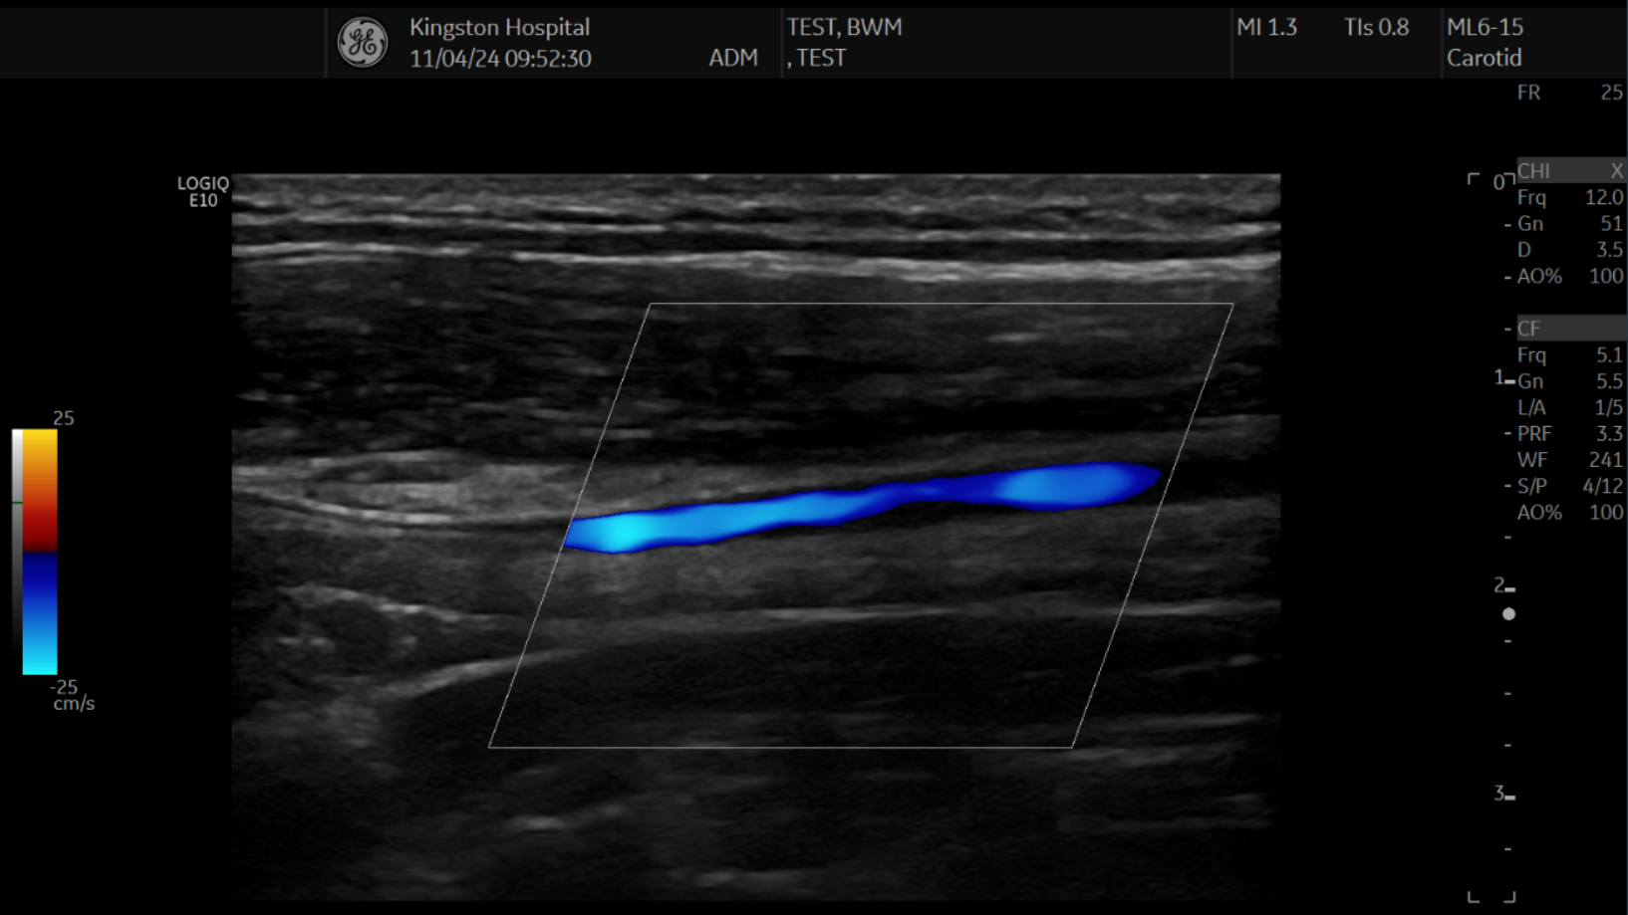
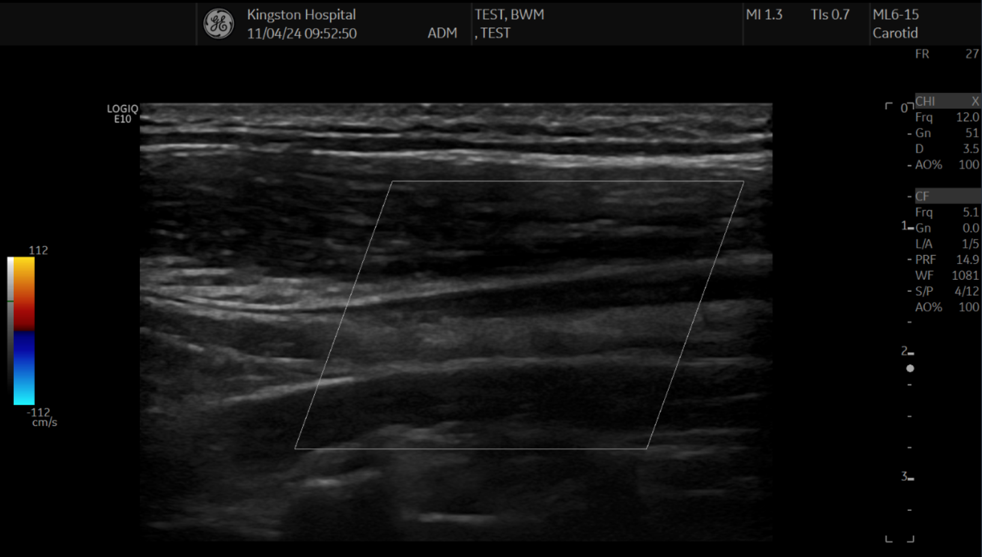
25cm/s
25cm/s
112cm/s
112cm/s

Slide 42
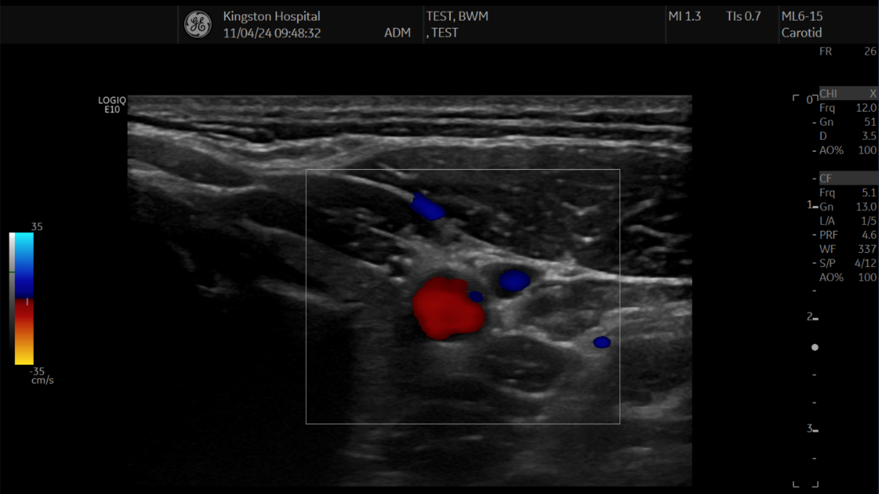
35cm/s

Slide 43
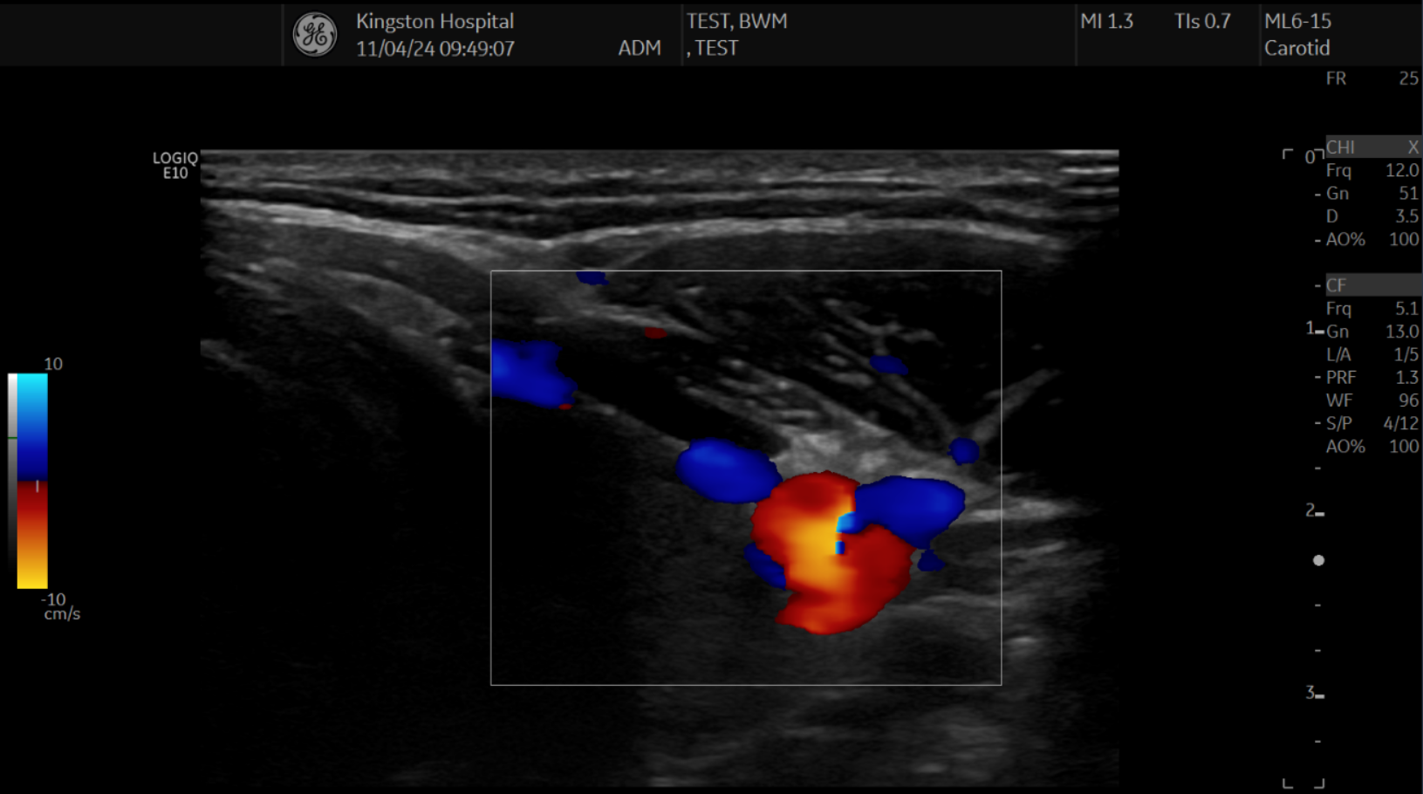
10cm/s

Slide 44
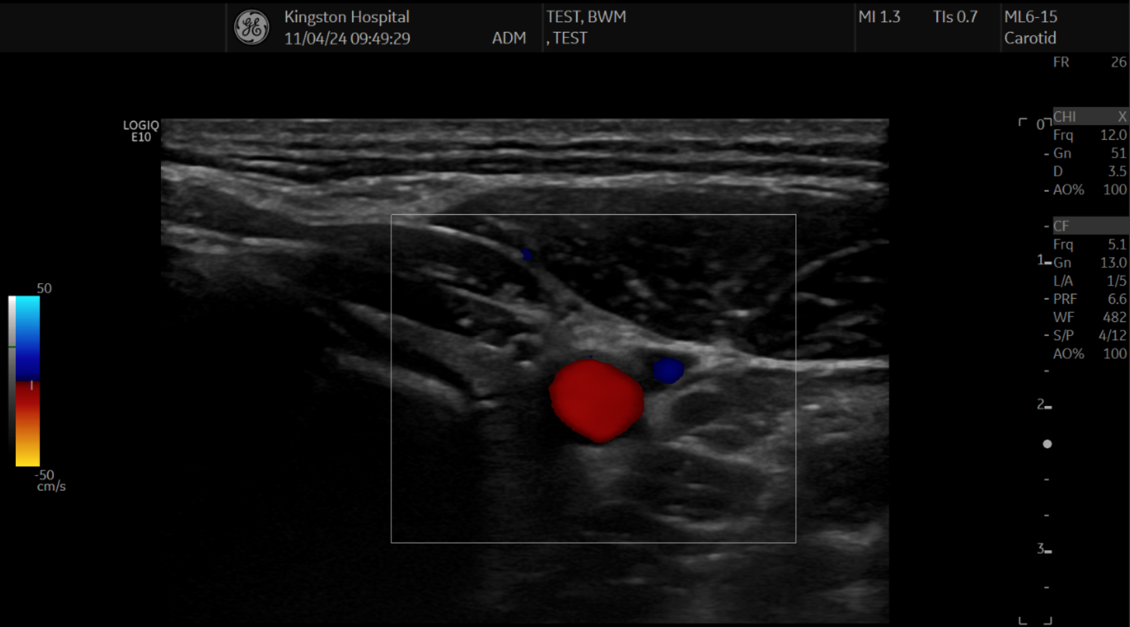
50cm/s

Slide 45
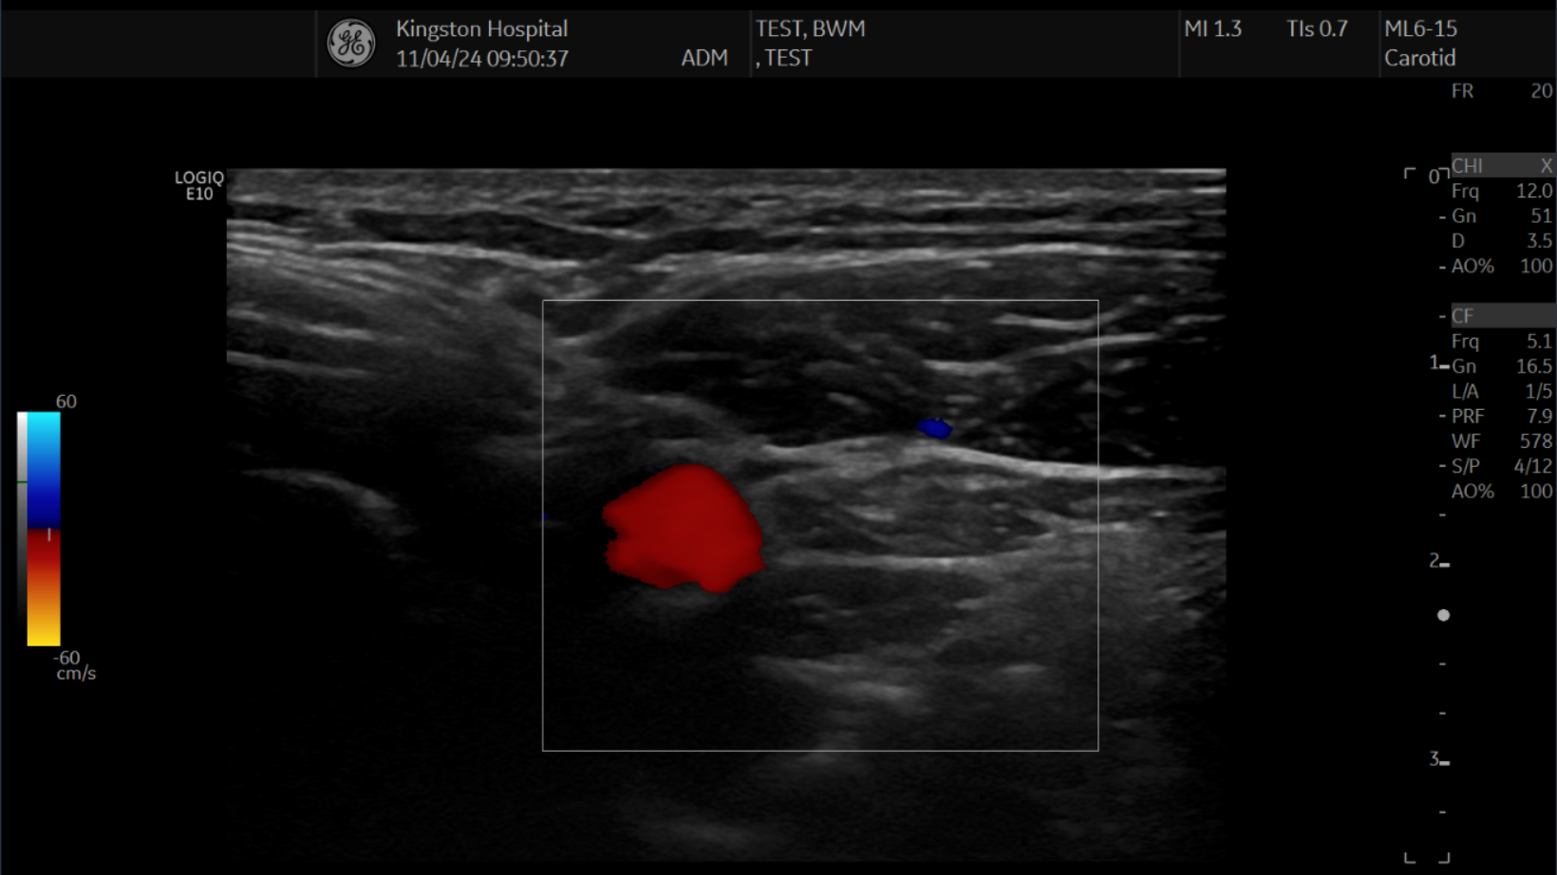
60cm/s

Slide 46
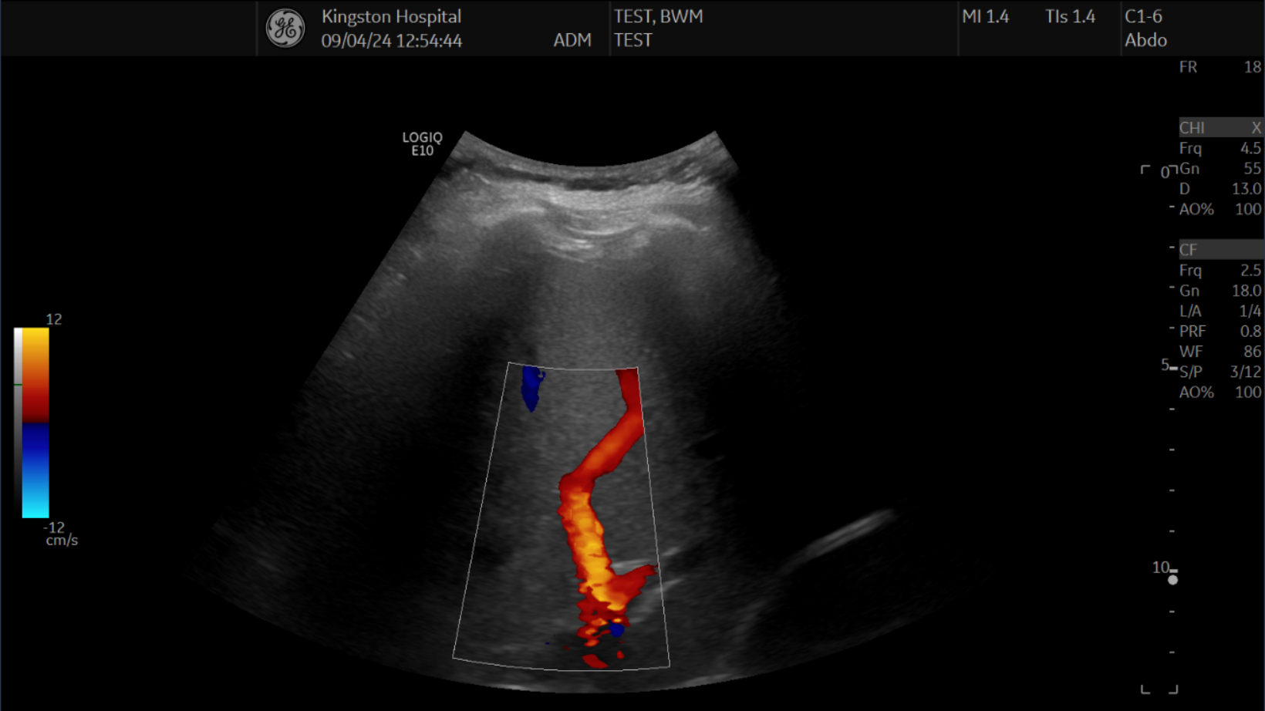
12cm/s

Slide 47
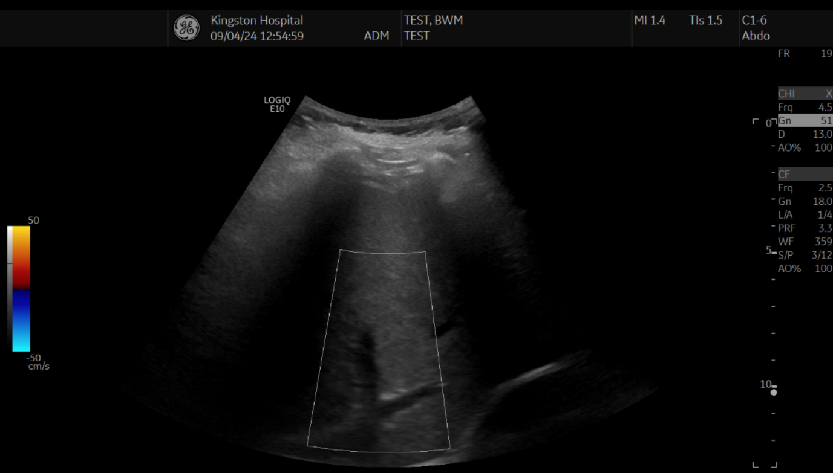
50cm/s

Slide 48
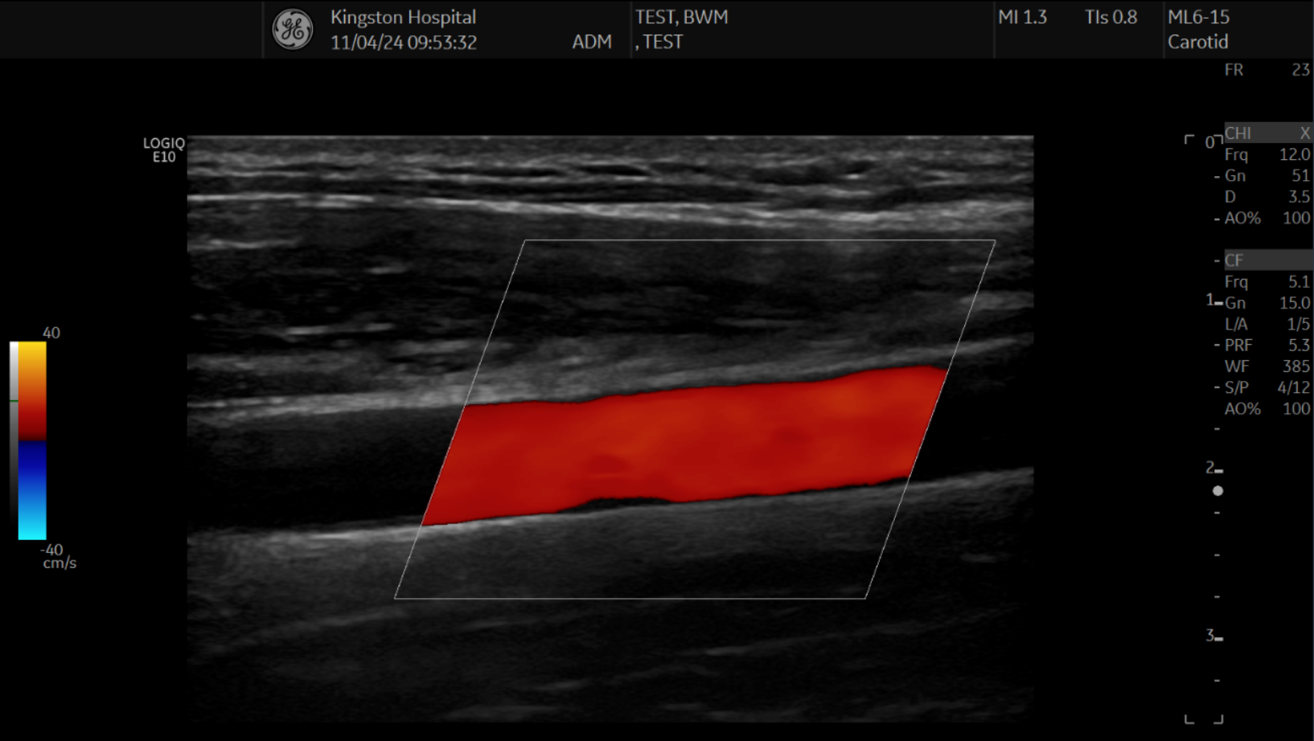

Slide 49
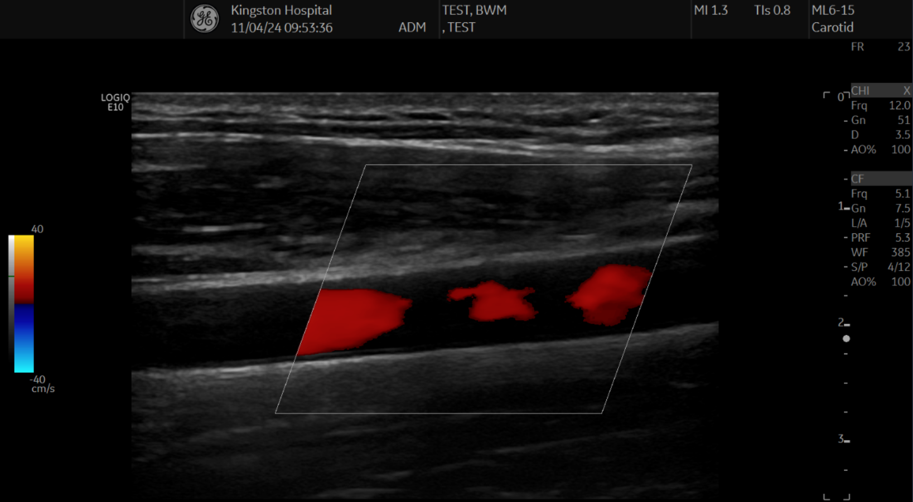

Slide 50
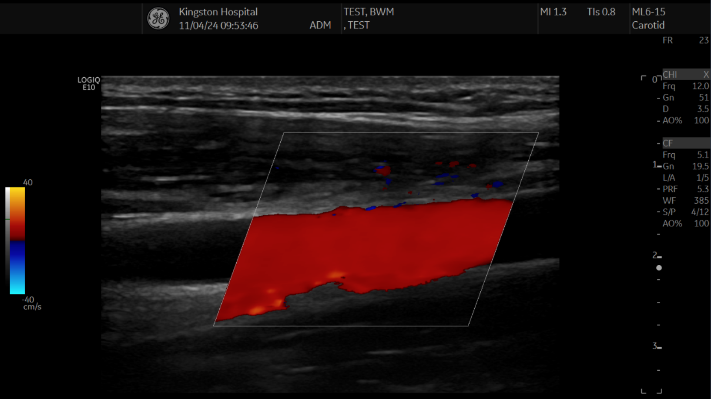

Slide 51
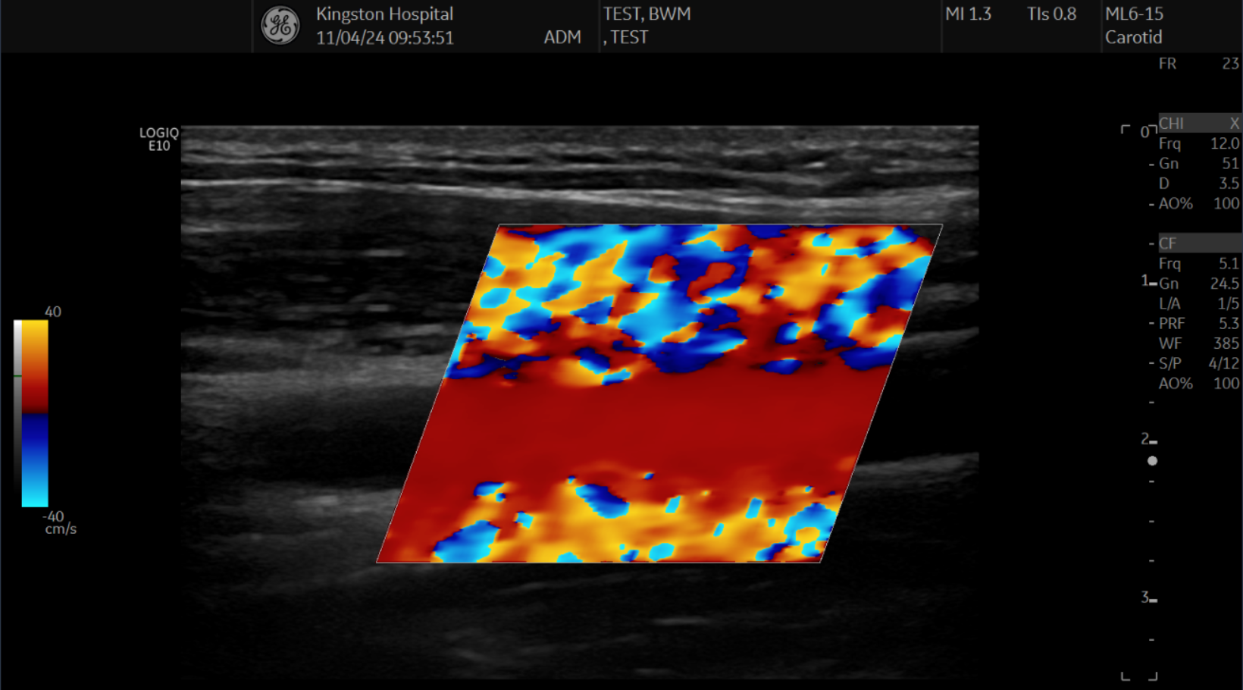

Slide 52
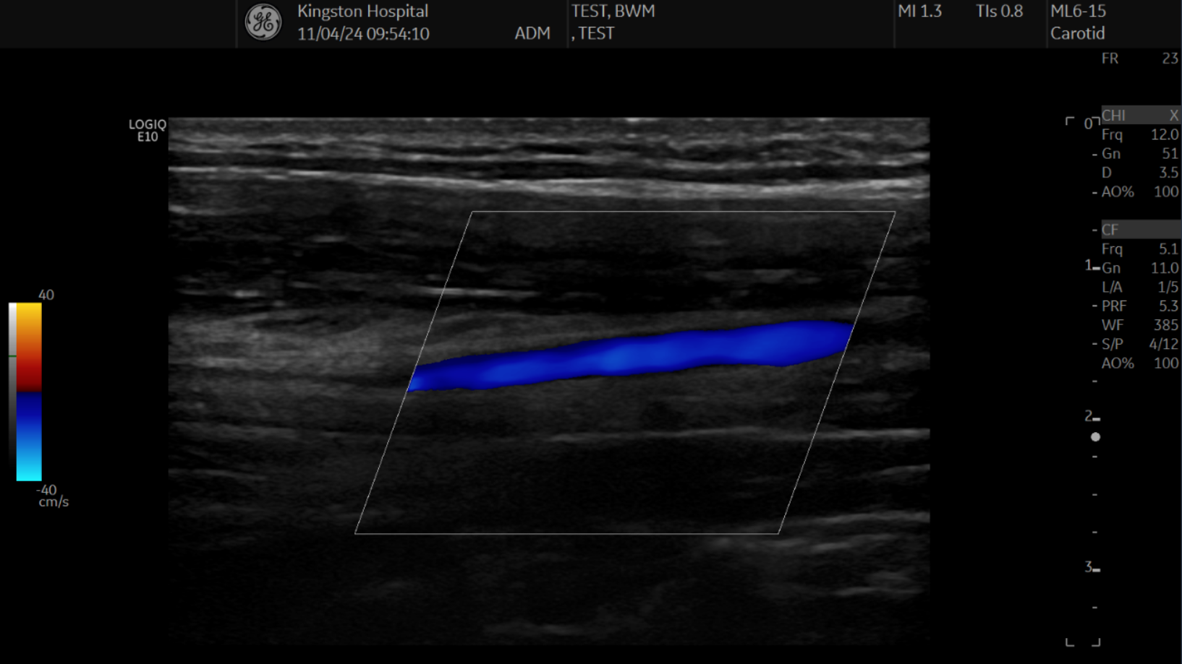

Slide 53
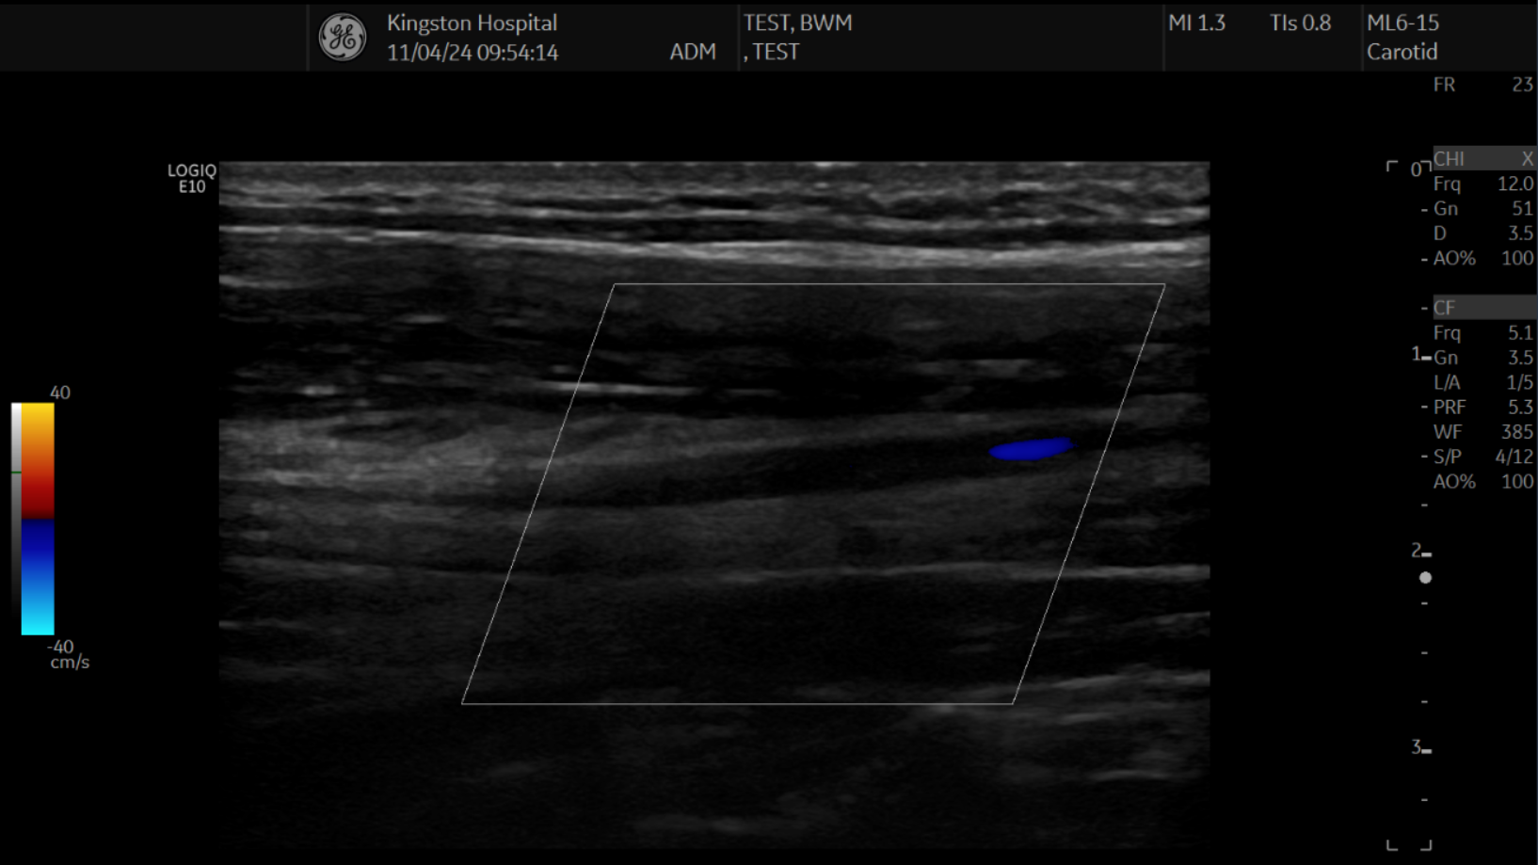

Slide 54
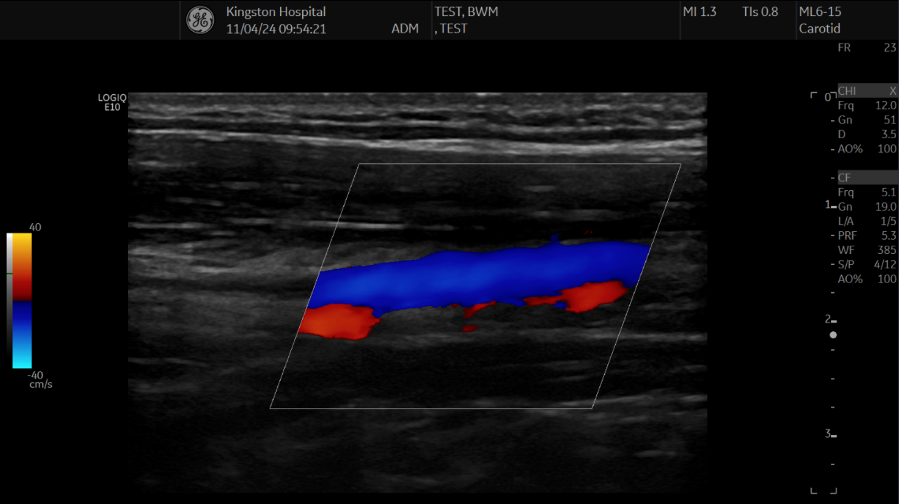

Slide 55
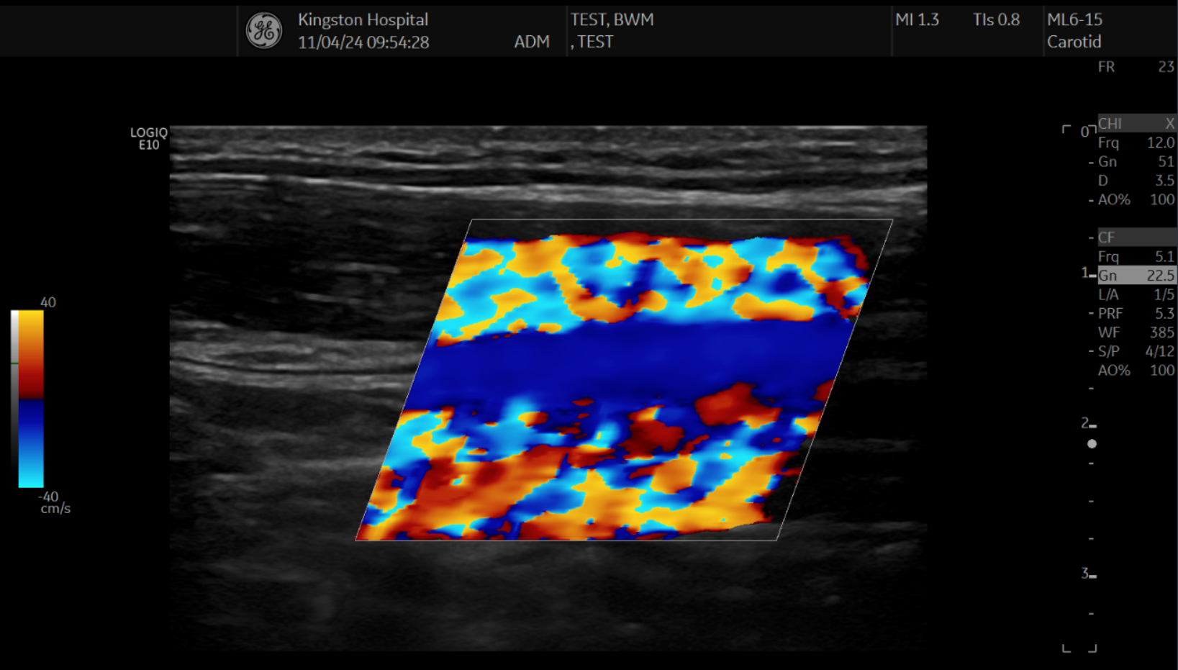

Slide 56
Colour Doppler beam angle

Slide 57
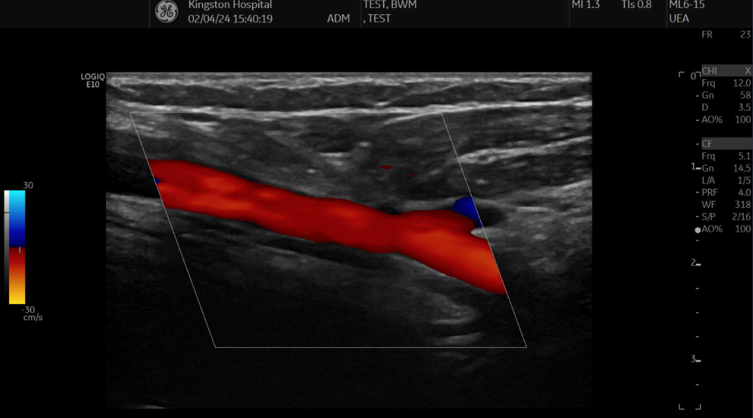

Slide 58
58°

Slide 59
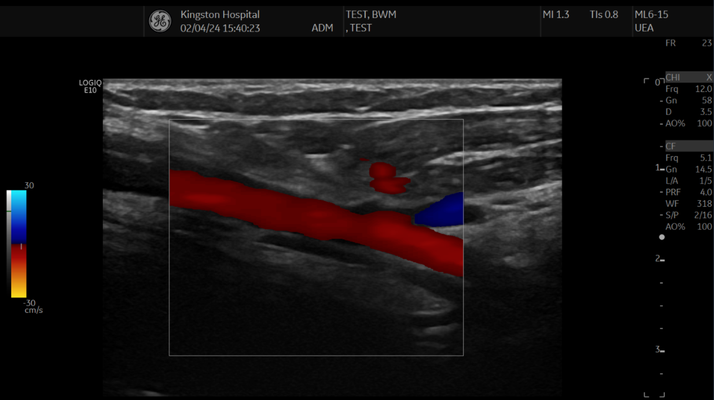

Slide 60
78°

Slide 61
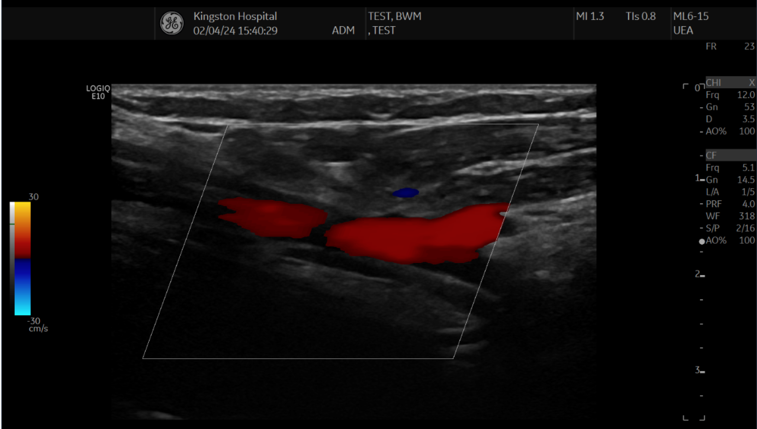

Slide 62
98°

Slide 63
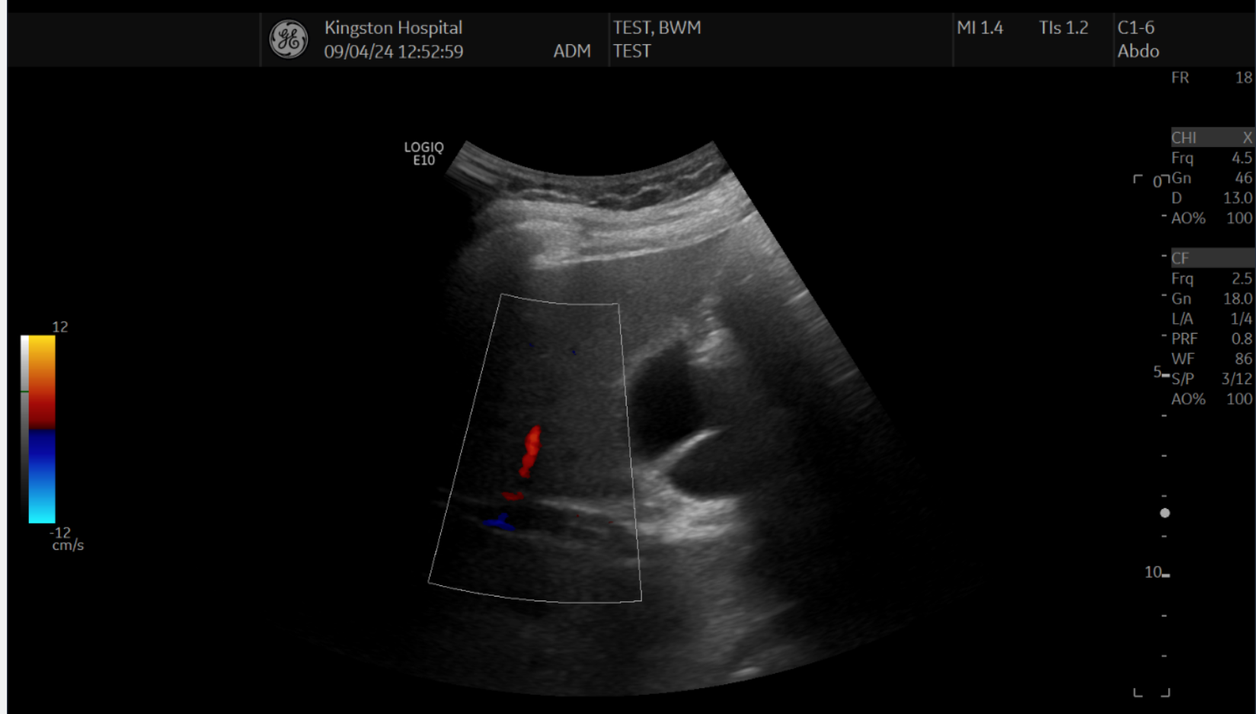

Slide 68
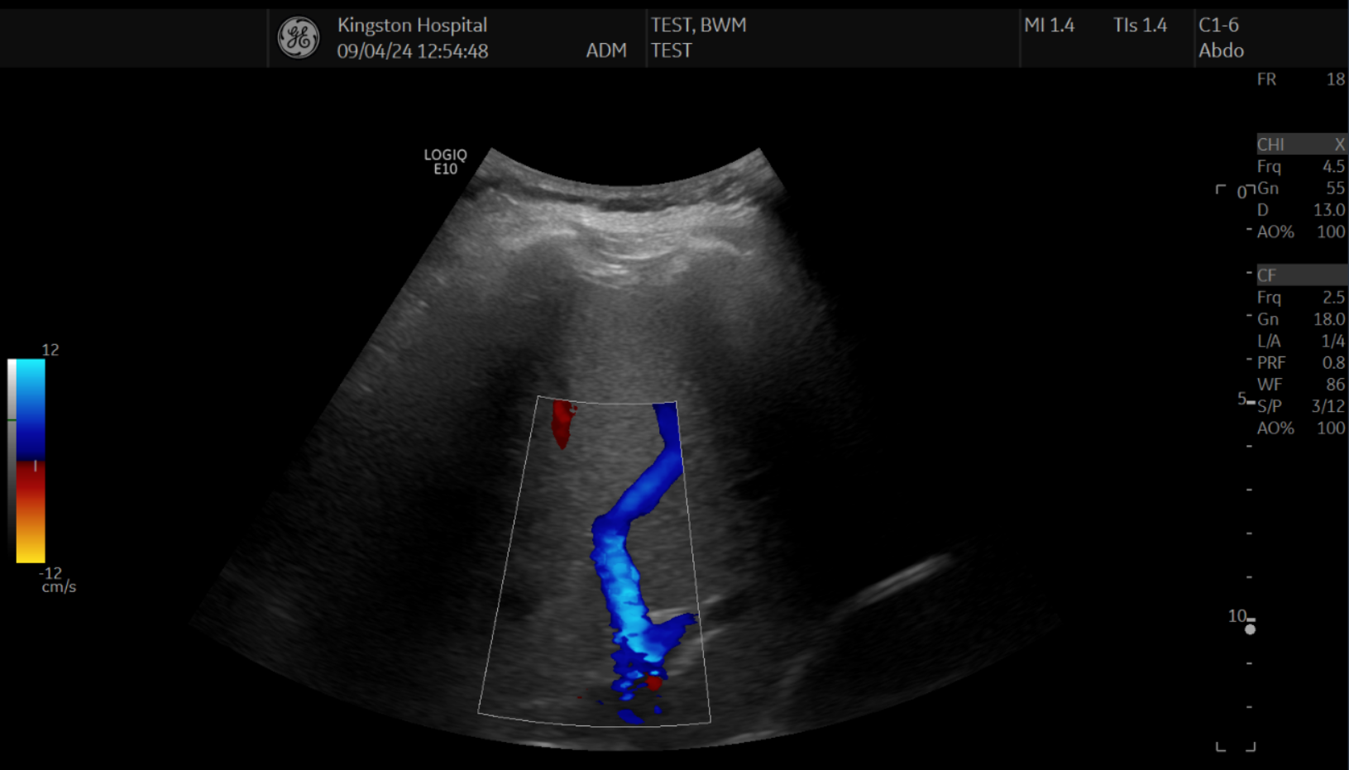

Slide 70
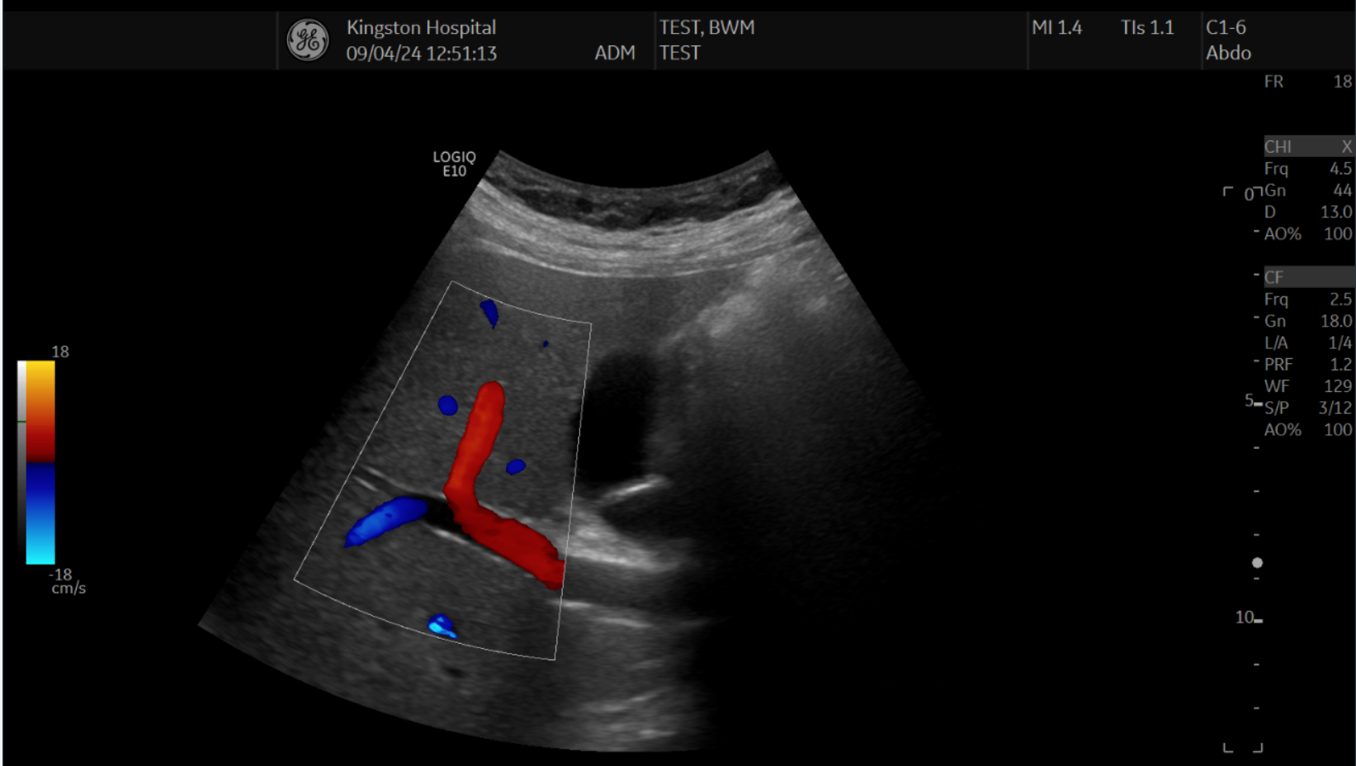

Slide 72
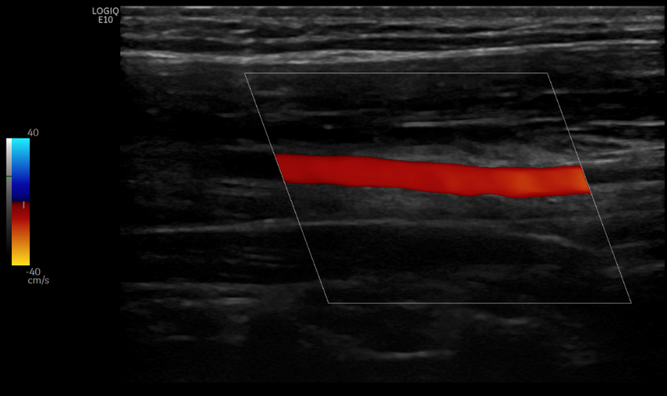
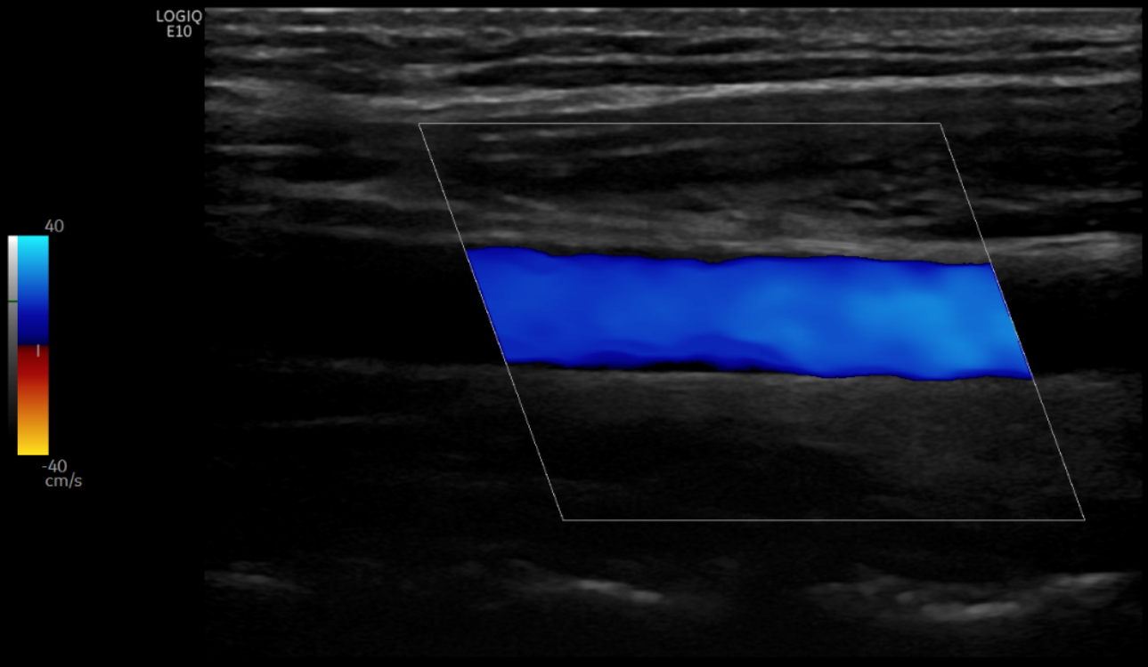

Slide 73
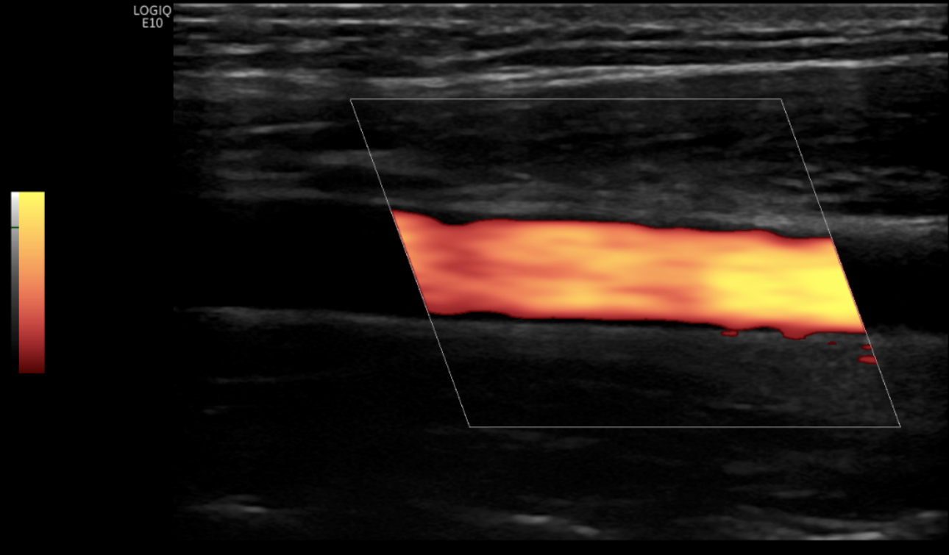
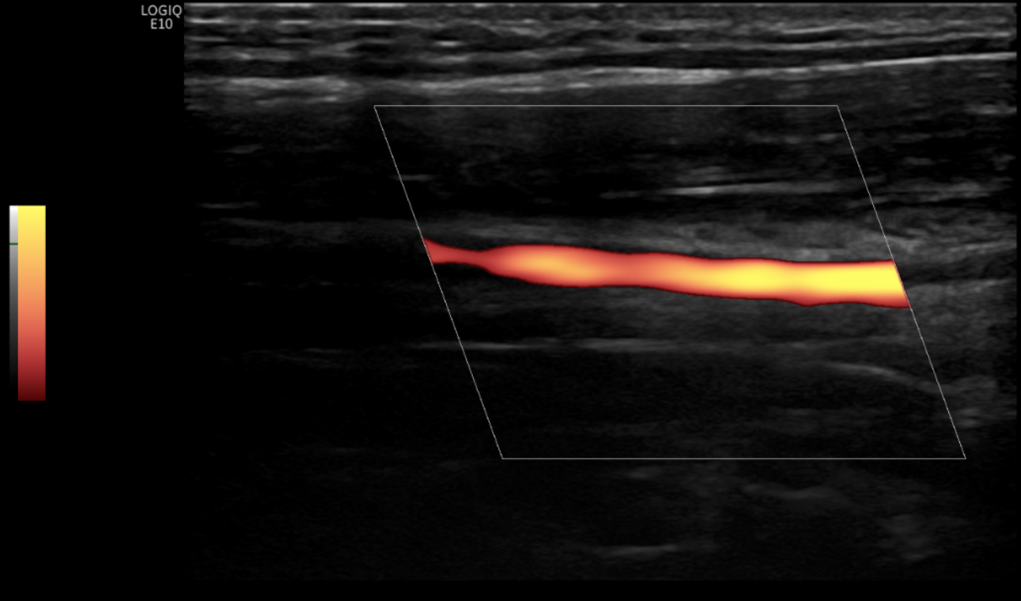
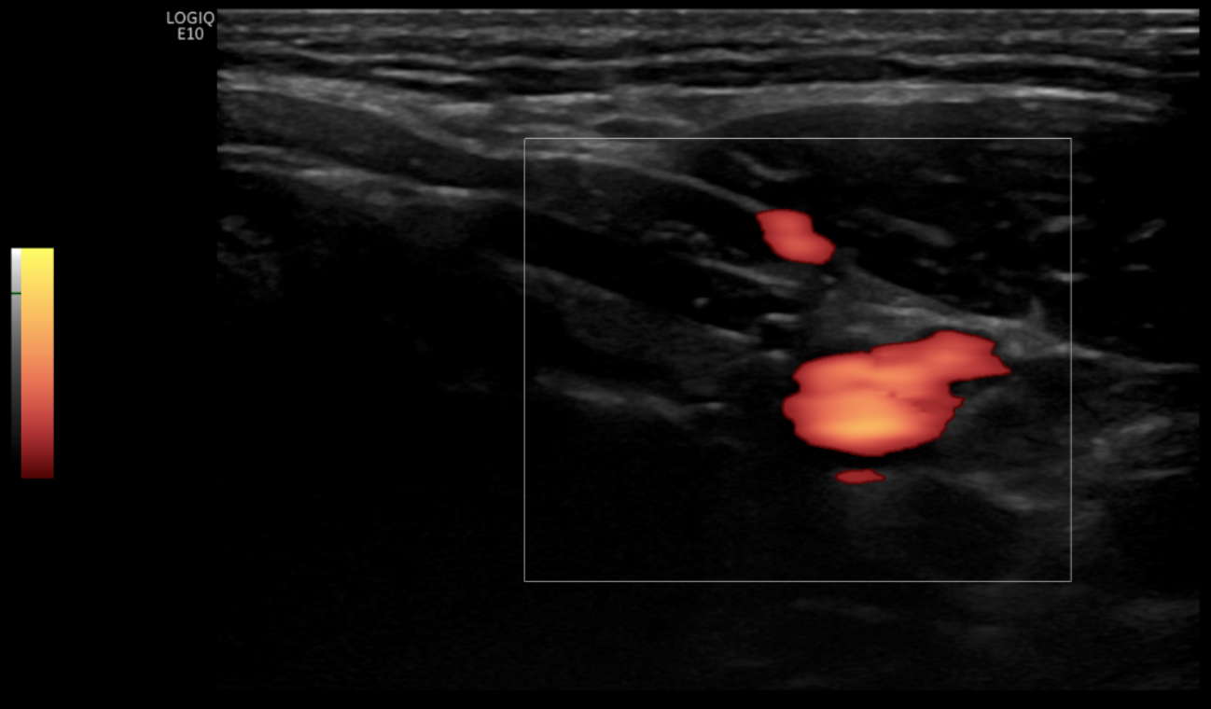

Slide 74
Spectral Doppler beam angle

Slide 75


Slide 76
53°

Slide 77


Slide 78
73°

Slide 79


Slide 80
94°

Slide 81
Doppler beam angle | Doppler angle (corrected) | Peak Systolic Velocity (cm/s) | Pulsatility index
53° | 60° | 88 | 1.8
73° | 60° | 48 | 1.9
94° | 60° | 44 | 2.3

Slide 82
Doppler angle correction

Slide 85
54°

Slide 86


Slide 88


Slide 90


Slide 92


Slide 94
Doppler beam angle | Doppler angle (corrected) | Peak Systolic Velocity (cm/s) | Pulsatility index
54° | 70° | 112 | 2.3
54° | 60° | 76 | 2.3
54° | 45° | 54 | 2.3
54° | 30° | 44 | 2.3
54° | 0° | 38 | 2.3

Slide 95


Slide 97
Spectral Doppler optimisation

Slide 98


Slide 99


Slide 100


Slide 101


Slide 102


Slide 103


Slide 104


Slide 105


Slide 106
63cm/s
55cm/s
x
52cm/s
x
x

Slide 107
Umbilical artery Doppler

Slide 108


Slide 109

Kennedy & Woodward, 2019 RadioGraphics

Slide 110
Kennedy & Woodward, 2019 RadioGraphics

Slide 112
~0°
~90°

Slide 116
~90°
~0°
~0°
~90°
~0°
~90°
~90°

Slide 117
Uterine artery Doppler

Slide 118


Slide 120
~60°

Slide 122
~90°

Slide 124
~0°

Slide 125
Middle cerebral artery Doppler

Slide 126


Slide 127

~0°

Slide 128
~90°

Slide 129
Remember:
PI / RI do not require angle correction
PSV / EDV do require angle correction
PI / RI still require good Doppler beam angle!
Angle correction
~60°
Doppler beam
angle ~60°

Slide 130
Applying Doppler settings in fetal echocardiography

Slide 131

2024 ObGynKey
Parasagittal view of the aortic arch with the brachiocephalic arteries (yellow arrow) on grayscale (A), (conventional) colour Doppler (B), power Doppler (C), and bidirectional high-definition flow (D). In B, displaying the brachiocephalic arteries can be achieved only by reducing the pulse repetition frequency, which leads to aliasing artifact within the aortic arch (white arrows). In C, power Doppler shows uniform, laminar and well-defined filling of the aortic arch (arrow) and brachiocephalic arteries. In D, high-definition flow demonstrates the most optimal display of the aortic arch (arrow) and great vessels with clear borders and uniform filling. DAO, descending aorta.

Slide 132


Apical four-chamber view of the fetal heart with colour Doppler. A large colour box is chosen (65 degrees), which results in a slow frame rate of 11 Hz (11 frames/s). A slow frame rate impedes visualization of the fetal heart on colour Doppler.
Apical four-chamber view of the fetal heart with colour Doppler. An appropriate size colour box is chosen (30 degrees), wide enough to cover the fetal heart. This results in an improved frame rate of 39 Hz (39 frames/s).

Slide 133

Apical four-chamber view of the fetal heart with colour Doppler showing the effect of colour gain on the display of colour Doppler. In A, a high-gain setting is chosen, resulting in colour overlap over the septum, mimicking the presence of an atrioventricular septal defect (star). In B, an appropriate colour gain setting is chosen, resulting in optimal display of colour flow across the atrioventricular valves during diastole.

Slide 134

Apical four-chamber view of the fetal heart with colour Doppler showing the effect of velocity scale (pulse repetition frequency [PRF]) on the display of colour Doppler. In A, a low colour Doppler velocity scale is chosen (18 cm/s), resulting in colour aliasing of blood flow across the atrioventricular valves, thus mimicking flow turbulence (open arrow). In B, the colour velocity scale is appropriately chosen (44 cm/s), resulting in optimal display of blood flow across the atrioventricular valves in diastole.

Slide 135



Slide 136

Colour Doppler
Power Doppler

Slide 137
Simply put…
Doppler ultrasound is used to investigate the presence, direction and velocity of blood flow
  For investigating presence of blood flow – use power Doppler
  For investigating direction / velocity of blood flow – use colour / spectral Doppler
The angle of blood flow in relation to the beam can affect Doppler measurements – don’t scan at 90°!
Poor optimisation can mimic pathology – if your Doppler signal is abnormal, make sure the Doppler angle, scale, gain and frequency are optimised!
Doppler angle correction affects the velocity scale and calculated PSV & EDV values
PI and RI are affected by Doppler beam angle, but not affected by Doppler angle correction

Slide 138
Doppler SOS
Is there no / poor colour signal?
  Reduce the colour scale (PRF)
  Increase the colour gain
  Change the Doppler beam angle (move the probe / sample a different section of vessel)
Is there colour bleed / aliasing?
  Increase the colour scale (PRF)
  Decrease the colour gain
Is the spectral trace abnormal? (absent damped EDV, raised PI, reduced PSV)
  Ensure Doppler beam angle is optimised
  Ensure angle correction is applied
  Sample multiple sections of the vessel for consistency
  If trace is still abnormal after Doppler optimisation – it’s probably abnormal!

Slide 139

A final note on ultrasound artefacts…
If you’re still awake!

Slide 140
Ultrasound machine assumptions
Speed of sound propagation is 1540m/s in all tissues
The ultrasound beam travels in a straight line only
The time taken after emission of a pulse for an echo to return to the transducer from an interface is directly related to the distance of the interface from the transducer
Attenuation of sound in tissue is uniform
An echo generated at an interface returns directly in a straight line without generating any secondary echoes
All echoes detected by the transducer have arisen from the central axis of the beam
The intensity or strength of the returning echo is proportional to the density of the reflector generating the echo

Slide 141

Speed of sound artefact
The machine assumes speed of sound in all tissues is 1540m/s
However, speed of sound is slower through this area, therefore the sound wave reaches this posterior section of the wall later than the adjacent sections of the wall
The machine recognises the longer echo time and assumes this section of wall is deeper in tissue

Slide 142
Speed of sound artefact
The machine assumes speed of sound in all tissues is 1540m/s
However, speed of sound is slower through this area, therefore the sound wave reaches this posterior section of the wall later than the adjacent sections of the wall
The machine recognises the longer echo time and assumes this section of wall is deeper in tissue
QUICK FIX
Adjust scanning plane to avoid having tissues of interest lying posterior to the object causing the artefact.

Slide 143

Mirror image artefact
The machine assumes that all beams travel in one straight line, and echoes only arise from the central axis of the beam
A strong specular reflector (eg. lung pleura, liver wall) may reflect the beam out of it’s axis and generate echoes from an object in a different location
The machine does not recognise the changing path of the ultrasound beam and places the structure in the assumed path of the ultrasound beam

Slide 144


Slide 145

Real subclavian artery
Lung pleura (specular reflector)
Reflection of subclavian artery

Slide 146
Real subclavian artery
QUICK FIX
Adjust scanning plane to avoid scanning directly onto the specular reflector.
Lung pleura (specular reflector)
Reflection of subclavian artery

Slide 147

Refraction artefact
The machine assumes that all beams travel in one straight line, and echoes only arise from the central axis of the beam
A refractive structure (such as the rectus abdominis muscle) may bend ultrasound beams in two different directions, resulting in duplication of the same structure

Slide 148
Refraction artefact
The machine assumes that all beams travel in one straight line, and echoes only arise from the central axis of the beam
A refractive structure (such as the rectus abdominis muscle) may bend ultrasound beams in two different directions, resulting in duplication of the same structure
QUICK FIX
Adjust scanning plane to avoid scanning through the refracting tissue.

Slide 149


Side lobe artefact
The ultrasound machine assumes that all echoes arise from the central axis of the beam
Ultrasound beams have additional, smaller beams (‘lobes’) arising at the side of the beam, which can generate separate echoes
The machine assumes these echoes come from the main axis, and displays them as such on the image

Slide 150
Side lobe artefact
The ultrasound machine assumes that all echoes arise from the central axis of the beam
Ultrasound beams have additional, smaller beams (‘lobes’) arising at the side of the beam, which can generate separate echoes
The machine assumes these echoes come from the main axis, and displays them as such on the image
QUICK FIX
Adjust scanning plane to move side lobes. This should remove or change the appearance of the artefact. A genuine solid mass will be visible from multiple planes.

Slide 151
Acoustic attenuation artefacts
The machine assumes that the ultrasound beam is uniformly attenuated by tissues, and corrects for this phenomenon via time-gain compensation
Dense structures will attenuate the ultrasound beam more, therefore posterior tissues will appear darker due to the reduced ultrasound beam intensity
Fluid-filled structures will not attenuate the ultrasound beam, therefore posterior tissues will appear brighter due to the increased ultrasound beam intensity

Slide 152


Acoustic shadowing – dense structure attenuates ultrasound beam, causing posterior shadowing
Acoustic enhancement – fluid-filled structure does not attenuate ultrasound beam, causing posterior enhancement

Slide 153
QUICK FIX
Adjust scanning plane to avoid tissues of interest being positioned directly behind the object causing the artefact.
Acoustic shadowing – dense structure attenuates ultrasound beam, causing posterior shadowing
Acoustic enhancement – fluid-filled structure does not attenuate ultrasound beam, causing posterior enhancement

Slide 154

‘Twinkle sign’
Generation of alternating colours behind a strongly reflective surface (eg. calcified plaque) – may be mistaken for colour aliasing caused by a tight stenosis
Above-left: apparent ulcerated plaque
Above-right: adjusting settings reveals a twinkle artefact giving the impression of ulceration

Slide 155
‘Twinkle sign’
QUICK FIX
Increase colour scale (PRF) and adjust colour gain. Genuine blood flow will be altered by changing settings, whereas the artefact will likely remain. Additionally, adjust imaging plane.
Generation of alternating colours behind a strongly reflective surface (eg. calcified plaque) – may be mistaken for colour aliasing caused by a tight stenosis
Above-left: apparent ulcerated plaque
Above-right: adjusting settings reveals a twinkle artefact giving the impression of ulceration

Slide 156

Element dropout
Complete drop-out of signal in one section of the image, regardless of where the probe is placed
Indicates a broken transducer element
Important to perform frequent QA to identify malfunctioning elements

Slide 157
Element dropout
Complete drop-out of signal in one section of the image, regardless of where the probe is placed
Indicates a broken transducer element
Important to perform frequent QA to identify malfunctioning elements
QUICK FIX
Call an engineer!

Slide 158
Artefacts: friend or foe?
Artefacts may be helpful when performing diagnostic scans:
  Acoustic shadowing and acoustic enhancement give information about the density of structures
  Speed of sound error may identify heterogeneous structures within tissues (e.g. liver mass)
  Colour aliasing is useful for identifying high-velocity jets caused by stenoses
  Twinkle artefact is useful for identifying calcified plaques or fibroids

Slide 159
Thanks for listening!
Sorry for droning on!

