Slide 1
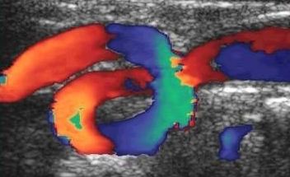
Doppler Ultrasound
Nicholas F Killough BSc. MSc.
Senior Clinical Vascular Scientist
Ulster Hospital

Slide 2
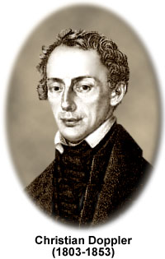
Christian Doppler
19th century Austrian professor of Mathematics & Physics.
Concluded from theory that frequency of sound heard from moving objects will change according to its speed and direction.
Later this was verified by an experiment.
Notes:
1841 Attended Prague Polytechnic
1850 Head of the institute of experiment Physics in Vienna University
Doppler died on 17 March 1853 at age 49 from a pulmonary disease in Venice.

Slide 3
What is the Doppler effect?
You hear the high pitch of the siren of an approaching ambulance, and notice that its pitch drops suddenly as the ambulance passes you.
When the ambulance approaches the sound waves “bunch up”. The frequency or pitch of the siren is higher as a result.
When the ambulance travels away from you the sound waves “stretch out”. The frequency or pitch of the siren is lower as a result.
Notes:
If a source is emitting sound waves, the frequency of reflected sound from an object in its path increases or decreases if the object is moving towards or away from the source respectively.
This is the Doppler effect (Christian Andreas Doppler (1803–1863), an Austrian mathematician) and the change in frequency is the Doppler shift.
Ultrasound from a stationary probe directed towards flowing blood detects a Doppler shift from red blood cells that is proportional to blood flow velocity and well within the audible range.

Slide 4
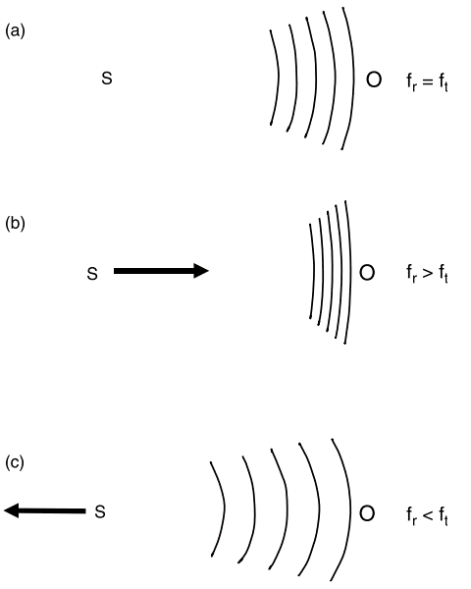
What is the Doppler effect?
The Doppler eﬀect as a result of motion of the source (S) relative to a stationary observer (O).
  There is no motion and the observer detects sound at a frequency equal to the transmitted frequency.
  The source moves towards the observer and the observer detects sound at a higher frequency than that transmitted.
  The source moves away from the observer and the observer detects a lower frequency than that transmitted.

Slide 5
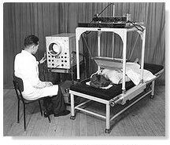
Development of Doppler Ultrasound
Medical applications of the ultrasonic Doppler techniques were first implemented in Osaka, Japan in 1955 for the study of cardiac valvular motion and pulsations of peripheral blood vessels

Slide 6
The Doppler shift frequency
F_{d}= F_{r}- F_{t}
F_{d}- Frequency detected (Doppler shift)
F_{r}- Frequency received
F_{t}- Frequency transmitted
Notes:
The difference between the received and transmitted frequency is known as the Doppler shift frequency. The Doppler shift from moving blood is in the low kilohertz range e.g. The audible range.

Slide 7
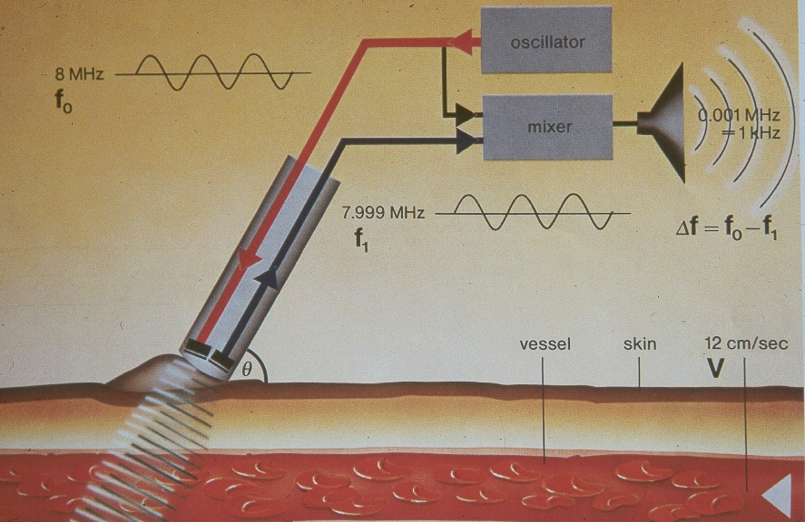
The Doppler shift frequency
Example
Notes:
Putting values into the Doppler equation for the velocities found within the body and the transducer frequencies used the Doppler frequencies detected are in the middle of the audible range ie: 0-15kHz.
The simplest way of appreciating the Doppler signal is therefore to put the detected output through a loudspeaker. Where the direction of flow is detected, flow towards and away from the transducer may be played through two speakers eg:stereo headphones on a hand held Doppler.

Slide 8
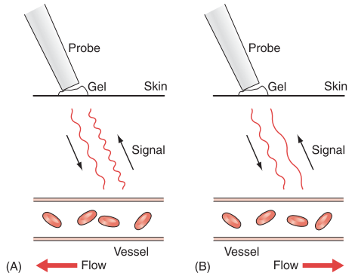
The Doppler shift
Doppler shift
  A: Blood moving towards the probe produces a positive Doppler shift.
  B: Blood moving away from the probe produces a negative Doppler shift.
Notes:
Why do we use Doppler?
To detect flow in vessels.
Detect the direction of flow.
Detect the type of flow: Arterial pulsatile flow or slow phasic venous flow.
Detect the type of flow: Normal vs. abnormal
To measure the velocity of blood flow.

Slide 9
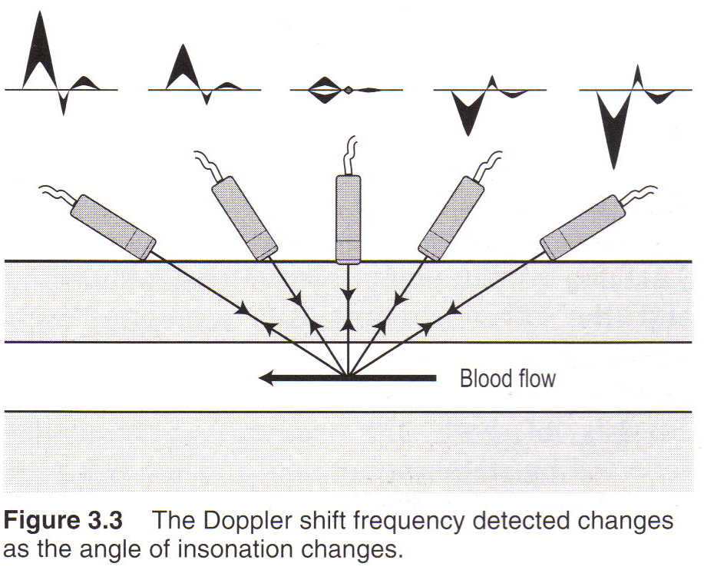
The Doppler shift and angle of insonation

Slide 10
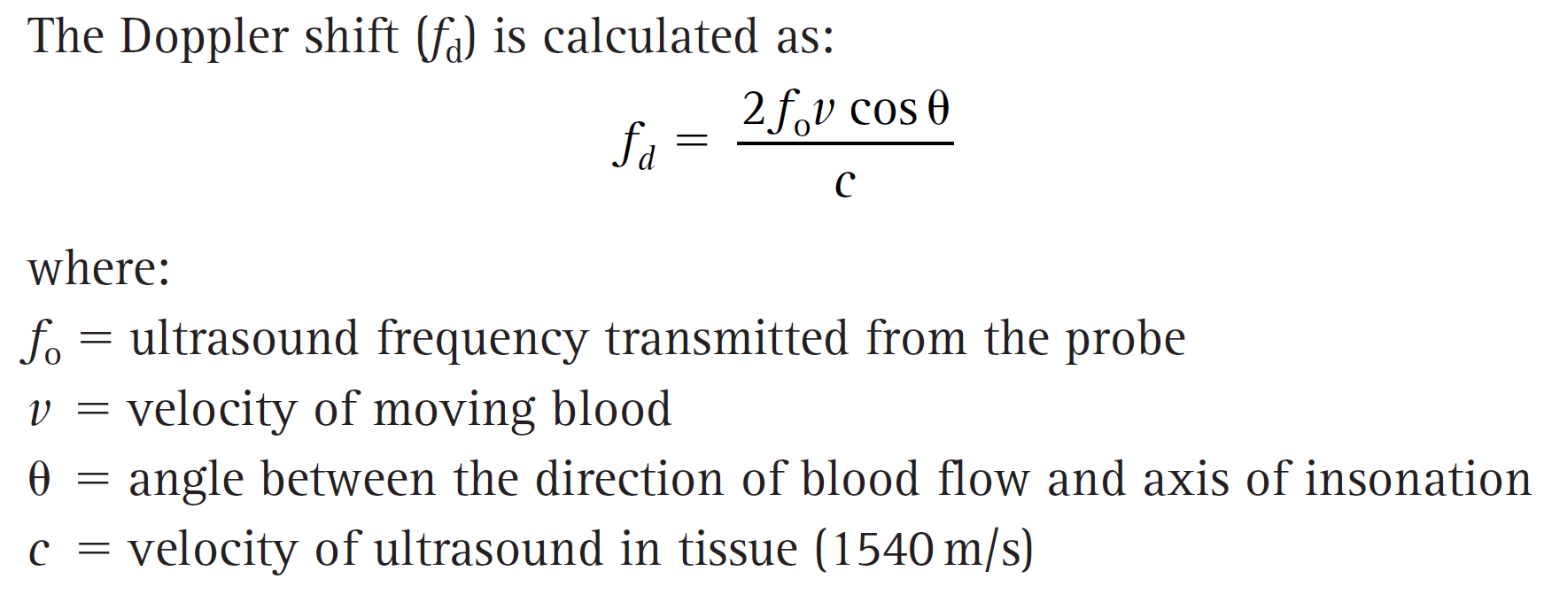
The Doppler equation
Notes:
Blood cell moving v=50cm/s
Transmitted frequency f_{o}= 3 MHz
Speed of sound in soft tissue c = 1540 m/s
Angle of insonation = 60°
So f_{d} = 2kHz (ie. audible frequency)

Slide 11
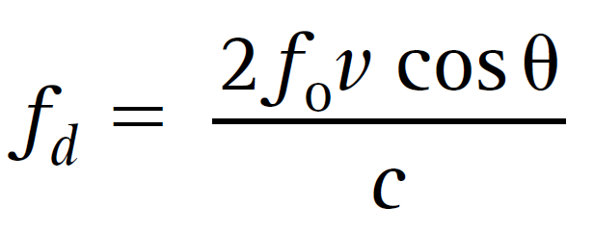
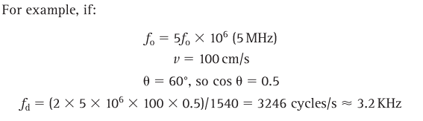
The Doppler equation and detected frequency

Slide 12
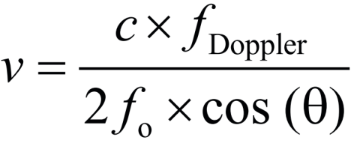
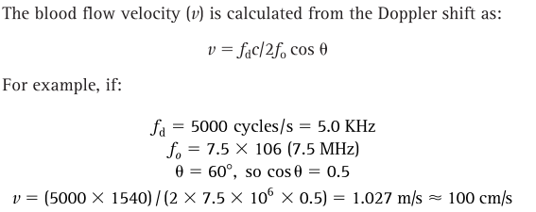
The Doppler equation and speed of blood
⁶

Slide 13
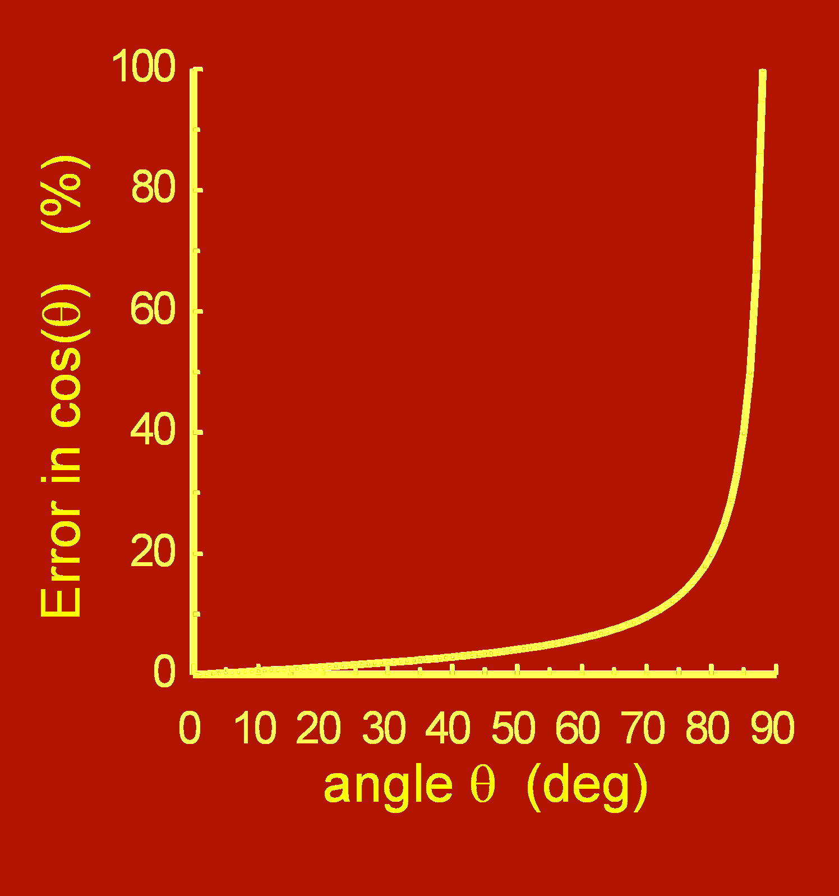
Error and the Doppler Angle
Doppler Angle
  As the angle increase past 60° the percentage error in the calculation of the frequency increases.
  We use ≤60° in vascular ultrasound as the majority of blood vessel are parallel with the surface of the skin and the % error is within reasonable margins.
Notes:
It is well known that using a Doppler angle of greater than 60° increases the risk of error in determining the velocity because the error due to the cosine term in the Doppler equation increases along with the increasing Doppler angle. Although an error of 5° made in measuring velocity measurement at a 45° Doppler angle causes an error of only 9%, this error becomes 16% at 60° and 26% at 70°. The other source of error in connection with the Doppler insonation angle is the intrinsic spectral broadening (ISB) effect of linear transducers

Slide 14
Error and the Doppler Angle
⁶
v = (7700000/(15000000*cos(θ))
v = 0.513· / cos (θ)
θ = 60° v=1.026m/s
θ = 45° v= 0.707m/s
θ = 15° v=0.531m/s
θ = 80° v=2.96m/s

Slide 15
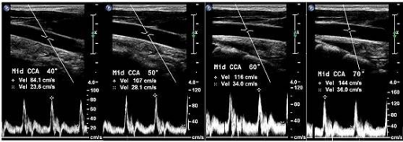
Error and the Doppler Angle
40°
PSV- 84.1cm/s
50°
PSV- 107cm/s
60°
PSV- 116cm/s
70°
PSV- 144cm/s

Slide 16
Types of Doppler
Continuous wave Doppler
Colour Doppler (Duplex)
Spectral Doppler (Duplex)
Spectral and Colour Doppler (Triplex)
Power Doppler

Slide 17
Colour Doppler (Duplex)
Standard ultrasonic pulse-echo imaging generates anatomical cross-sectional images of the body (B-Mode).
In the case of ultrasound colour flow imaging, known as colour Doppler imaging (Duplex), a colour map depicting movement is superimposed on the B-mode image.

Slide 18
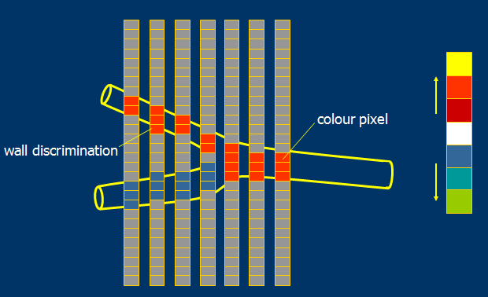

Colour Flow Mapping
Notes:
The colour map determines which colours are assigned to the detected Doppler shift.
The colour map has two channels a + and -.
The channels are separated by a black line known as the baseline (Wall filter).
The channel above is always the positive channel.
The channel below is always the negative channel.
In a typical map the shades of colour closer to the baseline are dark and become lighter further away from the baseline.
The end of each channel farthest from the baseline is called the Nyquist limit. ( Named after electronic engineer Harry Nyquist)

Slide 19
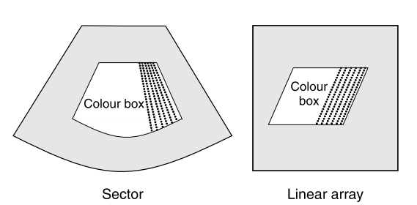
Colour Flow Box
Notes:
Colour imaging involves multi-gate sampling and its sensitivity can be increased and decreased by changing the packet size.
The Colour box is the region of the display within which the colour Doppler information is displayed.
The Colour box is superimposed over the region of grey scale imaging. The shape of the box varies depending on the type of transducer selected.
Linear arrays produce rectangular boxes which can be steered left and right typically by 10-20°.
Convex arrays and phased arrays have a sector shape these can not be steered.
As we increase the size of the box frame rate is reduced.

Slide 20
Detecting the Doppler shift
To detect Doppler shifts we can use one of two process
  Time-domain processing
  Phase-shift processing
The time-domain approach is more mathematically intensive but carries a greater degree of accuracy. This method requires extensive computing power and is used in spectral formation.
The Phase-shift approach is less accurate but can be calculated quickly by assessing changes in the phase of the sound waves sent and received, this is used in colour imaging.

Slide 21
Detecting the Doppler shift
Autocorrelation – Phase Shift
The autocorrelator is a device for use in colour flow systems which estimates the quantities displayed in the colour flow image.
Autocorrelation compares a signal with a previous version of itself to detect what changes have taken place.
This device and modifications of the device are used as the basis for virtually all commercial colour flow systems.
Notes:
In the autocorrelator technique, the colour system sends multiple pulses down each scan line to detect the Doppler shift.
The number of pulses sent down each line is called the packet size or ensemble length.
The minimum packet size is 3 and the maximum is 32. A typical packet size used in colour imaging is between 7-10.
Larger packet sizes uses a greater number of pulses to generate each colour line. This improves the accuracy of the Doppler shift detected.
However it will have a negative impact on frame rate because it will take longer to generate each scan line. A balance is made between frame rate and sampling accuracy.

Slide 22
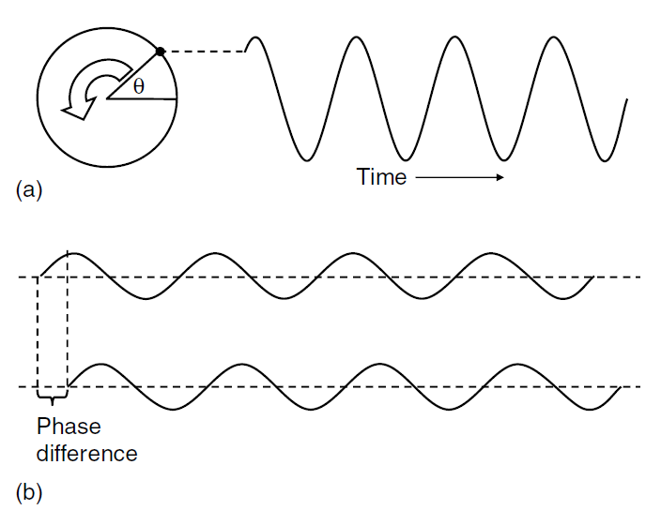
Detecting the Doppler shift
Autocorrelation – Phase Shift
0 40
Notes:
Phase describes the position within a cycle of oscillation and is measured in degrees.
Two waves of the same frequency and amplitude can be compared in terms of their phase difference.
In this example there is a phase difference of 40°

Slide 23
Detecting the Doppler shift
Autocorrelation – Phase Shift
Phase 1
(Stored)
Autocorrelator
F_{d} mean
Phase 2
Variance
Δθ
Phase difference
Notes:
Example single target (θ_{d} = 40°)
F_{t} = 3MHz
C=1540m/s λ=c /F_{t} λ=0.513.mm
PRF= 16KHz
If the target has caused a phase change of 40°
Then the target has moved 40/360 (0.11.) of the λ
0.11 of 0.513mm = 0.057mm
If the PRF is 16KHz
Then one cycle takes 1/16KHz = 62.5μs
In 62.5μs the target moved 0.057mm/2 (go and return signal)
Velocity = distance/ time ∴ 0.057/ (2*62.5μs) = 456.29mm/sec
The Doppler equation
F_{d} =((2*0.456m/s*3x10⁶ ) /1540) = 1777.78 Hz or 1.78KHz
Frequency from the autocorrelator
The phase changed by 0.11 periods in 62.5us.
Therefore the time to complete one cycle = 62.5/0.11 = 568us
One period takes 568us then the detected frequency is the reciprocal of this
1/568=0.0017605633802817MHz
=1.76KHz
Difference of 20Hz. This is reduced by increasing the sample number.
The autocorrelator produces one value for frequency at its output.
In the case of a single velocity target this will be the Doppler frequency of that target as shown above.
In the majority of cases there will be multiple moving targets and as a results multiple frequencies will be present.
The output will then be the mean of the Doppler frequency of all the velocities present.

Slide 24
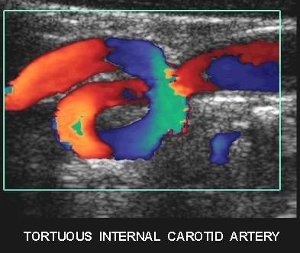
Colour indicates flow direction
Dark red to dark blue through black is a change in direction
Notes:
Lower magnitude shift are assigned shades closer to the baseline while higher magnitude Doppler shifts are assigned shades further from the baseline.
If a shift exceeds the Nyquist limit it is mapped with a lighter shade from the opposite channel. This is called aliasing.
(The Nyquist frequency, named after electronic engineer Harry Nyquist, is half of the sampling rate of a discrete signal processing system.)
PRF/2= Nyquist limit
A lesser used function in colour Doppler is the variance mapping. This is a specialised form of colour mapping that displays one additional piece of information.
The variance map displays both the colour channels with an additional colour to indicate locations in the colour box from which a wide range of Doppler shift are being detected.
Turbulent blood flow is the most common cause for a wide degree of variance.
Variance maps are primarily used in paediatric echocardiography. (Ventricular and atrial septal defects.)

Slide 25
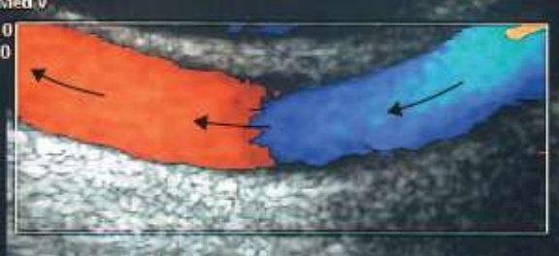
Colour indicates flow direction
Dark red to dark blue through black is a change in direction
Notes:
Lower magnitude shift are assigned shades closer to the baseline while higher magnitude Doppler shifts are assigned shades further from the baseline.
If a shift exceeds the Nyquist limit it is mapped with a lighter shade from the opposite channel. This is called aliasing.
(The Nyquist frequency, named after electronic engineer Harry Nyquist, is half of the sampling rate of a discrete signal processing system.)
PRF/2= Nyquist limit
A lesser used function in colour Doppler is the variance mapping. This is a specialised form of colour mapping that displays one additional piece of information.
The variance map displays both the colour channels with an additional colour to indicate locations in the colour box from which a wide range of Doppler shift are being detected.
Turbulent blood flow is the most common cause for a wide degree of variance. Variance maps are primarily used in paediatric echocardiography. (Ventricular and atrial septal defects.)

Slide 26
Interpreting Colour
dark red to dark blue - through black
  change in direction of flow
yellow to green - “over the top”
  high velocities (aliasing)

Slide 27
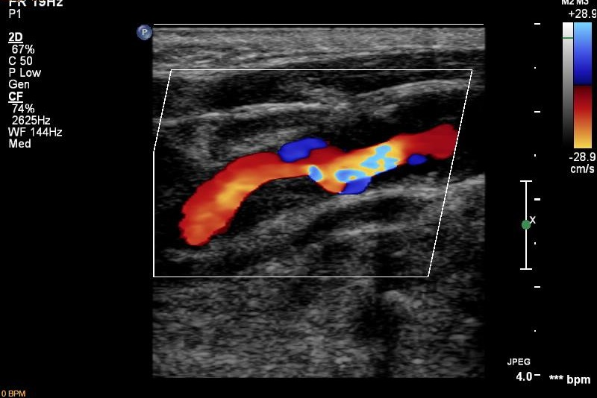
Colour aliasing
Internal Carotid Stenosis
Notes:
Aliasing is a Doppler artefact that can occur with both colour and spectral Doppler displays.
Aliasing occurs when the detected Doppler shift exceeds the upper limit that the system can accurately detect.
This upper limit is called the Nyquist limit.
When a detected Doppler shift exceeds the Nyquist limit it is erroneously wrapped around and displayed in the upper end of the opposite channel.
This can sometimes limit your diagnostic ability but is more commonly used as a tool to hone in on the point of greatest narrowing.

Slide 28
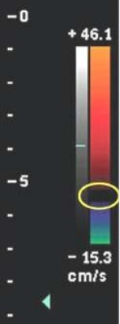
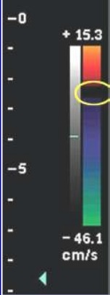
Changing the colour baseline
Notes:
When colour baseline is changed the colour velocity range is changed.
The range is depicted on the top and bottom of the positive and negative channels in cm/s or as a PRF value KHz.

Slide 29
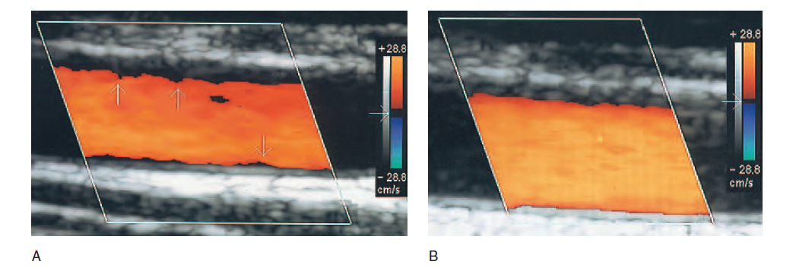
Changing the colour baseline
Notes:
Effect of using the filter.
A: The filter is set too high, removing the low-velocity flow near the vessel walls (vertical arrows).
B: The filter setting is reduced to display the low frequencies detected near the vessel walls.
The filter setting may be displayed on the colour scale (horizontal arrows).

Slide 30
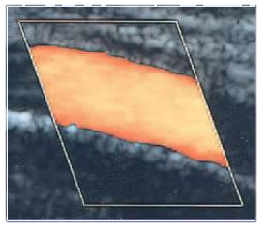
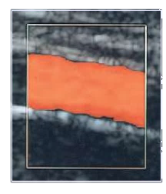
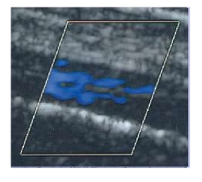
Colour box steering
Small angle Moderate angle Large angle
Good Image Flow is not optimal Unusable image
Steered either left or right by a maximum of 10-25 degrees depending on the machine. The sensitivity of the transducer decreases as the beam is steered.

Slide 31
Changing the colour controls
Gain
Notes:
No blood–tissue discriminator present – there is colour throughout the colour box consisting of a uniform colour
in the region of flow, surrounded by random noise in the surrounding regions.

Slide 32
Changing the colour controls
Gain
Notes:
Application of the Doppler amplitude threshold using the colour gain removes most of the colour from the region of no flow; however, there is some ‘bleeding’ of the colour into the tube.

Slide 33
Changing the colour controls
Colour write priority
Notes:
Application of the B-mode amplitude threshold using colour write priority removes the bleeding.

Slide 34
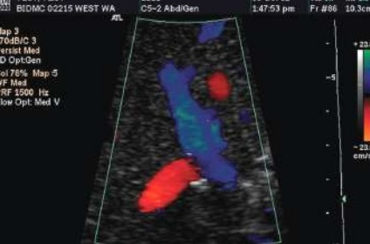
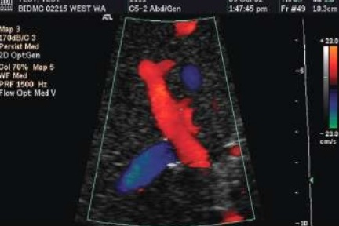
Changing the colour controls
Inversion of colour flow
Portal venous flow appears blue falsely suggesting flow reversal
Using colour inversion we can correct the displayed image to appropriately depict the correct flow direction

Slide 35
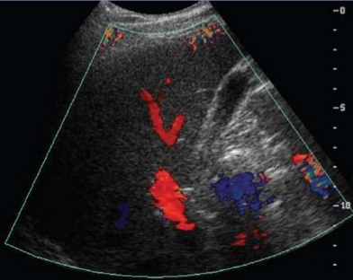
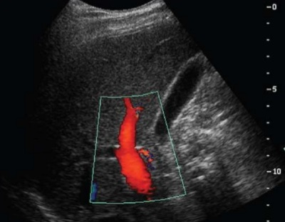
Colour box size and Frame rate
12fps
26fps
Large colour box reducing frame rate and colour resolution
Reducing the size of the box improves frame rate and colour resolution
Notes:
As we increase the size of the colour box we need to send more pulses to generate the requested information. This has a detrimental effect on frame rate.
Oversized colour boxes cause decreased frame rates and decreased resolution of the colour information displayed.
Reducing the size increases frame rate and increases the resolution of the colour information displayed.
Colour boxes should be kept as small and superficial as possible.

Slide 36
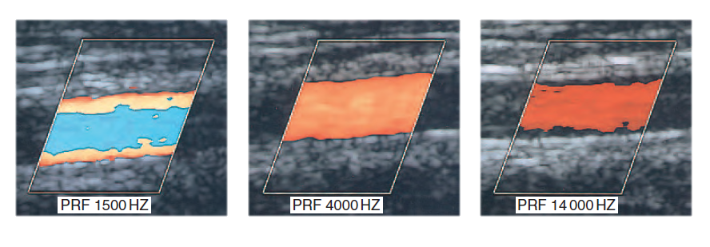
Colour Aliasing
Notes:
Aliasing.
A: This will lead to the assignment of the incorrect colour to represent the velocity present within the vessel, shown here in blue.
B: Increasing the PRF may overcome aliasing.
C: If the PRF is set too high it may prevent low velocities present at the vessel walls from being detected.

Slide 37
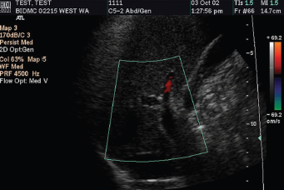
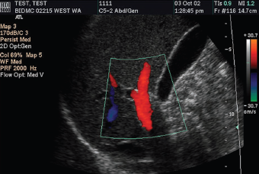
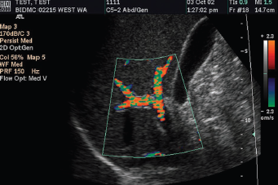
Adjusting color velocity scale
High color velocity scale (69 cm/sec)
Apparent absence of flow in PV
Color velocity scale 30 cm/sec
Normal flow in a patent PV
Color velocity scale 2 cm/sec
Color aliasing in PV & its branches
Kruskal JB et al.RadioGraphics 2004 ; 24 : 657 – 675.

Slide 38
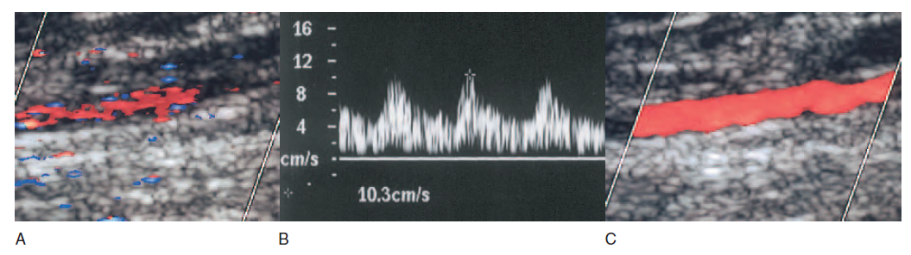
Low flow
Notes:
A: Poor colour filling is seen in the posterior tibial artery distal to a long arterial occlusion because the PRF is set too high at 2500 Hz, and the colour controls have not been optimized.
B: The Doppler waveform confirms low-velocity damped flow with a peak systolic velocity of 10 cm/s.
C: In order to improve the colour flow display, the PRF has been lowered to 1000 Hz, the colour write priority increased and the colour sensitivity control increased.
Note that only 79% colour gain is needed in image C, compared to 85% in image A.

Slide 39
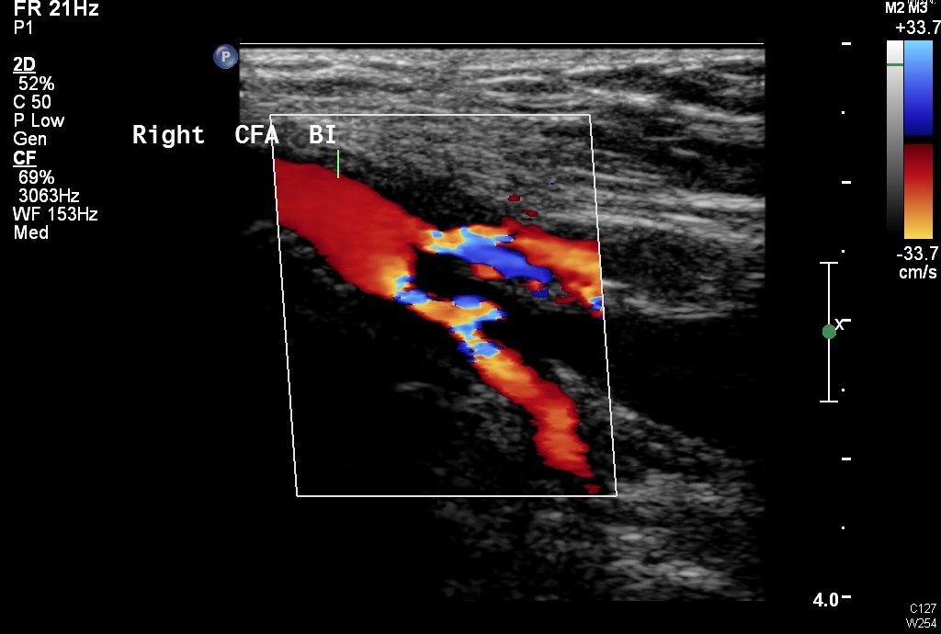
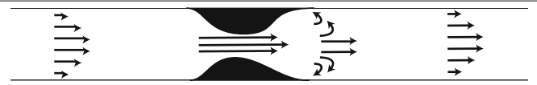
Colour aliasing
SFA and Profunda Stenosis on Colour
Notes:
Example aorto-bi-fem with SFA and prounda origin stenosis.

Slide 40
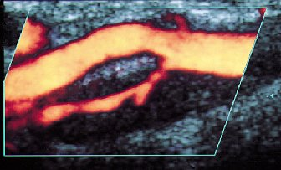
Power Doppler
Power Doppler simply displays the power of the Doppler signal.
This makes it easier to distinguish small vessels with low echoes. In its basic form it just displays the presence of moving blood, but it does not indicate the velocity or direction of flow.
It has the advantage that it is not dependent on the angle of insonation and it has higher sensitivity compared with colour flow.
Notes:
Power od the Doppler signal.

Slide 41
Power Doppler
Disadvantages
  No directional information (some new machines have directional information on their curved arrays)
  No information is provided about the velocity of the flow
  Very motion sensitive- not suitable for rapid scanning along vessels.
Advantages
  No aliasing
  Angle independent
  Increased sensitivity to detect low-velocity flow
  Superior depiction of plaque surface morphology (Particularly ulceration)
  Useful for imaging tortuous vessels
  Increases accuracy of grading stenosis when using calliper placement

Slide 42
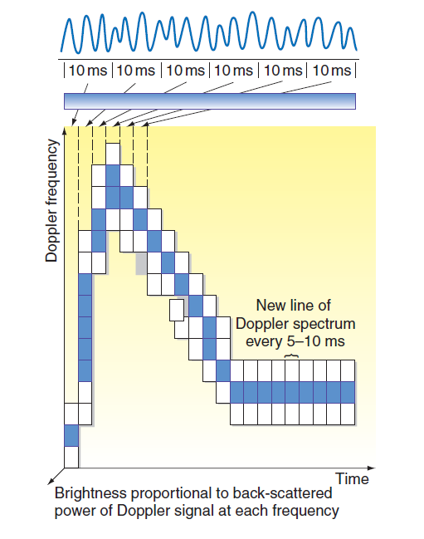
Pulse wave Doppler
Pulsed Doppler provides the most information about blood flow.
Pulsed Doppler is a form of spectral Doppler. This means that it displays a graphical depiction of the detected Doppler shifts, as a spectra, from the flowing blood.
The other spectral Doppler modality is continuous wave Doppler.
Notes:
Spectral analysis of the Doppler signal enables the frequencies present within the signal to be displayed as consecutive spectra.
This produces a display of the changes in blood velocity over time.

Slide 43
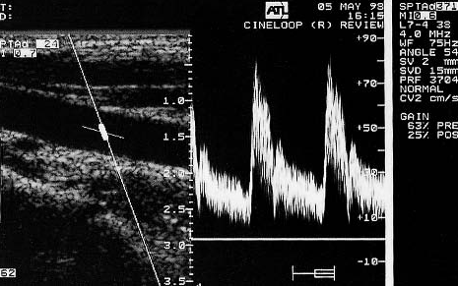
Spectral Doppler
Beam path
PSV
Sample volume
EDV
Angle correction
cursor
Baseline
Thrush A, Hartshorne T. Peripheral vascular ultrasound: How, why and when.
Elsevier Churchill Livingstone, London, 2nd edition, 2005.

Slide 44
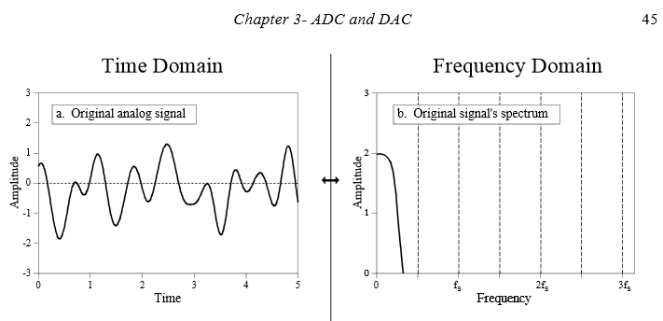
The fast Fourier transform (FFT) and time domain processing
Notes:
A spectrum analyser calculates the amplitude of all of the frequencies present within the Doppler signal, typically using a method called the ‘fast Fourier transform’ (FFT), in which a complete spectrum is produced every 5–40 ms.
In the spectral display the brightness is related to the power or
amplitude of the Doppler signal component at that particular Doppler frequency.
The high speed with which spectra are produced means that detailed and rapidly updated information about the whole range of velocities present within the sample volume can be obtained.

Slide 45
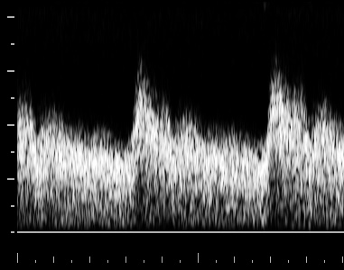
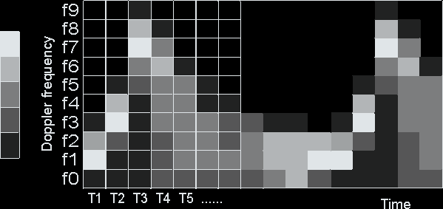
Doppler Spectral analysis
Notes:
Spectral analysis is used in these machines to produce a frequency spectrum showing time on the horizontal axis and Doppler frequency shift on the vertical axis.
The baseline corresponds to zero Doppler shift.
The spectrum contains information on the speed and direction of blood flow.

Slide 46
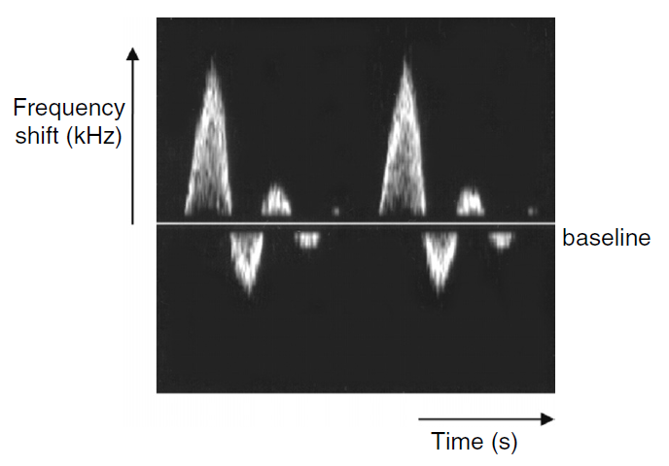
Pulse wave Doppler
Notes:
Spectral display. This is a display of the Doppler frequency shift versus time.
The Doppler waveform from the femoral artery is shown.
Vertical distance from the baseline corresponds to Doppler shift, while the greyscale indicates the amplitude of the detected ultrasound with that particular frequency.

Slide 47
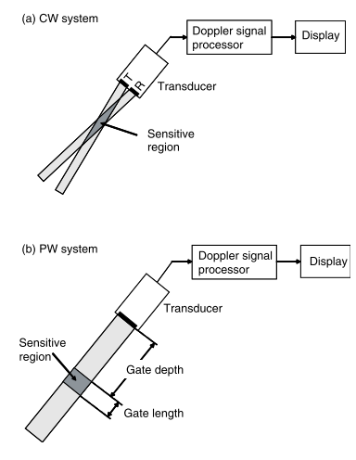
Pulse wave (PW) vs Continues wave (CW)
Notes:
CW transducers use two crystals with one set to continually send signals and the other set to continually listen for returning signals.
PW systems use an array of crystals and spend most of the time listening for returning echoes.

Slide 48
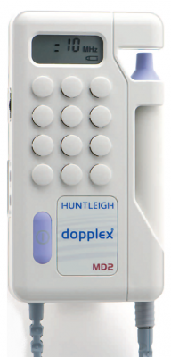
Continues wave Doppler
Notes:
Doppler demodulation for CW Doppler.
Reference signal of frequency f t .
Detected signal which has been Doppler-shifted and whose frequency is f r = f t + f d .
The reference signal is multiplied by the detected signal.
The high-frequency oscillations are removed by low-pass filtering.
The end result is the Doppler frequency shift signal f_{d} (the example shown contains no clutter).
A high-pass filter is an electronic filter that passes signals with a frequency higher than a certain cutoff frequency and attenuates signals with frequencies lower than the cutoff frequency. A low-pass filter does the opposite.

Slide 49
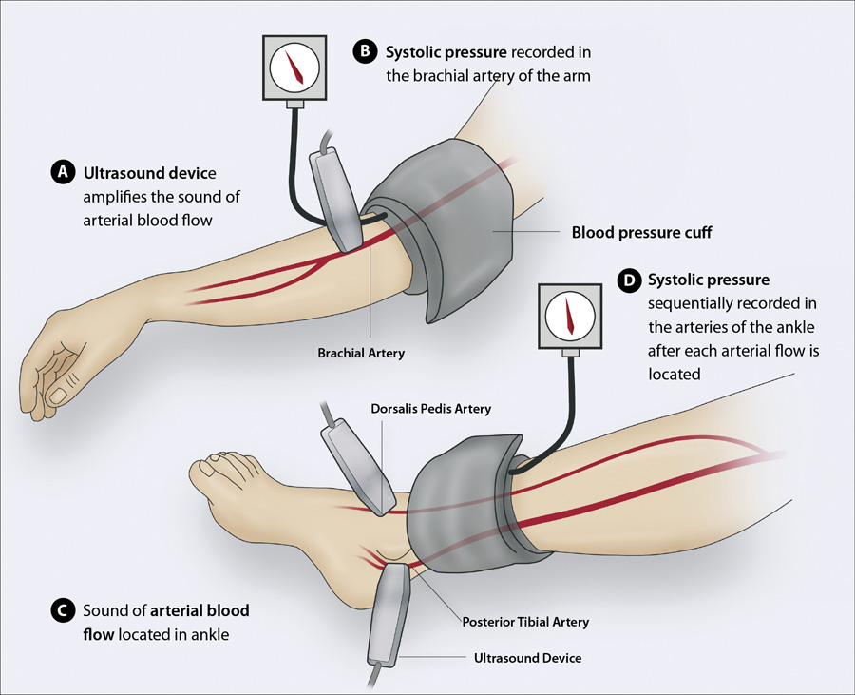
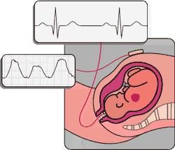
Continues wave Doppler
Notes:
Doppler demodulation for CW Doppler.
Reference signal of frequency f t .
Detected signal which has been Doppler-shifted and whose frequency is f r = f t + f d .
The reference signal is multiplied by the detected signal.
The high-frequency oscillations are removed by low-pass filtering.
The end result is the Doppler frequency shift signal f_{d} (the example shown contains no clutter).

Slide 50
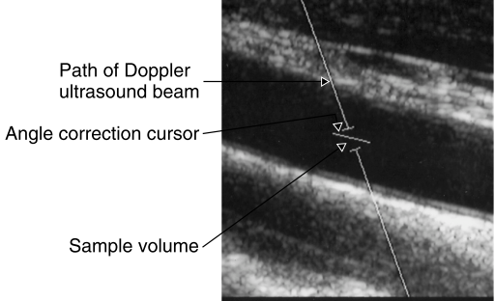
Pulse wave imaging

Slide 51
The Doppler shift and angle of insonation

Slide 52
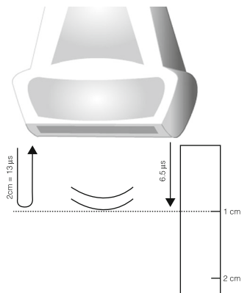
Pulse wave range gating
Notes:
We can work out how long it takes a pulse to travel through soft tissue over a particular distance.
T= 2d/c
T= 1cm*2 / 1540= 0.0012987012987012987012987012987s = 12.987μs ~13μs for the sound to go and return 1cm.
This information is the bases of all measurements in B-mode

Slide 53

Pulsed Doppler Signal Processing

Slide 54

Aliasing of Pulsed Doppler Signal

Slide 55

Aliasing of Pulsed Doppler Signal

Slide 56

Aliasing of Pulsed Doppler Signal

Slide 57
Pulse wave range gating
Notes:
Spectral analysis is used in these machines to produce a frequency spectrum showing time on the horizontal axis and Doppler frequency shift on the vertical axis.
The baseline corresponds to zero Doppler shift.
The spectrum contains information on the speed and direction of blood flow.

Slide 58

Sampling position
Notes:
Spectral Doppler displays showing two measurements made at the same point in a flow rig with constant flow. The measurement made with the beam positioned close to the edge of the transducer (a) gives a lower velocity(111 cm/s) than the measurement made with the beam place in the centre (b) of the field of view (140 cm/s). Panels (c) and (d) show the same effect where the peak systolic velocity has been measured at the same point in a carotid artery with the Doppler beam at the edge (c) and the Doppler beam in the centre (d) of the transducer, resulting in velocity measurements of 68 and 90 cm/s respectively.

Slide 59



Spectral wall filter
Wall filter 50 Hz
Wall filter 75 Hz
Wall filter 550 Hz
Wall thump removed
Filter frequency too high
Altered waveform
Wall thump
Thrush A, Hartshorne T. Peripheral vascular ultrasound: How, why and when.
Elsevier Churchill Livingstone, London, 2nd edition, 2005.

Slide 60


Understanding pulse wave imaging

Slide 61


Intrinsic spectral broadening
Notes:
A number of elements of a linear-array transducer are used to produce the Doppler beam, leading to a range of angles of insonation ( θ ).

Slide 62
Obtain waveform and make measurements
image should be frozen when Doppler is ‘live’
rest finger on skin to prevent slippage
find highest velocities obtainable (listen to the audio signal)
freeze waveform and make measurements
make the measurements with manual caliper placement

Slide 63

Sample Volume Width
must include the target
  if set too small might miss highest velocity
avoid contamination from adjacent vessel

Slide 64


Slide 65
Doppler ultrasound artefacts
Doppler ultrasound suffers from the same artefacts as B-mode ultrasound. In addition, there are the following artefacts:
Aliasing – higher Doppler shifts mis-registered due to PRF set too low
Angle dependence – as the angle of insonation approaches 90º, the Doppler signal may be very small.
Noise, such as flash artefacts due to movement of the probe
Drop-out – scanners set a threshold frequency shift, below which no colour is displayed. At low velocities, no colour may be displayed.
NB. Be careful with colour flow imaging- images can be misleading

Slide 66

Doppler Scale
set to avoid aliasing if possible
set scale and baseline offset to use available space for best resolution of measurement

Slide 67


Appearance of Aliasing
Increase frequency scale
- increases pulse repetition frequency

Slide 68



Spectral aliasing
CCA
Peaks cross baseline
Dropping baseline
Increasing scale
Rubens DJ et al. Doppler artifacts & pitfalls.
Ultrasound Clin 2006 ; 1 : 79 – 109.

Slide 69


Doppler scale
ECA
ECA

Slide 70


Adjusting spectral velocity scale
Spectral scale: 200 cm/sec
Spectral scale: 50 cm/sec
Color Doppler image, color bar, & color scale unchanged
Spectral component is active
Kruskal JB et al.RadioGraphics 2004 ; 24 : 657 – 675.

Slide 71
Importance of Setting Gain Correctly

Slide 72




Adjusting spectral Doppler gain
Gain setting 0%
Gain setting 38%
Gain setting 77%
Gain setting 100%
Kruskal JB et al.RadioGraphics 2004 ; 24 : 657 – 675.

Slide 73

Doppler Angle Cursor Placement
- always use 45 – 60 degree range
- use beam steering and ‘heel and toe-ing’

Slide 74
Doppler Angle Cursor Placement
Notes:
Minuscule transducer angle changes can affect the accuracy
of the Doppler waveform, shown by the appearance of the normal reversal of
flow in early diastole (bottom). This reversal was absent in the other image
(top), which was taken first and before optimal transducer manipulation had
been sought.

Slide 75

45 - 60°

Slide 76

Cursor Placement for Velocity Measurements
a) 2nd peak > 1st peak – use 2nd peak
b) ignore spike turbulence
c) ignore small end diastolic dip

Slide 77

Suggested reading

