Slide 1
Doppler Leg Ultrasound Refresher
Content from Alison Warwick and Anne-Marie Rooney Audit
Notes:
This is a short overview of the journey of performing Venous Doppler legs in Downe . The best method of reviewing if this new protocol was to audit .

Slide 2
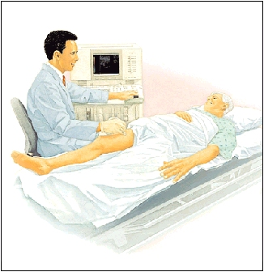
Background
Up until 2013 Doppler ultrasound performed and reported by radiologists only.
Notes:
Turning point was when Dr Thompson retired.

Slide 3
Background
Up until 2013 Doppler ultrasound performed and reported by radiologists only
In 2013/14 staff changes saw this service become increasingly sonographer led.
Notes:
Radiologists as per job plans cover ultrasound 50% of time.
Only me . To provide an service even equivilent to before we thought best to aim for a sonographer led service but needed therefore to train sonographers on this site.

Slide 4
Background
Up until 2013 Doppler ultrasound performed and reported by radiologists only
In 2013/14 staff changes saw this service become increasingly sonographer led.
In adherence with NICE guidelines (NICE CG144) a two-visit, proximal leg imaging scheme was introduced to train sonographers.
Notes:
On discussion and advice with and from Dr Tipping , Dr Hyland , Dr Corry , DR Boyd and Rosemary we thought best to adhere as closely to NICE guidelines as possible .
We Introduced a 2 visit proximal leg imaging pilot, which would be reviewed and audited 3 months after implementation or when numbers performed allowed .

Slide 5

NICE Guideline CG144
If DVT suspected + Wells score of ≥2 :
Proximal leg imaging within 4 hours of request
OR
A D-Dimer test , interim anti- coagulant and a Proximal Doppler leg exam within 24 hours of request.
Notes:
As on slide NICE guidelines are:
Sometimes due to weekends unfortunately to begin with we realised the time between request and scan would be longer.

Slide 6
NICE Guideline CG144
If DVT suspected + Wells score of >/= 2 :
Proximal leg imaging within 4 hours of request
OR
A D-Dimer test , interim anti- coagulant and Proximal Doppler leg exam within 24 hours of request.
If exam negative
Repeat exam in 6-8 days if D-Dimer above 0.5 only .
Notes:
As slide

Slide 7
NICE Guideline CG144
If D- Dimer > 0.5 but Wells score < 2
=
A Proximal leg Doppler exam is performed once only .
Notes:
One only exam if the D-Dimer is raised but the Wells score is below 2.

Slide 8
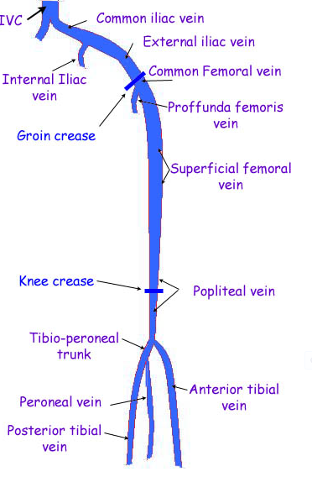
Proximal leg veins
X
--------------
Notes:
Imaging for proximal leg unchanged but now when popliteal vein trifurcates indicates end point unless,
A specific area of tightness, pain or swelling in calf,
Extensive thrombus present in superficial veins/ perforators extending near to deep veins. Usually we comment if within 3 cm of extending towards deep veins.
Check for Baker’s cyst

Slide 9

Report Prompt
February 2016 -
“This patient has had a proximal leg vein ultrasound scan as per NICE guideline CG 144 . For patients with a negative scan a repeat proximal leg vein ultrasound scan is indicated in 6–8 days if they have a Wells score of ≥2 AND a positive D‑dimer test . If your patient meets these criteria, please request a repeat proximal leg vein ultrasound scan stating clearly both the Wells score and D-dimer result in the request information.”
Also ‘Prompt Doppler Ultrasound Leg’ for report template
Notes:
Break through was with the implementation of the Doppler prompt eloquently worded by Dr Corry.
Prompted at the end of every negative report.
Sonographers were no longer responsible for assessing if patients fitted criteria for second scan.

Slide 10
To Reassure
Successful US practitioner led service
System in place will pick up lower limb DVT
Time with Gillian - refresher
Completion of Scheme of Work

Slide 11

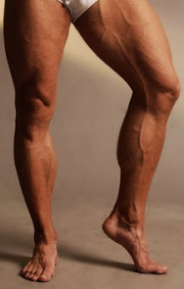
Our dream ☺
Notes:
We wish BUT

Slide 12
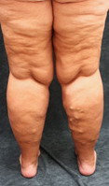
Reality
Thank you ☺
Notes:
Reality

