Slide 1

Diabetic myonecrosis
A rare complication of diabetes

Slide 2
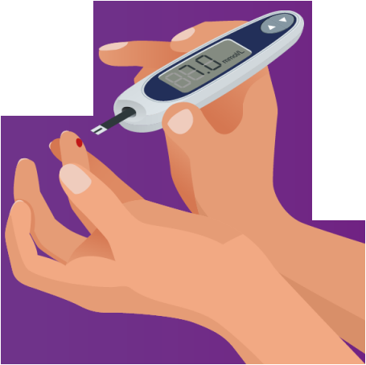
What is diabetic myonecrosis (DMI)?
Sometimes known as diabetic muscle infarction, DMI is a serious complication of longstanding poorly controlled diabetes
It causes muscle infarct usually in the muscles of the thigh but has also been reported to affect the calf and arm muscles
DMI is extremely rare with less than 200 reported cases between its discovery in 1965-2011 [1]

Slide 3
Symptoms and causes
Most common symptom is acute onset of unilateral pain and oedema. This clinical presentation often leads to the misdiagnosis or investigations for a deep vein thrombosis.
Pathophysiology is very unclear and only theorised to be secondary to atherosclerosis, vasculitis or microvascular complication of diabetes.

Slide 4

Patient demographic
More common in women
Average age of presentation 44
Known diabetic complications:
Neuropathy
Nephropathy
Retinopathy

Slide 5
Our Patient
28 year old female presented to ED with a swollen and tender right thigh.
She has a past medical history of type 1 diabetes diagnosed at the age of 4 and renal failure.
Awaiting combined kidney and pancreas transplant
Test | Test value | Normal range
White blood cell count | 19.89 10⁹/L | 4.0-11.0 10⁹/L
CRP | 384mg/L | <6.0 mg/L
Creatinine | 910 umol/L | 45-84 umol/L

Slide 6
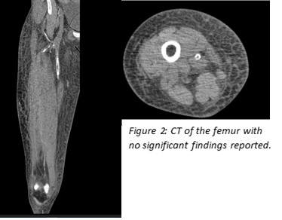
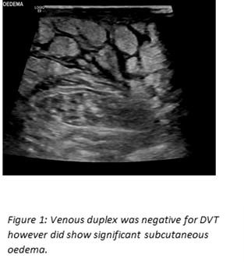
Imaging

Slide 7
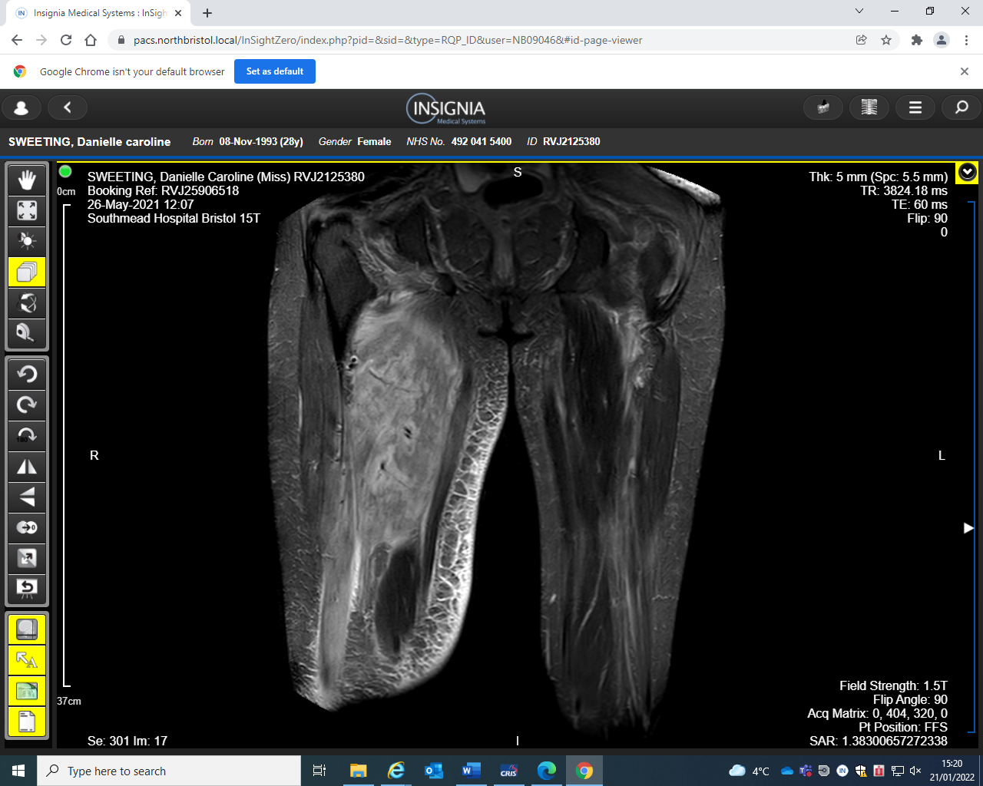
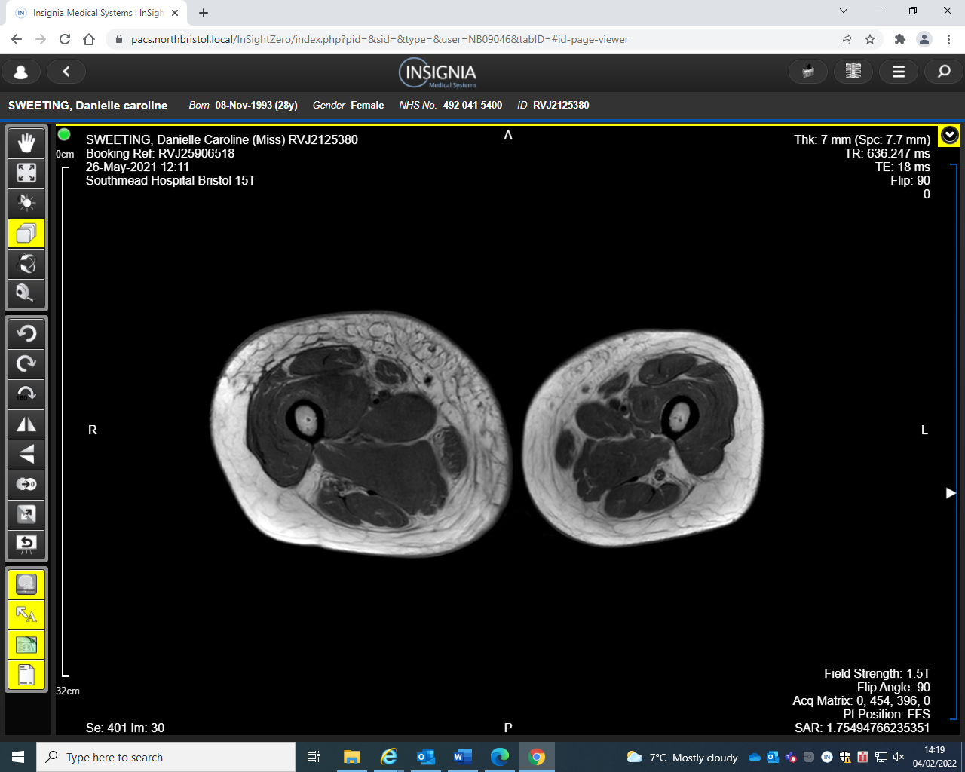
1 week later…
Figure 3: MRI of the femur with Gadolinium confirming a diagnosis of DMI.
‘intrinsic streaks of no enhancement within the involved oedematous muscle on contrast images.’

Slide 8
Treatment & prognosis
No consensus
Systematic review supports a combination of bed rest, glycaemic control and NSAIDs.
Physio and surgery are not recommended in the acute phase as this can prolong recovery time.
Prognosis is extremely poor with a high recurrence rate of ~ 40% and the majority of patients dying within 5 years of diagnosis [2]

