Slide 1
Case Study
Compartment syndrome
Aneurysms &
Pseudoaneurysms

Slide 2
Case Study:
73 year old female, total knee replacement 25/9/18
Referred for venogram 10 days post op
  worsening calf pain with localised tenderness along deep venous system
  Entire leg swollen
  Calf swelling more than 3cm compared to left leg
  Pitting oedema
  Foot drop

Slide 3
Case Study:
US Venogram demonstrated:
  Large 55.7 x 34.1 x 30.4 mm vascular area with arterial flow ?popliteal aneurysm
  Also noted within knee there is a large 18.4 x 61.8 mm mixed echo area which traces behind the whole knee, suggestive of a haematoma, unsure of its origin ? post-operative
  The popliteal vein was not visualised
  Further imaging may be recommended, please discuss with a Consultant Radiologist
? Calf veins assessed

Slide 4
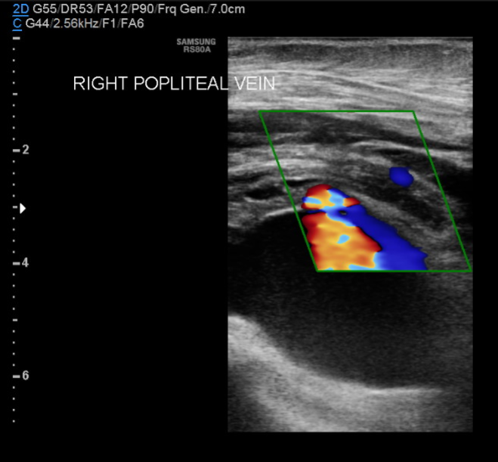
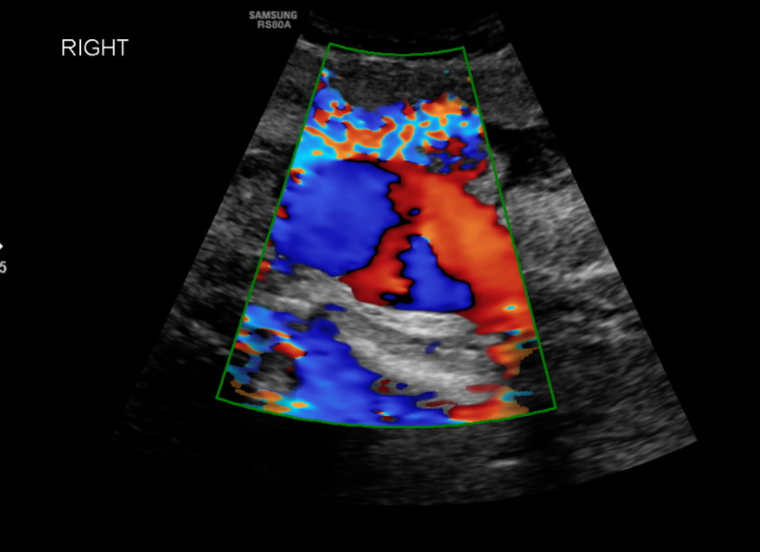
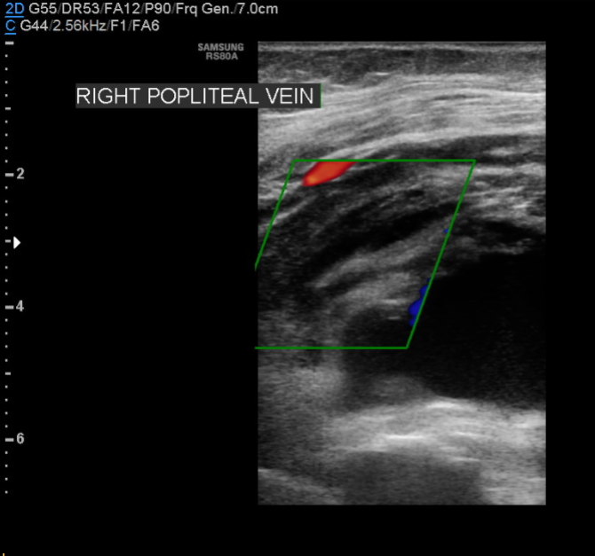
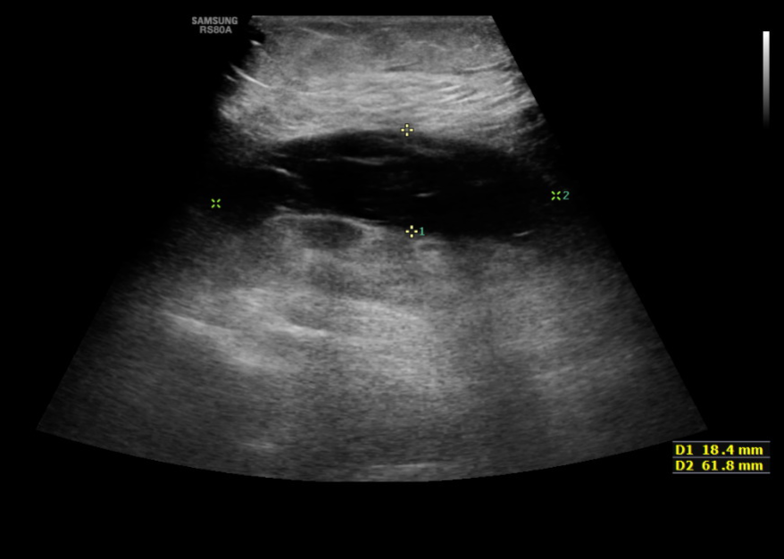

Slide 5
Case Study:
CTA performed 13 days post op
  Referral states ‘Since surgery she has no sensation and no motor function in her right foot. Difficult to feel pulses due to swelling. Posterior tibial pulse feeble. USS showed popliteal aneurysm & haematoma.’
  Report:
    a large part of the popliteal artery is obscured by artefact from the recent knee replacement
    However, the distal popliteal artery appears to be occluded, and there is an associated rounded soft tissue mass
    The anterior and posterior tibial arteries are patent from the trifurcation, but the peroneal artery is occluded through most of its length. The appearance are consistent with a distal popliteal artery occlusion, secondary to aneurysm or pseudo-aneurysm formation.
    Incidental finding of right renal cell carcinoma

Slide 6
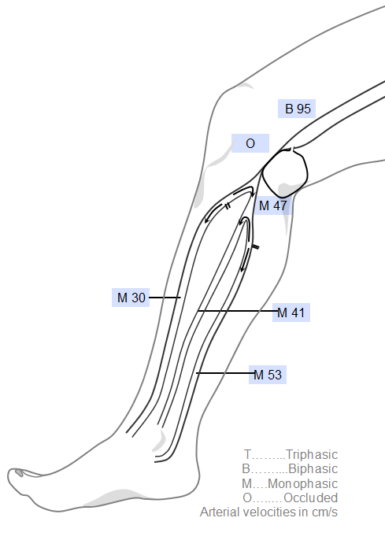
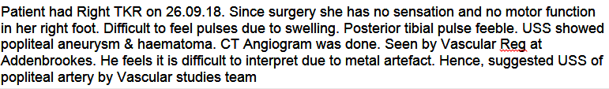
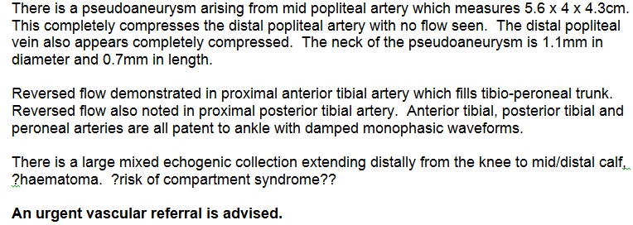
Case Study:
Vasc lab duplex performed 14 days post op.

Slide 7
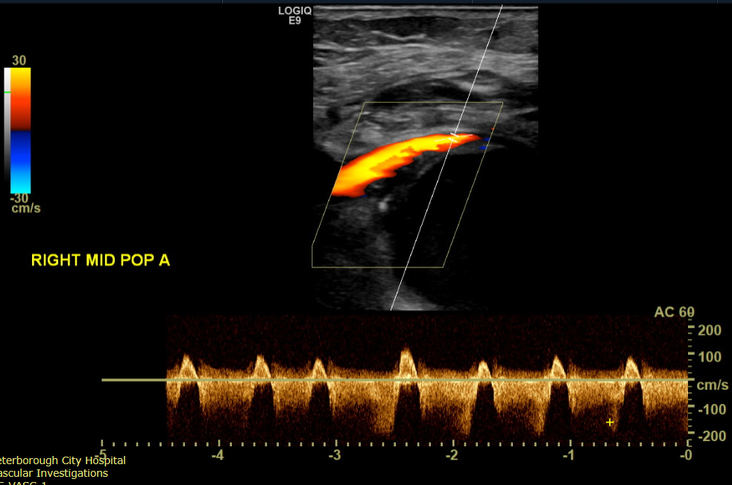
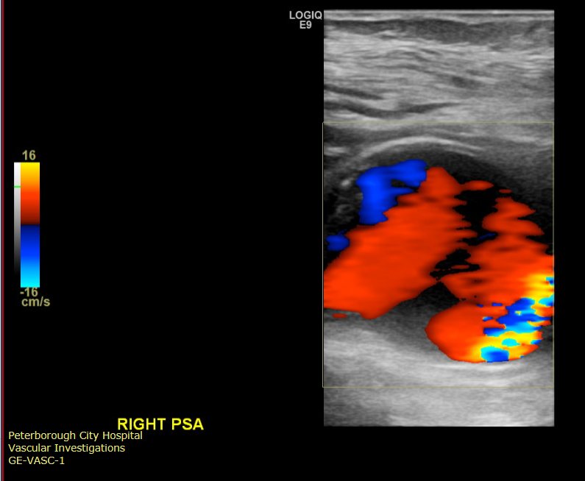
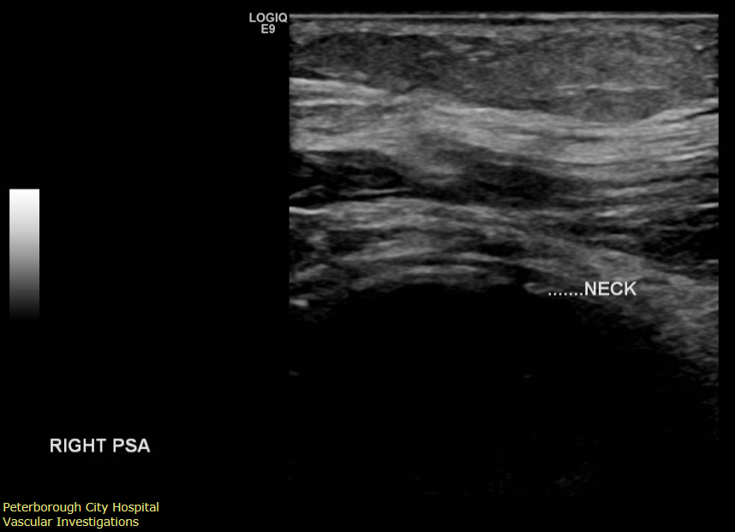
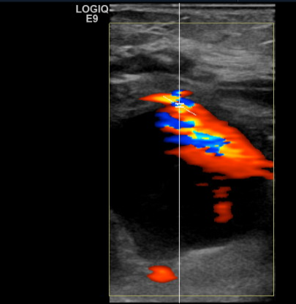

Slide 8
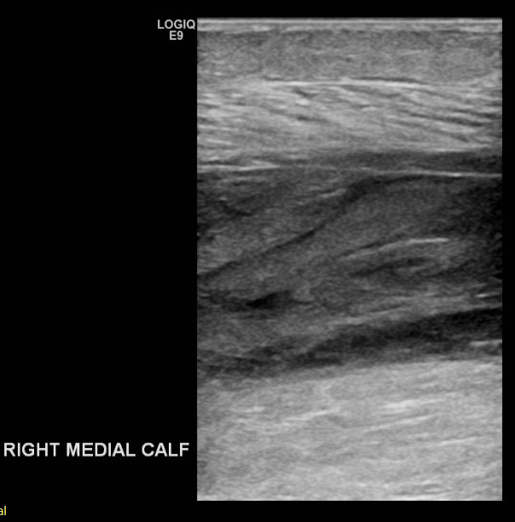
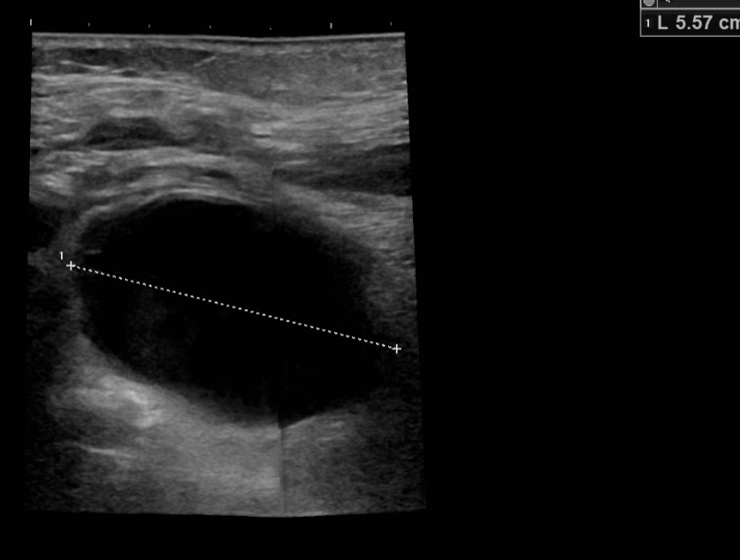
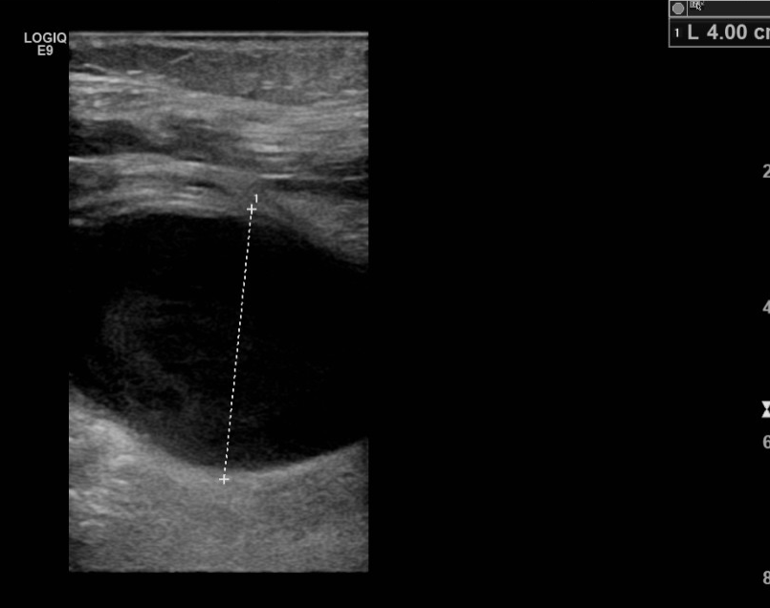
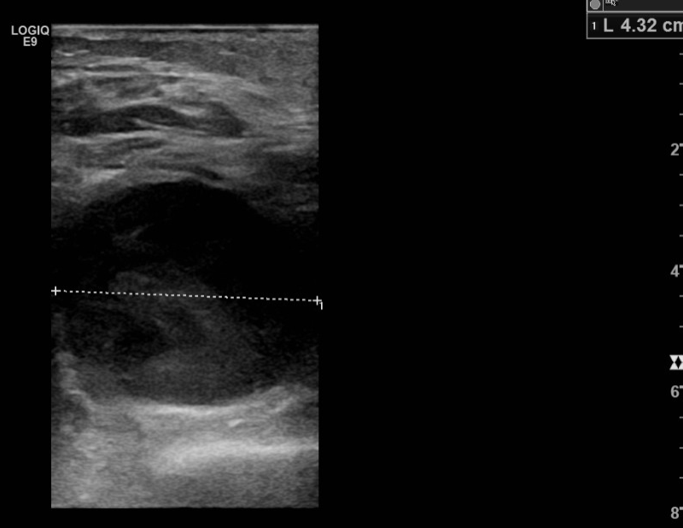

Slide 9
Case Study:
The patient was blue lighted to Addenbrookes (regional vascular centre)
Compartment syndrome diagnosis confirmed but too late to perform a fasciotomy to relieve the pressure as the muscle was already dead
Amputation likely to be the best option now for the patient

Slide 10
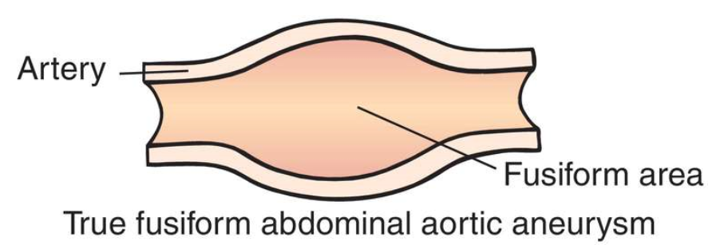
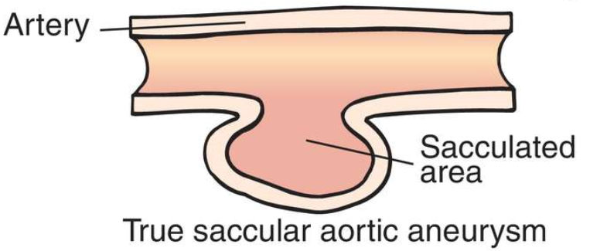
True Aneurysms
Abnormal dilatation of an artery
Involves all three layers of the vessel wall (intima, media and adventitia)
May be fusiform (involving the entire circumference of the artery), or saccular (involving part of the circumference of the artery)
Can affect any artery, but most frequently the aorta, common iliac arteries, common femoral arteries and popliteal arteries
Risk of rupture (particularly the aorta), embolisation, or occlusion due to accumulation of thrombus

Slide 11
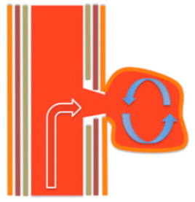
Pseudoaneurysms
Caused by any injury to the vessel that results in a defect in the arterial wall and permits escape of blood under pressure
Blood is contained by the adventitia or surrounding tissues, but not by the three layers of normal arterial wall
Usually occurs as a result of damage to the artery wall as a result of:
  arterial injury during surgery
  penetrating trauma
  inadequate compression following catheterisation during angiography
  puncture by permacaths
  IV drug use etc.
Direct communication of blood flow between the vessel lumen and the pseudoaneurysm through the hole in the vessel wall – the neck.
Risk of rupture or compression of surrounding vessels or structures

Slide 12
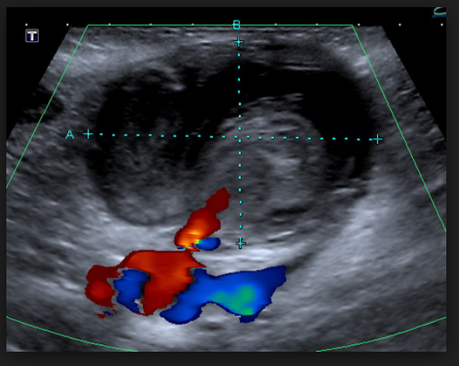
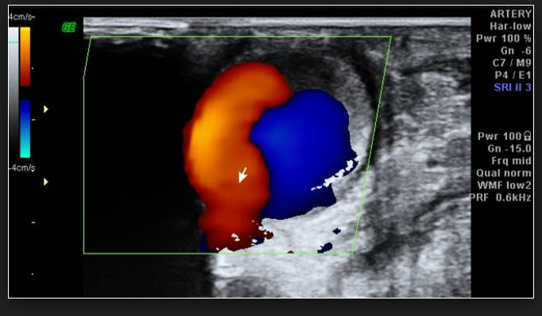
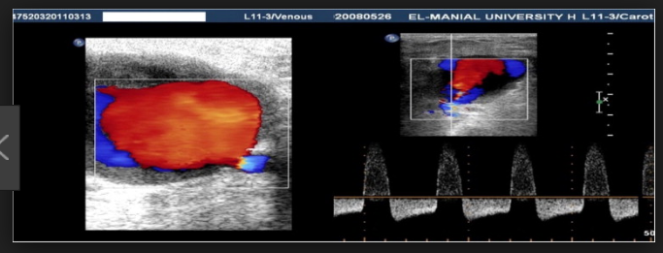
Pseudoaneurysms: Ultrasound Features
Turbulent forward and backward flow, often visualised as a ‘yin-yang’ sign with colour Doppler and a characteristic ‘to and fro’ pattern with spectral Doppler.
Arises from the artery, rather than being continuous with it

Slide 13
Pseudoaneurysms: Treatment
  Injection of thrombin to cause the blood within the pseudoaneurysm to clot
  Surgical ligation
  Ultrasound guided compression – use the ultrasound transducer to compress the neck of the pseudoaneurysm. This stops flow into it and causes it to clot.
    Dependent on diameter and position of the neck, and patient build
    Very uncomfortable for the patient (and physically hard for the vascular scientist!)
    Can take up to 30 minutes of application of considerable pressure
    Risk of rupture

Slide 14
Compartment Syndrome
Occurs when the pressure increases within a bundle of muscles enclosed by a fascia (muscle compartment) due to swelling or bleeding.
Restricts the blood flow to the area and damages the muscles and nerves
Acute – sudden onset usually following trauma (bone fracture or crush injury), burns, reperfusion after a period of poor blood flow, intra-compartmental bleeding, or any other cause of swelling within a compartment

Slide 15
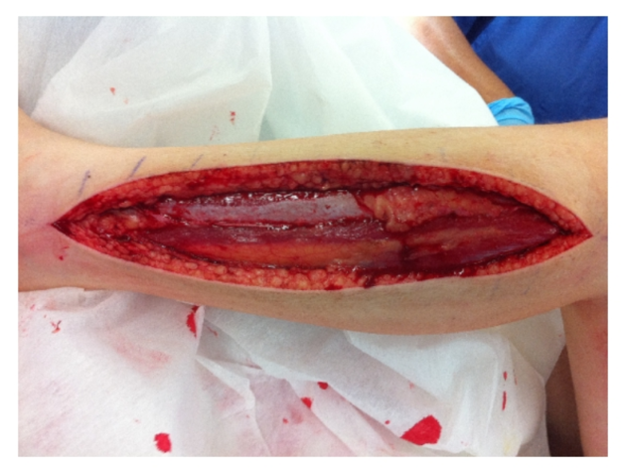
Compartment Syndrome
Symptoms
  Intense pain (especially when the muscle is stretched), tingling/burning sensation, severe cases – numbness or weakness (permanent damage)
Diagnosis
  Clinical diagnosis.
  Intra-compartmental pressures can also be measured
Treatment
  Fasciotomy. Surgical incision into the fascia to release the pressure.
  Medical emergency. Needs treatment within hours to avoid permanent damage.

