Slide 1
Charing Cross Symposium
26-29 April 2016

Slide 2
Highlights
Venous stenting
Lymphoedema
AAA challenges
Personal exercise trackers for claudicants
Non-healing diabetic foot ulcers

Slide 3
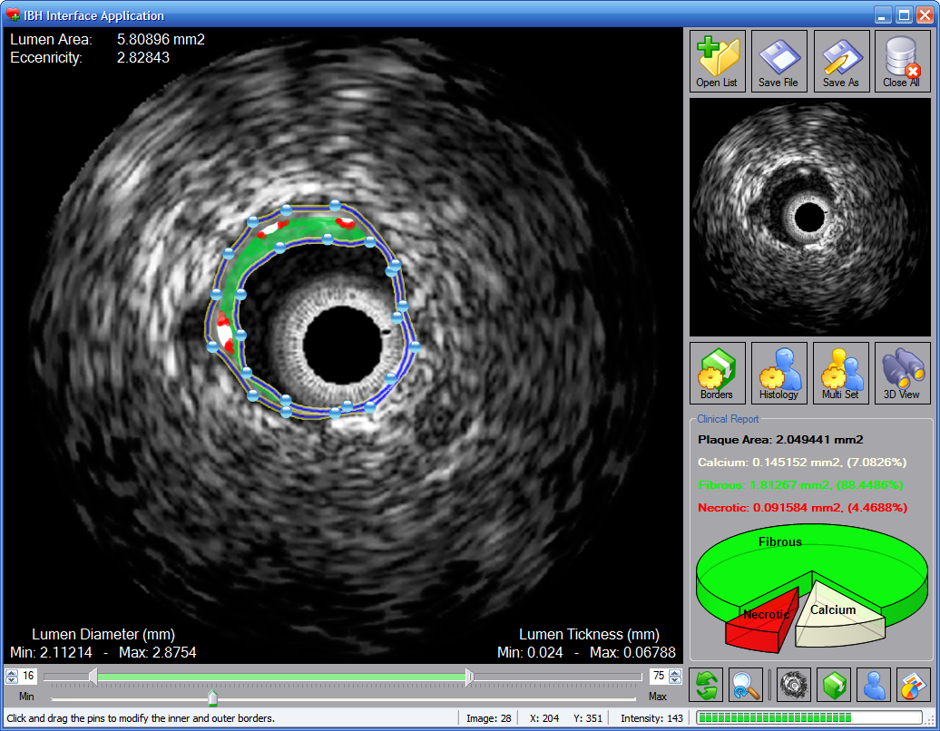
MSTI–multi sequence thrombus imaging with IVUS.
Determine morphology of clot to identify those more amenable to lysis.
Venous stenting

Slide 4
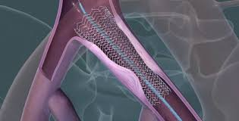
Venous stenting
Importance of pre-dilating vein before stent insertion – venous rupture is extremely rare.
Augment flow by putting fistula in to increase flow through stented venous segments to improve patency.
The use of anti-platelet therapy post venous stenting.
Need to develop a new tool to measure QofL for those that have had deep venous intervention.

Slide 5
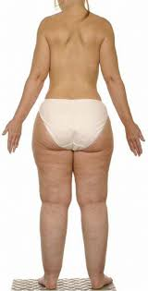
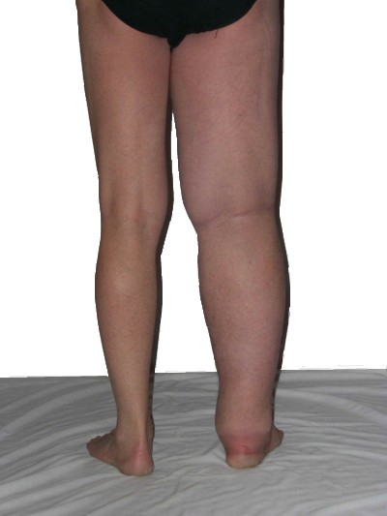
Lymphoedema/Lipoedema
Some cases are venous in origin some are not.
Reduced number of valves and shorter length of valve leaflets in lymphoedema patients.
Genetic components in venous disease and lymphoedema.
No sustained venous reabsorption.
Lymph drainage impaired as result of venous hypertension overloading the system.
In non-venous lymphoedema only mild improvement in swelling with elevation overnight.
Lipoedema – disproportionate fat distribution – feet normal and no effect from dieting – exclusively female.
Lipoedema – skin soft – no hardening like in lymphoedema.

Slide 6
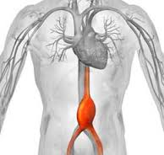
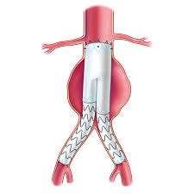
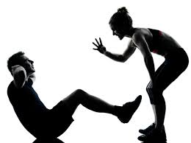
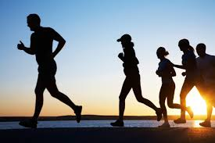
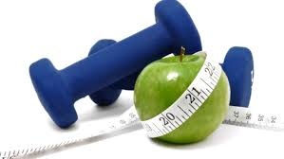

AAA challenges
Meta-analysis analysed data from EVAR 1, DREAM, OVER and ACE RCTs that compared elective endovascular and open repair of AAA:
  Revealed overall no difference in survival benefit (total or aneurysm-related) between EVAR & open repair over first 5 years of follow-up.
  Younger patients do better with EVAR than older patients. Would have expected to offer open repair to younger patients but as group actually do better with EVAR.
  Big question about very long-term durability of EVAR - makes us pause to think about exactly which patients should be treating.
4.5-5.5 cm surveillance interval – this is an opportunity to get the patient fit to enable better outcome post repair.
Highlights the importance of nurse led lifestyle advice.

Slide 7
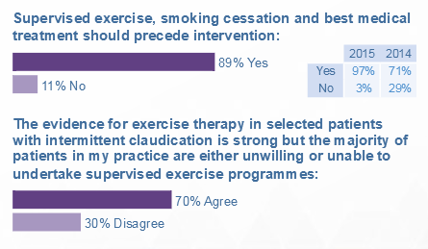
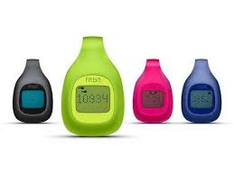
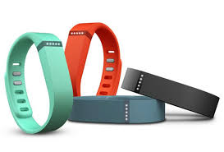
Personal exercise trackers
Work needs to be done to develop new approaches to motivating patients to engage with exercise programmes - possibly encouraged by electronic remote monitoring devices.

Slide 8
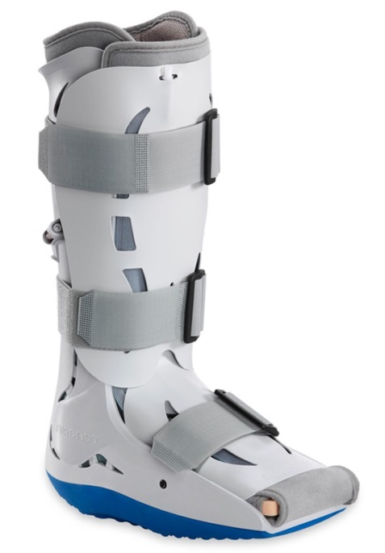
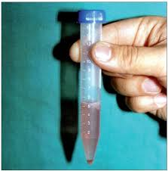
Non-healing diabetic ulcers
Vessel perfusion is one thing but you also need oxygen diffusion – why some patients still lose a limb despite successful revascularization. More blood is only better if you have a well functioning foot.
Oxygen transport to the capillaries is independent of pressure.
Perfusion angiography gives a measurement of the functionality of the microcirculation. Helps in decision of who to treat and who not to treat.
Removing pressure from the wound is of paramount importance – diabetics will walk on ulcers as don’t feel pain. Need to put them in casts or cast walkers.
Autologus skin cell suspension – skin sample put in a kind of blender to make a suspension then apply to cleaned wound with negative pressure. Good results in sample of 7 patients.
Pedal arch is a key factor in the outcome for distal bypass in terms of time to healing but not patency or survival.

Slide 9

National Audit Stats
30 day mortality quite high after major amputation but this is quite a sick group – death at 1 year would be high anyway.
40% of patients did not have any imaging before major amputation.
60% did not have any attempt at revascularisation.
In 2000 waiting time for CEA >40 days, now 12 days in 2014/15.
4 day wait for patients to see GP after symptoms.

