Slide 1
Case Study from MDT
Eleanor Walker

Slide 2
Patient Hx
Lady, age 73
Risk factors HTN, smoker 10-15/day
Symptoms- Presented with a stroke on 16 May 2015 and made good recovery
Not on best medical therapy at time of stroke
Duplex 20/5/15: Left distal CCA >75% stenosis, left ICA origin <50% stenosis; Right ICA origin 50-69% stenosis
CT angiogram performed 21/5/2015, results: Left CCA disease seen to extend down to the root of the neck
Stoke team referral to Vascular Consultant

Slide 3
Additional Hx relevant to this presentation
Recent left cerebral hemispheric event with documented left common carotid significant stenosis
Previous irradiation to neck in 1999 for laryngeal cancer
Fixed neck
Due to complex history discussed at the network x-ray meeting

Slide 4
Discussion at network x-ray meeting
CT angiogram results: Left CCA disease seen to extend down to the root of the neck
Consensus may benefit from carotid stenting.
Patient keen to be treated locally; question is this a possibility?
  Traditionally send to centres at Oxford or Sheffield for CAS.
  Radiologists felt that as we are the new MAC centre this is an intervention we should be providing
Consideration for carotid stenting
  Due to previous radiation to the neck in 1999 for laryngeal cancer, her neck was indurated
  high risk candidate for an open carotid endarterectomy.
  given previous neck radiation and induration in her lower neck and CT angiogram the degree of narrowing extends to the root of the neck consensus carotid stenting the best option (MDT meeting).
  Patient given options of carotid artery stenting under local anaesthetic versus best medical therapy as two options
  had a week to think and decided to have the carotid artery stenting at Southmead Hospital.

Slide 5
Patient discussion
Patient did not wish to travel for treatment and wanted treatment to be at the local Hospital
Proceed with carotid artery stenting under the care of Dr Neil Collin, Interventional Radiologist at NBT
Stenting was booked for 9th June 2015

Slide 6
Angioplasty 9/6/2015
Angiogram carotid arteries findings
  Bovine arch anatomy. Mild stenosis right common carotid artery. Tight stenosis left common carotid artery, presumed result of radiation arteritis. Internal and external carotid arteries are patent normal calibre. Major intracerebral vessels are patent. Right vertebral patent. Left vertebral patent small calibre.
Arterial stent left carotid
  8mmx50mm viabahn stent graft placed across left common carotid stenosis. 6mm balloon dilation with good result.
  No macroscopic embolisation. GCS 15, neurologically intact. Starclose haemostasis clip right CFA.
  Home after period of observation in daycase on dual antiplatelet.

Slide 7
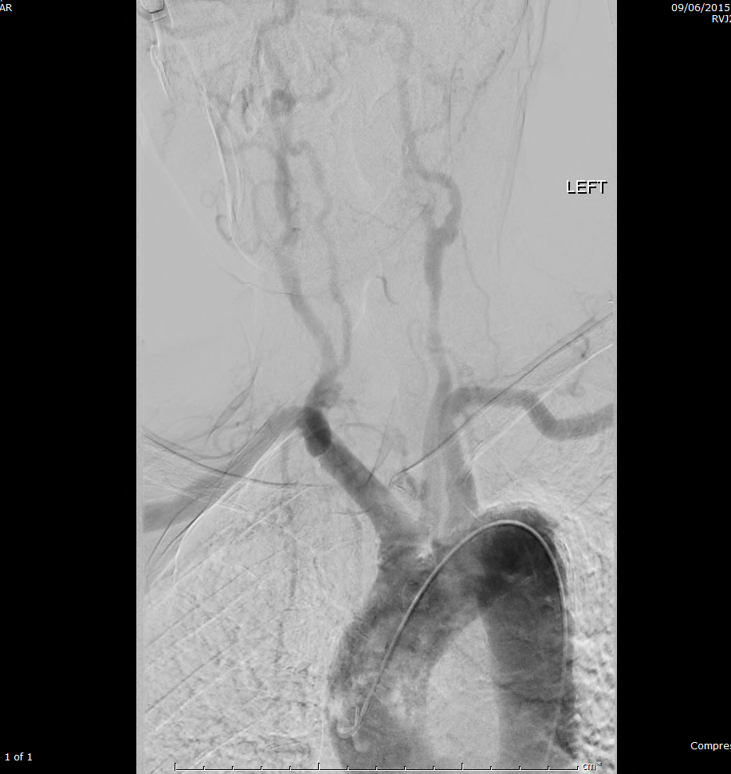
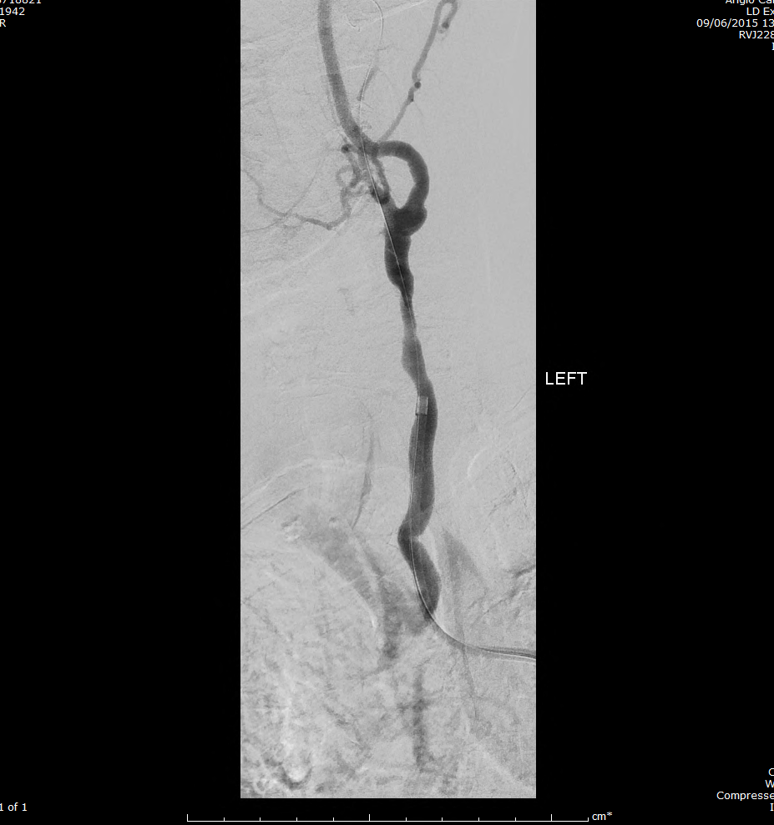
Pre stent insertion images

Slide 8
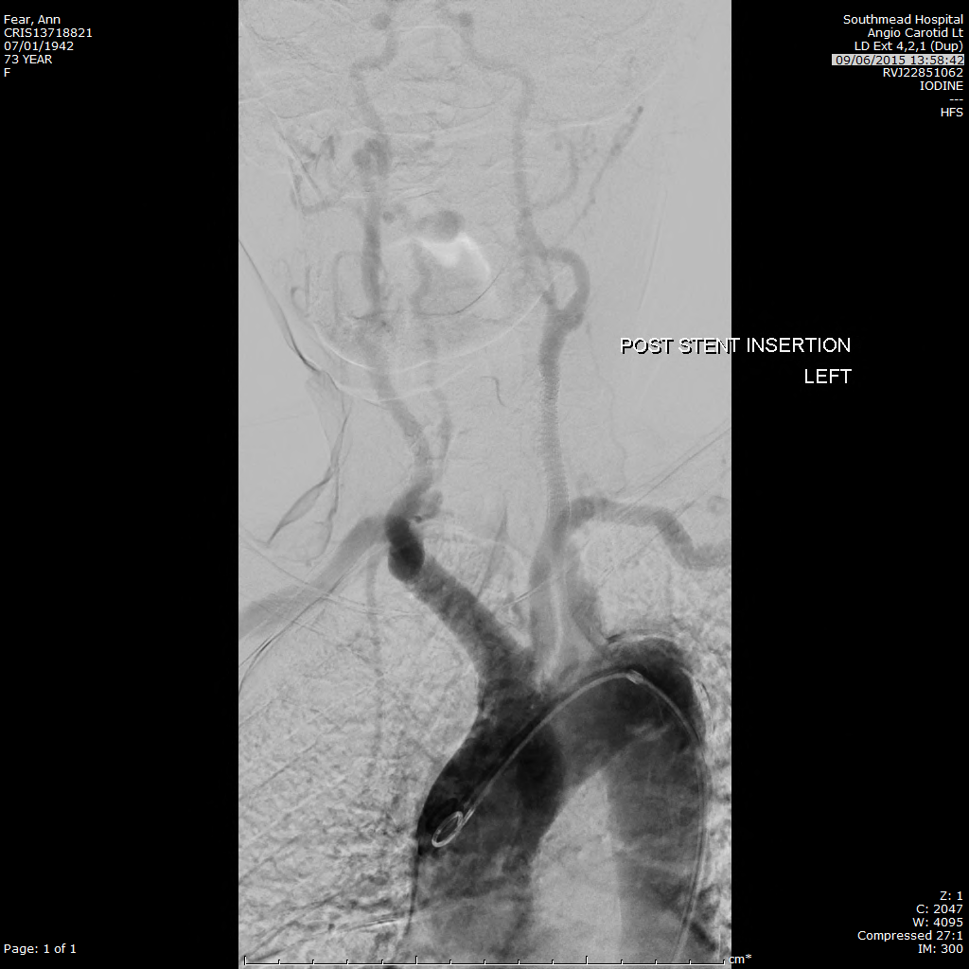
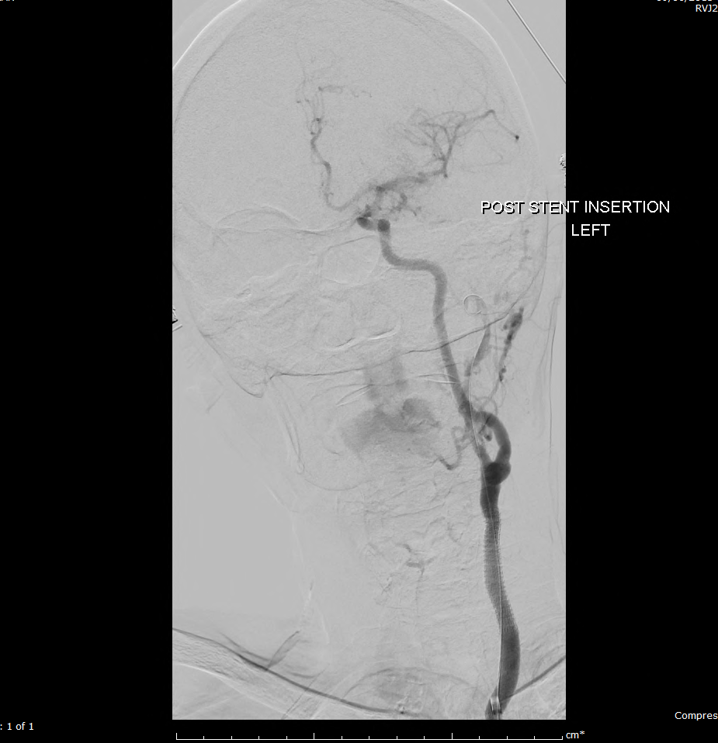
Post stent insertion images

Slide 9
Neck irradiation and carotid arteries
Radiation treatment well established for certain cancers but leads to damage to surrounding tissue.
Patients 5 times more likely to have duplex detected stenoses than age and risk factor matched population.
Soft tissue and skin fibrosis, induration and ischaemia.
One of the effects leads to radiation arteritis.
Can affect any blood vessel adjacent to site being irradiated.
Lack of collaterals due to area being affected not just one part of artery- vessels above and below good quality.
Damage can take many years to manifest (usually 5-10 years, range 2-25 years) and only becomes apparent with onset of ischaemic symptoms.

Slide 10
Endothelial cell damage in medium to large vessel associated with intimal fibrin deposition
Media starts to fibrose over weeks
Early lesions - thrombosis 5 years
Intermediate lesions - occlusion with poor collaterals 10 years
Late lesions - peri arterial fibrosis with accelerated atherosclerosis 25 years

Slide 11
Radiation effect on the artery
Stenosis caused by irradiation is progressive and should warrant intervention
Stenoses are often in the proximal CCA and distal ICA
Duplex not recommended as sole assessment as the disease pattern is often outside the field of view of ultrasound.
Additional imaging MRA, CTA and angiography.

Slide 12
Duplex not recommended as sole assessment in post neck radiotherapy carotid arteries as the disease pattern is often outside the field of view of ultrasound.
Additional imaging MRA, CTA and angiography.

Slide 13
Treatment of the Radiation effect on the artery
Surgical endarterectomy possible for the carotid bifurcation and the distal CCA but tissue planes are compromised and nerve damage is more common complication.
Vein interposition grafts have been performed, but nerve palsies reported in 23-28% of patients post op.
Carotid artery stenting is treatment of choice but numbers are small and long term outcomes not been reported in large numbers.
Annual duplex surveillance for the carotid stent is recommended to detect recurrent stenosis.

Slide 14
Recent return to outpatient
24/8/2015 seen in Vascular Outpatient Clinic Southmead
‘has recovered well from her carotid artery stenting and has had no neurological symptoms since’
Plan: Discharge from Vascular Clinic. To continue anti-platelets and statins

Slide 15
Bibliography
Rare Vascular Disorders: A Practical Guide for the Vascular Specialist, p59-64, Simon D. Parvin and Jonothan J. Earnshaw
Vascular and Endovascular Surgery: A comprehensive review, p336, Wesley S. Moore
Outcomes of carotid artery stenting versus historical surgical controls for radiation-induced carotid artery stenosis J Vasc Surg 2011; 53:629-36
Carotid artery stenting for stenosis following revascularisation for cervical irradiation J Endovasc Ther 2002;9:14-9
Duplex imaging and incidence of carotid radiation injury after high- dose radiotherapy for tumours of the head and neck Arch Surg 1990; 125:1181-3
Accelerated carotid artery disease after high dose head and neck radiotherapy: is there a role for routine surveillance J Vasc Surg 1999;30:1045-51
Carotid artery repair for radiation associated atherosclerosisis a safe and durable procedure, J Vasc Surg 1999;29:90-9
Irradiation injury to large arteries, Br J Surg 1980; 67:341-3

Slide 16
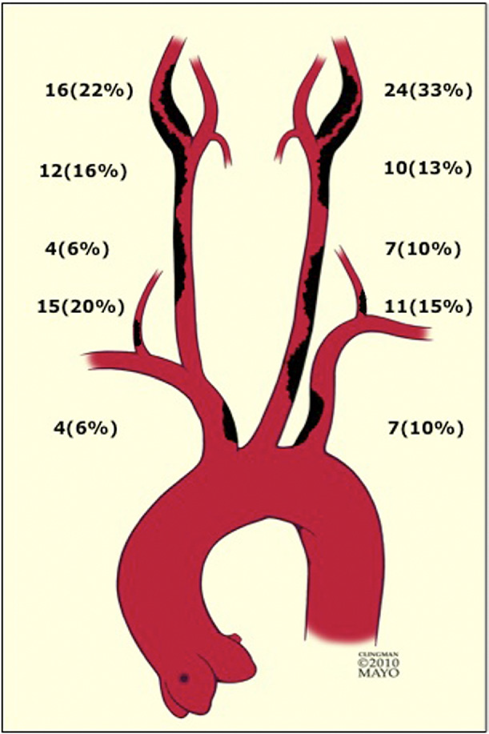
Disease pattern
Distribution of carotid, subclavian, and vertebral arteries stenosis in 60 patients who had undergone previous neck irradiation
Journal of Vascular Surgery 2011; 53:629-36

