Slide 1
Carotid Doppler ULTRASOUND
Leah Cunningham,
courtesy of Janine Fletcher, Vascular scientists

Slide 2
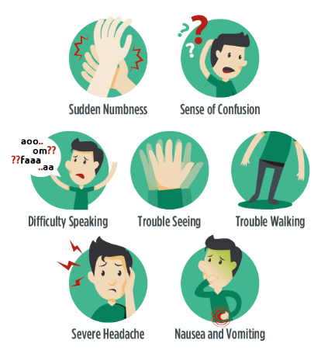
Signs and symptoms
Hemiparesis (weakness)
Paraesthesia
Dysphasia, Aphasia
Amaurosis fugax
Bruit

Slide 3
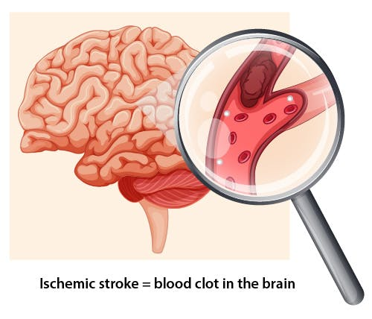
What causes stroke/TIA?
Infarction in the brain. This can be:
Haemodynamic (rarely); very tight stenosis or an occlusion causes fall in perfusion pressure. Symptoms tend to be progressive
Thrombo-embolic (85%); clots/debris travel within arterial system and lodge in cerebral hemisphere. 50% arise from disease in the carotid arteries. Symptoms are often transient
Notes:
obstruction of the blood supply to an organ or region of tissue, causing local death of the tissue.

Slide 4
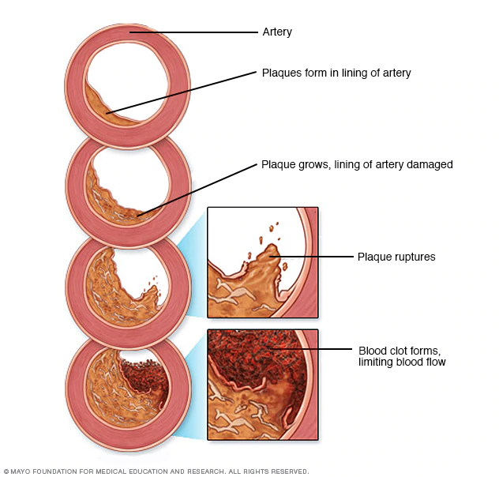
Carotid disease
Most commonly due to atherosclerosis causing build up of plaque on the artery walls

Slide 5
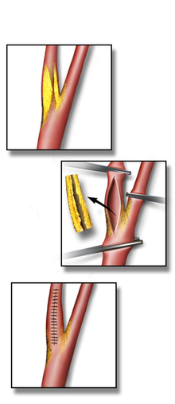
Carotid imaging requirement
NICE guidelines
“All people with suspected TIA who after specialist assessment are considered as candidates for carotid endarterectomy should have carotid imaging within 1 week of onset of symptoms.”
Surgery is likely to be beneficial in people with stable neurological symptoms from TIA who have symptomatic carotid stenosis of significant diameter reduction

Slide 6
Carotid duplex ultrasound
Duplex = imaging plus Doppler (flow) studies
Cheap
Accessible
No radiation or contrast needed

Slide 7
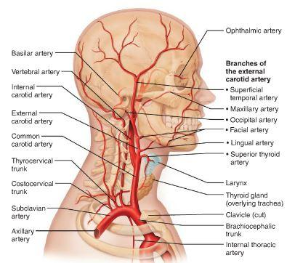
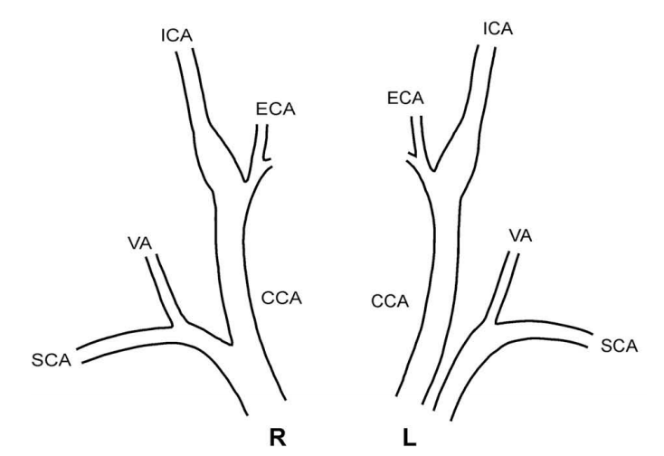
What do we scan?
Extracranial anatomy

Slide 8
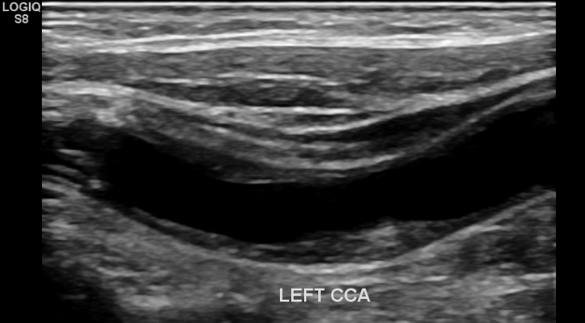
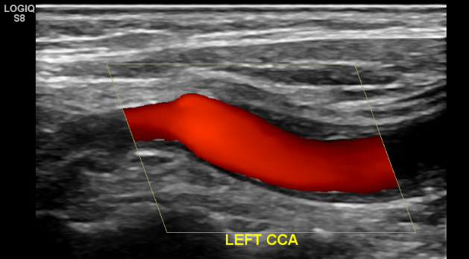
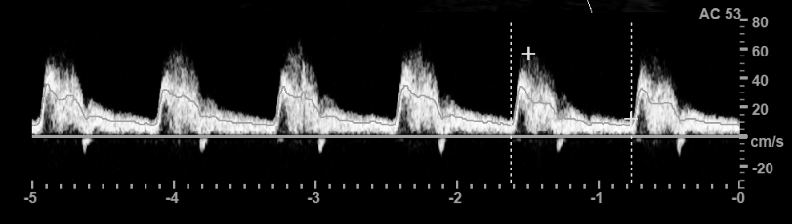
Duplex scanning
B mode imaging
Colour Doppler
Spectral Doppler

Slide 9
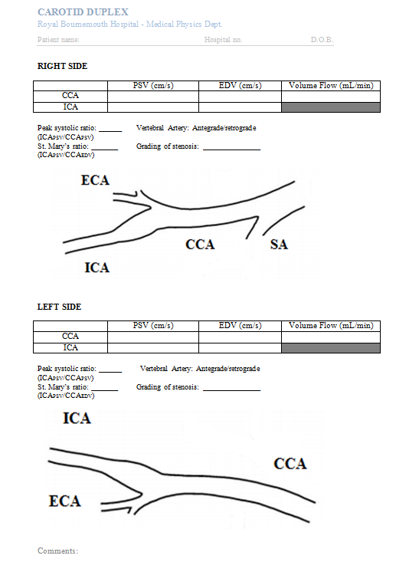
Overview
Define Plaque
site
extent
appearance
Record Velocities
Grade Stenoses
Note points of interest

Slide 10
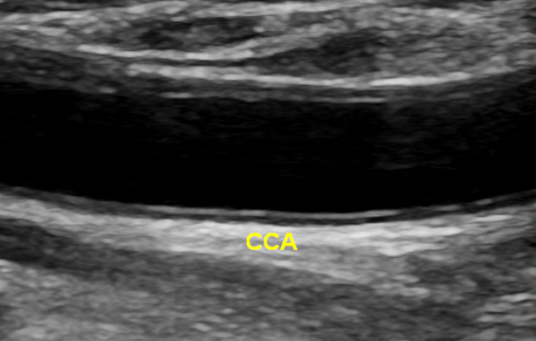
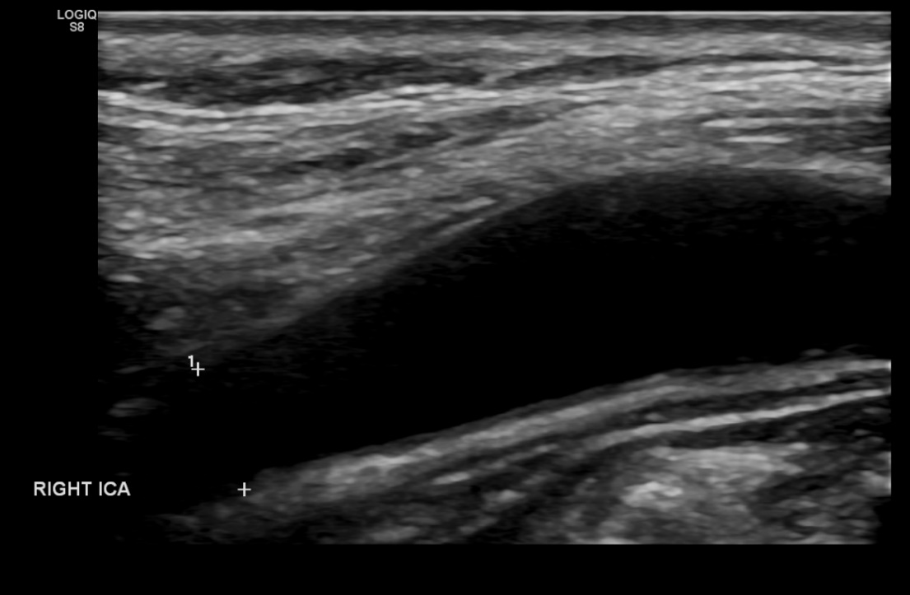
B mode imaging
Normal

Slide 11
B mode imaging
Plaque classification
Echogenic/echolucent
Heterogeneous/homogeneous
Irregular/smooth
Isolated/extensive
Ulcerated?
Notes:
Link to liklihood of rupture stability

Slide 12
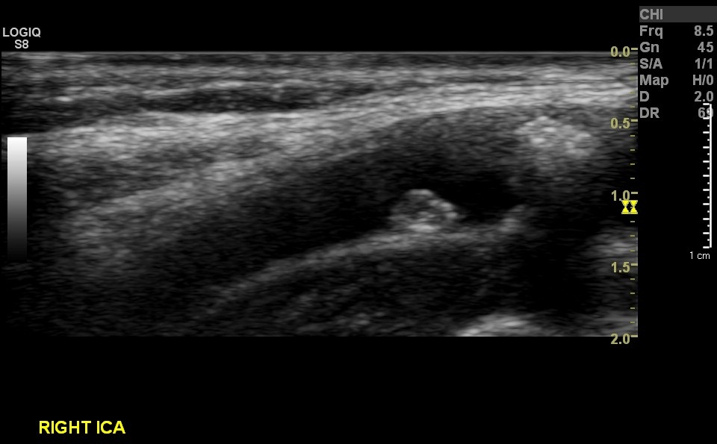
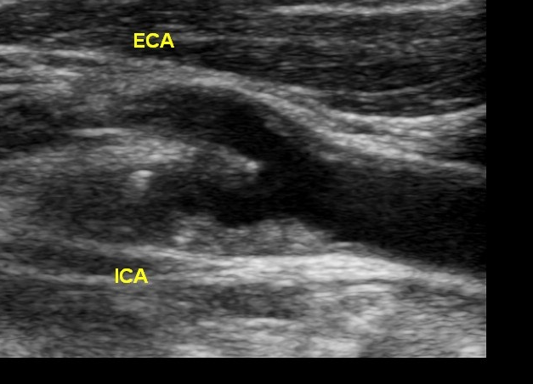
B mode imaging
Disease

Slide 13
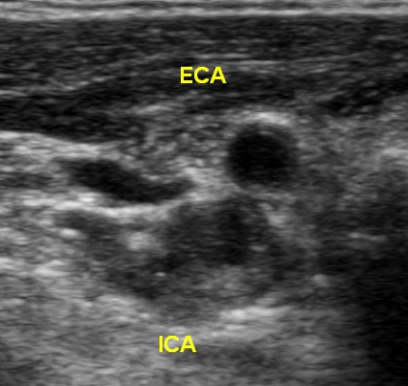
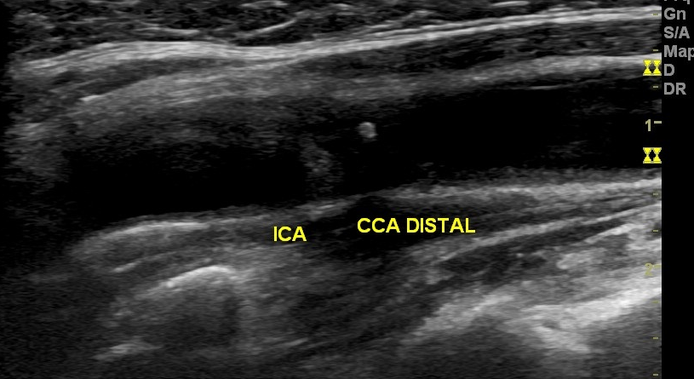
B mode imaging
Disease

Slide 14
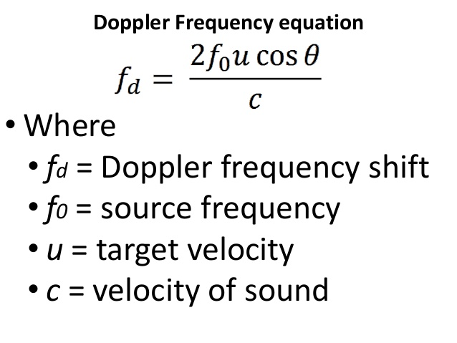
How does Doppler work?

Slide 15
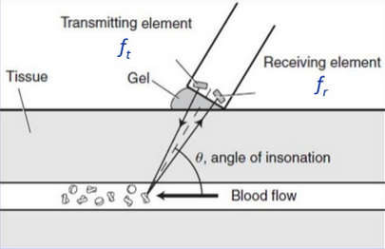
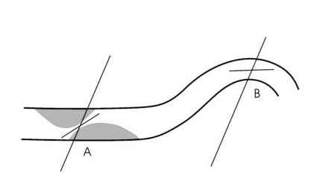
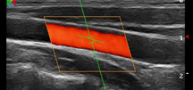
Aligning Doppler angle

Slide 16
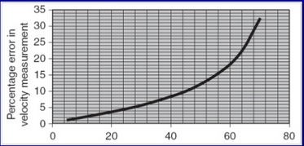
Importance of Doppler angle
Angle of insonation should NOT be more than 60° as % error is too great

Slide 17
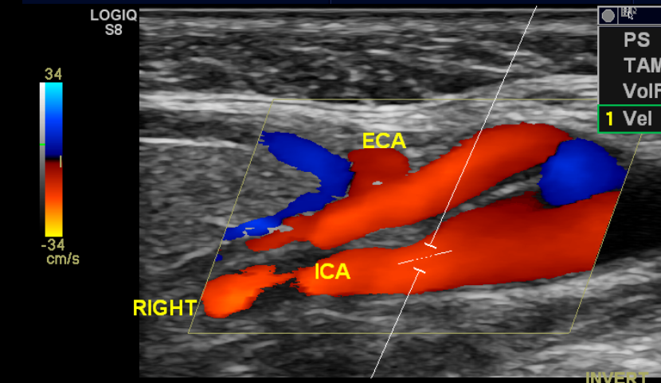
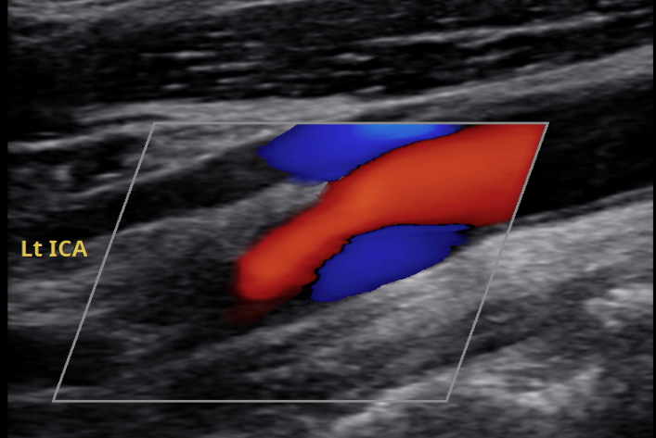
Colour Doppler
Normal

Slide 18
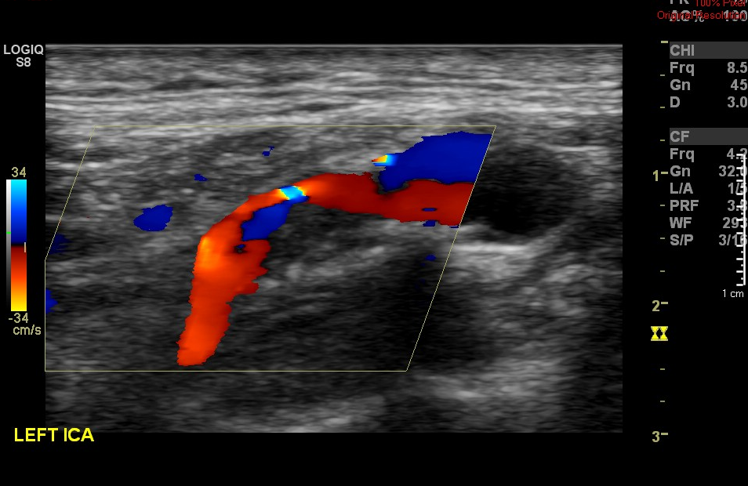
Colour Doppler
Stenosis

Slide 19
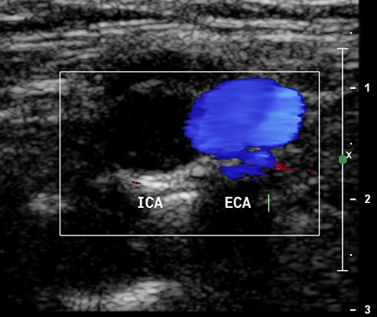
Colour Doppler
Occlusion

Slide 20
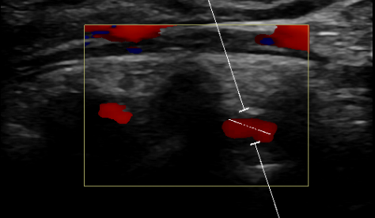
Colour Doppler
Vertebral artery assessment

Slide 21
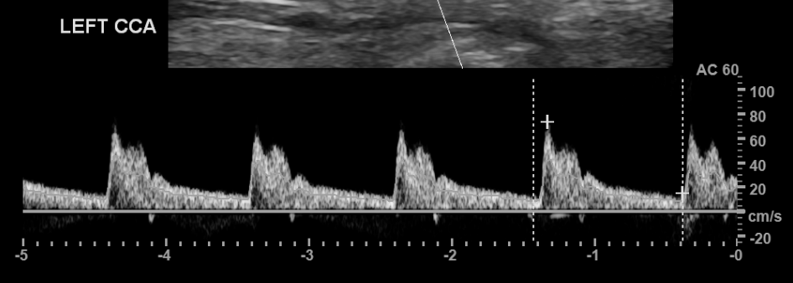
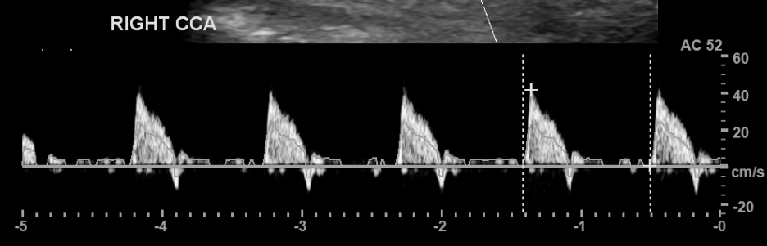
Spectral Doppler
Normal CCA
Pre-occlusion

Slide 22
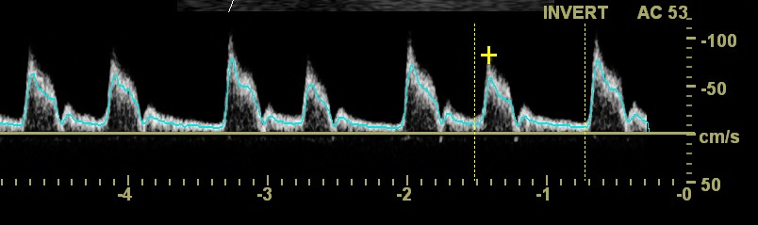
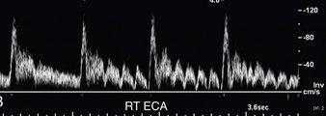
Spectral Doppler
Normal ECA

Slide 23
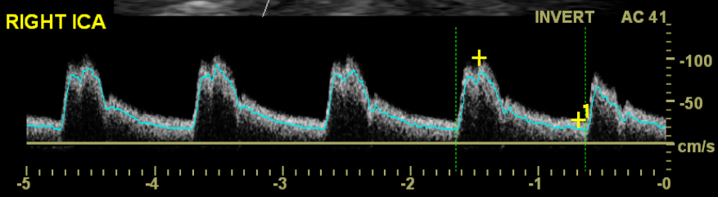
Spectral Doppler
Normal ICA
Notes:
At systole: Sharp systolic rise time, Clear Systolic Window, At diastole: Continuous forward flow through diastole

Slide 24
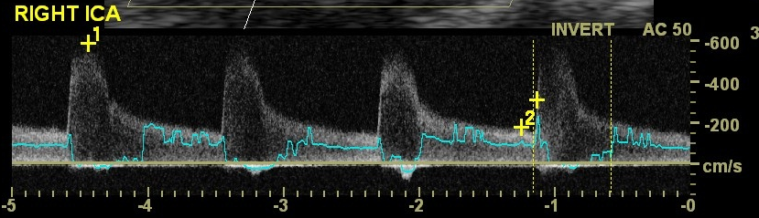
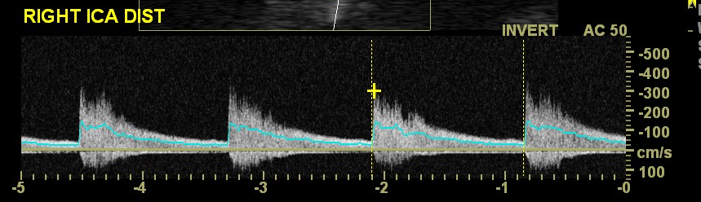
Spectral Doppler
Stenosis

Slide 25
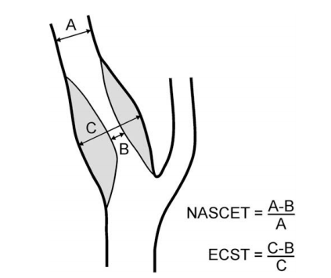
How do we grade a stenosis?
2 pivotal studies: NASCET and ECST
Looked at benefit of performing surgery for different degrees of stenosis
Symptomatic
50–99% according to NASCET criteria
70–99% according to ECST criteria
Notes:
North American symptomatic carotid endarterectomy trial and European carotid surgery trial

Slide 26
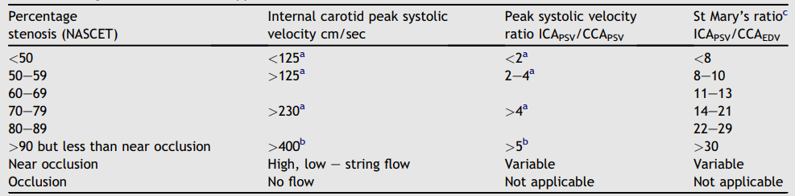
How do we grade a stenosis?
Carotid imaging is used to define the extent of carotid artery narrowing- the % stenosis
Haemodynamic significance
Oates, C. P. et al. 2008. Joint Recommendations for Reporting Carotid Ultrasound Investigations in the United Kingdom. European journal for vascular and endovascular surgery. Volume 37 (3) p251-61

Slide 27
Case study
80 year old male
Ex-smoker
Hypertension
Known CAD
Episode of left leg weakness
Right arm was also weak later

Slide 28
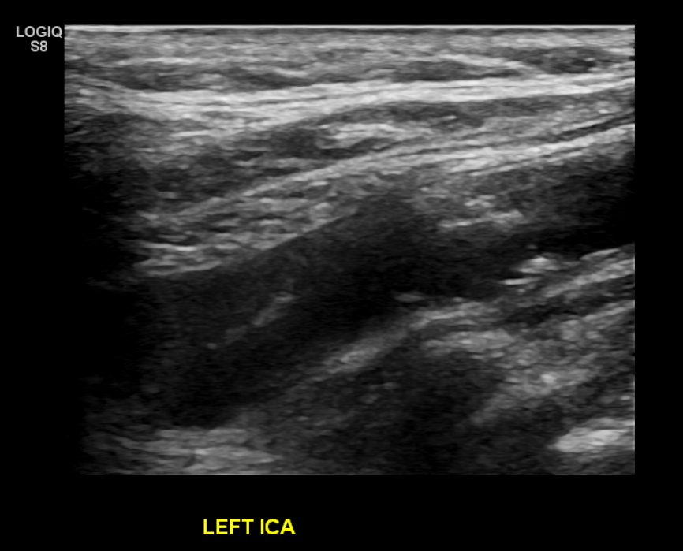
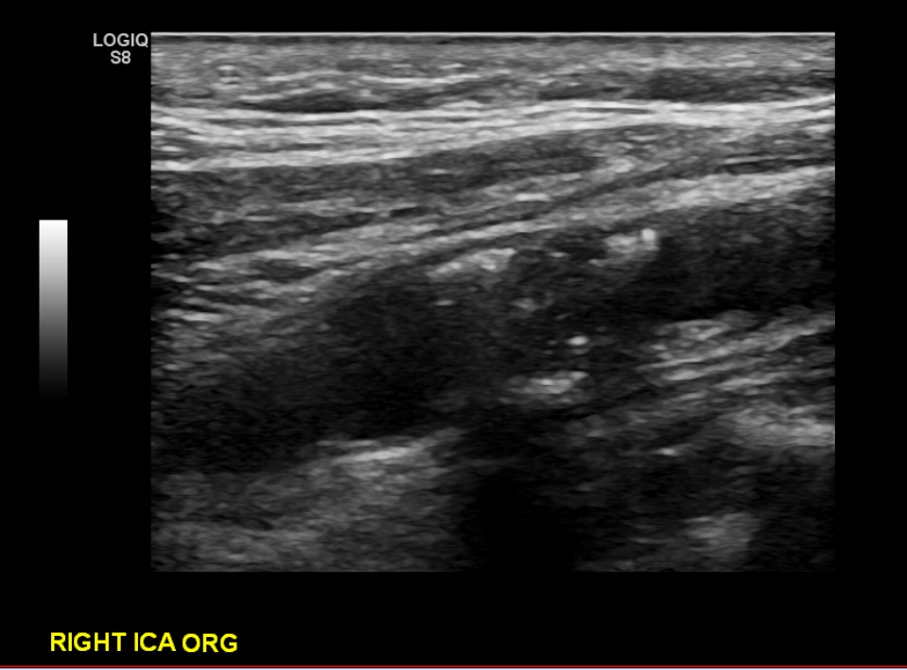
Case study

Slide 29
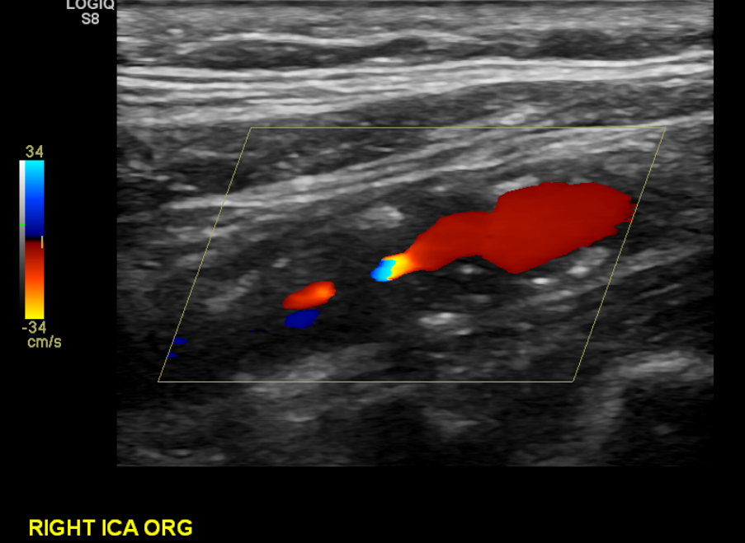
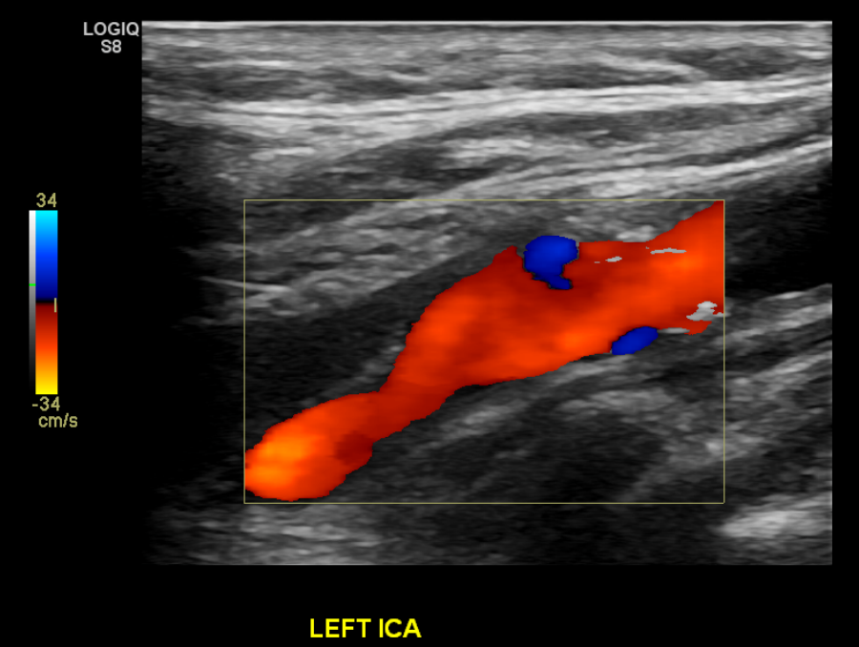
Case study

Slide 30
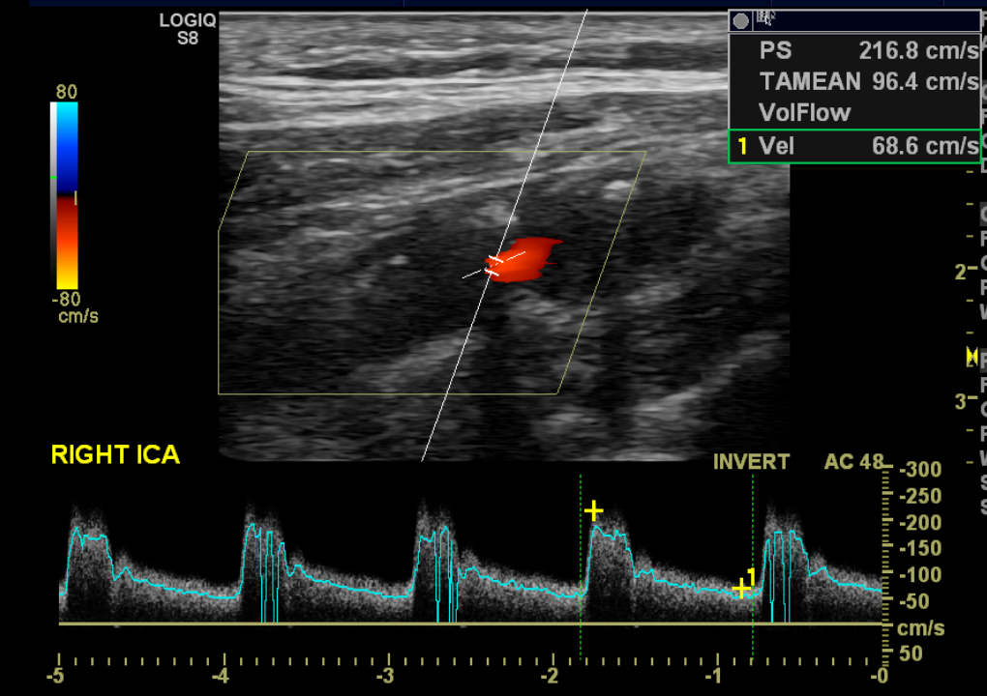
Case study

Slide 31
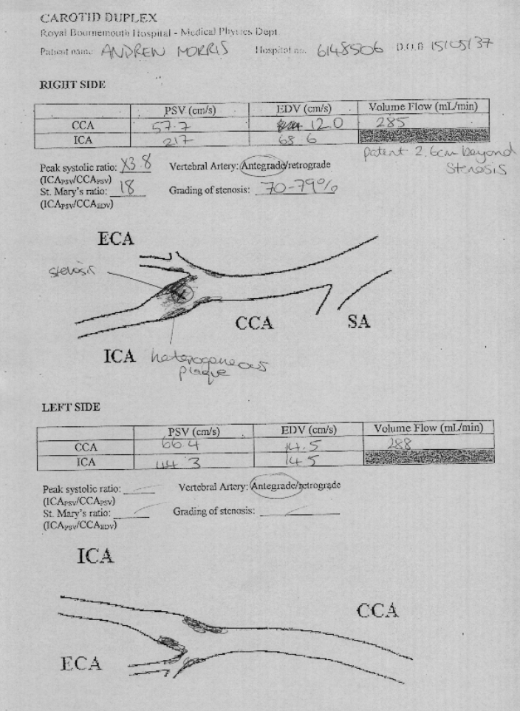
Case study

Slide 32
Case study
Vascular referral
Right carotid lesion is not consistent with bilateral symptoms
Risk of right sided carotid endarterectomy not deemed appropriate
7 day heart monitor requested to look for other sources of emboli

Slide 33
Other abnormalities
Subclavian steal
Dissection
Aneurysm
Carotid body tumour

Slide 34
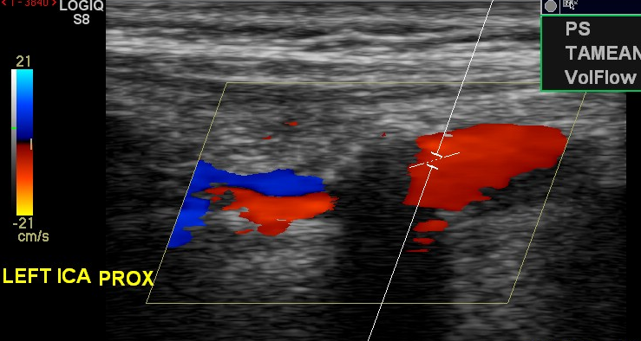
Are there limitations?
Patient positioning/mobility
Neck size/length
Doppler angle correction
Acoustic shadowing from calcified plaque

Slide 35
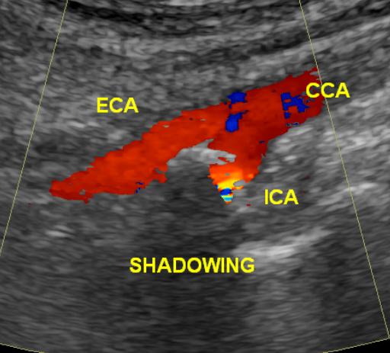
Are there limitations?
Difficult to correct Doppler angle due to shadowing

Slide 36
Other uses?
Pre-endarterectomy
Confirm disease
Confirm patency of ICA
Mark bifurcation
Pre-cardiac surgery
To reduce peri-operative events
Pulsatile tinnitus
In NICE guidance

Slide 37
DEMO

