Slide 1
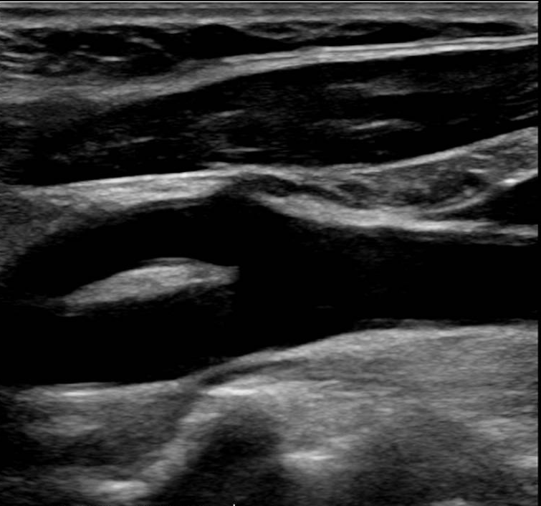

Carotid artery duplex

Slide 2
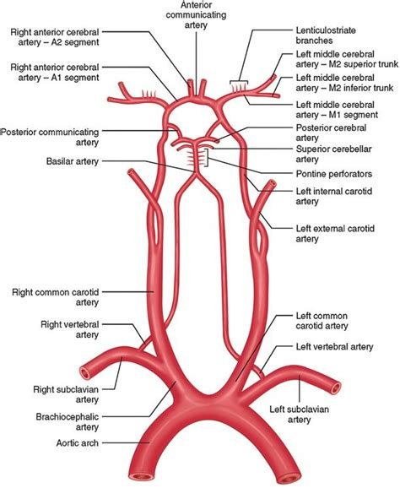
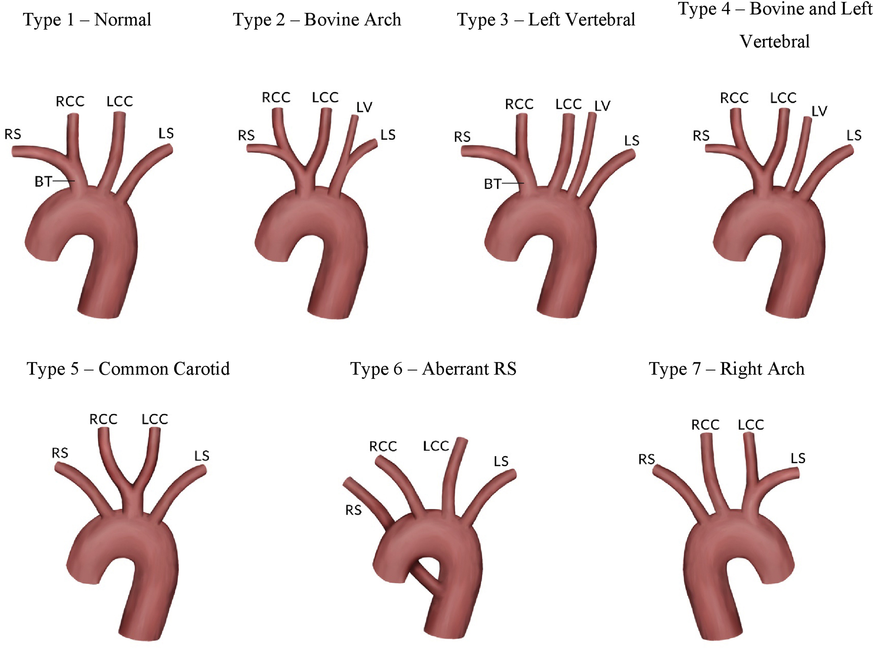
Anatomy

Slide 3
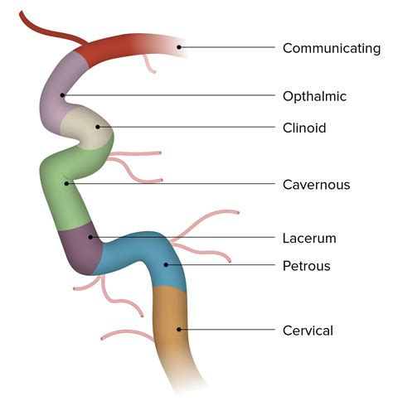
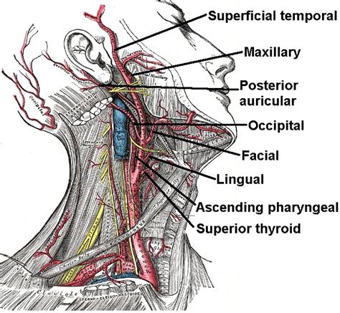
Internal carotid artery segments
Branches of the external carotid artery

Slide 4
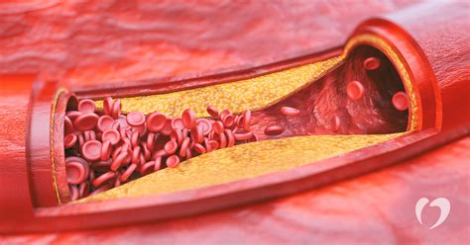
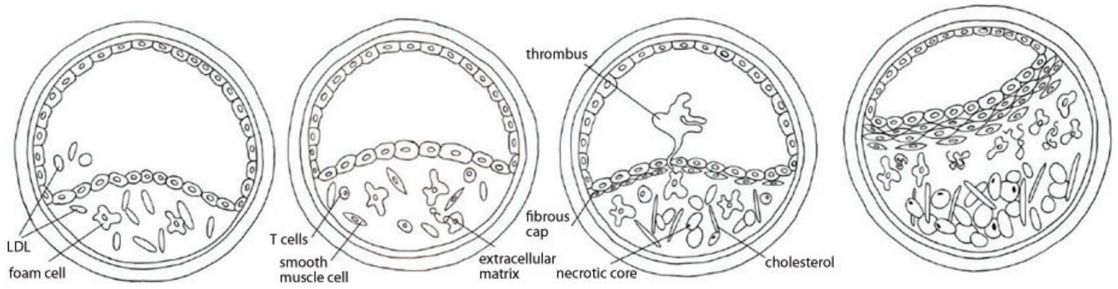
Atherosclerosis
Linked to:
High blood pressure
Smoking
Obesity
Smoking
Diabetes
Inflammatory and immune process causing remodelling of the artery wall.
Notes:
Ultrasonography-of-vulnerable-atherosclerotic-plaque-in-the-carotid-arteries-Bmode-imaging.pdf

Slide 5
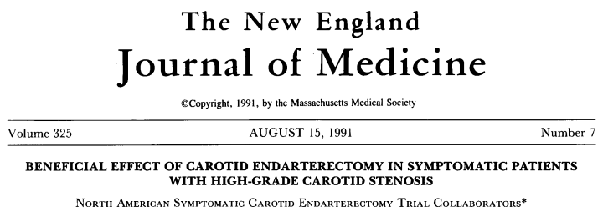
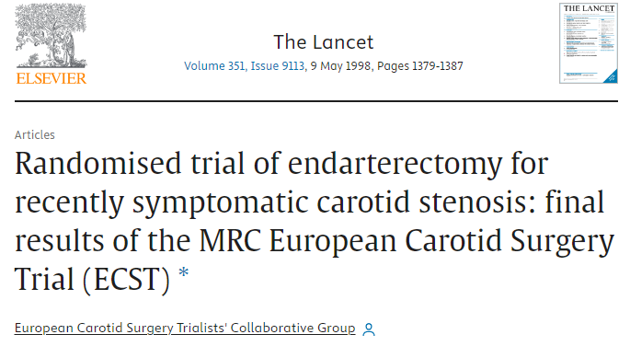
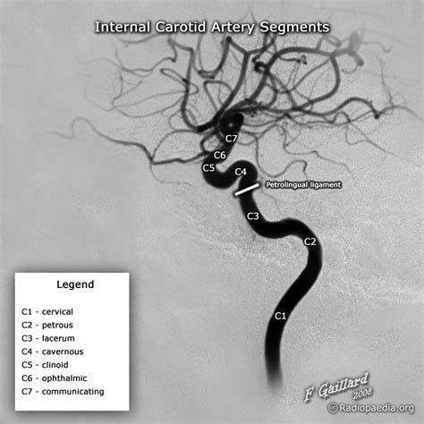
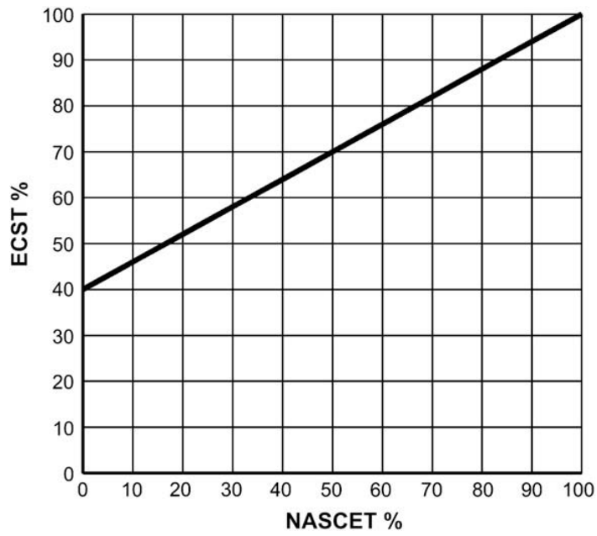

Slide 6
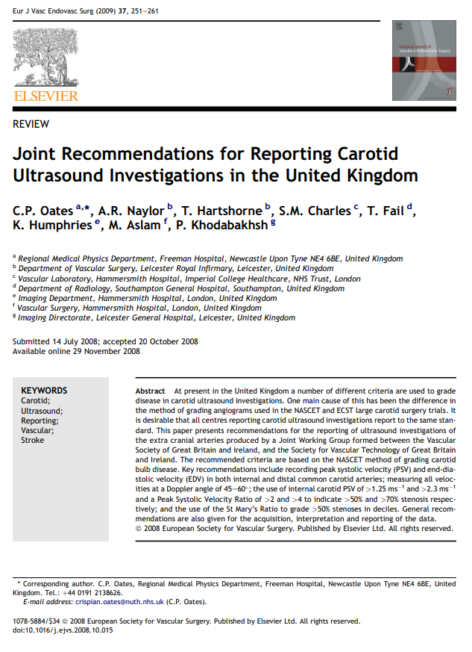
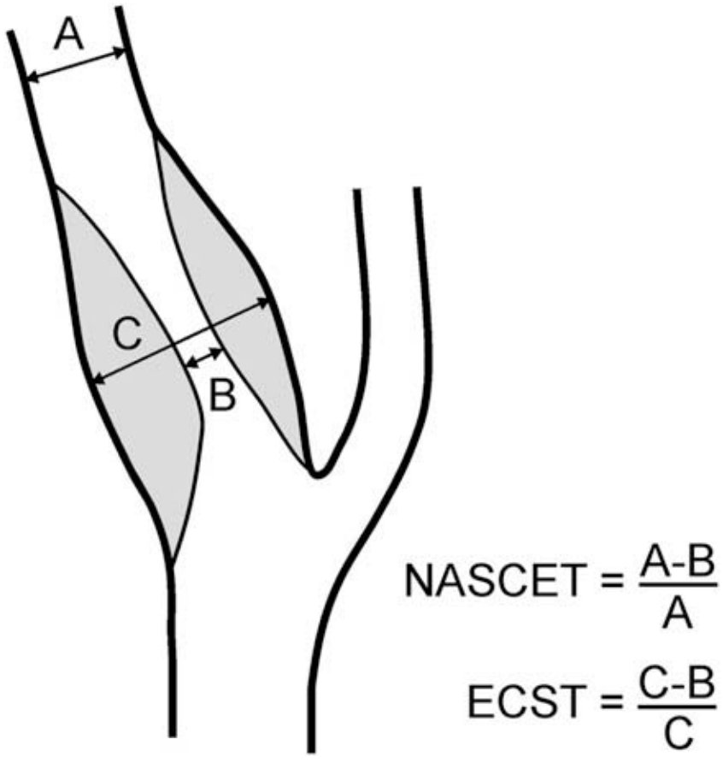

Slide 7
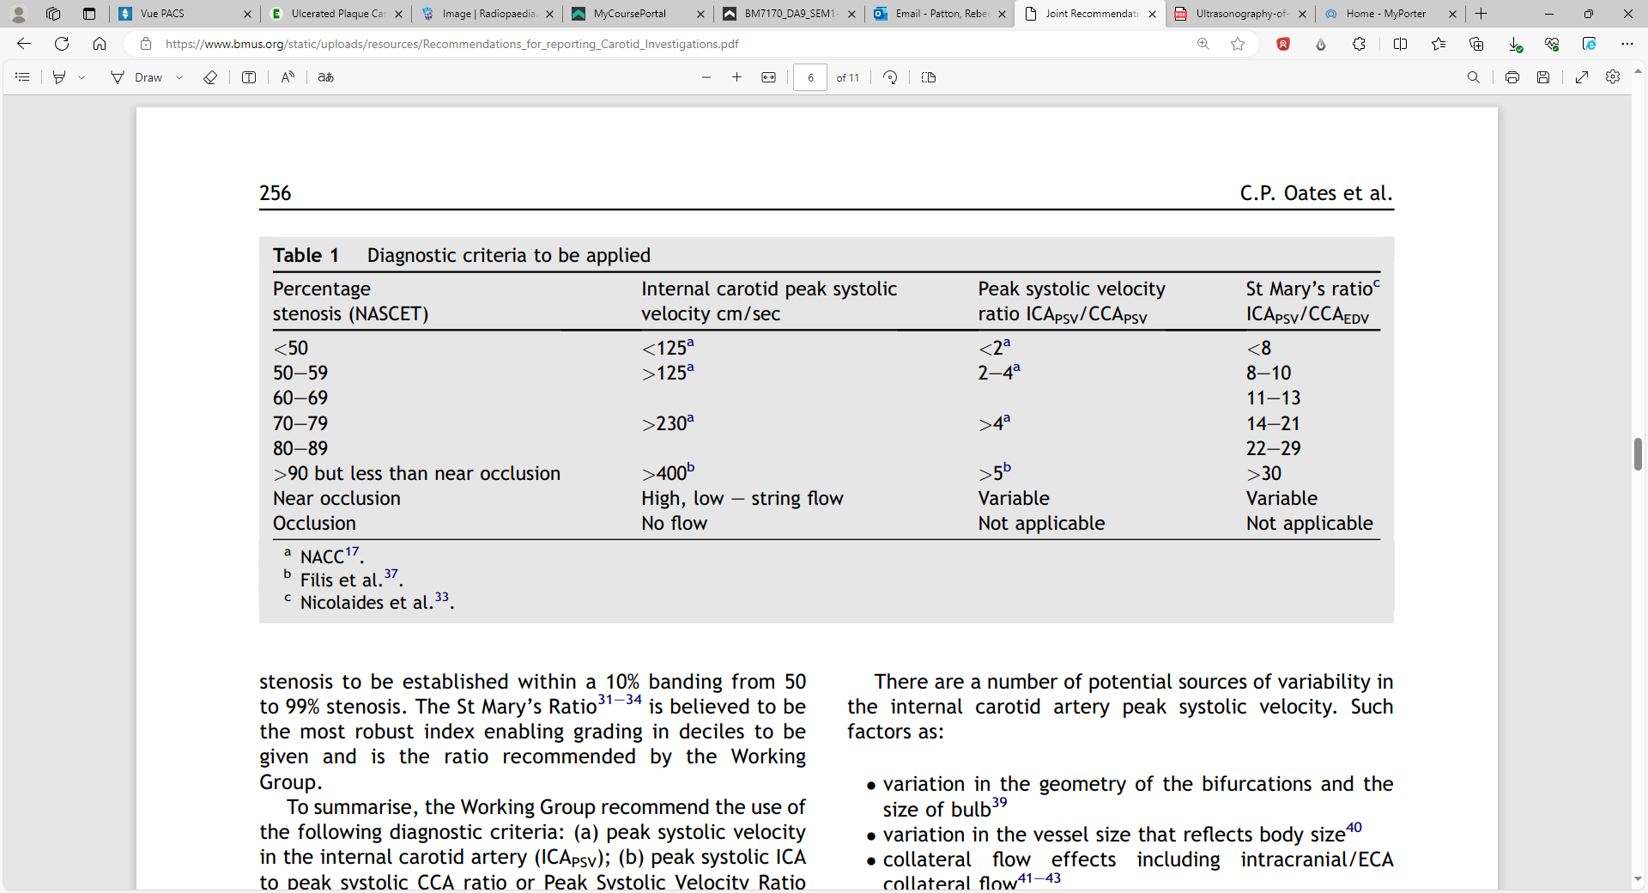

Slide 8
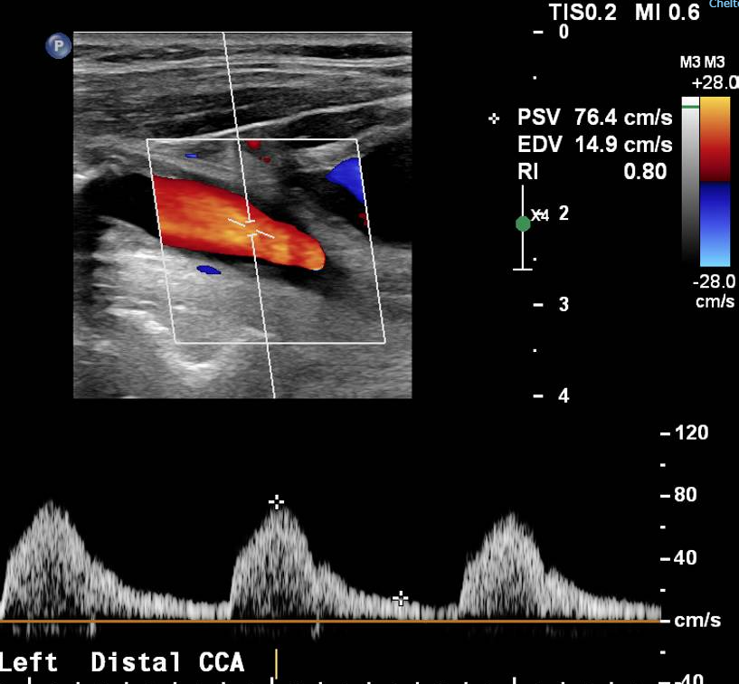
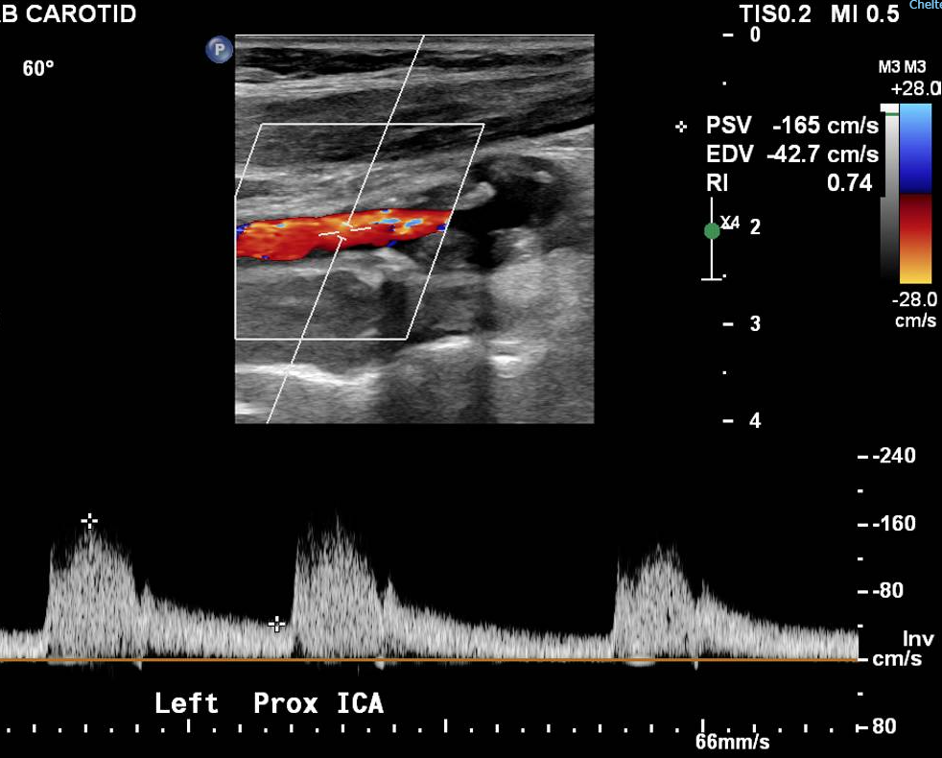

Slide 9
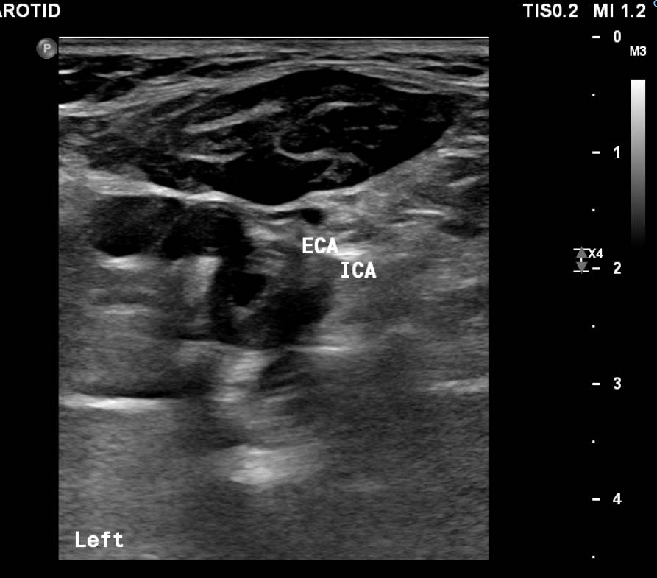
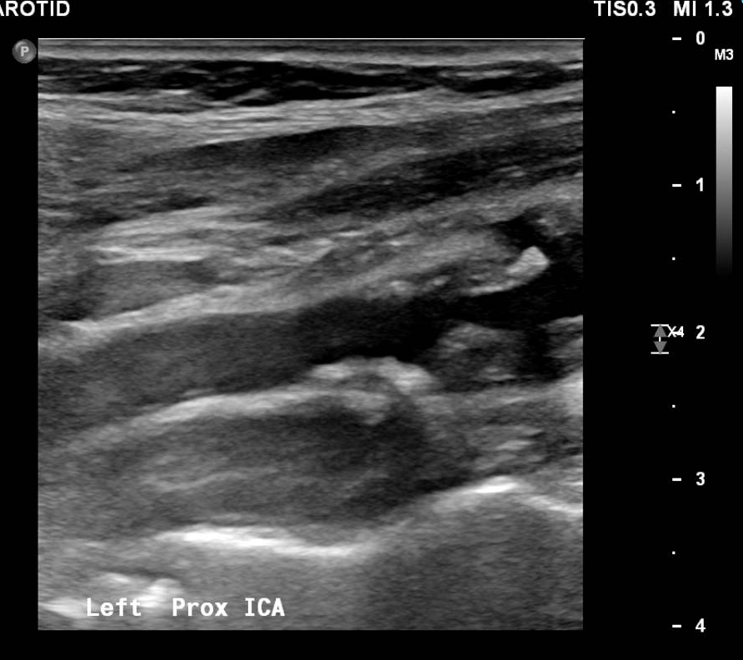

Slide 10
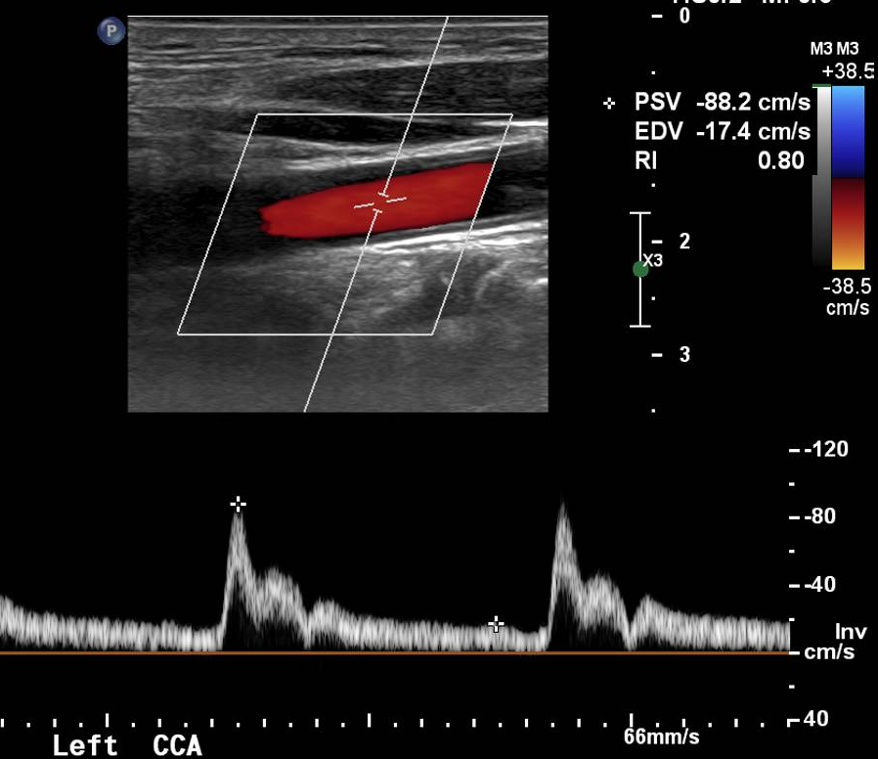
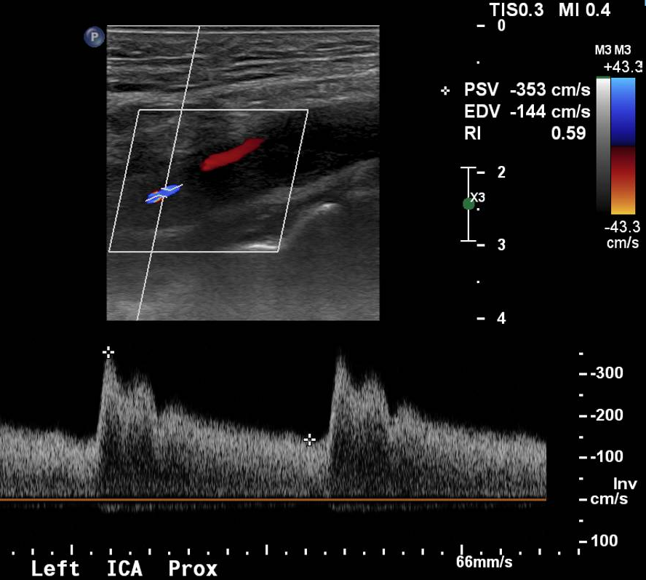

Slide 11
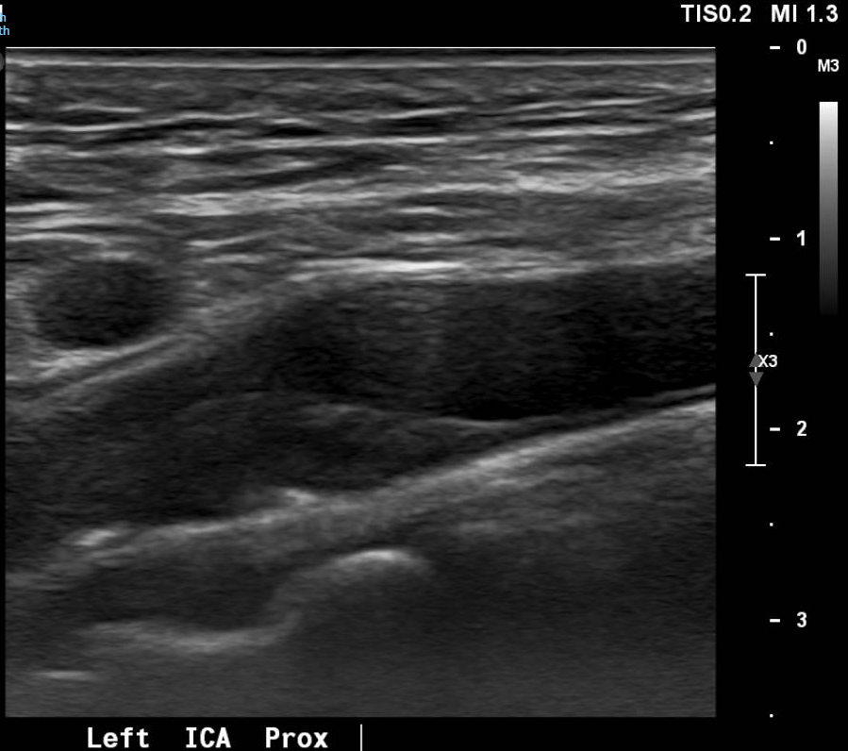

Slide 12
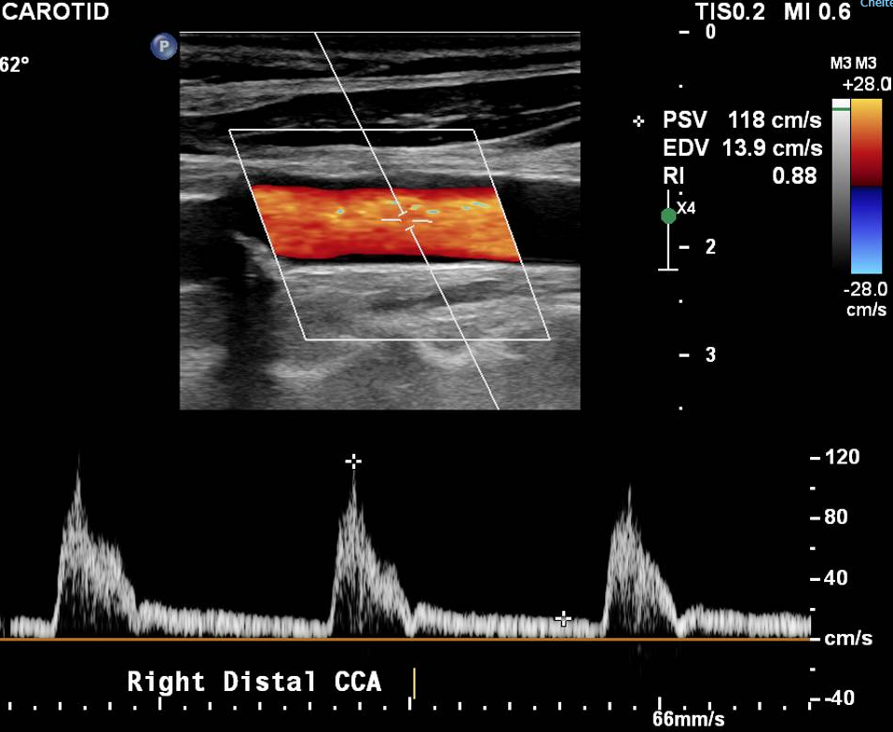
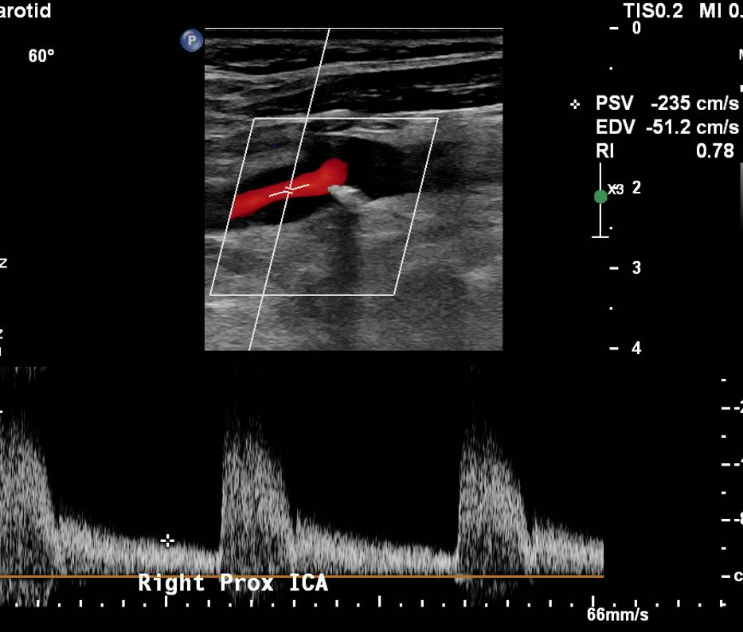

Slide 13
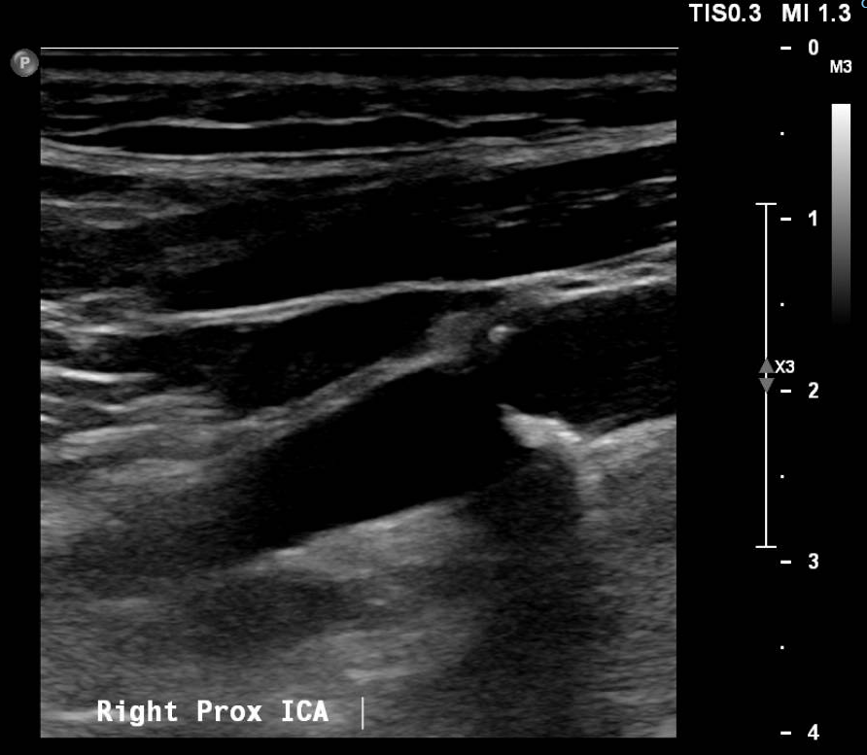

Slide 14
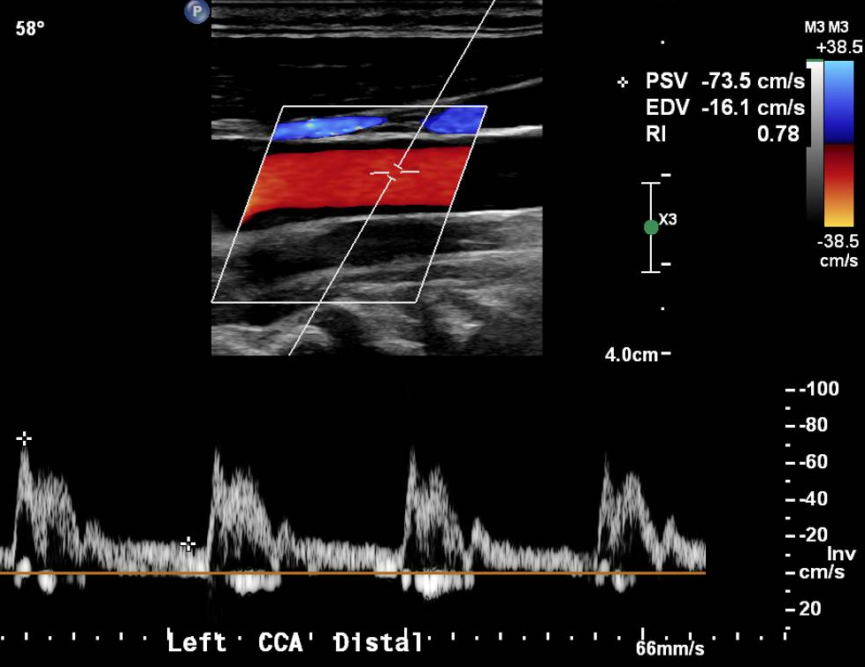
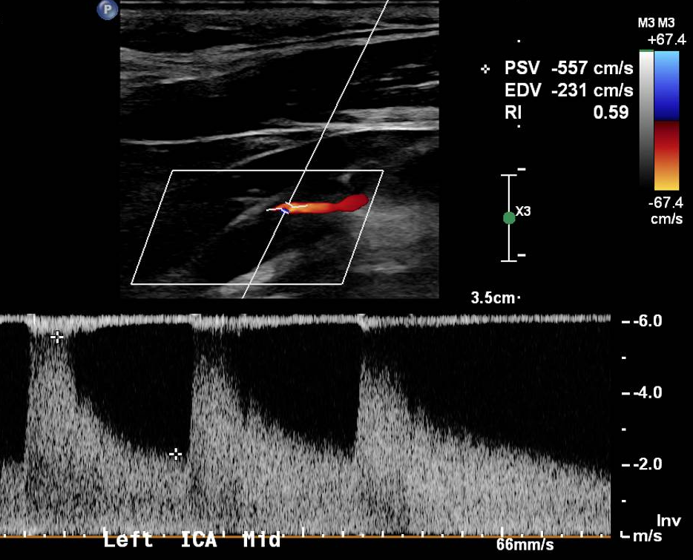

Slide 15
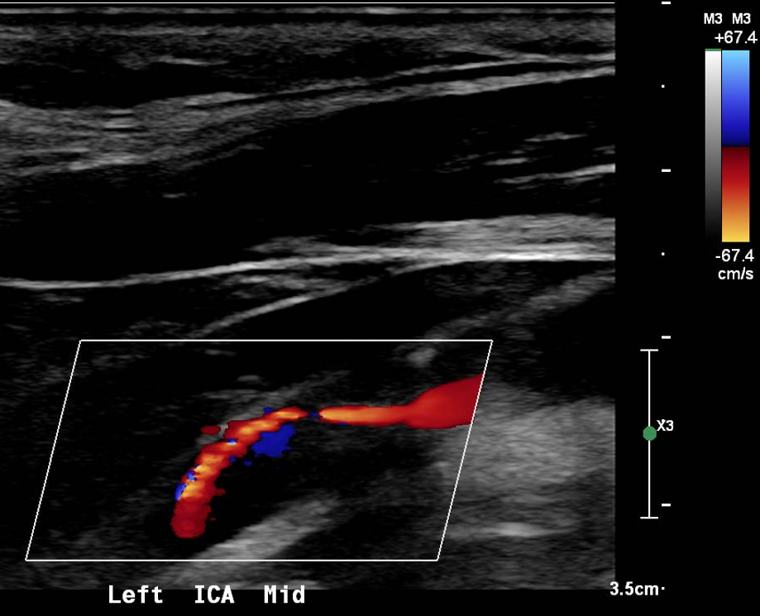

Slide 16
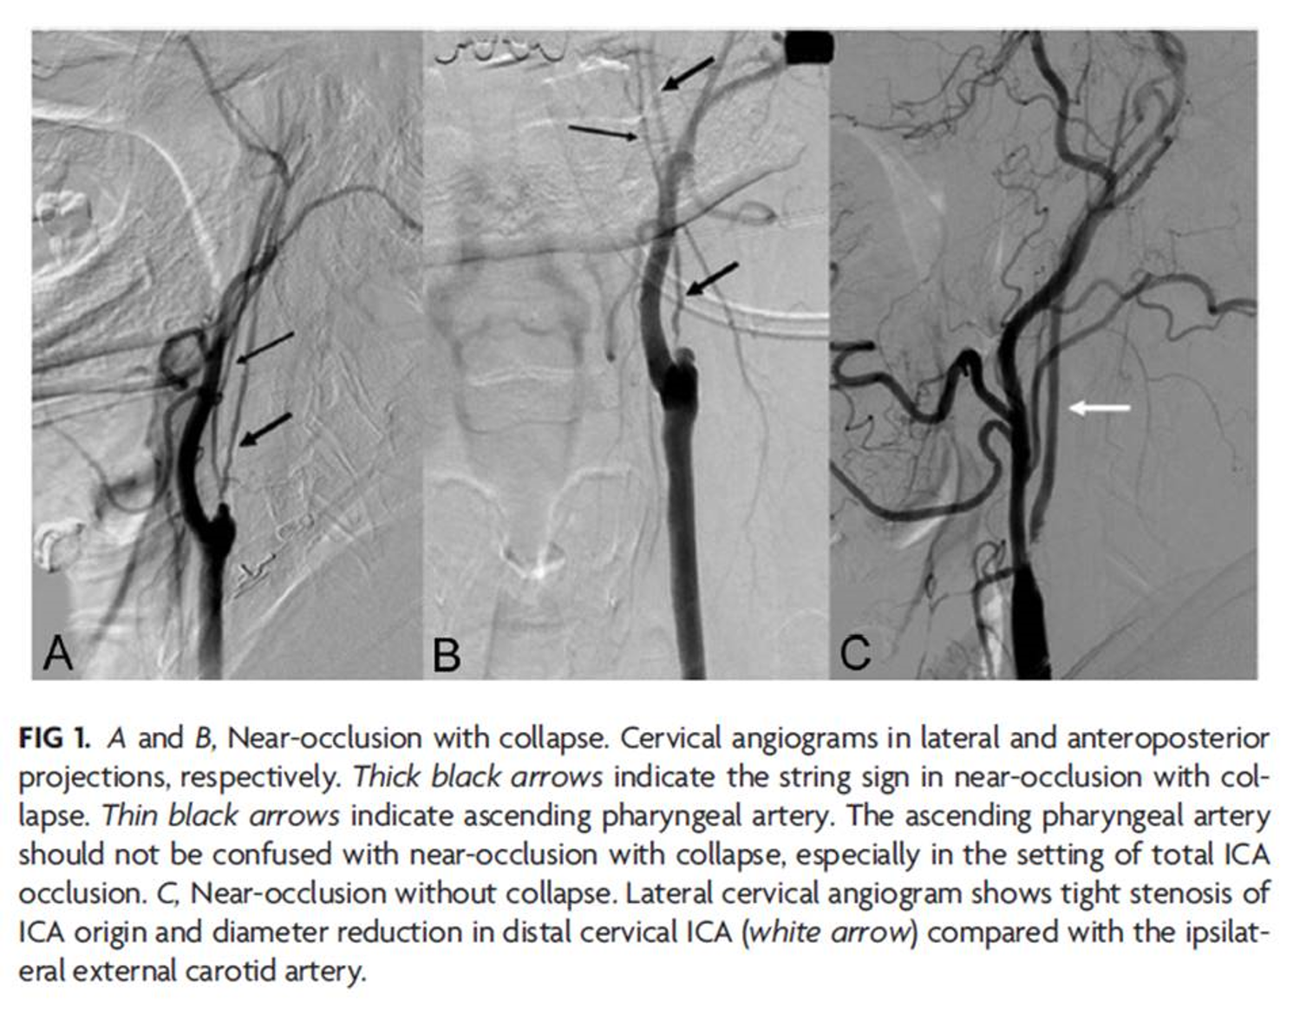
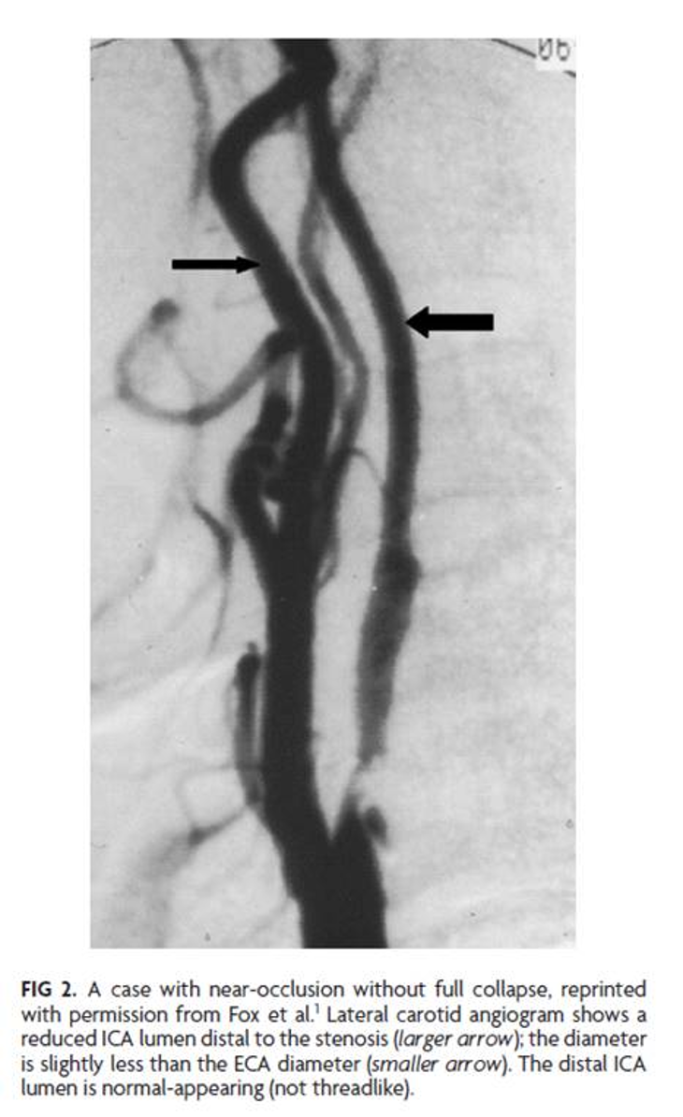
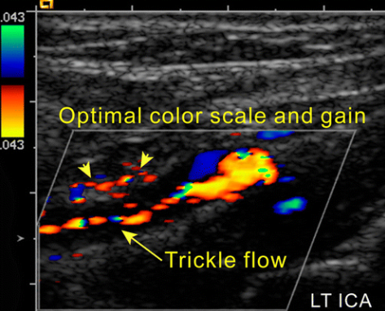
Internal carotid artery near occlusion
There is a tight stenosis with a reduced or collapsed distal lumen
Two types: with and without full collapse
Prevalence 0.5-23 % of carotid cases

Slide 17
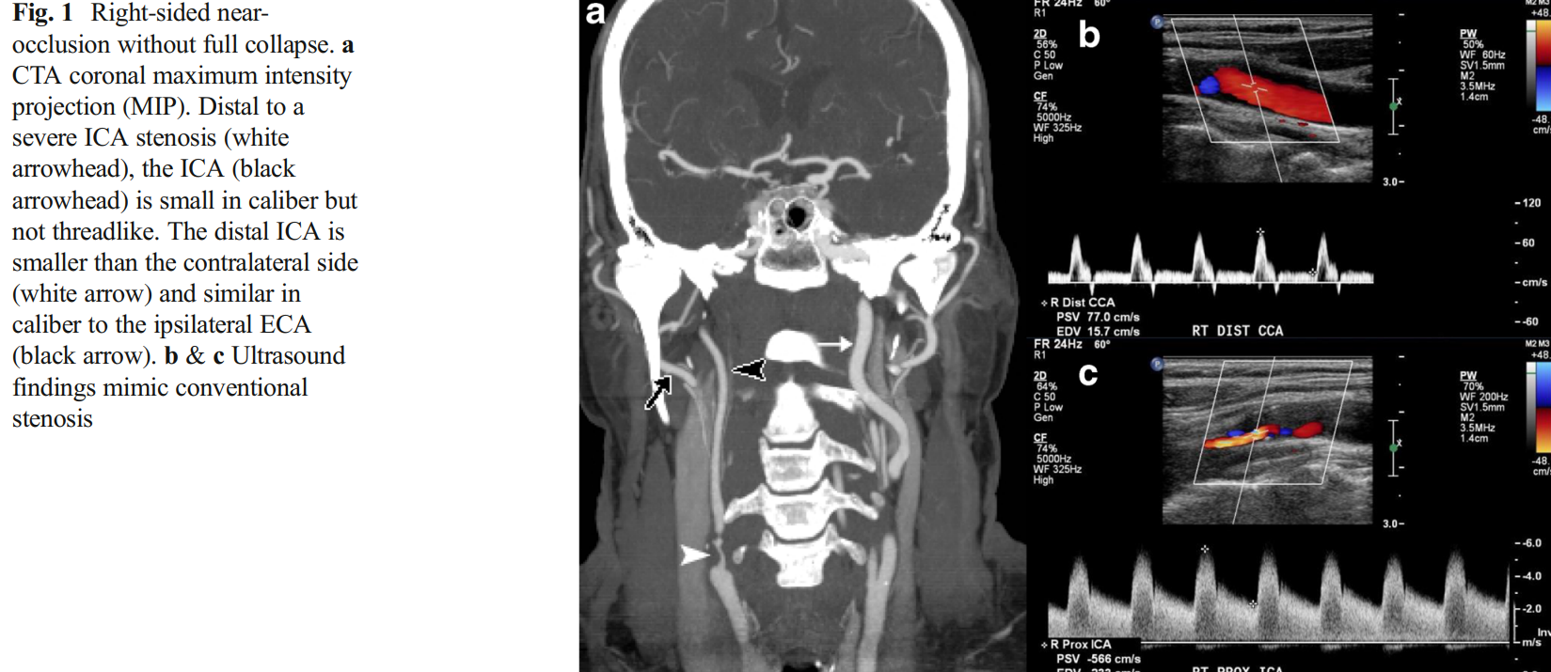
Near occlusion without full collapse

Slide 18
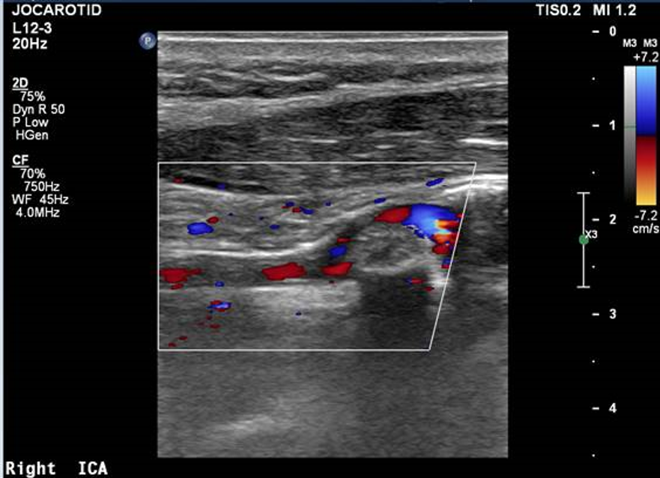
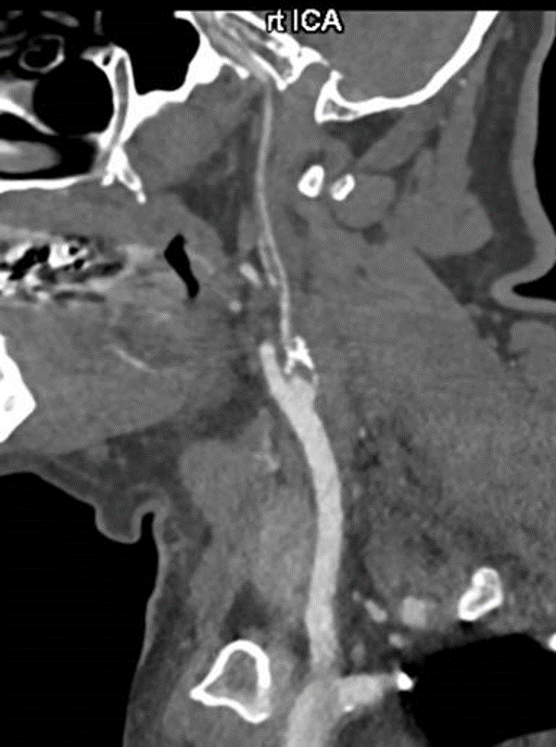
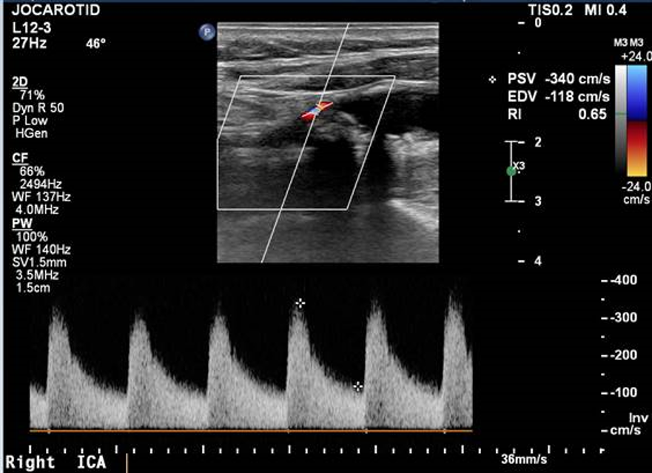
Near occlusion with full luminal collapse

Slide 19
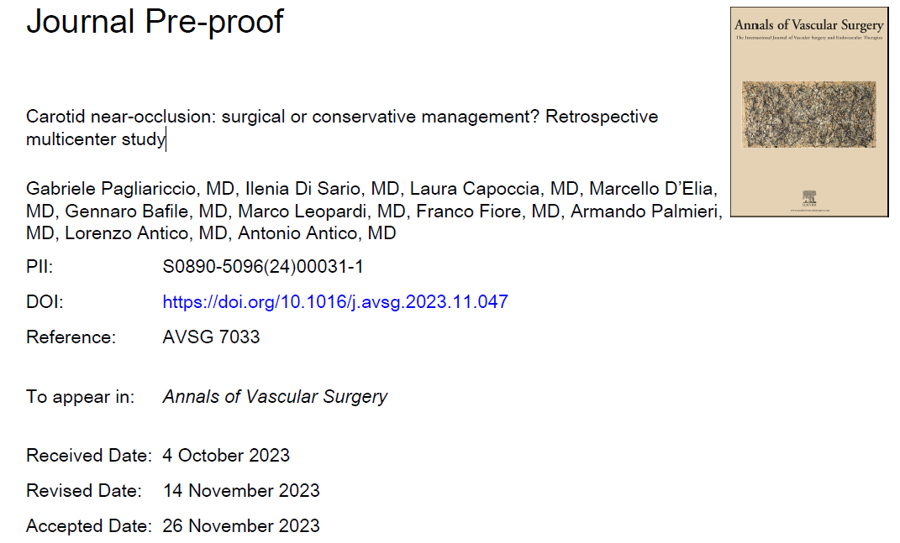
Why is this important?
Both the NASCET and ECST data revealed there was a lower stroke risk with a carotid near occlusion compared with a conventional stenosis.
The decision to treat surgically or conservatively is highly debated
Very recent paper looking at carotid near occlusions supports surgical treatment only in patients without full luminal collapse.

Slide 20
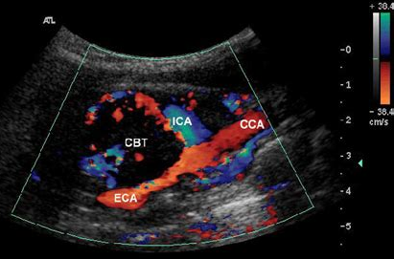
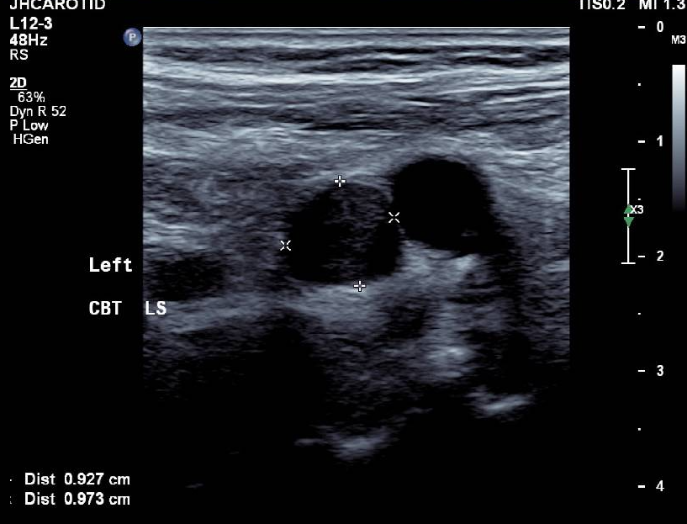
Carotid body tumour
Arising from the paraganglion cells of the carotid body

Slide 21
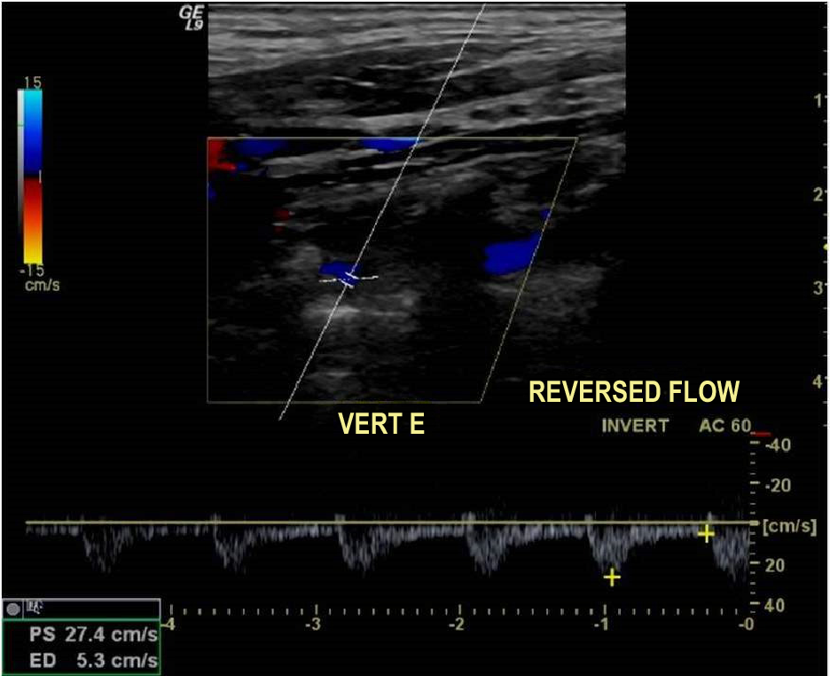
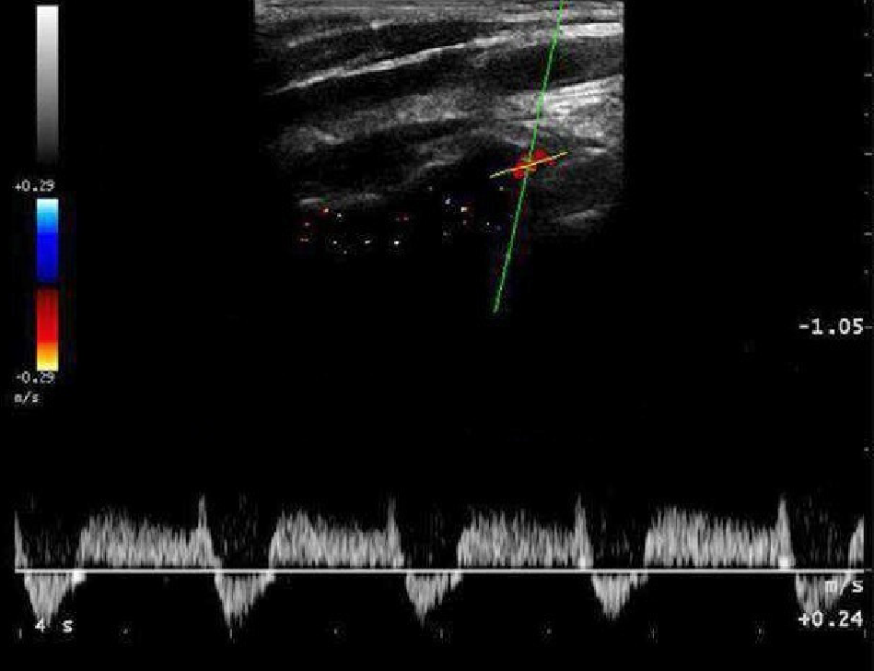
Subclavian steal syndrome
Stenotic or occlusive disease in the proximal subclavian artery with retrograde flow in the ipsilateral vertebral artery.
Weak pulse and reduced systolic blood pressure on the affected side.

