Slide 1
Ultrasound Scanning of Carotid Arteries
Isaac Colliver – adapted from Jeny Anton’s presentation

Slide 2
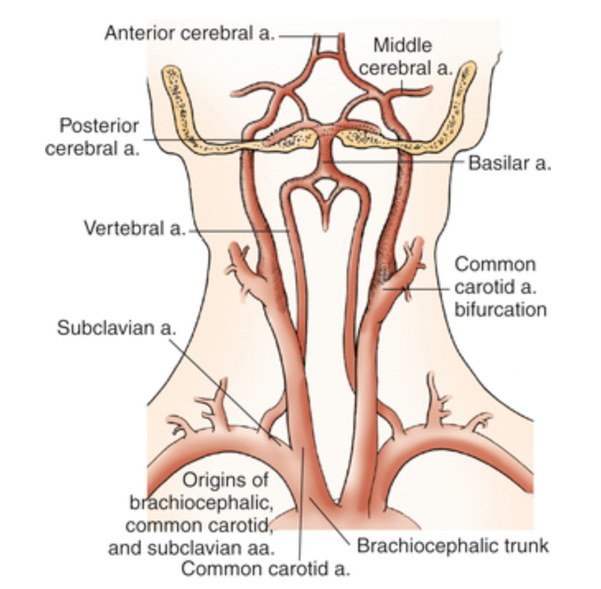
Anatomy
ICA
ECA
CCA
Notes:
The common carotid arteries originate around the aortic arch, of which there are number of anatomical variations possible (see next slide).
The common carotid branches at the carotid bulb to form the extracranial and intracranial carotid arteries. (The carotid body is nestled in between these two vessels, just above the carotid bulb.) The ECA branches further to feed the arteries of the face and neck, whilst the ICA continues without branches to the circle of Willis.
The vertebral artery lies along the neck vertebrae and hence is often not visible in continuity due to passing beneath the bones of the vertebrae. However, the proximal segment can sometimes be seen, usually if the vessel is of a larger calibre or the patient has a small neck; where the vertebral artery joins the vertebrae varies between individuals.

Slide 3
Anatomy

Slide 4
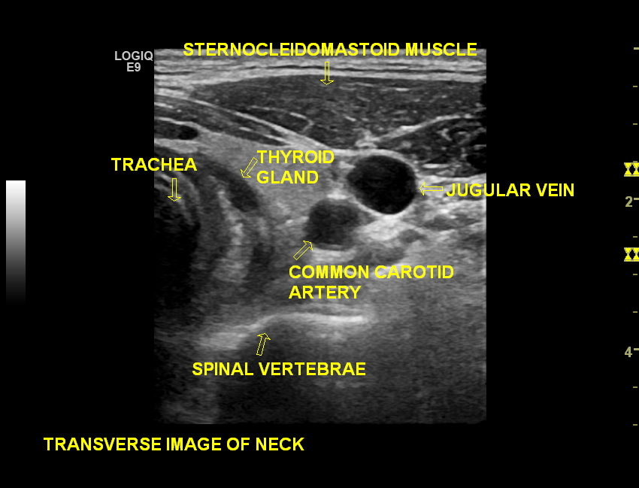
Anatomy

Slide 5
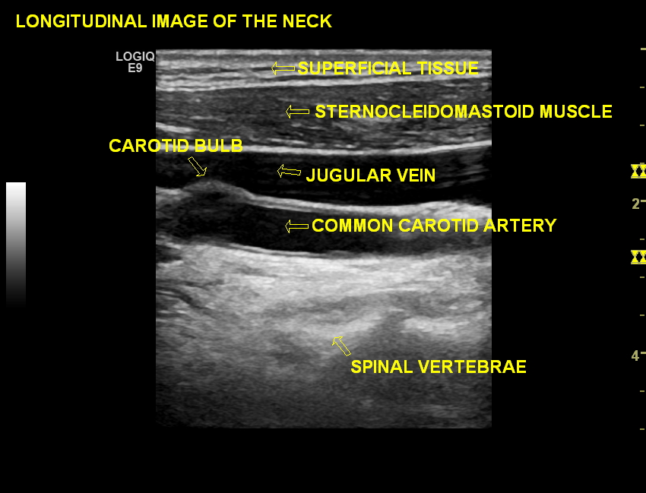
Anatomy

Slide 6
Why is it important?
Stroke is the third most common cause of death in the United Kingdom
Over 80% of strokes are ischaemic, i.e. caused by occlusion of a blood vessel supplying the brain.
Carotid bifurcation is a common site for atheroma, which is a potential source of emboli.
Carotid endarterectomy is usually performed in patients with flow limiting disease and relevant symptoms.
~8% of ischaemic strokes are caused by extracranial ICA stenosis, whilst an additional ~3.5% are caused by ICA occlusion
Total ~11-15% of ischaemic strokes caused by ICA disease
Notes:
What are carotid arteries and why are they important?

Slide 7
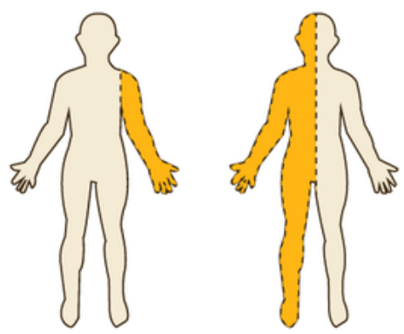
Symptoms
Typical carotid territory symptoms ( Anterior Circulation)
● Mono or hemiparesis -sensory or motor (a.k.a unilateral weakness)
● Monocular visual loss (amaurosis fugax)
● Higher cortical dysfunction (dysphasia— incomplete language function, visuospatial neglect, etc.)
Typical vertebrobasilar symptoms (Posterior Circulation)
● Bilateral loss of visual field (e.g. Diplopia, Homonymous hemianopia)
● Problems with gait and stance
● Dysarthria ( slurred speech)
● Vertigo

Slide 8
Indications for Scanning
Transient ischaemic attack (TIA) or stroke
Amaurosis Fugax
Trauma to neck ( carotid dissection)
Pulsatile lumps (aneurysms or carotid body tumours)
Carotid Bruit
Pre- operative investigation (i.e CABG or pre-EVAR)
Other less specific indications
Vertigo/dizziness/lightheadedness
Tinnitus (ringing ears)
bilateral visual symptoms

Slide 9

The scanning process...

Slide 10
History taking
What symptoms did the patient have?
When was the last symptom – how often did they occur, how long does it typically last?
Have they fully recovered from their symptoms?
Previous carotid endarterectomy or stenting
(Medication?)
Notes:
Clinical history: Clinical histories should be obtained using open questioning to identify the issue that has led the patient for an extracranial examination, followed by closed questioning to clarify details (e.g. duration of event). Attentiveness to verbal and non-verbal cues can help the patient feel they have described their symptoms accurately, aided by confirming the operator’s interpretation of symptoms with the patient before recording as clinical history.
Specific symptoms (see below) must be queried in order to establish the likelihood of a cerebrovascular event. If any of these symptoms are reported then the history should record the date and approximate time of the most recent event and those within the past two weeks, as well as the general frequency and average duration of events.
Presenting signs and symptoms of cerebrovascular disease
Unilateral paraesthesia
Dysphasia / aphasia / dysarthria / anarthria
Hemiparesis / hemiplegia / focal weakness
(Hemi-; Quatro-)Anopia / visual field defects
{Balance difficulties / non-orthostatic dizziness}
Patients may present with additional symptoms which suggest other types of carotid disease, such as: carotid dissection (neck pain, headache, Horner’s syndrome, with or without recent neck trauma, usually with focal neurological symptoms), carotid body tumour (neck swelling, sometimes with prominent pulse, cranial nerve dysfunction including vocal changes), carotid aneurysm (pulsatile neck swelling, with or without focal symptoms), vertebral artery compression (dizziness on head manoeuvres).
Examples of a recorded extracranial clinical history are included below.
History: Right-sided weakness and dysphasia lasting ~2 hours, with some mild/residual symptoms persisting today.
History: Two recent episodes (02/06/18 and 05/06/18) of transient Right arm weakness. Ex-smoker; COPD. Clinically, Left hemisphere TIA/lacunar event.
History: Right rubeosis.
History: Recent episode of transient Left orbital migraine lasting approximately 1 hour, followed by one episode of transient dysphasia lasting approximately an hour and a half. Previous TIA ~11 years ago with Left-sided paraesthesia. HTN. DLP. Ex-smoker. Hypothyroidism.
History: Recent episode of dysphasia and Right facial weakness lasting for 8 hours. Previous Left TIA and CEA. IHD. Dyslipidaemia. PMH. HTN. Mild Alzheimer's disease. Patient also described trauma to Left posterior neck ~12 months ago with residual persistent swelling.
History: One episode of Left arm weakness, lasting ~30 minutes, on 24/02/18.
History: Long-standing history of recurrent episodes of Right amaurosis fugax, lasting seconds-to-minutes, occurring once every 6-8 weeks. Last episode >4 weeks ago.
History: Left eye total hyphema.
History: Long-standing history (>months) of Left eye visual disturbances (patient described zig-zag flashing lines lasting ~minutes). Last episode several weeks ago.
History: One week long episode of dizziness, now subsided, occurring approximately 2 months ago. No other unifocal symptoms.
History: Patient gave a clear report of recurrent episodes of Right eye amaurosis fugax and Right temporal headache occuring since 25/06/18, following trauma to Right face on 23/06/18.
History: Onset of Left facial, arm, leg weakness and Left facial paraesthesia on 25/03/18; symptoms still present today.
History: Acute onset Right superior homonymous quadrinopia. Vague description of transient Left hand paraesthesia some months ago.
History: Episode of Right arm & leg weakness and paraesthesia, onset 02/04/18, symptoms still present. Possible description of visual disturbances? HTN. HLD.
History: Left arm and leg weakness and paraesthesia, onset 02/04/18, still mildly present today. Previous similar episodes in Jan '18 and July '17.
History: Crescendo TIA episodes - general feeling of unwellness on 09/04/18; approximately 4-to-5 episodes of Right sided weakness and paraesthesia on 10/04/18; no episodes on 11/04/18; further two episodes on 12/04/18 at approximately 10:15am and 11:50am.

Slide 11
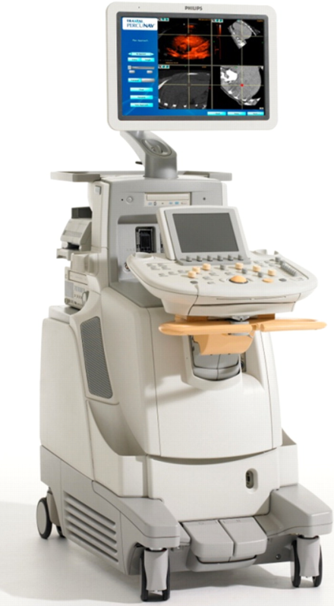
Equipment
Ultrasound machine with Colour and Pulsed Doppler functions
Medium to high frequency linear probe (5-12 mHz)
Curvilinear probe (3-5mHz) may be needed for deeper vessels
Carotid preset
Height-adjustable couch and chair
Temperature-controlled scanning room with dimmable lighting

Slide 12
Patient position
Different ways to scan a patient… You decide what is best for your posture!!!!
Supine on the bed with neck slightly extended and head turned away from side being scanned.
Scan patient seated e.g in a wheelchair (e.g. due to restricted mobility, breathing difficulties)

Slide 13
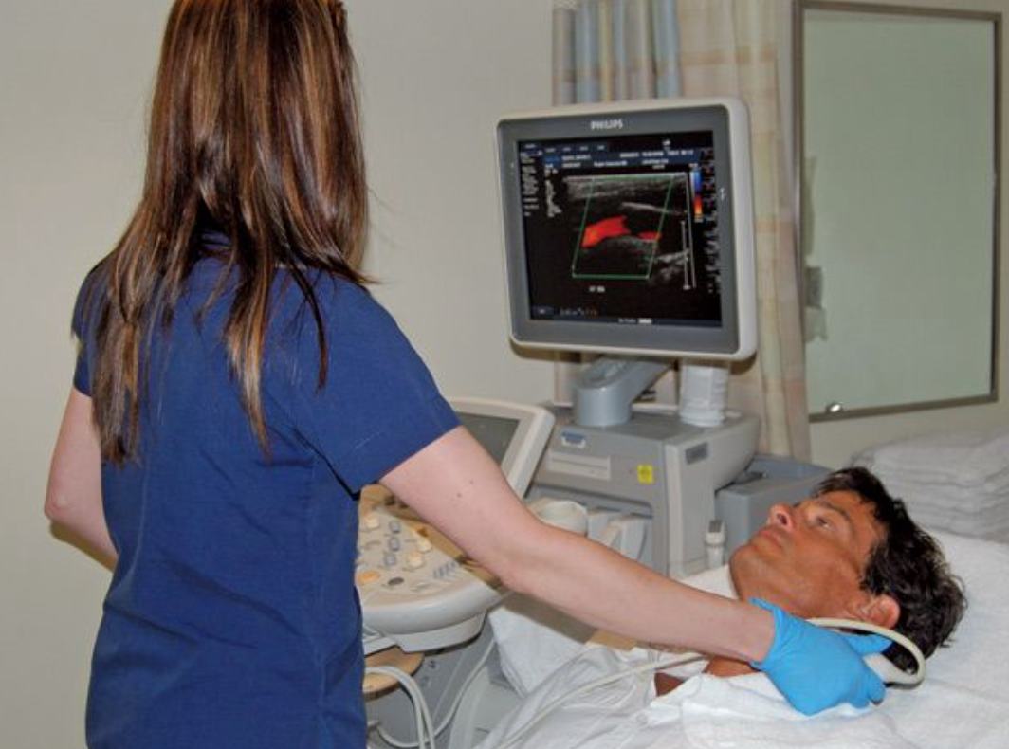
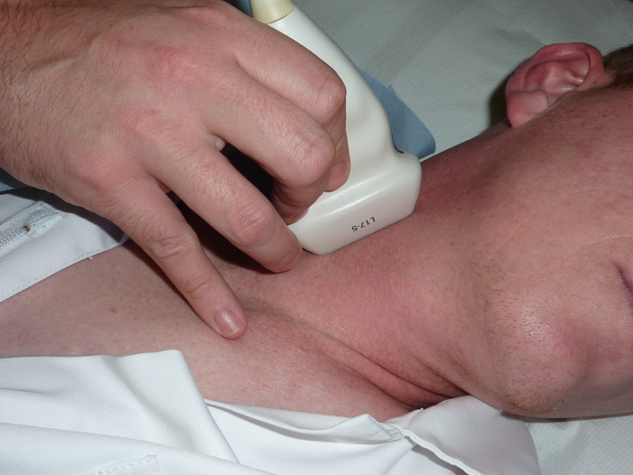
Sonographer position
Scan sitting or standing - ensure patient at correct height
Rest hand/wrist gently on patient.
Machine and screen facing operator at correct height.
Avoid twisting. Stay close to patient!!!

Slide 14
Scanning Technique
The carotid arteries are best visualised through the sternocleidomastoid muscle using a lateral approach in:
B-Mode
Colour Mode
Pulsed Mode

Slide 15
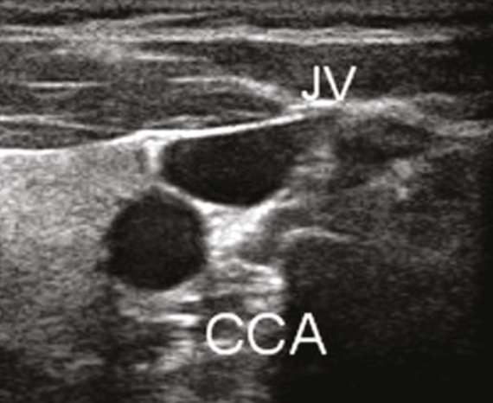
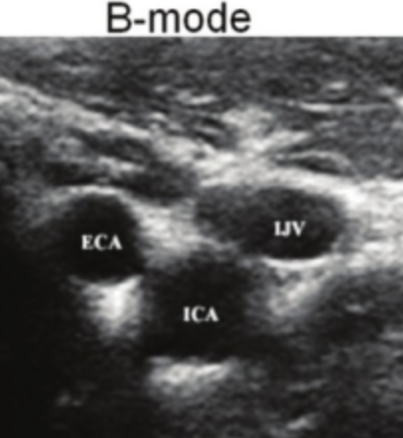
B-Mode Imaging
Start in transverse.
Find CCA at the base of neck.
Trace CCA up to carotid bifurcation and along ICA and ECA
ICA typically larger and lies more lateral than ECA.
Trace ICA up to level of mandible.
Note presence, location, appearance of any disease and orientation of arteries.
Repeat in longitudinal imaging plane

Slide 16
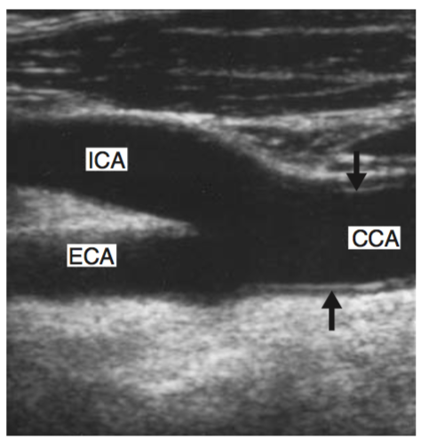
B-mode Image optimization
• Gain
• Focal zone
• Dynamic range/ grayscale maps
• Depth
• Harmonics

Slide 17
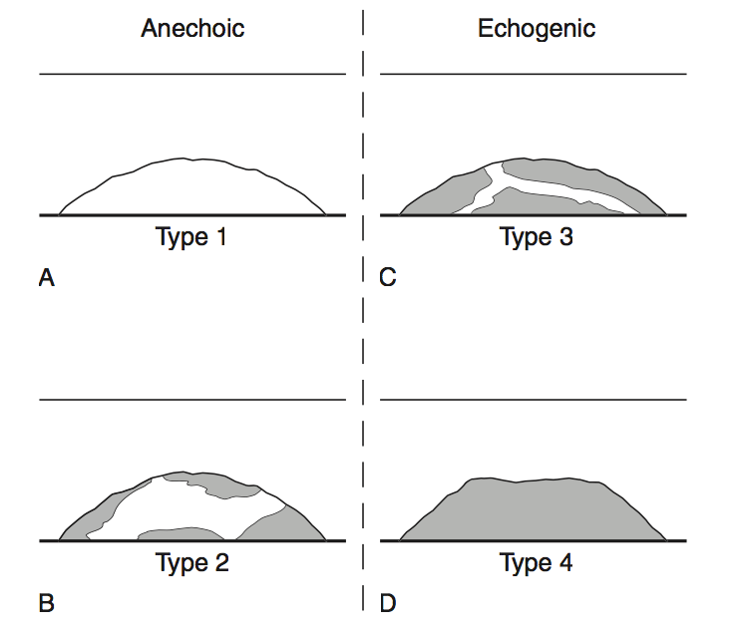
Plaque categorisation
Appearance of a plaque is dependent on the scanner controls being set to give an optimal image.
Plaque features can be described in terms of : echogenicity (from anechoic to hyperechoic), surface (from smooth to cavitated) and texture (from homogeneous to heterogeneous).
Low risk plaque :
Echogenic, Homogenous and smooth
High risk plaque:
Echolucent, Heterogenous and
ulcerated/irregular

Slide 18
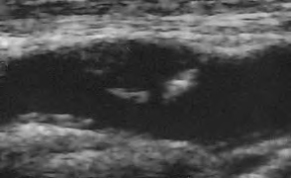
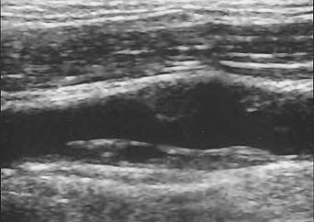
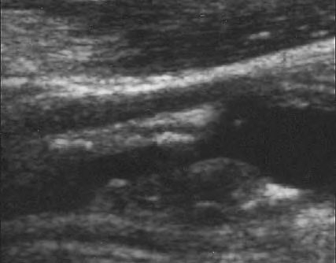
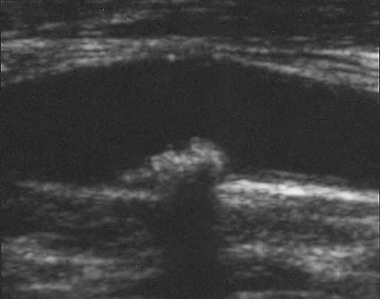

Slide 19
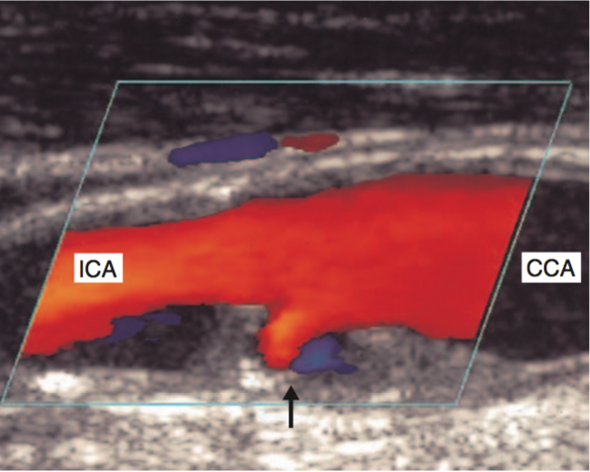
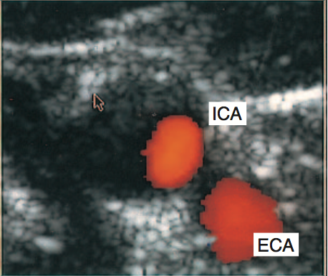
Colour Mode Imaging
Scan from base of neck to jaw line mainly in longitudinal.
Transverse view helpful in proximal CCA and possibly at site of stenoses
Calibrate PRF (get rid of aliasing) to the CCA, box size and direction, and gain for optimal wall to wall filling
Identify CCA, ICA and ECA
Identify any areas of flow disturbance for further evaluation with pulsed Doppler.

Slide 20
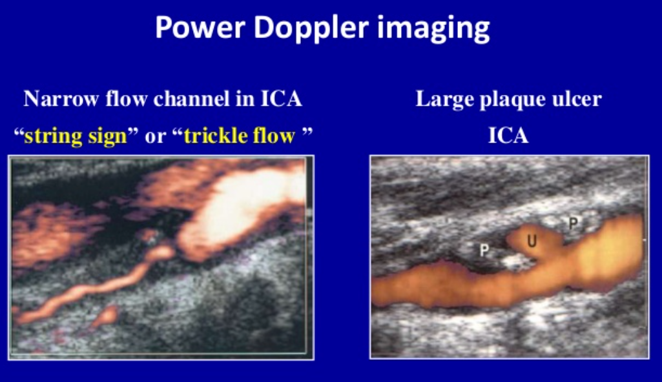
Power Doppler
Angle independent
No aliasing
> ?Helpful when distinguishing subtotal from total occlusion
Useful when scanning tortuous vessels
Better visualization of plaque surface morphology

Slide 21
Pulsed Doppler
Record Doppler waveform at in CCA (~2 cm from bifurcation), ICA and ECA.
If disease is present, sample Doppler waveform in any areas of flow disturbance identified with colour Doppler.
find highest velocities obtainable (listen to the audio signal)
freeze waveform and make measurements
make the measurements with manual caliper placement
Notes:
CCA waveform should be taken within approximately 2 cm of the carotid bulb/bifurcation for reproducibility; where there is flow disturbance and/or disease it is acceptable to measure the waveform more proximally.

Slide 22
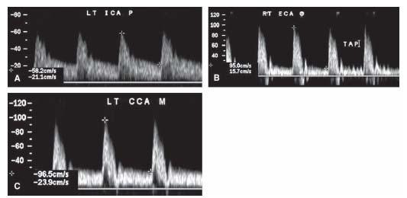
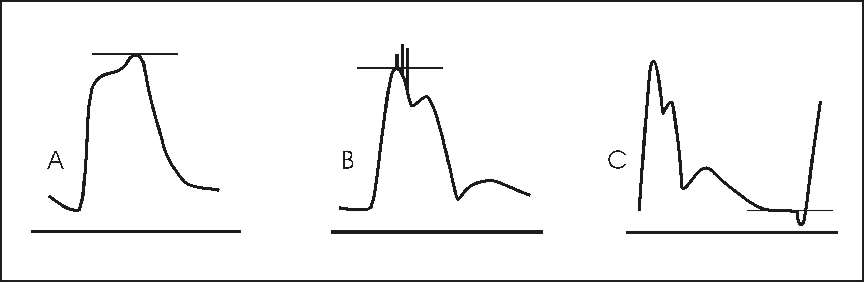
Doppler Waveforms
Notes:
a) 2nd -peak > 1st -peak – use 2nd -peak
b) ignore spike turbulence
c) for EDV ignore small end diastolic dip

Slide 23
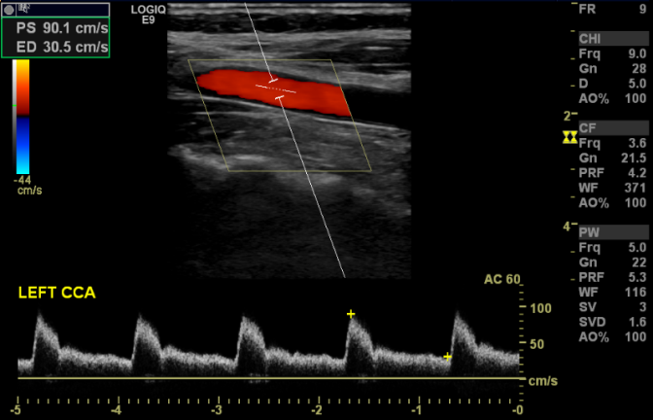
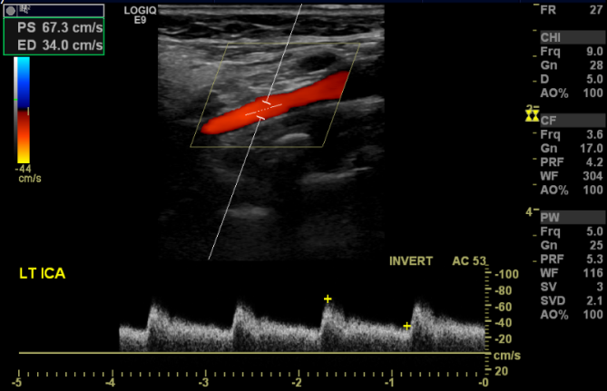
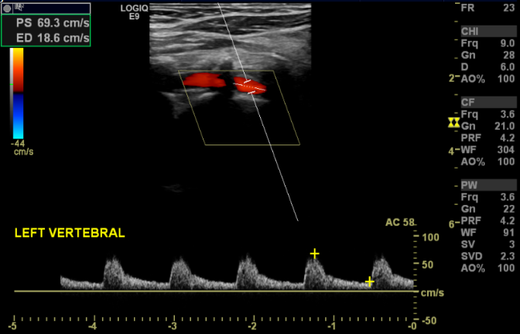
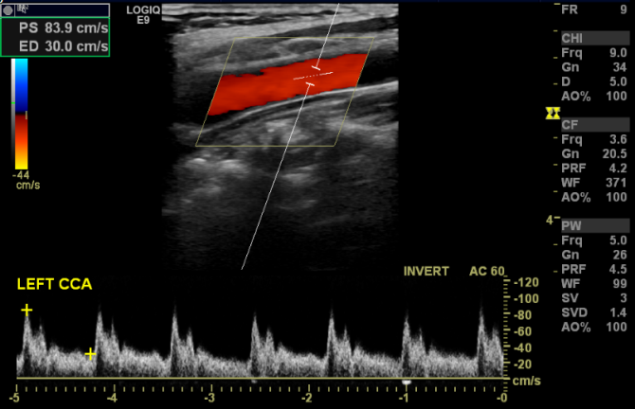
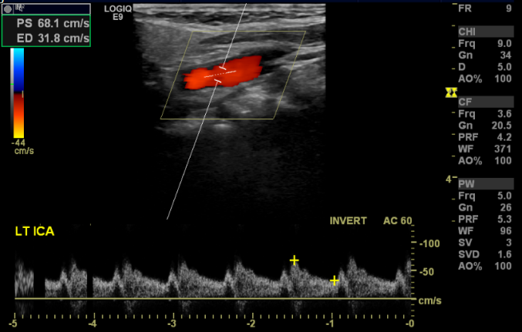
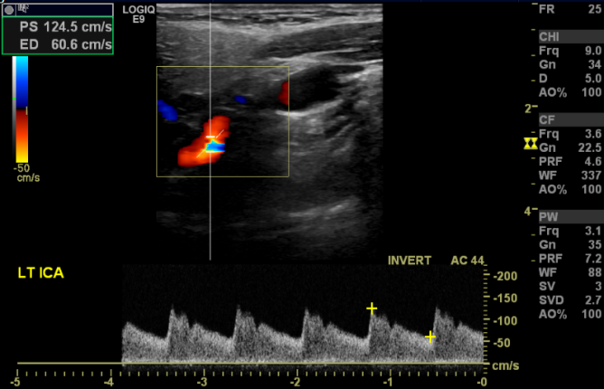
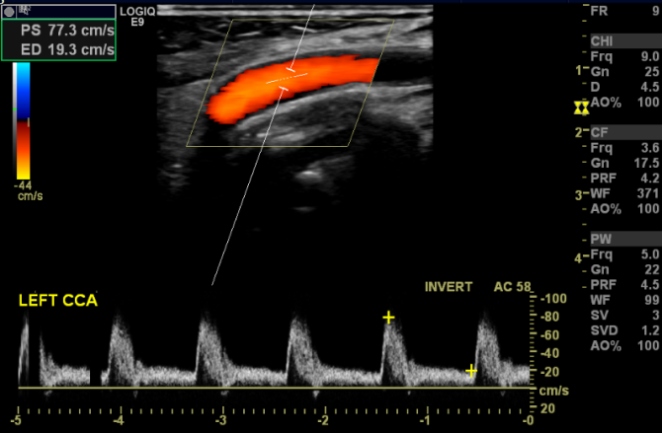
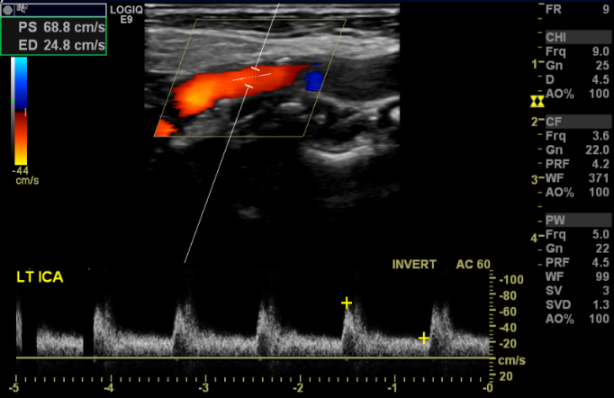
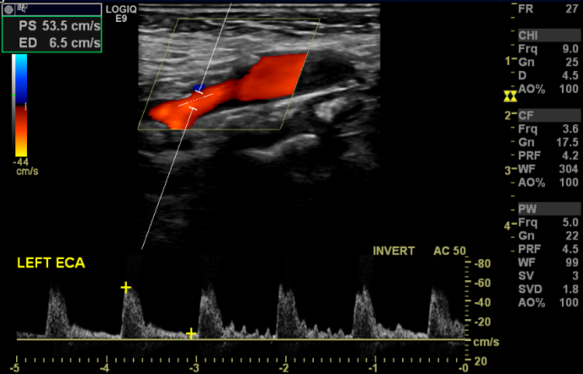
Notes:
Above (left) are three examples of different patient’s CCA and ICA, exhibiting normal variations in pulsatility, velocity, and waveform shape (e.g. turbulence due to anatomical variation).
Similarly, vertebral waveforms (top right) will be variable between individuals – most commonly smaller vertebral arteries will have more pulsatile waveforms. Importantly, there should be forward diastolic flow – absence of diastolic forward flow (i.e. a high resistance waveform) is suggestive of distal severe stenosis or occlusion.
(mid right) tortuosity of ICA that leads to velocity increase without plaque. (bottom right) ECA waveform with a temporal tap
The ECA is often distinguishable due to its more pulsatile waveform and lower diastolic flow, however the most reliable sign of the vessel’s identity is the presence of branches. In the absence of branches a ‘temporal tap’ can be performed to cause reverberations in the proximal waveform due to distal changes in resistance as a consequence of the temporal tap. It is important to note the ICA may sometimes also exhibit reverberations in response to a temporal tap, but they will not be as pronounced as those seen in the ECA. The image to the right demonstrates each of these identifiable signs of the ECA.
Finally, one of the less common variations of normal in the ICA are tortuosities which can cause non-pathological increases in velocity – demonstrated in the image to the left.

Slide 24
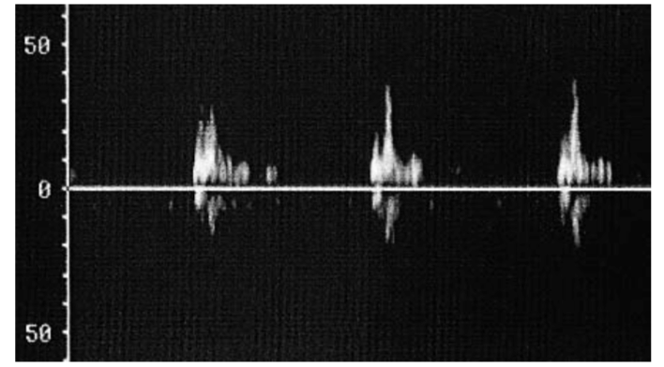
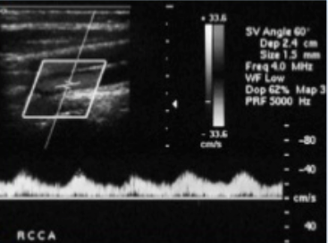
High-resistance waveform shown in a non-diseased ICA proximal to an MCA occlusion.
Tardus Parvus waveform in CCA due to proximal stenosis e.g. innominate artery

Slide 25
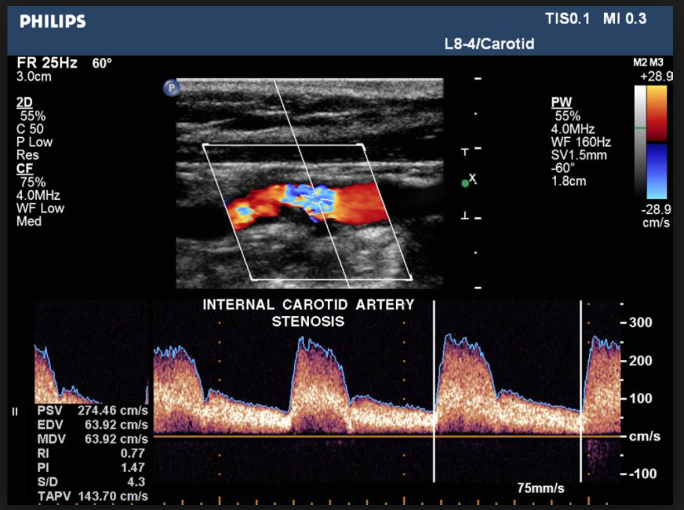
Velocity measurement
Select correct Doppler angle (45 to 60 degrees)
Align angle with flow direction
Appropriate gain
Steer box
Trace Doppler sample volume through any atheromatous areas to ensure maximum velocity is recorded.

Slide 26
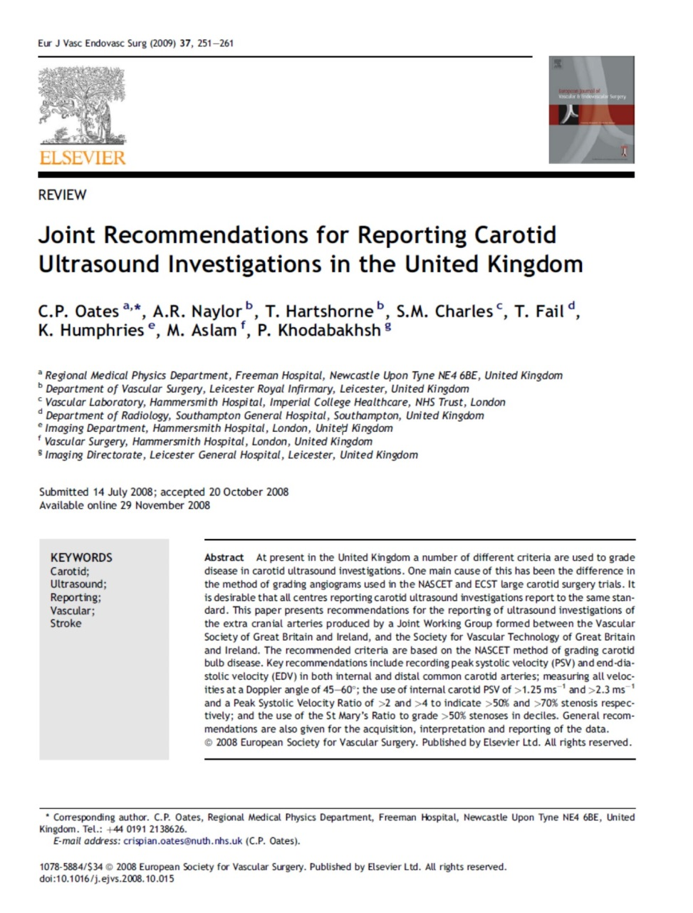
Grading the disease
The confusion!!!

Slide 27
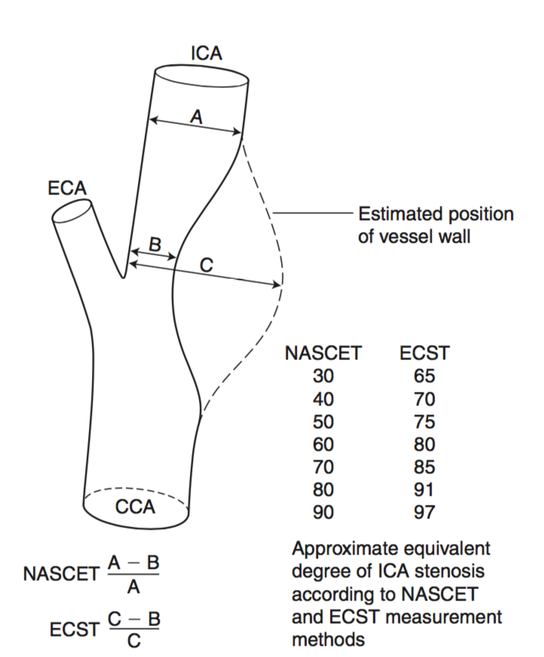
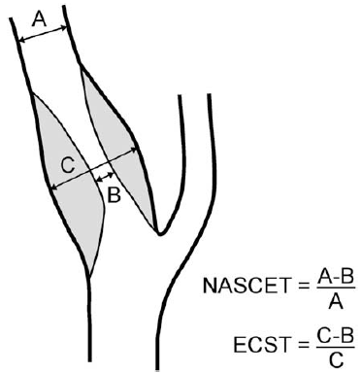
Two randomised controlled trials performed in the1990s :
North American Symptomatic Carotid Endarterectomy Trial (NASCET) European Carotid Surgery Trial (ECST)
Used both conventional angiography to quantify carotid artery stenosis but by different methods.
At same time carotid duplex scanning was gaining popularity and criteria were being developed –some based on ESCT method and some on NASCET method
Notes:
ECST has the advantage of describing plaque burden, valuable as the danger is from emboli release from large/vulnerable plaque than the haemodynamic effect of the stenosis. But the percentage stenosis is more variable as the plaque/bulb ratio will vary throughout the plaque and bulb. NASCET is more consistent and describes the haemodynamic effect more accurately.
Both are imperfect as anatomy has inter-patient and intra-patient variability.

Slide 28
Evidence for Carotid endarterectomy
Rothwell et al. (2003) reanalysed data from ESCT using NASCET criteria and concluded:
CE highly beneficial in symptomatic 70-99% stenosis measured by NASCET criteria (stroke risk reduced by 21%).
CE moderately beneficial in symptomatic 50-69% stenosis measured by NASCET criteria (stroke risk reduced by 6%).
Surgery was of no benefit in patients with near occlusion.
Asymptomatic Carotid Surgery Trial – benefit of surgery small in asymptomatic patients with significant stenosis (50 endarterectomies to prevent 1 stroke over three year interval)

Slide 29
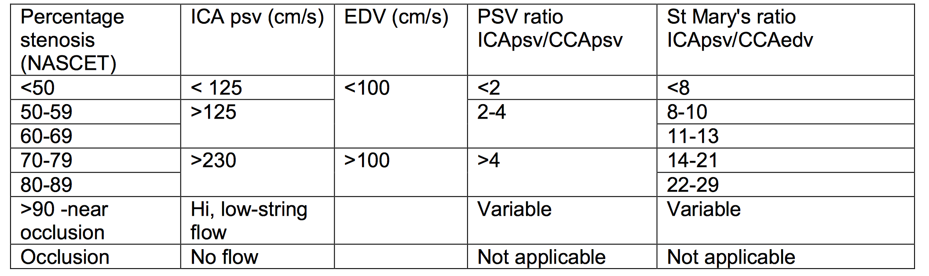
Diagnostic criteria
SVT recommends to measure the PSV, PSV ratio and the St Mary's ratio when assessing the degree of carotid artery stenosis on ultrasound.
Note:
Peak systolic velocity is the primary criteria defining lesions greater than 50%
Agreement of 2 or more criteria is suggested for lesions above 50%
Limitations:
•Severe disease on one side may lead to overestimation of disease on contralateral side due to compensatory collateral flow. •Irregular heart rate (AF)
Notes:
Intrinsic spectral broadening (see Ch. 6) may lead
to errors in velocity measurements that are dependent
on the angle of insonation. Some centers choose
to overcome angle-dependent variations in velocity
recordings by using a fixed angle of 60°.
Misdiagnosis has potentially fatal consequences. Under-diagnosis exposes a patient to further risk of stroke with the possibility of permanent neurological disability or mortality. Over-diagnosis exposes a patient to the possibility of unnecessary secondary imaging (potentially with a radioactive modality) and surgery which carries the risk of neurological disability from stroke, myocardial infarction, or mortality. Furthermore, over-diagnosis may expose the patient to unnecessary pharmaceutical treatment which carry a risk of side-effects. Consequently, it is important to be aware of the limitations of carotid artery ultrasound so as to minimise their impact upon the diagnostic assessment.
Limitations of carotid artery ultrasound include:
Only the cervical carotid arteries can be assessed; the intracranial portion cannot be imaged, and imaging the thoracic portion is of variable possibility.
Severe calcification prevents visual identification of plaque and can prevent Doppler insonation depending on the area and extent of calcification.
Successful diagnosis with carotid ultrasound is dependent upon the operator’s ability
External neck fixations limit access to the neck and may obstruct comprehensive insonation of the arteries. Similarly, patients with exceptionally limited neck mobility may also prohibit a successful scan.
Complete insonation of the vertebral arteries is often not possible due to shadowing from the vertebrae. Furthermore, the origins of the vertebral arteries can be difficult to image – especially when they arise from unconventional positions (e.g. aortic arch).
There is no standardised grading criteria for carotid bulb stenosis; grading follows angiographic method of measuring residual lumen relative to size of the bulb.
Carotid artery stenosis can only be graded in deciles where the CCA EDV is above 7-15 cm/s (low CCA EDV is seen in cases such as valve regurgitation, or arterial calcification; severe distal stenosis). Furthermore, occasionally some discrepancy between measurements may arise – such as a >125 cm/s ICA PSV but velocity ratios indicate the stenosis is less than 50%.
Identifying the tightest point of stenosis can depend on image quality, which is further complicated in particularly tight stenosis where there is a very small volume of blood with which to sample. To maximise the chance of measuring the highest velocity, repeated live sampling should be performed after image optimisation.
Heart arrhythmias can obfuscate reliable measurement of velocities.
Blood velocities have physiological variance between individuals, consequently normal velocity ranges may not be appropriate for certain patients.
Established grading criteria for ICA disease is not validated in cases that also have disease in the CCA
In cases where there is a flow limiting stenosis, PSV may deceptively decrease leading to under-diagnosis if the operator does not carefully observe the visual appearance of the stenosis.

Slide 30
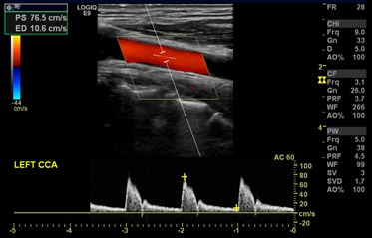
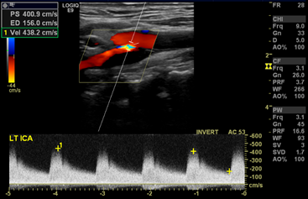
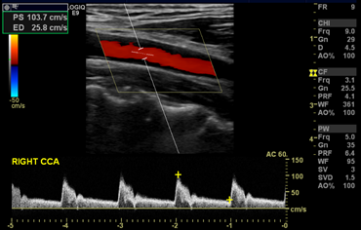
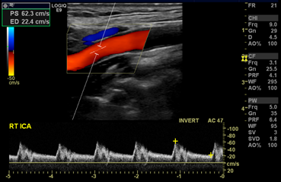
Example – below: CCA velocity spectrogram taken from within 2 cm of the carotid bifurcation (left), and an ICA velocity spectrogram taken within the stenotic jet around a stenosis (right). The velocity ratios indicate a >90% stenosis using the St Mary’s ratio (ICA PSV/CCA EDV), which is concordant with the PSV ratio estimate of 70-99% stenosis, in addition to the ICA PSV being >125 cm/s which indicates a >50% stenosis (under the NASCET criteria).
This is in contrast to a normal set of carotid spectrograms from the same patient on the contralateral side (below).
Notes:
Colour flow mapping aliasing may indicate areas of abnormally high velocity, providing the scale is set appropriately. These areas can then be interrogated further with spectral Doppler to measure the blood flow velocity. In the CCA and bulb, stenoses are considered haemodynamically significant when they are greater than 70% of the lumen at the point of stenosis. For the CCA percentage of stenosis is usually calculated using the highest PSV through the stenosis or in the stenotic jet divided by the PSV from the most proximal clear section of vessel. This technique is not feasible for the bulb so percentage stenosis is usually graded by calliper measurement. In the ICA, stenoses are considered haemodynamically significant when they are greater than 50% by NASCET criteria – which is roughly equivalent to a stenosis greater than 70% by ECST criteria (see Figure 1). The degree of stenosis for the ICA may be calculated using three methods, with diagnostic confidence given when two or more methods are concordant; a PSV >125 cm/s in the ICA is indicative of a 50-69% (NASCET) stenosis whilst a PSV >230 cm/s is indicative of a 70-99% (NASCET) stenosis, furthermore >400 cm/s indicates a >90% stenosis but less than sub-occlusion – however PSV is affected by multiple variables (bifurcation geometry, bulb size, vessel calibre, menstrual cycle PSV changes, age, blood pressure, collateral flow effects including flow contralateral to a stenosis); ICA PSV/CCA PSV ratio normalises the ICA velocity to the individual and provides stratification into moderate stenosis (50-69%) with a value between 2 and 3.9, or severe stenosis (>70%) with a value >4; ICA PSV/CCA EDV provides further stratification into deciles between 50% and 99% stenosis, but it is important to note the reliability of the measure declines where CCA EDV is below 15 and should not be used where the CCA EDV is below 8 cm/s. CCA velocities should be recorded in a normal segment of artery within 2 centimetres of the carotid bifurcation due to variation in velocity throughout the length of the CCA.

Slide 31
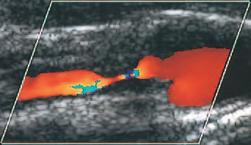
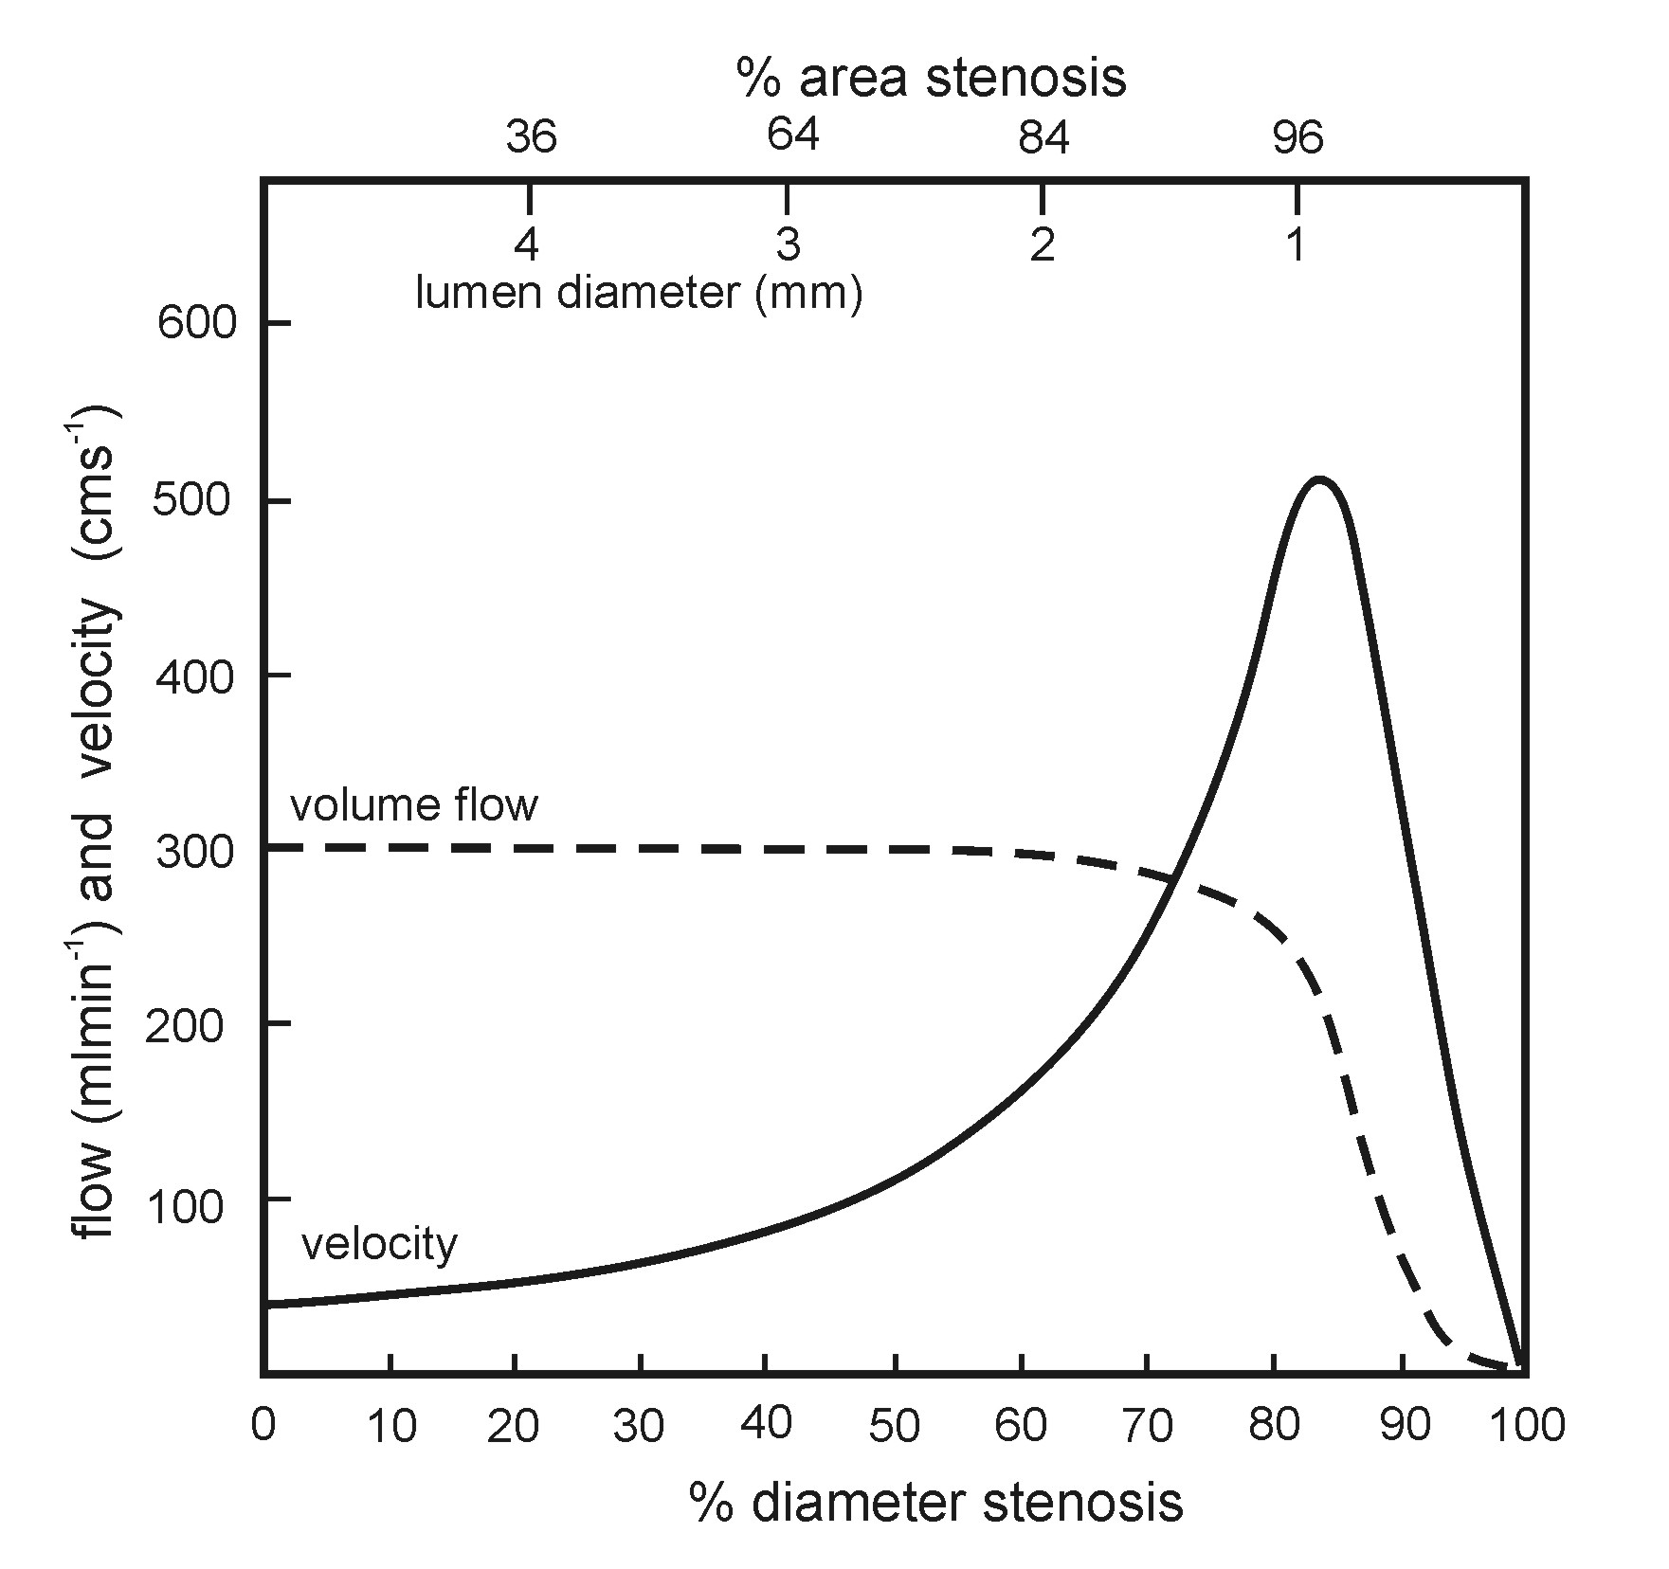
Grading stenosis-examples

Slide 32
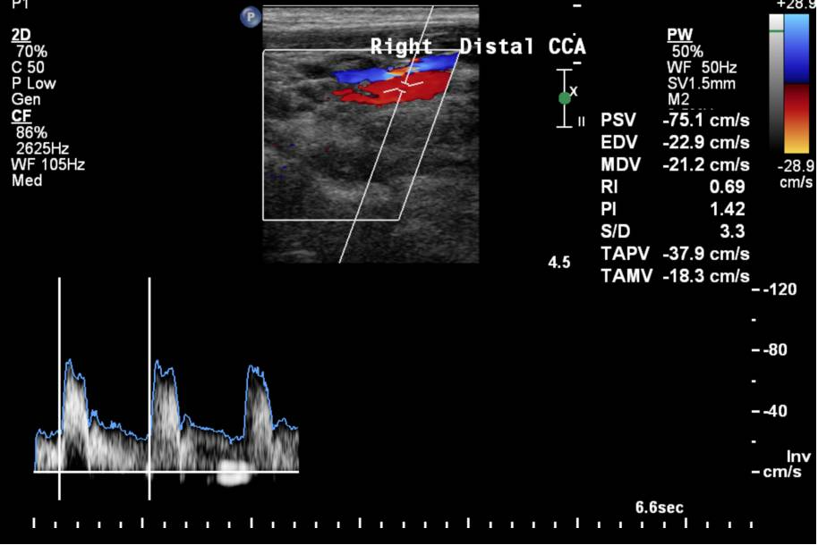
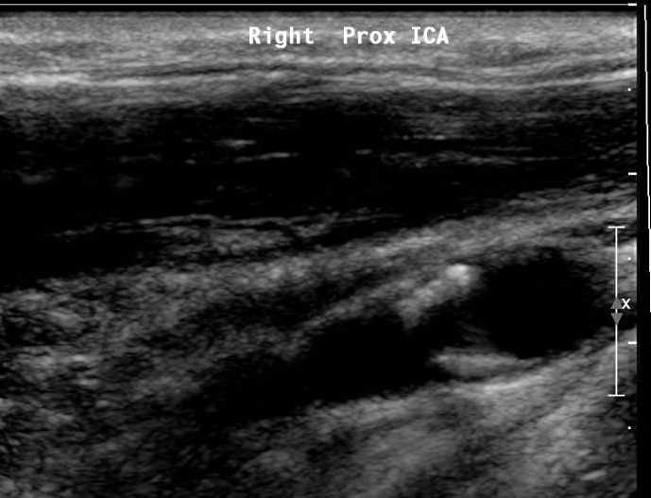
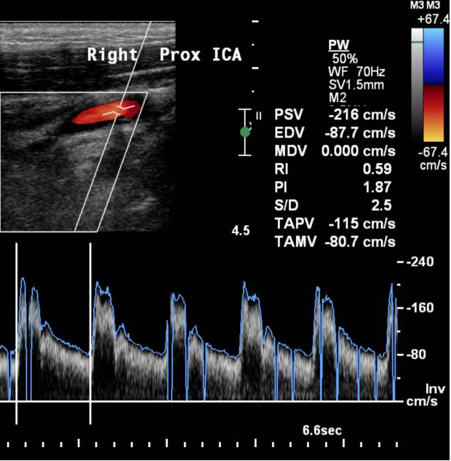

Slide 33
Calculation
CCA PSV 75 cm/s
CCA EDV 23 cm/s
ICA PSV 216 cm/s
PSV Ratio 2.9
St. Mary’s Ratio 9.4
(ICA PSV to CCA EDV ratio)
ICA PSV Stenosis
<125 <50%
>125 >50%
>230 >70%
>400 >90%
PSV ratio
<2 <50%
>2 >50%
>4 >70%
>5 >90%
SMR
<8 <50%
8-10 50-59%
11-13 60-69%
14-21 70-79%
22-29 80-89%
>30 >90%
Notes:
Agreement between two metrics – e.g. ICA PSV + one ratio = ignore the third metric that suggests a different % stenosis

Slide 34
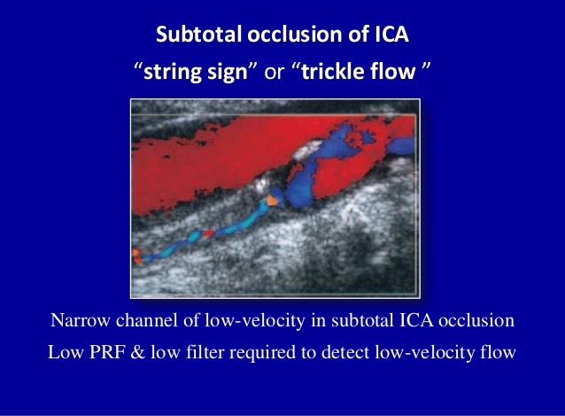
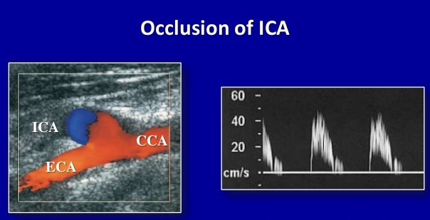
ICA occlusion
Optimise settings for low flow
‐ reduce colour velocity scale
‐ remove wall filters
‐ increase gain
Check in both longitudinal and transverse
Check with pulsed Doppler /Power Doppler
May require alternative imaging

Slide 35
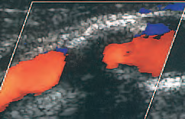
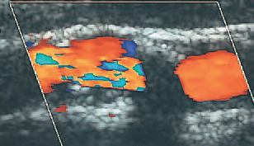
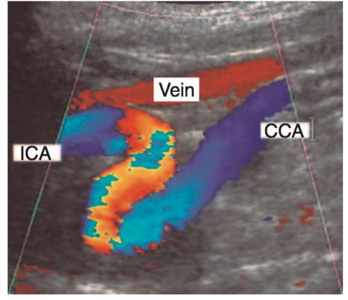
Problems encountered with Carotid imaging
Calcification
Vessel tortuosity
Notes:
Calcification may prevent any B-mode, color or spectral Doppler information from being obtained from within the vessel. The initial appearance of the absence of flow detected by the color flow imaging may mislead the sonographer into thinking that the vessel is occluded. However, the presence of bright echoes on the anterior wall and an absence of echoes below this should suggest calcification

Slide 36


Vertebral artery
Use Colour Doppler to image mid CCA in longitudinal
Move transducer more antero-posteriorly
The vertebral processes seen as bright echoes
Vertebral artery is deeper and seen in segments between transverse processes of the spine
Spectral waveform shows low resistance, cephalad flow

Slide 37




Subclavian Steal
Normal flow
Complete reverse flow
Partial reverse flow

Slide 38



Non-atheromatous carotid artery diseases
ECA
ICA
Carotid Body Tumour
Dissection

Slide 39


Incidental findings
Notes:
Left – an incidental finding of a Right-sided thyroid nodule measuring 2.0 x 2.5 cm - likely to be benign due to hypo-echoic cystic spaces with spongiform/honeycomb appearance, additionally peripheral vascularity also indicates benign status.
Right – another incidental finding of a Right-sided thyroid nodule, measuring 1.0 x 1.0 cm; peripheral and intra-nodular vascularity is of indeterminate nature and requires fine-needle biopsy. Not recommended reading but you can if you want more guidance on how to report thyroid nodules: Xie et al 2016 Ultrasonography of thyroid nodules: a pictorial review. Insights Imaging 7; pages 77-86.) Generally the safest way to report it would be along the lines of: “Thyroid nodule noted on Left/Right side, recommended referral to ENT for review, if clinically appropriate.”
Other possible incidental findings:
Carotid body tumour
Carotid dissection
Lymphadenopathy

Slide 40
Reporting
Locations and appearance of any atheroma seen within the CCA, bifurcation and ICA
Significant velocity increases seen in the carotid arteries and an estimation of the degree of narrowing present
Abnormal waveforms seen within the CCA,ICA and ECA
Endpoint of ICA disease – e.g. distance from bifurcation, and/or distance of distal ICA fairly clear of disease up to gonial angle
Presence and direction of vertebral artery flow
Limitations of the examination
Other findings – e.g. carotid body tumour, aneurysm, dissection, inflammation, or incidental findings such as a thyroid nodule
Notes:
Urgency – present consensus is to intervene in symptomatic carotid stenosis within 2 weeks of the last neurological event (NASCET and ECST showed ~30% risk reduction). Increased evidence suggesting 3-7 days post-event improves outcomes. Naylor (2015; Expert Reviews in Cardiovascular Therapies) summarises early risk of natural stroke as 5-8% at 48h, 4-17% at 72h, 8-22% at 7 days, and 11-25% at 14 days.
This is contrasted with CEA interventional stroke rates of 4.4% at 48h, 1.8% at 3-7 days, and 4.4% at 8-14 days (Loftus et al, 2017; Angiology). Batchelder et al (2015; EJVES), using an audit of 100 patients in comparison to unspecified previous audit data, demonstrated that early (0-3) recurrent events (TIA or spontaneous embolisation) can be reduced significantly (4-to-5 fold reduction) with dual antiplatelet therapy.
Loftus et al (2017; Angiology) suggest that the higher procedural risk is justifiable for urgent (0-2 day) intervention in patients with crescendo TIA or evolving stroke as it is outweighed by the risk of recurrent events, postulating that more strokes are prevented by early intervention than waiting for the patient to stabilise.
Early intervention (within 2 weeks) is hugely influential in improving patient outcomes, with a further modest improvement within 3-7 days. It is as yet unclear whether urgent intervention (within 0-2 days) provides a benefit in all patient conditions that outweighs the increased operative risk. It is likely that ‘best medical therapy’ (i.e. dual antiplatelet therapy) and other risk-factor modifications will positively influence the benefit of urgent intervention.

Slide 41
Reporting
A report should include a brief clinical history, with specific detail as to the symptoms or event which necessitates an investigation.
NICE guidance mandates that carotid imaging reports should clearly specify which criteria (NASCET or ECST) were used for grading the degree of carotid stenosis.
ICA stenosis >50% (NASCET), >70% bulb or CCA stenosis (relative to size of vessel at point of stenosis), superficial temporal arteritis, dissection, carotid body tumour, carotid aneurysm should all be reported as a matter of urgency.
Significant carotid stenosis with a recent TIA require referral to a vascular surgeon on the same day of detection.
Candidates for surgery require additional detail in the ultrasound report, including the state of the distal ICA and how much is visible below the gonial angle, as well as position of significant CCA plaque (to inform location of CCA clamp during endartectomy).
Grading criteria use 3 methods – ICA PSV (>125 cm/s), ICA PSV/CCA PSV ratio, and the St Mary’s ratio (ICA PSV/CCA EDV – inappropriate when the CCA EDV is low <7-10 cm/s). Two concordant methods are usually used to grade a stenosis, with preference given to the St Mary’s ratio due to its ability to grade stenoses in deciles (see EAI-6-C-10 for further detail).
Direction and shape (e.g. high-resistance) of vertebral artery flow waveform should also be commented on, with suitable explanation and statement of any further investigation (e.g. subclavian artery scan) carried out as a result.
Any subsequent investigation performed at the discretion of the operator (e.g. transcranial Doppler, temporal ultrasound scan) should be included with the carotid report.

Slide 42
Recommended reading
Peripheral Vascular Ultrasound: How, Why and When Book by Abigail Thrush and Timothy Hartshorne
Reanalysis of the Final Results of the European Carotid Surgery Trial (P.M. Rothwell et al.,Stroke,2003;34:514-523.)

Slide 43



Thank you!
Any questions ?

