Slide 1
Carotid Service Review
Jersey General hospital 2019

Slide 2
Stroke
Defined by WHO as rapidly developing clinical signs of focal (at times global) disturbance of cerebral function, lasting more than 24hours or leading to death with no apparent cause other than that of vascular origin.
Stroke accounted for 40000 deaths in the UK in 2015 (7% all deaths)
Estimated to cost the UK economy £9 billion a year
Preventable and treatable disease
15% Ischaemic strokes are preceded by a TIA

Slide 3
Transient Ischaemic Attack(TIA)
Defined as stroke signs and symptoms that resolve within 24 hours
High risk of having a stroke if they have an ABCD2 score of >4
People who have had crescendo TIA’s are at high risk of stroke even with an ABCD2 score of 3 or less
Some people who have had a TIA will have a significant carotid stenosis which requires surgery to reduce the risk of stroke
All patient’s who have had a TIA or non-disabling stroke, who after specialist assessment have been considered candidates for carotid endarterectomy should have carotid imaging within 1 week of onset of symptoms
People who present more than 1 week after symptoms can be treated as low risk

Slide 4
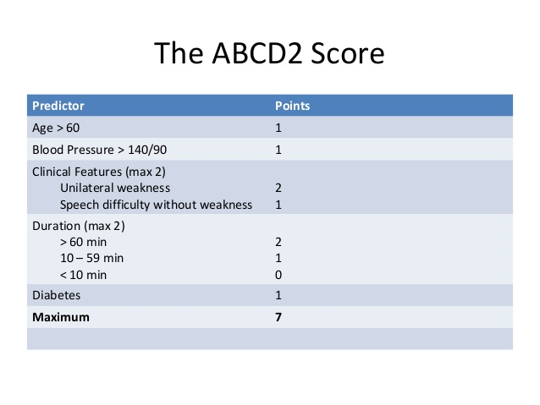
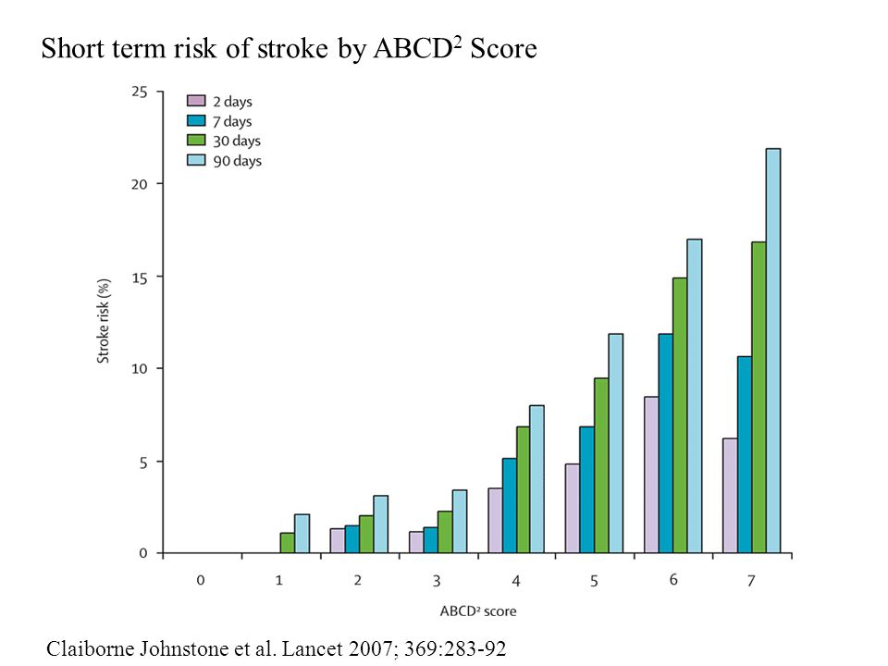
ABCD2 Score and Risk of Stroke

Slide 5
NICE guidelines
People with stable neurological symptoms from acute non-disabling stroke or TIA who have symptomatic carotid stenosis of 50–99% according to the NASCET (North American Symptomatic Carotid Endarterectomy Trial) criteria, or 70–99% according to the ECST (European Carotid Surgery Trialists' Collaborative Group) criteria, should:
be assessed and referred for carotid endarterectomy within 1 week of onset of stroke or TIA symptoms
undergo surgery within a maximum of 2 weeks of onset of stroke or TIA symptoms
receive best medical treatment (control of blood pressure, antiplatelet agents, cholesterol lowering through diet and drugs, lifestyle advice).
However National Stroke Association -50-69% stenosis by NASCET criteria recommends surgery only for certain patients and only at centres with peri-operative complication rate of less than 6%
10 year National Strategy for Stroke sets a target of 48 hours from symptom to Carotid Endarterectomy for high risk patients

Slide 6
From last year
Longer than ideal between Duplex and CEA (Range 4 -19 days)
Good agreement with CT for patients with 70-89% stenosis (All 3 patients)
More care to be taken when diagnosing an internal carotid artery occlusion on Duplex as patients will not have further imaging (2 of 8 found to be patent)

Slide 7
Review this year
Review all carotid scans done between 30.09.18-31.07.19
Patients no longer having CTA before surgery(2 exceptions)
Speeded up the process (4 patients had CEA, range same day to 10 days)
Excluding one patient who had CTA, 47 days from ultrasound to CEA(CT done 40 days after UDCAB) patient had expressive dysphasia, ABCD2 score of 3
Review the carotid grading to see if we are complying/correctly grading stenosis following the Joint recommendations for reporting carotid ultrasound 2009

Slide 8
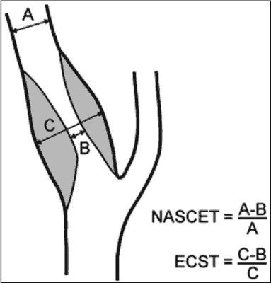
NASCET vs ECST

Slide 9
Carotid Ultrasound Scans Performed 30.09.18 – 31.07.19 (263 patients)

Slide 10
70-95% Stenosis- 7 patients
PSV >230 cm/s
PSV ICA/PSV CCA = >4
St Marys Ratio (PSV ICA/EDV CCA
= 14-34
No CTA, Had CEA 6 days later. All velocity criteria agree
Not a surgical candidate (On review PACS images although PSV 240 cm/s, both Ratios place degree of stenosis in range 50-69%
Patient awaiting cardiac surgery, no CTA, all 3 velocity criteria in agreement. No F/U available
No CTA, CEA 10 days later. All 3 velocity criteria in agreement
No CTA, CEA done 3 days later. All 3 velocity criteria in agreement
No CTA, CEA done the same day, all 3 velocity criteria in agreement
Graded as approx 70% on Duplex, St Marys and PSV grade as 70-79% and ICA/CCA ratio 50-69% . No infarct seen on MRI. Not for surgery

Slide 11
Stenosis 50-69%
Velocity Criteria
Patient’s and Outcome
PSV >125cms <230 cm/s
PSV ICA/PSV CCA ratio 2-4
St Marys Ratio 8-13
Use St Marys ratio to distinguish between 50-59% and 60-69% lumen diameter loss
50-59% St Mary’s 8-10
60-69% St Marys 11-13
Important because surgery will be considered in 60-69% patients
L ICA 60-69%, All 3 velocity criteria in agreement
L ICA 50-59% PSV and ICA/CCA ratio 50-69%. St Marys 70-95% (?grade as 60-69%
50-59% PSV 126cm/s but ICA/CCA ratio <2 and St Mary’s ratio 6 so should be graded as <50%
L ICA 60-69%. ICA PSV 254cm/s, ICA/CCA ratio 2.3, St Mary’s ratio 14. So should have been graded 70-95%. Non TIA symptoms of dizziness so unlikely a surgical candidate anyway.
L heavily calcified ICA, PSV and ratios of at least 50-69% but likely higher- patient had CEA done 10 days later with no CT
R ICA 60-69% but left carotid symptoms. All 3 velocity criteria in agreement
L ICA 60-69 %, CTA done 42 days later showing approx. 70% stenosis but no new neurological events so surgery not performed. All 3 velocity criteria in agreement
L ICA 60-69% but likely higher, due to calcification CTA done 40 days showing 90-95% stenosis. Patient had CEA done 7 days after CTA.
L ICA and R ICA 60-69%, No CTA or intervention as no infarct on CT. R ICA all velocity criteria <50%. L ICA Doppler angles not great, Ratios <50?%

Slide 12
Placement of the velocity cursor
A) Delayed systolic peak
B) Spike turbulence on the systolic peak
C) When the foot of the systolic peak dips below the end-diastolic velocity

Slide 13
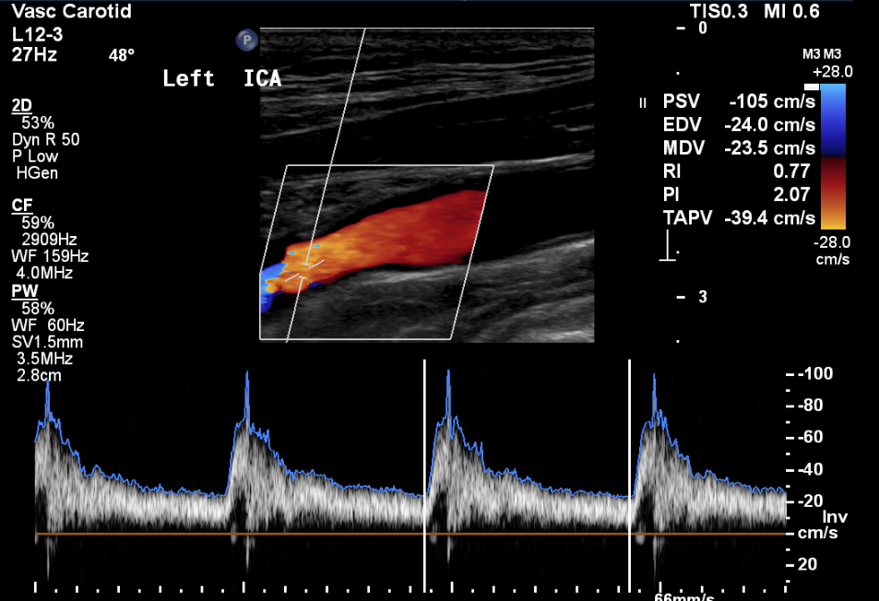
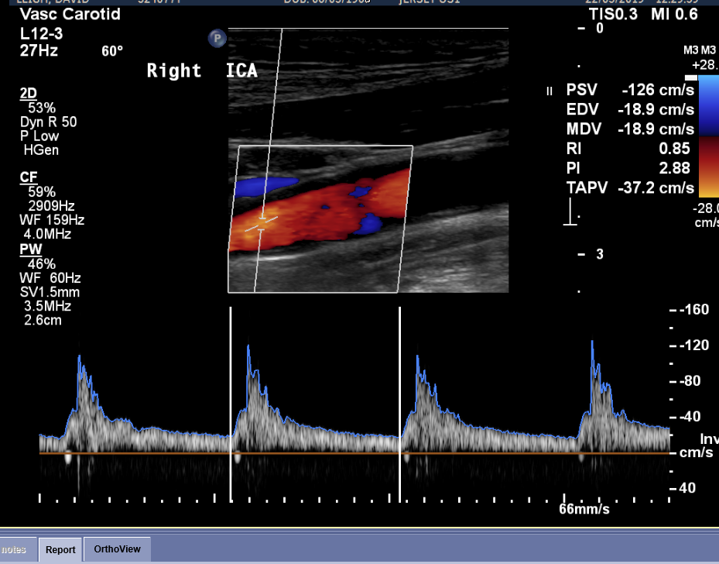
Problems with High Q

Slide 14
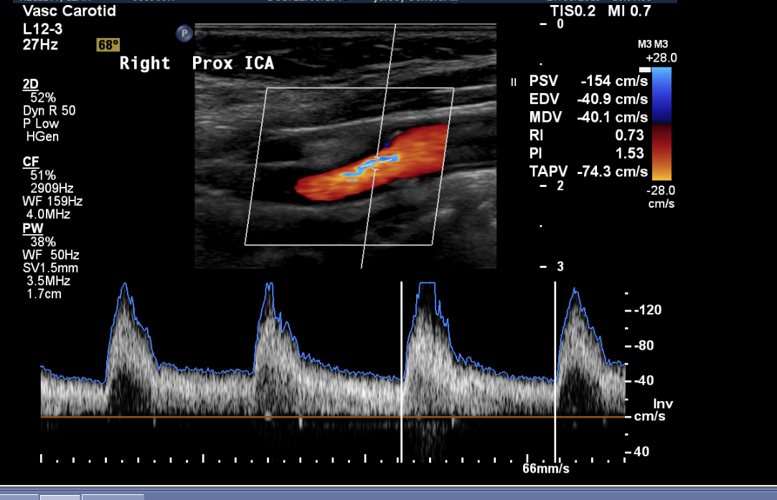
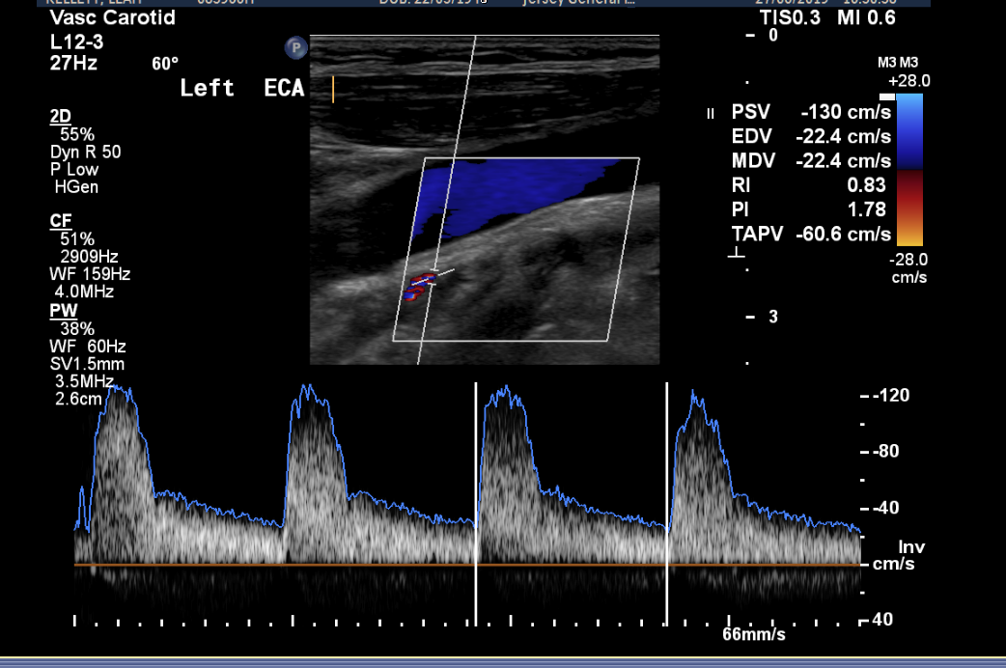
More problems with HighQ

Slide 15
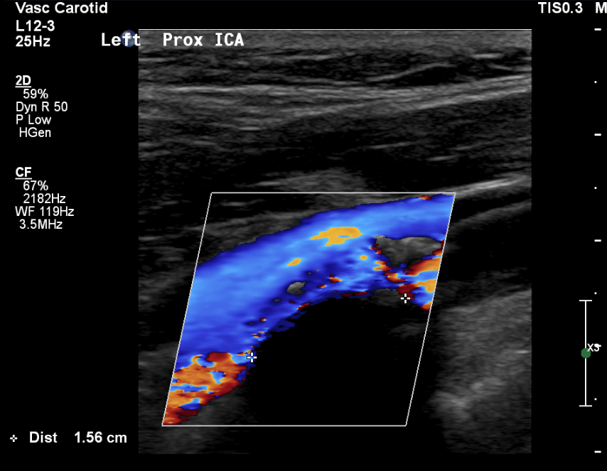
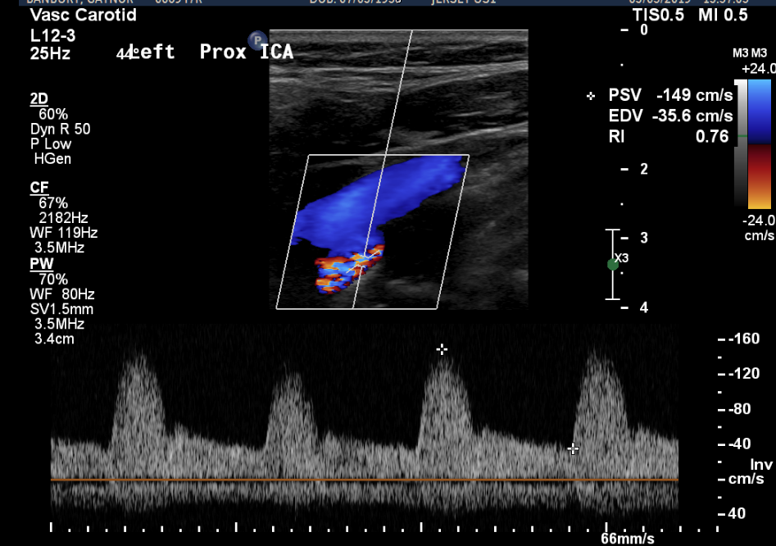
Poor Visualisation

Slide 16
Sources of variability in ICA PSV
Variation in the geometry of the bifurcations and size of bulb
Variation in the vessel size, that reflects body size
Collateral flow effects
Change in ICA flow over menstrual cycle
Change with age and blood pressure
The physical parameters of the ultrasound machine

Slide 17
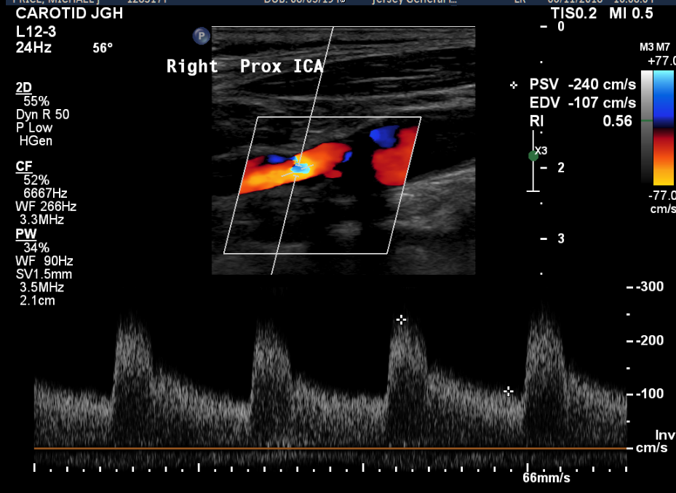
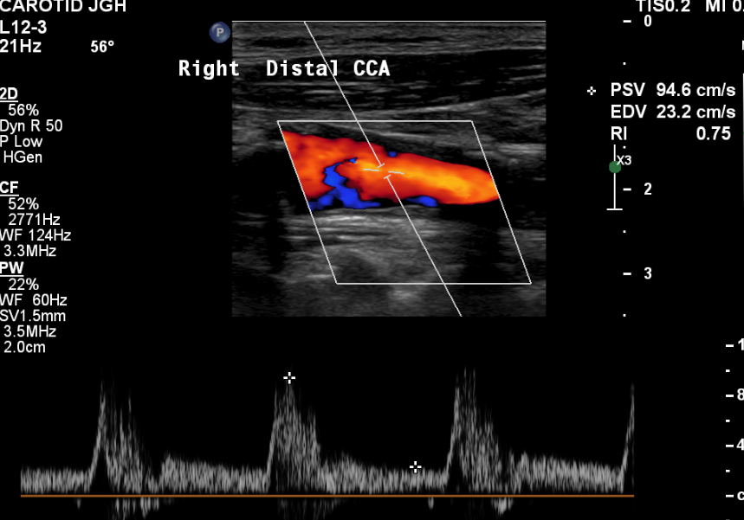
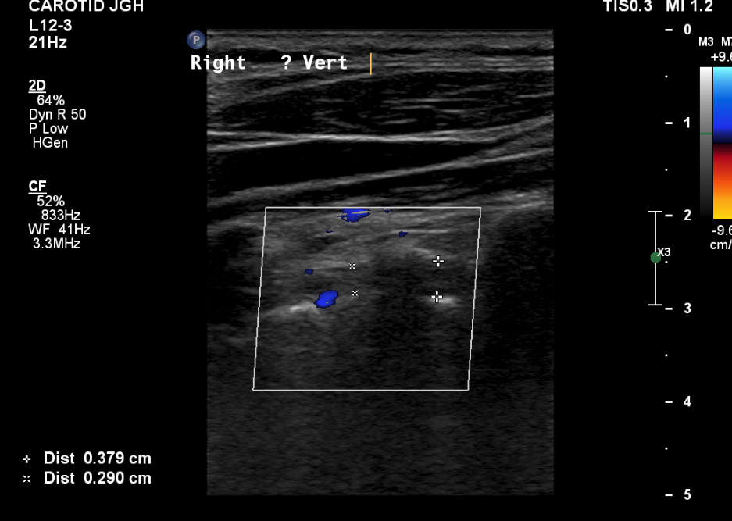
Difficult to grade
Raised PSV without raised ratios
? Due to vertebral artery occlusion

Slide 18
St Mary’s ratio cautions
Bilateral zero or retrograde EDV flow in CCA-Suggests aortic valve disease
Bilateral reduction in diastolic flow suggests arteriosclerosis
Bilateral significant disease- collateral flow effects
Inadequate visualisation
Unusual waveforms

Slide 19
Vetting Summary
Ask for an ABCD2 score and timing of neurological event
If they have a lot of comorbidities/ITU/HDU patient check they have been assessed as a suitable surgical candidate. There is no point scanning if the patient is not fit for surgery
Treat as urgent if ABCD2 score 4 or more and TIA is recent(Ideally within 24hours if poss) and contact referring team (likely Marion Croft) if they have a stenosis on the symptomatic side
Treat as soon(Within 1 week) if ABCD2 score 3 or less and/or TIA more than 2 weeks ago
Treat as soon/moderate (Within 2-3 weeks) if pre cardiac surgery
Treat as urgent (<24hours if poss) if request states crescendo TIA (Defined as 2 or more TIAs within 1 week)

Slide 20
Summary
Generally good concordance with all 3 grading criteria, especially for 70-95% stenosis. A couple of discrepancies in 50-69% grading criteria
Long delays for the 2 patients who had CTA (42 days and 36 days) delaying one CEA to 43 days after Duplex and the other patient not having surgery as deemed to have past the high risk stage because TIA was so long ago.
Avoid using HighQ
Remember to look at both ratio’s now that patients are not having CTA to ensure correct grading and ask for a second opinion if difficult to grade
Remember to check your angle, needs to be 60 degrees or less- Will highlight yellow if over 60 degrees on the ultrasound machine
Discuss with Duty Rad if unable to accurately grade due to calcification and try to arrange early CTA to confirm degree of stenosis
After discussion with GW and ABC all patients should now have a second Duplex scan on the morning of surgery (Good practice to have two Duplex scans prior to surgery if no CTA/MRA in case of operator error or reporting error)

