Slide 1
Carotid Duplex Scanning

Slide 2
Carotid Duplex Audit
Two comparisons in audit
  Comparing scan 1 vs scan 2
  Analyse velocities against grading criteria
30 patients
  29 audited – 1 had MRA vs US

Slide 3
Findings
Scan 1 median % grading vs Scan 2 median % grading:
  (median to account for 10% grading margin reported e.g. 60-70% stenosis. Median = 65%)
14 of 29 patients (48%) had no discrepancy between their reported stenosis percentages.
10 had a 2.5% or 5% discrepancy (34%)

Slide 4
24 patients had very similar grading (83%)

Slide 5
Scan 1 vs Scan 2 Carotid Stenosis Grading

Slide 6
Findings continued…
1 patient had a 40% difference – complex patient due to chronic contralateral CCA occlusion.
4 patients had a 10% or 15% difference (14% of sampled patients).
  Pt A: 60-70% vs 50% (scans 10 days apart)
  Pt B: ~60% VS >50% (caveat on 2nd report; velocities may not accurately grade the significance due to echolucent plaque/thrombus)
  Pt C: 30-40% vs 45% (two episodes 3 months apart. Not an official “2nd scan”)
  Pt D: 10% difference in medians (scans on same day)

Slide 7
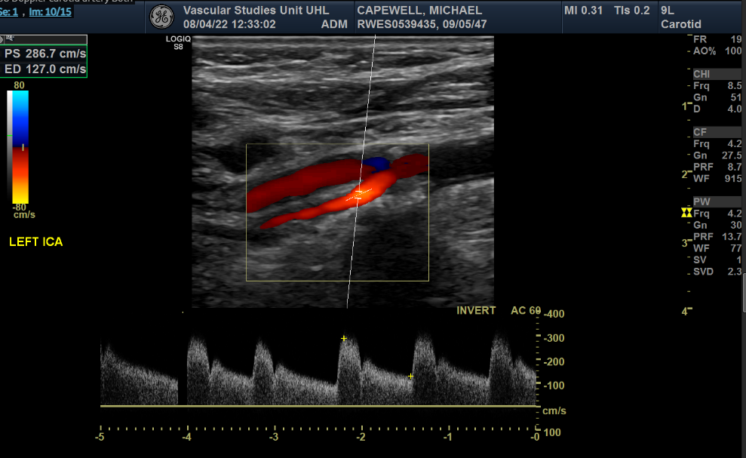
How would we grade Pt D?
Scan 1 (Machine: S8)

Slide 8
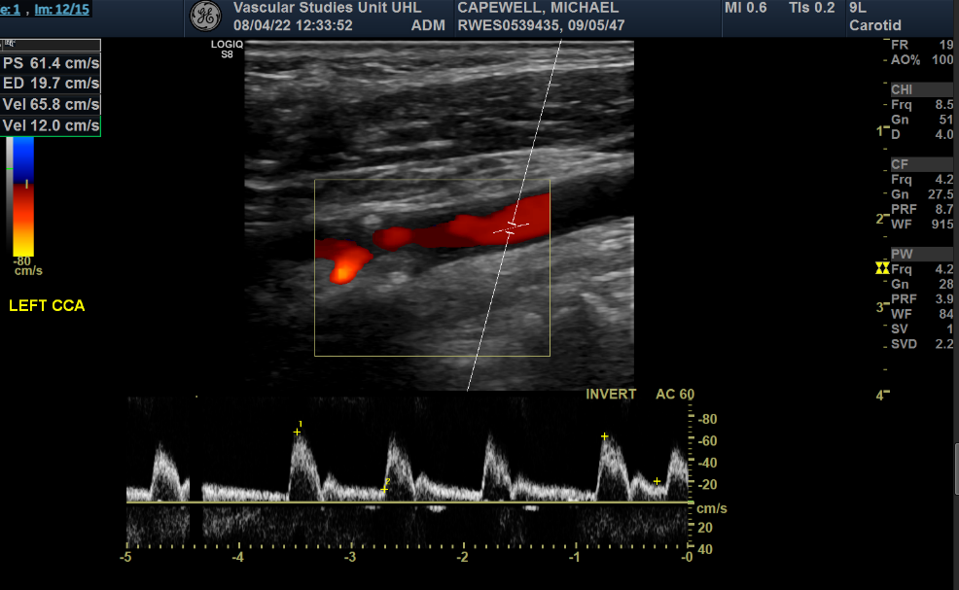
Scan 1

Slide 9
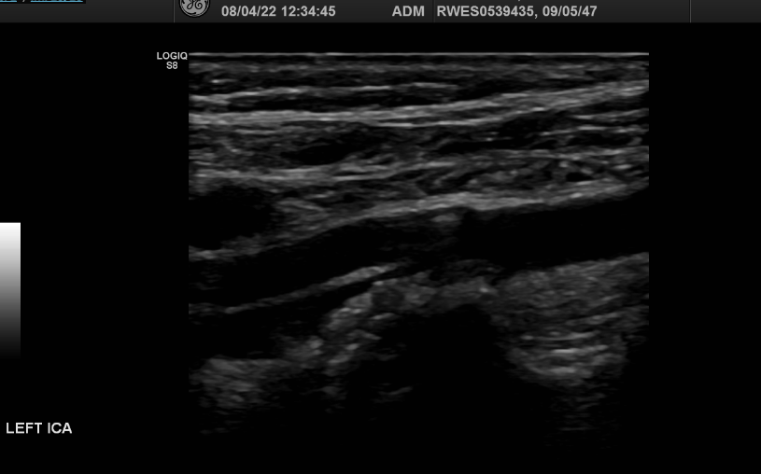
Scan 1

Slide 10
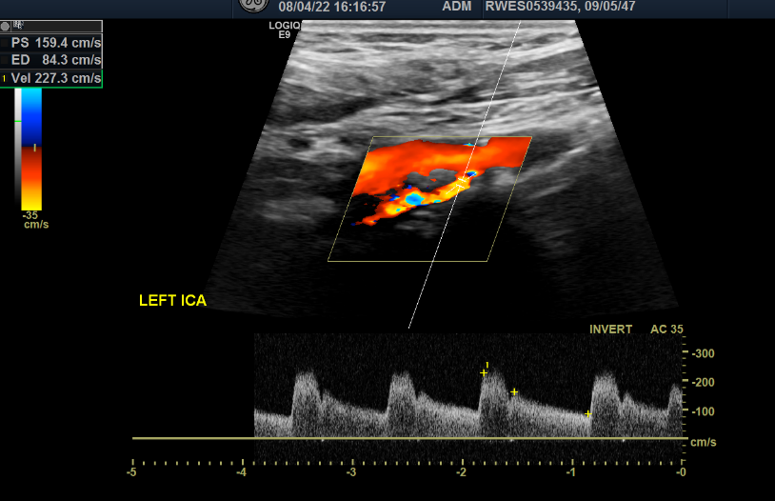
Scan 2 (Machine: E9)

Slide 11
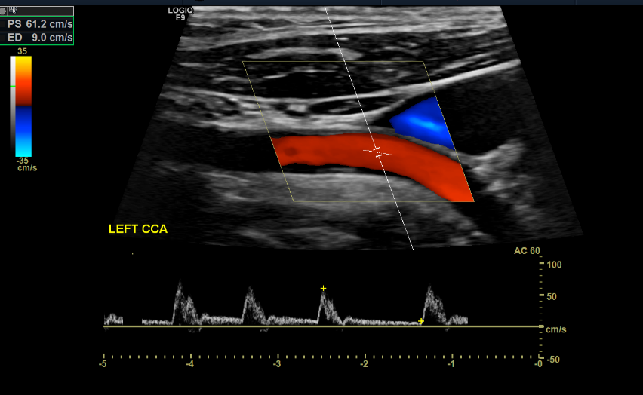
Scan 2

Slide 12
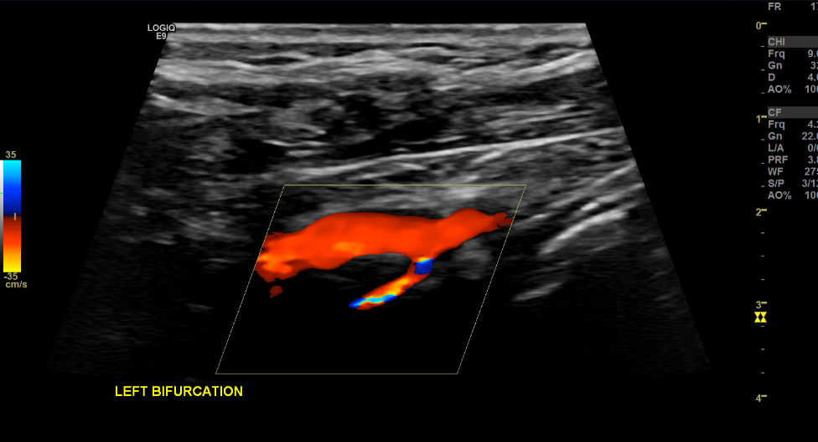
Scan 2

Slide 13
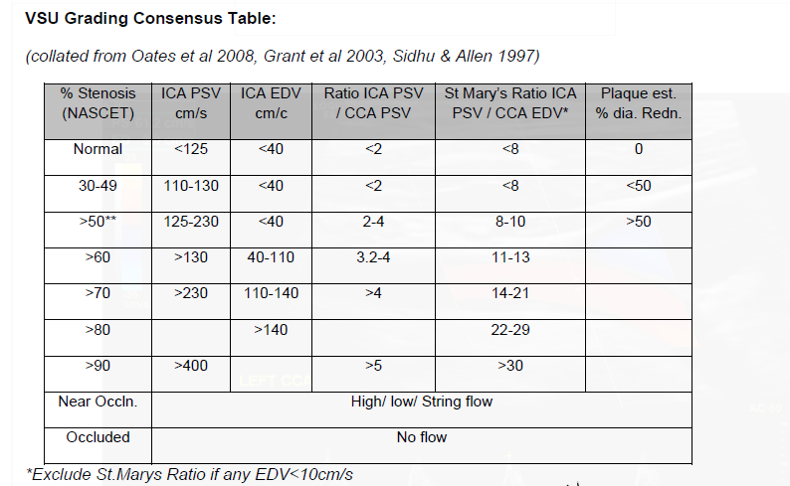

Slide 14
Reported Stenosis vs Grading Criteria
2nd part of audit
The greatest range that the 4 different grading criteria would report the disease as was 30%.
24 of 29 patients were reported within 5% of how the grading criteria would categorise the disease (83%).
Notes:
The greatest difference between a range that the 4 different grading criteria would report the disease as was 30%.

Slide 15
Scan 1 Analysis - Report (median) vs Criteria Grading Table (median)

Slide 16
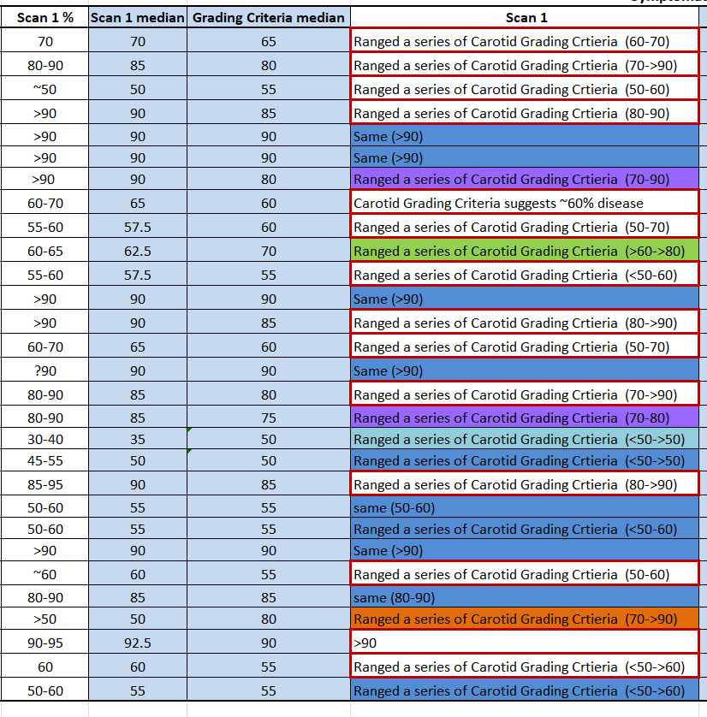
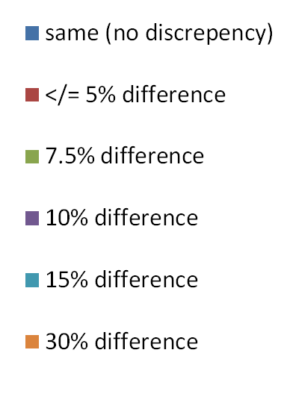
Scan 1 - Report vs Criteria Grading Table (median)
Key

Slide 17
Red - Scan 2 grading (median)
Green – Grading by criteria grading table (median)
Blue - Difference between Scan 2 and criteria grading table

Slide 19
Why might we be getting reporting discrepancies
Different day
Different machine
Different sonographer

Slide 20
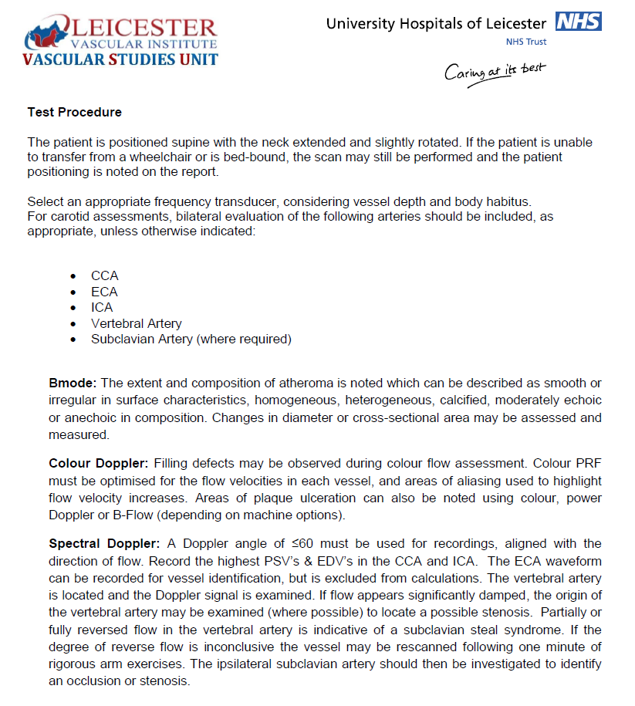
Scanning a significant stenosis
VSU Protocol

Slide 21
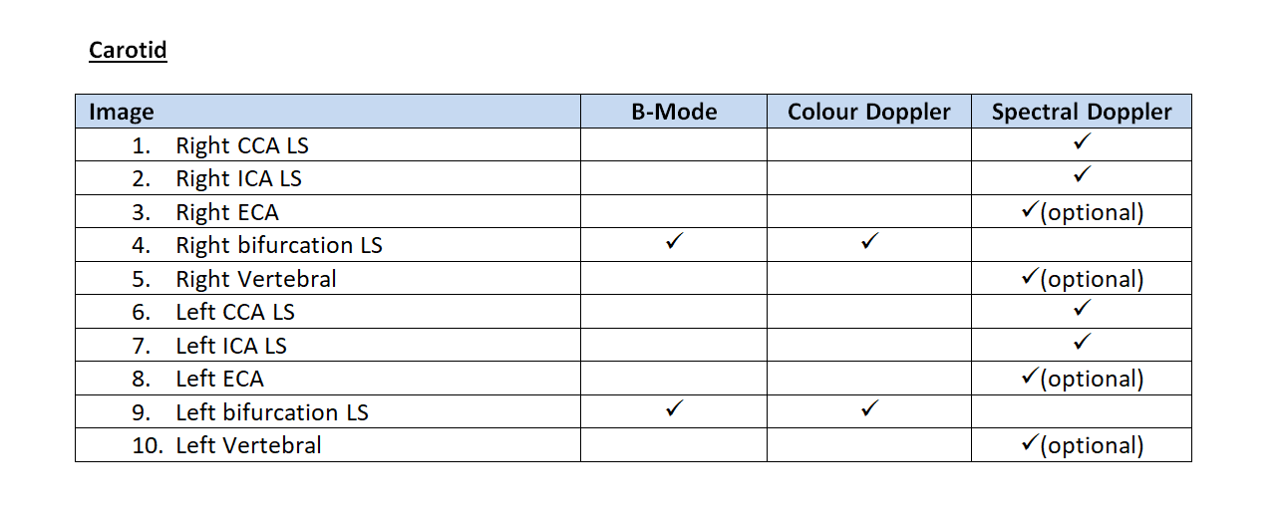
Carotid Duplex Scanning
Minimum image requirements

Slide 22
Discussion points
Should we report an exact percentage, or a range? If a range, 5, 10 or 20% range?
Which grading criteria do you each think is most representative?
Affect on velocities of echolucent plaque/thrombus vs calcified plaque.

Slide 23

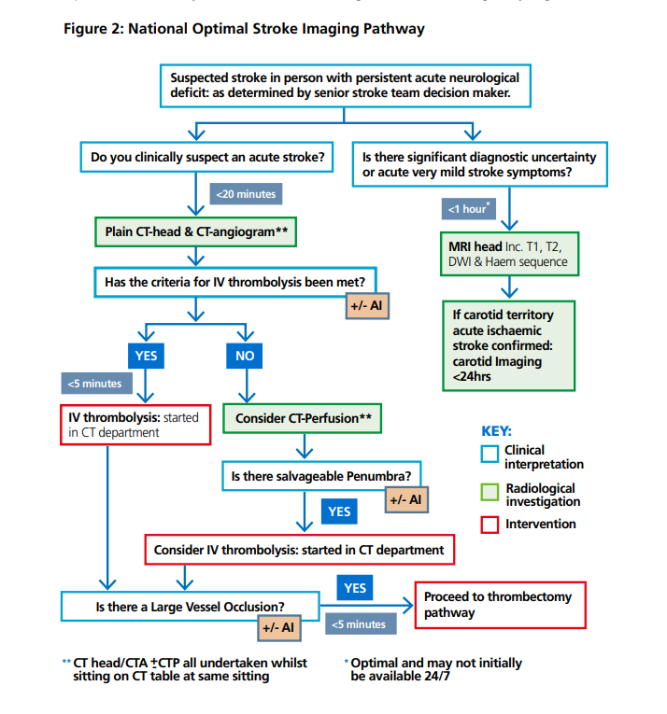

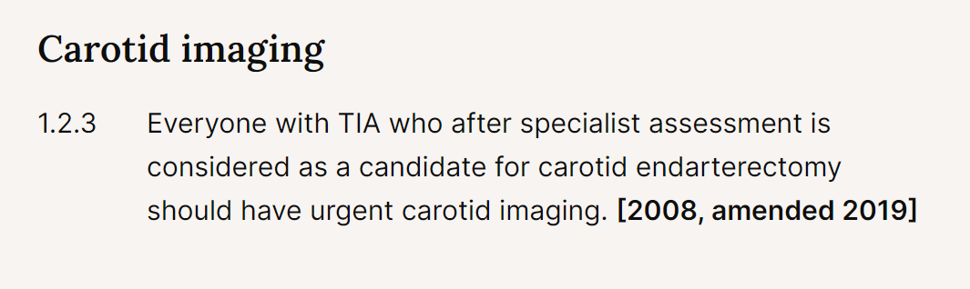
What the literature says
Regarding ICA grading criteria

Slide 24
Summary
Compare the 1st and 2nd scan grading categories to see if they fall within a similar range. If the 2nd scan is different %stenosis range, this audit will investigate this and aim to report the reason or whether this is a significant discrepancy applying the process as described in the MDT Ultrasound Audit V1 (Document 034) FINDINGS: 83% of patients same grading category reported at scan 1 and 2.
The 1st scan and the 2nd scan grading categories are investigated to ensure they have applied and reported the appropriate % stenosis grading for the velocity data FINDINGS: 83-86% of patients graded in accordance to grading criteria.

