Slide 1

Carotid Artery Ultrasound
Image interpretation and reporting

Slide 2
Today’s presentation
Doppler effect
Haemodynamics
Carotid artery anatomy and disease
Carotid artery imaging - Xray angiography, US – clinical trials – NASCET and ECST.
Reporting criteria – quantifying stenoses
Alternative pathologies

Slide 3
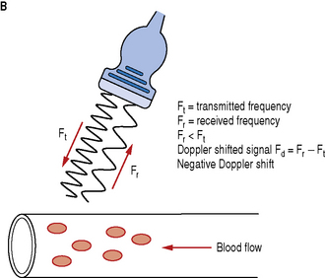
Doppler effect
The wave transmitted (Ft) from the probe hits the moving red blood cell and is reflected back and recieved by the probe (Fr).
The frequencies of these two waves are different. The difference in frequencies is known as the Doppler frequency (Fd).

Slide 4
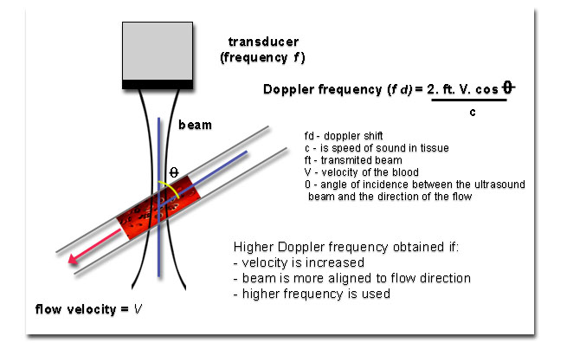
Doppler effect
The ultrasound machine measures the doppler frequency (Fd) and uses this in the doppler equation below to calculate the velocity. All the values are given except Fd and angle Ɵ.

Slide 5
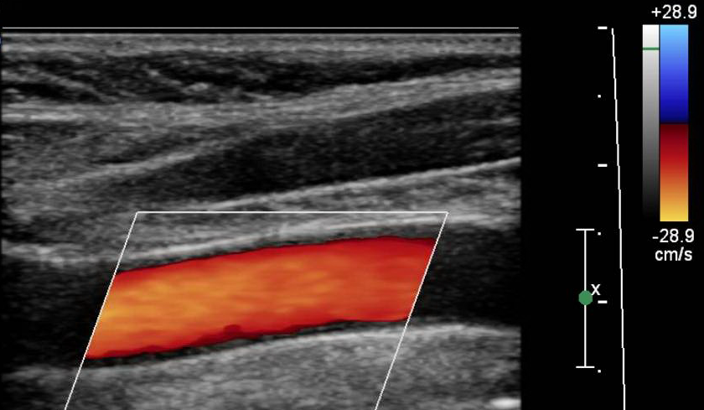
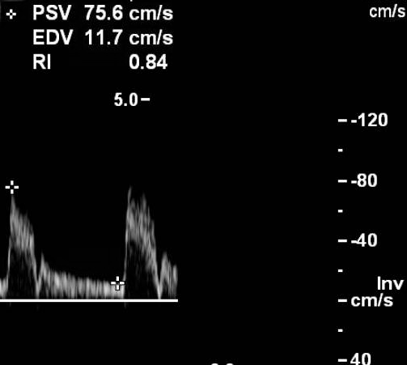
Doppler effect
We can apply a colour scale to the range of velocities.
Or we can apply a spectral trace over time to the range of velocities.

Slide 6
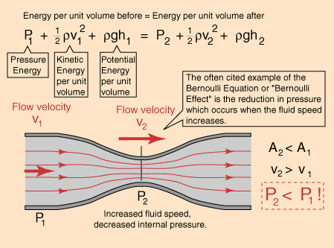

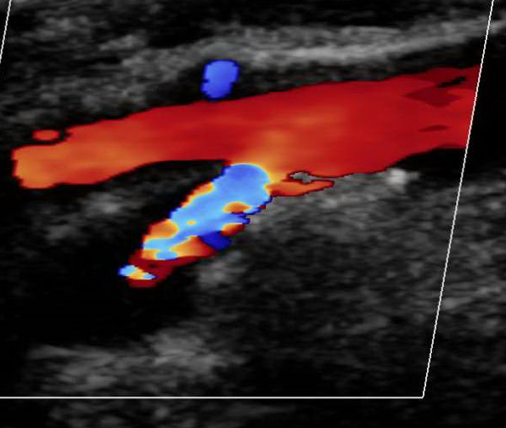
Haemodynamics
The increase in velocity is used to quantify the stenosis with ultrasound.

Slide 7
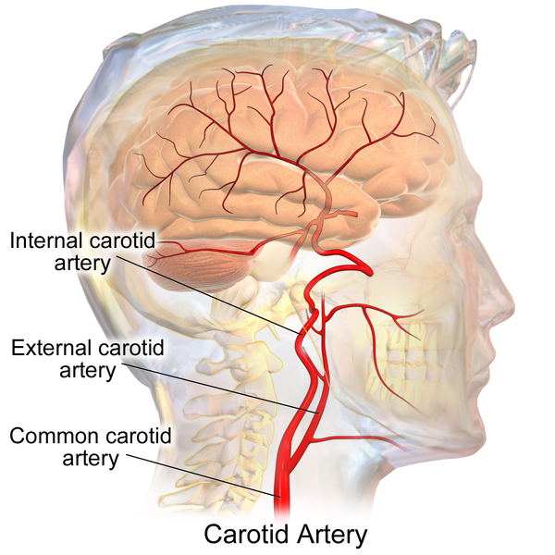
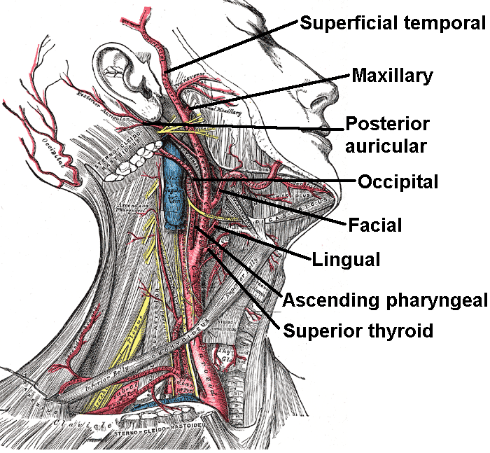
Extracranial Anatomy
ICA has no branches
ECA has branches
ECA generally but not always lies medially and anterior to the ICA.

Slide 8
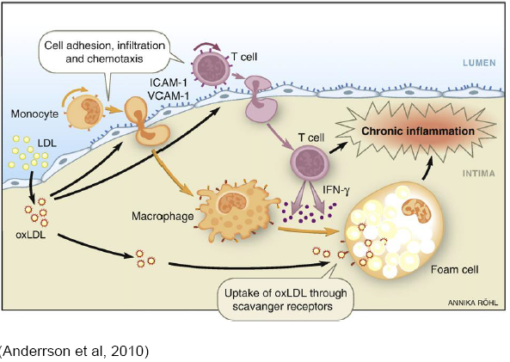
Carotid artery disease
ECA
ECA
ICA
ICA

Slide 9
Clinical trials
North American Symptomatic Carotid Endarterectoy Trial (NASCET)
European Carotid Surgery Trial (ECST)
Both trials compared carotid endarterectomy vs. best medial treatment (Aspirin).
Both used X-ray angiography to quantify carotid artery stenosis
Many outcomes, data still being analysed today.

Slide 10
Findings of NASCET and ECST
Early surgical intervention for symptomatic carotid artery stenosis has been shown to significantly reduce the risk of stroke following TIA/minor stroke.
UK NICE guidelines suggest high risk patient’s should therefore be imaged within 24 hours, and surgery be performed within 48 hours.
New Zealand guidelines just say “urgent” carotid imaging. Dependant on hospital resources.

Slide 11
Quantifying a stenosis
NASCET and ECST methods of measuring stenosis on angiography. NEARLY everyone now uses the NASCET method.
ECA
ICA
a
b
c
CCA
NASCET = (a-b) x 100
a
ECST = (c-b) x 100
c

Slide 12
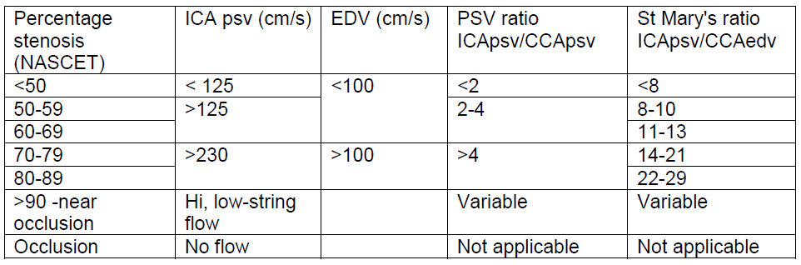
Quantifying a stenosis
Over the years ultrasound velocity and ratio criteria have been developed that correlate with X-ray angiography NASCET measurements (gold standard).
The below criteria are now recommended by ASUM, ARDMS and SVTGBI.

Slide 13
Reporting
The velocity used to calculate the degree of stenosis should be the highest velocity which is relevant to the stenosis.
So if there is no stenosis, the velocity from the proximal ICA should be used for ratios.

Slide 14
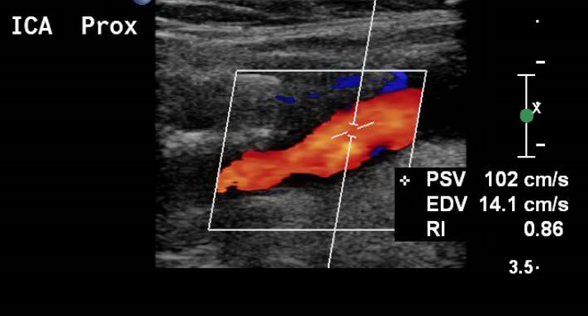
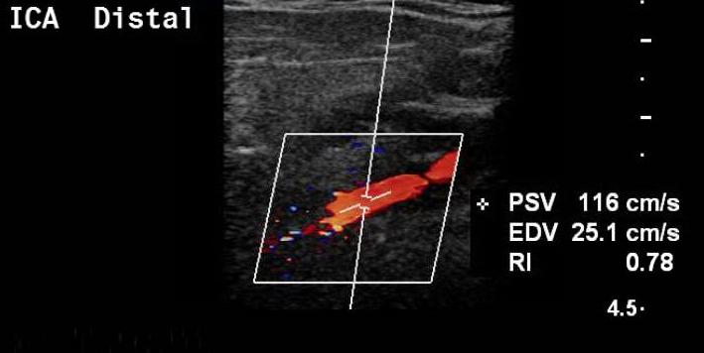
Haemodynamics
The ICA can also be tortuous and taper in size slightly, which can increase the velocity, even when there is no stenosis.

Slide 15
Quantifying a stenosis
CCA
ECA
ICA
ICA PSV/EDV
CCA PSV/EDV
ECA
ICA
CCA

Slide 16
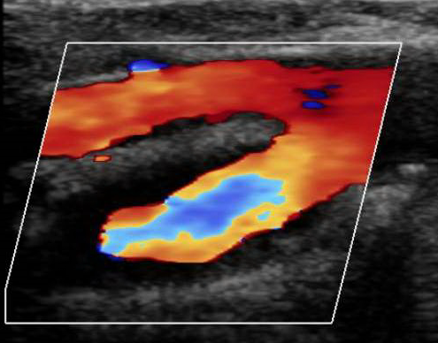

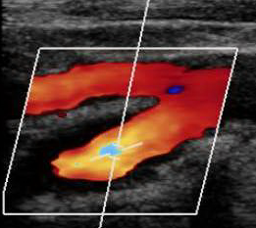

Colour doppler
Increase the pulse repetition frequency (PRF) to single out the high velocities.
We are exploiting the aliasing artefact.

Slide 17
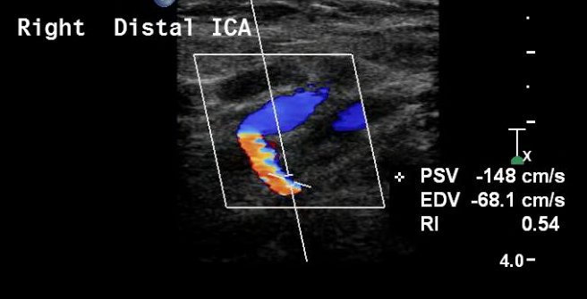
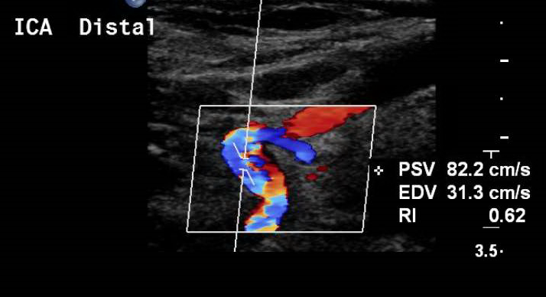
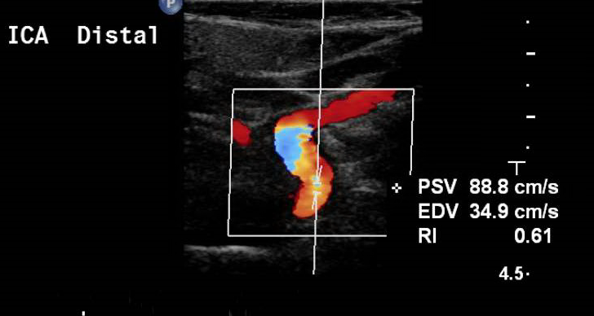
Watch the angle!

Slide 18
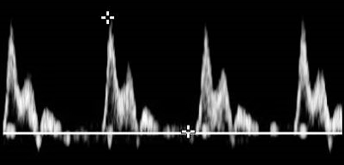
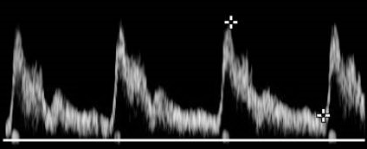
Haemodynamics
ECA waveform is higher resistance than the ICA – what does this mean?
ECA – The blood is moving forwards but does not continue to flow.
ICA – The blood is moving forwards and continues to flow till the next pulse.

Slide 19
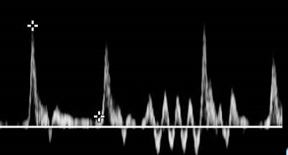
Haemodynamics
A temporal tap is also used to identify the ECA.
A tap on the head just in front of the ear should be seen in the pulsed-wave waveform in the ECA, as below, but not in the ICA.

Slide 20
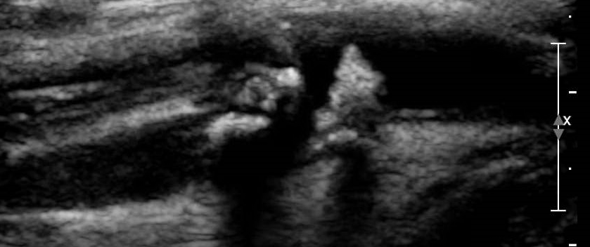
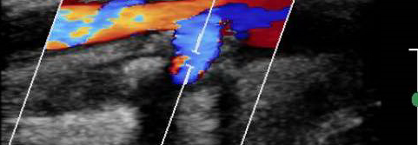
Occlusions
No flow in seen in the ICA in colour or spectral doppler.
ICA often appears narrow calibre in B-mode imaging.
“Stump” flow can be seen at the ICA origin.
Sub-occlusions characterised by a thin colour doppler trace – can be low or high velocity.

Slide 21
Plaque morphology
Comment on length of the plaque and distance from the carotid bifurcation.
Echolucent / echogenic. Smooth vs. mixed. Calcification.
Irregular/regular shape – evidence of ulceration.

Slide 22
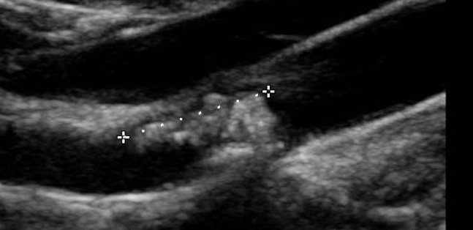
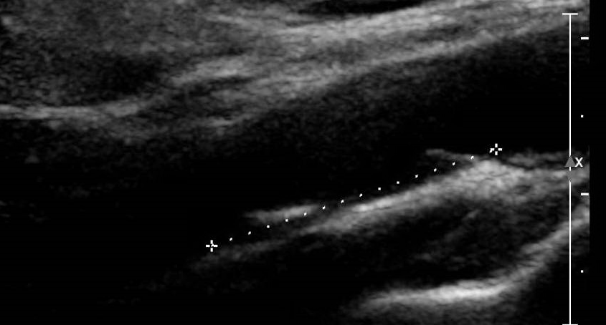
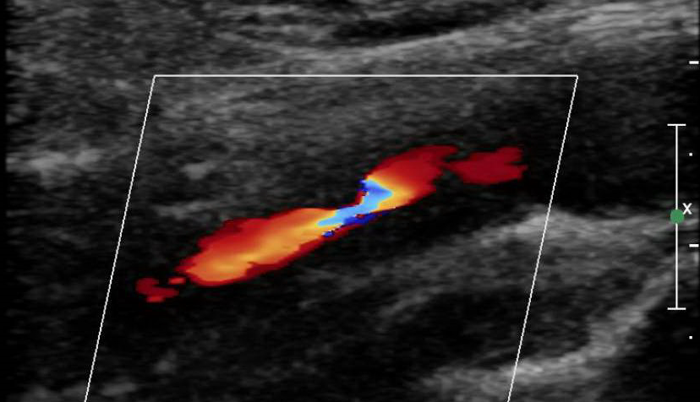
Plaque morphology

Slide 23
Carotid body tumour
Carotid body sits between the ECA and ICA at the carotid bifurcation.
Tumour presents as highly vascularised mass which splays the ICA and ECA.

Slide 24
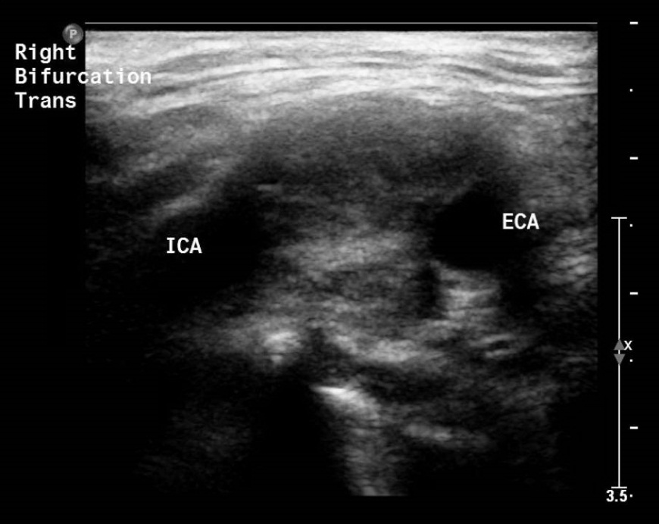
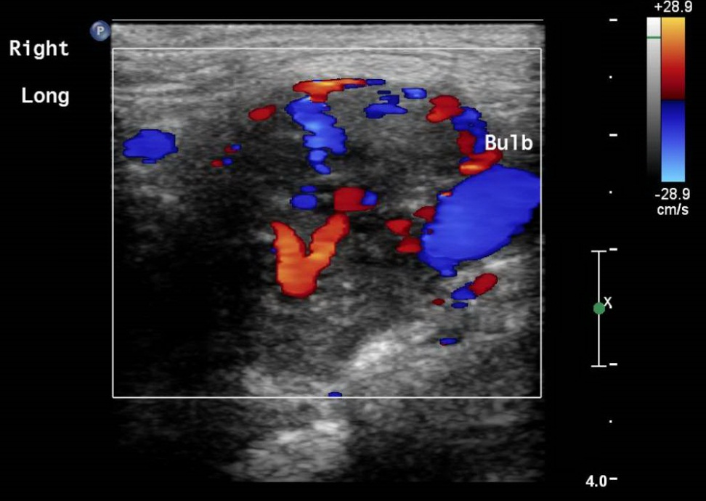
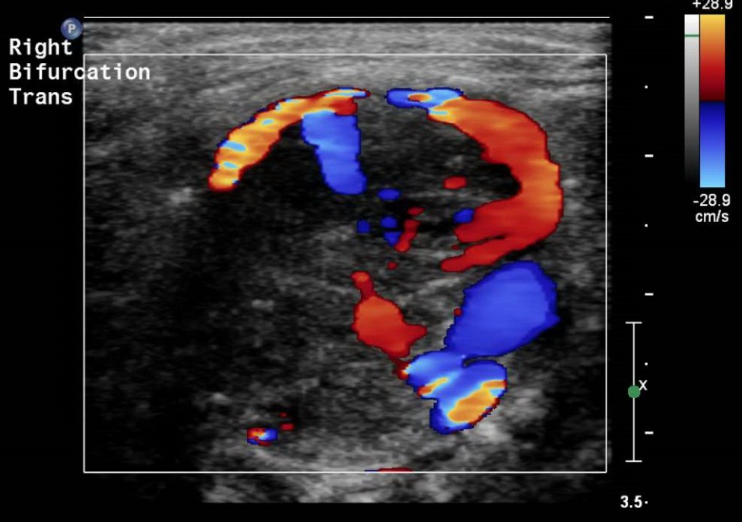
Carotid body tumour

Slide 25
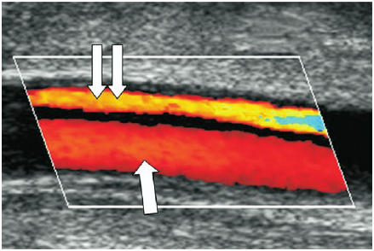
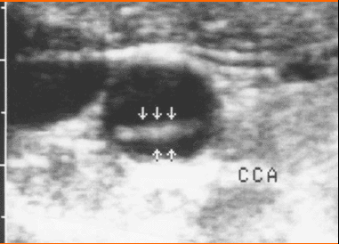
Dissection.
Dissection.
The intima becomes detached from the media and adventitia of the vessel. This can be mobile with flow on both sides, or stationary and thrombosed on one side.

Slide 26
Aneurysm
Defined by an 50% increase in size of the vessel compared to the artery immediately proximal.
May or may not contain thrombus.

Slide 27
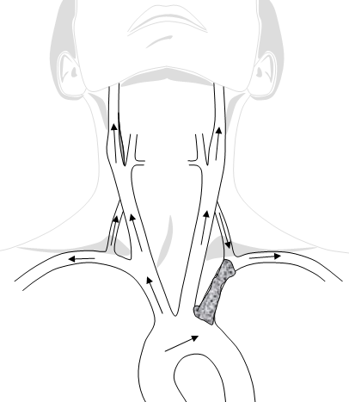
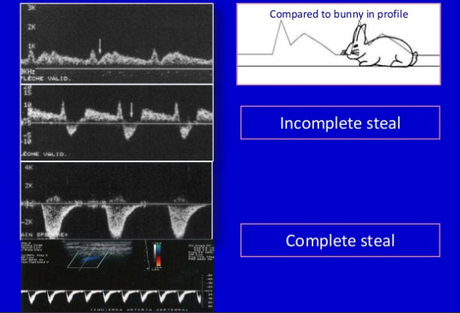
Subclavian steal syndrome
Characterised by partial or full retrograde flow in the vertebral artery.

Slide 28
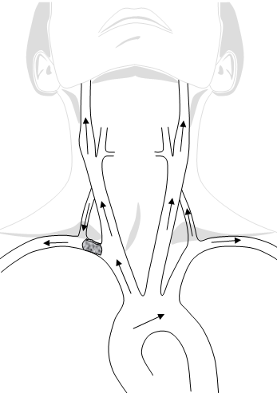
Subclavian steal

Slide 29
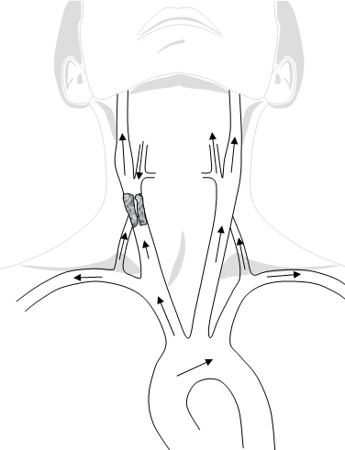
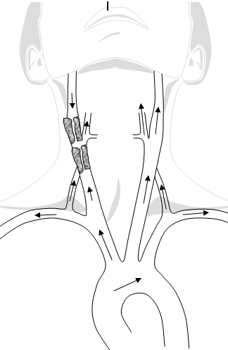
Other steals

Slide 30
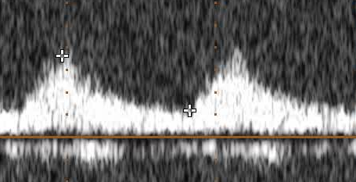
CCA waveforms
Slow rise to PSV time (Tardus parvus) can indicate proximal disease e.g. at the brachiocephalic origin or aorta.
High resistance flow, similar to the ECA, can be an indicator for significant ICA disease.

Slide 31
CCA waveforms
Unusual waveforms that are appears in all arteries e.g. carotid, subclavian, vertebral etc. are likely due to cardiac issues, such as aortic regurgitation.
Unilateral unusual waveforms are more likely to be attributed to disease e.g. innominate stenosis.

Slide 32
References
Grant, E.G. (2003) Carotid artery stenosis: grayscale and Doppler ultrasound diagnosis--Society of Radiologists in Ultrasound consensus conference. Ultrasound Quarterly [online]. 19 (4), pp.190-8.
Oates, C.P. (2008) Joint recommendations for reporting carotid ultrasound investigations in the United Kingdom. European Journal Of Vascular And Endovascular Surgery: The Official Journal Of The European Society For Vascular Surgery [online]. 37 (3), pp.251-61.
MRC. (1991) MRC European Carotid Surgery Trial: interim results for symptomatic patients with severe (70-99%) or with mild (0-29%) carotid stenosis. European Carotid Surgery Trialists' Collaborative Group. Lancet [online]. 337 (8752), pp.1235-43.
NASCET Investigators. (1991) Clinical alert: benefit of carotid endarterectomy for patients with high-grade stenosis of the internal carotid artery. National Institute of Neurological Disorders and Stroke, Stroke and Trauma Division. North American Symptomatic Carotid Endarterectomy Trial (NASCET) investigators. Stroke (00392499) [online]. 22 (6), pp.816-7.
Naylor, A.R (2003) Overview of the Principal Results and Secondary Analyses from the European and North American Randomised Trials of Endarterectomy for Symptomatic Carotid Stenosis. European Journal of Vascular and Endovascular Surgery [online]. 26 (2), pp.115-129.
Ricotta, J.J. (2011) Updated Society for Vascular Surgery guidelines for management of extracranial carotid disease. J Vasc Surg [online]. 54 (3), pp.e1.

