Slide 1

Bridging the Gap: Implementation of Duplex Ultrasound Techniques in General Medical Ultrasound Practice
Ben Warner-Michel
Ultrasound Clinical Lead – Salford Royal Hospital

Slide 2
Doppler use in general medical ultrasound
Skilful use of colour and spectral Doppler is crucial in general medical ultrasound investigation
Visceral haemodynamics – portal system, transplant kidney / liver
Perfusion – ischaemia, inflammation, vascularity of mass lesions
Obstetrics – uteroplacental insufficiency, pre-eclampsia
It is often poorly understood and incorrectly applied, resulting in avoidable artefacts and suboptimal diagnostic imaging which can cause serious clinical sequalae

Slide 3
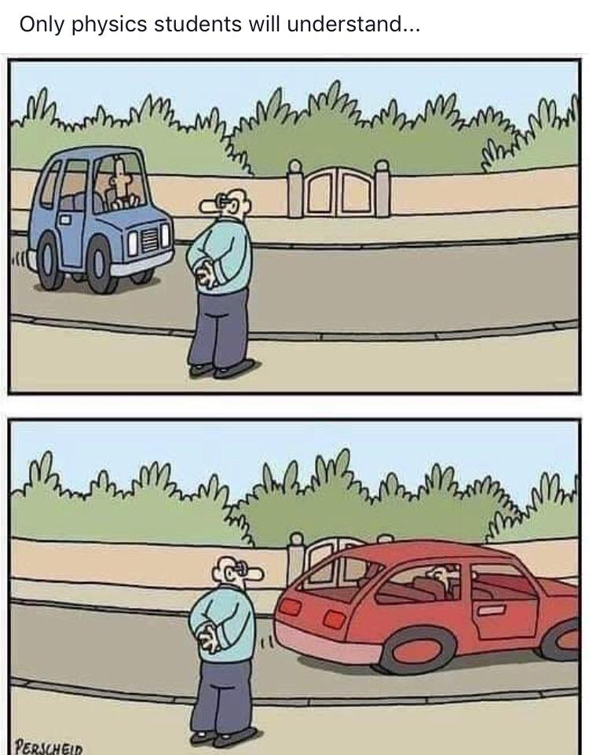
Common uses of Doppler in general medical ultrasound

Slide 4
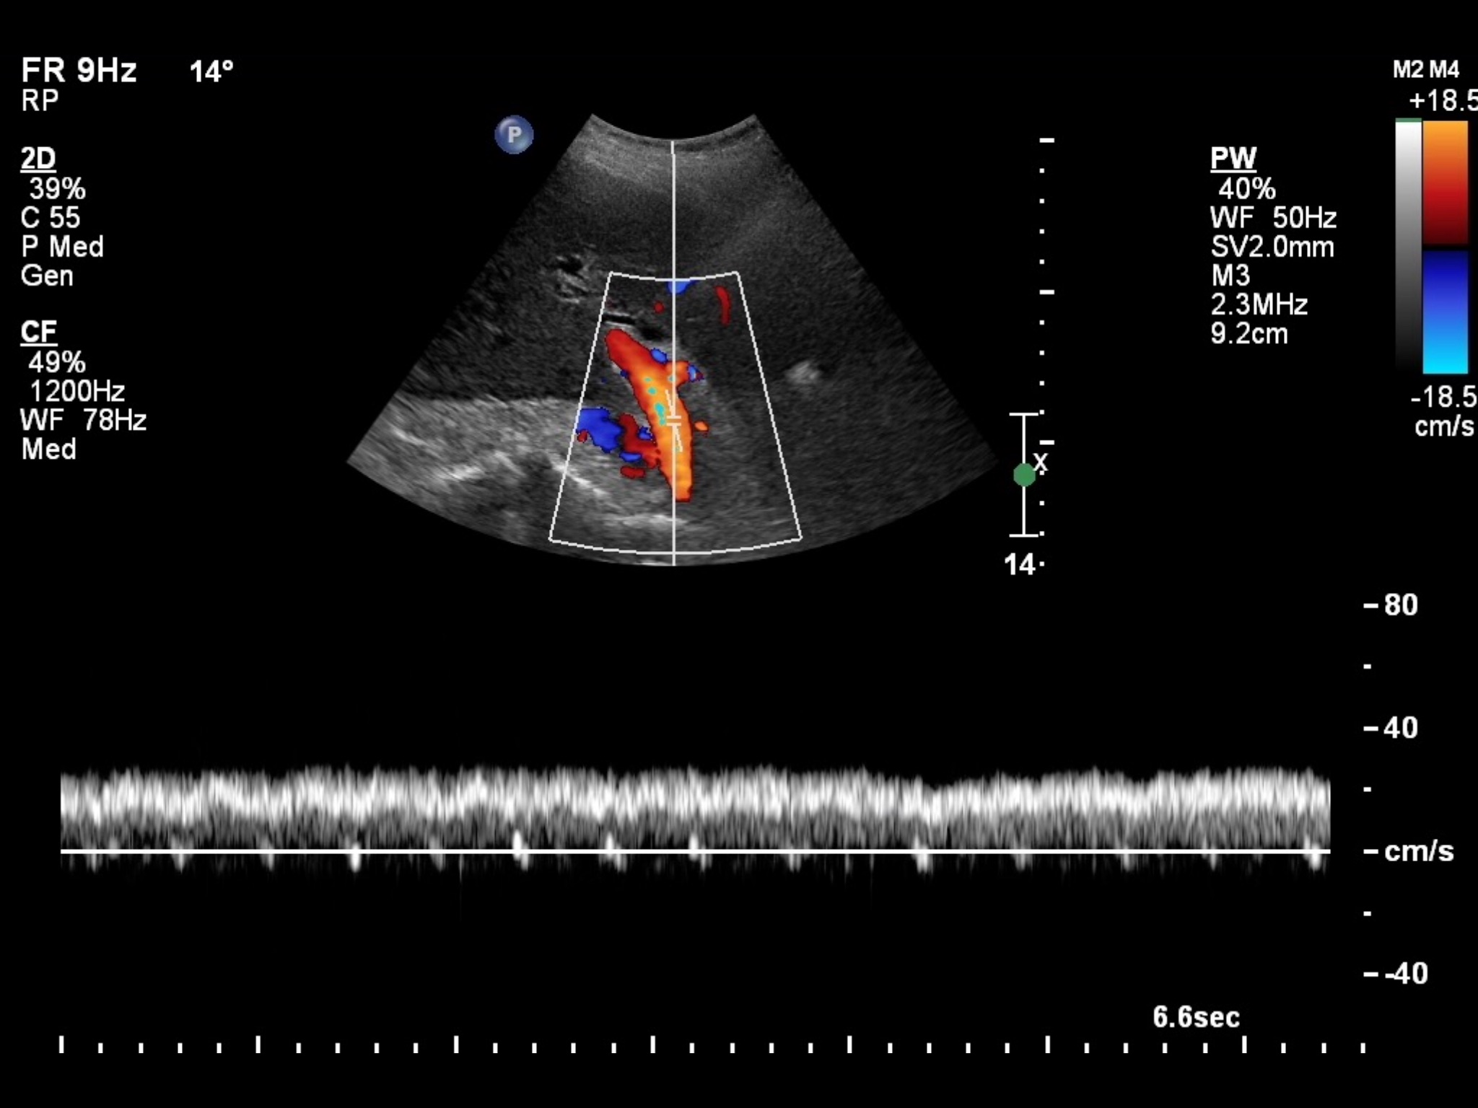
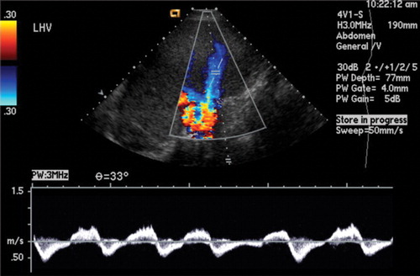
Hepatic ultrasound
McNaughton & Abu-Yousef, 2011 RadioGraphics
Schienfield et al., 2009 RadioGraphics

Slide 5
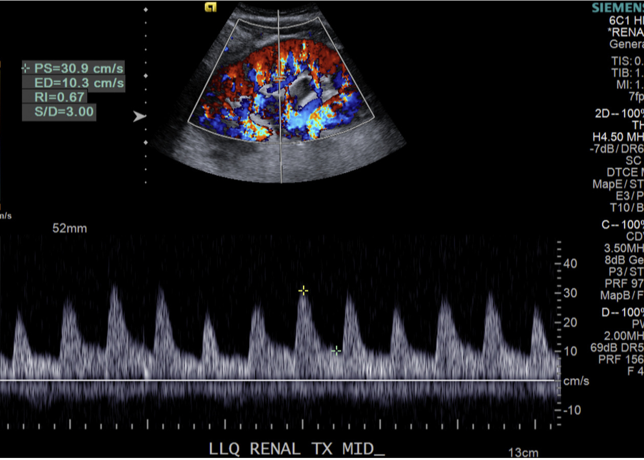
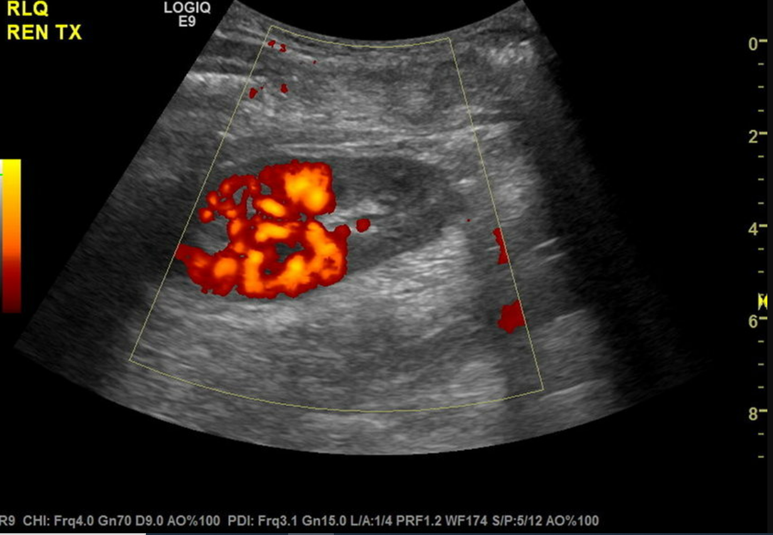
Renal ultrasound
Fananapazir & Troppmann, 2018 Abdom. Radiol.
Singla et al., 2022 Clin. Kidney J

Slide 6
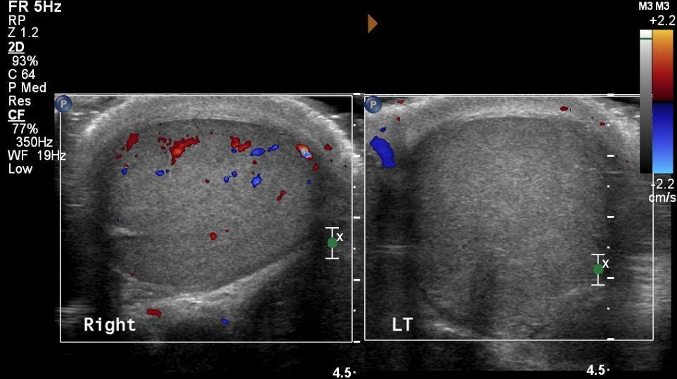
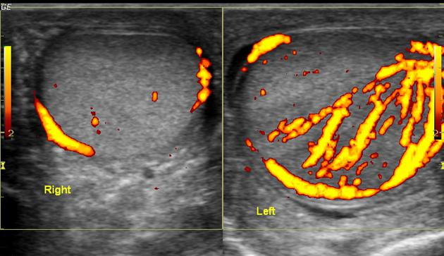
Scrotal ultrasound
Patel, 2023 Radiopaedia
Tadros, 2019 SAEM

Slide 7
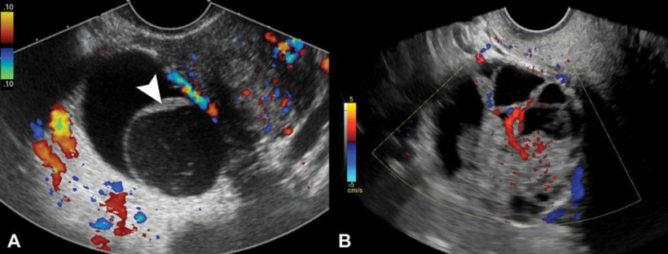
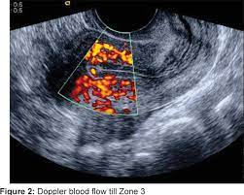
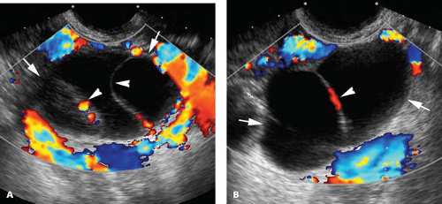
Gynaecological ultrasound
Bahadur et al., 2011 J. Hum. Reprod. Sci.
Gupta et al., 2022 Radiology

Slide 8
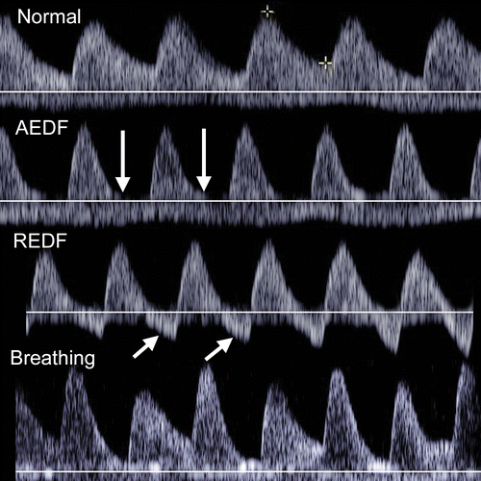
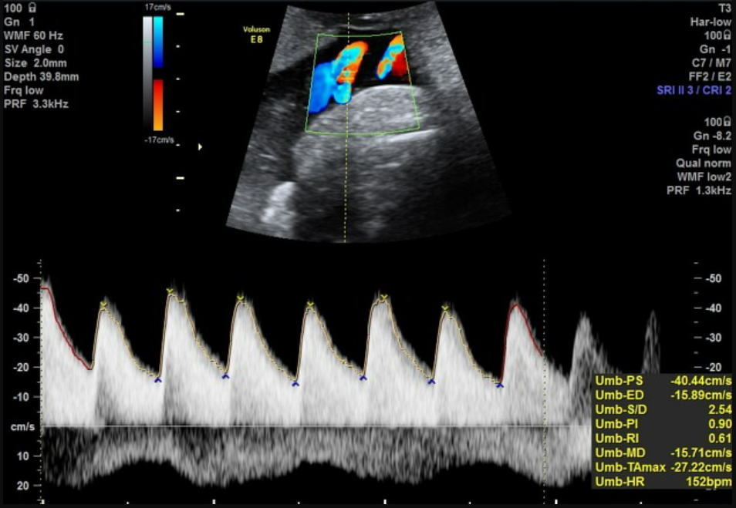
Obstetric ultrasound
Kennedy & Woodward, 2019 RadioGraphics
Knipe, 2023 Radiopaedia

Slide 9
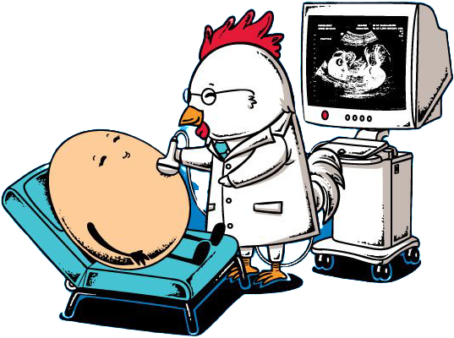
Ramifications of inappropriate Doppler usage

Slide 10
Over-detection of vascularity
High colour Doppler gain / low PRF, twinkle artefact and motion artefact result in artefactually increased vascular signal
False demonstration of perfusion in testicular / ovarian torsion
Delayed intervention is likely to result in loss of testis / ovary
Misclassification of benign lesions as potentially malignant
Unnecessary stress and anxiety for patient
Increased radiation / contrast exposure – CT
Unnecessary biopsy – thyroid lesions

Slide 11
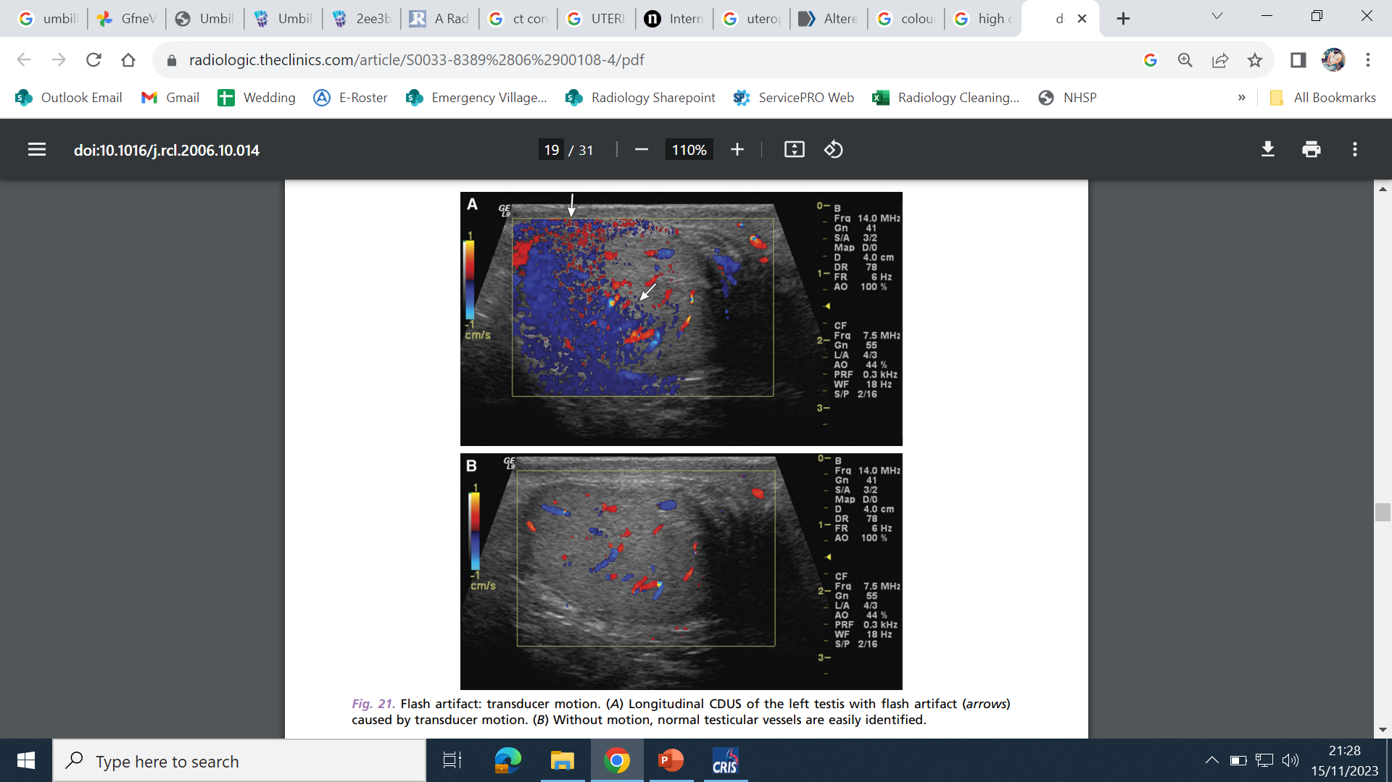
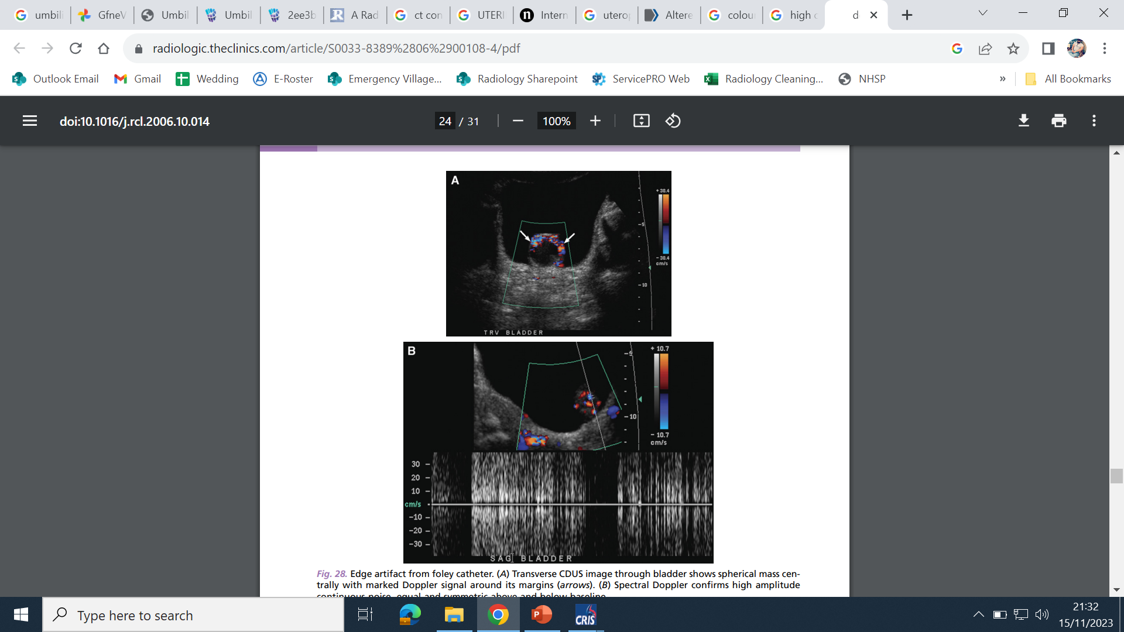
Rubens et at., 2006 Radiol. Clin. N. Am.

Slide 12
Under-detection of vascularity
Low colour gain / high PRF or inappropriate Doppler angle results in reduced detection of true colour Doppler signal
False identification of portal vein thrombosis
Radiation & contrast exposure – CTA
False exclusion of orchitis
Delayed treatment of infection due to investigating incorrect differential diagnosis
Misclassification of malignant lesions as benign
Surveillance / discharge instead of intervention leads to worse patient outcomes

Slide 13
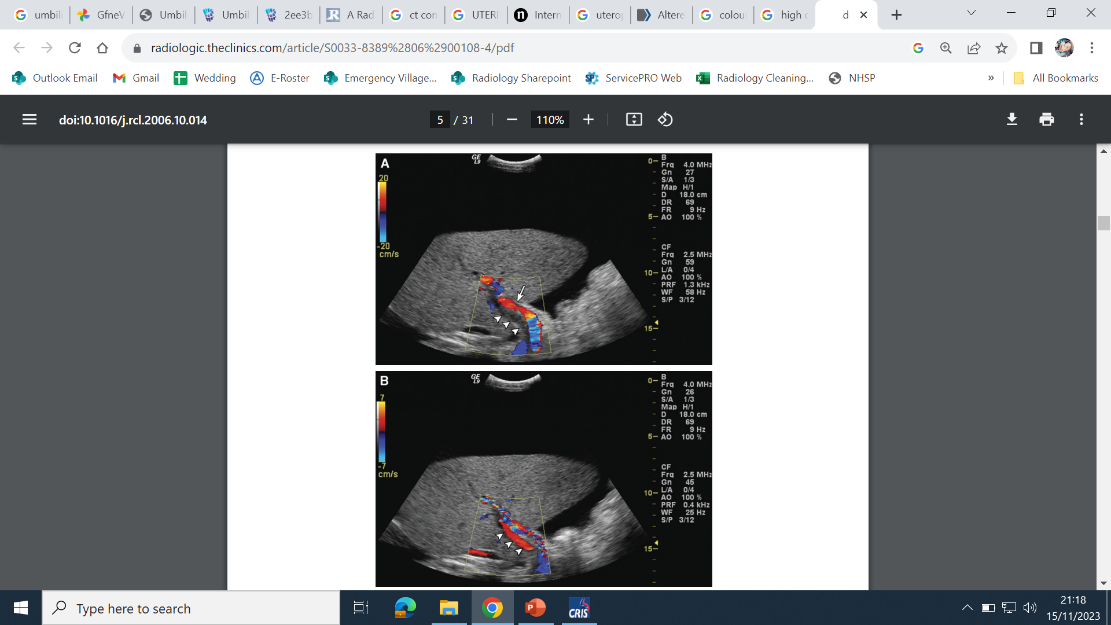
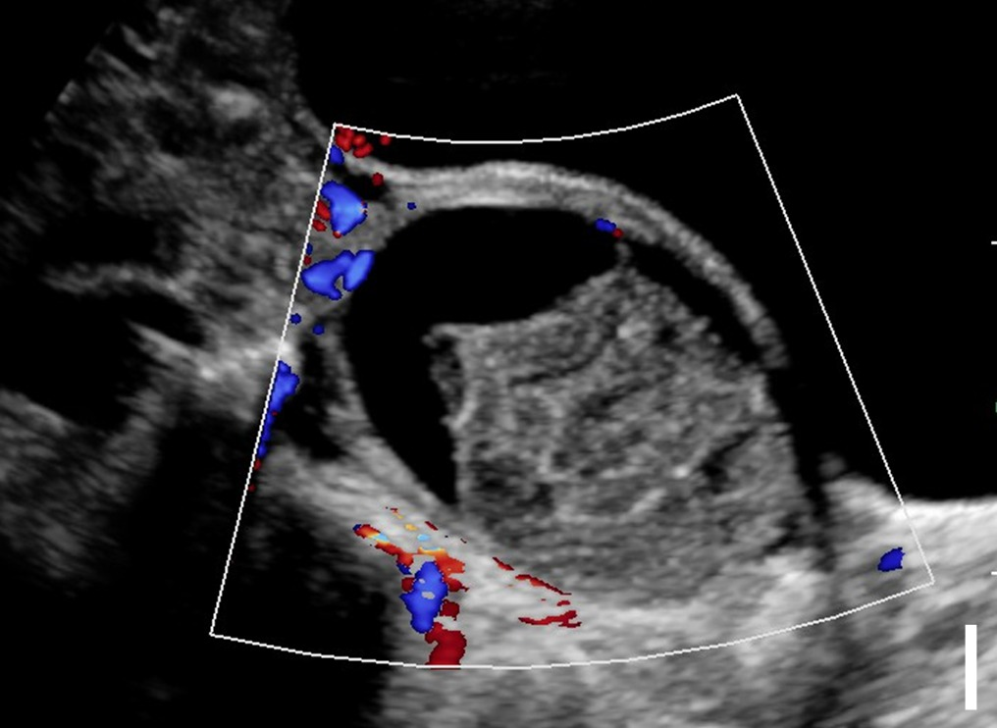
Gupta et al., 2022 Radiology
Rubens et at., 2006 Radiol. Clin. N. Am.

Slide 14
Inappropriate spectral Doppler usage
Inaccurate spectral Doppler trace due to inappropriate spectral Doppler sample site, angle, gain, wall filter etc.
Falsely reduced / absent end-diastolic waveforms in umbilical artery Doppler
Suggestive of degenerating placental vascular bed
May lead to clinicians considering early delivery
Falsely reduced portal venous flow velocity
Suggestive of portal hypertension and/or cirrhosis
May lead to further imaging / surveillance appointments

Slide 15
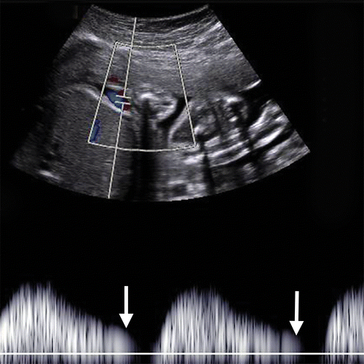
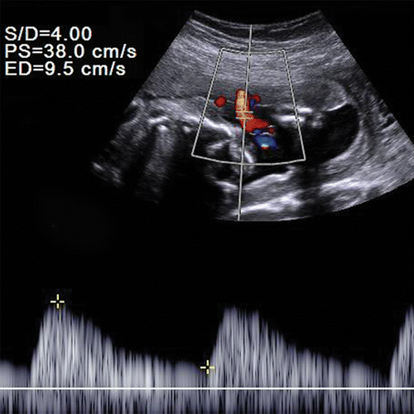
Kennedy & Woodward, 2019 RadioGraphics

Slide 16
Reflections
Vascular scientist mentality is not just about Doppler!
Logical and regimented
Systematic scanning is useful for scan types with a wide range of anatomy
Highly quantified
A detail-orientated imaging mentality is useful for subjective ultrasound findings
Technical imaging
Requires great knowledge of ultrasound ‘knobology’ and adaptive scanning techniques

Slide 17
Process
Formal academic
PgCert / PgDip
Isolated modules
Extending remit of practice to certain examinations
Native / transplant renal imaging
Portal system Doppler
Pelvic congestion

Slide 18

Doppler ultrasound is a highly useful tool in vascular and non-vascular imaging fields
Misuse of Doppler ultrasound has serious consequences
Skilful use of Doppler is difficult to learn
Vascular scientists are ideal candidates for expanding practice into general ultrasound

Slide 19
Thank you!
Go raibh maith agat!

