Slide 1




Slide 2
Three Imaging Methods
B/W image = anatomy
‘Colour’ Doppler = blood movement /
direction
‘Waveform’ Doppler = quality of flow
(e.g. velocity, VFR)

Slide 3
Three areas to examine
The supplying artery
Main body of the fistula (vein)
Outflow into deep veins

Slide 4
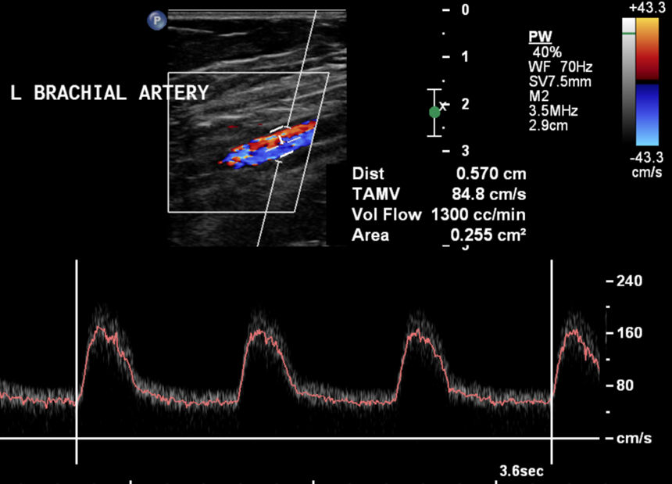
Brachial Artery (normal inflow)

Slide 5
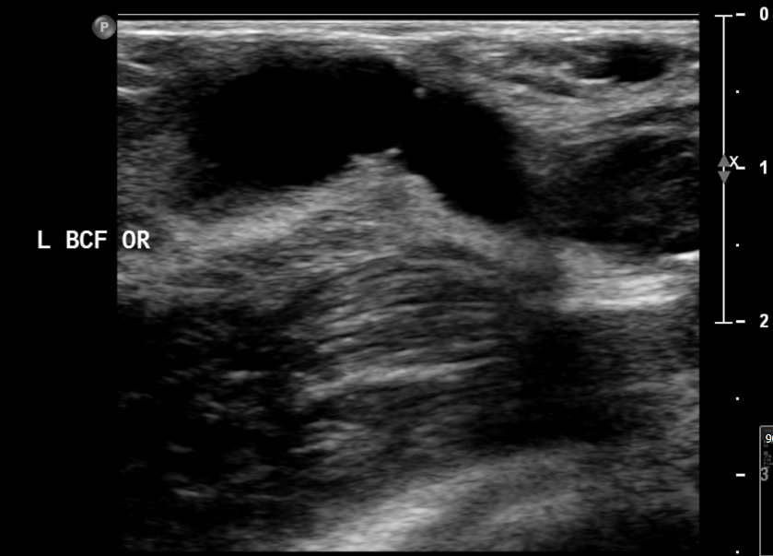
Pristine fistula origin

Slide 6
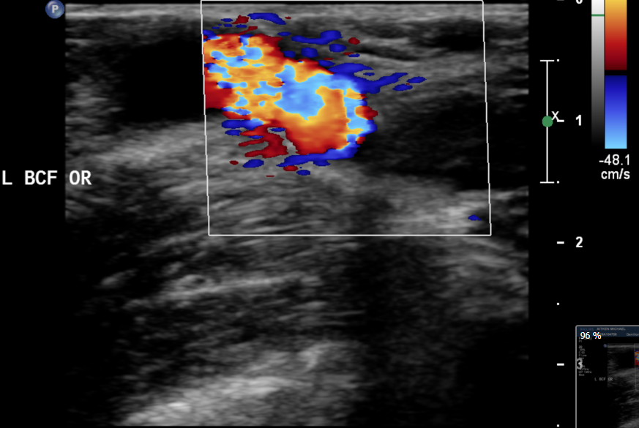
FISTULA ORIGIN Typical perivascular vibration

Slide 7
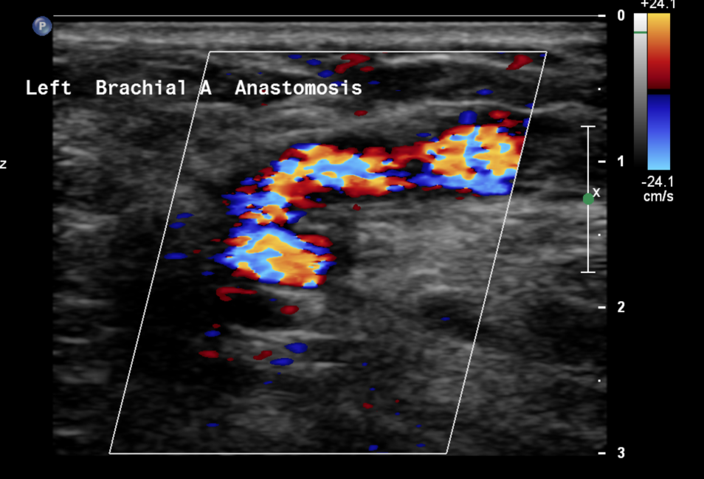
Tortuous anastomosis

Slide 8
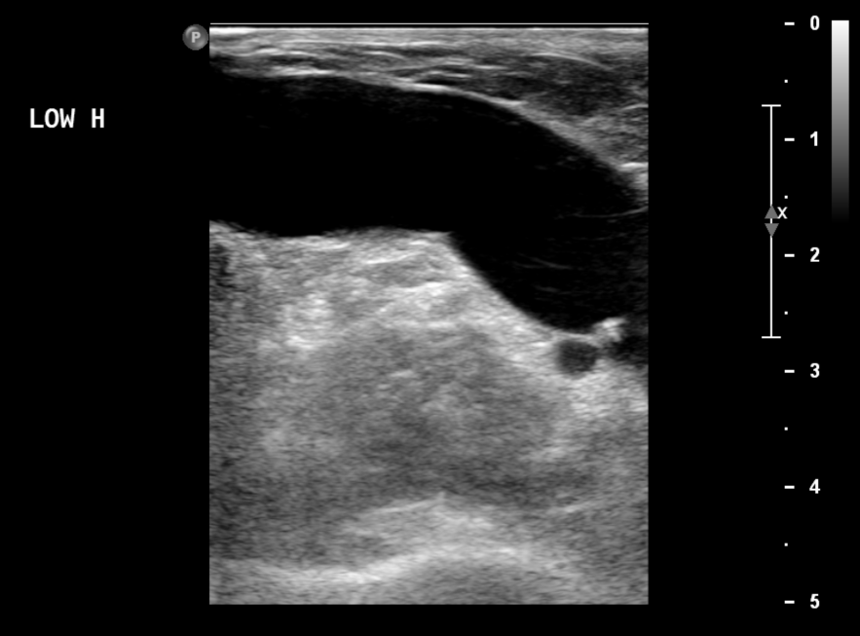
Main body of Fistula

Slide 9
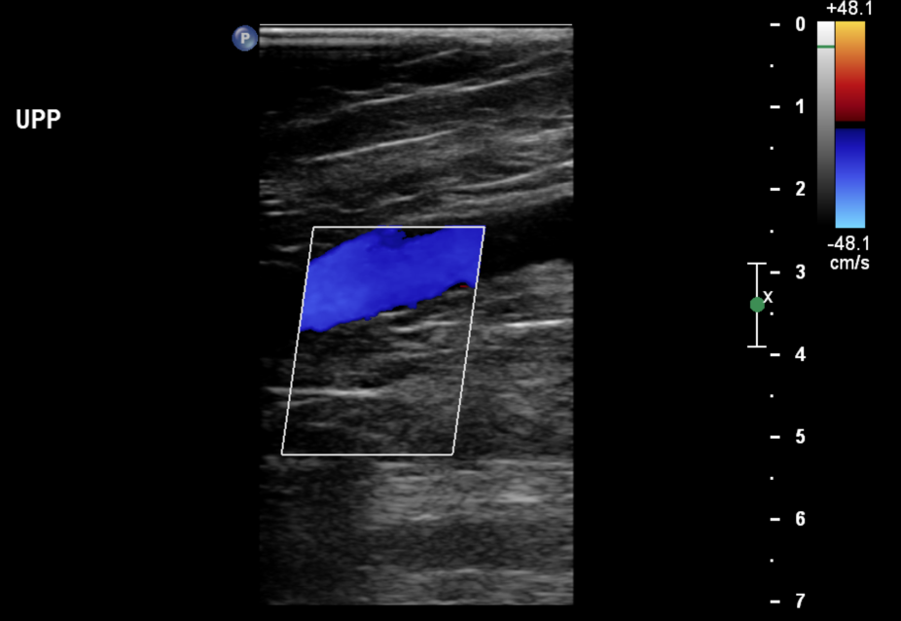
Colour filling entire fistula

Slide 10
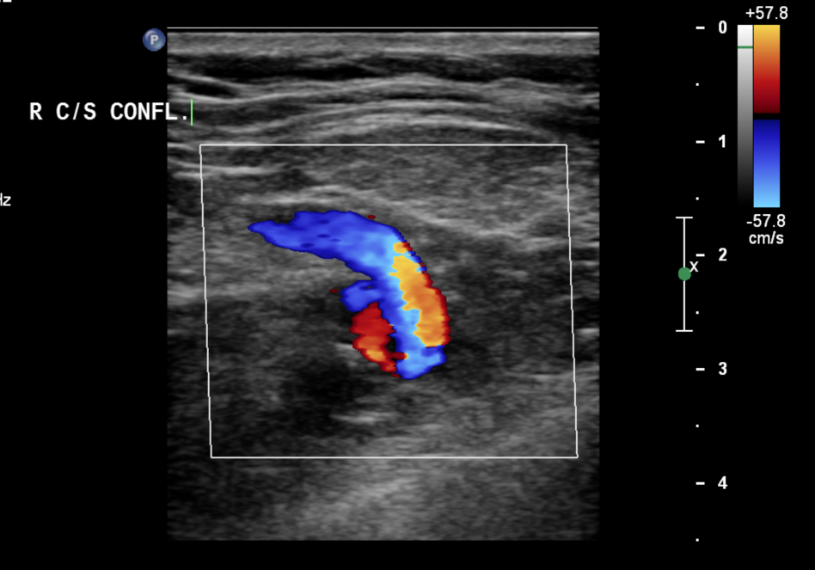
Outflow : Cephalo-Subclavian confluence

Slide 11
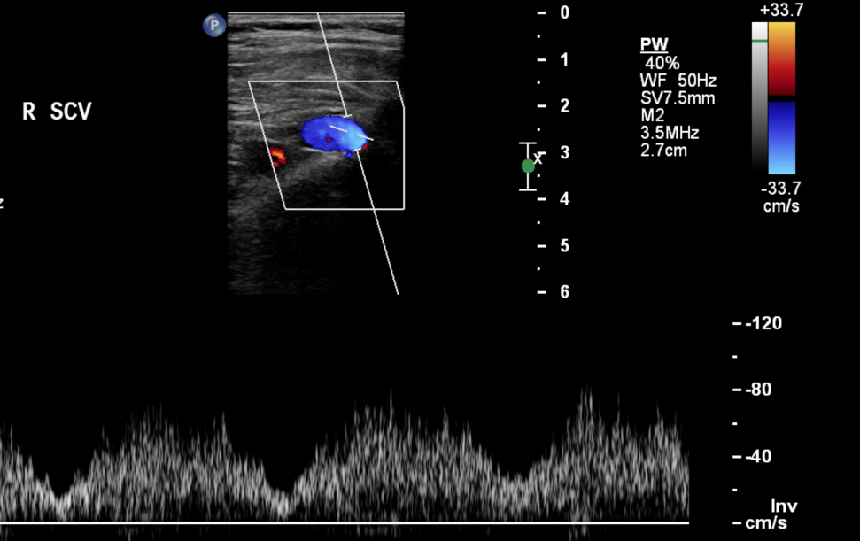
Outflow : SCV typically pulsatile, high volume

Slide 12
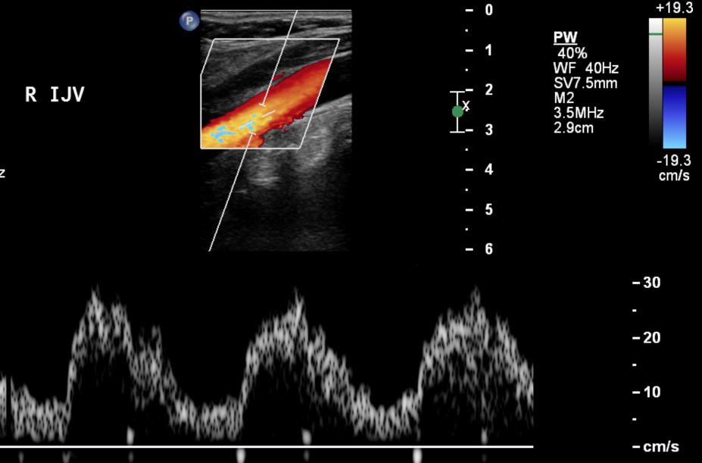
IJV : slightly pulsatile, antegrade flow

Slide 13
Volume Flow Rates (VFR)
Time Averaged Mean Velocity & Cross Section Area
Over 3 cardiac cycles
500 / 600mL/min = borderline sufficient
<350 / 400mL/min = critically low

Slide 14
Doppler measurements
Straight segment
Tilt probe to angle vessel on screen
Steer colour box in line with vessel direction
Colour sensitivity to match expected flow velocities
Doppler angle 30° to 60°

Slide 15

VFR

Slide 16
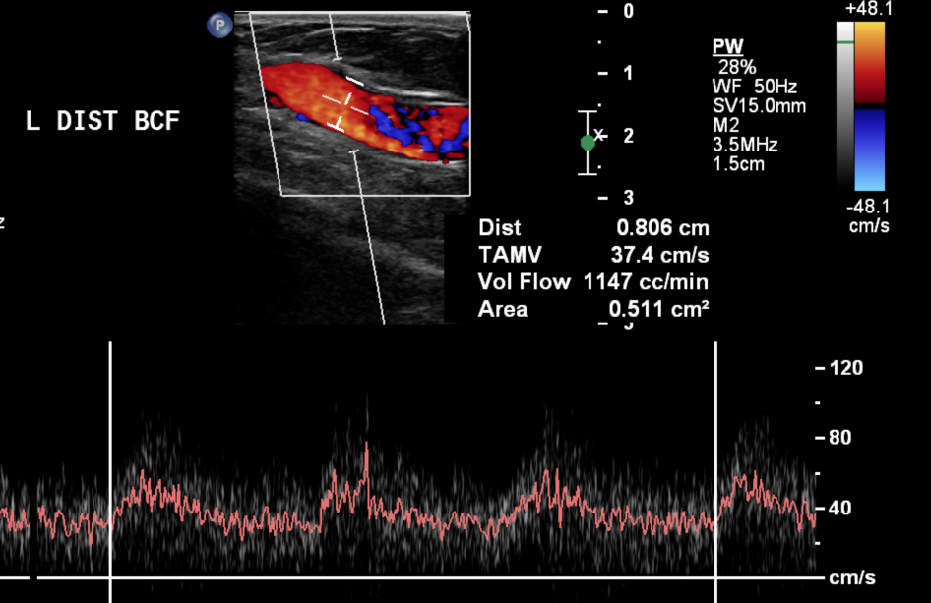
Typical Fistula Waveform : slightly ‘scrappy’ profile

Slide 17
COMMON ABNORMALITIES

Slide 18

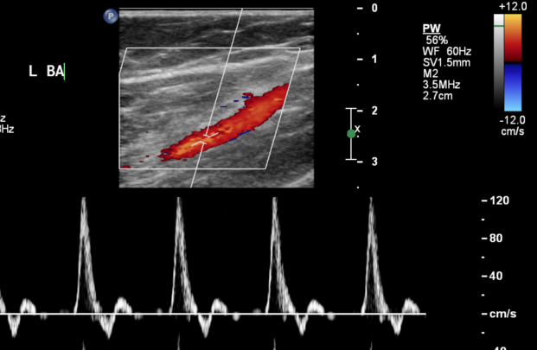
Triphasic inflow = problem with fistula Typical low resistance flow Triphasic arterial flow

Slide 19
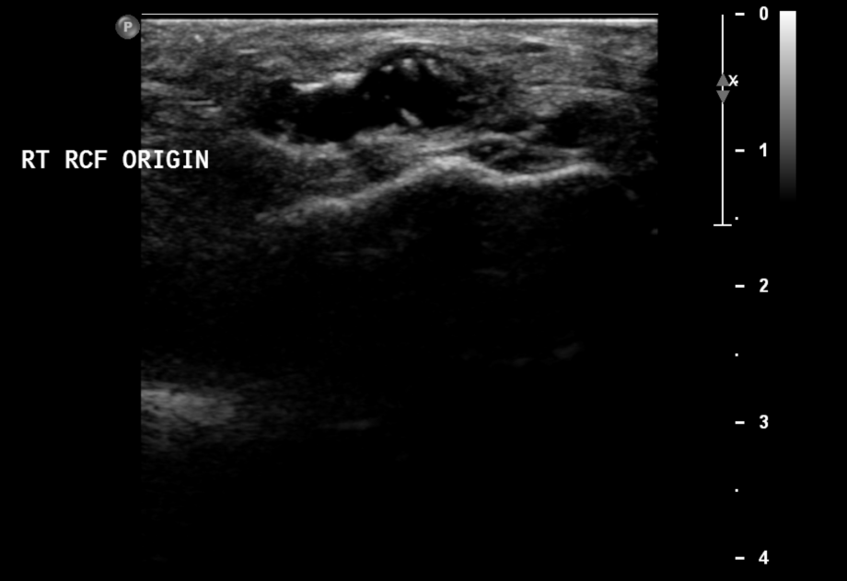
Long standing fistula origin No stenosis

Slide 20
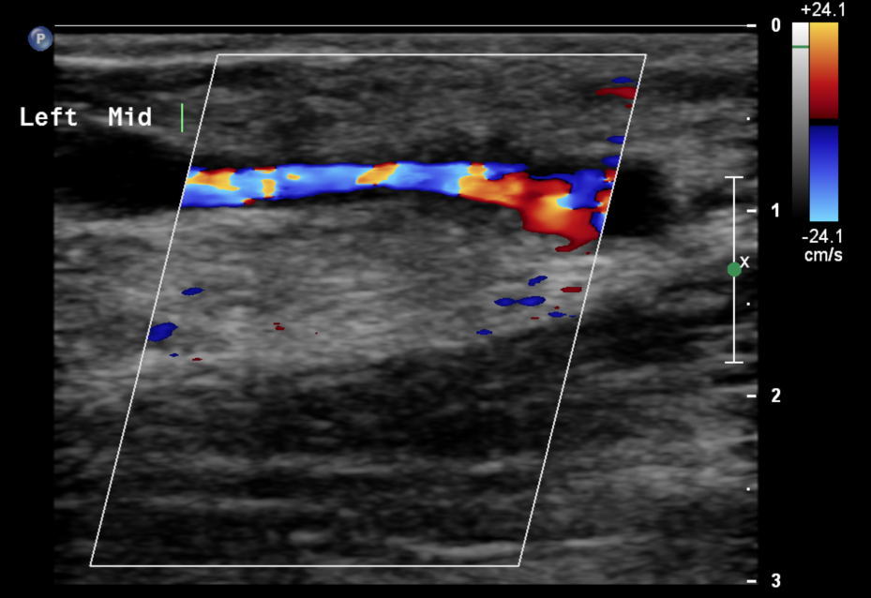
Repeated access : stenosed

Slide 21
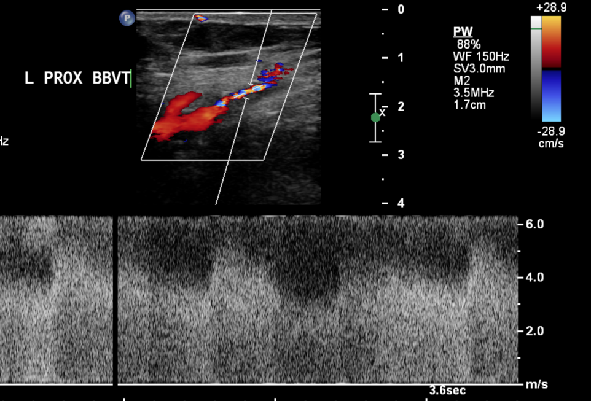
Critically stenosed : flow limiting

Slide 22
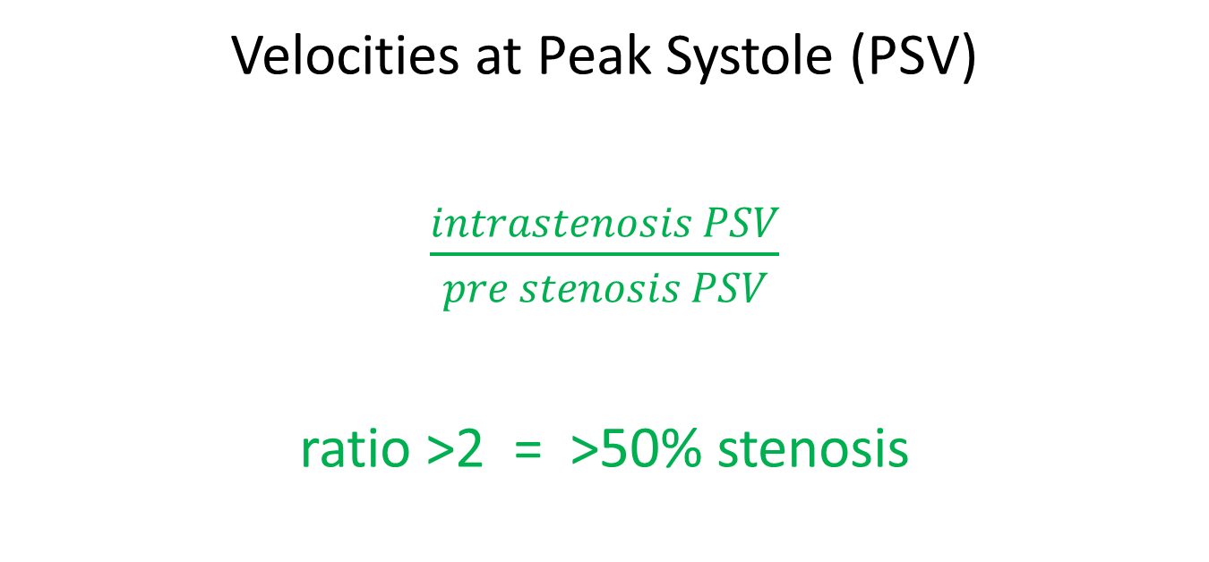
Fistula Stenosis
Velocities at Peak Systole (PSV)
$\frac{intrastenosis PSV}{pre stenosis PSV}$
ratio >2 = >50% stenosis

Slide 23
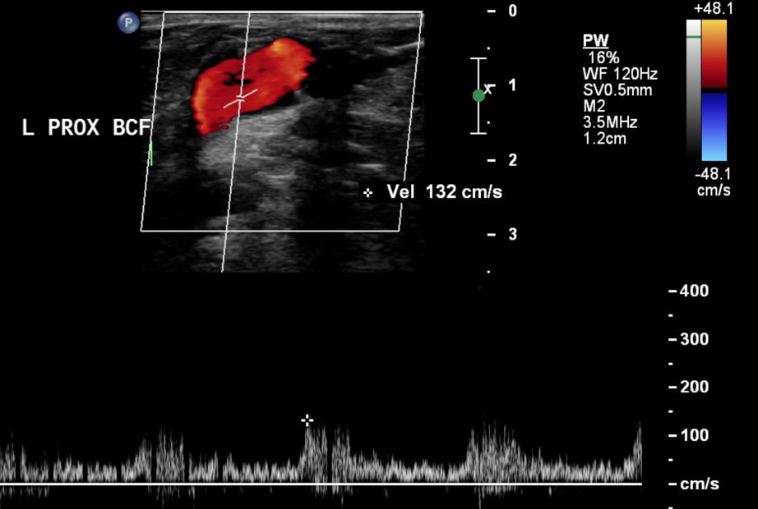
Fistula : pre stenosis PSV

Slide 24
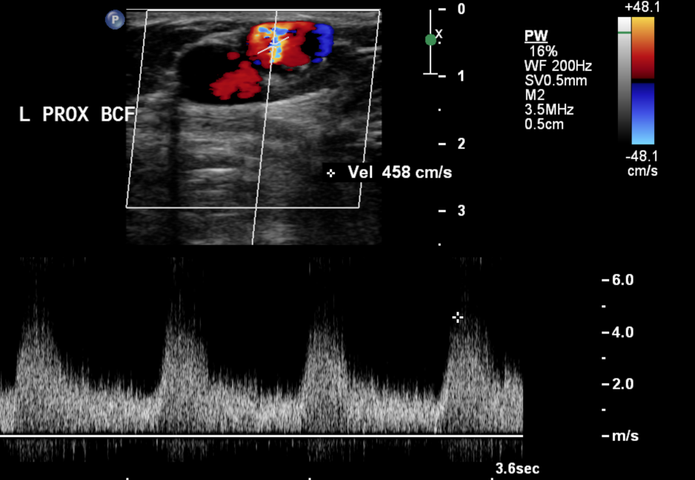
Fistula : intra stenosis PSV

Slide 25
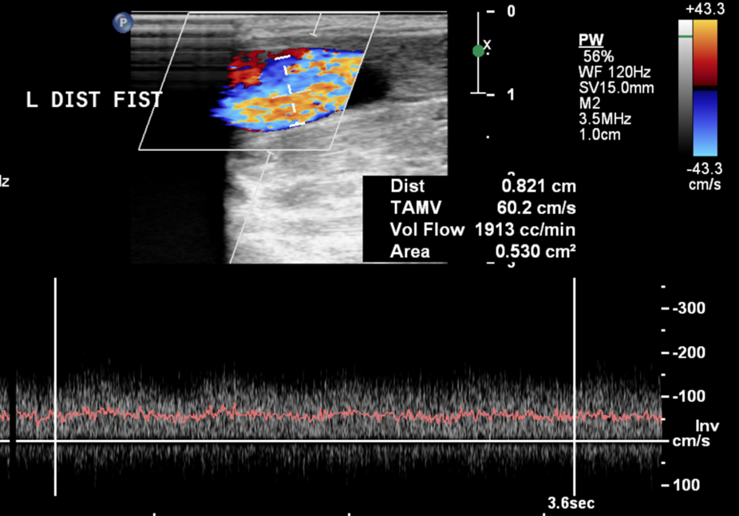
Post stenosis loss of pulsatility

Slide 26
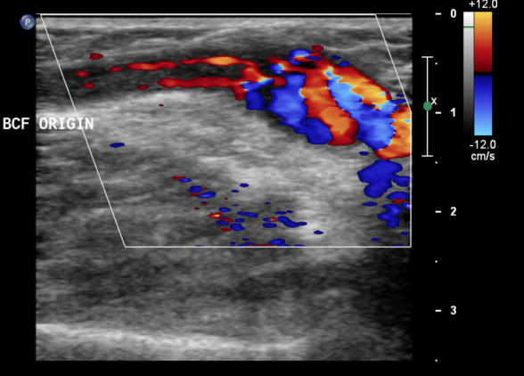
Extensive thrombus Not occluded

Slide 27
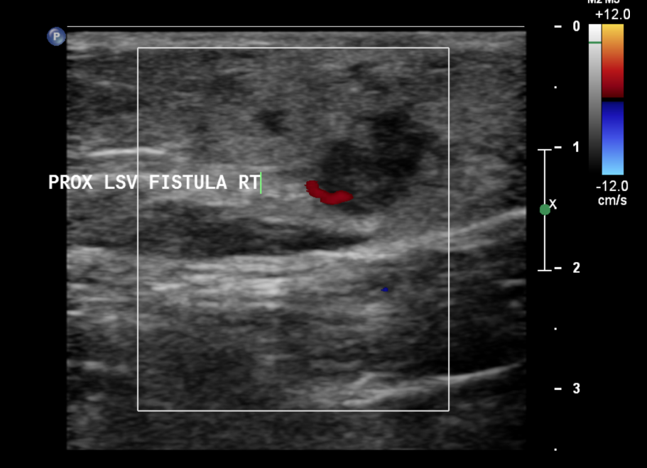
Barely patent : transverse image

Slide 28
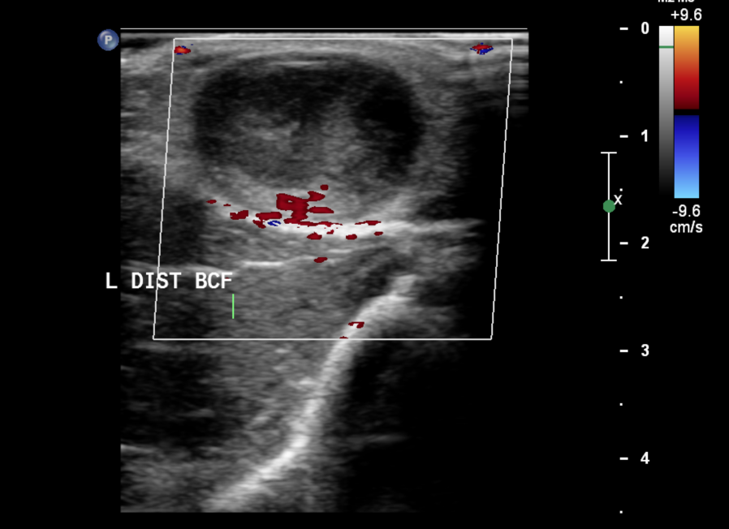
Occluded (thrombosed)

Slide 29
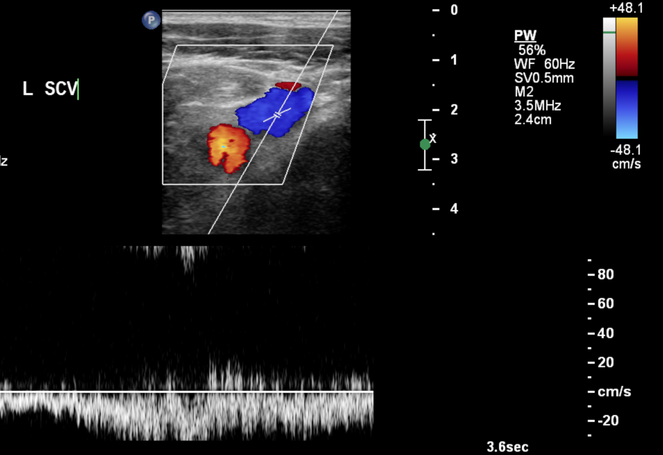
SCV flow returns to normal No ‘arterialised’ flow

Slide 30
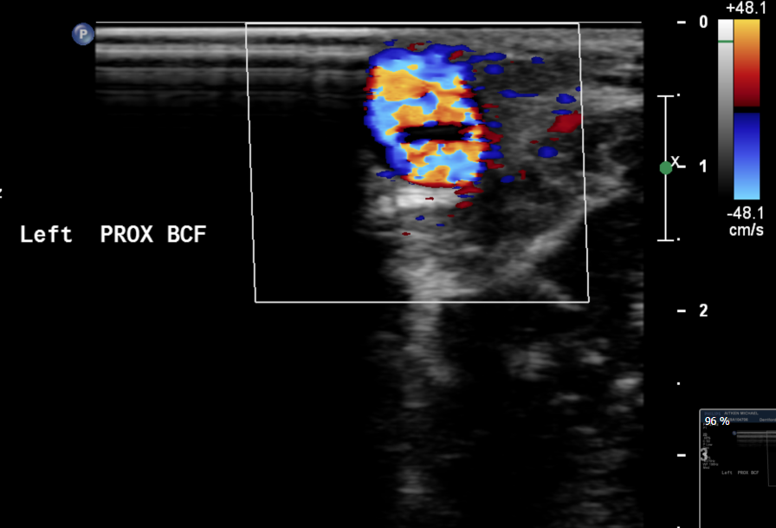
Rigid valve

Slide 31
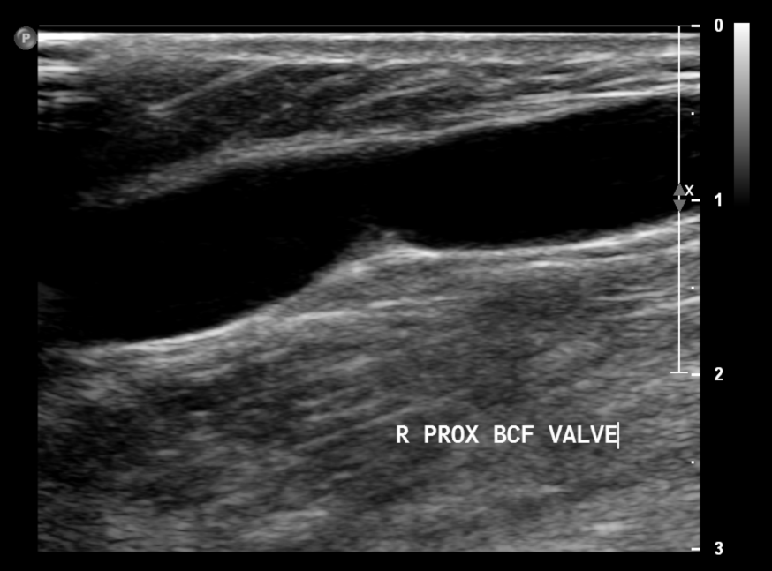
Valve causing a stenosis

Slide 32
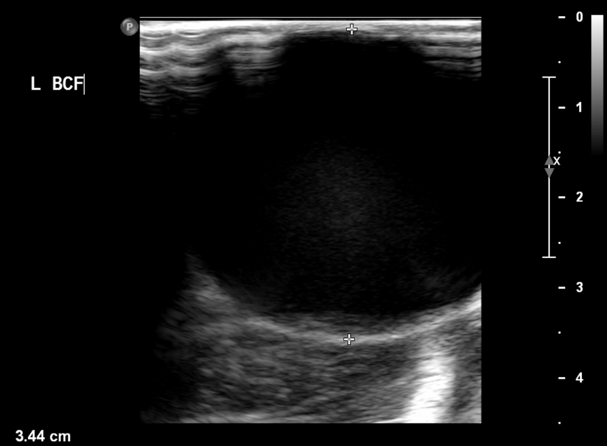
Aneurysmal BCF (outflow chronically impeded?)

Slide 33
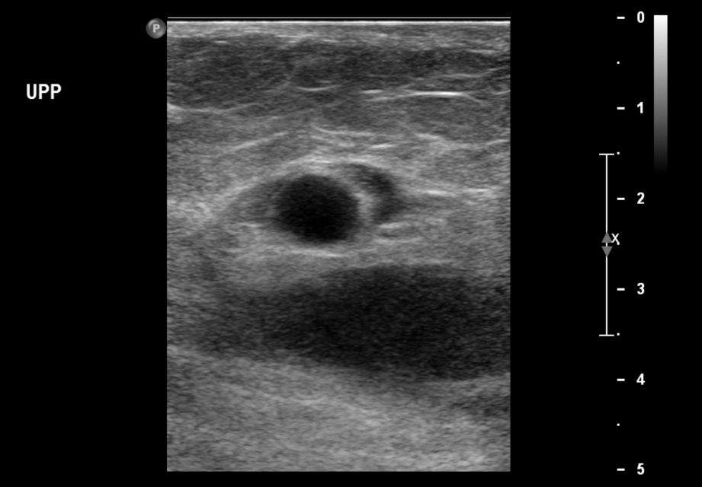
Haematoma

