Slide 1

BMUS
10th December 2015
Cardiff

Slide 2
Vascular 1 -Carotid plaque
Neil Pugh- Cardiff provided an overview
Plaque morphology- Gray-Weale categories
Plaque surface: Ulceration/irregular morphology
Objective assessment using grey-scale median (GSM)
Intra-plaque haemorrhage associated with neovascularisation (SMI, DCEUS)
Importance may be realised for the 50-70% stenosis level
Plaque classification | Plaque characteristics
Type I | Almost entirely echoleucent plaque with either no or thin echogenic luminal cap
Type II | Mostly echoleucent plaque with scattered echogenic foci
Type III | Mostly echogenic plaque with scattered echoleucent foci
Type IV | Homogenous echogenic plaque
Notes:
Parameters. Symptomatic patients more likely to have type I or II, or ulcerated. GSM <32 = echoleucent. D contrast enhance US showed better enhancement of microbubbles in the symptomatic group.

Slide 3
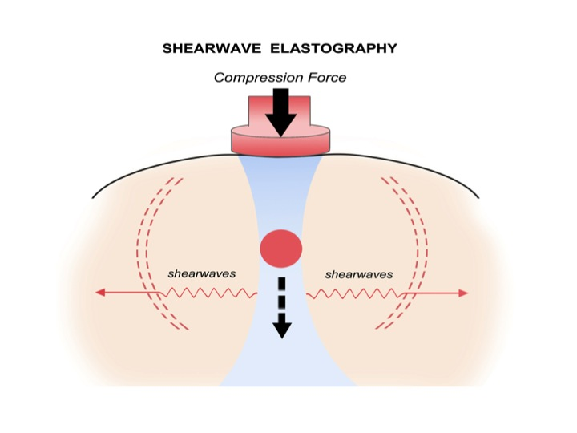
Emerging uses of ultrasound
Dr Ramnarine – Leicester
Shear Wave Elastotography (SWE) may be better than Grey-Scale Median (GSM) at assessing the unstable plaque
Phantoms used butter to represent atheroma; in vivo studies also performed
Notes:
GSM <32 echoleucent

Slide 4
Carotid plaque volume
J Burrough – Manchester
Carotid plaque burden is significantly higher in the symptomatic Vs non-symptomatic patients undergoing CEA
Carotid plaque burden measured by 3D US and compared to water immersion technique (of endarterectomised plaque)
No significant difference seen between the two techniques
Mean CPV 728.9+/-206.7mm³
Also showed a reduction in plaque volume with time post symptoms, ? Dual antiplatelet
Notes:
10 patients

Slide 5
Vascular 2 – Venous compression disorders
General overview of DVTs
US assessment of upper limb venous system
A. Smith - Hull
Use of Sonovue to enhance visualisation of calf veins
Used curvilinear probe for whole limb (n=12)
Improved visualisation from 54% to 79%
P. Williams – Cardiff
DVT clinic – Is D-dimer test useful?
Following NICE guidelines a nurse-led clinic (2013) provided Wells score and D-dimer tests. Retrospectively found that of 314 patients with a Wells score of 1 and positive D-dimer only 16 were DVT positive (87% false positive rate)
Concluded that D-dimer does not reduce the amount of unnecessary scans, therefore all patients suspected of DVT have a Doppler
Notes:
2015 266 arm scans at BRI

Slide 6
Vascular 3 – Assessment of non-atherosclerotic diseases
H Dixon, London
Cystic Adventitial disease – cystic mass within the vessel wall, often causing external compression on movement.
Case study – young man with cystic disease of popliteal artery, claudication symptoms on exercise
L Waring, University of Cumbria
Musculature of popliteal fossa
I Williams, Cardiff
Popliteal entrapment, iliac endofibrosis
EC Bartlett, Kings
Colour Doppler in the assessment of focal testicular lesion (85% malignant lesions showed increased vascularity)
A Pellew-Nabbs, Warrington & Halton
AV fistulae secondary to stab wound – case study
44 year old man, stab injury to thigh 10 years ago, presented with generalised leg pain and calf claudication symptoms
SFA-FV wide necked AV fistula identified on venous duplex (GP misinterpreted symptoms as ? DVT)
Patient awaiting surgical ligation
Notes:
Penile Doppler didn’t turn up.

Slide 7
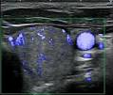
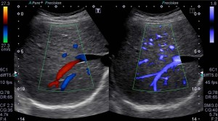
Toshiba innovations
Neil Pugh – Cardiff
Use of new Superb Microvascular Imaging (SMI)
Now routinely used in Cardiff for post-EVAR surveillance over CT
Has been shown to be as sensitive as CT in detection of endoleaks
Thyroid nodule
Hepatic vein

Slide 8
The great carotid debate
Neil Pugh Vs. Crispian Oates
This house believes that we should follow SVT recommendations and measure the PSV, PSV ratio and the St Mary’s ratio when assessing the degree of carotid artery stenosis on ultrasound.
Before FOR: 79%
After FOR: 41%
2003 Society of Radiographers guidelines (Grant 2003)
Notes:
Compared the SRU 2003 carotid grading criteria with CT angio and saw 93% agreement for >70% stenoses
This represents a 20% increase in agreement as compared with the 2009 recommendations

