Slide 1
Audit Training for Auditors
Glenn Almond-Smith – Clinical Lead for Quality & Audit
Peter Kabogoza – National Clinical Lead
12/02/2024

Slide 2
Agenda
10:00 - 10:10 Introductions
10:10 - 10:30 G.A-S Audit categories, scoring recap with examples in practice.
10:30 - 13:00 PK October audits (General & MSK).
13:00 – 13:45 Lunch break
13:45 – 14:15 G.A-S Interesting audit cases to provoke discussion.
& P.K
14:15 – 15:45 Live audit practice.
15:45 – 16:00 Q&A / AOB.

Slide 3
Audit Categories & Scoring Recap
Images
Specific Standard Quality and Overall Image Quality
Full set of images taken to answer clinical concern.
All relevant measurements for pathologies are recorded.
Images that are of diagnostic quality.
Sonographer has optimised images to best of their ability.
Report
Report Quality and Advice & Recommendations
Is the report accurate? – patient demographics, relevant pathologies included etc.
Does the report answer the clinical question?
Has the appropriate advice and recommendation been given?
Does the recommendation follow protocol?
Notes:
BASIS OF OUR AUDITS - is to ensure we follow our protocols. A lot of time and effort goes into our protocols to ensure we follow the most up to date guidance from BMUS, College of Radiologists and the Vascular society etc. Need to ensure we are following that guidance with appropriate escalation policies to ensure patients with significant pathology are referred appropriately and within the documented timescales.

Slide 4
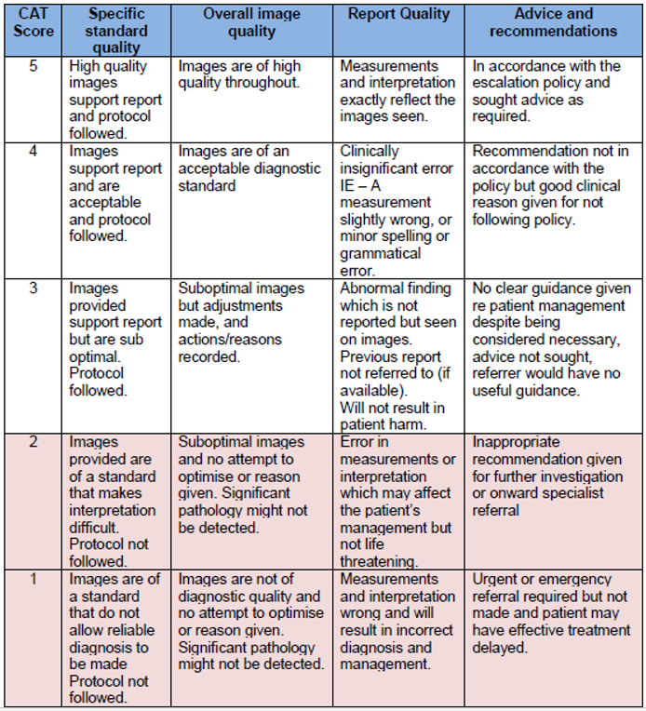
Audit Categories & Scoring
Notes:
Audit Categories and Scoring
4 main categories
Images look at - Specific Standard Quality & Overall Image Quality.
Report – Report Quality & Advice & Recommendations.
Scoring system is from1 to 5. 5 being the best with complete agreement. The report and images are of good doagnostic quality and accurately reflect what is written in the report.

Slide 5

Audit Findings
Of the 4 categories, audit findings most often relate to…
  1. Specific Standard Quality
  2. Overall Image Quality
  3. Report Quality
  4. Advice & Recommendations
Notes:
1. Specific Standard Quality – Images required to take for each scan time, to meet SOP guidelines. For instance, ensuring measurements are taken and saved on images, if colour Doppler is required in an MSK assessment or for vascular ensuring spectral and colour Doppler are utilized to interrogate specific vessels such as the CFA, or phasic waveform image of the CFV.
2. Overall Image Quality – has the image been optimised and does it clearly demonstrate the anatomy / pathology? B-Mode settings adjusted (gain, TGC, focus, dynamic range), depth / zoom, Colour scale, gain - ?turbulence / aliasing.
Report Quality – legible? Adequate spacing, spelling mistakes, accurate information?
Advice & Recommendations – Have we answered the clinical question. Has the appropriate recommendation been made according to InHealth escalation policy guidelines. Is the recommendation justified?

Slide 6
Audit Findings
Of the 4 categories, audit findings most often relate to…
  1. Specific Standard Quality
  2. Overall Image Quality
  3. Report Quality
  4. Advice & Recommendations
  This tells us….
  Correct images taken to meet protocol standards.
  Image acquisition / optimisation is good.
  But…
  Reporting is likely being rushed.
  May not be utilising the second opinion team for difficult pathology.
  Advice & recommendations may not follow protocol - pathology may not be linked back to the clinical indications / clinical concern.
Notes:
1. Specific Standard Quality – Images required to take for each scan time, to meet SOP guidelines. For instance, ensuring measurements are taken and saved on images, if colour Doppler is required in an MSK assessment or for vascular ensuring spectral and colour Doppler are utilized to interrogate specific vessels such as the CFA, or phasic waveform image of the CFV.
2. Overall Image Quality – has the image been optimised and does it clearly demonstrate the anatomy / pathology? B-Mode settings adjusted (gain, TGC, focus, dynamic range), depth / zoom, Colour scale, gain - ?turbulence / aliasing.
Report Quality – legible? Adequate spacing, spelling mistakes, accurate information?
Advice & Recommendations – Have we answered the clinical question. Has the appropriate recommendation been made according to InHealth escalation policy guidelines. Is the recommendation justified?

Slide 7
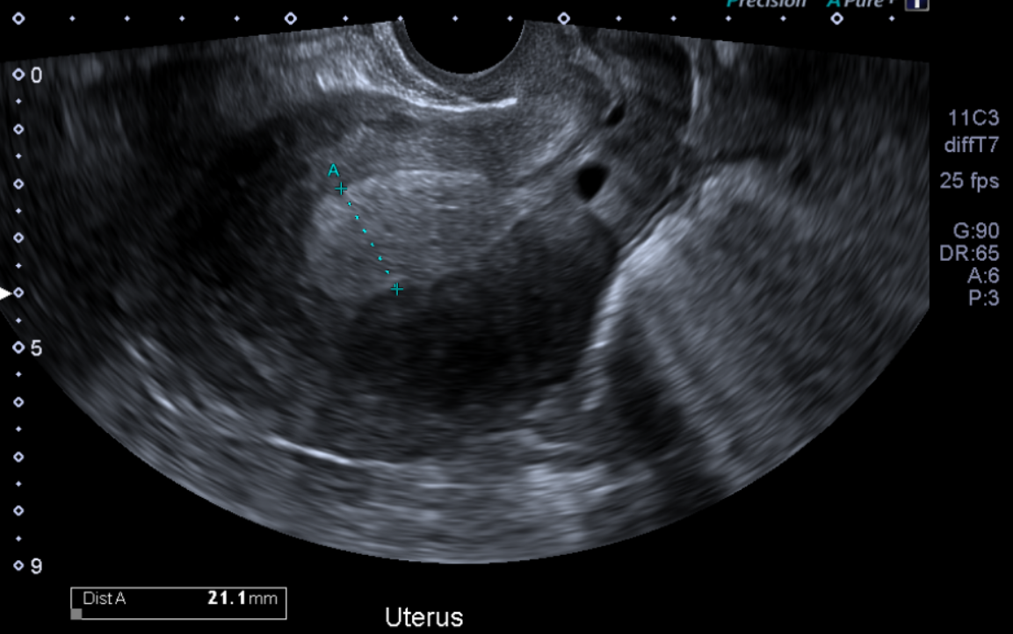
Example 1: Relating findings to clinical indications
Examination: US Pelvis TA and transvaginal
NHS: 4426427037
Clinical Indications: Heavy period. 3 weeks prolonged bleeding. ?fibroid, location and size.
LMP: Unsure due to prolonged bleeding.

Slide 8
Example 1: Relating findings to the clinical indications.
Examination: US Pelvis TA and transvaginal
NHS: 4426427037
Clinical Indications: Heavy period. 3 weeks prolonged bleeding. ?fibroid, location and size.
LMP: Unsure due to prolonged bleeding.
Findings: The endometrium appeared thickened measures 21mm with inhomogenous echotexture and cystic spaces, may suggest hyperplasia.
Conclusion: Feature of uterine adenomyosis and endometrial hyperplasia. Left peri ovarian simple cyst, otherwise normal ovaries.
Recommendations: Specialist review/opinion is recommended for further management/investigation of the endometrium.
Recommendations: Rescan on Day 5-10 in 6-8 weeks to monitor interval changes for endometrial thickening.

Slide 9
Example 1: Relating findings to the clinical indications.
Examination: US Pelvis TA and transvaginal
NHS: 4426427037
Clinical Indications: Heavy period. 3 weeks prolonged bleeding. ?fibroid, location and size.
LMP: Unsure due to prolonged bleeding.
Recommendations: Specialist review/opinion is recommended for further management/investigation of the endometrium.
*Agreement with the sonographer’s original report.

Slide 10
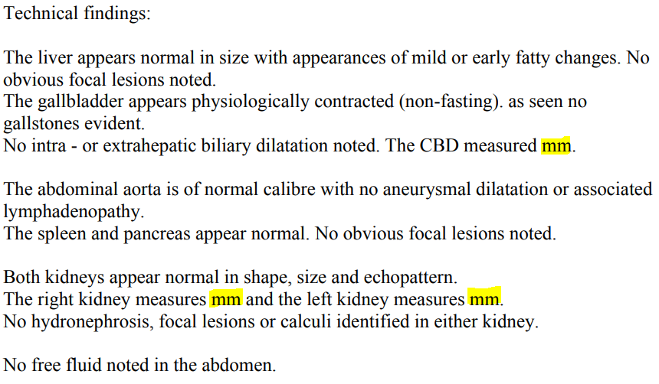
Example 2: Report Quality
Examination: US Abdomen

Slide 11
Example 2: Report Quality
Examination: US Abdomen
Auditor feedback is shared with the sonographer to review.
“Missing measurements in the report. Requires addendum.”
Sonographer issues an addendum – InPhase raised for ‘Report related issue’.
New report is issued to the GP.
*General rule – reports that require addendums, but do not result in patient harm or change patient management would score 3 for ‘Report Quality’

Slide 12
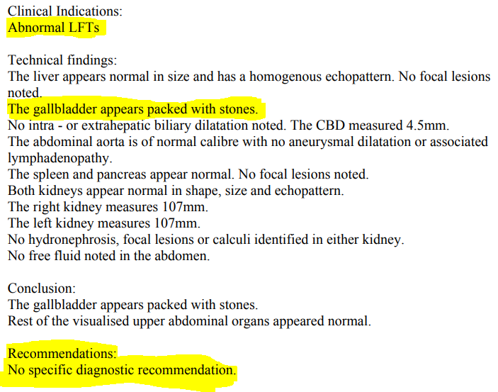
Example 3: Advice & Recommendations
Examination: US Abdomen

Slide 13
Example 3: Advice & Recommendations
Examination: US Abdomen
As the clinical indications / clinical concern is abnormal LFTs, coupled with the diagnosis of gallbladder packed with stones, this patient should have had a specialist referral recommendation.
This may have delayed the patient’s pathway.
CAT 2 Audit

Slide 14
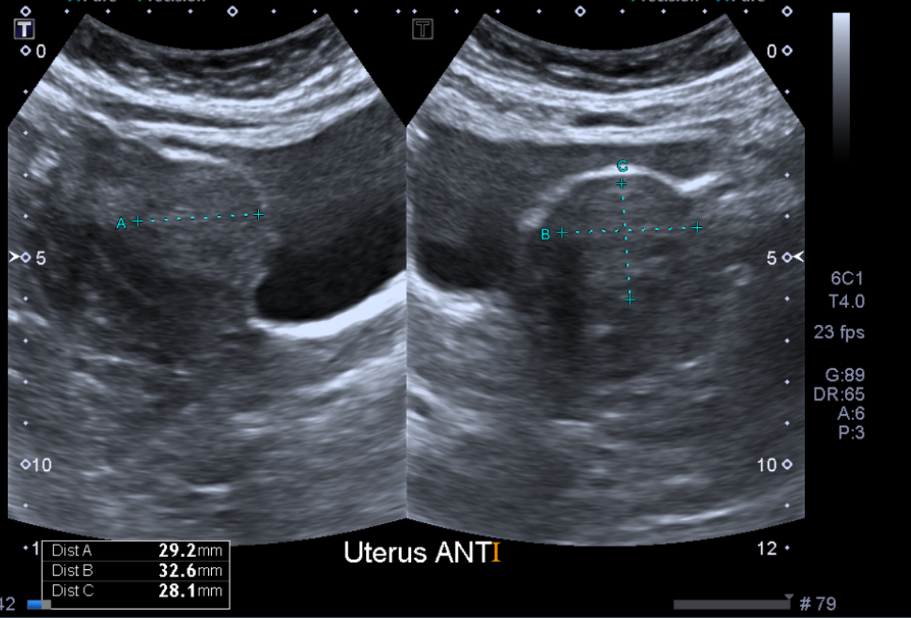
Example 4: Image Quality - feedback
Examination: US Pelvis TA & TV

Slide 15
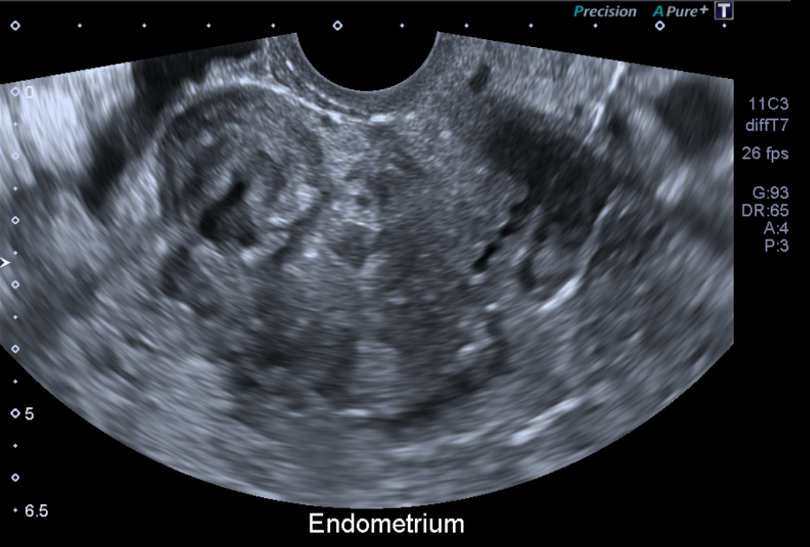
Example 4: Image Quality - feedback
Example 3: US Pelvis TA & TV

Slide 16
Example 4: Image Quality - feedback
Examination: US Pelvis TA & TV
Auditor feedback comments: “The fibroid appears to be over-measured on TAS. Better to measure fibroid size on TVS as better images with good border demarcation.”
Feedback merely demonstrating what would be ‘ideal’, based on the images taken for the highest quality outcome.

Slide 17
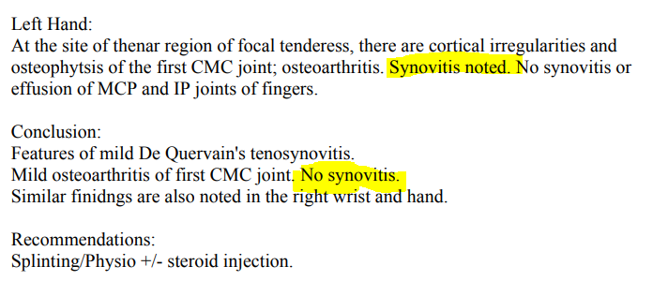
Example 5: MSK – Report Quality
Examination: US Wrist.
Conclusion contradicts the main body text regarding synovitis.
Will not result in patient harm but confusing.

Slide 18
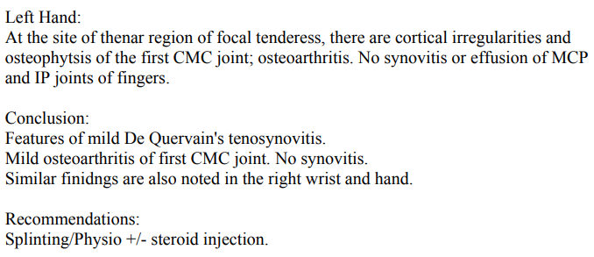
Example 5: MSK – Report Quality
Example 4:
Sonographer emailed to review and issue an addendum.

Slide 19
Interesting Audit Case 1
Examination: US Pelvis TA and transvaginal
NHS: 4305636948
Appointment Date: 12/10/2023
Clinical Indications: Missed a few periods, irregular bleeding, mirena in situ. previous cyst on ovary.
LMP: Bleeding everyday for few months.
Findings: The visualised endometrium measures 13 mm and appears heterogeneous containing multiple small cystic spaces.
The intra uterine coil device is in place and is located in the upper third of the endometrial cavity.
Conclusion: IUCD in situ. Heterogeneous endometrium containing small cystic spaces. Normal uterus and ovaries.
Recommendations: Follow up scan in 6-8 weeks within 5th-10th day of menstrual cycle for reassessment of the endometrium.

Slide 20
Interesting Audit Case 1
Auditor 1 feedback: The endometrium looks unremarkable.
Auditor 2 feedback: Agree the endometrium looks normal. The patient had a coil at time of scan and the endometrium is not heterogenous. Patient did not require a follow-up. Addendum required.
Addendum issued:
“The visualised endometrium measures 13 mm and appears normal. The intra uterine coil device is in place and is located in the upper third of the endometrial cavity.”
Conclusion: IUCD in situ. Normal uterus, endometrium and ovaries.
Recommendations: No diagnostic recommendations.

Slide 21
Interesting Audit Case 1
Clinical Indications: Follow-up scan, 06/12/2024
LMP: Not sure due to spotting.
Findings: The uterus is anteverted and appears normal in size and shape with homogenous myometrium. No obvious fibroid lesion seen.
The endometrium appears mildly thickened and measures approximately 17mm in thickness. Appears inhomogenous with cystic spaces and minimal vascularity, may suggest hyperplasia.
Both ovaries appear normal in size, shape and follicular pattern. The right ovary measures 6cc in volume. The left ovary measures 9cc in volume.
No free fluid. No obvious adnexal mass noted.
Conclusion: Endometrium appears mild thickened and inhomogenous with cystic spaces and minimal vascularity, may suggest hyperplasia. Normal appearing uterus and ovaries.
Recommendations: Specialist referral is recommended for further management/investigation of the endometrium.

Slide 22
Interesting Audit Case 1
Auditor feedback: The coil has now been removed and the endometrium is normal (takes time to reduce in size).
Addendum issued:
“The endometrium measures approximately 17mm in thickness. Endometrial changes, likely due to post-removal of the coil.”
Conclusion: Endometrial changes, likely due to post-removal of the coil. Otherwise, normal pelvic ultrasound.
Recommendations: No recommendation required.

Slide 23
General Audit Practice
Notes:
BASIS OF OUR AUDITS - is to ensure we follow our protocols. A lot of time and effort goes into our protocols to ensure we follow the most up to date guidance from BMUS, College of Radiologists and the Vascular society etc. Need to ensure we are following that guidance with appropriate escalation policies to ensure patients with significant pathology are referred appropriately and within the documented timescales.

Slide 24
MSK Audit Practice
Notes:
BASIS OF OUR AUDITS - is to ensure we follow our protocols. A lot of time and effort goes into our protocols to ensure we follow the most up to date guidance from BMUS, College of Radiologists and the Vascular society etc. Need to ensure we are following that guidance with appropriate escalation policies to ensure patients with significant pathology are referred appropriately and within the documented timescales.

