Slide 1
Audit
Glenn Almond-Smith
Clinical Lead Quality & Audit
03/10/2023

Slide 2
Contents
Why do we have audit & what is its purpose?
What are the benefits of audit?
What key areas do we look at?
Common audit errors
Themes & Trends in practice
Summary
Shout Outs!

Slide 3
Why is audit so important?
Contractual obligation
Ensures quality, instills best clinical practice
CQC requirement – helps achieve excellent rating!
Helps us win more business with a robust audit and quality control function.
All sonographers are audited within the organisation (5% KPI)

Slide 4
The benefits
  1. Demonstrates where we’re doing well!
  2. Used for learning / improves our practice / learn from mistakes
  3. Identifies specific areas for improvement
  4. Highlights recurring themes/trends
  5. Identifies errors – enables us to rectify them.

Slide 5
Audit Process
4 key areas of practice;
  1. Specific Standard Quality
  2. Overall Image Quality
  3. Report Quality
  4. Advice & Recommendations
  Q. Which area has the most errors / queries raised through audit?
Notes:
1. Specific Standard Quality – Images required to take for each scan time, to meet SOP guidelines. For instance, ensuring measurements are taken and saved on images, if colour Doppler is required in an MSK assessment or for vascular ensuring spectral and colour Doppler are utilized to interrogate specific vessels such as the CFA, or phasic waveform image of the CFV.
2. Overall Image Quality – has the image been optimised and does it clearly demonstrate the anatomy / pathology? B-Mode settings adjusted (gain, TGC, focus, dynamic range), depth / zoom, Colour scale, gain - ?turbulence / aliasing.
Report Quality – legible? Adequate spacing, spelling mistakes, accurate information?
Advice & Recommendations – Have we answered the clinical question. Has the appropriate recommendation been made according to InHealth escalation policy guidelines. Is the recommendation justified?

Slide 6
Audit Process
4 key areas of practice;
  1. Specific Standard Quality
  2. Overall Image Quality
  3. Report Quality
  4. Advice & Recommendations
  Q. Which area has the most errors / queries raised through audit?
Notes:
1. Specific Standard Quality – Images required to take for each scan time, to meet SOP guidelines. For instance, ensuring measurements are taken and saved on images, if colour Doppler is required in an MSK assessment or for vascular ensuring spectral and colour Doppler are utilized to interrogate specific vessels such as the CFA, or phasic waveform image of the CFV.
2. Overall Image Quality – has the image been optimised and does it clearly demonstrate the anatomy / pathology? B-Mode settings adjusted (gain, TGC, focus, dynamic range), depth / zoom, Colour scale, gain - ?turbulence / aliasing.
Report Quality – legible? Adequate spacing, spelling mistakes, accurate information?
Advice & Recommendations – Have we answered the clinical question. Has the appropriate recommendation been made according to InHealth escalation policy guidelines. Is the recommendation justified?

Slide 7
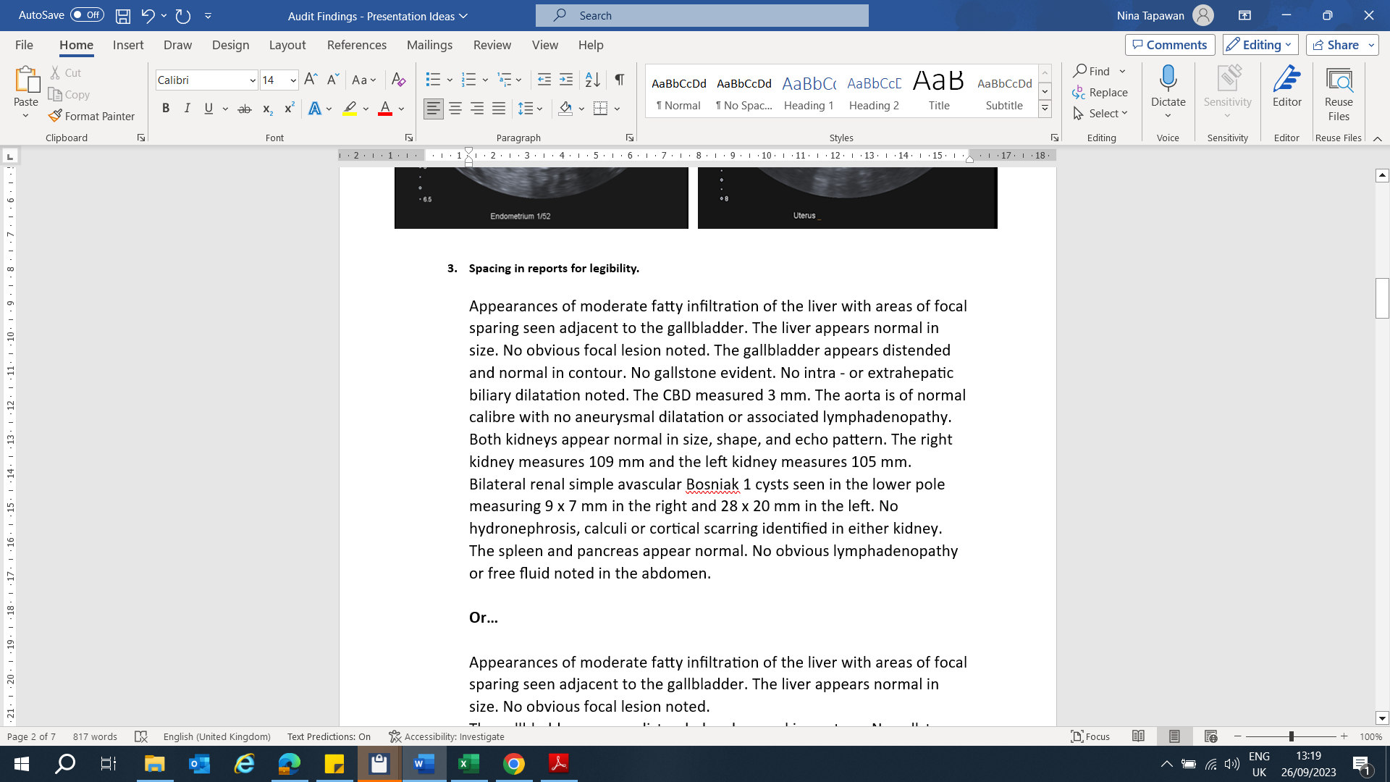
Themes & Trends
Report Quality
Notes:
So with that in mind lets review some images and reports and identify mistakes or areas for improvement….

Slide 8

Themes & Trends
Report Quality – Spacing

Slide 9
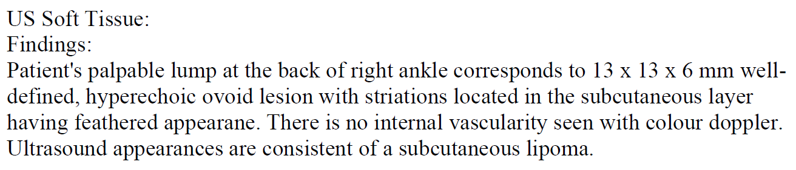
Themes & Trends
Report Quality

Slide 10
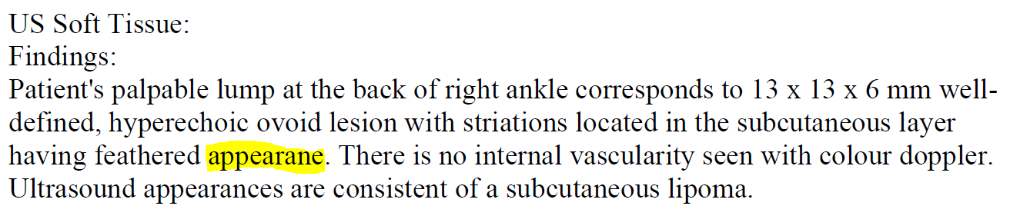
Themes & Trends
Report Quality – Spelling mistakes

Slide 11
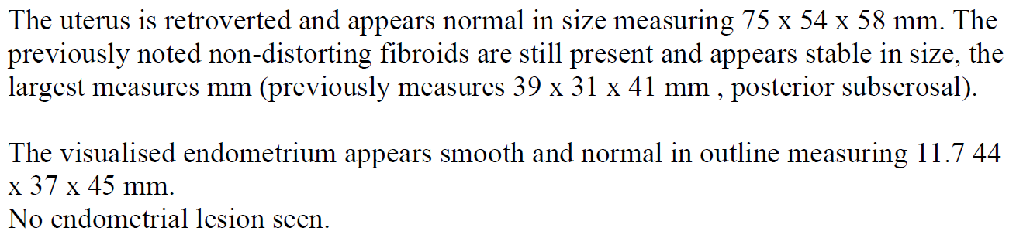
Themes & Trends
Report Quality

Slide 12
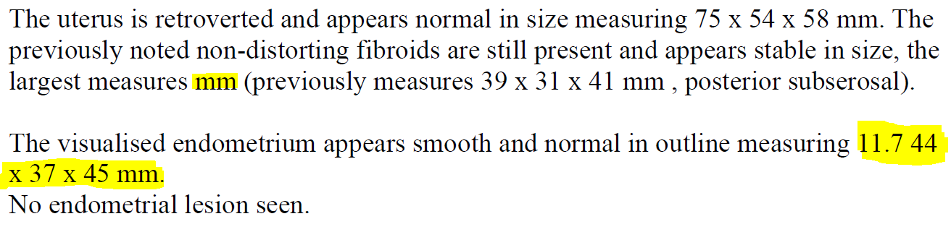
Themes & Trends
Report Quality – Typo mistakes / missing information

Slide 13
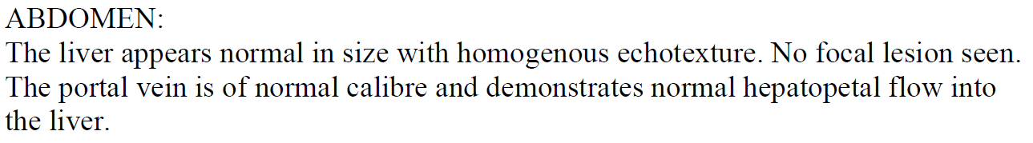
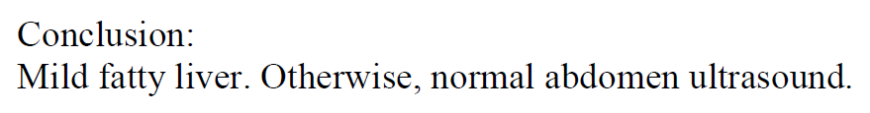
Themes & Trends
Report Quality

Slide 14



Themes & Trends
Report Quality – Conflicting information

Slide 15
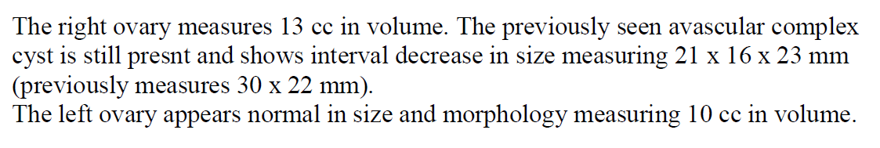
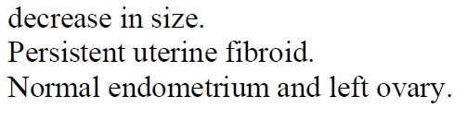
Themes & Trends
Report Quality

Slide 16






Themes & Trends
Report Quality – Typo mistakes / conflicting information

Slide 17
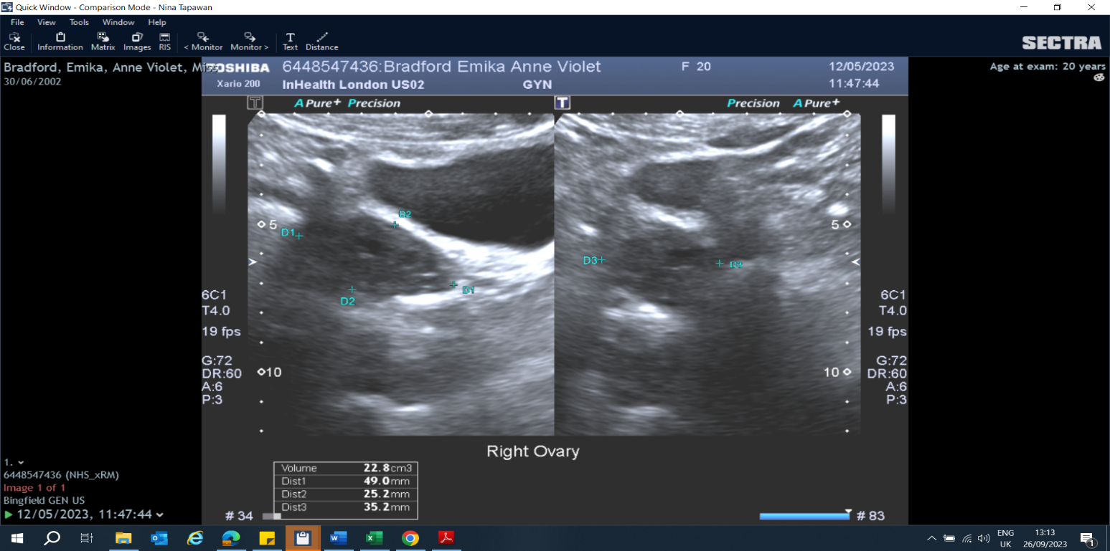
Themes & Trends
Overall Image Quality / Advice & Recommendations
Clinical Indications = ?PCOs
Patient declined TVUS
Are the images of sufficient diagnostic quality to make a definitive diagnosis?

Slide 18
Themes & Trends
Overall Image Quality / Advice & Recommendations
What is the best recommendation to give on this report?

Slide 19
Themes & Trends
Advice & Recommendations – Sub-optimal TA study
CONCLUSION:
Suboptimal transabdominal pelvic ultrasound due to underfilled bladder. The ovaries could not be accurately evaluated.
RECOMMENDATION:
A. A Transvaginal study is recommended for optimal evaluation of the ovaries.
B. A second attempt for transabdominal pelvic ultrasound with the patient fully prepared or preferably transvaginal approach if the patient will consent for optimal evaluation.

Slide 20
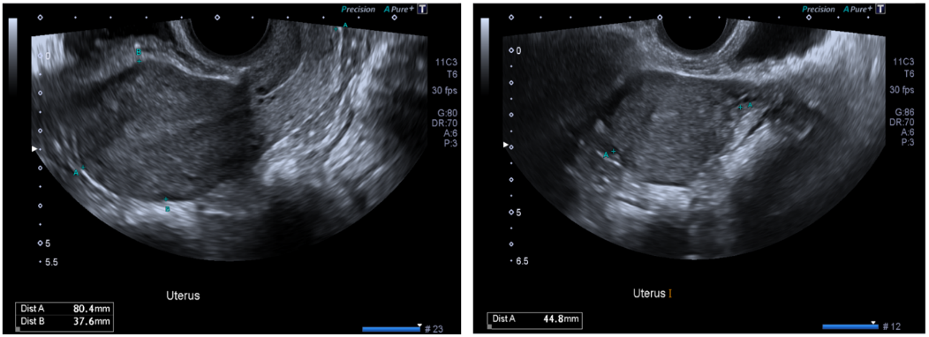
Themes & Trends
Report Quality
A = 80 X 37 X 44 mm
B = 80 X 37 X 44 mm
C = 80 X 38 X 44 mm
D = 80 X 38 X 45 mm

Slide 21
Themes & Trends
Report Quality – Typo mistakes / Accuracy
A = 80 X 37 X 44 mm
B = 80 X 37 X 45 mm
C = 80 X 38 X 44 mm
D = 80 X 38 X 45 mm

Slide 22
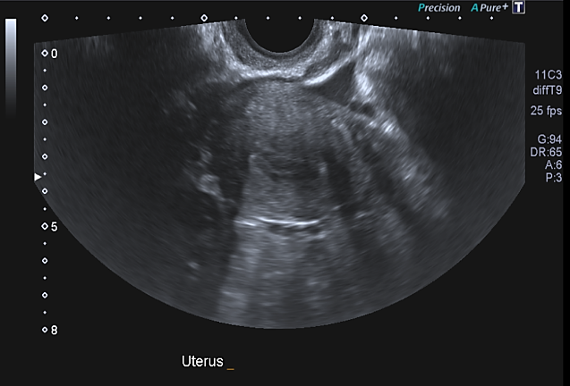
Themes & Trends
Specific Standard Quality – Include measurements on images

Slide 23
Themes & Trends
Report Quality
Conclusion;
The previously seen ovarian cyst is still present.

Slide 24
Themes & Trends
Report Quality – Comparative Study Information
Conclusion;
The previously seen ovarian cyst is still present.
Is the appearance stable?
2. Has there been a change in size (increase/decrease)?
- add volume measurements if necessary to help clarify.
3. Are there any changes in appearance?

Slide 25
Summary
  Everybody is doing a great job!
  Reporting errors are the main things that crop up in audit findings. This can be simple typo errors, wrong descriptors, or incorrect labelling (left or right).
  Recommendations may be inaccurate. There have been some updates with the protocols and changes to escalation, but everyone has the guidelines. If in doubt – make use of the second opinion team! People are available to help clarify.
  Proofread your reports – templates are great for saving time but be sure to read through the report once amended to eliminate any errors. Check your main body text supports your conclusion.
  Have you answered the GP’s clinical question?

Slide 26
Shout outs
  Krisch – “Well done for using linear probe for gallbladder pathology!”
  Sandy – “Good images performed!”
  “Overall good scanning by all the sonographers with some of the reports exceptionally good in clarity for clinicians and recommendation wise. So, WELL DONE TO EVERYONE ON THE TEAM.”
  Debra – “Good report!”
  Melanel – “Very well reported by sonographer given the difficulties!”
“Please let the sonographers know they are doing a great job with some of the reports being brilliantly put together. So, keep the good work going.”
Krisch – “Good pick up for pancreatic mass!”

