Slide 1

Asymptomatic Carotid Artery Screening: Con or Common Sense?
Matthew Adams
Camperdown Vascular Laboratory

Slide 2
Why the controversy?
Emotional language
For profit screening companies
Too many false positives
Questionable follow-up protocols
High cost to patient

Slide 3

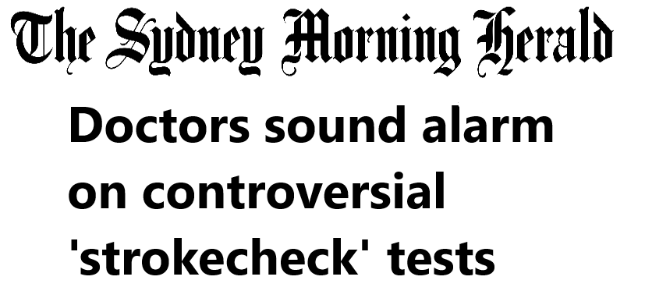
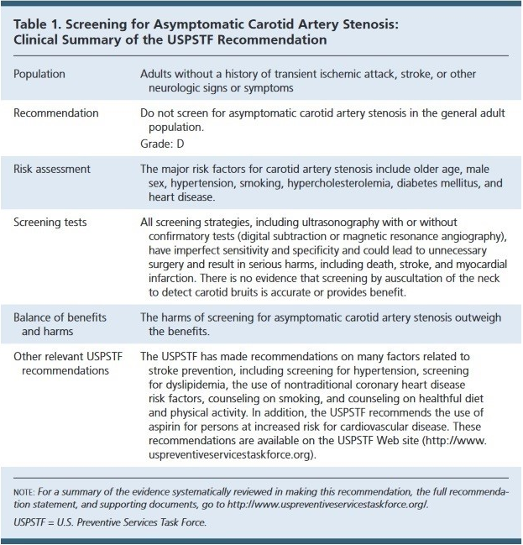

Slide 4
What IS the accuracy of carotid artery ultrasound?
Experience v inexperience
Specialised v non-specialised
Would it REALLY do more harm than good?
Should surgery be seen as the end point of asymptomatic carotid artery screening?

Slide 5
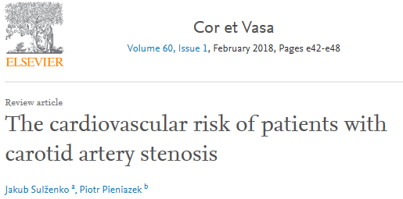
77% prevalence of CAD in those with asymptomatic CAS
3 x higher risk of CVD mortality than in matched population

Slide 6
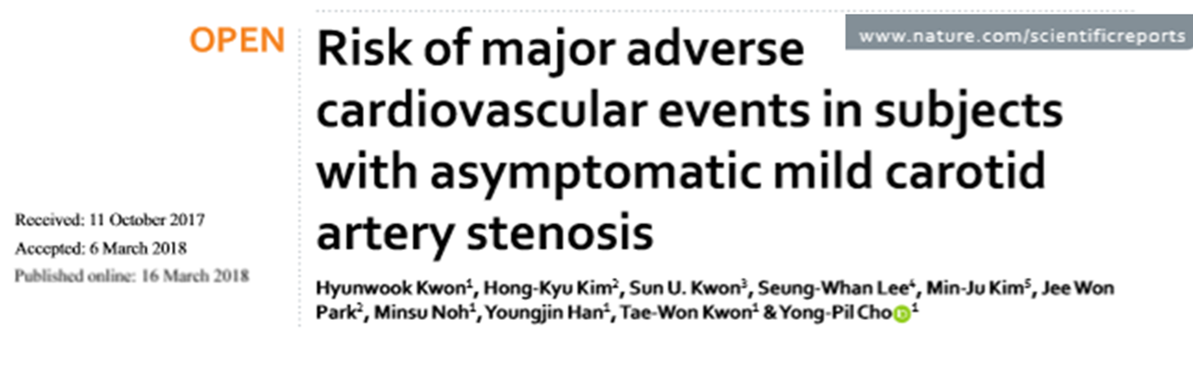
MACE in 13.8% and 15.9% in mild and moderate asymptomatic CAS
‘’carotid screening could be a useful tool in CV risk stratification’’

Slide 7

Currently used risk factor scores out of date and may underestimate risk
ANY amount of carotid plaque = 10year cardiac event risk >20% or ~2% annually

Slide 8
The way forward?
Prospective pilot study, n=100
Patients to be >40yo + 2 or more CV risk factors recruited from GPs
Haemodynamically significant plaque – Vascular review
Normal & non flow limiting plaques – Cardiology review + BMT + lifestyle coaching
Yearly follow up

