Slide 1

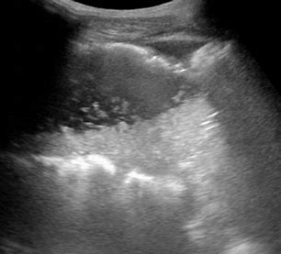

Artifacts in ultrasound

Slide 2
What is an artifact?
A false portrayal of the anatomy in an image
To correctly interpret the ultrasound image you should:
Recognise an artifact and acknowledge it for what it is
Be able to minimise it or take advantage of it
Have a knowledge of artifacts

Slide 3
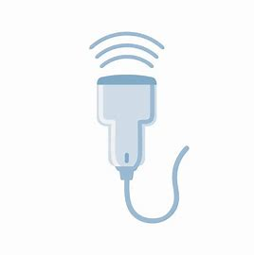
Machine basics
Pulse is sent into the tissue.
Depth of the reflector is determined by the time taken between the pulse being generated and the echo being received
Returning echoes are analysed and displayed as an image
Notes:
Blog not found (dizunishima.blogspot.com)

Slide 4
Basic assumptions made by the machine
1) The pulse travels in a straight line
2) Speed of sound is constant (1540 m/s)
3) Echoes are generated from the centre of the beam
4) The beam is small in height, width and slice thickness
5) Each reflector only generates one echo

Slide 5
Attenuation Artifacts
The intensity of the ultrasound decreases as the wave propagates through the body.
Attenuation can be due to reflection, scattering, absorption, refraction or any combination of these
Attenuation artifacts occur when attenuation is greater or lesser than expected
Greater attenuation = acoustic shadowing
Lesser attenuation = acoustic enhancement

Slide 6
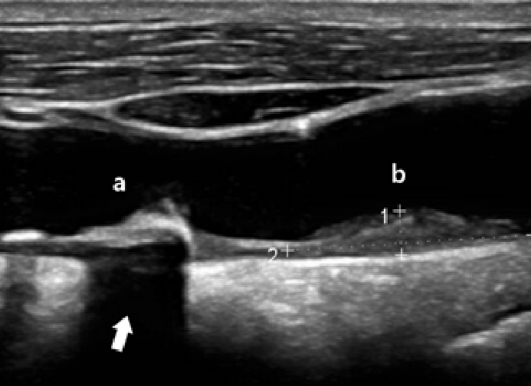
Acoustic Shadowing
Atherosclerotic plaques in distal common carotid artery. (a) Acoustic shadowing (arrow) caused by hyperechoic plaque with calcification. (b) Isoechoic plaque with smooth surface.
Atherosclerotic plaques in distal common carotid artery. (a) Acoustic shadowing (arrow) caused by hyperechoic plaque with calcification. (b) Isoechoic plaque with smooth surface.
Atherosclerotic plaques in distal common carotid artery. (a) Acoustic shadowing (arrow) caused by hyperechoic plaque with calcification. (b) Isoechoic plaque with smooth surface.
US beam encounters highly attenuating object (e.g. bone) or highly reflective structure (e.g. soft tissue/air)
Examples
Bone
Calcified structures
Gas
The apparent lack of signal deep to an imaged tissue interface, due to all (or nearly all) of the transmitted sound wave being reflected back to the transducer or absorbed by the tissue causing a ‘shadow’
Atherosclerotic plaques in distal common carotid artery. (a) Acoustic shadowing (arrow) caused by hyperechoic plaque with calcification. (b) Isoechoic plaque with smooth surface.
Notes:
acoustic shadowing ultrasound - Bing images

Slide 7
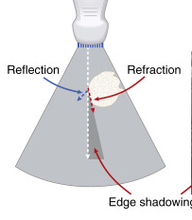
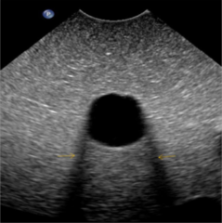
Edge Shadowing
Occurs at the edges of rounded tissue structures caused by reflection away from the beam at the boundary edge and refraction of the beam within the structure. These interactions result in an edge shadow.
Shadow occurs at the margin of a well defined structure
Can be reduced by compound imaging
Examples
Cysts
Aorta
Cluster of varicose veins
Is it useful?
No
Notes:
ultrasound artifacts Flashcards | Quizlet

Slide 8
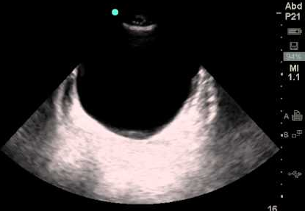
Acoustic Enhancement
Characteristic of fluid-filled structures such as cysts and the urinary bladder. The fluid attenuates the sound less than the surrounding tissue
Results in increased echoes deep to structures that transmit sound exceptionally well
Can be reduced by making changes to TGC
Examples
Bladder
Liver cysts
Is it useful?
Cyst identification
Notes:
DES instent restenosis: mechanisms and interventional management- Elias Hanna - YouTube

Slide 9
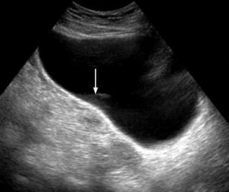
Beam-width Artifact
Occurs when a reflective object is located beyond the widened ultrasound beam, after the focal zone
Assumption that these echoes are from within the imaging plane and are displayed as overlapping the structure of interest
Can recognise this as an anechoic structure contains peripheral echoes
To reduce this artifact:
Adjust focus
Ensure transducer is at the centre of the object of interest
Notes:
https://radiologykey.com/ultrasound-imaging-2/
To understand this artifact, it is important to remember that the ultrasound beam is not uniform with depth, the main beam leaves the transducer with the same width as it, then narrows as it approaches the focal zone and widens again distal to this zone

Slide 10
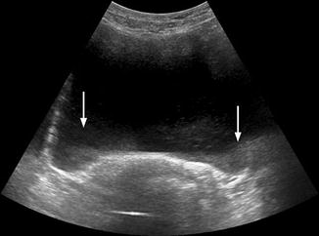
Slice Thickness Artifact
Information from the non-imaging plane is displayed on the 2D image
This is similar to the beam width artifact but occurs due to the thickness of the beam which is 90° to the scan plane
The transducer will receive echoes from either side of the intended slice and will be included in the displayed image
Can be reduced by using harmonic imaging and using a higher frequency transducer
Is it useful?
No
Notes:
These artifacts are displaced in front of and behind the assumed plane of origin. Increasing slice thickness will increase the number of artifactual echoes seen in the display.
https://radiologykey.com/ultrasound-imaging-2/

Slide 11
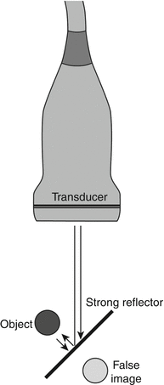
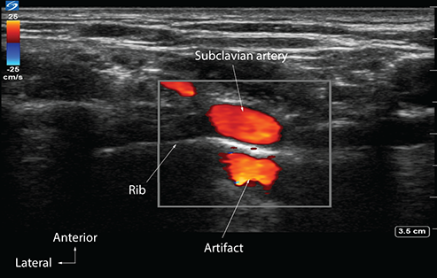
Mirror Image Artifacts
Caused by the false assumption that an echo returns to the transducer after a single reflection
US beam encounters a highly reflective interface, reflected echoes then encounter the back of a structure and reflected back to the strong reflector before being reflected to the transducer
Results in a duplicated structure deep to the strongly reflective interface
Is it useful?
No
Notes:
Regional anesthesia - Anesthesia Morbidity and Mortality
Can be visualised at the infraclavicular window.
Commonly seen during a carotid ultrasound

Slide 12
Reverberation Artifacts
US assumes that an echo returns to the transducer after a single reflection and the depth of the object is related to the time for this round trip
When the ultrasound beam encounters two, strong and parallel reflectors, the beam reflects back and forth between the two
As a result multiple echoes are recorded and displayed
Common reflectors; abdominal wall, gas, foreign bodies

Slide 13
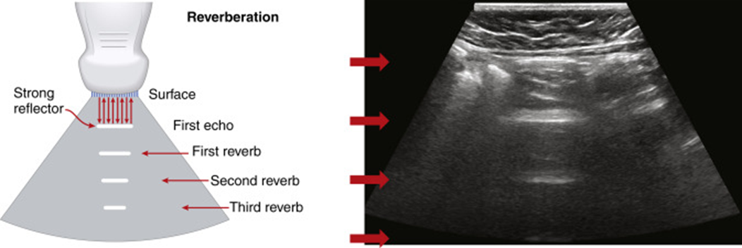
Reverberation Artifacts
Artifact often caused by reflections between a reflective interface and the transducer or between reflective interfaces, such as calcified tissues, or air pocket/partial liquid areas of the anatomy
Appear as multiple equally spaced parallel lines at progressive depth with decreasing amplitude
Notes:
https://radiologykey.com/ultrasound-artifacts/

Slide 14
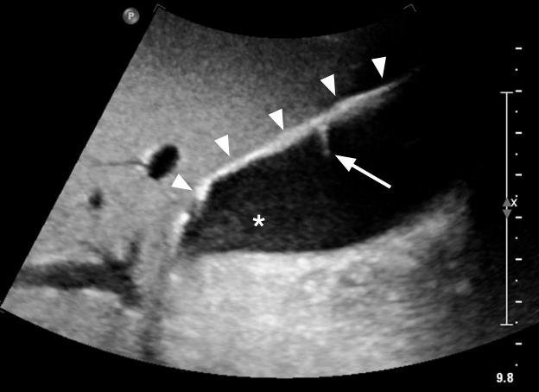
Comet Tail Artifact
Form of reverberation artifact. Multiple reflections (reverberations) occur between two reflective interfaces
Echoes are reflected back and forth repeatedly and are detected and displayed
Reflected echoes are displayed beneath the real reflector at intervals equal to the distance between the transducer and the real reflector
Each subsequent reflection is weaker than the previous one due to attenuation.
Seen as a tapering trail of echoes just distal to a strongly reflecting structure
Is it useful?
Identifying foreign objects
Notes:
https://radiologykey.com/ultrasound-artifacts/
Seen when there is a large difference in acoustic impedance between an object and its surrounding.
Useful in general ultrasound to identify abdominal pathology

Slide 15
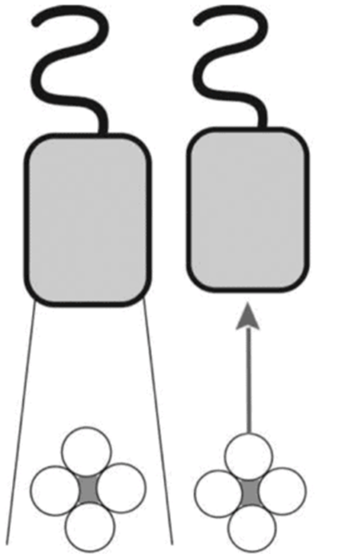
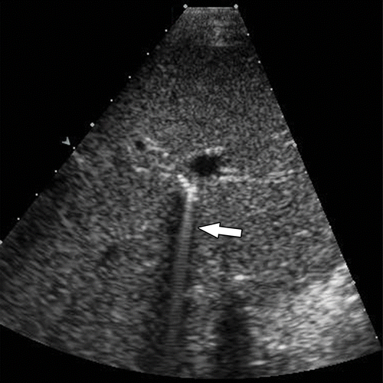
Ring Down Artifact
Transmitted ultrasound energy causes resonant vibrations within fluid trapped between air bubbles
Create a continuous sound wave transmitted back to the transducer
Displayed as a series of parallel bands extending posterior to a gas collection
Is it useful?
Identify abnormal collections of air
Notes:
Image shows ring-down in a liver
https://pubs.rsna.org/doi/abs/10.1148/rg.2017160175?journalCode=radiographics
https://www.pocus101.com/basic-principles-of-ultrasound-physics-and-artifacts-made-easy/

