Slide 1
Aortic Dissection
An ultrasound perspective

Slide 2
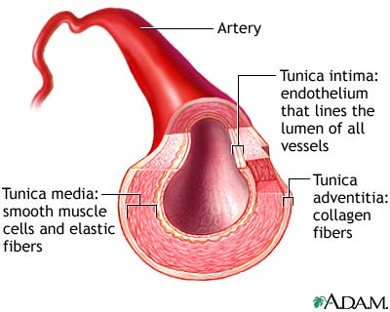
Anatomy - Arterial Walls
Arteries are composed of three different layers of tissue:
  The adventitia is the outer layer. It is predominantly composed of connective tissue with collagen and elastin.
  The media is the middle layer. It is the thickest layer, and composed of smooth muscle fibres and elastic tissue.
  The intima is the inner layer. It consists of a thin layer of endothelium overlying an elastic membrane.
Notes:
Vascular Ultrasound: How, Why and When
https://socratic.org/questions/blood-vessels-have-a-middle-layer-of-what-kind-of-muscle

Slide 3
Aortic Dissection - Overview
When a separation occurs in the intima of the aortic wall, causing blood to flow into a new false channel composed of the inner and outer layers of the media, this is known as an aortic dissection.
An aortic dissection is considered acute if the process is less than, or equal to, 14 days old.
Dissection most commonly occurs with a discrete intimal tear, but can occur without one.
From the initial intimal tear, aortic dissections can propagate distally towards the iliac arteries (antegrade dissection), proximally towards the aortic valve (retrograde dissection), or in both directions from the point of origin.
Notes:
If diagnosed after 14 days, it is deemed a chronic dissection.
https://bestpractice.bmj.com/topics/en-gb/445
https://teachmesurgery.com/vascular/arterial/aortic-dissection/

Slide 4
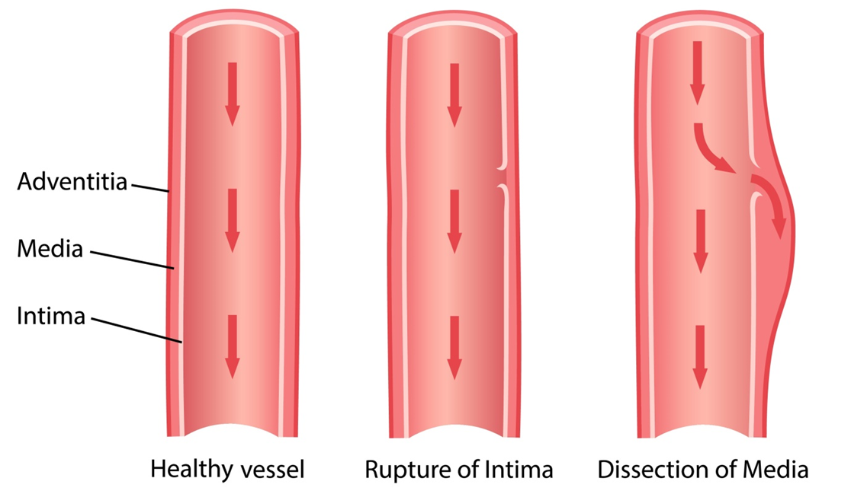
Aortic Dissection - Overview
Notes:
https://teachmesurgery.com/vascular/arterial/aortic-dissection/

Slide 5
Aortic Dissection - Epidemiology
The worldwide incidence of aortic dissection is between 0.5-2.95 cases per 100,000 people per year.
However, one prospective UK-based population study derived an incidence of 6 cases per 100,000 when out-of-hospital deaths were included.
Men are predominantly affected, typically those aged 50 or above.
The prognosis is grave, with 20% pre-admission mortality, and 30% in-hospital mortality.
Notes:
https://bestpractice.bmj.com/topics/en-gb/445/epidemiology
https://www.bmj.com/content/344/bmj.d8290.full.pdf+html

Slide 6
Aortic Dissection - Contributing Factors
Long-term arterial hypertension
Atherosclerosis
Dyslipidaemia
Smoking, drug abuse (cocaine / crack cocaine / amphetamine)
Hereditary connective tissue disorders:
  Marfan syndrome
  Loeys-Dietz syndrome
  Ehlers-Danlos syndrome
  Turner syndrome
Hereditary vascular diseases:
  Bicuspid aortic valve
  Coarctation
Notes:
https://www.sciencedirect.com/science/article/pii/S0140673614610059
https://www.thelancet.com/journals/lancet/article/PIIS0140673608609940/fulltext
https://bestpractice.bmj.com/topics/en-gb/445/aetiology
White men aged over 40 years with hypertension, or those under 40 with Marfan syndrome or bicuspid aortic valves, are at highest risk.
https://www.bmj.com/content/344/bmj.d8290.full.pdf+html
Hypertension, present in up to 72% of patients with AD, is the most important risk factor and causes increased shear forces that propagate the dissection.
https://www.ncbi.nlm.nih.gov/pmc/articles/PMC6682226/
The association between mutations in genes encoding the contractile apparatus of vascular smooth muscle cell and aortic dissection suggests that smooth muscle cell tone and function have an important role in the response of the aortic wall to stress. Furthermore, both annulo-aortic ectasia and bicuspid aortic valve have a genetic basis and are known to predispose to aortic dissection.
https://www.sciencedirect.com/science/article/pii/S0140673614610059
The risk factors most probably relate to a combination of inherited and acquired weakening of the aortic media and intimal disease.
https://www.thelancet.com/journals/lancet/article/PIIS0140673608609940/fulltext

Slide 7
Aortic Dissection - Contributing Factors
Vascular inflammation:
  Autoimmune disorders –
    Giant-cell arteritis
    Takayasu’s arteritis
    Behçet's disease
    Ormond’s disease
  Infection –
    Syphilis
    Tuberculosis
Deceleration trauma
  Car accident
  Fall from height
Notes:
https://www.sciencedirect.com/science/article/pii/S0140673614610059
https://www.thelancet.com/journals/lancet/article/PIIS0140673608609940/fulltext
https://bestpractice.bmj.com/topics/en-gb/445/aetiology

Slide 8
Aortic Dissection - Contributing Factors
Iatrogenic factors:
  Catheter or instrument intervention
  Valvular or aortic surgery –
    Side-clamping / cross-clamping / aortotomy
    Graft anastomosis
    Patch aortoplasty
Since pre-existing medial degeneration is an important risk factor in both conditions, patients may have an aneurysm prior to dissection.
However, most cases of acute dissection (>80%) develop in the absence of aneurysmal degeneration.
As a complication of acute dissection, the false lumen may later expand to form an aneurysm.
Notes:
https://www.sciencedirect.com/science/article/pii/S0140673614610059
https://www.thelancet.com/journals/lancet/article/PIIS0140673608609940/fulltext
https://bestpractice.bmj.com/topics/en-gb/445/aetiology
Most cases develop without aneurysmal degeneration and therefore factors other than ectasia (vessel dilation) predispose to acute dissection with intimal tearing, which is commonly preceded by medial degeneration or cystic medial necrosis.
https://www.sciencedirect.com/science/article/pii/S0140673614610059

Slide 9
Aortic Dissection - Pathophysiology
Studies suggest that aortic dissection is the end process of an array of different pathological processes, many of which promote weakening of, or increased stress on, the aortic wall (or both), causing a cycle of increasing wall stress.
The sequence of events might begin with a tear in a damaged intima.
  Atherosclerotic ulcers could potentially be an evolving stage in the development of such a tear.
  Alternatively, disruption of a vasa vasorum might result in an intramural haematoma, which could later rupture into the aortic lumen.
  However, many dissections probably develop without involvement of an intimal ulcer or intramural haematoma.
Notes:
https://www.thelancet.com/journals/lancet/article/PIIS0140673608609940/fulltext

Slide 10
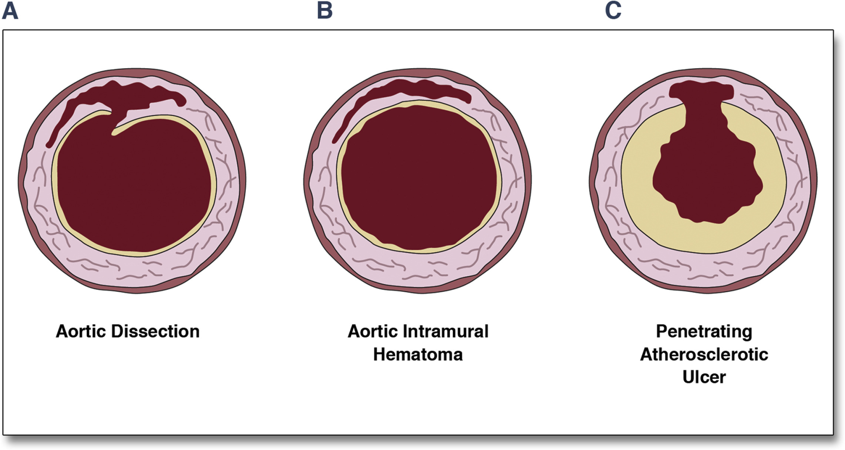
Aortic Dissection - Pathophysiology
Notes:
https://www.sciencedirect.com/science/article/pii/S1936878X14000692

Slide 11
Aortic Dissection - Pathophysiology
Once a dissection path has started, blood then passes through the media, extending distally or proximally (or both) for a variable distance, thus creating a false lumen.
The principle complications of aortic dissection are aortic rupture, cardiac failure (aortic regurgitation, acute myocardial infarction, or tamponade), and end-organ ischaemia.
The aorta gives rise to many important branches that supply oxygenated blood to the heart (coronary arteries), arms (subclavian arteries), brain (carotid and vertebral arteries), spinal cord (lumbar arteries), viscera (coeliac and mesenteric arteries), kidneys (renal arteries), and legs (iliac arteries).
Notes:
https://www.thelancet.com/journals/lancet/article/PIIS0140673608609940/fulltext
https://bestpractice.bmj.com/topics/en-gb/445/aetiology

Slide 12
Aortic Dissection - Pathophysiology
As the dissection propagates, flow through the false lumen can occlude flow through the branches of the aorta. A number of clinical manifestations may then occur, depending on the extent of the dissection and subsequent organ malperfusion.
Notes:
https://bestpractice.bmj.com/topics/en-gb/445/aetiology

Slide 13
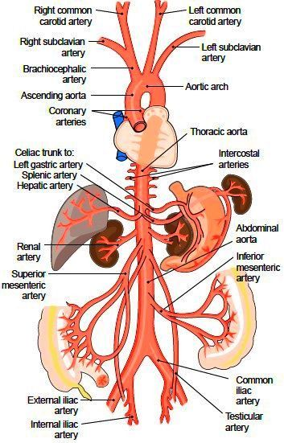
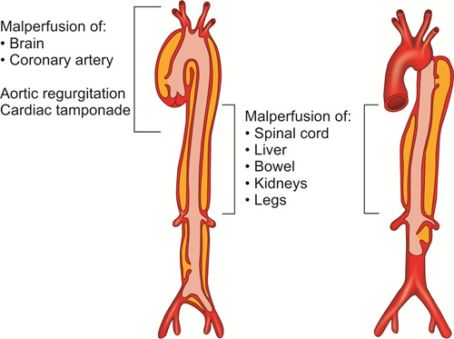
Aortic Dissection - Pathophysiology
Notes:
http://encyclopedia.lubopitko-bg.com/Systemic_Arteries.html
https://www.thelancet.com/journals/lancet/article/PIIS0140673608609940/fulltext

Slide 14
Aortic Dissection - Classification
Aortic dissection can be classified both in terms of its anatomical location (i.e. the site of the intimal tear) and the extent of propagation.
There are a number of classification systems available, of which Stanford and DeBakey are amongst the most traditional and widely used.
Decisions regarding surgical vs. non-surgical management are driven by these anatomical classification systems. As such, they are essential to planning treatment and managing patient outcomes.
Notes:
https://www.sciencedirect.com/science/article/pii/S0140673614610059
https://www.sciencedirect.com/science/article/pii/S0140673608609940
The DeBakey classification system categorises dissections on the basis of the origin of the intimal tear and the extent of the dissection, and the Stanford system divides dissections according to whether the ascending aorta is involved (type A) or not (type B) involved.
For the purposes of classification, the ascending aorta refers to the part of the aorta proximal to the brachiocephalic artery and the descending aorta refers to the aorta distal to the left subclavian artery.
https://www.sciencedirect.com/science/article/pii/S0140673614610059

Slide 15
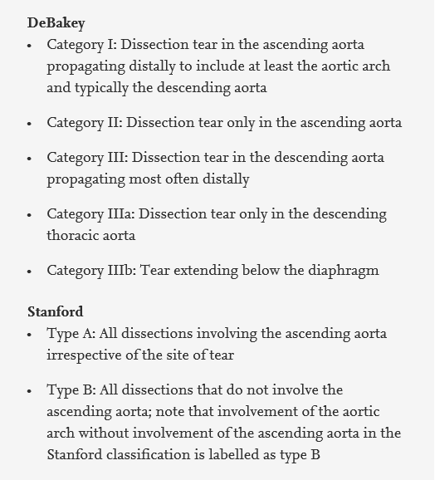
Aortic Dissection - Classification
Notes:
https://www.sciencedirect.com/science/article/pii/S0140673614610059
The DeBakey classification system categorises dissections on the basis of the origin of the intimal tear and the extent of the dissection, and the Stanford system divides dissections according to whether the ascending aorta is involved (type A) or not (type B) involved.
For the purposes of classification, the ascending aorta refers to the part of the aorta proximal to the brachiocephalic artery and the descending aorta refers to the aorta distal to the left subclavian artery.
https://www.sciencedirect.com/science/article/pii/S0140673614610059

Slide 16
Aortic Dissection - Presentation
Acute aortic dissection typically presents as an abrupt onset of chest or back pain, which may be described as sharp, tearing, or ripping. However, the presentation can be diverse, and approximately 10% of patients do not complain of pain.
No single symptom of aortic dissection is pathognomonic for the condition, as there is significant overlap with cardiac, pulmonary, abdominal, and musculoskeletal disorders. As such, diagnosis on the basis of clinical history and examination is not straightforward.
Rapid, accurate, non-invasive testing is therefore essential to reaching a prompt diagnosis, which is vital as urgent surgical intervention may be needed, and missing the diagnosis can be catastrophic.
Notes:
https://www.sciencedirect.com/science/article/pii/S0140673608609940
https://bestpractice.bmj.com/topics/en-gb/445/diagnosis-approach
Most patients have prior hypertension, often poorly controlled. Younger patients may have a connective-tissue disorder, or a recent history of heavy lifting or cocaine use. Family history may reveal aortic aneurysms, dissection, or a connective-tissue disorder.
The pain associated with aortic dissection may be located retrosternally, interscapularly, or in the lower back. Anterior chest pain is typically associated with an ascending dissection; interscapular pain usually occurs with a descending dissection. Pain may migrate through the thorax or abdomen, and the location of pain may change with time as the dissection extends. A minority of patients present with syncope or without pain. It is important to recognise that no single symptom of aortic dissection is pathognomonic for the condition, as there is overlap with cardiac, pulmonary, abdominal, and musculoskeletal disorders.
Patients may be haemodynamically stable or in hypovolaemic shock. Blood pressure differences in the upper extremities or pulse deficits in the lower extremities should be sought. Neurological deficits may indicate involvement of cerebral or intercostal vessels. There may be depressed mental status, limb pain, paraesthesia, weakness, or paraplegia. Symptoms of visceral ischaemia may be present. Occasionally, a diastolic decrescendo murmur may be discovered, indicating aortic insufficiency. There may be symptoms or signs of heart failure, pericardial tamponade, or a left pleural effusion.
One systematic review identified neurological deficit, hypotension, and a pulse deficit as the three clinical examination findings with the highest positive likelihood ratios for aortic dissection.
https://bestpractice.bmj.com/topics/en-gb/445/diagnosis-approach

Slide 17
Aortic Dissection - Diagnosis
Initial work-up often includes a chest x-ray (CXR), electrocardiogram (ECG), and blood tests (including cardiac enzymes and D-dimer).
If aortic dissection is suspected on the basis of the patient’s history and/or initial investigations, computed tomography angiography (CTA) is the primary modality used for diagnosis.
CTA has a sensitivity greater than 90% and a specificity greater than 85%.
CTA is fast, widely available, and relatively non-invasive. It provides important information about the extent of the dissection, the relationship between the true and false lumen, and the presence of aortic branch compromise.
Notes:
https://bestpractice.bmj.com/topics/en-gb/445/diagnosis-approach
https://www.sciencedirect.com/science/article/pii/S0140673614610059
https://www.sciencedirect.com/science/article/pii/S0140673608609940
Initial work-up includes chest x-ray, ECG, and cardiac enzymes to exclude pneumonia or myocardial infarction.
Blood tests including a complete metabolic panel and full blood count, including blood type and cross match, should also be requested. Despite a high sensitivity, D-dimer is not recommended as the sole screening tool for acute aortic dissection; while negative D-dimer may be helpful to rule out aortic dissection in low-risk patients, particularly when used within an integrated decision support tool, a positive D-dimer lacks specificity when used in isolation. However, D-dimer will be of value when considering the differential diagnosis (e.g., pulmonary embolus). Other biomarkers with the potential to assist in the diagnosis of aortic dissection include C-reactive protein, elastin degradation products, calponin, and smooth muscle myosin heavy chain, but none of these have been validated.
https://bestpractice.bmj.com/topics/en-gb/445/diagnosis-approach

Slide 18
Aortic Dissection - Diagnosis
For type A dissections, transoesophageal echocardiography (TOE) may be useful to confirm the diagnosis and to better evaluate the aortic valve.
Magnetic resonance angiogram (MRA) is the most accurate, sensitive, and specific test for aortic dissection, but is rarely used in the acute setting because it is more difficult to obtain than CTA.
Transthoracic echocardiography (TTE) may be used in certain scenarios if the patient is clinically unstable and there is any question about the diagnosis, or if CTA is unavailable or contraindicated.
Notes:
https://bestpractice.bmj.com/topics/en-gb/445/diagnosis-approach
Trans-thoracic echocardiography (TTE) may be used in the emergency department, intensive care unit (ICU), or operating theatre for acute proximal dissections if the patient is clinically unstable and there is any question about the diagnosis, or if CTA is unavailable or contraindicated.
https://bestpractice.bmj.com/topics/en-gb/445/diagnosis-approach
For type A dissections (ascending), trans-oesophageal echocardiography may be done in the ICU or operating theatre to confirm the diagnosis and better evaluate the aortic valve. Sensitivity and specificity are higher than for TTE.
https://bestpractice.bmj.com/topics/en-gb/445/diagnosis-approach

Slide 19
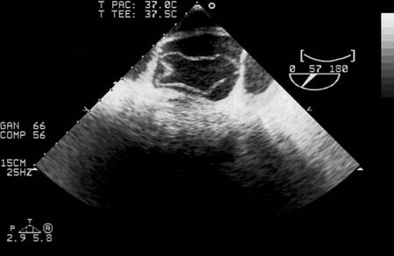
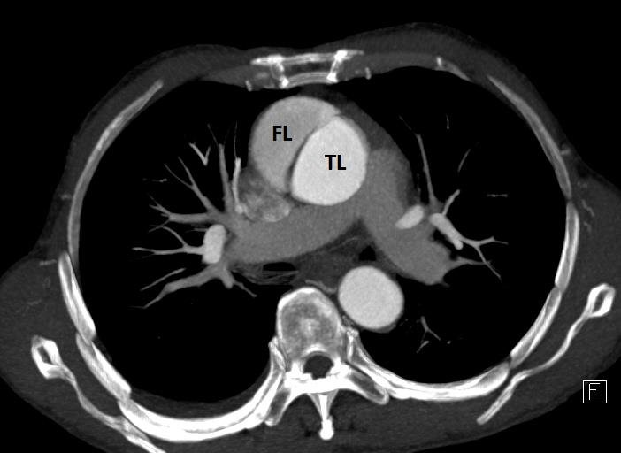
Aortic Dissection - Diagnosis
TOE
CTA
Notes:
https://bestpractice.bmj.com/topics/en-gb/445/diagnosis-approach
https://www.researchgate.net/figure/Stanford-type-A-aortic-dissection-in-a-55-year-old-man-with-chest-pain-symptom-A-2D_fig2_335760314
Left image:
Trans-oesophageal echocardiography (transverse aortic section) showing a circumferential dissection of the ascending aorta in a 30-year-old patient with features of Marfan syndrome.
https://bestpractice.bmj.com/topics/en-gb/445/diagnosis-approach
Right image:
Stanford type A aortic dissection in a 55-year-old man with chest pain symptom. 2D axial image shows dissection in the ascending aorta with high CT attenuation in the true lumen (TL) compared to relatively low attenuation in the false lumen (FL).
https://www.researchgate.net/figure/Stanford-type-A-aortic-dissection-in-a-55-year-old-man-with-chest-pain-symptom-A-2D_fig2_335760314

Slide 20

Aortic Dissection - Diagnosis
Is there a role for transabdominal ultrasound?
Notes:
https://www.sciencedirect.com/science/article/pii/S0735675717304345
https://www.sciencedirect.com/science/article/pii/S0736467906006561
https://www.sciencedirect.com/science/article/pii/S0736467913005246
https://www.ncbi.nlm.nih.gov/pmc/articles/PMC6682226/
https://link.springer.com/article/10.1186/2036-7902-4-S1-A14
https://onlinelibrary.wiley.com/doi/full/10.1111/j.1553-2712.2009.00448.x
https://escholarship.org/content/qt0js2h9v8/qt0js2h9v8.pdf
https://www.italjmed.org/index.php/ijm/article/view/itjm.2020.1379/1347
https://cdn.mdedge.com/files/s3fs-public/em049030135.pdf
https://theultrasoundjournal.springeropen.com/articles/10.1007/s13089-009-0010-y
https://www.sciencedirect.com/science/article/pii/S0736467917307175

Slide 21
Aortic Dissection - Ultrasound
In the context of the emergency department (ED), there are numerous case studies to support the use of point-of-care ultrasound (POCUS) for the rapid detection of aortic dissection.
Aortic dissection often presents a diagnostic dilemma for emergency clinicians, due to its variable, non-specific, and occasionally subtle presentation.
While CTA remains the primary imaging modality in such cases, patient instability or low clinical suspicion may prevent or delay this course of action.
To further compound the issue, there is an estimated 1-2% increase in mortality for every hour the diagnosis is delayed. Timely diagnosis is, therefore, pivotal.
Notes:
https://www.ncbi.nlm.nih.gov/pmc/articles/PMC6682226/
https://www.sciencedirect.com/science/article/pii/S0736467906006561
https://link.springer.com/article/10.1186/2036-7902-4-S1-A14
Sullivan et al. concluded that emergency physicians suspected the diagnosis in only 43% of patients that presented with an AD as a result of patients’ non-specific presentations.
https://www.sciencedirect.com/science/article/pii/S0736467906006561
Clinical variability contributes to emergency physicians’ suspicion for AD in confirmed cases being at only 43%.
https://www.ncbi.nlm.nih.gov/pmc/articles/PMC6682226/
In particular, the mortality rate secondary to thoracic aortic dissection is high and above all time-dependent, increasing from 1% to 1.4% for each hour of delay in treatment, and in any case up to 68% in the first 48 hours.
https://www.italjmed.org/index.php/ijm/article/view/itjm.2020.1379/1347
Untreated AD mortality rates approach 25% at 24 hours and 75% by two weeks.
https://www.ncbi.nlm.nih.gov/pmc/articles/PMC6682226/
If untreated, patients with proximal aorta involvement have a two-week mortality rate of approximately 80%.
https://escholarship.org/content/qt0js2h9v8/qt0js2h9v8.pdf
If unrecognized and untreated, aortic dissection results in a 90% mortality with in the first 3 months, usually due to acute aortic insufficiency, major branch vessel occlusion, or rupture into the pericardium, mediastinum, or left hemithorax.
https://theultrasoundjournal.springeropen.com/articles/10.1007/s13089-009-0010-y
Differentiating an acute STEMI from an aortic dissection can be extremely difficult in the ED. It is important not to delay reperfusion therapy for patients with a true STEMI (ST-Elevation Myocardial Infarction); however, the same treatment can be lethal for patients with aortic dissection.
https://www.sciencedirect.com/science/article/pii/S0736467917307175

Slide 22
Aortic Dissection - Ultrasound
Increasingly, POCUS is being used as part of the initial ED work-up for aortic dissection, especially in haemodynamically unstable patients, or patients with an atypical clinical presentation.
The key benefit of POCUS is that it can be performed rapidly and non-invasively at the patient’s bedside. It is an effective tool for narrowing the list of differential diagnoses, thus directing and optimising further investigations and, by extension, the patient’s management.
There are numerous sonographic signs for aortic dissection and, when multiple views are obtained via transthoracic and transabdominal ultrasound, POCUS has the potential to accurately diagnose this condition.
Notes:
https://link.springer.com/article/10.1186/2036-7902-4-S1-A14
https://www.ncbi.nlm.nih.gov/pmc/articles/PMC6682226/
Current imaging techniques, of which computed tomography angiography (CTA) represents the gold standard, can recognize or exclude alterations of the aortic wall with great efficacy; however the patient needs adequate selection.
https://www.italjmed.org/index.php/ijm/article/view/itjm.2020.1379/1347
Emergency ultrasound (EUS) has been shown to be useful in the diagnosis of abdominal aortic aneurysm (AAA). Ultrasound of the aorta is included as a primary study for emergency ultrasound by the American College of Emergency Physicians. As emergency physicians ultrasound the abdominal aorta to evaluate for aneurysm, other pathologies may be found.
https://www.sciencedirect.com/science/article/pii/S0736467906006561
Because one-third of the cases of aortic dissection extend into the abdominal aorta, these would be expected to be seen on transabdominal imaging of the aorta.
https://www.sciencedirect.com/science/article/pii/S0736467906006561
Numerous studies have documented a sensitivity of 67–80% and a specificity of 99–100% for the diagnosis of AD by transthoracic and transabdominal ultrasound when an undulating intimal flap is visualized.
https://www.sciencedirect.com/science/article/pii/S0736467906006561
https://escholarship.org/content/qt0js2h9v8/qt0js2h9v8.pdf
Evaluation of transthoracic and transabdominal ultrasound for aortic dissection shows that aortic root dilatation has a sensitivity of 77% and
specificity of 95%, and visualization of an intimal flap has a sensitivity of 67% to 80% and a specificity of 99% to 100%.
https://cdn.mdedge.com/files/s3fs-public/em049030135.pdf
Emergency physicians must maintain a high index of suspicion and use available resources, including point-of-care ultrasound (POCUS).
https://www.ncbi.nlm.nih.gov/pmc/articles/PMC6682226/

Slide 23
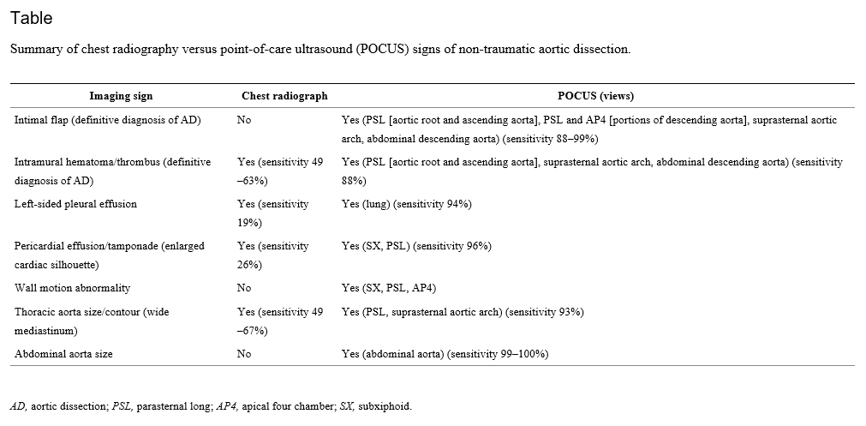
Aortic Dissection - Ultrasound
Notes:
https://www.ncbi.nlm.nih.gov/pmc/articles/PMC6682226/
POCUS is readily available, provides rapid evaluation and dynamic imaging for emergency physicians, and lacks the need for contrast or ionizing radiation. It is most critical in patients with undifferentiated shock where a protocol exists that includes an evaluation of the heart, lung, and aorta. TTE, lung, and transabdominal aorta POCUS views can show the following sonographic findings diagnostic of, or as a consequence of, AD: intimal flap separating the true and false lumens (sensitivity 67–79%; specificity 99–100%); aorta dilation (sensitivity 95%); intra-aorta thrombus; pericardial effusion (sensitivity 96%, specificity 98%); aortic regurgitation; wall motion abnormalities; and left pleural effusion (accuracy 93%).
https://www.ncbi.nlm.nih.gov/pmc/articles/PMC6682226/

Slide 24
Aortic Dissection - Summary
In summary:
  Aortic dissection is a condition with a relatively low incidence, but a relatively high mortality rate.
  Indeed, the risk of mortality increases over time, so the need for prompt diagnosis and treatment (whether that be medical, surgical, or endovascular) is self-evident.
  Unfortunately, the presenting signs and symptoms are highly variable and non-specific, so the diagnosis of aortic dissection is often missed during the initial evaluation.
  The initial work-up is often comprised of a physical examination, blood tests, and CXR. Though sometimes helpful, these tests are limited, and often prove to be unreliable.
  By comparison, the sensitivity of CTA, MRI, and TOE is far greater. Indeed, CTA is deemed the primary imaging modality in such cases.
Notes:
https://theultrasoundjournal.springeropen.com/articles/10.1007/s13089-009-0010-y
If unrecognized and untreated, aortic dissection results in a 90% mortality with in the first 3 months, usually due to acute aortic insufficiency, major branch vessel occlusion, or rupture into the pericardium, mediastinum, or left hemithorax.
https://theultrasoundjournal.springeropen.com/articles/10.1007/s13089-009-0010-y
Consequently, several studies have shown that the diagnosis of aortic dissection has been missed in up to 38% of patients on initial evaluation.
https://theultrasoundjournal.springeropen.com/articles/10.1007/s13089-009-0010-y
Timely lab and imaging tests for AD evaluation have limitations. Some evidence shows that D-dimer may help when matched with the AD detection risk score, while troponin can be an indirect marker for patients with resultant myocardial ischemia. Advanced imaging would still be required. As with our patient, the absence of aortic dilation does not exclude AD diagnosis, with a normal CXR occurring in 12.4% of patients with AD and mostly in those who have a normal aorta size.
https://www.ncbi.nlm.nih.gov/pmc/articles/PMC6682226/

Slide 25
Aortic Dissection - Summary
  However, these tests may not be readily available in the emergent setting, or the patient may be too unstable. Furthermore, low clinical suspicion may keep the patient from receiving the right test at the right time.
  POCUS can be performed quickly and non-invasively at the patient’s bedside, which represents a distinct advantage. Furthermore, POCUS is dynamic and does not require ionising radiation or contrast agents.
  Since POCUS is already used in the emergency department on a routine basis, it is well-established in this context.
  Though the sensitivity of POCUS (using a combined transthoracic and transabdominal approach) is comparatively modest, it nonetheless represents a valuable screening tool.
  POCUS can be used to narrow the list of differential diagnoses and, if an aortic dissection is discovered, the patient can then be managed quickly and accordingly.
Notes:
https://theultrasoundjournal.springeropen.com/articles/10.1007/s13089-009-0010-y
https://www.sciencedirect.com/science/article/pii/S0736467906006561
https://www.ncbi.nlm.nih.gov/pmc/articles/PMC6682226/
With imaging advances, there has been increased utilization of CTA (used as the initial imaging modality in 61% of patients), magnetic resonance imaging (MRI), and echocardiography (transesophageal [TEE] and/or transthoracic [TTE]), used as the initial imaging modality in 33% of patients. CTA and MRI imaging may not be readily available, while TEE requires mobilizing resources and sedation and cannot assess the abdominal aorta. Ultimately, IRAD showa that most patients required more than one imaging study.
https://www.ncbi.nlm.nih.gov/pmc/articles/PMC6682226/
POCUS demonstrates the extent of the dissection, with color Doppler showing differences of blood flow between the true and false lumen, further increasing diagnostic sensitivity. POCUS is distinctly able to visualize an intimal flap, which is required for the definitive diagnosis of AD. The dynamic nature of POCUS allows for flap assessment in several angles and locations to ensure that flap motion is independent of surrounding structures, is pulsatile, and is contained within the aorta. Characterization of the false lumen of AD by POCUS involves visualization of a wedge-like angle where the flap meets the aortic wall (“beak sign”) and strand-like structures in the lumen (“cobwebs”).
https://www.ncbi.nlm.nih.gov/pmc/articles/PMC6682226/
POCUS applications, including those needed for AD evaluation, are part of the list of ultrasound applications expected for emergency physician training and privileging under the American College of Emergency Physicians.
https://www.ncbi.nlm.nih.gov/pmc/articles/PMC6682226/
Whereas the primary use of abdominal aortic ultrasound by emergency physicians is to establish the diagnosis of acute AAA, other aortic pathology may be seen, including AD. Emergency physicians are also familiar with diagnosing pericardial effusion.
https://www.sciencedirect.com/science/article/pii/S0736467906006561
POCUS has shown promise as a fast and easily accessible screening tool that has a high specificity for the diagnosis of aortic dissection. Because of its low sensitivity, POCUS should not be used in isolation to rule out aortic dissection.
https://www.sciencedirect.com/science/article/pii/S0736467917307175

Slide 26
Aortic Dissection - Summary
  If the best outcome is to be achieved for the patient, emergency clinicians must maintain a high index of suspicion, and make the best use of available resources, including POCUS. This rapid, non-invasive technique may aid in the early detection and treatment of this complex (and often deadly) condition.
Notes:
https://www.ncbi.nlm.nih.gov/pmc/articles/PMC6682226/
https://escholarship.org/content/qt0js2h9v8/qt0js2h9v8.pdf
Emergency physicians must maintain a high index of suspicion and use available resources, including point-of-care ultrasound (POCUS).
https://www.ncbi.nlm.nih.gov/pmc/articles/PMC6682226/

Slide 27
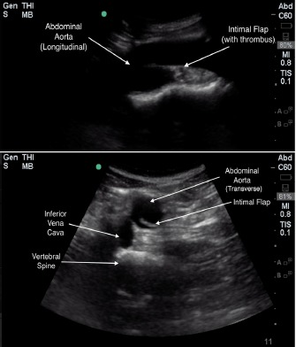
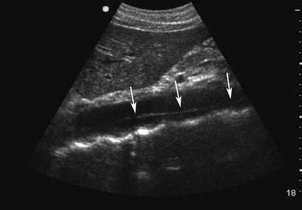
Aortic Dissection - Ultrasound
Notes:
https://www.ncbi.nlm.nih.gov/pmc/articles/PMC6682226/
https://theultrasoundjournal.springeropen.com/articles/10.1007/s13089-009-0010-y/figures/1
Transverse (bottom) and longitudinal (top) views of abdominal aortic dissection with intimal flap floating in true lumen.
https://www.ncbi.nlm.nih.gov/pmc/articles/PMC6682226/
A flap is seen in the long axis view of the abdominal aorta (arrows), extending the length of the aorta.
https://theultrasoundjournal.springeropen.com/articles/10.1007/s13089-009-0010-y/figures/1

Slide 28
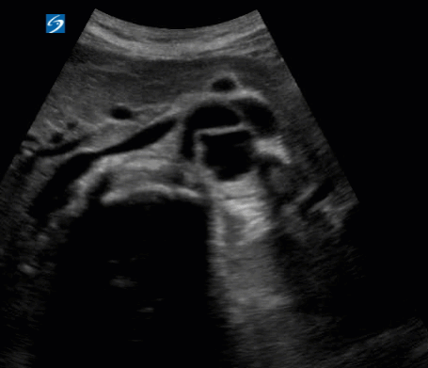
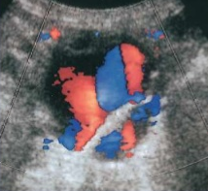
Aortic Dissection - Ultrasound
Notes:
https://med.emory.edu/departments/emergency-medicine/sections/ultrasound/image-of-the-fortnight/abdominal/aortic-dissection-jan-2018.html
https://www.slideshare.net/shaffar75/doppler-ultrasound-of-lower-limb-arteries

Slide 29
Aortic Dissection - Ultrasound
Notes:
NAAASP – 462 866 7691

Slide 30
Aortic Dissection - Ultrasound
Notes:
NAAASP – 462 866 7691

Slide 31
The Report
The ultrasound report should include the following:
  The maximum AP diameter of the abdominal aorta, stipulating how the aorta was measured.
  Patency (or lack thereof) of the false lumen.
  The minimum AP diameter of the true lumen.
  Any other relevant features, such as the location and extension of the dissection.
  The scan limitations, where applicable.
Notes:
“The maximum AP diameter of the abdominal aorta, stipulating how the aorta was measured.” – Refer to the Abdominal Aorta US Presentation for more details.
“Patency (or lack thereof) of the false lumen.” – Indicate whether the false lumen is patent or thrombosed.
“The minimum AP diameter of the true lumen.” – It may be difficult to identify which is the true lumen, in which case, this should be indicated in the report. Provide the minimum diameter, as this may be relevant if the reduction in calibre is flow limiting.
“Any other relevant features, such as the location and extension of the dissection.” – For example, proximal/mid/distal abdominal aorta.

Slide 32

Any questions?
Notes:
https://aircto.com/blog/importance-of-follow-up-questions/

