Slide 1
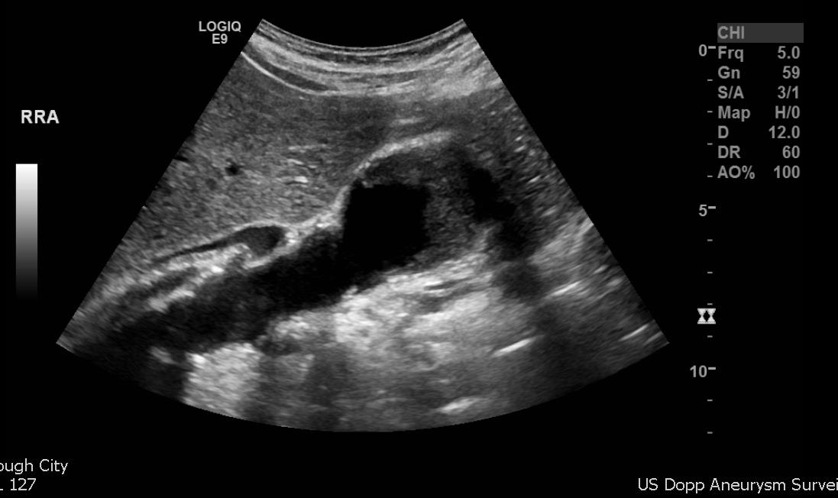
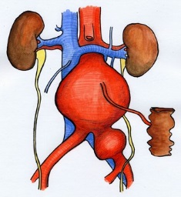
Aneurysms:
SCANNING pitfalls and repair

Slide 2
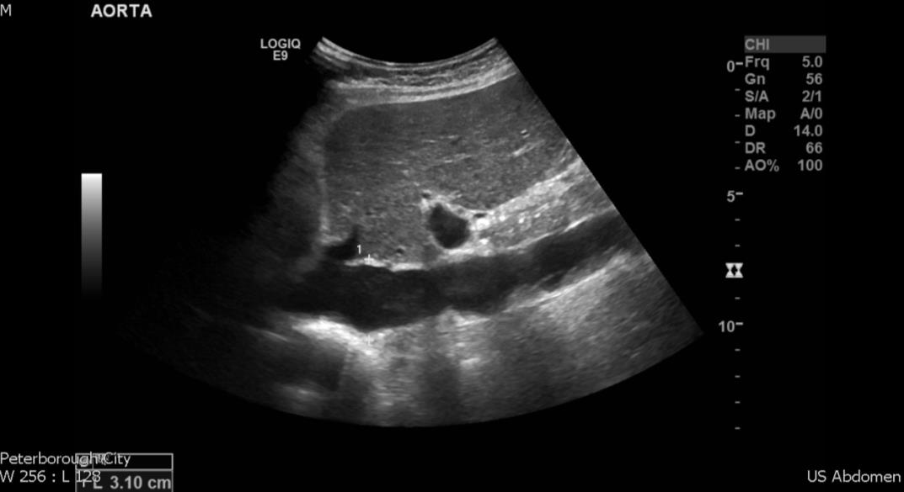
Aorta/IVC

Slide 3
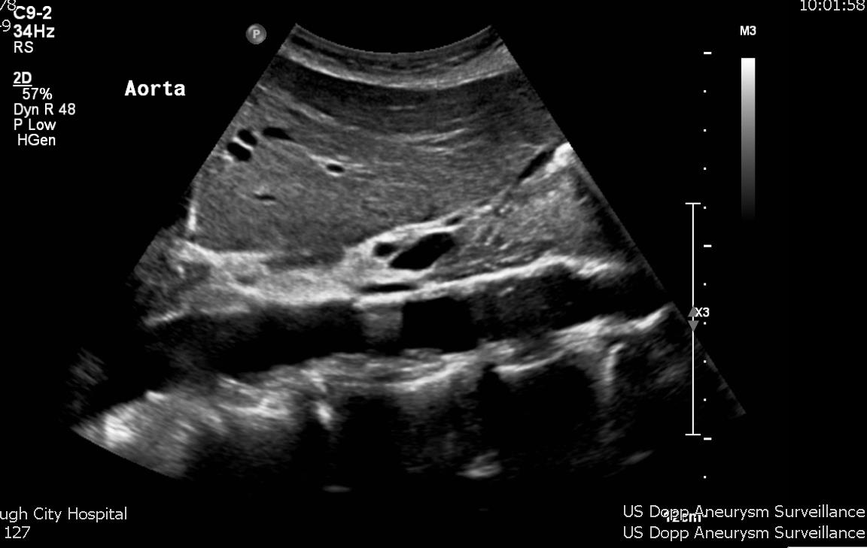
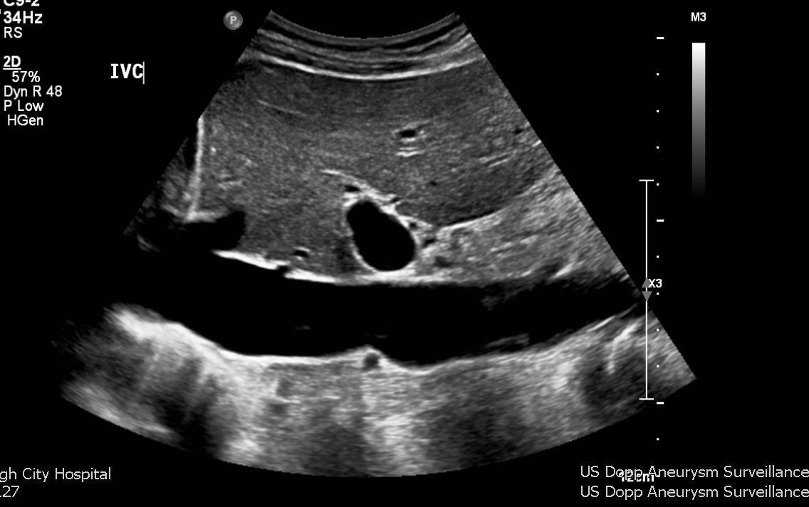
1.9cm aorta max. diameter (OTO)

Slide 4
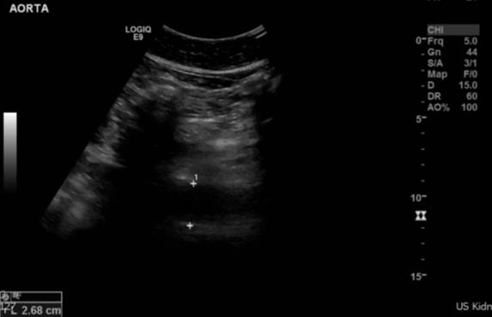
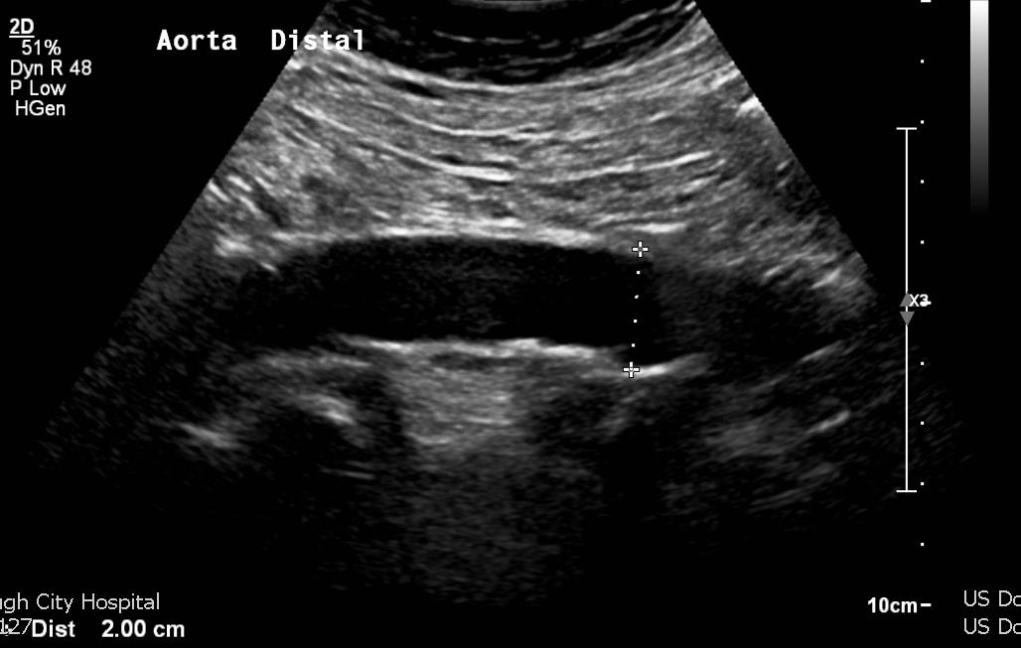
? IVC

Slide 5
Aorta vs IVC
Aorta | IVC
Thicker walls, rounded profile (transverse) | Thinner walls and more flattened/elliptical profile
No change with respiration | Lumen alters with changing abdominal pressure – respiration
Pulsatile | Flow profile affected by distance from right atrium (may be pulsatile proximally) and respiration
Non-compressible | Compressible
Located to the right | Located to the left
Landmarks: SMA, coeliac axis, renal arteries | Landmarks: hepatic veins, right renal artery

Slide 6
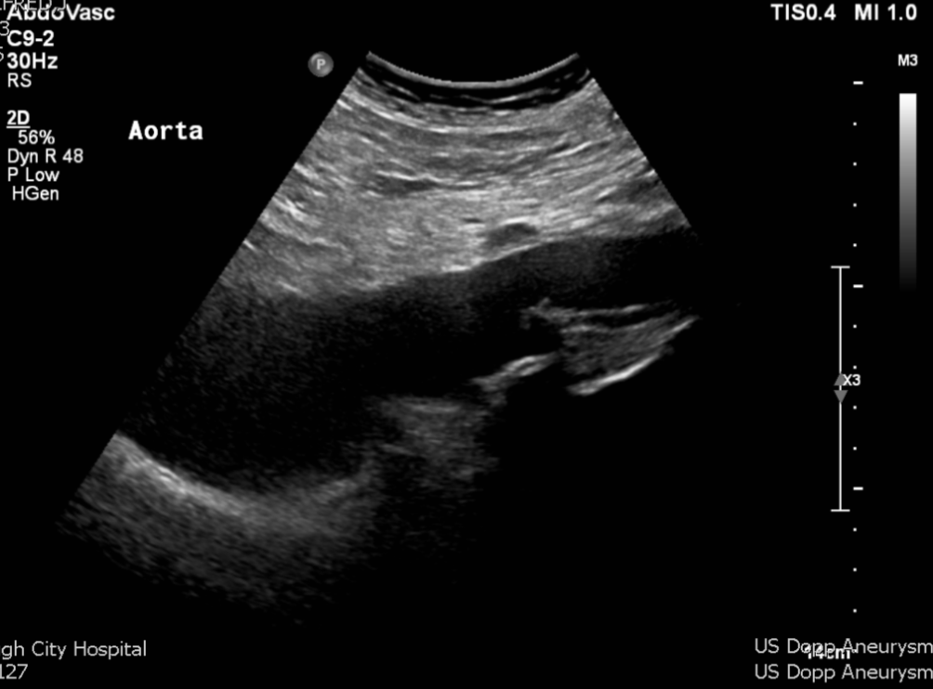
Previous AAA repair…
5.5cm supra-renal AAA
Repair graft

Slide 7
Pitfalls in aorta assessment
- Aorta or IVC?
- Entire length seen into bifurcation?
- Accurate measurement placement to avoid measuring an oblique section
- Inner or outer wall measurements?
- Spine!

Slide 8
Other true aneurysms and pathology
Aneurysmal common iliacs, internal iliacs, common femorals, popliteals…etc!
Dissection
Inflammatory aneurysm

Slide 9
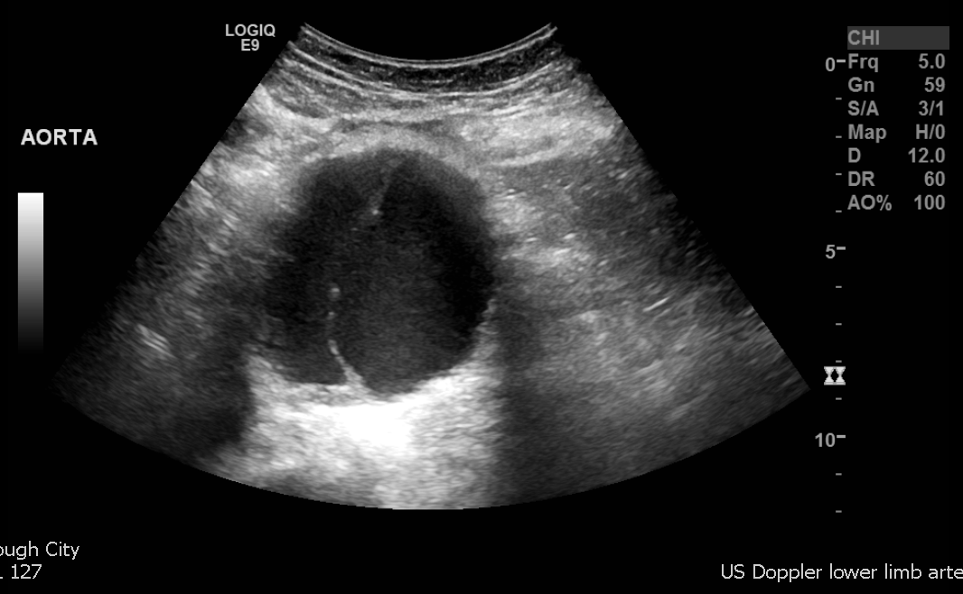
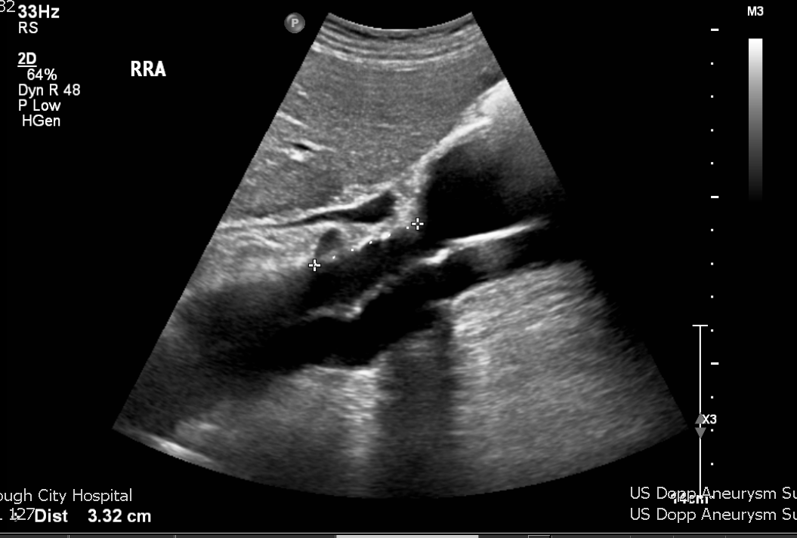
Dissection

Slide 10
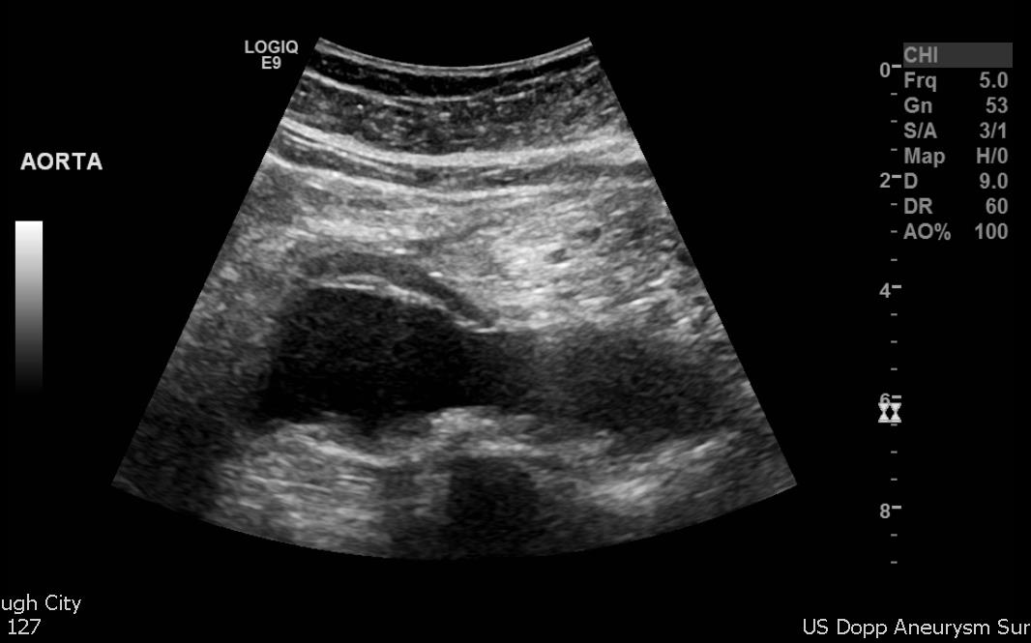
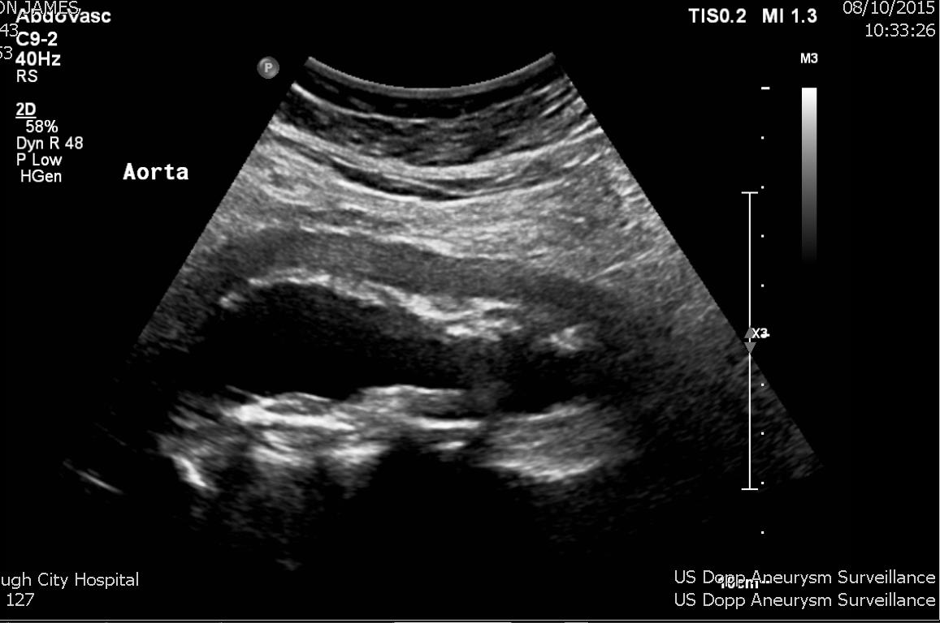
Inflammatory aneurysms
October 2014
October 2015

Slide 11
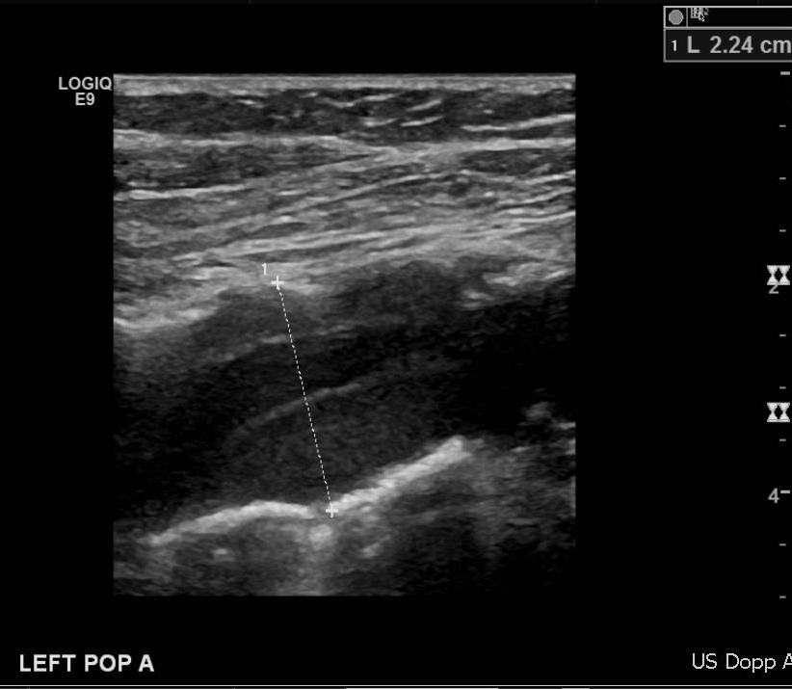
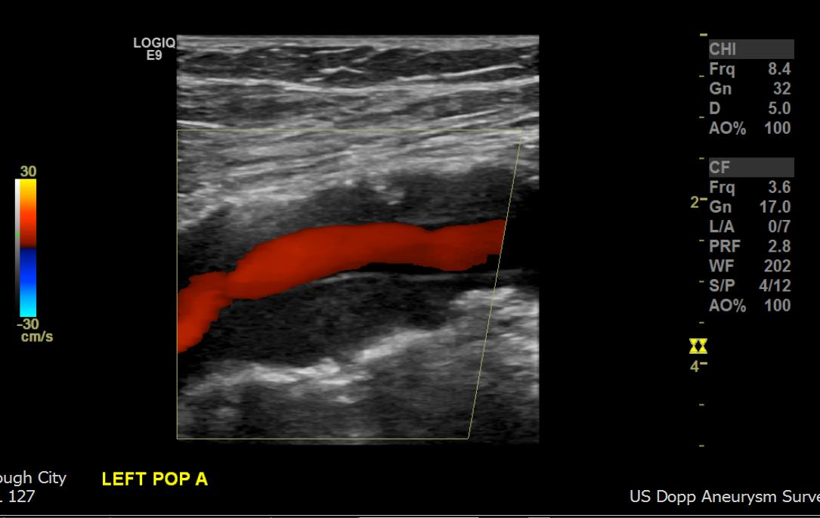
Popliteal aneurysms
Increased incidence in patients with aortic aneurysms
Bilateral in about half of patients
Complications include acute occlusion, embolisation (trash foot), occasionally rupture, DVT caused by compression of popliteal vein by the aneurysm

Slide 12
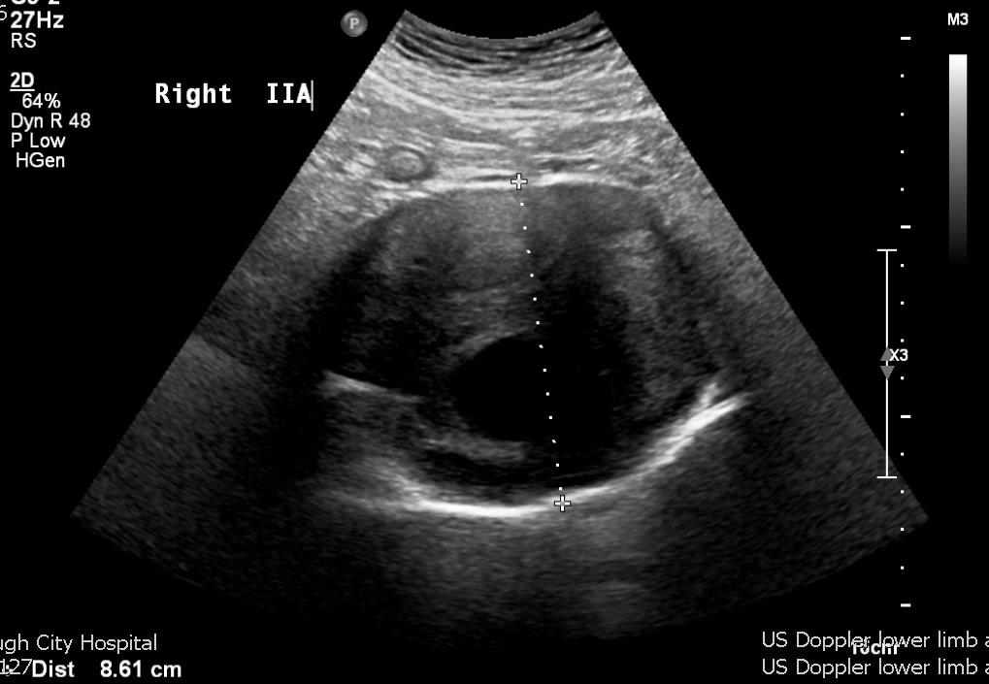
Iliac aneurysms
Usually occur as an extension of, or in association with, aortic aneurysm
Can get isolated iliac aneurysms
8.6cm right internal iliac artery aneurysm – previously ligated. Now increasing in size and filling via deep branches

Slide 13
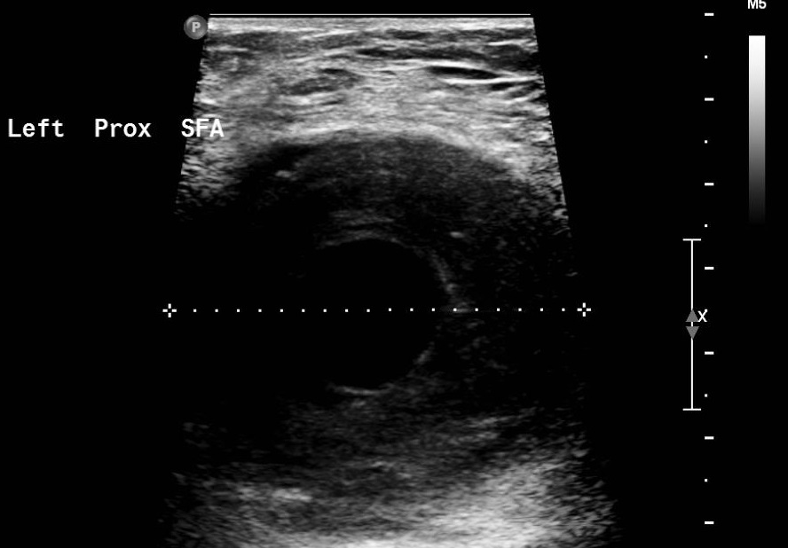
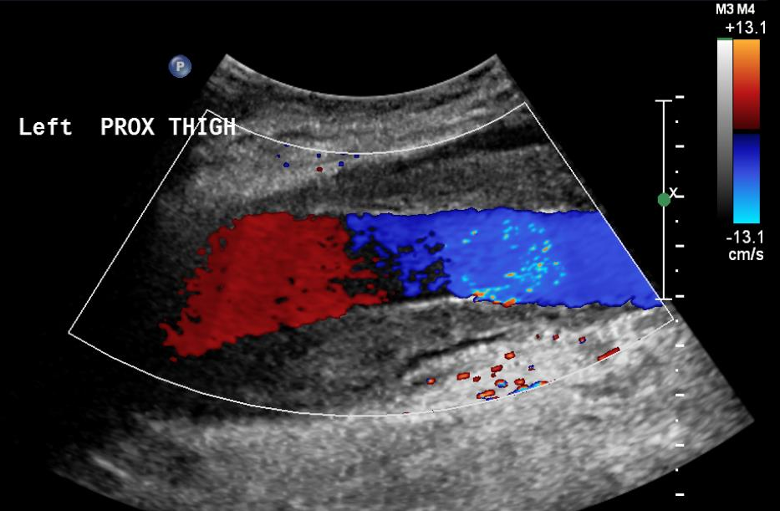
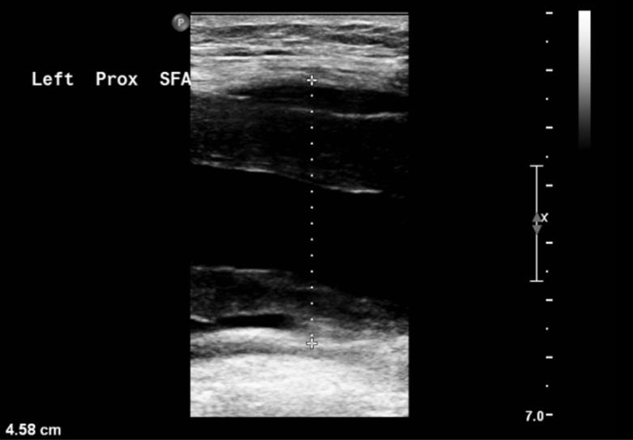
SFA aneurysm…
Venous ulcer – attended for venous insufficiency duplex

Slide 14
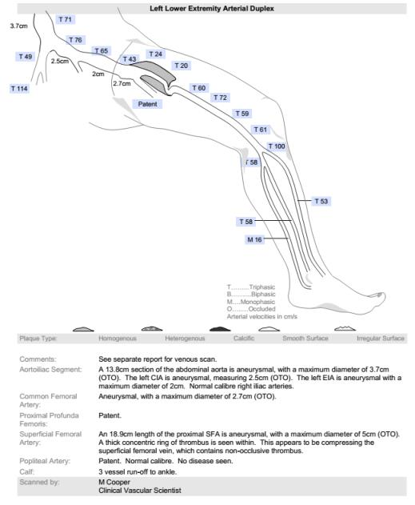
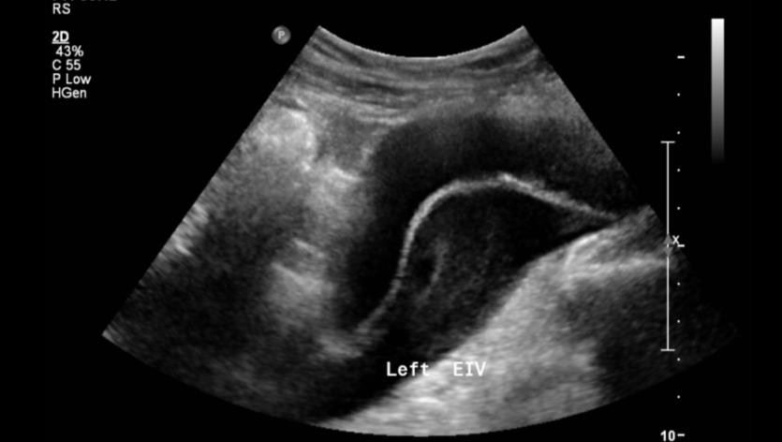
SFA aneurysm…

Slide 15
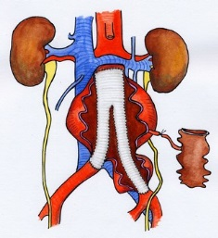
Aneurysm Repair - Open
  Straight tube graft stitched into position and aneurysm sac closed around the graft
  Ultrasound appearance post op: slight dilatation at anastomosis is normal
  No need for surveillance scans post op.
  Aorta can become aneurysm proximal to graft anastomosis

Slide 16
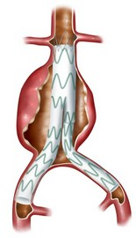
Aneurysm Repair – EVAR
Prosthetic stent graft deployed in the aorta via the femoral artery
Excludes flow into the aneurysm sac
Residual aneurysm sac should decrease in size
Requires ongoing surveillance to monitor sac size and assess for leaks
Reduced risk of complications during and post procedure than open repair and faster recovery
Greater rates of re-intervention due to stent migration, endoleak, kinking, occlusion, fracture

Slide 17
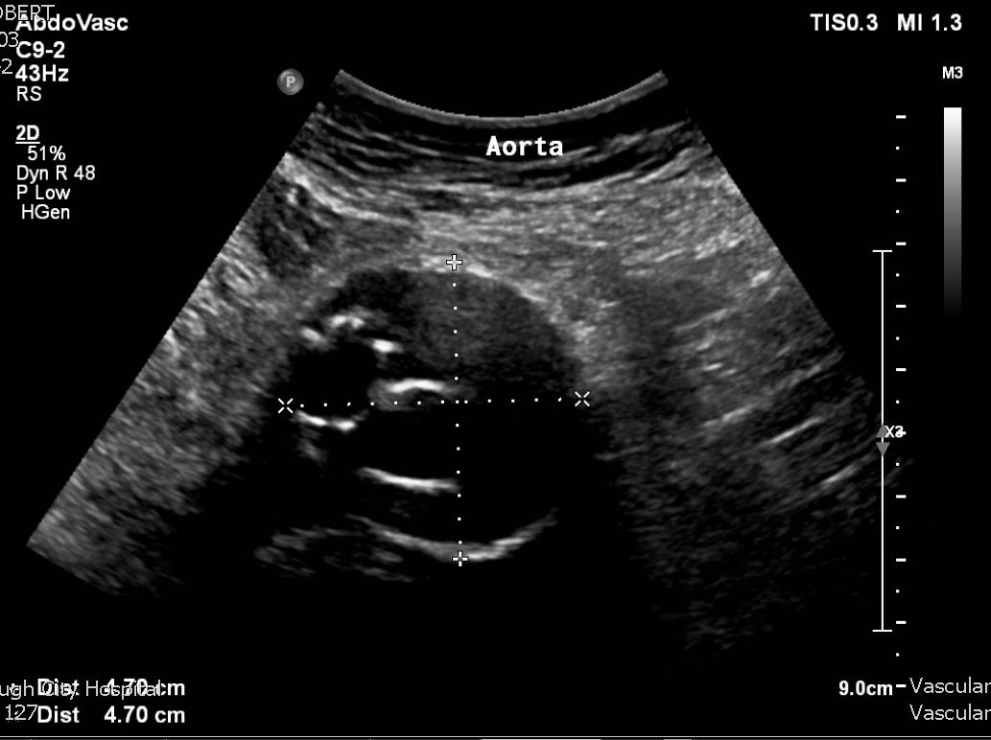
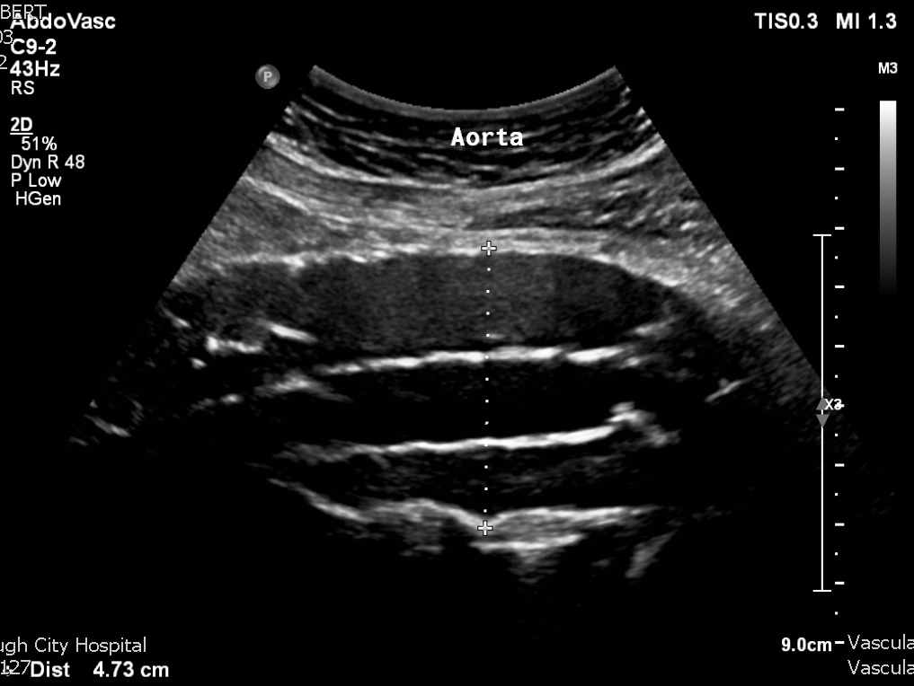
EVAR

Slide 18
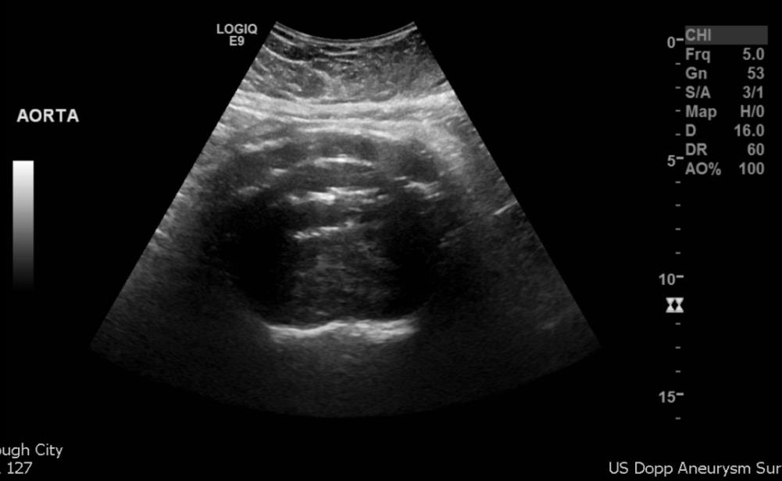
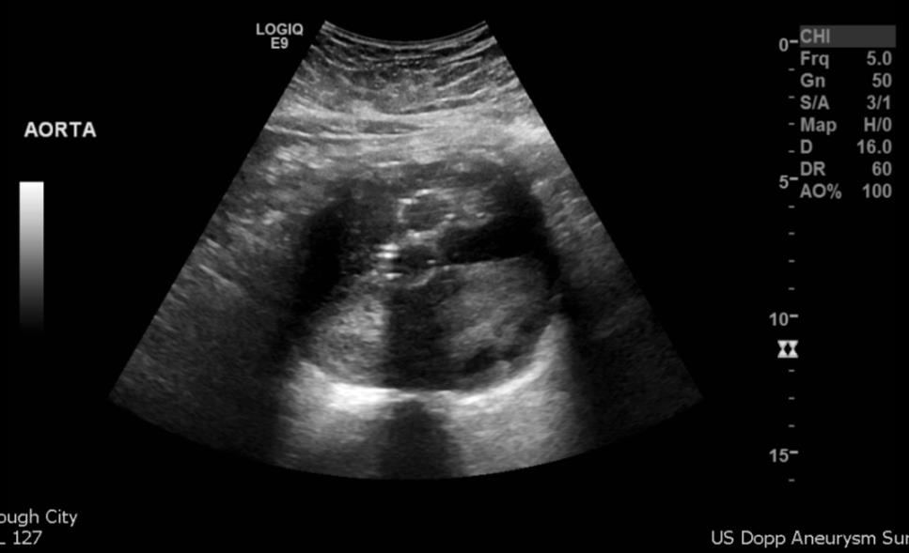
EVAR

Slide 19
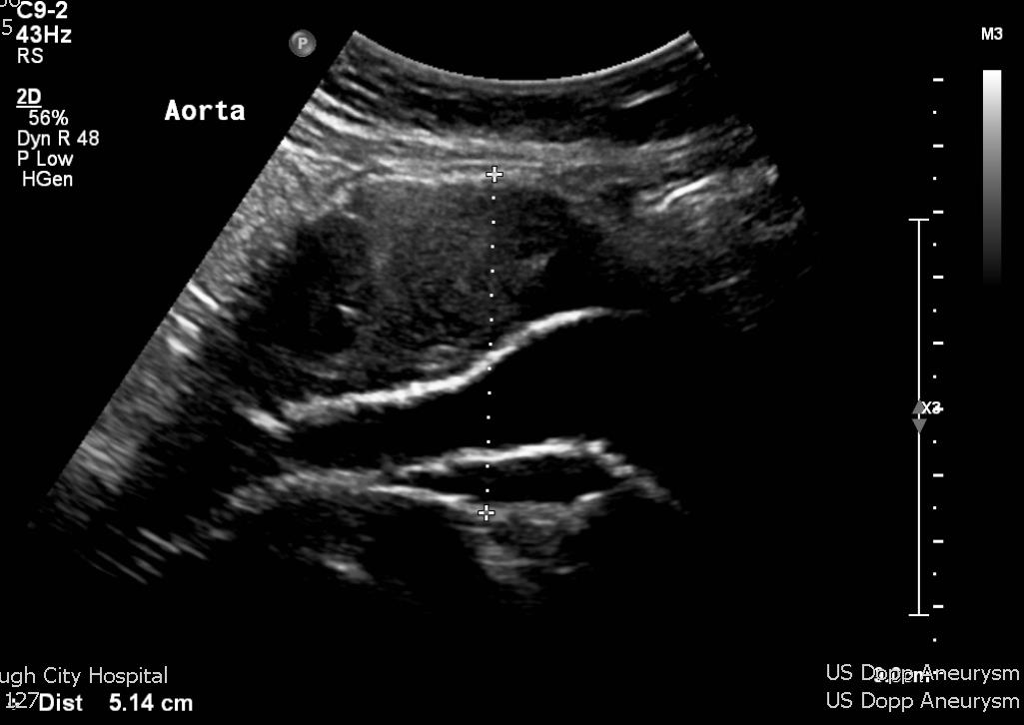
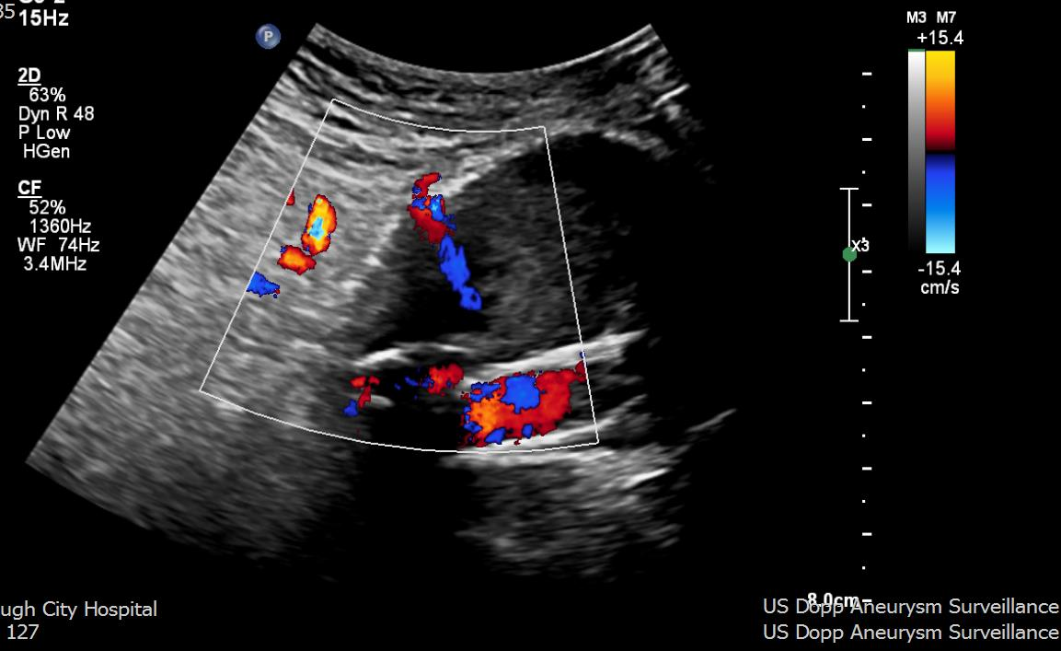
EVAR - endoleak

Slide 20
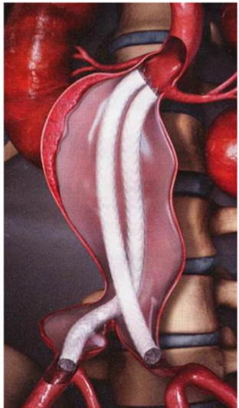
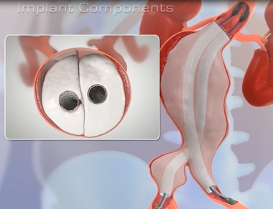
Nellix
Type of endovascular repair which seals the aneurysm sac
Bilateral stents inserted
Endobags filled with polymer
Reduced secondary interventions
Can still get leaks if insufficient polymer is used
Residual aneurysm sac will not reduce in size

Slide 21
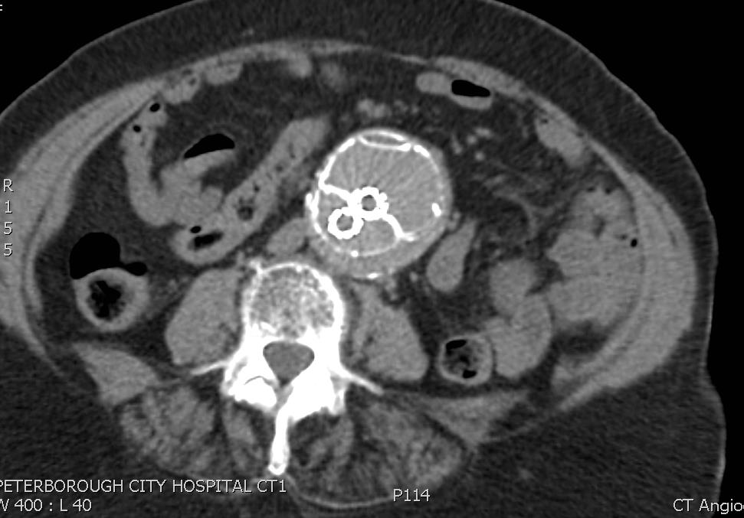
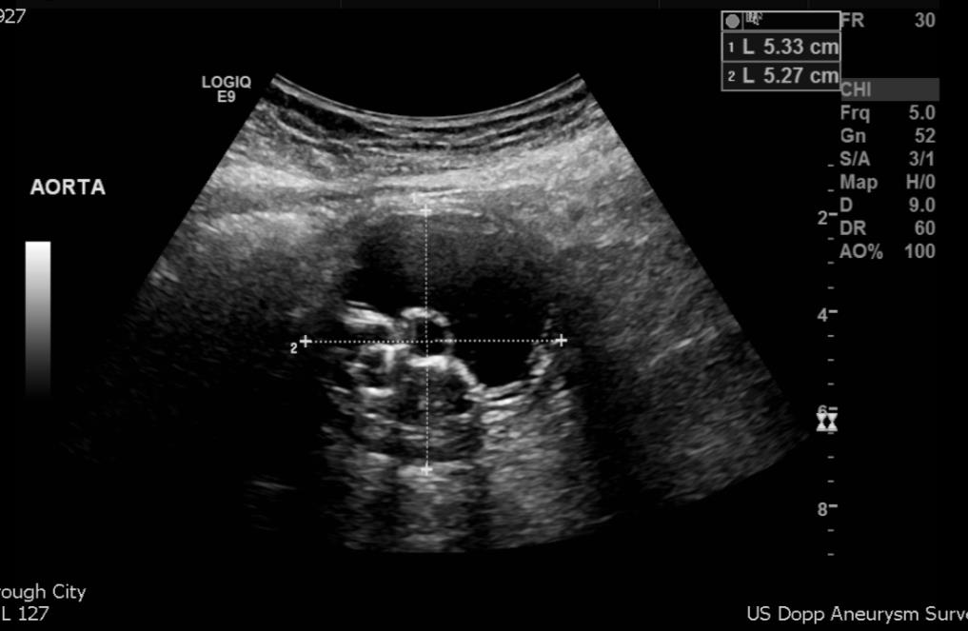
Nellix

