Slide 1
Enhancing Inclusivity and Recognition of all Registered Health Professionals in UHS by Facilitating Opportunities for Senior Leadership Roles Orange Group Puja Patel Jacob Jisha Laura Herbert Kudakwashe Mhundwa Marianne Mackenzie-Brown Maria James Jeorge Duldulao 14/07/2021

Slide 2
Objectives
To explore any disparity between different professional roles in senior leadership positions- Identify the barriers to progression.
Suggest proposals for change in job descriptions and interviewing.
Notes:
Specifically focusing on Band 8 and above.

Slide 3
What we have discovered
Information requested from HR
JD/ PS reviewed
Unable to identify if specific skills were required for the post or could be potentially open to wider health professionals?
Noted some disparity in certain roles
Data reviewed with workforce team
Data did not provide enough information to differentiate whether these roles were related to clinical or leadership roles
Notes:
Specifically focusing on Band 8 and above.

Slide 4
Notes:
Specifically focusing on Band 8 and above.

Slide 5
Barriers for change
Professional Group
Visibility & opinion
IT technical difficulties- search filters etc
Interview panel selection
Current opinion of peers
Public and patient perception of job role
Personal psychological barriers
Notes:
Promoting all professional groups by annual celebration day ( larger professional group has the biggest opportunity to celebrate their successes)

Slide 6

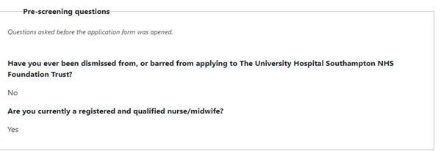
NHS Job Advert Portal
NHS Job Application Form
Notes:
Specifically focusing on Band 8 and above.

Slide 7
Work in progress
Board level representation - Development of new roles (Associate Director post)
Review of Job Descriptions/Person Specifications by HR
Providing various leadership training opportunities
Inclusive Leadership Programme
Notes:
Promoting all professional groups by annual celebration day ( larger professional group has the biggest opportunity to celebrate their successes)

Slide 8
Proposals for successful change
Increase the awareness and benefits of Mentorship
Promoting all professional groups by annual celebration day
Exploration of transferrable skills
Equitable distribution of resources
Independent panel member selected by HR in all interviews
Wider publicity of roles within the Trust:
e.g. job of the week / poster displays / staffnet / workplace
Jobs advertised in all portals relevant to post
Notes:
Promoting all professional groups by annual celebration day ( larger professional group has the biggest opportunity to celebrate their successes)

Slide 9
Desired outcomes
Creating a more diverse workforce
More equitable opportunities
Sustainable career (improved wellbeing)

Slide 10
Kuda’s Success Story!

Slide 11

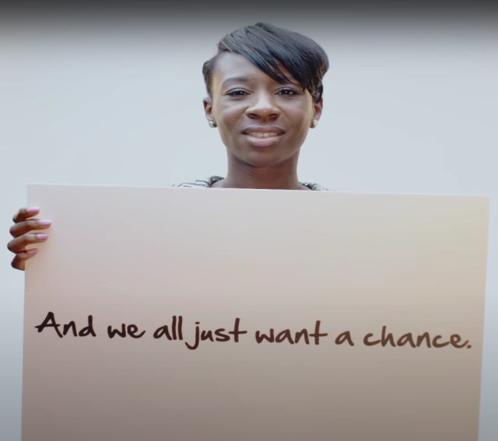

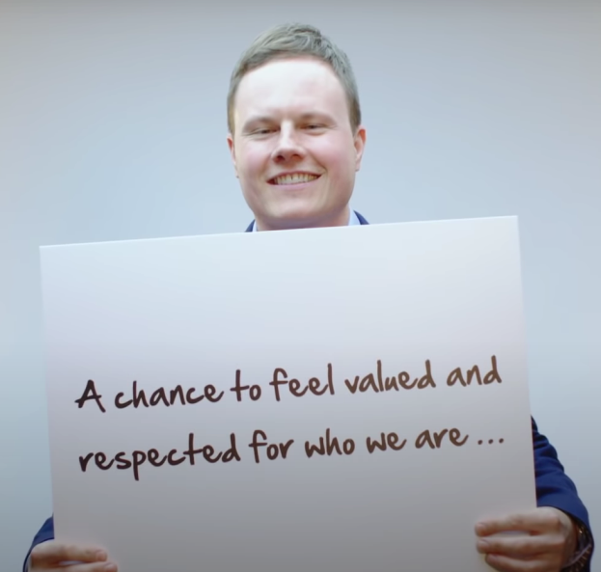
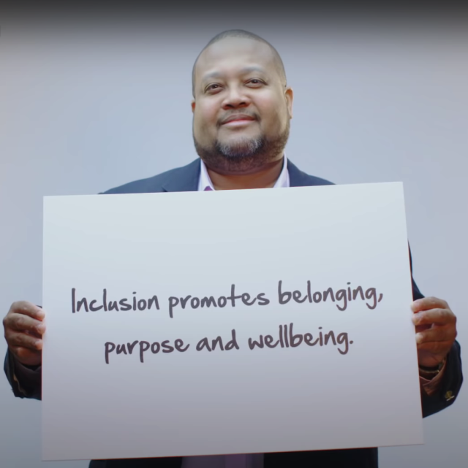
Thank you for listening… https://youtu.be/2g88Ju6nkcg

