Slide 1
A session with General Ultrasound
Louise Fearnside
Notes:
So I decided that I would like to go to General ultrasound and observe some different scans. I was mainly interested in seeing a transplant kidney scan but thought it would be a nice opportunity to see some more general scans too.
So on the first visit, I had organised to go down at a specific time to see a transplant kidney scan that was booked in. These are usually booked in ad hoc as these requests are quite sporadic.
The second session, I decided to go down when I had a free session and ask the one of the sonographers that was scanning if I could sit in and observe. That session that I sat in on was an MSK list.

Slide 2
General Ultrasound
Good set up
Focused Lists
Many G.P referrals
Quick turnaround
Notes:
My first impressions of their department is that it appears a good set up. The scanning rooms some off a central area that has a reception desk and seats (looks like a sub wait). Good size scanning rooms equipped with computers that they report on.
They appear to have for the most part focussed lists. So the session I was observing was MSK. I believe she had a colleague that was doing a gyne list etc.
My impression from that session is that they get quite a lot of G.P referrals. The majority that I saw were from G.P’s.
Also they seem to have a quick turnaround between patients. Their images seem to be automatically saved to PACS. The sonographer made good use of pre determined reporting templates that have been set up on CRIS. Which is something I need to do!

Slide 3
MSK List - Patient 1
Background
GP referral:
History: Swelling on the dorsum of foot - ? Lipoma
Examination
Physically examine – does it move under the skin?
Duplex scan
Hyperechoic, non- vascularised, neck which dives between the bones.
Diagnosis
“The lump in question relates to a 11 x 10 x 6 mm hypoechoic, cystic structure. This appears to arise from the underlying joint. There is no vascularity with colour Doppler. The appearances are consistent with a ganglion cyst”
Notes:
Patient 1 was a G.P referral. History was a swelling on the dorsum of the foot, query Lipima.
The first thing the sonographer did was to physically examine the lump. Check to see whether it moves under the skin. If it does, more likely to not to anything sinister.
She then scanned the lump which had the following features;
It was hyperechoic, non- vascularised when she checked with colour, and had a neck which dived between the bones.
Before I go on to show you the scan image, this was the conclusion taken from the report on CRIS.

Slide 4
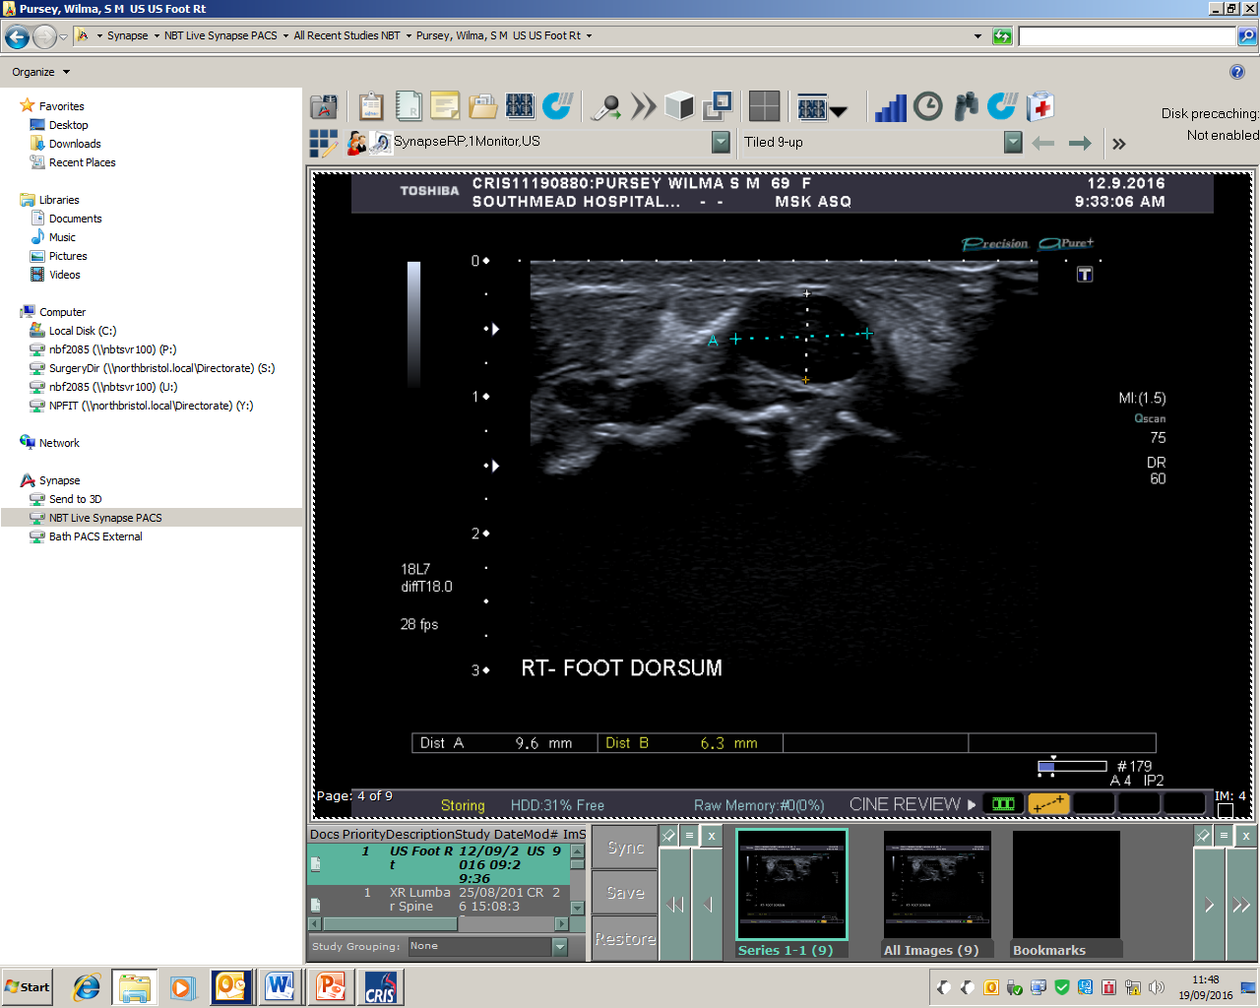
Ganglion Cyst
Notes:
So this was one of the images taken by the sonographer. It does appear anechoic structure. Many also display acoustic enhancement on the lateral borders, which you can easily seen here. The sonographer at the time did suggest that you could see an extension to the joint, but I’m not sure that I can see it on this image. Maybe not obvious to the untrained eye.

Slide 5
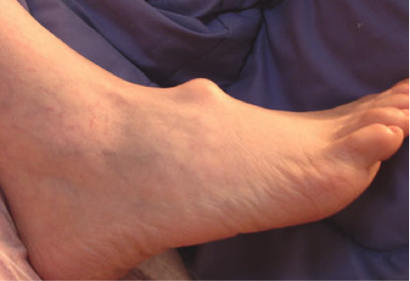
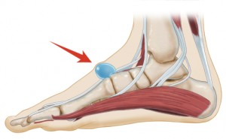
Ganglion Cyst
Most Common Soft Tissue Mass (50-70%)
Mucin Filled Hernia of synovial tissues surrounded by fibrous tissue
Unclear aetiology
Trauma, Inflammation, degeneration into ganglionic jelly
Spontaneous
Treatment?
Notes:
So I thought I would give you a bit more background information on ganglion cysts.
Ganglion cysts are the most common type of soft tissue mass, most commonly found on the wrist. They are a mucin filled hernia of the synovial tissues surrounded by fibrous tissue. They Develop in relation to joints or tendon sheaths.
The etiology of ganglion cysts is unclear. A prevalent theory is that trauma causes inflammation of the associated connective tissues, which then degenerate or liquefy into “ganglionic jelly.” The remaining connective tissue forms the cystic capsule to enclose this fluid, thus creating the ganglion cyst.
The cyst expand in size and the fluid cannot flow freely back into the synovial cavity.
They can be spontaneous without any particular cause.[19] Anyone can be affected by ganglion cysts, but they occur 3 times as often in women as they do in men. The occurrence of a ganglion cyst is related with osteoarthritis, and therefore most commonly seen in older patients. Ganglion cysts are predominantly seen in young adults and are rare in children [3].
Many, up to 50% can disappear without any treatment at all. If they are treated, they can be aspirated and then a steroid compound is injected into the empty cavity. So that acts as an inflammatory agent. Or they can be surgically excised.
See comment in PubMed Commons below J Ultrasound Med. 2007 Oct;26(10):1323-8; quiz 1330-1
Sonography of wrist ganglion cysts: variable and noncystic appearances.
Wang G¹, Jacobson JA, Feng FY, Girish G, Caoili EM, Brandon C.
Author information

Slide 6
MSK List – patient 2
Background
GP Referral:
History: Tender deep lump on the top of left buttock. Back pain. ? Nature of lump.
Examination
Physical examination – no obvious lump
B-mode scan
Subcutaneous tissue, lobular quality, cyst/collection,
compared other buttock, abdominal probe
Diagnosis
“There is no evidence of an encapsulated lipoma, subcutaneous lesion or gross structural abnormality demonstrated. If the area of concern rapidly changes in size or becomes very painful, we would be happy to rescan”
Notes:
This was patient 2.
Another G.P referral. This patient had a… So the scan was to check the nature of the lump.
So again the sonographer did a physical examination of the lump before starting the scan. This examination did not reveal any physically obvious lump.
The sonographer then performed a b-mode scan of the area, looking at the subcutaneous tissue, looking at the lobular quality of the tissue (which is normal) and checking for any cysts or collections. None was revealed with the linear probe so she checked with the abdominal probe and also compared the other buttock for any differences.
She concluded with…

Slide 7
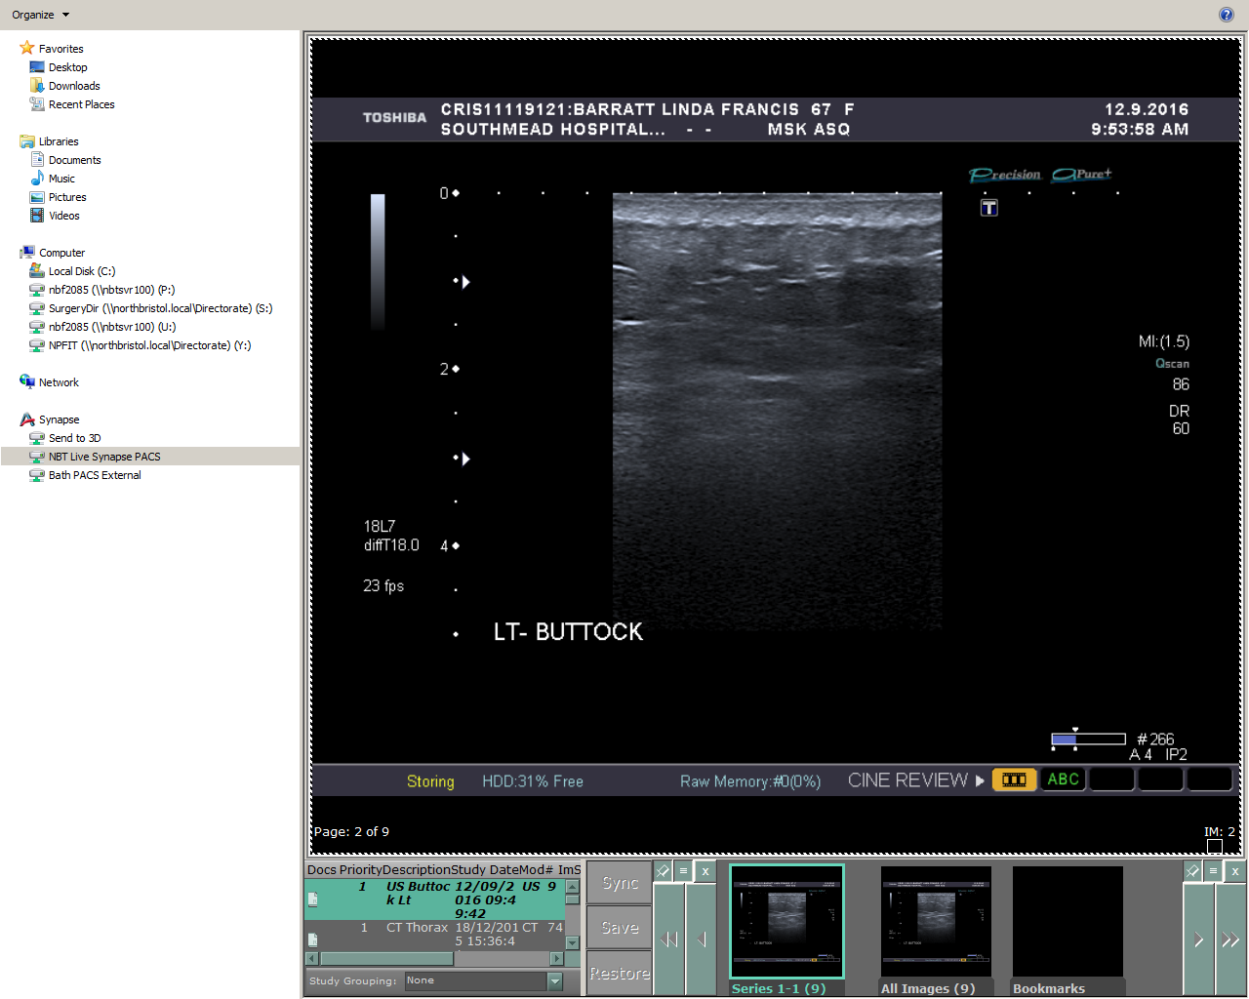
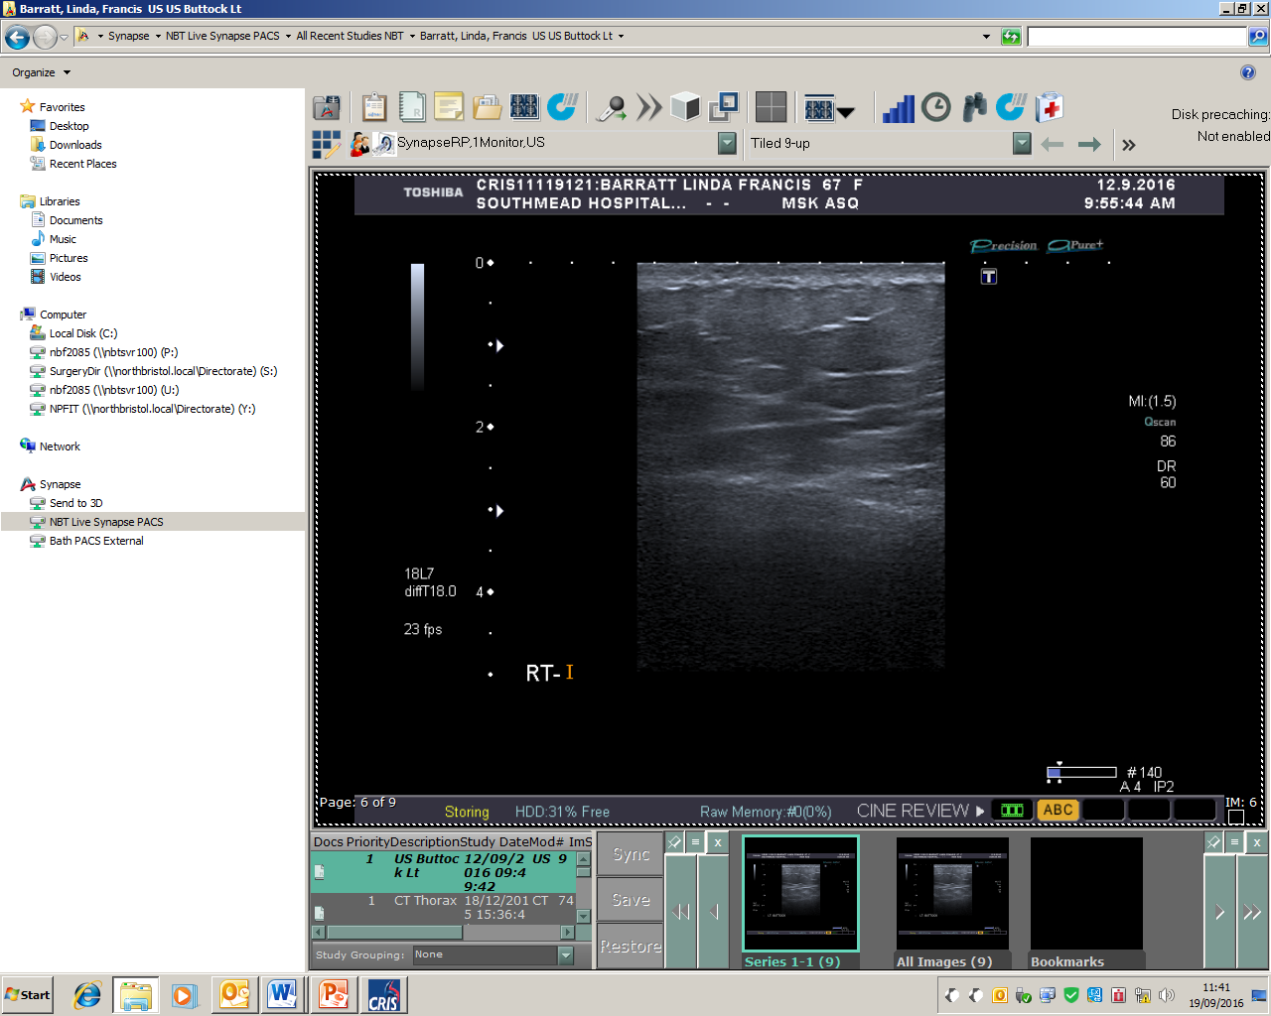
Patient 2 images
Notes:
So these are a couple of saved images from the scan. The sonographer compared the right side of the buttock with the left (which was the side that was being investigated) Actually, looking at the images there doesn’t seem to be any major differences between each side, even to the untrained eye. There certainly isn’t any obvious structure or collection.
Talking to the sonographer after the scan, she hinted that this lady might have some asymmetrical fat deposition which can happen when you get fat necrosis, usually following an injury. You can end up with a deficit in the subcutaneous tissue which can feel like a lump. Looking closer at the images, there may be subtle differences in the lobulation of the tissue with the right side looking slightly different to the left.
This lady suffers from back problems so maybe it is more back related, maybe nerve problems. Interestingly, when I looked her up on synapse, this patient has been referred to the department for the same complaint 8 years ago. The scan then also didn’t reveal anything.

Slide 8
MSK List – Patient 3
Background
GP referral
History: Long hx painful lump lateral malleolus. Cornified lesion. Slightly mobile Sub Cut lump - ? Nature. More painful recently
Examination
Physical examination
B-mode scan and CW
Used Gel pad on malleolus, tendons, vascularisation
Diagnosis
“Corresponding to the lump is question is an area of calcification within the subcutaneous tissue, which produces strong acoustic shadowing and measures approximately 11mm in diameter. The peroneus longus and brevis tendons are intact”
Notes:
Patient 3 was another G.P referral. This man had a long history of a painful lump on his lateral malleolus which was thought to be a cornified lesion. On top of this was..
Again she started with a physical examination. Then the scan in b-mode and then colour to check for any vascularisation.
She used a gel pad on the malleolus which apparently aids visualisation and acts as a scanning platform. Not seen this before. She also looked at the tendons, I have to admit that at this point I got quite lost!
The sonographer thought that visually it looked like a chronic bony extension of the lateral malleolus. On this one, the sonographer sought a second opinion from one of the consultant radiologists who was doing a scanning list next door. He ordered an x-ray to check for bone erosion.
The patient received an x-ray within about 30 mins on the same day which I thought was a good service.

Slide 9
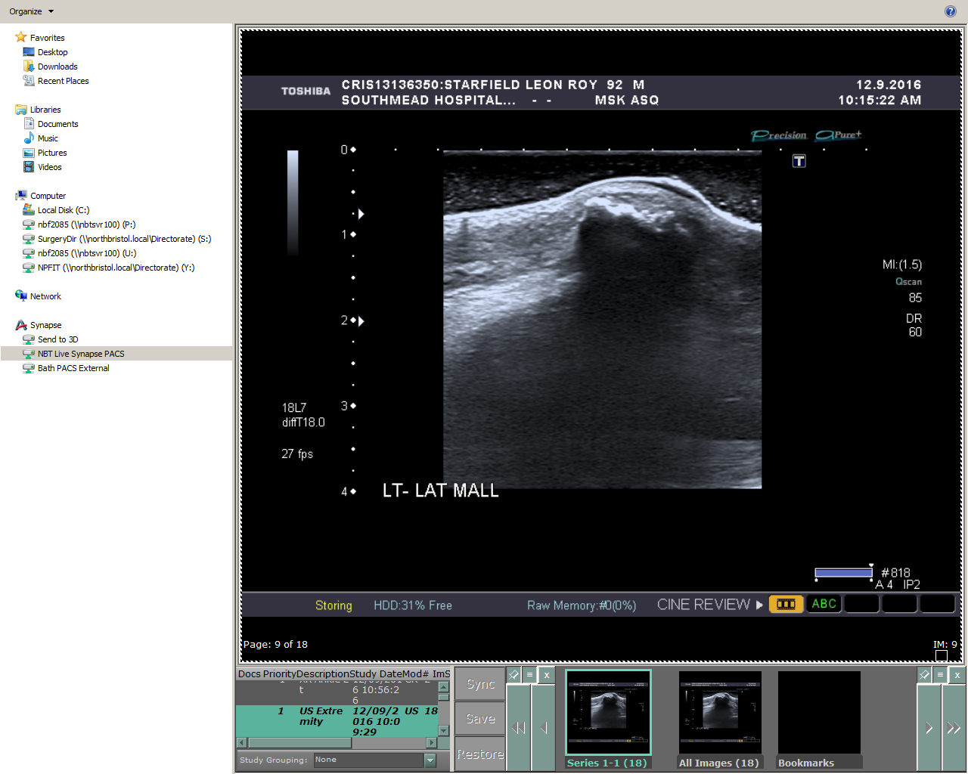
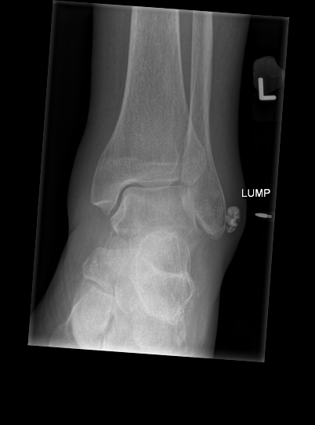
Patient 3 images
XR Ankle Lt :
There is a 15 x 7 mm rounded opacity in the deep soft tissues adjacent to the tip of the left fibula.
Differential includes soft tissue calcification from previous trauma or calcific periarthritis.
Notes:
These are a couple of images taken from synapse. The ultrasound on the left where you can clearly see the calcification and acoustic shadowing it produces.
On the right is the x-ray, where they have annotated “lump”.
So really, it looks like they have not conclusively said what it is but I guess they have ruled out bone erosion.
Periarthritis (I googled) is :inflammation of tissues around a joint capsule, including tendons and bursae

Slide 10
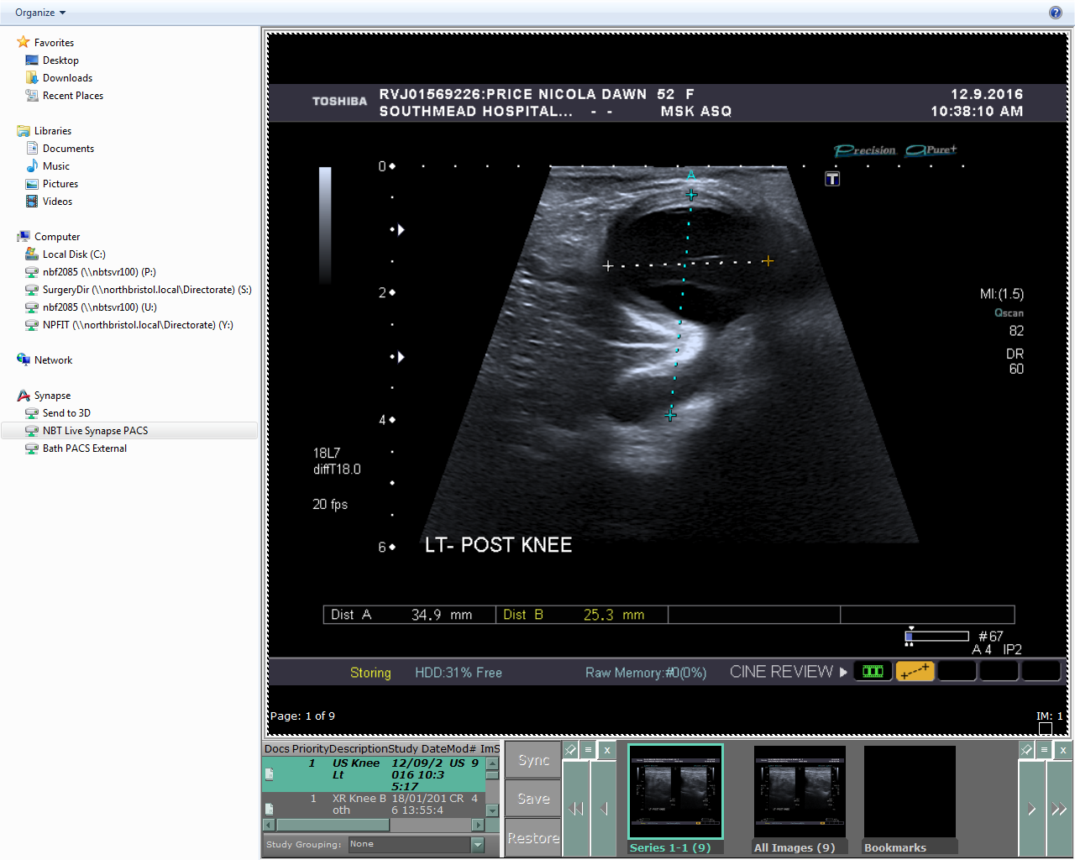
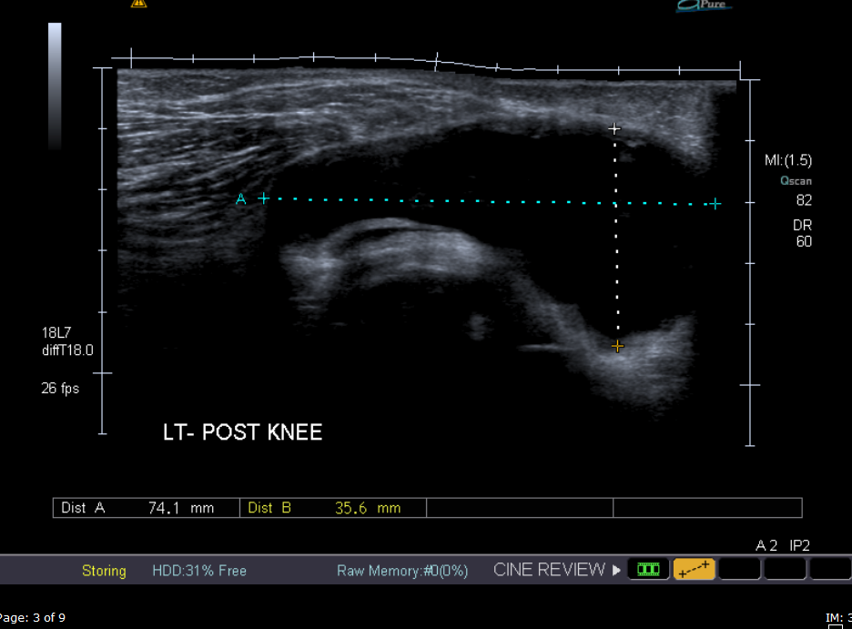
Patient 4
There is a 7.4 x 3.5 x 2.5 cm anechoic cystic structure demonstrated in the popliteal fossa. A fluid filled neck is seen arising from between the medial head of gastrocnemius muscle and semimembranosus tendon.
There is no vascularity with colour Doppler.
The popliteal vein and artery are patent.
The appearances are consistent with a Baker’s cyst.
Notes:
The last patient was a simple bakers cyst but I thought that it was interesting to show you their images and how they report it. So this was reported as:
They start in the distal calf and scan up the medial gastrocnemius muscle. Apparently this is the semi-membranous tendon and the cyst usually pops up up between this and the medial gastroc muscle.
She also used panoramic imaging so that she could obtain an accurate measurement of its length.

Slide 11
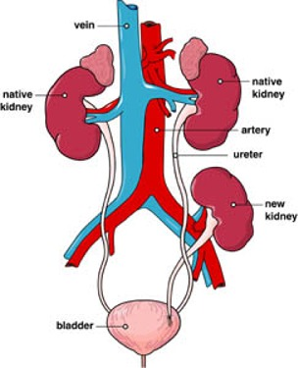
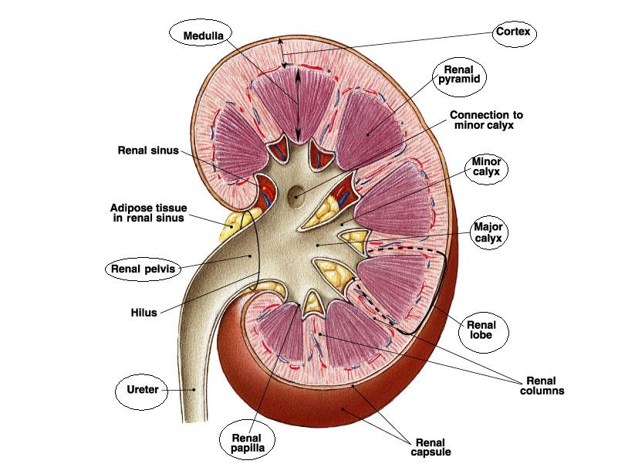
Transplant Kidney Scan
Notes:
So now I am going to go onto the transplant kidney scan that I saw.
I went back to general ultrasound to specifically see a transplant Kidney scan. Which they get on an ad-hoc basis either down in A&E, or booked into an outpatient clinic.
I thought I would show you briefly the basic anatomy of the kidney; Ill point out of few things; I won’t go into too much detail as they really are quite complicated. You have the Cortex round the outside and then the medulla and then the central, more echogenic complex which is the collecting system and renal vasculature together with any sinus fat.

Slide 12
Why Transplant?
Increases life expectancy vs Dialysis
Improves quality of life
Reduction in Financial burden
- 1st year 20,000 £6000 thereafter
Vs £30,000 p/y Dialysis
Free from restrictions – diet and fluid
Notes:
Firstly I thought I would give you a brief background on kidney transplants.
So a transplant increases life expectancy when you compare it to dialysis. A 30 year old with a transplant is 100 times less likely to die than on dialysis. (From Dr Ravanan slides, audit 2015)
It also improves quality of life.
There is a reduction in financial burden.
Patients are free from restrictions in things like diet and fluid on top of the huge time investment that dialysing produces.

Slide 13
Transplant Site
Retroperitoneal Space of Iliac Fossa
End to side anastomoses
transplant renal vessels
to Common/External iliac
artery/veins
Notes:
Usually, the kidney is transplanted in the retroperitoneal space of the iliac fossa. An end to side anastomoses is used to join the txP renal vessels to the iliac system.

Slide 14
Role of Ultrasound
Invaluable initial imaging modality
- Clinical features graft failure often absent/non specific
Superficial nature – ideal for scanning!
Good first line modality - but relatively non-specific on reasons for functional complications
Main role
Surgical complications, monitoring, biopsy guide
Notes:
Ultrasound can be invaluable as the first initial imaging as often clinical features of graft failure are absent.
The superficial nature of the transplants means that they are easy to scan. I’d say much easier than scanning a native kidney – has anyone tried to do that?
It is a good first line modality to detect a functional complication however is relatively non-specific on reasons for failure, such as infection, delayed graft function, acute rejection, extrinsic compression, drug toxicity, perioperative ischemia
So the main role would be to look at any surgical complications : Ultrasound plays a pivotal role in identifying and quantifying vascular complications of renal transplants Which include arterial and venous stenosis and occlusion, kinking which I will talk about in a later slide.
While vascular complications occur in less than 10% of transplant recipients, they are an important, and often correctable, source of morbidity and mortality in renal transplantation
While ultrasound is useful in the detection of a funcitonal abnormality, the specificity is poor as cases of rejection, drug toxicity, peri-operative ischemia and acute tubular necrosis are difficult to distinguish from one another by imaging criteria alone.
In cases of severe acute rejection, the transplanted kidney becomes edematous and manifests as a globular, hypoechoic mass with poor differentiation of the central renal sinus fat (Figure 9). The edema leads to increased vascluar resistance and elevation of the resistive index (Figure 10).
However, the finding of increased resistive index is a non-specific finding which can also be seen in the setting of infection, acute tubular necrosis, perioperative ischemia, hydronephrosis and extrinsic compression (Figure 11). Differentiation of these entities often requires ultrasound-guided biopsy

Slide 15
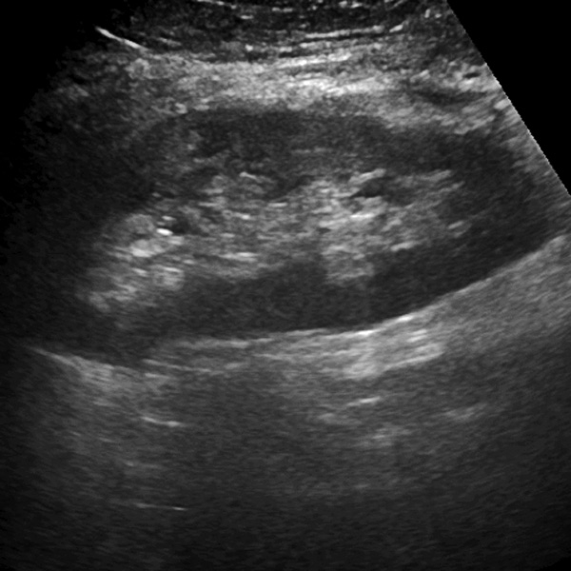
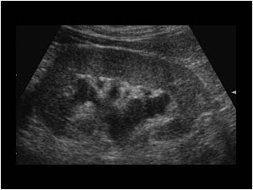
Basic Ultrasound techniques/features
High Freq linear array (superficial)
Minimal Pressure – compromise diastolic flow
Anatomic detail clearer/cortex more echogenic
Kidney enlargement common
~30%, can be 200%
Slight dilation collecting system
Baseline scan within 2 days
Then 1-2 weeks, 3 months
Notes:
So usually only need to use the high frequency probe. Minimal pressure should be used as you could accidently affect the diastolic flow.
You usually find that the anatomic detail of the transplant kidney is much clearer and the cortex is more echogenic, basically because of the superficial nature of the kidney.
Transplant kidneys usually enlarge over a period of several months an average of 30% but the increase can be as big as 200%.
It is normal to have a slightly dilated collecting system in a well functioning transplant. This is thought to be mainly due to an increased volume of urine produced (as it is acting as the sole kidney). However the filling should be minor and confined to the renal pelvis. This is an ultrasound image of an abnormally dilated collecting system which is termed Hydrophrenosis of the kidney – swelling due to build up of urine for one reason or another.
It is advisable to do a scan within the first two days after surgery and then again at around 3 months. This was published in an imaging article in radiology in 2013.
Ultrasonographic Features of Kidney Transplants and Their Complications: An Imaging Review
Chrysafoula Kolofousi,¹ Konstantinos Stefanidis,¹ Demosthenes D. Cokkinos,¹ Dimitrios Karakitsos,² Eleni Antypa,¹ and Ploutarhos Piperopoulos¹
Radiology Volume 2013 (2013), Article ID 480862, 12 pages

Slide 16
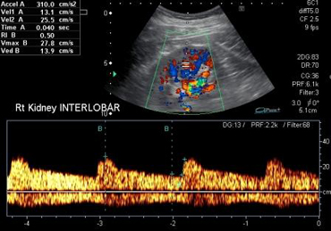
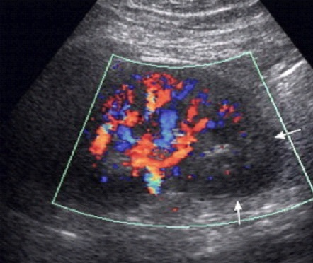
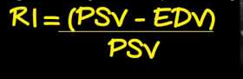
Basic Colour/Spectral Doppler
Low Colour scale, increased colour gain
Generally well perfused? Global assessment
Possible to get segmental infarction
Typical calculations – Main vessels,
Intrarenal
PSV
RAR
Notes:
So this is what a well perfused transplant kidney looks like. You should use a relatively low colour scale with increased colour gain. Generally looking to see if it is well perfused, so assessing it globally.
It is possible to get segmental infarction which I think would be quite easy to spot.
You should then assess the intrarenal vessels of the parenchyma to assess the kidney function (functioning part of the kidney that filters the blood and makes urine). This picture shows a normal trace for one of the interlobular arteries.
The trace shows good diastolic flow, which should be approximately a third of the systolic flow. It should have a sharp upstroke.
The resistive index is a useful indicator and should be between 0.56 and 0.7. *this was taken from slides presented by Simon Freeman at the BMUS summer school.
RI = PSV – EDV / PSV.
The acceleration time should be <90m/s.
If you have a reversal of diastolic flow, it would indicate a severe problem which I will talk about later (renal TxP vein thrombosis).
RI – gives an assessment of parenchymal pressure

Slide 17
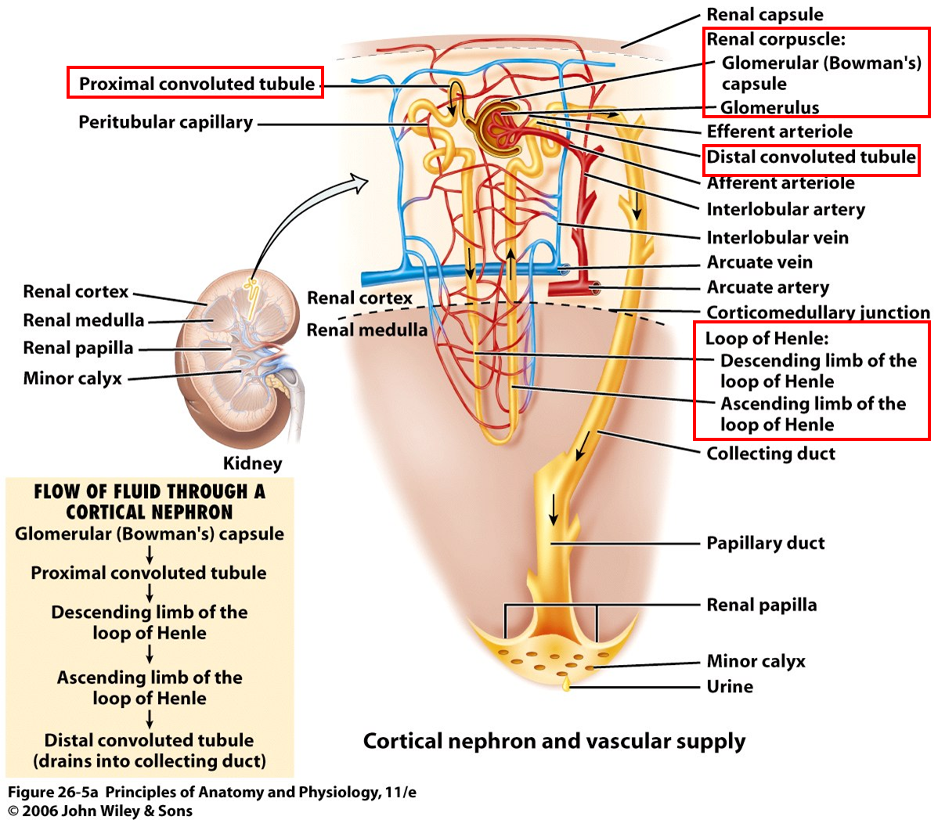
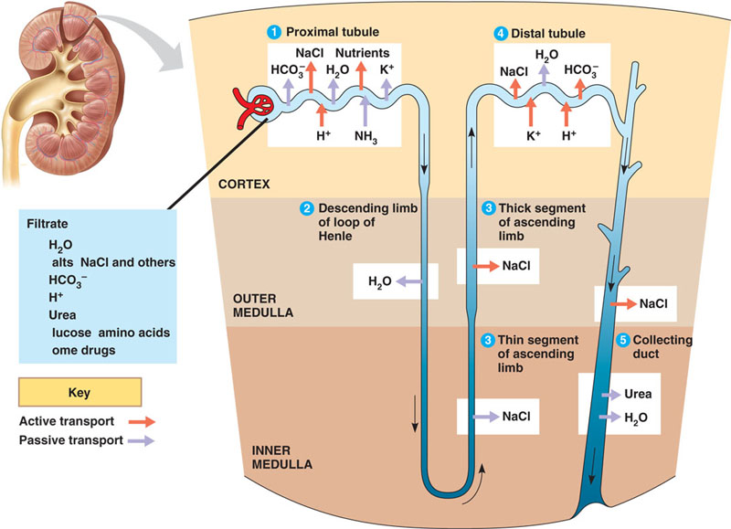
Nephron Anatomy
Notes:
This slide is to show how intricate and complex the kidney is. When I see this, I have flash backs to Higher Biology.

Slide 18
Early Complications
Four main Types
Vascular – thrombosis, kink, AVF, pseudoaneurysm
Urological – urine leak, urinomas.
Collections - urinoma, lymphocoele, haematoma, abscess.
Delayed graft function (ATN)
One of the diseases of the parenchyma
Common cause of early renal function impairment, usually resolves within 2 weeks
Ultrasound non specific on type of graft dysfunction
Notes:
Early complications are divided into four types.
Vascular actually accounts for relatively small percentage of complications, approx 10%. Having said that they are relatively easily rectified so they are important to pick up in that subset of patients.
Thrombosis if the most common complication, usually in the first week. Relatively rare <5% of patients. Usually after surgical difficulty at the venous anastomosis. Might present as swelling and tenderness of the graft, or abrupt cessation of urinary function. The kidney may look large and hypoechoic with loss of differentiation. Might see thrombus in main renal vein and no flow. Or increased venous PSV in partial thrombus.
Might be able to perform a thrombectomy.
There might be a kink in the vascular system in either the artery or vein.
Might get an AVF. These are a well recognised complication of renal biopsies (up to 16%). Biopsy needle strikes both the arterial and venous walls. You would see an area of turbulent flow and aliasing with very high velocities and low Resistive index of the feedling artery aswell as arterialised flow in the draining vein. They are usually not haemodynamically significant and can resolve spontaneously. If becomes a problem ie steal, they can be embolised.
Pseudoaneurysms are rare complications of biopsies and due to arterial wall injuries. Appears as a cystic structure on ultrasound with turbulent flow. Most thrombose spontaneously. If become troublesome they could consider embolization. Extra renal PA very rare, usually at the arterial anastomosis.
So there are early urological complications.
You may get urine leak from the renal pelvis, ureter or the re-implantation site into the bladder due to surgical technique or ureter necrosis. You will get a collection of urine, urinoma and they usually appear in the first two weeks after transplantation between graft and bladder. On ultrasound it looks like an anechoic structure with well defined borders. Patients might present with decreased urine output and pain/ tenderness around the graft. To confirm, US guided aspiration would reveal increased levels of creatine. Differentiates it from a seroma of lymphocele.
So collections are an early complication. We’ve already talked about urinomas. As a whole, perinephric collections (capsule of connective tissue that envelops the kidney) are seen in about half of transplants and include..
Lymphoceles are the most common affecting up to 20%. Due to surgical disruption of the lumphatic channels along the iliac vessels. Require simple monitoring. Can potentially compress the vascular system or affect the collecting system resulting in hydronephrosis. They appear anechoic but can have sepations present.
Haematomas common. They are usually located within the subcutaneous tissue or around the transplant, most resolve. Large ones could potentially displace the graft, produce hydronephrosis or compromise the vascular supply. Appear complex and echogenic.
Absesses rare. So any of these perinephric collections can become infected and turn into an absess. They can be difficult to distinguish from a haematoma. The typical image of a low echogenic structure with a thick irregular wall is rarely found. If gas is seen then an abscess is possible.
Acute tubular necrosis is one of the diseases of the parenchyma. Although its name is confusing, it is a common cause of early posttransplantation renal function impairment. Usually resolves within two weeks. It is caused by donor kidney ischemia during transplantation and reperfusion injury. US cannot distinguish between this and other causes of graft dysfunction such as acute rejection. You might see renal enlargement, altered echogenicity of the parenchyma, increased size of the renal pyramids and altered resistive indices and reduced or absent diastolic flow. But as I’ve said, these appearances are not exclusive to ATN.

Slide 19
Late Complications
Three Main types
Vascular – artery/vein stenosis
Artery most common, anastomosis, almost always surgical comp.
Long seg stenosis – later complication hyperplasia/scarring.
Direct Indicators: PSV >250 ml/min, RAR >3.5
Normal flow parameter: 80-118 cm/s
Urological – uretic stenosis
Medical – acute rejection, chronic rejection, drug toxicity, recurrent disease.
Notes:
There are three main types of late complications. Vascular, urological and also medical.
Renal artery stenosis is the most common, up to 10%. They usually occur in the first 3 months but can be longer. Usually at anastomosis but also possible but uncommon in the iliac artery just proximal to the anastomosis or in the proximal renal artery. Long segment, distal stenosis is usually a later complication that usually results from intimal hyperplasia or scarring
The criteria for a significant stenosis is usually a PSV> 250cm/s. RAR >3.5 (direct indicators). Parvus tardus wavefrom. AT >90ms (In direct indicator). If both direct and indirect signs present then US 95% accurate.
Normal flow parameters:
80-118cm/s, Volume flow 346-422ml/min.
Parameters for stenosis exceeding 50/60% - SV >190cm/s, ≥250cm/s, Systolic ratio >3.
If you clinically had hypertension without any explained graft dysfunction or hypertension with an audible bruit, it may be worth performing a scan to look for a renal artery stenosis.
Renal vein stenosis – Anywhere along transplanted vein. Ultrasound findings
Increased flow velocities. No absolute values. Focal stenosis velocity > than 2-3 fold considered haemodynamically significant.
Late urological problems include ureteric stenosis although this is rare (2%). Usually occur within the distal third. Usually at he uterovesical junction and may be due to scarring from ischemia.Very rarely, collections may compress the ureter. Obstruction manifests itself by elevated serum creatinine but a differential diagnosis may be chronic rejection. Difficult to diagnose with ultrasound as you have a certain dilation of the collecting system due to increased flow through the functioning kidney and loss of tonicity.
The cause may be medical, so acute and chronic rejection, drug toxicity or recurrent disease.
Acute rejection is the most common (up to 37%), usually within 3 weeks. They might by asymptomatic but also may have flu like symptoms, pyrexia or graft tenderness. Ultrasound might reveal high RI values (>0.9). In very severe cases might have reversed diastolic flow but it may hard to differentiate it from ATN.
Chronic rejection is the most common late graft failure. Renal function progressively declines. Main predisposing factor is previous episodes of acute rejection. Diagnosis is usually made histologically. US appearance is not typical and cannot accurately diagnose.
Drug toxicity may be an issue. Immunosuppressive agents that are given to avoid acute rejection may toxic to the kindey, causing vasoconstriction on the glomerular arterioles and interstitial fibrosis.
Patients may also get recurrent disease if they have a long term graft, so the grafts become susceptible to the diseases of the native kidney.

Slide 20
Tx Kidney Patient 5
Background
Nine year kidney transplant. Kidney function declined
Examination
Image Bladder – Smooth walls, no stones, tumours or thickened bladder walls
Tx Kidney –
Start in B-mode – Image cortex, hydrophrenosis, length
Power Doppler – Global Perfusion, all 3 poles
Spectral Analysis – Interlobular artery in each pole. Calculate the R.I.
Around the kidney – any collections etc?
Diagnosis:
“The transplant kidney in the RIF measures 13.2cm length and appears normal in echotexture. There is slight prominence of the renal pelvis at the upper pole but no hydronephrosis. Good global blood flow. RIs = 0.65 lower, 0.71 mid, 0.64 upper pole. No perinephric fluid noted. Semi-full bladder”
Notes:
So back to the scanning.
This patient was referred as her kidney function had declined.
The first thing that the sonographer did was to image the bladder.
She then imaged the transplant kidney in B-mode. Looking at the cortex and looking for any hydronephrosis. She then measured the length, in this case it was 13.2 cm. Apparently anything under 9 cm would be concerning.
She then went straight to power doppler to look at the global perfusion in the lower, middle and upper poles.
She then put on colour doppler and perfomed spectral analysis on an interlobular artery in each pole, specifically the resistive index.

Slide 21
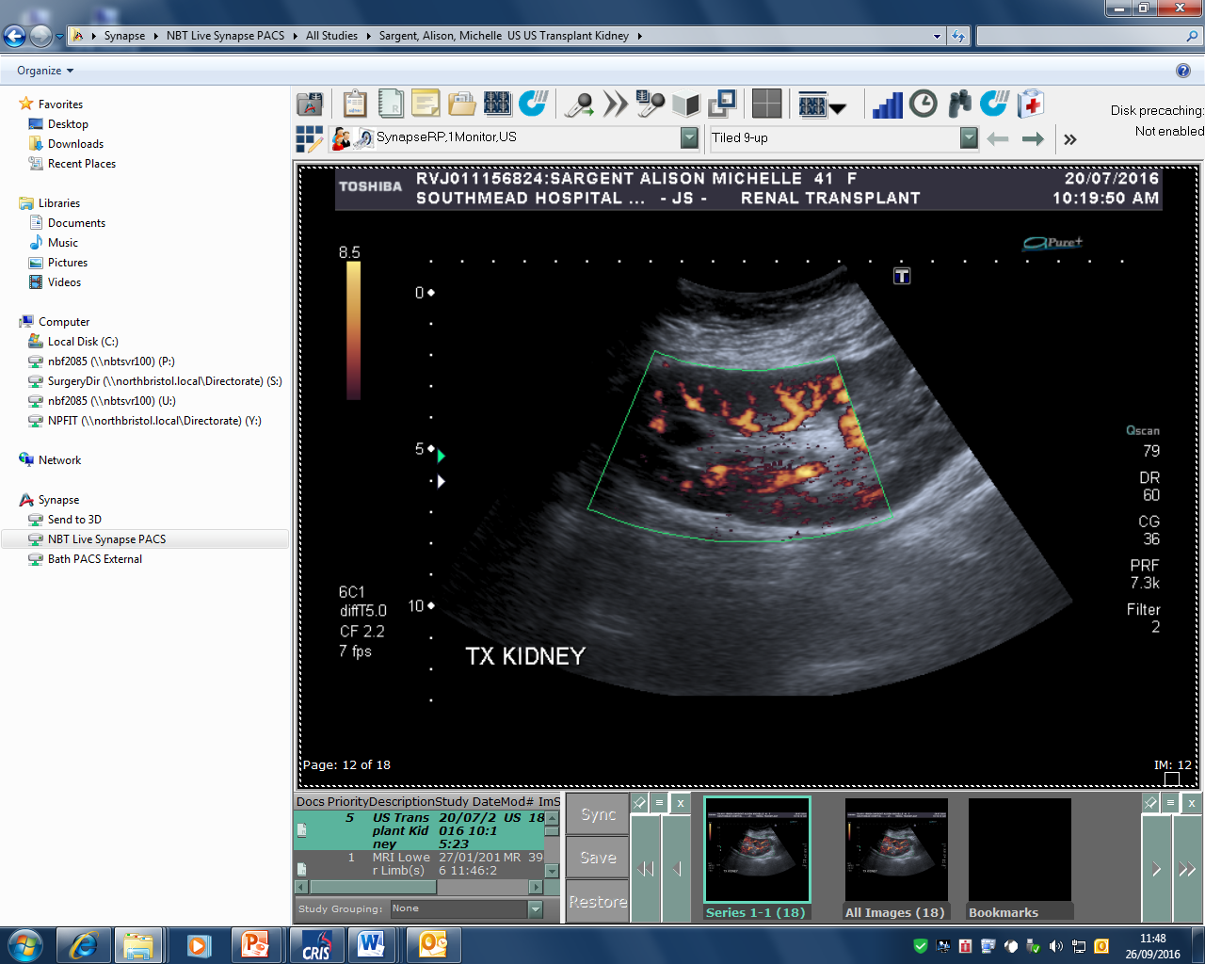
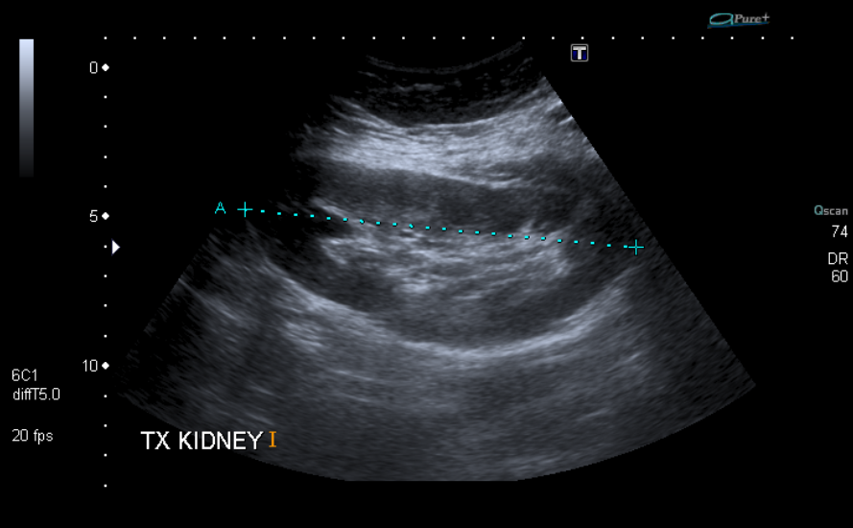
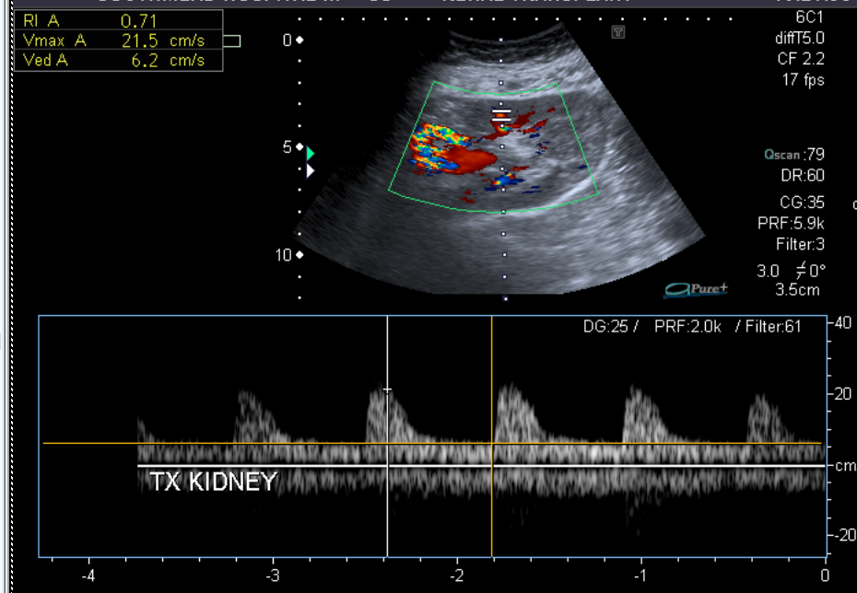
Tx Kidney patient Images
Notes:
These are some of the images that the sonographer saved for this patient.

Slide 22
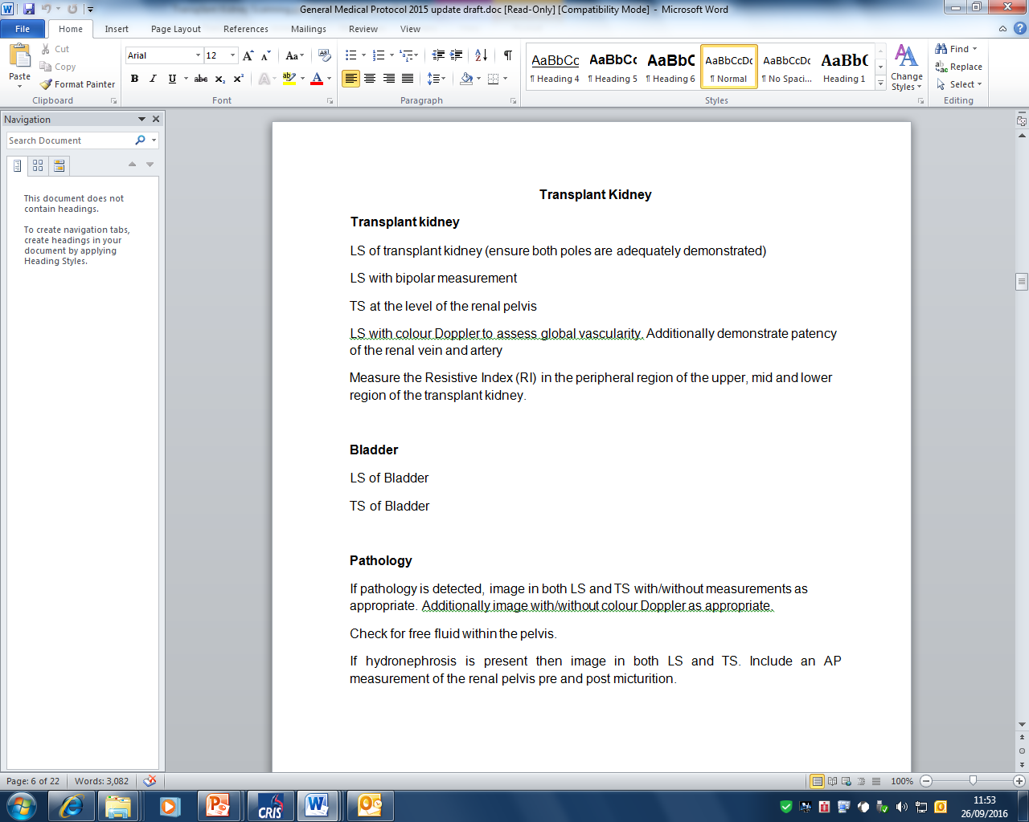
Protocol
Notes:
This is general ultrasounds kidney transplant protocol which is basic.
With the post-op scan there is no deviation from the above protocol. They do not specifically look at the txp renal artery/vein and the anastomoses to the iliac system.
What about surgical complications? Would that be useful.
Timings of scans?

Slide 23
Conclusion
New transplant consultants
? Changes to surveillance
Potential future involvement?
Notes:
The trust have appointed a couple of new transplant surgeons which lila, Simon and I were involved with.
It would be interesting if they bring any changes or recommendations to the surveillance of transplant kidney scans.
Also it is a thought that potentially we could have some kind of future involvement in the scanning of transplant kidneys. Maybe looking at potential vascular surgical complications?

