Slide 1

Ultrasound - A Tool for Deep Venous Disease Assessment & Surveillance
1
Vikki Galgerud
Accredited Vascular Scientist – IVS, Royal Oldham Hospital
Taha Khan
Vascular Consultant – Royal Oldham Hospital
Additional Thanks to Bex Patton
Notes:
Hi, My name is Vikki and I work closely with Taha at Royal Oldham Hospital. When Taha joined us he brought with him a new technique for venous stenting.
Chronic Venous disease and Post Thrombotic Syndrome (PTS) can have various presentations, pain, oedema, heaviness, aching, and ulceration as the skin breaks down under excessive venous pressure. Whilst risk to life is low, the quality of life for these patients is very low and comparable with other debilitating disorders such as COPD, Heart Failure and Diabetes.
Venous stenting has shown to relieve these symptoms and greatly improve quality of life in these patients.

Slide 2
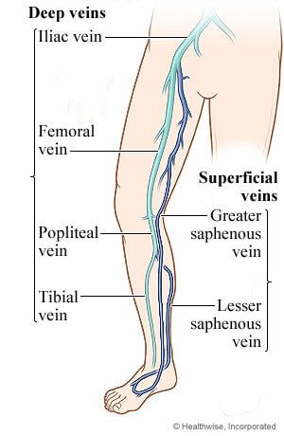
Veins in the lower limbs
2
Superficial venous system
Deep venous system
Notes:
Not going to focus on the superficial system, today, the only thing to note is that the superficial system offers a degree of inflow in a venous stent patient, so it is worth noting the patency during the initial scan.

Slide 3
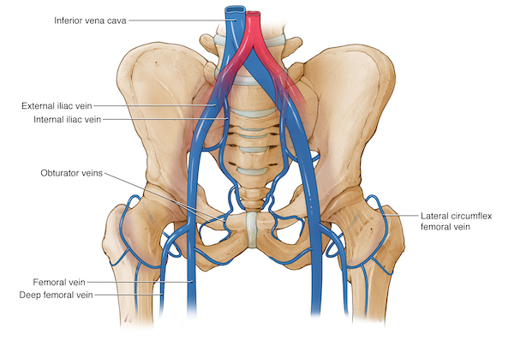
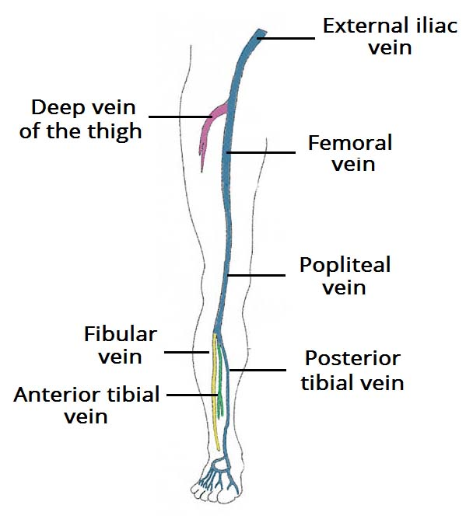
Deep Veins
3
(Lower limbs)
Notes:
The main veins in the deep system I will be talking about will be the IVC, iliac veins, CFV, PorfV, SFV and PopV. Calf veins are not as crucial to inflow, HOWEVER if it is acute this is relevant information.

Slide 4
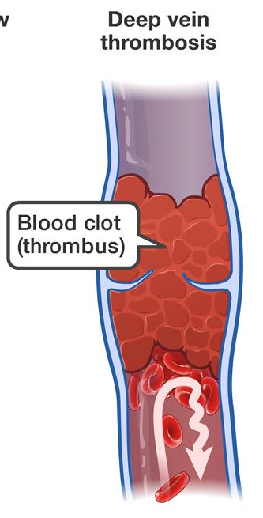
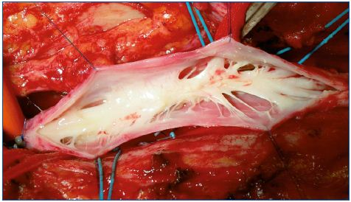
Disease Morphology
4
Disease morphology
Thrombosis
Fibrosis
Thrombosis + fibrosis
Notes:
DISEASE MORPHOLOGY –
Ultrasound can determine chronic or fresh disease.
Is if fresh thrombus – Appears echolucent on US
Is there fibrosis – Chronic disease appears as a bright echogenic regions on US. Fibrosis as striations through the vessel lumen.
Are both present? – has fresh thrombus formed on fibrotic lesions? This can be difficult but not impossible to assess. Compression of the vessels can help to diagnose this.

Slide 5
Pattern of Disease
5
Acute (thrombus)
Chronic (Fibrosis)
Acute on Chronic
Compression (NIVL)
Combination of the above ( Most common).
Special Scenarios – Eg Radiotherapy.
Notes:
Pattern of disease progression
Most scenarios have a combination of the above.
Repeated iliac compression can cause thrombus to form in the vessel distal to the region of compression.

Slide 6
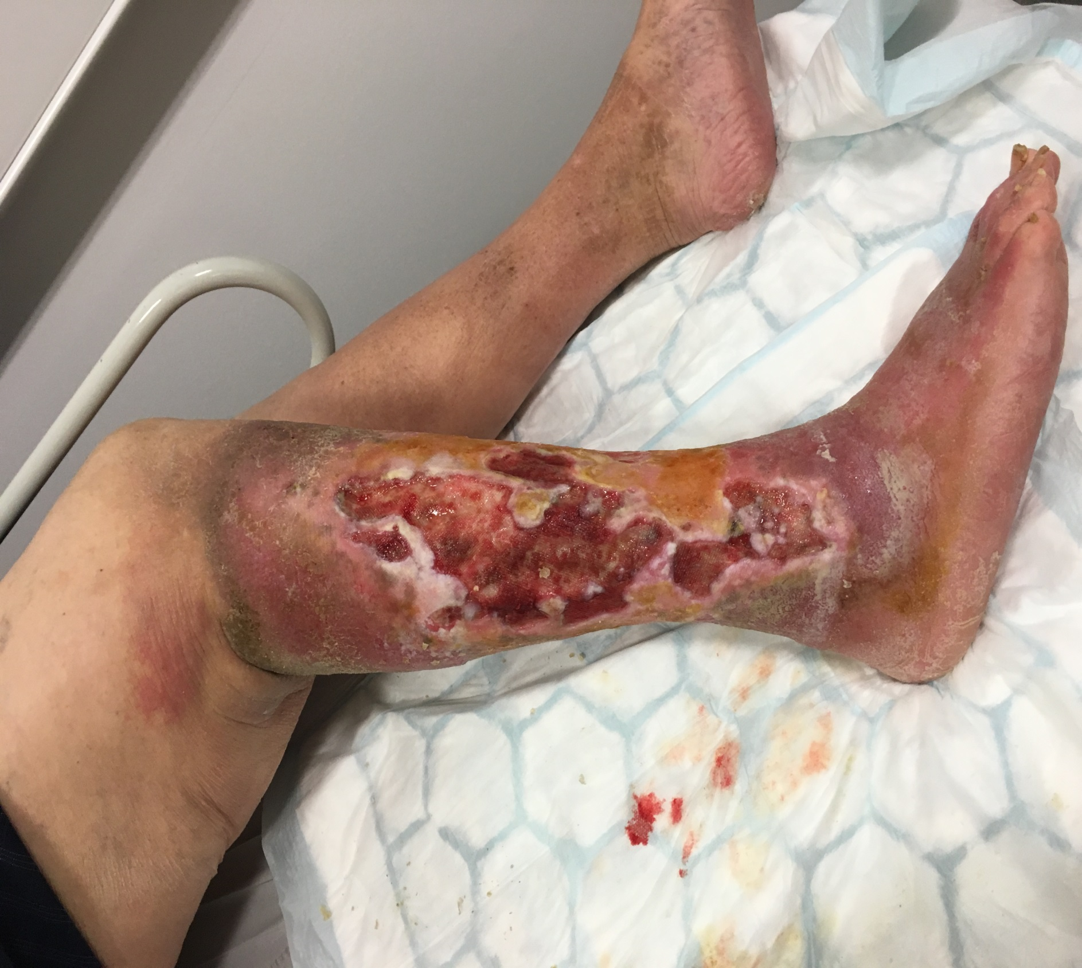
Venous Disease and PTS
6
Notes:
If left untreated or is poorly diagnosed or treated ulceration can develop. We have all seen the extent of venous ulcers and the symptoms of venous disease.
Symptoms of PTS;
Some or all of these symptoms can occur in the affected leg:
Long term pain
Continued or intermittent swelling
Aching
Cramp
Itching
Numbness l Hardened or dark patches of skin
Leg ulcer
You are more likely to get PTS if you:
are over age 65 years
have a blood clot in the deep veins above the knee (a condition called proximal DVT)
have more than one blood clot in the same leg at least twice
have blood clot symptoms one month after being diagnosed with the blood clot
are very overweight
have trouble keeping your blood thinner levels stable during your first three months of treatment

Slide 7
Summary of Venous Disease
7
Treatment
Acute
Thrombolysis (lysis)
+/- venoplasty
+/- stent
Chronic
Venoplasty +/- Stent
Acute
DVT
Iliofemoral DVT
Chronic
Post-thrombotic syndrome (PTS)

Slide 8
Historic Treatment of Deep Venous Disease and Post Thrombotic Syndrome (PTS)
8
Living with PTS
Different approaches to treating PTS
Anticoagulation
Early Venous Stents
Notes:
1 – Living with PTS – Debilitating pain, swelling, ulceration and in a minority – need for amputation.
2 - Past treatments – Compression stockings – Dressings – Patients don’t tolerate this well.
3 – Blood thinners –life on anticoags – Compliance, forget to take it – Risks – Bleeding, stroke, gastrointestinal bleeding.
4 – Tried and failed – Traditional tried to treat this with compression and anticoag – for young patients they just can’t accept this as a way of life Medical management alone does not treat PTS.
Early venous stent – Largely based around using arterial stents – Lacked adequate radial force (ability to push out and keep vein open) and has flexability issues
Now we have dedicated venous stents.
Stents would thrombose and occlude.

Slide 9
Venous Stenting
9
Advances in venous stents
Factors involved with intervention & decision making
Venoplasty/Thrombolysis – Performed prior to stenting.
Notes:
Get the newer stents out for people to look at
Factors involved in whether to stent a patient;
Patient ability to comply with anticoagulation and surveillance.
Inflow – Is the inflow though 3 vessels (CFV, PFV, LSV) good enough?
Benefit Vs risk – Is the patient 85 with minor swelling versus extensive ulceration???
Disease is not a factor
Catheter directed thrombolysis – Performed before the stenting procedure
Angiojet – Delivers litic agent into thrombus – after 30 mins suck clot out through same device.
EKOS – Ultrasonic vibration used to essentially vibrate the litic agent into the clot.

Slide 10
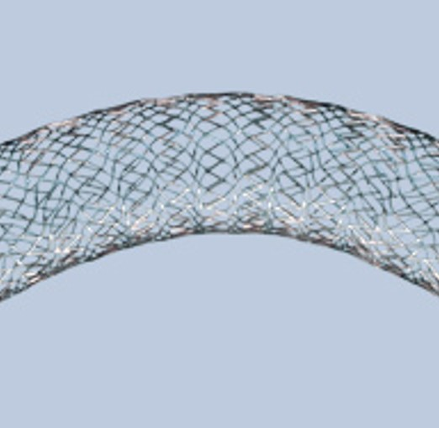
Modern Venous Stents
10
Boston Scientific
Vici – Closed Cell Stent
Notes:
Get the newer stents out for people to look at
Difference between open and closed cell stents – Why would you choose?

Slide 11
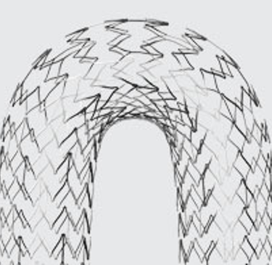
Modern Venous Stents
11
Medtronic
Abre – Open Cell.
Notes:
Get the newer stents out for people to look at
Difference between open and closed stents - It is the space between the struts – with closed cell stents there is less space between the struts so these stents are more rigid but have more radial force
Open cell stents have more space between the struts so these stents are more flexible but have less radial force.
Open cell stents are used where more flexibility is required e.g. as the vessel passes over the hip joint.
Close cell stents are used where radial force is more important e.g. iliac vessels

Slide 12
What is needed to ensure that the stents remain patent?
12
Flow – inflow and outflow
Compression / Stenosis / Occlusion
Thrombophilia (Haematology)
Technical
Notes:
Our role is to focus on the top 2
Inflow being from the SFV/ProfV/LSV

Slide 13
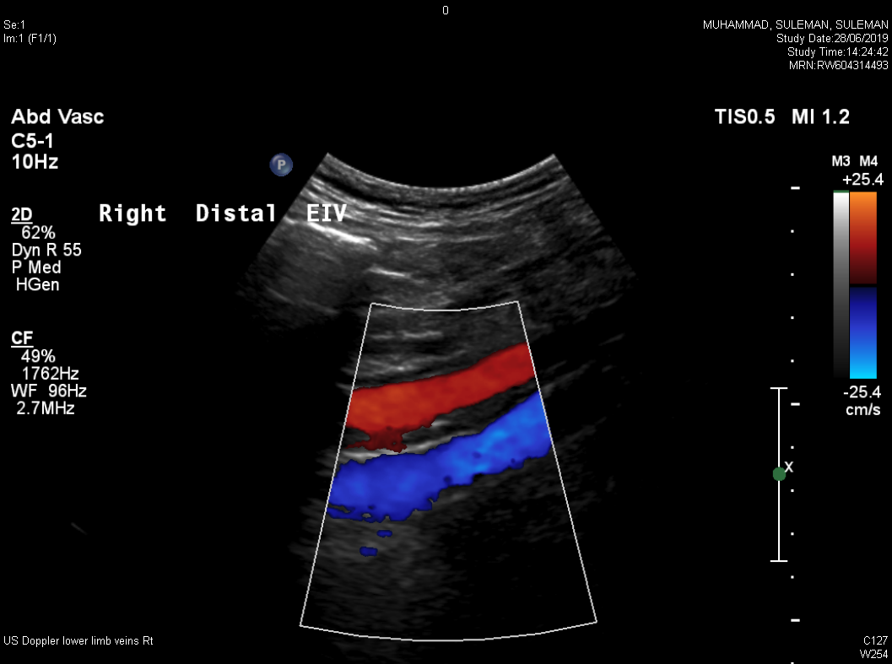
Imaging of The Deep Venous System
13
Cross-sectional (CT\MRV)
Venography
IVUS – Intravascular Ultrasound
Ultrasound Imaging
Notes:
Various ways to image the deep venous system –
Our consultants rely on all 4 imaging modalities to give a complete picture and to tailor treatment to the patient – for example, can they gain access antegrade via the SFV or retrograde via a the jugular vein.
Optimisation of iliac veins – colour box, scale, depth……..

Slide 14
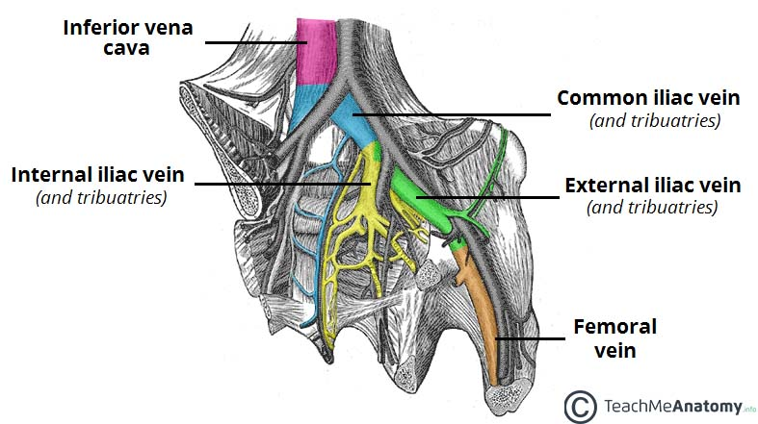
How is Our Role Useful?
14
Disease location
Pop vein to IVC
What can be stented
IVC
CIV
EIV
CFV
Is it important to directly visualise iliac veins?
Notes:
Vessels involved – What can be stented – IVC/CIV/EIV/CFV
PopV – IVC – Where along that venous tree is the disease.
See image of Valsalva –Does this look like a good Valsalva? wasn’t particularly phasic but did cause flow reversal, CVS wasn’t satisfied and checked the iliac veins anyway…..Patient had an occluded distal EIV.
Scanning iliac veins is important and to directly visualise them in someone presenting with venous symptoms, as assessing phasic flow alone may not be accurate – Collateral vessels can compensate.
Why can’t we stent leg veins? – Calibre – Smaller in diameter so stents do not do well. Only have one inflow and one outflow – CFV has inflow from ProfV and SFV.
MULTIPLE PLANES – Able to assess the vessel in transactional and longitudinal planes giving a more complete picture and the ability to try and look around calcified plaques.
TOOLS - Greyscale/Colour/Power/Spectral Doppler
NON INVASIVE – No exposure to ionising radiation, needles or potentially harmful contrast.
SUPERFICIAL AND DEEP – Able to assess both superficial and deep systems with good accuracy – limitations in patients with large body habitus.
DYNAMIC – Able to assess flow as it moves passed the transducer in an almost real time image, wall to wall filling, nature of flow through a vessel, how it behaves around thrombus. And assess surround tissues to highlight potential issues; infections etc.

Slide 15
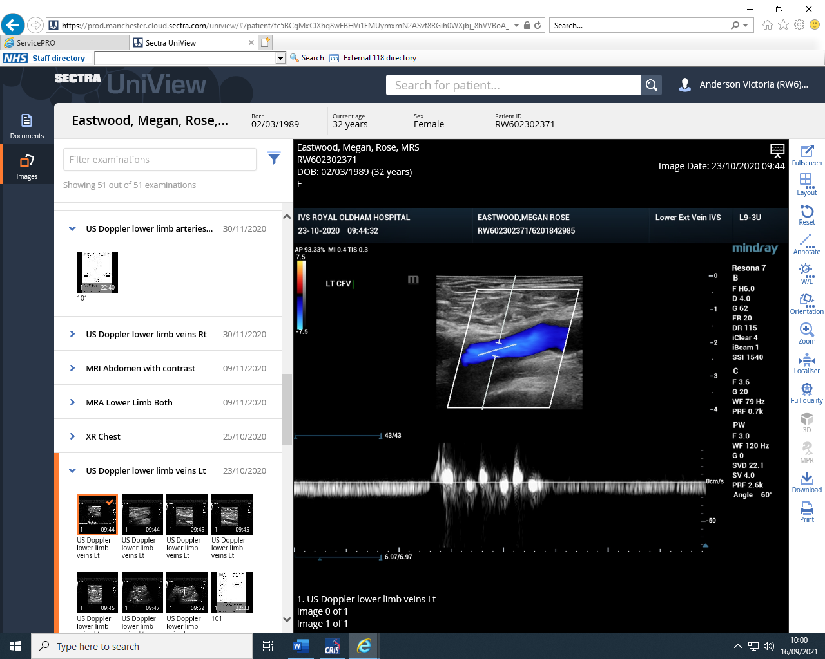
Is This a Good Valsalva?
15
Notes:
Vessels involved – What can be stented – IVC/CIV/EIV/CFV
PopV – IVC – Where along that venous tree is the disease.
Scanning iliac veins is important and to directly visualise them in someone presenting with venous symptoms, as assessing phasic flow alone may not be accurate – Collateral vessels can compensate.
See image of Valsalva –Does this look like a good Valsalva? wasn’t particularly phasic but did cause flow reversal, CVS wasn’t satisfied and checked the iliac veins anyway…..Patient had an occluded distal EIV.
Why can’t we stent leg veins? – Calibre – Smaller in diameter so stents do not do well. Only have one inflow and one outflow – CFV has inflow from ProfV and SFV.
MULTIPLE PLANES – Able to assess the vessel in transactional and longitudinal planes giving a more complete picture and the ability to try and look around calcified plaques.
TOOLS - Greyscale/Colour/Power/Spectral Doppler
NON INVASIVE – No exposure to ionising radiation, needles or potentially harmful contrast.
SUPERFICIAL AND DEEP – Able to assess both superficial and deep systems with good accuracy – limitations in patients with large body habitus.
DYNAMIC – Able to assess flow as it moves passed the transducer in an almost real time image, wall to wall filling, nature of flow through a vessel, how it behaves around thrombus. And assess surround tissues to highlight potential issues; infections etc.

Slide 16
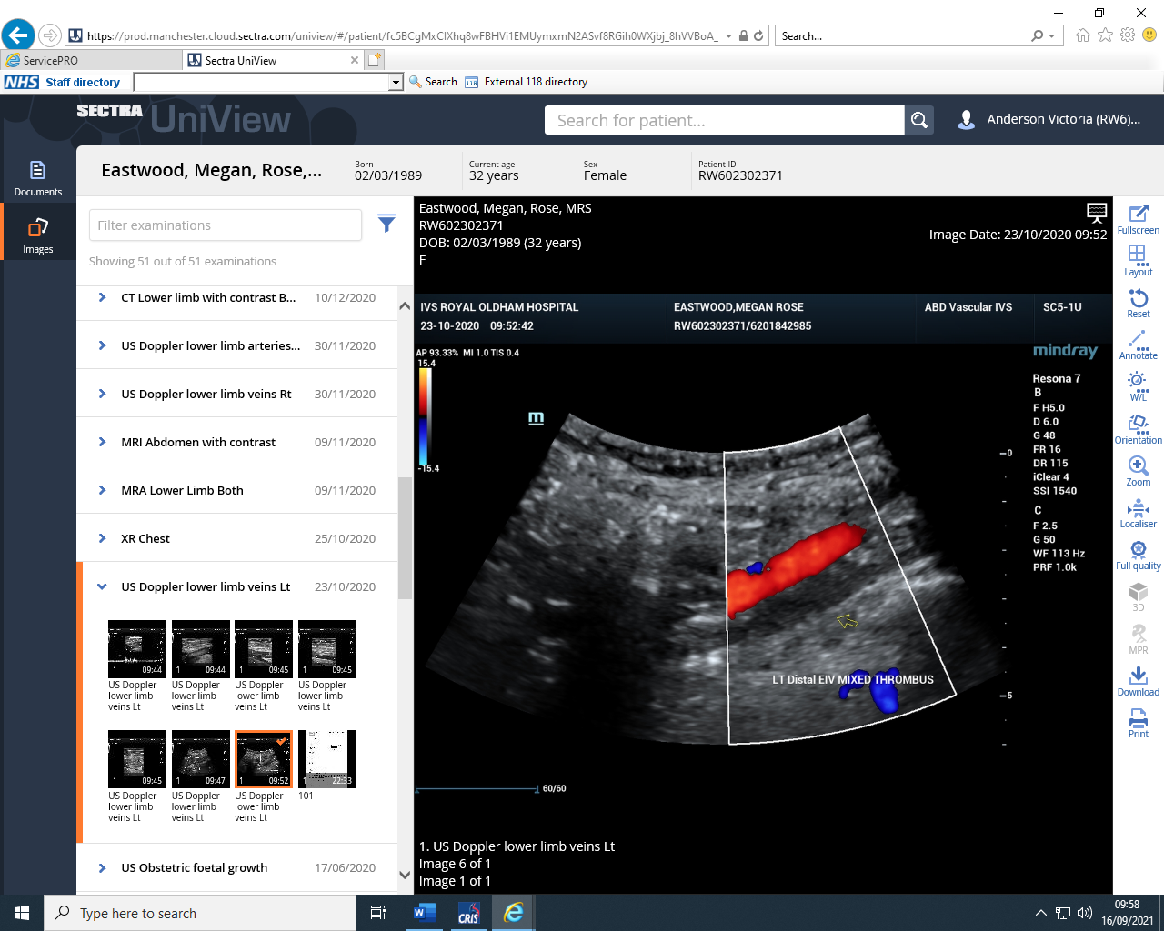
CVS Wasn’t satisfied….
16
Notes:
Vessels involved – What can be stented – IVC/CIV/EIV/CFV
PopV – IVC – Where along that venous tree is the disease.
Scanning iliac veins is important and to directly visualise them in someone presenting with venous symptoms, as assessing phasic flow alone may not be accurate – Collateral vessels can compensate.
See image of Valsalva –Does this look like a good Valsalva? wasn’t particularly phasic but did cause flow reversal, CVS wasn’t satisfied and checked the iliac veins anyway…..Patient had an occluded distal EIV.
Why can’t we stent leg veins? – Calibre – Smaller in diameter so stents do not do well. Only have one inflow and one outflow – CFV has inflow from ProfV and SFV.
MULTIPLE PLANES – Able to assess the vessel in transactional and longitudinal planes giving a more complete picture and the ability to try and look around calcified plaques.
TOOLS - Greyscale/Colour/Power/Spectral Doppler
NON INVASIVE – No exposure to ionising radiation, needles or potentially harmful contrast.
SUPERFICIAL AND DEEP – Able to assess both superficial and deep systems with good accuracy – limitations in patients with large body habitus.
DYNAMIC – Able to assess flow as it moves passed the transducer in an almost real time image, wall to wall filling, nature of flow through a vessel, how it behaves around thrombus. And assess surround tissues to highlight potential issues; infections etc.

Slide 17
How is Our Role Useful?
17
Disease location
Pop vein to IVC
What can be stented
IVC
CIV
EIV
CFV
?Why don’t we stent thigh veins?
Notes:
Vessels involved – What can be stented – IVC/CIV/EIV/CFV
PopV – IVC – Where along that venous tree is the disease.
Scanning iliac veins is important and to directly visualise them in someone presenting with venous symptoms, as assessing phasic flow alone may not be accurate – Collateral vessels can compensate.
See image of Valsalva –Does this look like a good Valsalva? wasn’t particularly phasic but did cause flow reversal, CVS wasn’t satisfied and checked the iliac veins anyway…..Patient had an occluded distal EIV.
Why can’t we stent leg veins? – Calibre – Smaller in diameter so stents do not do well. Only have one inflow and one outflow – CFV has inflow from ProfV and SFV.
MULTIPLE PLANES – Able to assess the vessel in transactional and longitudinal planes giving a more complete picture and the ability to try and look around calcified plaques.
TOOLS - Greyscale/Colour/Power/Spectral Doppler
NON INVASIVE – No exposure to ionising radiation, needles or potentially harmful contrast.
SUPERFICIAL AND DEEP – Able to assess both superficial and deep systems with good accuracy – limitations in patients with large body habitus.
DYNAMIC – Able to assess flow as it moves passed the transducer in an almost real time image, wall to wall filling, nature of flow through a vessel, how it behaves around thrombus. And assess surround tissues to highlight potential issues; infections etc.

Slide 18
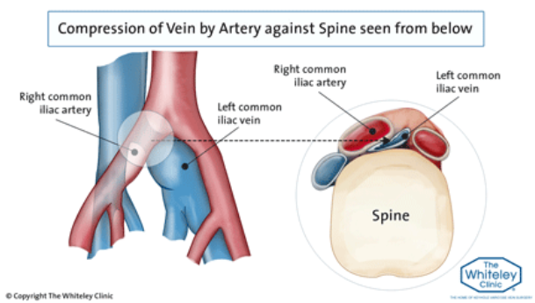
Venous Compression
18
May-Thurner
Surrounding organs
e.g. fibroids
50% Compression
will require
intervention
Notes:
May Thurner syndrome, where a vein is being compressed by an artery in various different locations as you can see on the diagram.
May-Thurner is traditionally is thought of as a female disorder – however since scanning more iliac veins it is apparent that men also suffer from May-Thurner.
Other forms of compression can come from surrounding tissues such ash Fibroids.
50% Level of compression is significant…………….Image in AP+ ML this can be used to compare once venous stent is in place.
Image found at : classic-May-Thurner-syndrome-left-common-iliac-vein-compressed-by-right-common-iliac-artery.png (448×258) (thewhiteleyclinic.co.uk)

Slide 19
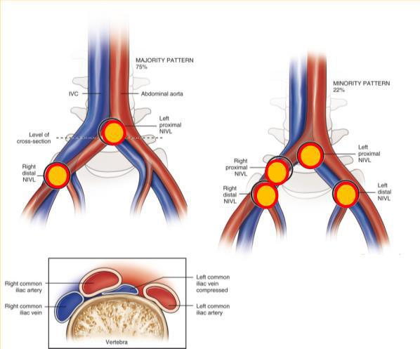
Points of Compression
19
Different regions of compression
R CIA / L CIV
Ipsilateral artery compressing underlying vein.
NIVL - None thrombotic iliac vein lesion
Notes:
Most common – RCIA over LCIV.
Other points:
NIVL – None thrombotic iliac vein lesion. - Lesion caused by compression not thrombus

Slide 20
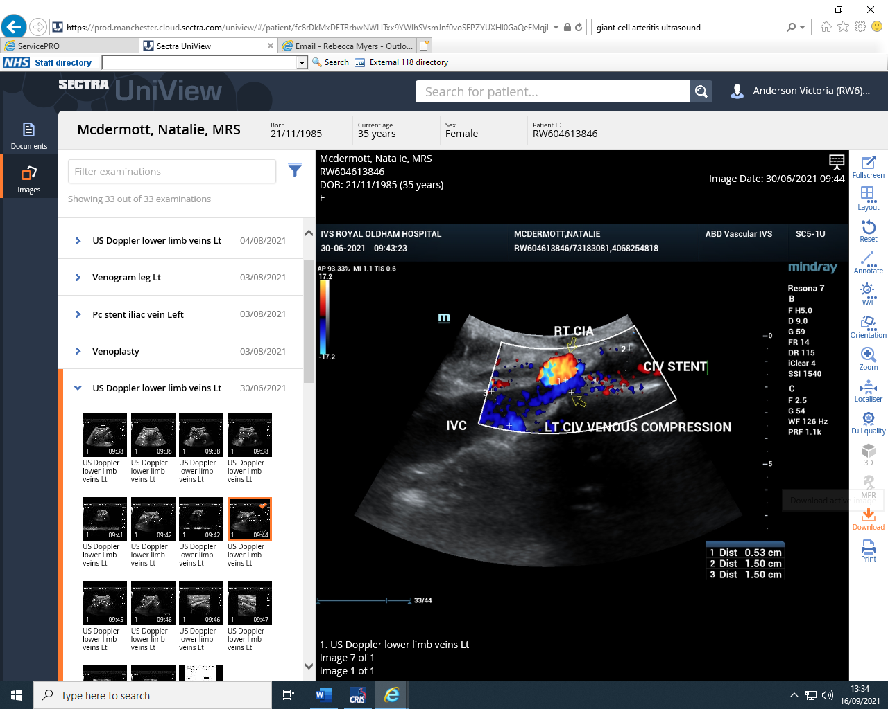
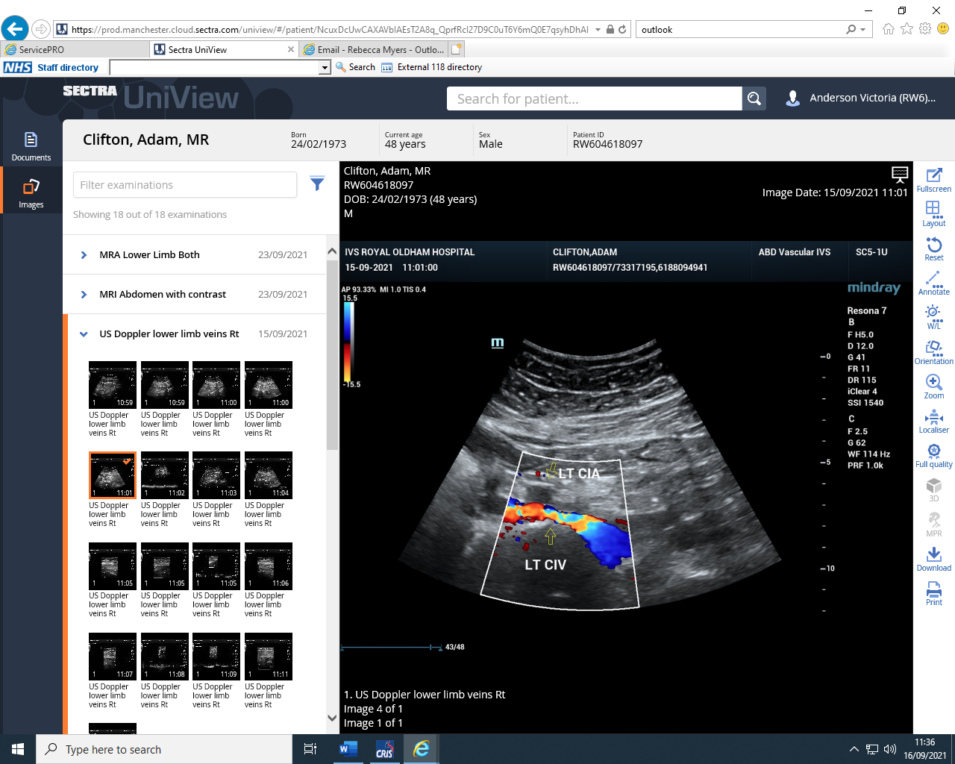
Venous Compression
20
Stent done in different hospital. Did not reach the IVC
Native L CIV being compressed by R CIA between stent and IVC
Stent was extended
Ipsilateral compression
L CIA compressing L CIV

Slide 21
Flow
21
“Healthy Vessel to Healthy Vessel”
Inflow
SFV
ProfV
PopV/LSV/SSV
Outflow
IVC
Iliac Vein
Notes:
Stenting is done from healthy vessel to healthy vessel – disease can be in between.
Level of disease in the SFV/ProfV –
PopV/LSV SSV – Also important to know the status of the PopV
LSV/SSV – Also provide a degree of flow.
Outflow – Must have somewhere to go that’s a healthy vessel.

Slide 22
Other Sonographic Features Relevant to stenting
22
Access points – SFV or IJV.
If IVC is diseased is contralateral CIV/EIV diseased also?
Competence
Notes:
Pre Stent Scan –
Disease morphology and location in the IVC/CIV/EIV/CFV/ProfV/SFV/PopV occasionally will require SFJ/LSV.
Any compression or narrowing of the veins (radiotherapy)
Is the inflow good enough for the stent to remain patent.
Access points – If the SFV is heavily chronically diseased then access will be better via the IJV
If IVC is diseased is contralateral CIV/EIV diseased also?
Competency – Requires orthograde flow from distal to proximal – Stockings can compensate.

Slide 23

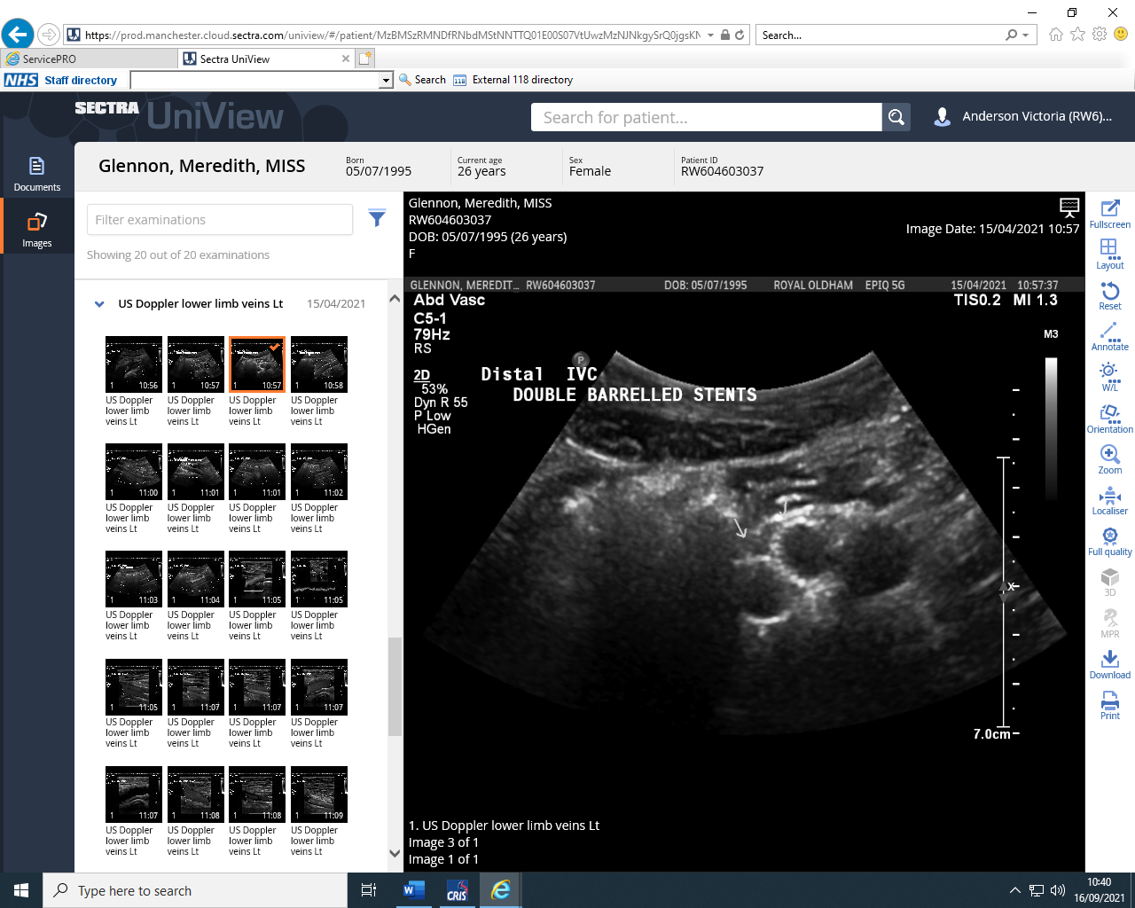
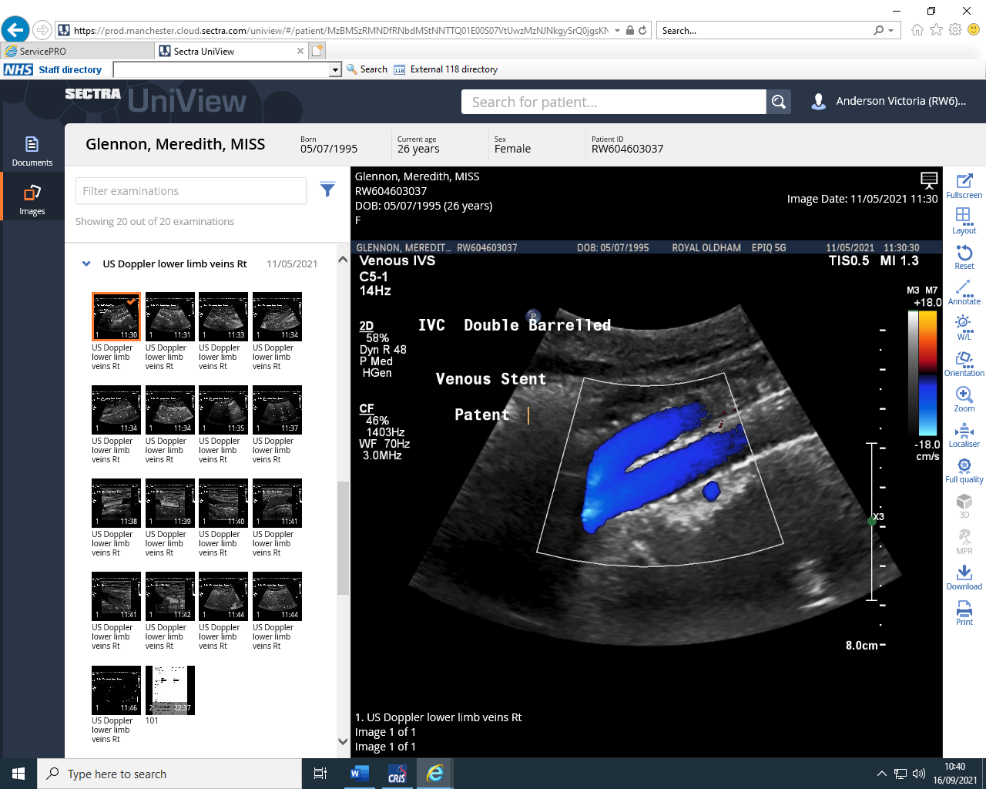
Post Stent Procedure Scan.
23
Where is the stent?
Is the stent patent?
Residual disease in CFV/SFV/ProfV – Inflow is really important at this point.
Distance from end of the stent to the ProfV (Day 0/1 scan)
Any residual compression.
Notes:
Post Stent Scan –
Where is the stent? Where does it start and end, Is it double barrelled if its bilateral venous disease?
Is the stent patent? Any disease found within stents needs to be measured in LS for % reduction and monitored – anything over 50% will require intervention.
Residual disease in CFV/SFV/ProfV – Inflow is really important at this point.
Distance from PorfV the stent ends (Day 0/1 scan)
Any residual compression.

Slide 24
Post Stenting Procedure Scan.
24
Where is the stent?
Is the stent patent?
Residual disease in CFV/SFV/ProfV – Inflow is really important at this point.
Distance from end of the stent to the ProfV (Day 0/1 scan)
Any residual compression.
Notes:
Post Stent Scan –
Where is the stent? Where does it start and end, Is it double barrelled if its bilateral venous disease.
Is the stent patent? Any disease found within stents needs to be measured in LS for % reduction and monitored – anything over 50% will require intervention.
Residual disease in CFV/SFV/ProfV – Inflow is really important at this point.
Distance from PorfV the stent ends (Day 0/1 scan)
Any residual compression.

Slide 25
Intervention for Diseased Stents
25
Over 50% thrombus identified within stent lumen
Thrombolysis performed again
Balloon venoplasty and/or further stenting.
Notes:
Catheter directed thrombolysis –
Angiojet – Delivers litic agent into thrombus – after 30 mins suck clot out through same device.
EKOS – Ultrasonic vibration.

Slide 26
Surveillance
26
Why is it important?
Time Frame
Day0/1
2 Weeks
6 Weeks
12 Weeks
6 months
Annually
Notes:
Why – 40% of stents that run into trouble will do so within the first 6 weeks.
If a stent blocks and remains so for longer than 4-6 weeks the candyfloss like clot inside it turns to rubber – fibrosis. Then it becomes much harder, almost impossible to get stent open again.
Cannot remove stents without significant open procedure. Vein will then occlude and shrivel up.

Slide 27
Documentation + Communication
27
Essential
Detailed
Accurate
Good Relationship
Notes:
ESSENTIAL - to extrapolate the information from the vascular scientist to the consultant.
DETAILED – To give the consultant the complete picture of the extent of disease. But at the same time being concise.
ACCURATE – Results must be accurate good images and cineloops demonstrating disease with an accurately written report.
GOOD RELATIONSHIP – Important to have a good working relationship between the C/AVS and the consultant trust what you are telling them. Being able to communicate any problems immediately to the consultant.

Slide 28
CASE STUDIES
28

Slide 29
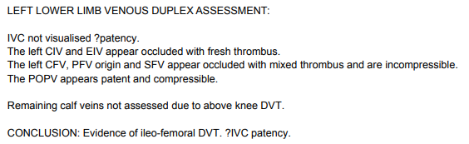
CASE 1 – 25yr F. Feb 2021
Notes:
Patient presented with OCC CIV/EIV/CFV/PFV/SFV –
PopV was patent.
IVC was not visualised……

Slide 30
CASE 1 – 25yr F.
Venogram performed 1 day later
IVC – Appears Stenotic/occluded
Also confirmed compression of L CIV at origin – May Thurner diagnosis
Right side occluded also to CFV level.
Pelvic Veins were also affected by acute thrombus.
Notes:
As the IVC is diseased it transpired that the right side was also diseased as were the pelvic veins, patient underwent bilateral vein stenting with double barrelled IVC stents.

Slide 31
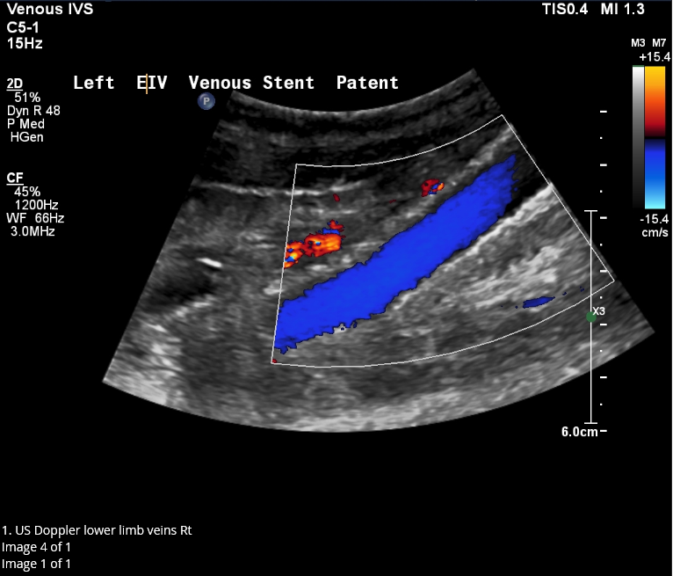
CASE 1 – 25yr F. Post Stent Duplex Day 1
Good patency of EIV post stent.
Controls have been well optimised.
Notes:
Day 1 post scan – Often difficult to obtain such good images on day 0/1 due to post procedure bowel gas, patient discomfort, dressings etc.
Important to optimise your controls for iliac vein scanning. Reduce scale, depth, sector width. Increase colour gain, change write priority.

Slide 32
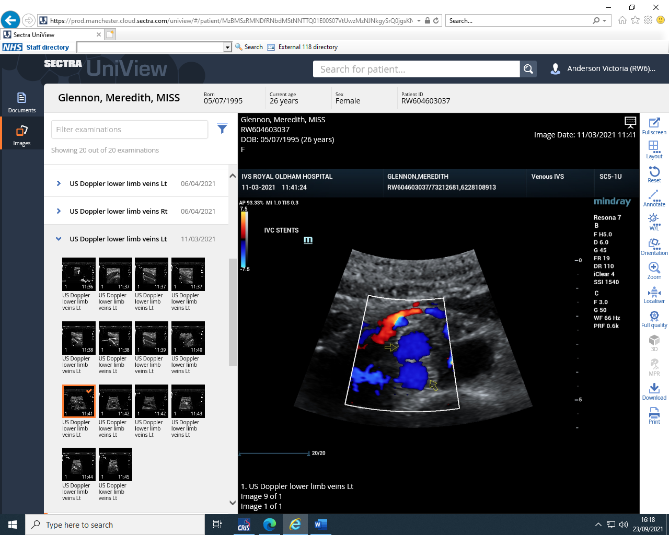
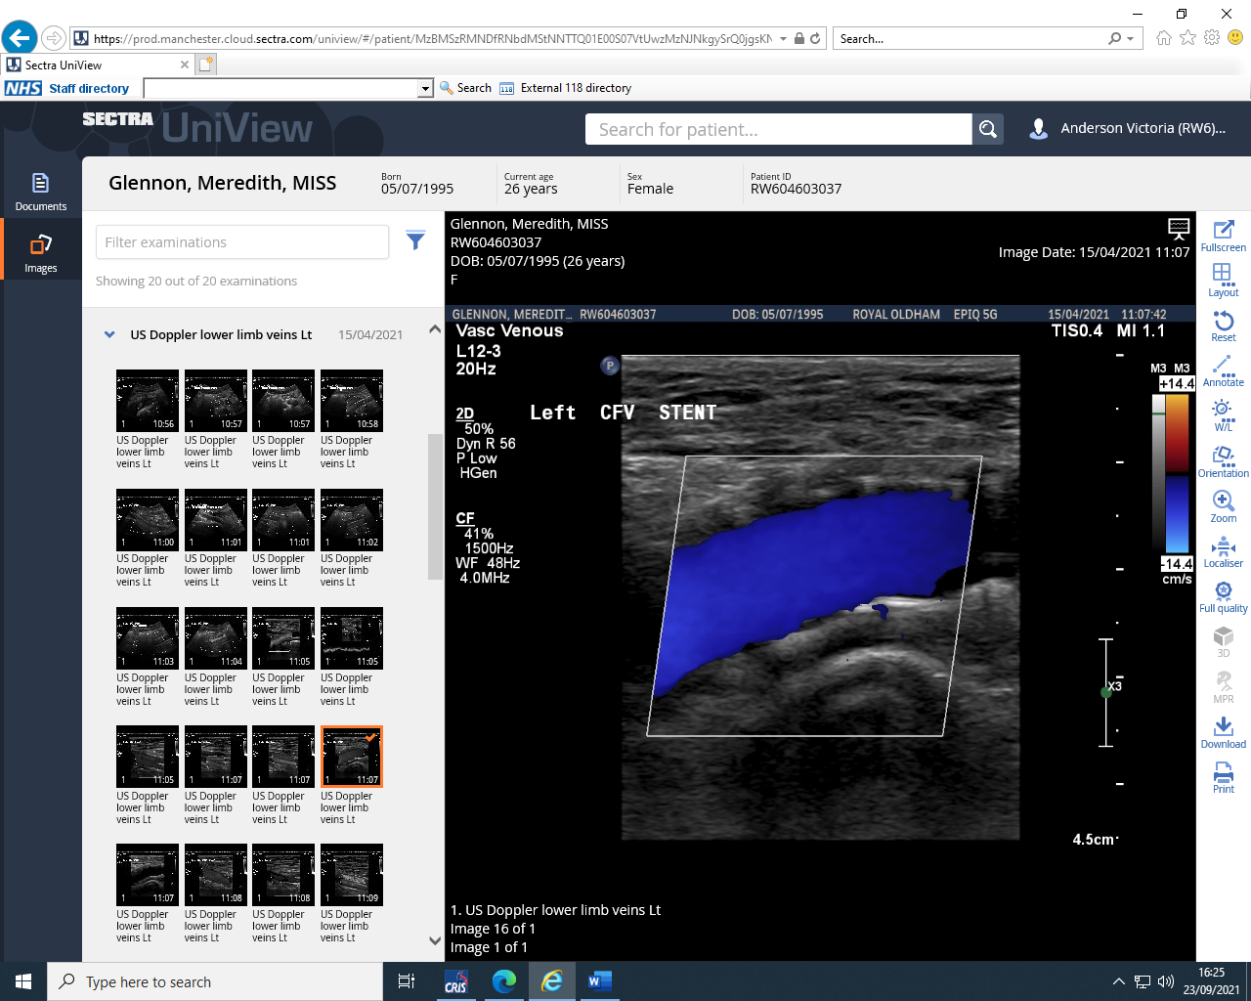
CASE 1 – 25yr F. Post Stent Duplex
12 Weeks post -
4 Weeks Post –
Patent IVC Stents
All stents reported patent.
All stents reported widely patent.
Notes:
Examples of vessels reported as widely patent at 4 weeks and 12 weeks surveillance.

Slide 33
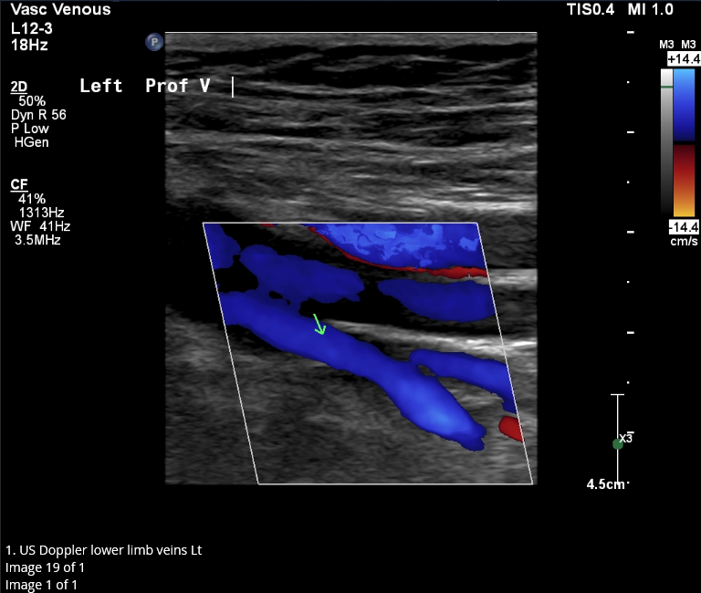
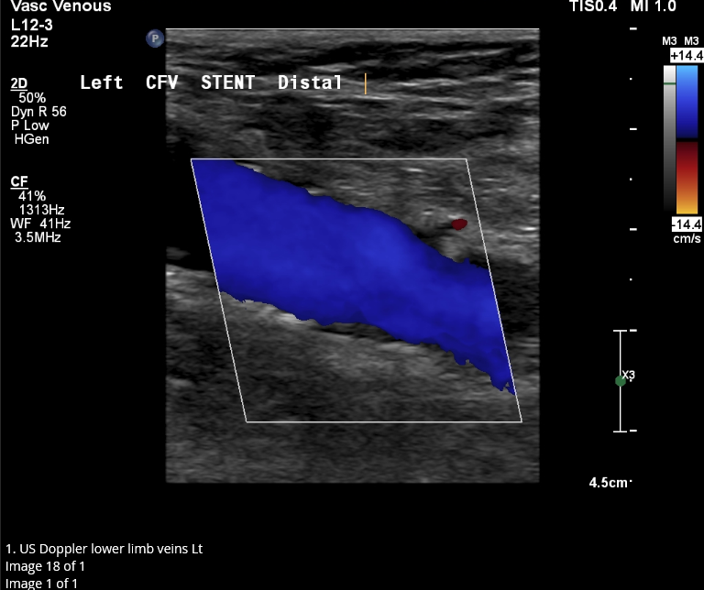
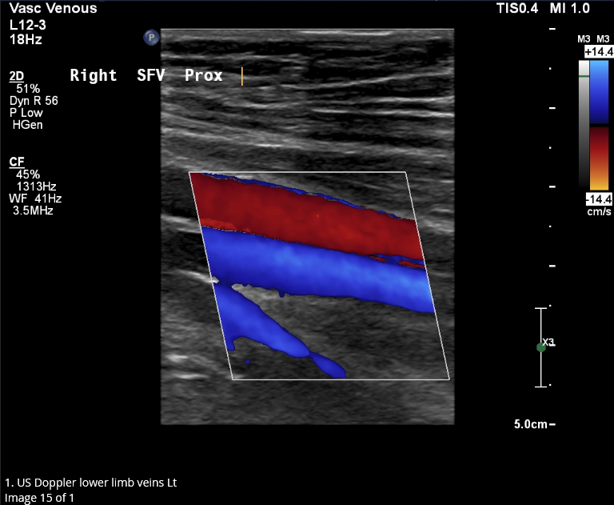
CASE 1 – 25yr F. Post Stent Duplex
Other vessels are patent due to thrombolysis performed on acute thrombus.
Notes:
Non stented vessels are patent due to thrombolysis performed prior to stent procedure.

Slide 34
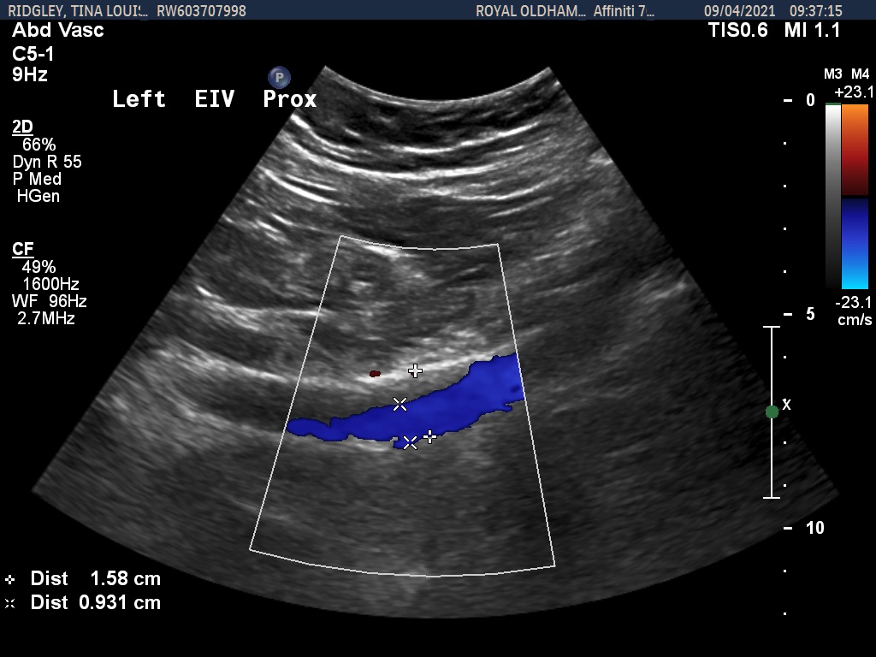
CASE STUDY 2 – 46F – 12 week Duplex
33
Scan shows 50-55% stenosis due to thrombus within stent lumen.
Notes:
46yr old female demonstrates >50% thrombus on 12 week post stent scan
Can be a challenge in the iliac system to grade the % stenosis accurately where the vessels dip away from the probe almost perpendicular to the probe. .

Slide 35
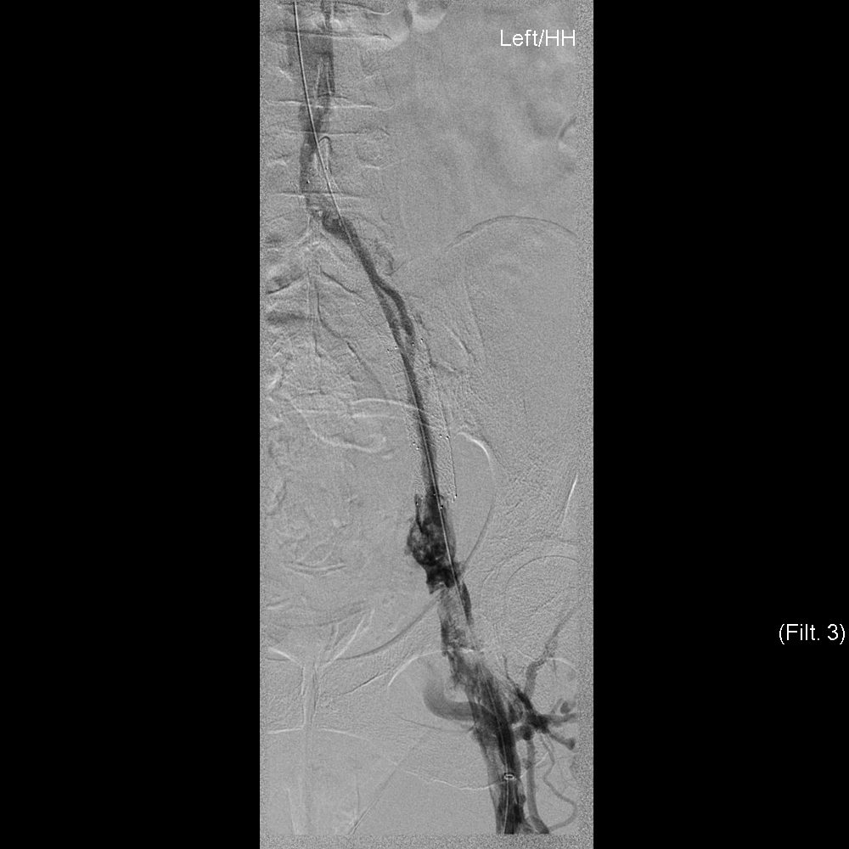
Case Study 2 – Venogram 12 weeks
34
A few days later
venogram was performed
Venogram demonstrates
stenosis.
Notes:
Venogram shows there is a stenosis between the 2 points – Supporting the Duplex result.

Slide 36
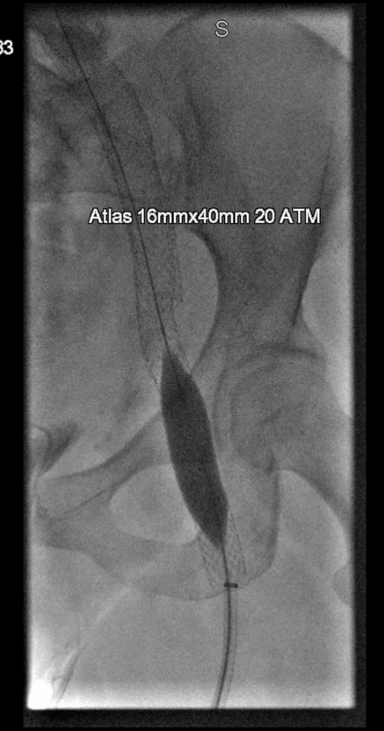
Case Study 2
35
Balloon Venoplasty performed
Extended the stent to the ProfV
Origin.

Slide 37
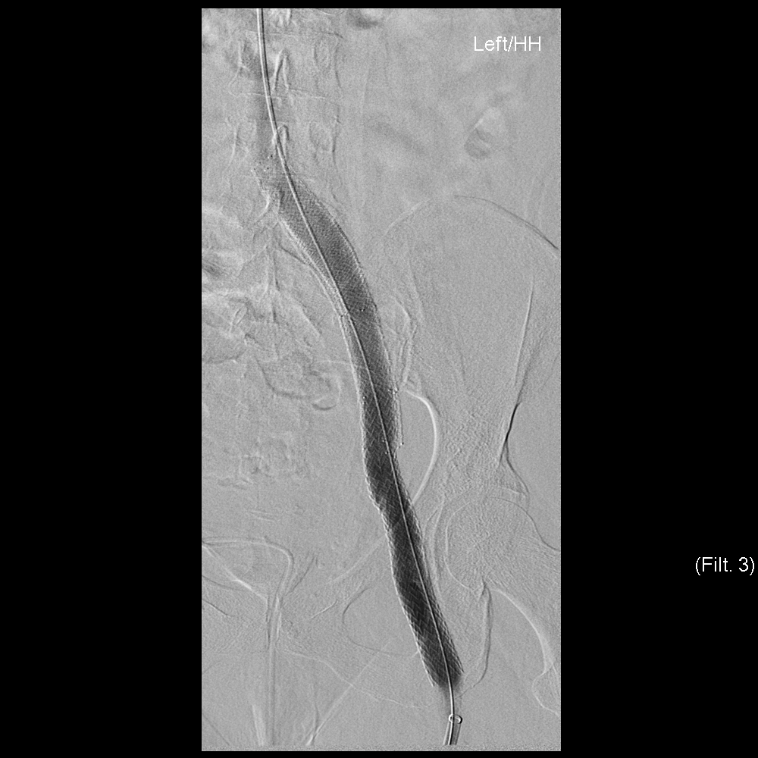
Case Study 2
36
Post procedure venogram
Good flow through previously
diseased stent.
Notes:
Demonstrates a good opacity of flow through the previously diseased vessel.

Slide 38
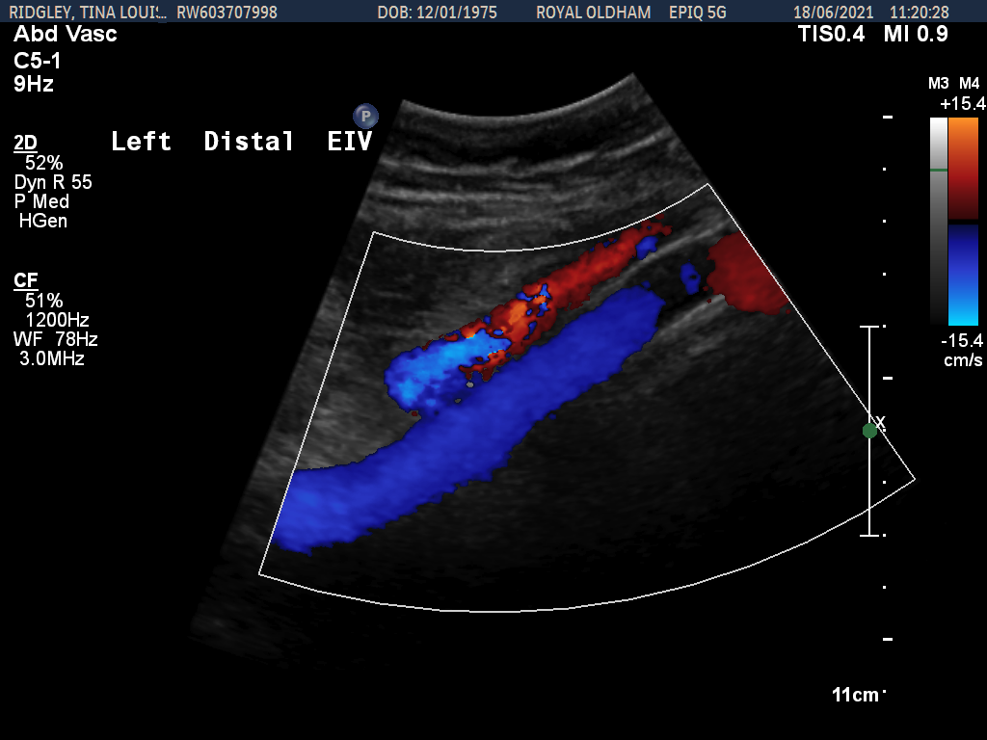
Case Study 2
37
Duplex imaging
demonstrating good flow.
Notes:
Vascular ultrasound performed to support the venogram result.

Slide 39
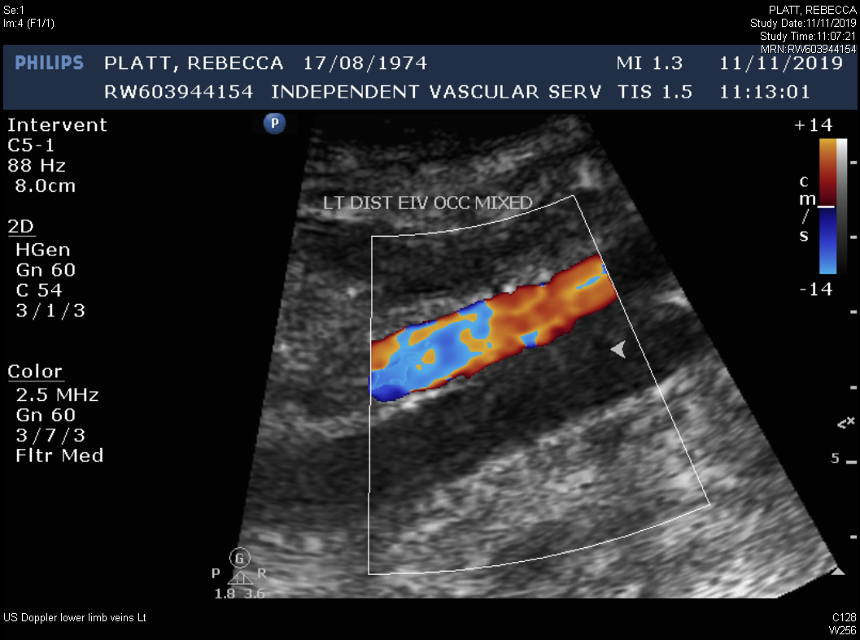
Case 3 - 45y F – 11th November 2019
38
Notes:
45yr Old female presents 11 Jan 2019 - presents to hospital with pain and swelling in left lower limb - US diagnoses extensive ileo-femoral DVT.
Over the next few days patient had Thrombolysis and a stent implanted.

Slide 40
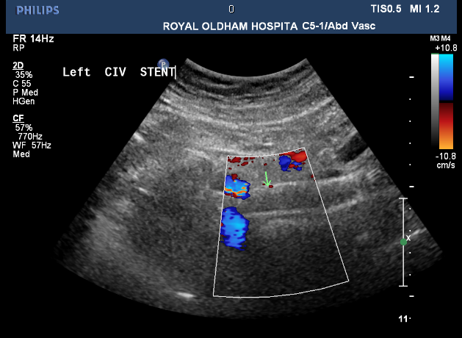
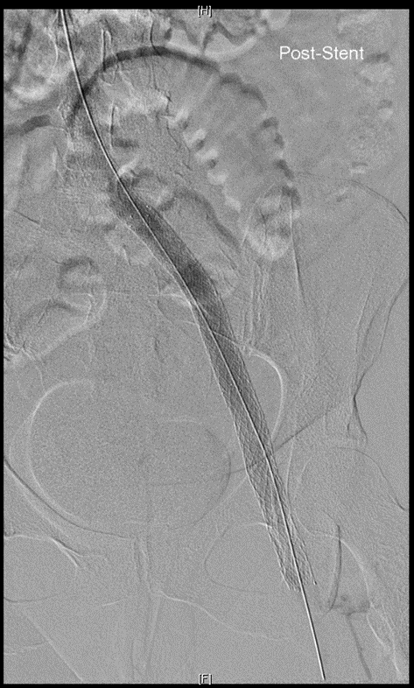
45y F – 25th November 2019
39
Notes:
Ultrasound queried if stent was occluded during routine surveillance. US suggested alternative imaging if appropriate.
Venogram showed stent was patent but with very low flow in the CIV region.
2 modalities working together – US highlighted a problem – Venogram confirmed flow and the next step was taken.

Slide 41
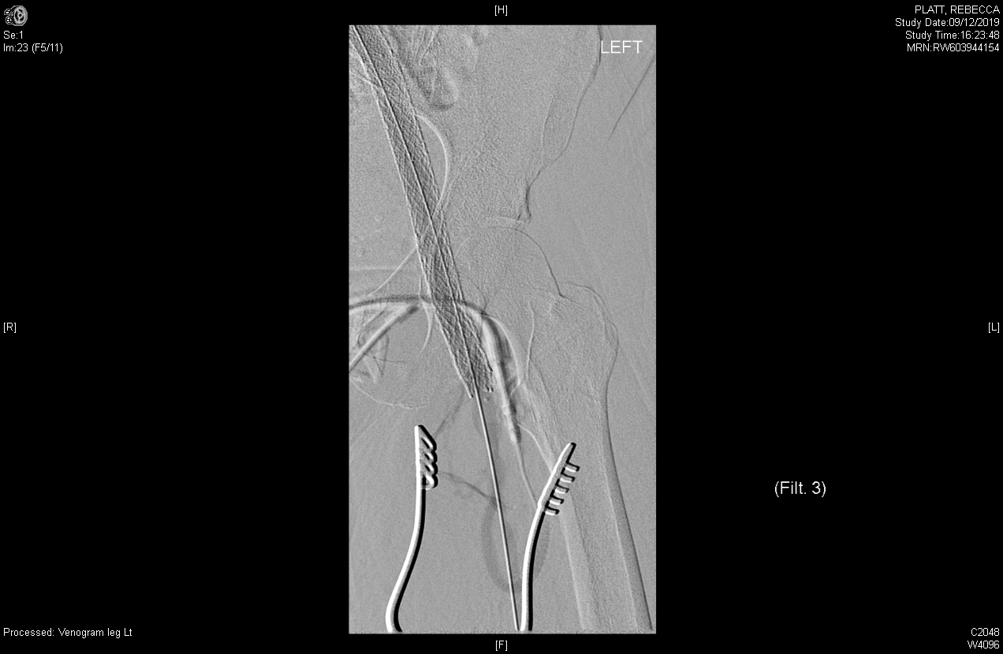
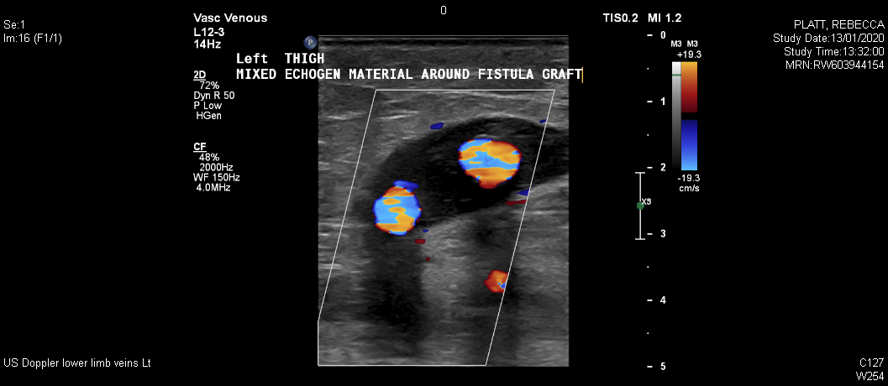
45y F. Fistula Implantation
40
Notes:
Patient had a fistula implanted connecting the Origin of the SFA to the SFV Utilising arterial pressure to increase the outflow in the lower limb into the stent to prevent the risk of failure.
US image shows TS image of widely patent fistula November 2019
May 2020 scan showed that fistula was still patent but starting to thrombose spontaneously – Which is the paln rather than further intervention to remove.

Slide 42
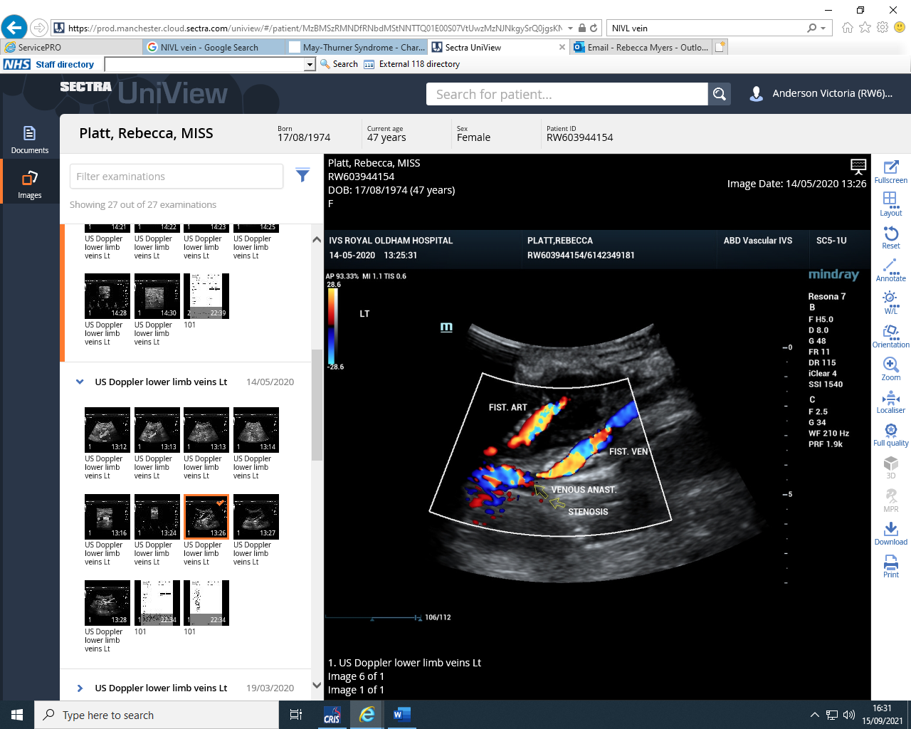
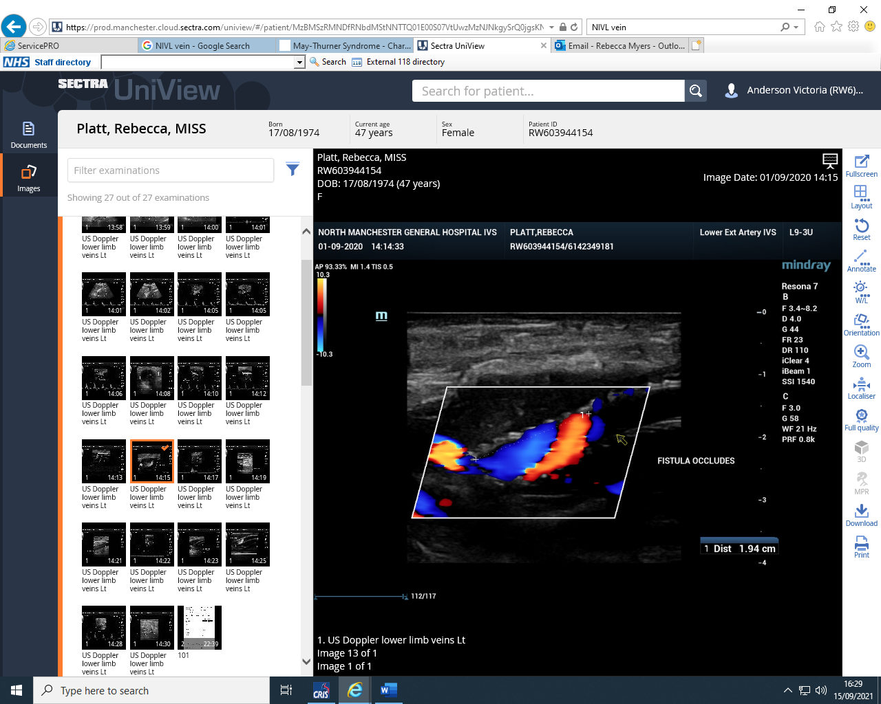
41
May 2020 – Fistula spontaneously occluding
Sep 2020 – Fistula has occluded
Notes:
Sep 2020 – Fistula occluded.
How will the fistula spontaneously occlude?

Slide 43
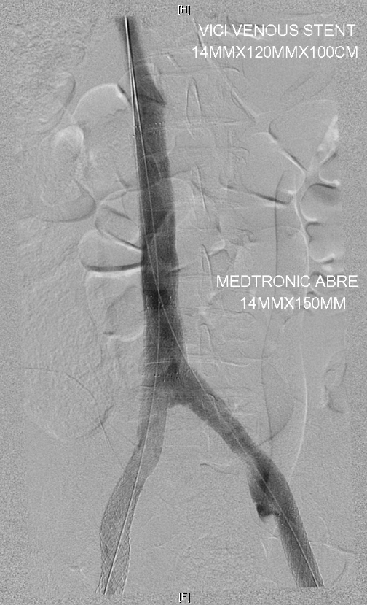
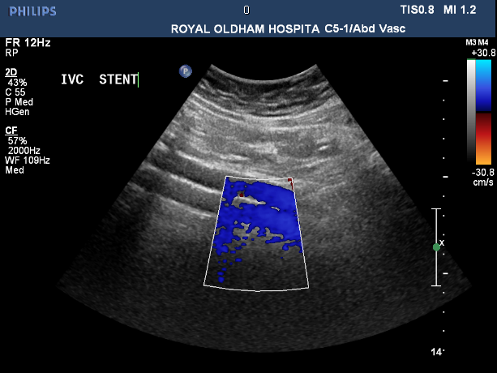
Challenges
42
Complicated anatomy/devices
Double-barrel IVC reconstruction
IVC
Bowel Gas
Scar tissue
Calcification
RSI Risk
Notes:
For example – Double barrelled IVC reconstruction – can be tricky to see both limbs depending on the angle, depth and other limitations of abdominal ultrasound.
IVC & CIV bifurcation – tricky to see as anatomically lies behind the umbilicus.
Other things that make it difficult – Bowel Gas – Scar tissue – Calcification of overlying arteries – Acoustic shadowing from overlying structures.
Beware of RSI – amount of pressure required to scan the abdomen is huge in some patients.

Slide 44
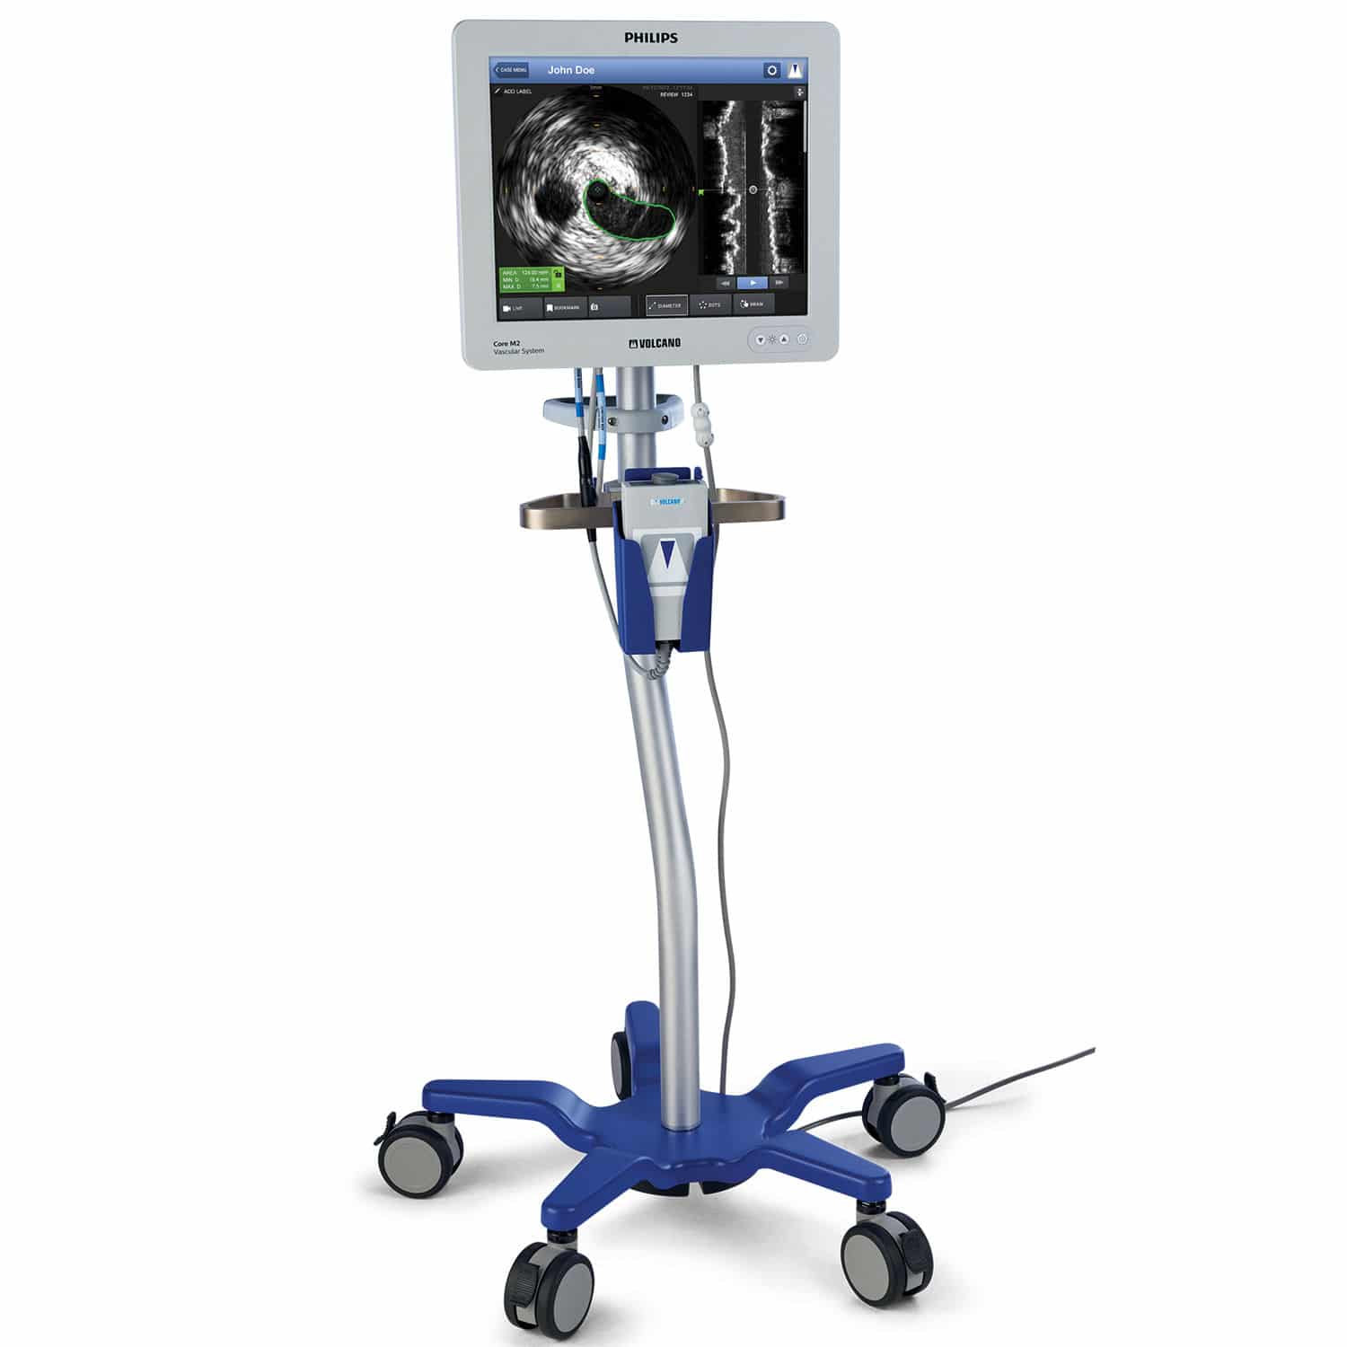
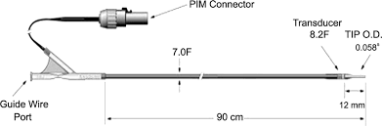
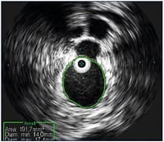
IVUS
43
Intravascular Ultrasound Scanning
Notes:
Intravascular ultrasound – Allows ultrasound views of a vein from the inside of the vessel.
The transducers have been miniaturized to less than four hundredths of an inch and placed on the tip of a catheter. This catheter can be slipped into the vessels over the same guide wire that is used to position angioplasty balloons or stents. It becomes, in effect, a tiny camera that gives us a cross-sectional view of the vessel
According to Venous news article “In comparison with IVUS, venography has proven to be a wholly ineffective means of determining degree of venous stenosis”

Slide 45
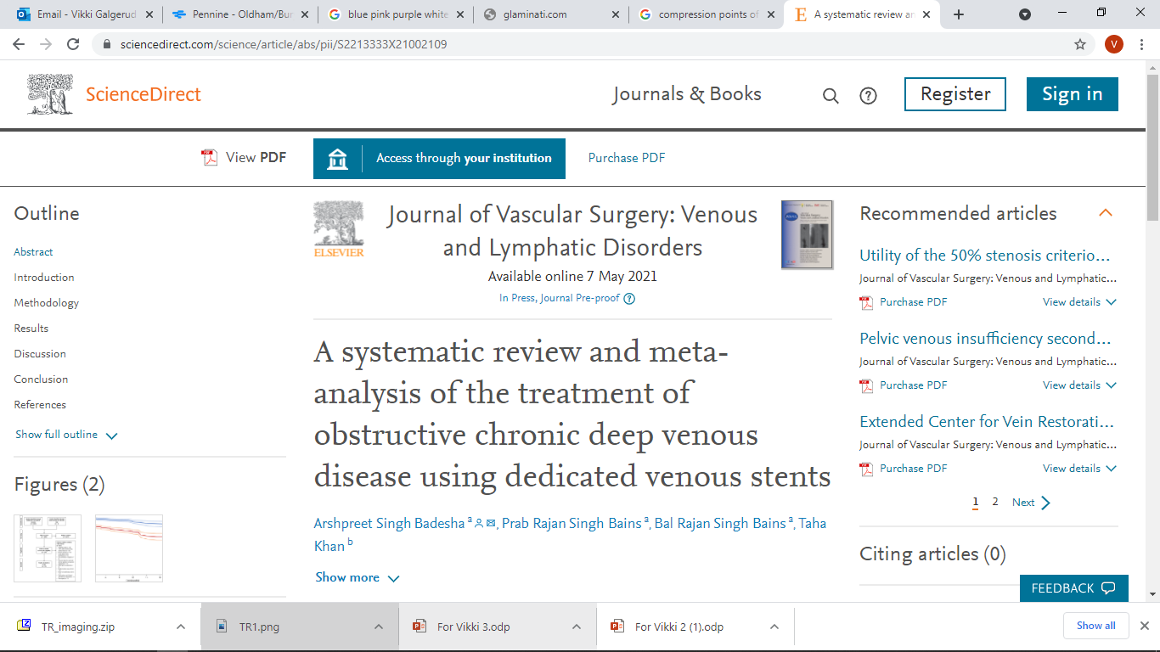
Success of venous stents
45
The pooled-primary and secondary
stent patency rates at 12 months
were 74.0% and 90.4%,
respectively. –
Conclusion: Deep venous stenting using dedicated venous stents is a safe technique to treat obstructive chronic deep venous disease and within the limitations of this study, is associated with good patency outcomes and symptomatic improvement.
Notes:
Interesting journal regarding the effectiveness of venous stenting – Quick Stat…

Slide 46
IN CONCLUSION
46
Deep venous disease is a significant burden to both the patient and society.
A standardised approach to deep venous duplex imaging is essential for pre stenting and surveillance scans.
Surveillance is essential to ensure stent patency and improve outcomes
Deep venous stenting is a developing field and is yielding significant benefits to patients.

