Slide 1

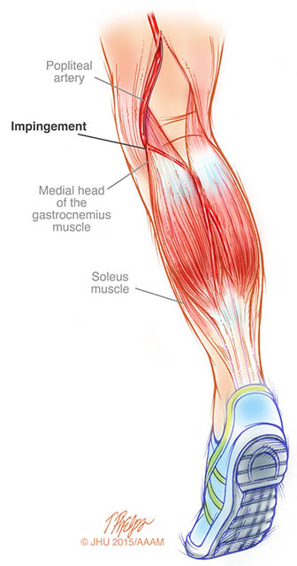
Popliteal Artery Entrapment Syndrome (PAES) - Research
By Mike Crook and Nazrina Islam
Notes:
So why have we decided to do a study? Well this all started when I got a phone call from Rich a few years or so ago to have a look at and update the scan protocols. I saw there wasn’t anything specific on popliteal entrapment and decided to write something for it. Unfortunately there isn’t much out there to work with and SVT protocol didn’t seem comprehensive enough. Previously we just used to look for arterial compression in dorsi and plantar flexion and having sat through MDT meetings where we had MR or CT saying one thing and ultrasound saying another and I was asked by the surgeons if we were sure the artery was being compressed; I though any protocol should include solid information such as a velocity shift or vessel diameter reduction. Unfortunately this sparked a debate in MDT, where the protocol was followed and the surgeons ask Steve well what do the velocity shifts mean, how severe is the entrapment. So this is where we find ourselves now and I’ll hand over to Naz to talk about the study.

Slide 2
What is popliteal artery entrapment syndrome?
Notes:
Popliteal artery follows an abnormal medial course
Medial head of gastrocnemius muscle lies in a lateral location impinging on popliteal artery that runs a normal course
An accessory slip of gastrocnemius muscle impinges the popliteal artery that runs a normal course
Popliteus muscle or fibrous band impinges the popliteal artery that runs a normal course
Types 1- 4 and the popliteal vein is also entrapped
Functional popliteal entrapment

Slide 3

Patient demographic
60% of patients are younger than 30 years old
Male to female ratio of 15:1
Professional sportsmen/women or people in physical jobs
Precise prevalence is unknown
Notes:
Who does it affect?
Precise prevalence is unknown but in a post mortem study ~4% of the bodies had one form of anatomical defect. So it seems an anatomical issue is more common than symptoms? The other thing of note is that popliteal entrapment is often bilateral with studies suggesting rate between 22 – 67%.

Slide 4
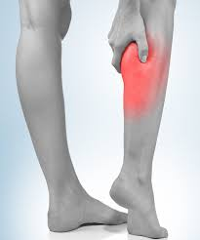
What are the symptoms?
Pain/Tiredness/cramp localised to calf muscles, often during exercise
Paraesthesia (Numbness)
Cold foot and calf
Swelling
Discoloration of the toes and nails

Slide 5
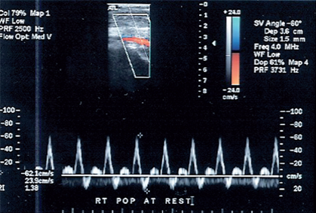
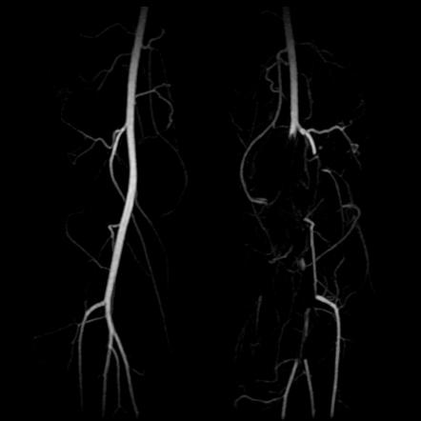
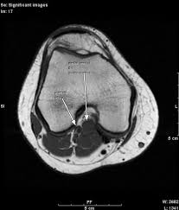
Diagnosis
Ultrasound (US)
CT/CT angiography
MRI
Angiography/DSA

Slide 6
Alternative Diagnoses?
Venous thrombosis
Muscle rupture
Compartment syndrome
Accelerated atherosclerosis
Tibial stress fractures
Tendonitis
Arteritis
Thromboangiitis obliterans
Cystic adventitial disease
Arterio-venous fistula
Neuropathy
Notes:
As you can see there are loads of alternative diagnoses, you can see from this why it is often difficult to reach a diagnosis. However, since the patients that we see with regards to this are usually young and athletic, more often than not symptoms are due to MSK issues. However there is a general consensus the Popliteal entrapment is under diagnosed.

Slide 7
Management
Surgical release of the gastrocnemius muscle
Botox injections
Debulking
Vascular reconstruction
Catheter mediated thrombolysis

Slide 8
Case Study
https://www.youtube.com/watch?v=deugGU69qnw
https://www.ncbi.nlm.nih.gov/pmc/articles/PMC5769514/
https://www.jvascsurg.org/article/0741-5214(91)70048-C/fulltext
https://www.ncbi.nlm.nih.gov/pmc/articles/PMC4592677/
https://www.ejvesreports.com/article/S1533-3167(06)00066-5/fulltext
file:///C:/Users/nislam/Downloads/ECR2012_C-1736%20(6).pdf
https://www.sciencedirect.com/science/article/pii/S0741521499700984
https://journals.lww.com/acsm-csmr/fulltext/2015/09000/Popliteal_Artery_Entrapment_Syndrome.11.aspx
Notes:
Present case study to put things into context

Slide 9



The development of a Popliteal Artery Entrapment Syndrome (PAES) diagnostic criteria using duplex ultrasound imaging -Pilot Study
Chief Investigator - Mr. Wolowczyk
Principal Investigators – Steven Rogers and Mike Crook
Co-investigator – Nazrina Islam

Slide 10
Currently…
US is first line diagnostic tool but used in conjunction with other imaging modalities
No set NICE/SVT guidelines
Current US ‘criteria’:
-’Eyeballing’ vessel in different stress positions with and without resistance
Subjective
↑ false negative/false positive results
Notes:
Despite the increased recognition of PAES, it is still poorly understood and often misdiagnosed – there is no consensus amongst clinicians when it comes to strategies, diagnosis or management.
Though ultrasound is frequently utilised in diagnosing PAES – currently, there is no universal diagnostic criteria in place for PAES using ultrasound. Ultrasound imaging is cost-efficient, non-invasive and is an ideal first line technique for diagnosing PAES compared to CT and MRI.
Popliteal artery occlusion without resistance is a more severe form of PAES than when popliteal arterial flow is limited with resistance. ¹⁸ An increase in velocity of the popliteal artery can also be an indication of PAES with flexion manoeuvres.
One study found two of seven affected limbs had normal ultrasound findings both in neutral and flexion movement

Slide 11
Study objectives
To develop a diagnostic criteria for the diagnosis of PAES with the use of duplex ultrasound: velocities and diameters of popliteal artery
To develop a gold standard diagnostic criteria for PAES which can be adopted universally by global healthcare systems
Notes:
This pilot study aims to

Slide 12
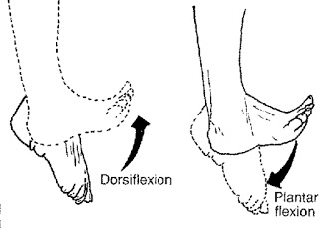
Investigation
Full bilateral arterial scan
ABPIs will be taken
Popliteal arteries will then be assessed:
-Velocities and diameters of proximal and distal regions
In both dorsi- and flexi-position
No resistance
Moderate resistance
High resistance
Notes:
Graded dynamic assessment is then performed using B mode and colour Doppler imaging. The ankle is actively plantar flexed without resistance and external compression of the artery is checked. The sonographer or assistant adds resistance to the plantar flexion with manual pressure on the sole of the foot.
Finally the patient is assessed in the erect position whilst plantar flexing by standing on toes. Repeated plantar flexion until the patient is symptomatic may be required to demonstrate the occlusion.

Slide 13
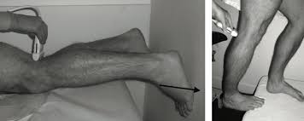

Slide 14
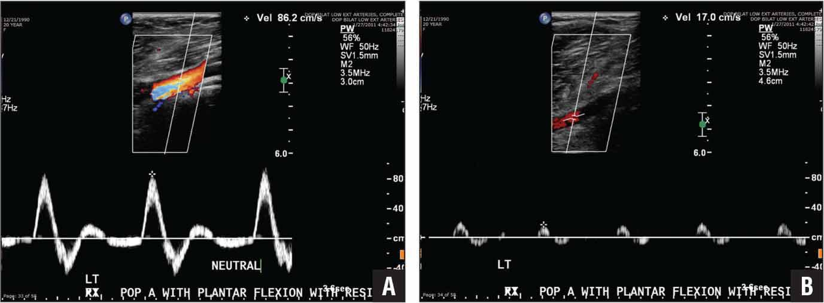

Slide 15
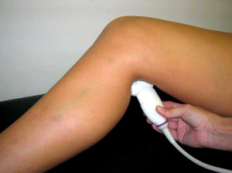
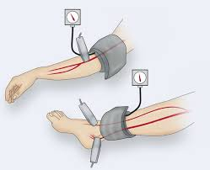
Hypothesis
Duplex US assessment alongside ABPI measurements can be used to develop a useful and a definitive diagnostic criteria for determining PAES

Slide 16



Study Design
Inclusion Criteria:
20 healthy individuals who don't exercise (exercise less than twice per week)
20 elite athletes (exercise 3 – 5 times per week)
20 patients who either prospectively or retrospectively are/have been investigated for symptomatic PAES

Slide 17
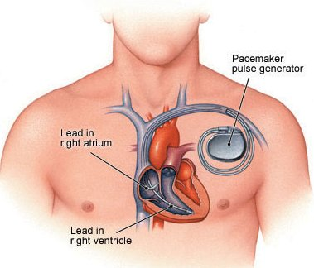
Exclusion Criteria:
Patients who have been treated for PAES
Patients who have had prior lower limb vascular surgery
Patients with other health conditions alongside PAES
People who are unable to perform vigorous exercise
People with Pacemakers or internal cardiac defibrillators

Slide 18
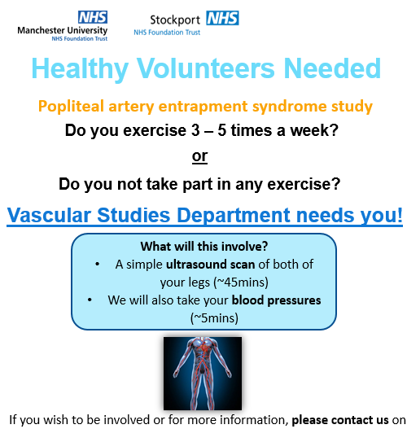
Recruitment:
Healthy individuals (through advertising on notice boards at Stepping Hill/Wythenshawe hospital)
Elite athletes –by contacting local sports clubs directly
Patients with PAES – via the vascular secretaries team at Wythenshawe Hospital

Slide 19



Study Benefits
Groundwork for a US diagnostic criteria for PAES
PAES may be found in one of the individuals from the healthy group
Notes:
The number of popliteal artery entrapment syndrome case reports is increasing

Slide 20
Further research
Further studies:
Is there a link with development of PAES and certain sports?
Link between PAES and certain professions?
-Commercial benefits; screening tool
Comparison with MRI/CT
Scope for 3D US
Notes:
Huge scope for research

Slide 21
Study process
Literature review
Develop protocol
Research ethics approval
Secure SVT grant
R&D: Wythenshawe & Stepping Hill
Recruit patients
Analyse Data
Present results at SVT
IRAS application
Further research

Slide 22
References
Fowl RJ, Kempczinski RF. Popliteal artery entrapment. In: Rutherford RB, ed. Vascular surgery. 5th ed. Philadelphia, Pa: Saunders, 2000; 1987–1993.
Gibson MH, Mills JG, Johnson GE, Downs AR. Popliteal entrapment syndrome. Ann Surg 1977; 185(3):341–348.
Collins PS, McDonald PT, Lim RC. Popliteal artery entrapment: an evolving syndrome. J Vasc Surg 1989;10(5):484–489; discussion 489–490.
Ruth Eliahou, MD • Jacob Sosna, MD • Allan I. Bloom, MD. RadioGraphics 2012; 32:E33–E49
https://www.ncbi.nlm.nih.gov/pmc/articles/PMC5832165/

