Slide 1
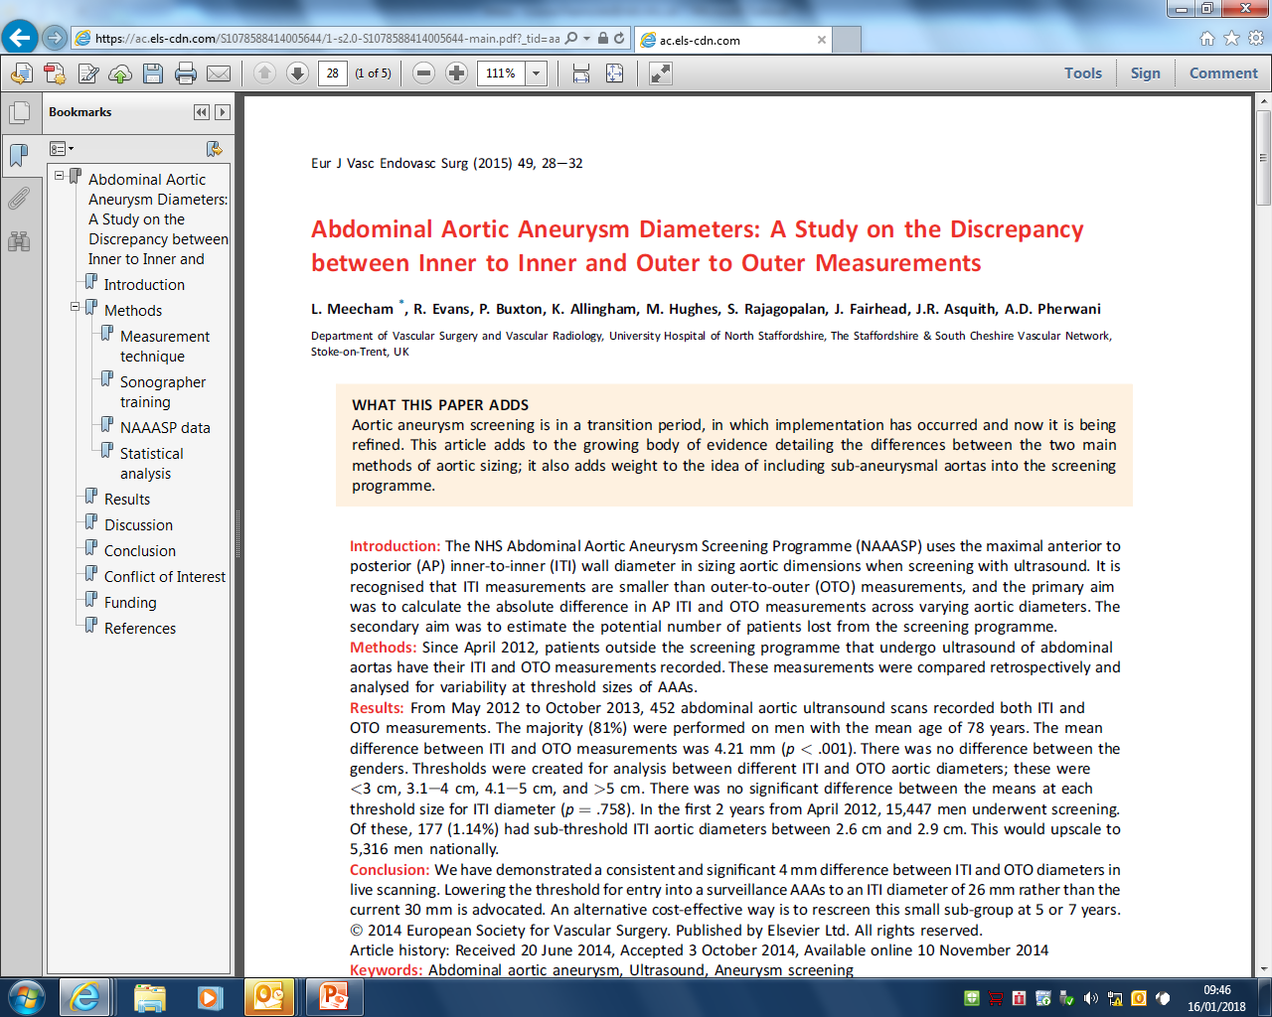
AAA training 31st January 2018

Slide 2
Background
OTO, ITI, AP – proven reproducibility
UKSAT – 1998 – thresholds based on outer to outer measurements
NAAASP – inner to inner measurements – MASS trial (2002) – better reproducibility
Naturally smaller measurement Vs OTO
Implications?
Subthreshold
Lower detection rates
Downscaling of >5.5
Notes:
This paper gives a bit of a background on the proven reproducibility of OTO and ITI measurement.
They mention the UKSAT of 1998 which based thresholds for intervention on outer to outer measurements. Despite the treatment threshold being formulated using OTO NAAASP uses ITI, primarily based on the MASS

Slide 3
Study aims
1.
Establish the absolute difference between the AP ITI and OTO measurements
2.
Establish the potential number of patients lost from the screening programme.

Slide 4
Method
2012 - VL in prep for local screening programme (Staff & South Cheshire) asked to provide both ITI and OTO on patients where AAA were suspected/ with a known AAA entered into the local hospital based surveillance programme.
7 qualified vascular sonographers/radiologists. Phillips IU22 machine.
ITI and OTO measurement taken in LS (sagittal plane only). Live real time measurements with calliper software taken and recorded on report
Data collected May 2012 to Oct 2013. Retrospectively looked at using radiology reports.
Stats: ITI – OTO variables compared using paired sample t test and independent samples t test. Analysis of variance (ANOVA) for intravariable means. SSPS

Slide 5
Results
Of 822 abdominal aorta scans, 452 had both OTO and ITI measurements.
364 (80%) male. Mean age 78.
Mean difference in ITI and OTO = 4.21 mm (1-16mm, p <0.001).
Mean difference on gender NS.

Slide 6
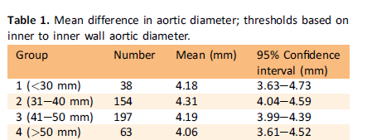
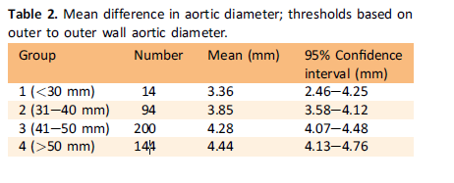
Results
NS
P = 0.007
Notes:
So when you recategorise the thresholds using the outer to outer wall diameter, you are naturally going to get more aneurysms in the larger groups.
They say they obtain statistical significance in the second table as the aortic size increases however their n numbers on the lower category is 14 compared to 144 for the >50mm group. Are the n numbers of the smaller group large enough for statistical significance? Confidence intervals overlap?

Slide 7
Numbers
2012 – 2014 – 15,447 scans (Staff & Chess)
199 (1.29%) S AAA
26 (0.17%) AAA requiring Tx
177 (1.14) Subthreshold (26-29mm).
Extrapolation to national programme – subthreshold would affect ~ 5’316 for 2yr period.

Slide 8
Study conclusions
Historically – detection rate based on OTO. May partly explain discrepancy between NAASP and previous studies.
Authors do not advocate deviation from current protocol – instead, lowering threshold for inclusion into screening to 26mm (cite glos AAA 20 year review)
Long term studies – 15 yr f/u multicentre (6)study *(2013) - After 5 years, 59% of patient with subthreshold AAA progressed above threshold. At 10 years, it was 96%.
No consensus on interval of surveillance for subthreshold
RESCAN collaborators – 7.4 years for a 3cm AAA to reach threshold. ? Surveillance scan at 5-7 years reasonable??
Notes:
They cite long term studies
Currently there is no consensus on the interval of surveillance for subthreshold

Slide 9
Thoughts
This study, retrospective.
Limitations –
“results gathered in the same manner as those that would be recorded in the screening programme”
– why did they not record a TS measurement? Why only just over half have both measurements? Limited to the scans of only certain sonographers? Bias? No information on inter operator variability
Limited explanation and discussion of the results, esp table 1 & 2
But food for thought!

