Slide 1
AAA Screening Quiz
Wednesday 9th January 2019
Lila Elliott, Libby Lockwood
CST

Slide 2
Section 1: Anatomy
The superior mesenteric artery typically originates from the:
Coeliac Trunk
Aorta inferior to the renal arteries
Common mesenteric trunk or axis
Aorta between the coeliac axis and the renal arteries
Aorta superior to the coeliac axis

Slide 3
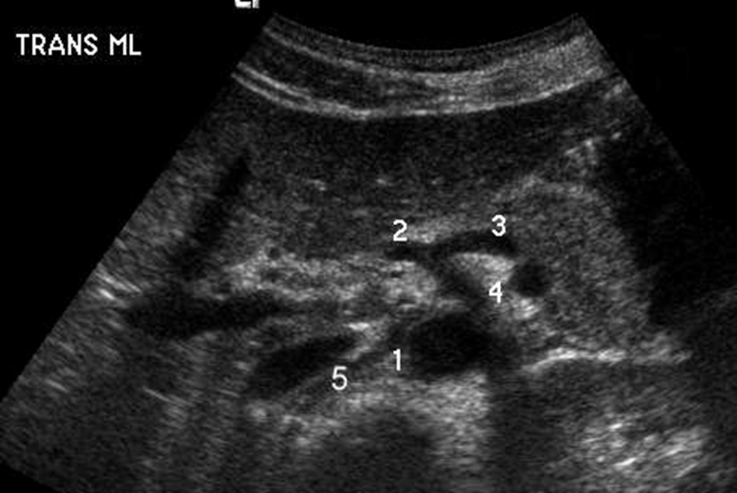
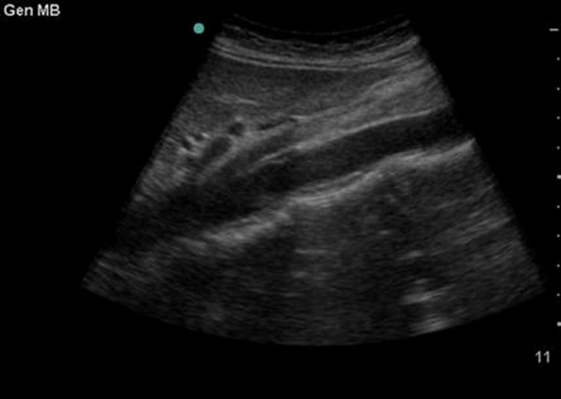
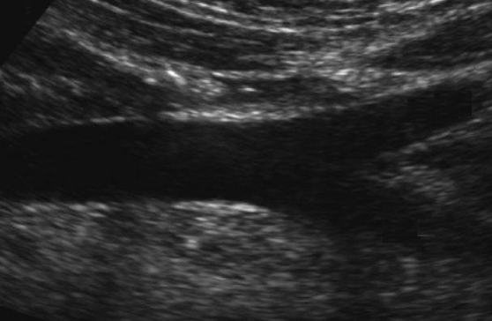
2. Label the vessels in the Ultrasound images below:
9
7
6
8
11
12
10

Slide 4
3. Working proximal to distal, which is the correct anatomical sequence of arteries arising from the abdominal aorta?
Coeliac axis, Superior mesenteric artery, Left renal artery, Right renal artery, Inferior mesenteric artery.
Superior mesenteric artery, Coeliac axis, Inferior mesenteric artery, Left renal artery, Right renal artery.
Left renal artery, Coeliac axis, Right renal artery, Superior mesenteric artery, Inferior mesenteric artery.
Coeliac axis, Right renal artery, Left renal artery, Superior mesenteric artery, Inferior mesenteric artery.

Slide 5
4.Label blood vessels A and B
5.Name two structural differences between arteries and veins.

Slide 6
6. There are four features that can be used to differentiate between the aorta and IVC during the ultrasound examination. What are they?

Slide 7
Section 2: Pathology
7. Describe the shape of the aneurysms in the following ultrasound images.

Slide 8
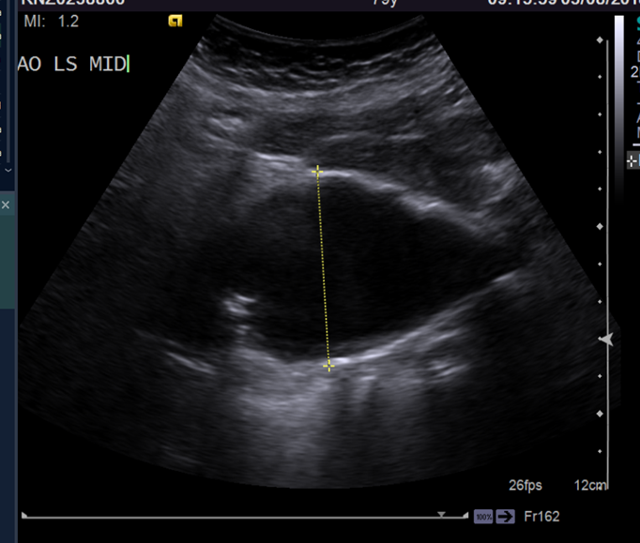
a)

Slide 9
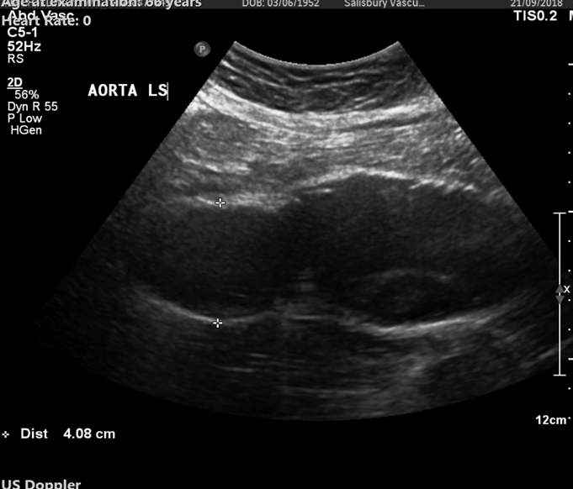
b)

Slide 10
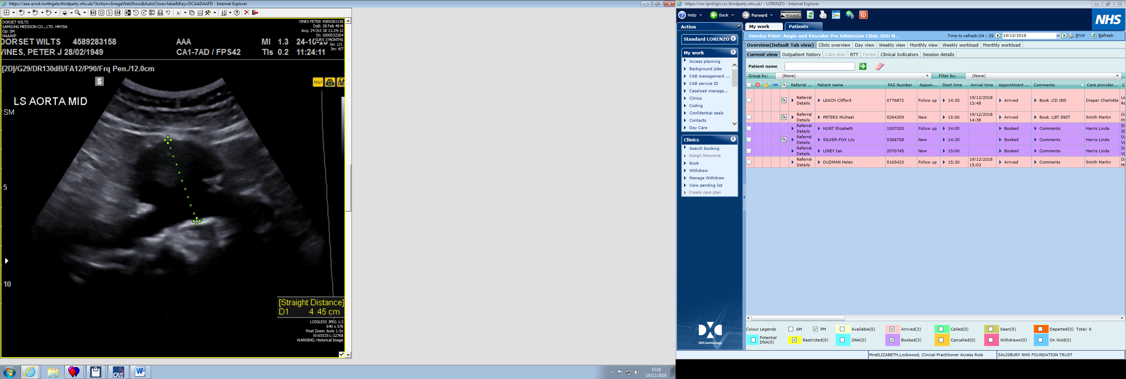
c)

Slide 11
8. What is the pathology of the abdominal aortic aneurysms in the following images?

Slide 12
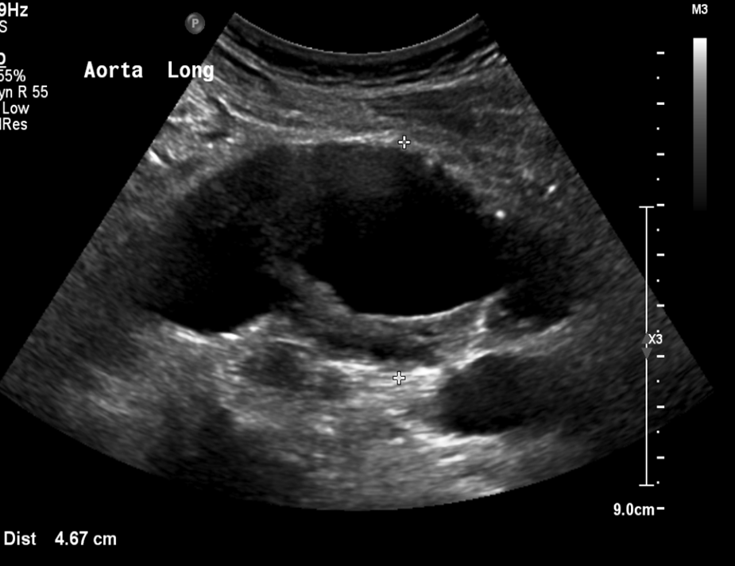
a)

Slide 13
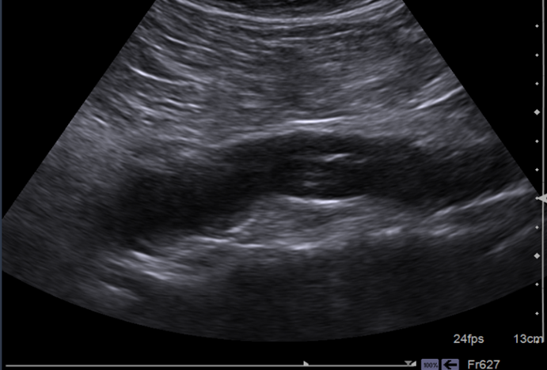
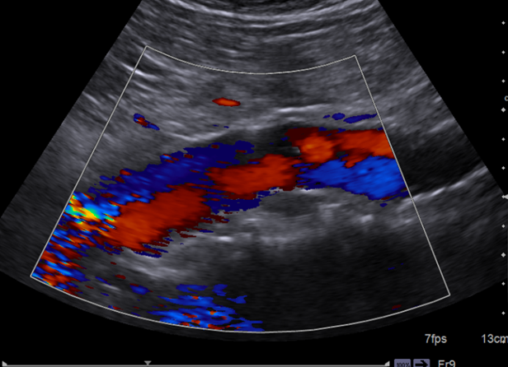
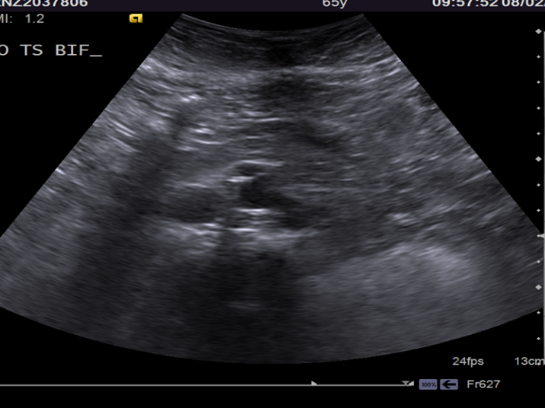
b)

Slide 14
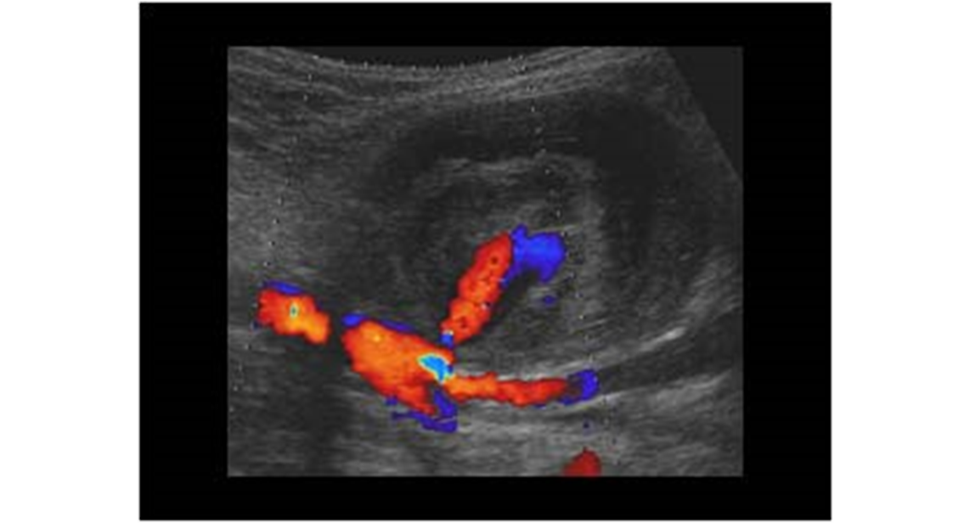
c)

Slide 15
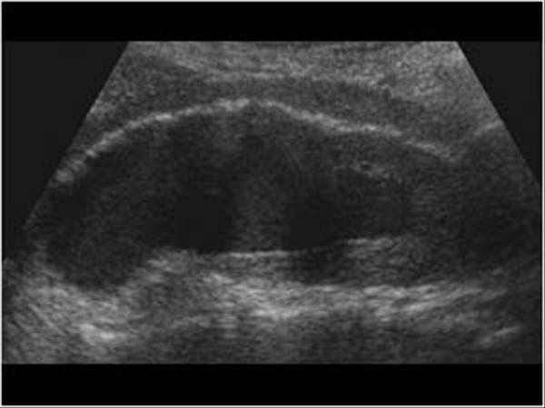
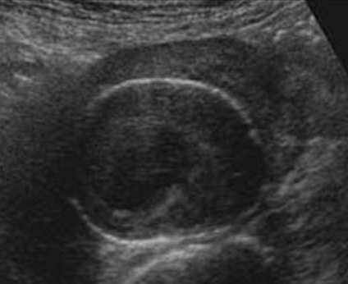
d)

Slide 16
9. The aetiology of arterial aneurysms includes all the following except:
Degenerative
Congenital
Syphilitic
Inflammatory
Saccular

Slide 17
Section 3: Ultrasound
10. Define ultrasound (there are four key points).
11.Creating an ultrasound image is done in three steps. Can you name the three steps?

Slide 18


Clue…

Slide 19
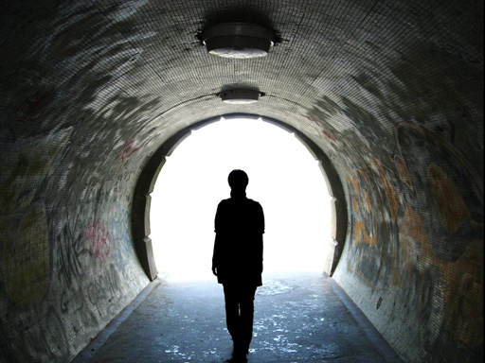
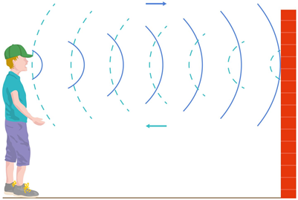
Sound Bite

Slide 20

Sound Bite 2

Slide 21

Answers

Slide 22
Section 1: Anatomy
The superior mesenteric artery typically originates from the:
Coeliac Trunk
Aorta inferior to the renal arteries
Common mesenteric trunk or axis
Aorta between the coeliac axis and the renal arteries
Aorta superior to the coeliac axis
The superior mesenteric artery typically originates from the: (1 point)
Coeliac Trunk
Aorta inferior to the renal arteries
Common mesenteric trunk or axis
Aorta between the coeliac axis and the renal arteries
Aorta superior to the coeliac axis

Slide 23
2. Label the vessels in the Ultrasound images below: (12 points)
9
Left Renal Artery
Hepatic Artery
Superior Mesenteric Artery
7
Splenic Artery
Left Common Iliac Artery
Celiac Axis
6
8
Aorta
Celiac Axis
11
Inferior Vena Cava
Aorta
12
Right Common Iliac Artery
10
Right Renal Artery
10

Slide 24
3. Working proximal to distal, which is the correct anatomical sequence of arteries arising from the abdominal aorta? (1 point)
Coeliac axis, Superior mesenteric artery, Left renal artery, Right renal artery, Inferior mesenteric artery.
Superior mesenteric artery, Coeliac axis, Inferior mesenteric artery, Left renal artery, Right renal artery.
Left renal artery, Coeliac axis, Right renal artery, Superior mesenteric artery, Inferior mesenteric artery.
Coeliac axis, Right renal artery, Left renal artery, Superior mesenteric artery, Inferior mesenteric artery.
Coeliac axis, Superior mesenteric artery, Left renal artery, Right renal artery, Inferior mesenteric artery.
Superior mesenteric artery, Coeliac axis, Inferior mesenteric artery, Left renal artery, Right renal artery.
Left renal artery, Coeliac axis, Right renal artery, Superior mesenteric artery, Inferior mesenteric artery.
Coeliac axis, Right renal artery, Left renal artery, Superior mesenteric artery, Inferior mesenteric artery.

Slide 25
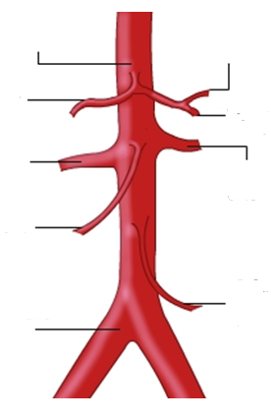
Coeliac axis
Left gastric artery
Hepatic artery
Splenic artery
Right renal artery
Left renal artery
Superior mesenteric artery
Inferior mesenteric artery
Bifurcation and iliac vessels
Notes:
The maximum external diameter (measured from outer wall to outer wall) at different levels will vary:
3 cm at the epigastrium
1.5 cm at the bifurcation

Slide 26
4. Label blood vessels A and B (1 point)
Artery
Vein

Slide 27
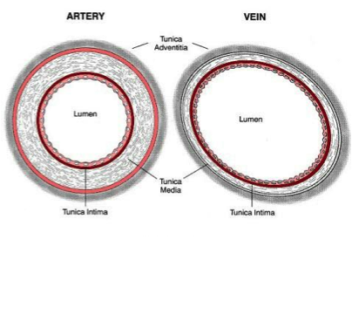
5. Name two structural differences between arteries and veins. (2 points)
1. Arteries have thick, elastic, muscular walls whereas veins have thin walls with few elastic fibres.
2. Veins have one-way valves whereas arteries do not have any valves.
Notes:
Arteries need these properties to give them the strength and elasticity needed to cope with the high pressure surges of oxygenated blood coming from the heart. The elasticity allows the walls to recoil back to their original shape after they have increased in diameter to allow the surge of blood through.
Veins need valves as the blood flowing through them is at such a low pressure that they need something to prevent it going backwards! They are needed to prevent blood pooling. Arteries do not need valves as the blood is flowing at such a high pressure that it cannot go backwards.

Slide 28
6. There are four features that can be used to differentiate between the aorta and IVC during the ultrasound examination. What are they?
(4 points)
The aorta is commonly on the left hand side of the body.
The aorta has anterior branches (coeliac axis and superior mesenteric artery)
The aorta is non-compressible whilst the IVC can be compressed
The wall of the aorta is thicker than wall of the IVC.

Slide 29
Section 2: Pathology
7. Describe the shape of the aneurysms in the following ultrasound images. (3 points)

Slide 30
a)
Fusiform

Slide 31
b)
Dumbbell

Slide 32
c)
Saccular

Slide 33
8. What is the pathology of the abdominal aortic aneurysms in the following images? (4 points)

Slide 34
a)
Intraluminal thrombus

Slide 35
b)
Dissection

Slide 36
c)
False Aneurysm

Slide 37
d)
Inflammatory Aneurysm

Slide 38
d)
Adventitia
Halo
Lumen
Aortic wall
Thrombus

Slide 39
9. The aetiology of arterial aneurysms includes all the following except: (1 point)
Degenerative
Congenital
Syphilitic
Inflammatory
Saccular
Degenerative
Congenital
Syphilitic
Inflammatory
Saccular
Notes:
Syphilitic: This inflammation weakens the wall, producing an aneurysm. Syphilitic Aneurysm: If a person has untreated syphilis, the infection may spread to the part of the aorta nearest the heart, resulting in a thoracic aortic aneurysm 15 to 30 years after the first signs of syphilis.

Slide 40
10. Define ultrasound (4 points)
Ultrasound is acoustic (sound) energy
Energy in the form of waves
Frequency above the human hearing range
Frequency above 20 thousand cycles per second (20,000 Hz).

Slide 41
11.Creating an ultrasound image is done in three steps:
(3 points)

Slide 42
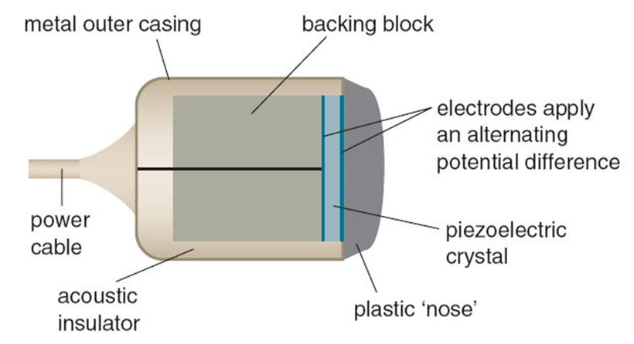
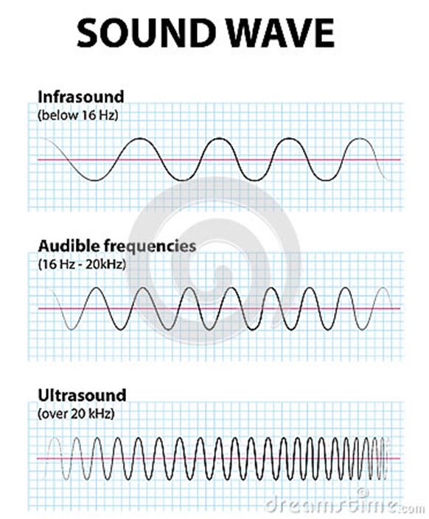
Step 1:
Producing a sound wave

Slide 43
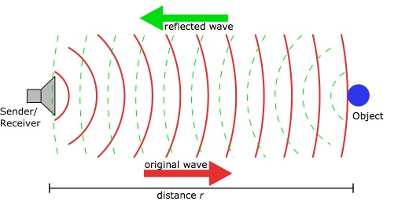
Step 2:
Receiving Echoes
Sound Bite

Slide 44
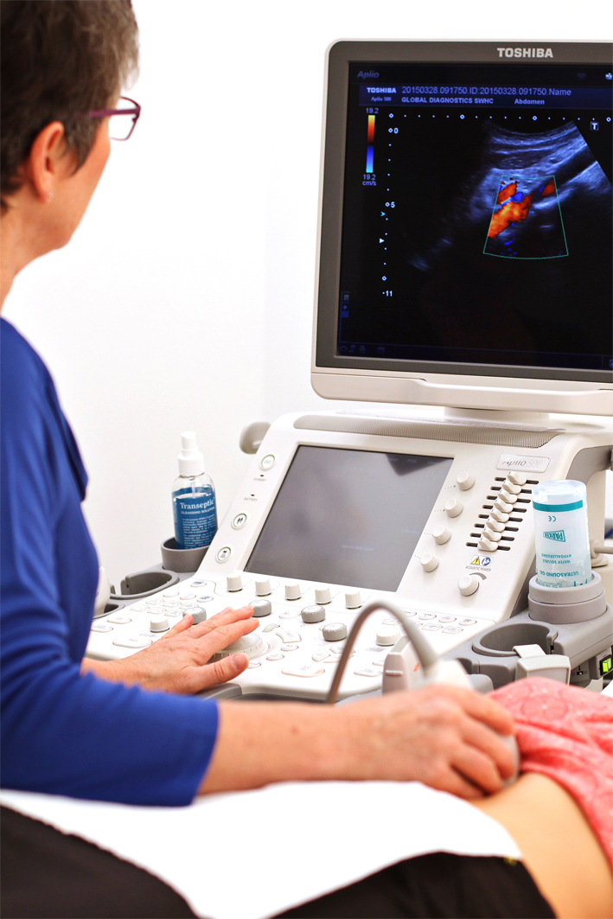
Step 3:
Interpreting Echoes
Sound Bite 2

Slide 45
Scores
Total: 36 points

