Slide 1

Basic Arterial and Venous Anatomy
Charlotte Roberts
Clinical Vascular Scientist
Independent Vascular Services Ltd.

Slide 2
Blood Vessels
Blood vessels are hollow tubes for carrying blood.
There are three varieties of blood vessels: arteries, veins, and capillaries
During blood circulation:
  The arteries carry blood away from the heart
  The capillaries connect the arteries to veins
  The veins carry the blood back to the heart
Besides circulating blood, the blood vessels provide two important means of measuring vital health statistics: pulse and blood pressure.

Slide 3
Circulatory System
On average, your body has about 5 litres of blood continually travelling through it by way of the circulatory system
The heart, the lungs, and the blood vessels work together to form the circle part of the circulatory system
The pumping of the heart forces the blood around the body

Slide 4
Circulatory System
The body's circulatory system has three distinct parts:
  Pulmonary circulation (lungs)
  Coronary circulation (heart)
  Systemic circulation (rest of the body)
Each part must be working independently in order for them to all work together

Slide 5
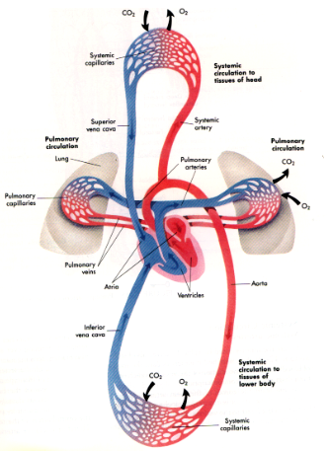
Venous return to right side of heart via IVC and SVC
To lungs via pulmonary arteries for gaseous exchange
Through pulmonary veins to left side of heart
Pumped into aorta and arterial system
Reaches systemic capillaries for nutrient and gaseous exchange

Slide 6
Systemic Circulation
Systemic circulation is a major part of the overall system
Supplies nourishment to all of the tissues located throughout the body, with the exception of the heart and lungs
The blood vessels (arteries, veins, and capillaries) are responsible for the delivery of oxygen and nutrients to the tissue
Oxygen-rich blood enters the blood vessels through the heart's main artery called the aorta
The forceful contraction of the left ventricle forces the blood into the aorta which then branches into many smaller arteries which run throughout the body
The same process of delivery of oxygen and nutrients to tissues happens in the pulmonary and coronary circulation

Slide 7
Arterial System
The inside layer of an artery is very smooth, allowing the blood to flow quickly
The outside layer of an artery is very strong, allowing the blood to flow forcefully, with a ‘rebound’ action to propel blood
The oxygen-rich blood enters the capillaries where the oxygen and nutrients are released
The waste products are collected and the waste-rich blood flows into the veins in order to circulate back to the heart where pulmonary circulation will allow the exchange of gases in the lungs

Slide 8
Vessel layers
Tunica intima - endothelial cells one cell thick
provides smooth lining for blood flow.
Tunica media - smooth muscular layer surrounded
by fibrous tissue, can vary in thickness depending
upon artery function, muscles encircle therefore
can regulate blood flow . Inner receives nutrients by
diffusion from luminal blood, outer via vasa vasorum.
Tunica adventitia/externa - elastic lamina composed of fibrous tissue. Adds strength - if weakened forms
aneurysms. Fibres run longitudinally giving
elasticity to vessels which store systolic energy
releasing it during diastole aiding blood flow, have
vasa Vasorum.

Slide 9
Arterial and venous wall structure
Artery
Vein
Distal arteries more muscular & control blood supply to area/organ
Proximal arteries more elastic & can store energy from cardiac cycle released in diastole
Arterioles shed adventitia & Capillaries purely intimal layer
Contain valves - more in lower limbs
to prevent reflux, less smooth muscle
than arteries, more fibrous tissue, thinner
walls and media than arteries but thicker
Adventitia.

Slide 10
Structure and function of blood vessels
nutrients,O2
metabolic waste,CO2
conducting arteries
(elastic)
aorta
iliac
collecting & distributing arteries (more muscular distally)
distal arteries, arterioles
functioning capillaries
(single endothelial cell layer, microscopic,
have pre-capillary sphincters)
conducting veins
(no valves)
IVC
iliac
collecting & distributing veins
(more valves distally)
distal veins, venules

Slide 11
Normal arterial anatomy

Slide 12
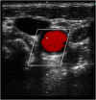

Arterial Anatomy
Artery walls are thick, multi layered and elastic in property
Walls of an artery move with the pulsatile blood flow from the heart

Slide 13
Can you place the arteries?
Right Subclavian
Left Subclavian
Aortic Arch
Thoracic Aorta
Radial
Dorsalis Pedis
Ulnar
Palmar Arch
Brachial
Left Common Carotid
Right Common Carotid
Femoral
Abdominal Aorta
Anterior Tibial
Common Iliac
Internal Iliac
External Iliac
Popliteal
Brachiocephalic
Axillary
Posterior Tibial
Notes:
Thoracic aorta – ascending aorta, aortic arch and descending aorta
Palmar arch – mainly ulnar artery with smaller contribution from radial
Brachiocephalic – off the aortic arch

Slide 14
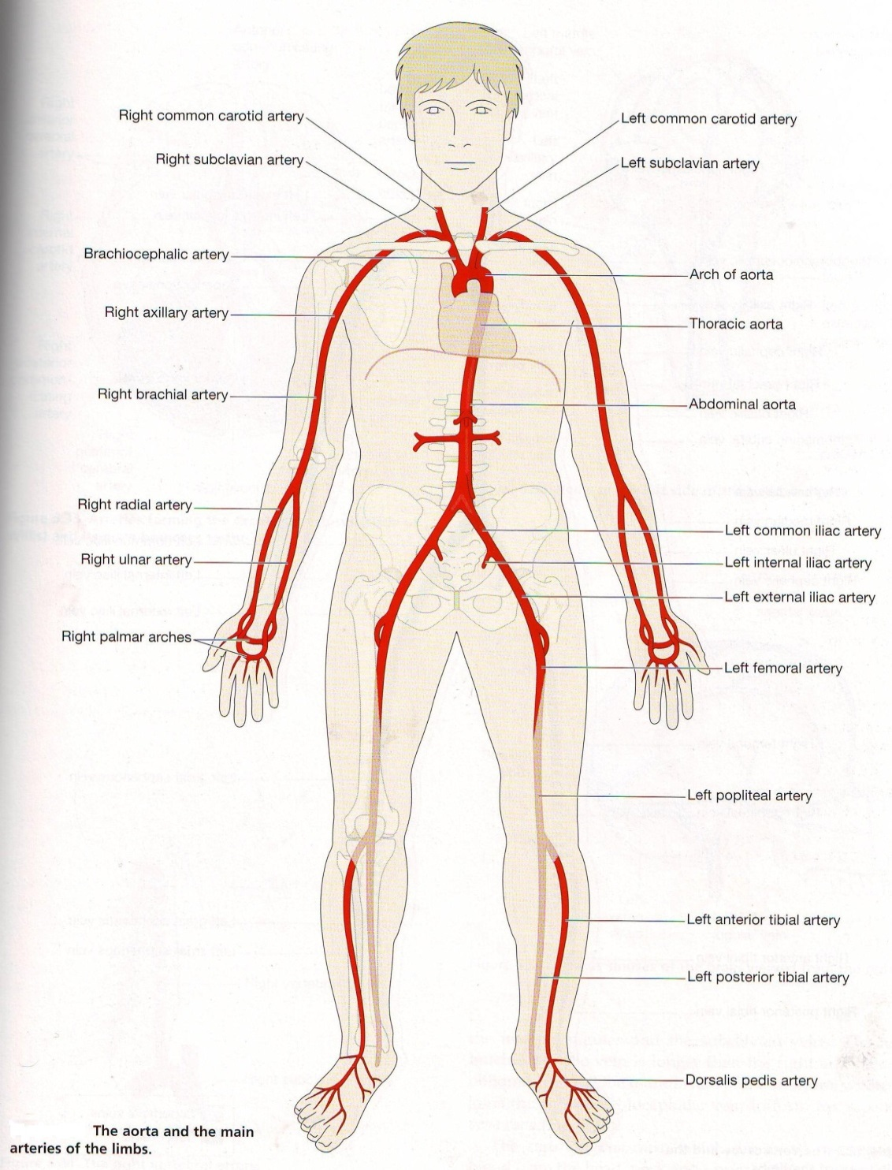

Slide 15
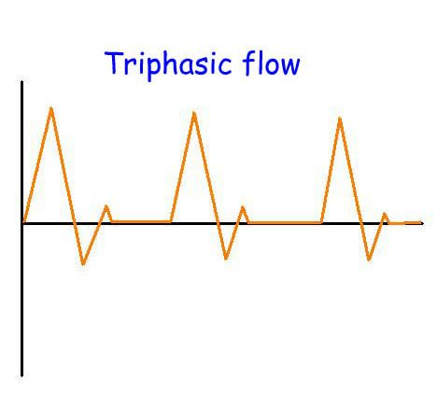
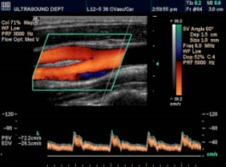
Arterial Blood Flow

Slide 16
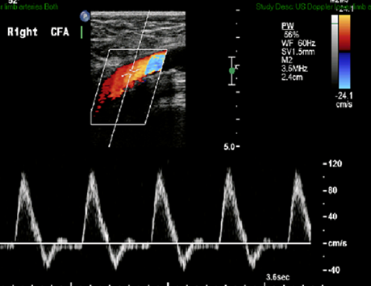
Arterial Blood Flow
For peripheral arteries (carotid arteries have different waveforms):
TRIPHASIC
  Healthy, no significant disease
BIPHASIC
  Mild disease, aging
MONOPHASIC
  Significant disease (usually)
Reduced
Hyperaemic
Notes:
Triphasic waveform – normal flow in healthy flexible peripheral arteries – sharp incline as blood flows from heart (systolic), temporary/transient flow reversal during early diastole and slow forward flow during late diastole

Slide 17
Renal and Portal System
During systemic circulation, blood passes through the kidneys
This phase of systemic circulation is known as renal circulation and during this phase, the kidneys filter much of the waste from the blood
Blood also passes through the small intestine during systemic circulation (known as portal circulation).
During portal circulation, the blood from the small intestine collects in the portal vein which passes through the liver. The liver filters sugars from the blood, storing them for later.

Slide 18
Heart Rate
We measure heart rate, or pulse, by touching an artery.
The rhythmic contraction of the artery keeps pace with the beat of the heart
Since some arteries are near the surface of the skin we can easily touch these to get an accurate measure of the heart's pulse
  Which arteries are commonly used?
Notes:
Neck (carotid)
Wrist (radial)
Elbow (brachial)

Slide 19
Blood Pressure
Blood Pressure is measured using two numbers
The first number, which is higher, is taken when the heart beats during the systole phase
The second number is taken when the heart relaxes during the diastole phase
Measured in millimetres of mercury (mmHg)
Normal blood pressure ranges from 110 to 140 mmHg (as the heart beats) over 60 to 80 mmHg (as the heart relaxes)
It is normal for blood pressure to increase when you are exercising and to decrease during sleep and should vary during the day (circadian rhythm)
If blood pressure stays too high or too low there is a risk of heart disease.

Slide 20
Normal venous anatomy

Slide 21
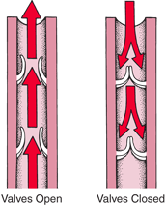
Basics of Venous Anatomy
Veins are thin walled with low velocity phasic flow
Easily dilated and compress with very little applied pressure
All veins have ‘one way’ valves
For scanning veins can easily be followed in the longitudinal or transverse planes
Veins are divided into 3 types
  Superficial
  Deep
  Perforating

Slide 22
Can you place the veins?
Popliteal
External and Internal Jugular
Internal and External Iliac
Inferior Vena Cava
Axillary
Medial Cubital
Superior vena Cava
Brachial
Short/Small Saphenous
Great/Long Saphenous
Dorsal Arch
Renal
Subclavian
Facial
Gonadal
Hepatic
Common Iliac
Cephalic
Basilic
Brachiocephalic
Common femoral
Notes:
Gonadal – testis/ovary back to heart
Median cubital – connects basilic and cephalic veins (superficial veins of the arm)
Brachiocephalic vein – within thorax where subclavian and IJV meet

Slide 23
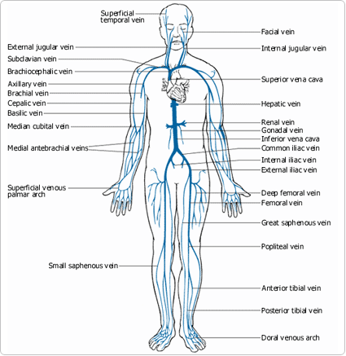

Slide 24
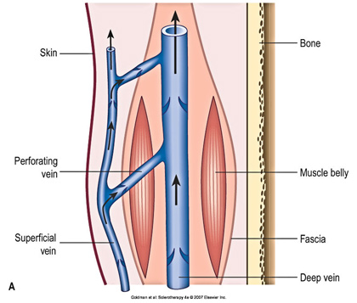
Superficial, Perforating and Deep Veins

Slide 25
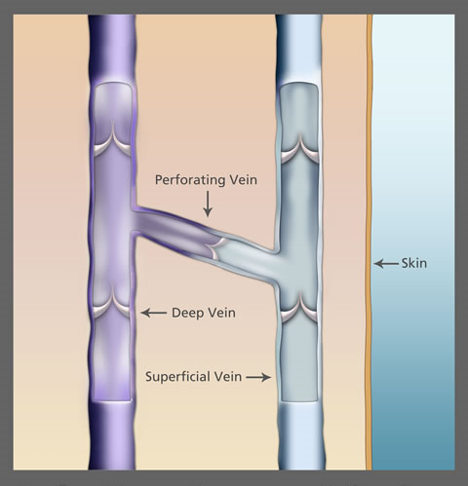
Perforator Veins
Perforating veins connect the deep system with the superficial system
Flow should be FROM superficial veins TO deep veins
Flow in the wrong direction (incompetent valves) can cause venous insufficiency, varicose veins and venous ulceration

Slide 26
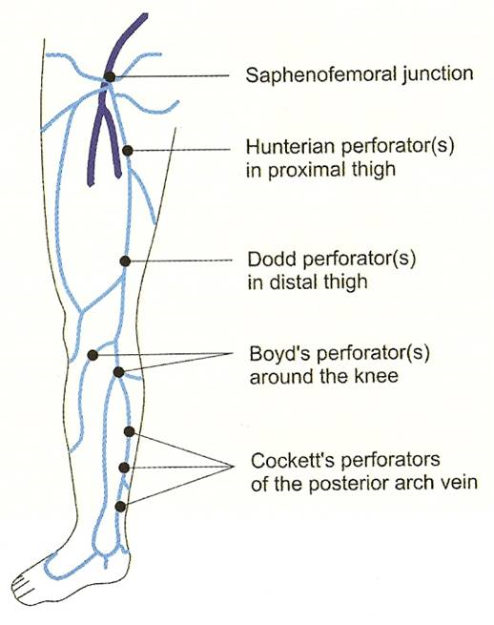
Leg Vein Perforators

Slide 27
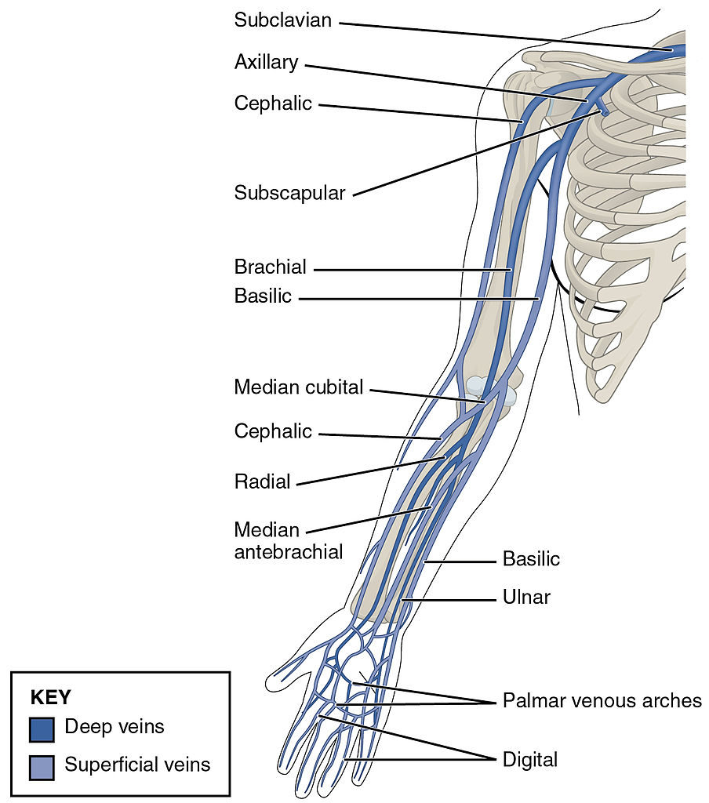
Arm Veins

Slide 28
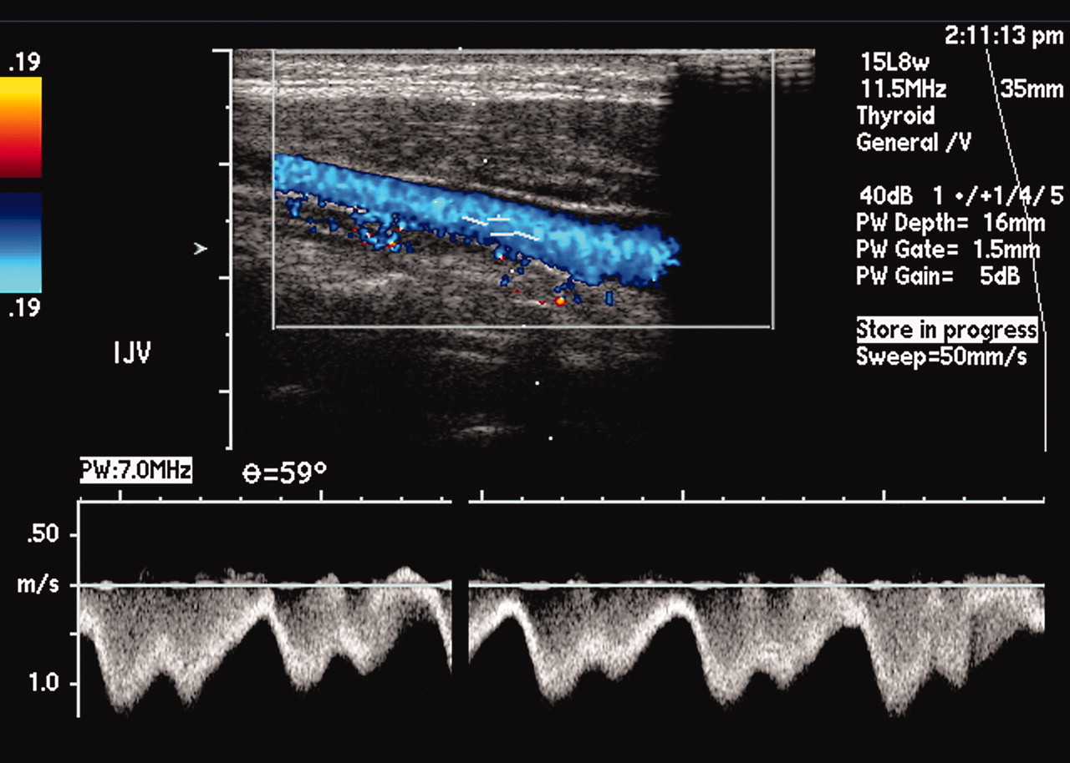
Normal venous waveforms
Notes:
phasicity

Slide 29
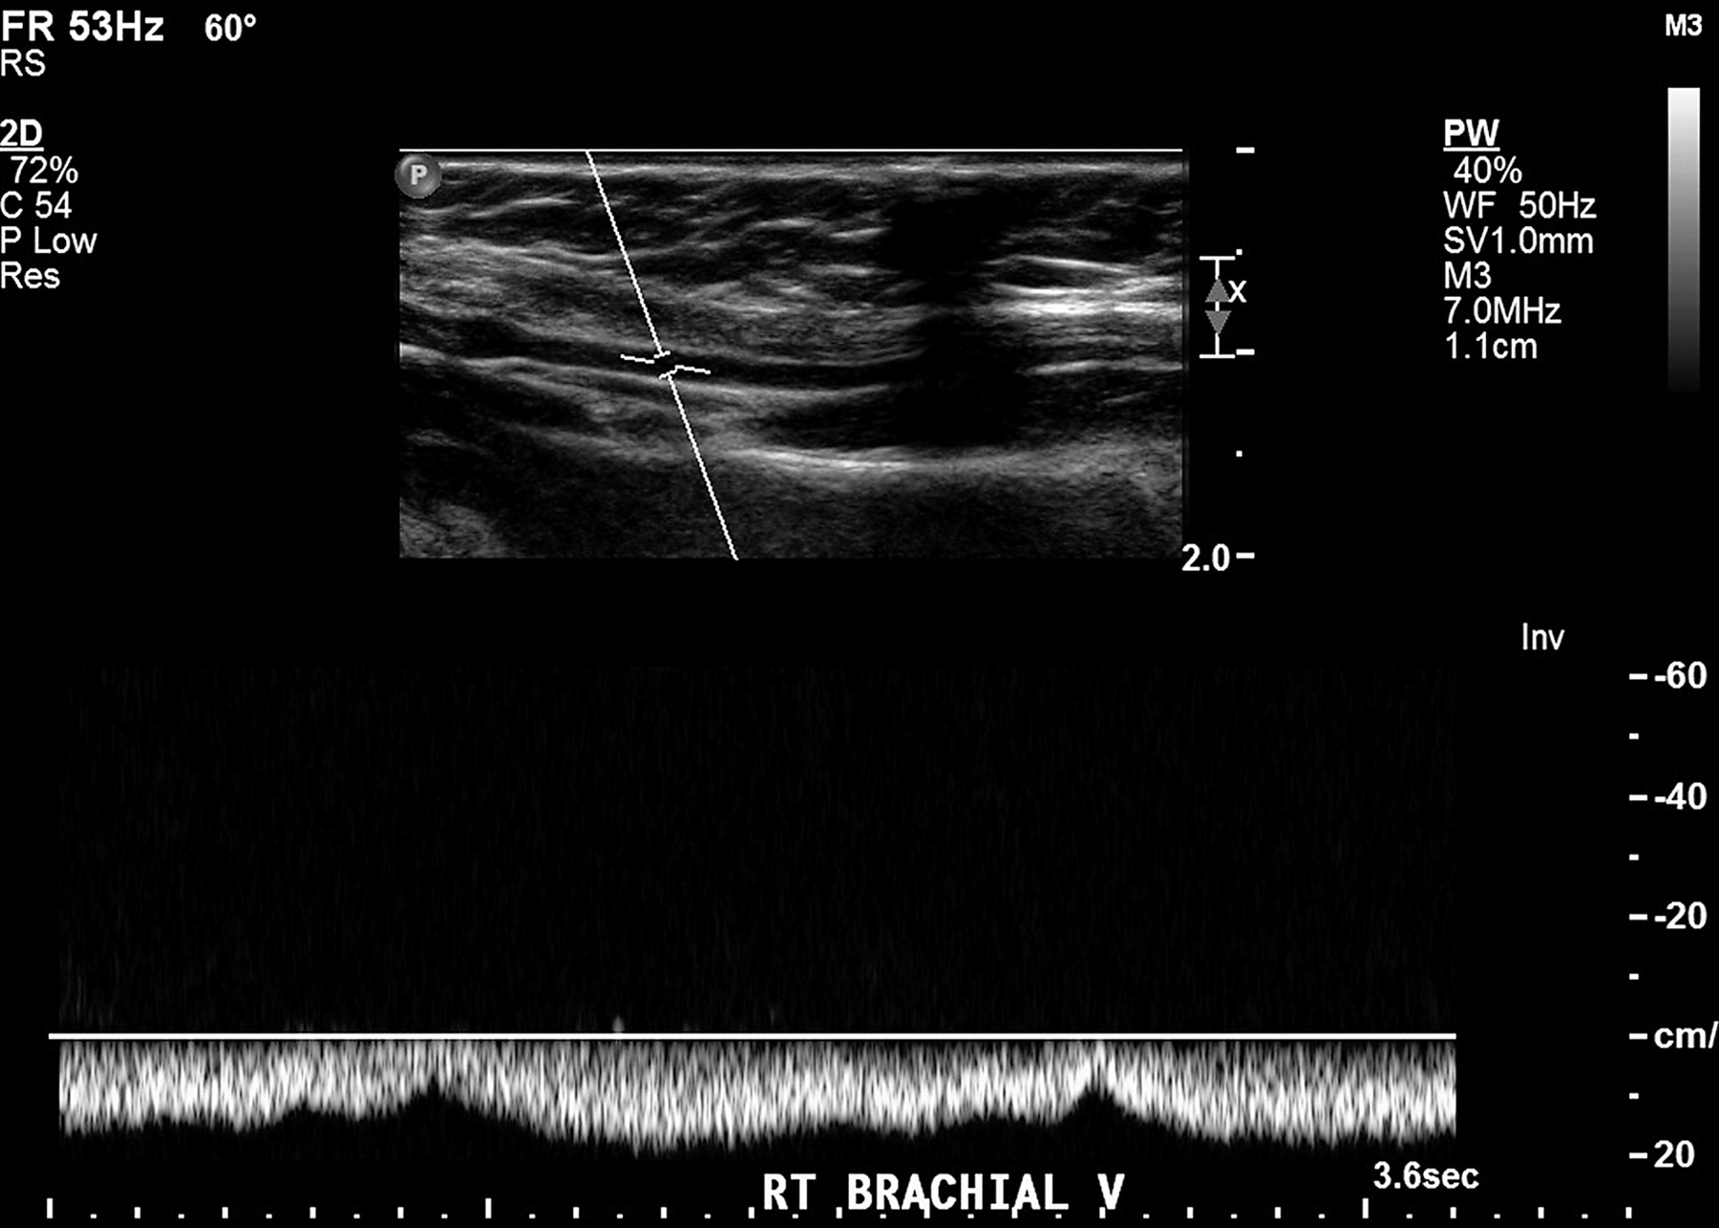
Normal venous waveforms
Notes:
continuous

Slide 30
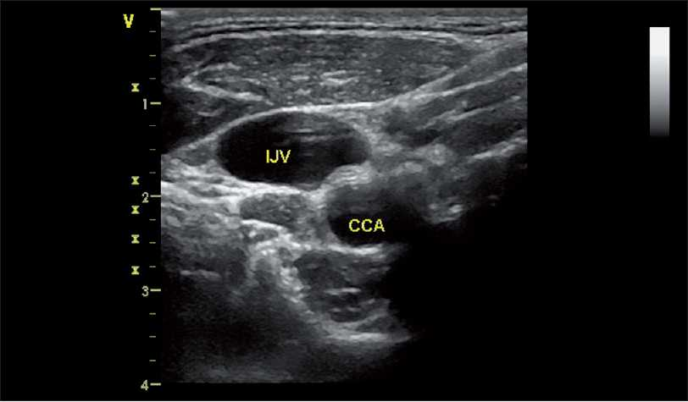
Internal Jugular Vein

Slide 31
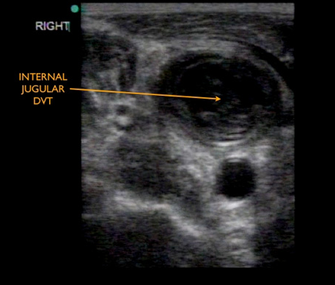
Internal Jugular Vein DVT
Notes:
Dilated
fresh thrombus

