Slide 1
Non-Medical Referral (NMR) for Radiological Examinations

Slide 2
Legal Authority for NMR Referrals
Non-medical health professionals may refer patients for medical exposure in accordance with their employers procedures.
Ionising Radiation (Medical Exposure) Regulations 2017

Slide 3
UHCW procedures for becoming a Non-Medical Referrer
A protocol is agreed by the Health Professionals CD and Radiology. This protocol is published on e-library.

Slide 4
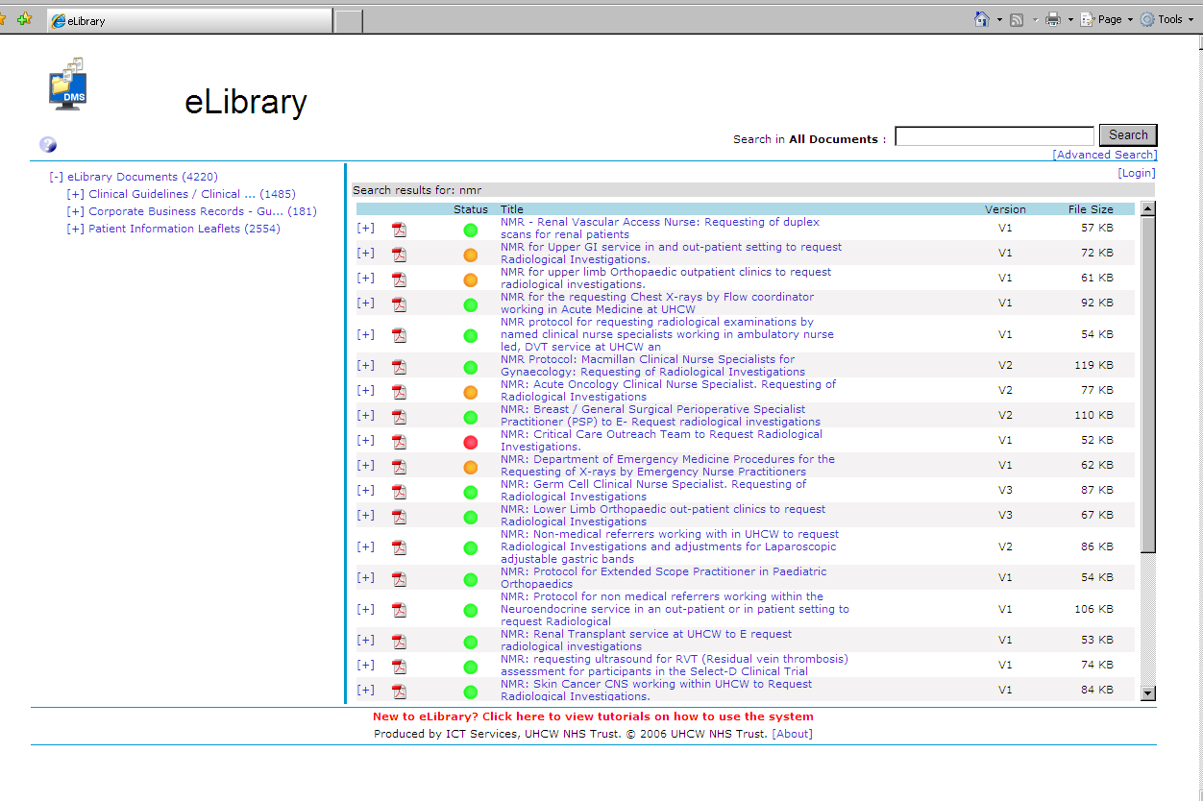
NMR Protocols on e-Library

Slide 5
UHCW process for becoming a Non-Medical Referrer
A protocol is agreed by the Health Professionals CD and Radiology. This protocol is published on the ‘e-library’.
Attend a short course in Radiation Protection.
Complete the Authorisation Page (Appendix 1) of the NMR protocol and send to Radiology.

Slide 6
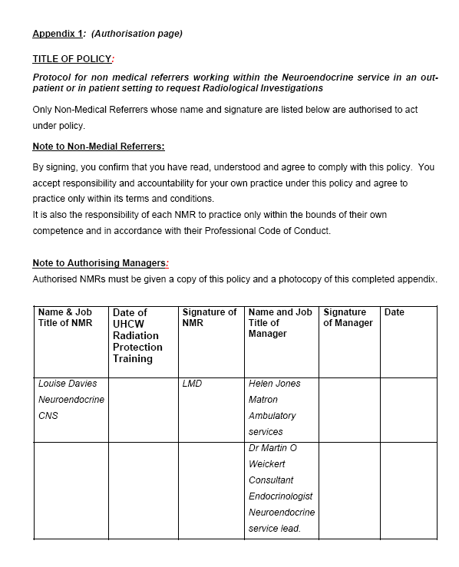
NMR Protocol –
Example ‘Appendix 1’

Slide 7
UHCW process for becoming a Non-Medical Referrer
A protocol is agreed by the Health Professionals CD and Radiology. This protocol is published on the ‘e-library’.
Attend a short course in Radiation Protection.
Complete the Authorisation Page (Appendix) 1 of the NMR protocol and send to Radiology.
Radiology add the NMR to the Radiology Approval Register (RAR).
Send a Request for Service (RFS) form to ICT.

Slide 8
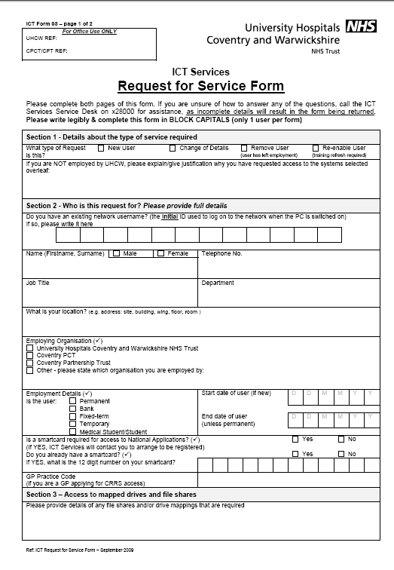
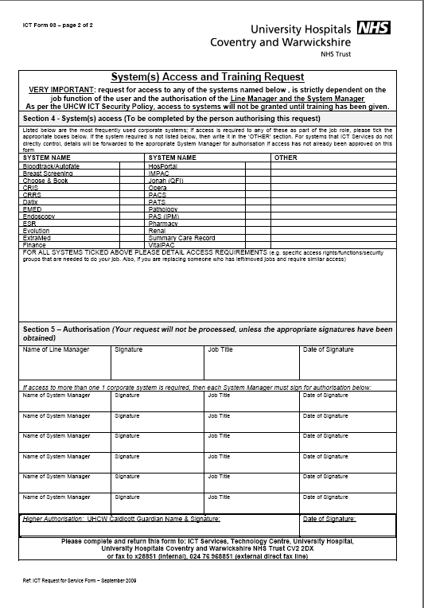
RFS Form

Slide 9
UHCW process for becoming a Non-Medical Referrer
A protocol is agreed by the Health Professionals CD and Radiology. This protocol is published on the ‘e-library’.
Attend a short course in Radiation Protection.
Complete the Authorisation Page (Appendix) 1 of the NMR protocol and send to Radiology.
Radiology add the NMR to the Radiology Approval Register (RAR).
Send a Request for Service (RFS) form to ICT
ICT send link to online training and arrange e-requesting access when assessment passed.

Slide 10

Non-Medical Referral
All referrals must include;
  your job title
  your professional registration number
  the COP no. of the protocol you are requesting under
To save entering this every time you submit a referral you can add this information to your profile on CRRS.

Slide 11
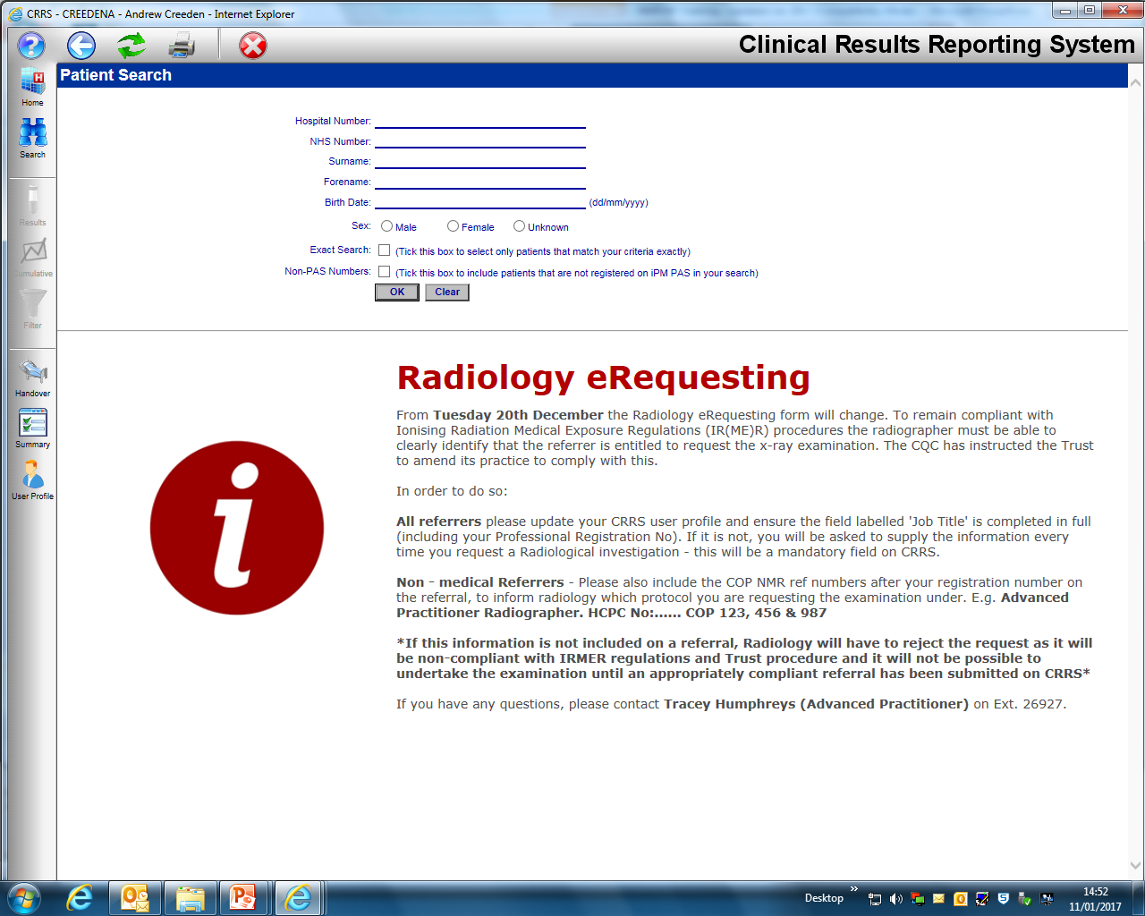

Slide 12
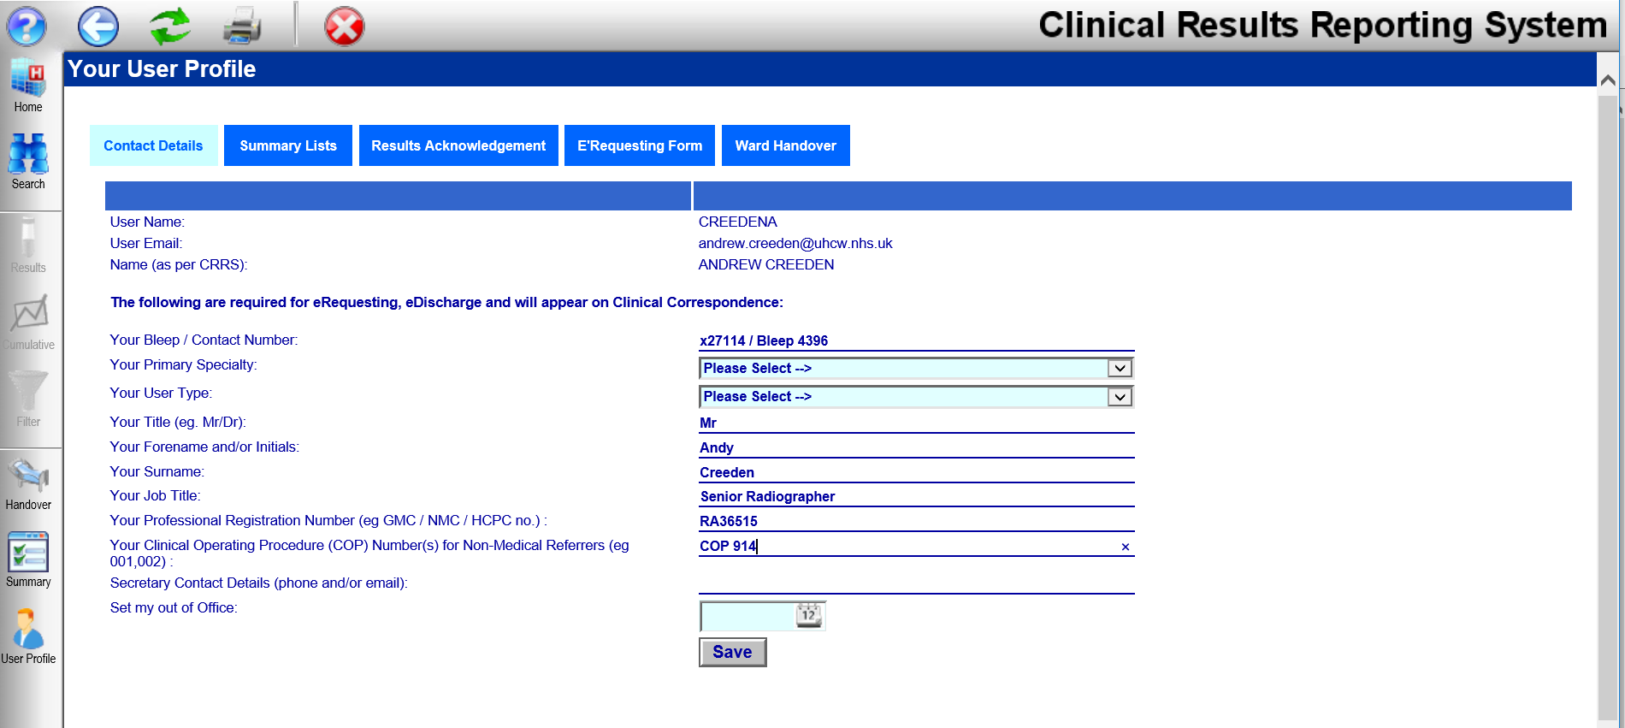

Slide 13

Non-Medical Referral
To comply with IR(ME)R NMR protocols must be strictly adhered to..
Ensure that you have read and fully understand the detail of the protocol you are requesting under.

Slide 14
NMR Protocol - Example ‘Table 1’
Request | Referral Criteria | Process for recording image interpretation and subsequent change to / effect on patient management
Chest X-ray | New onset shortness of breath. New onset chest pain Cardiac sounding. New onset Cardiac arrhythmias. New onset worsening Cardiac failure. New onset hypoxia. | Images will be reviewed by a medical practitioner and the interpretation and subsequent change to care will be recorded within the patient’s notes.

Slide 15

Warning!
Your protocol will require you to produce audit evidence of compliance to the protocol every 2 years.
An annual audit of a sample of NMR referrals will also be conducted by Radiology.
Where it is identified that a request has been made outside a referrers protocol a warning letter is sent to the referrer and their manager. A second breach results in the removal of e-requesting rights.

Slide 16

Information Governance
You are responsible for all referrals which come from your login.
Ensure that no-one else makes requests on your CRRS login!!

Slide 17
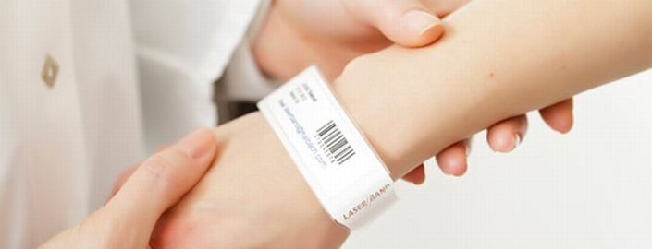
Ensure the correct exam is requested on the correct patient
3 point ID check when making requests (name, DOB, hospital no.)
Where incorrect patient or examination is carried out this has to reported to the CQC
Legal responsibility for the referral lies with the referrer

Slide 18
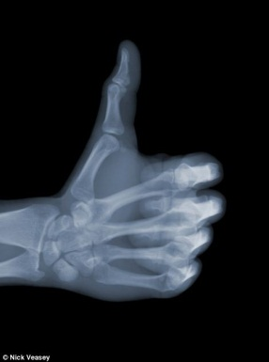
Required Information
State the proposed examination(s)
Give full clinical details of patient’s condition/injury + other relevant clinical history/co-morbidities
Ask a clinical question that can be answered by the proposed examination

Slide 19
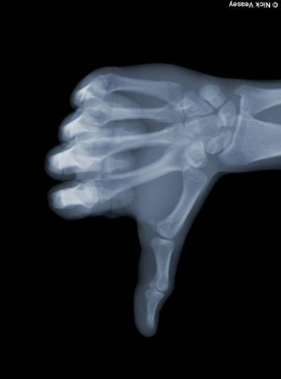
Poor requests can lead to….
Breach of referrers responsibility under IR(ME)R
Delays in patient turn-around time
Time wasted chasing up enquiries
Wrong images being obtained, therefore clinical question not answered
Pathology being missed

Slide 20
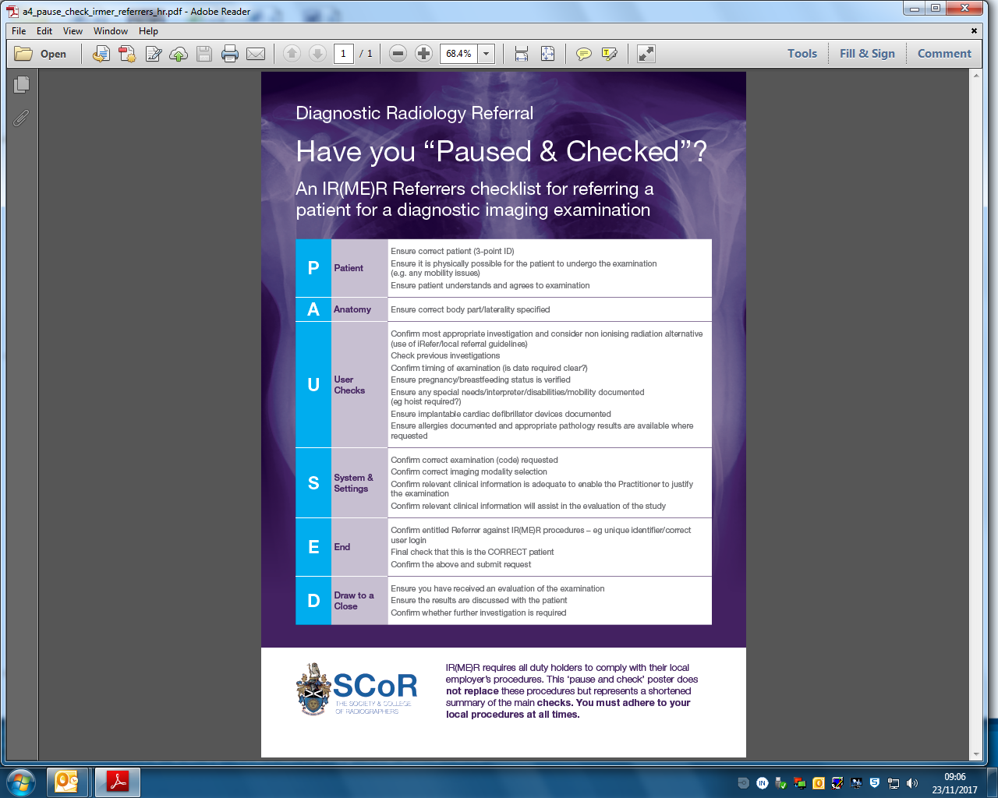

Slide 27
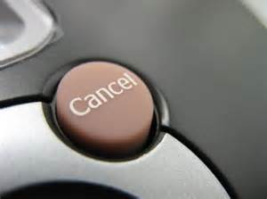
Canceling Requests
Once a request has been submitted it is not possible to cancel it on CRRS
To cancel a submitted request contact radiology by telephone immediately

Slide 28
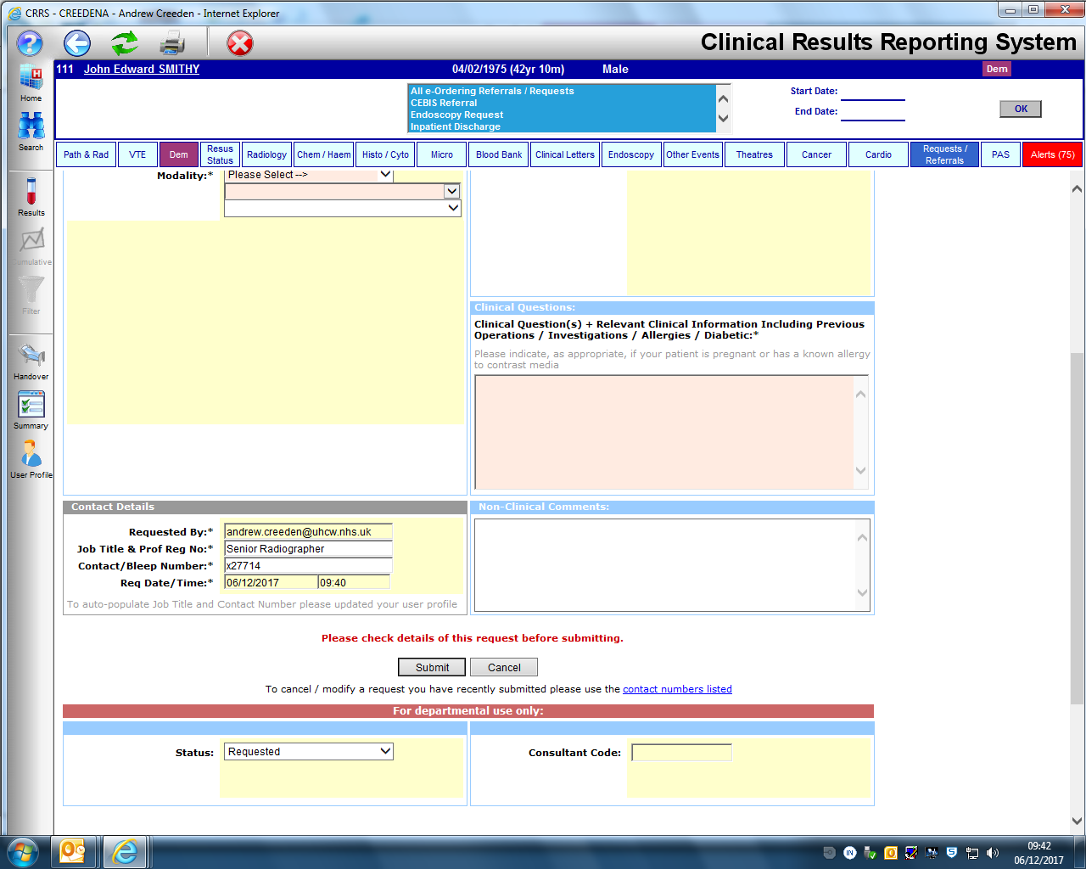

Slide 29
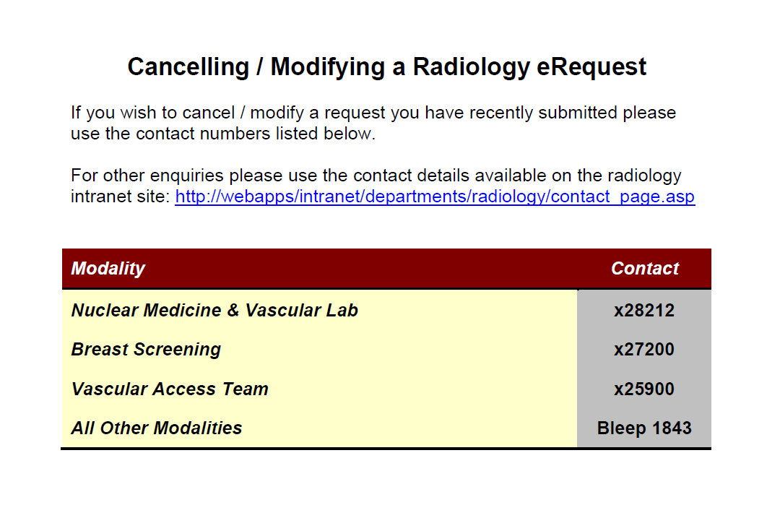

Slide 30

Summary
Non-Medical Referrers (NMRs) must first be on the Radiology Approval Register (RAR)
Ensure you have read and fully understand the requirements of your protocol
Ensure no-one else uses your login
‘Pause and Check’ before submitting the request

Slide 31
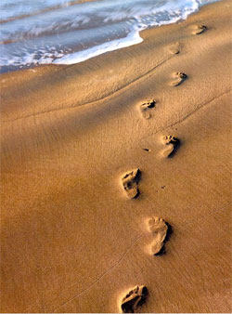
Next Steps
Complete the Authorisation Page (Appendix 1) and send it to Radiology
Send an RFS form to ICT

Slide 32

Questions?

