Slide 1
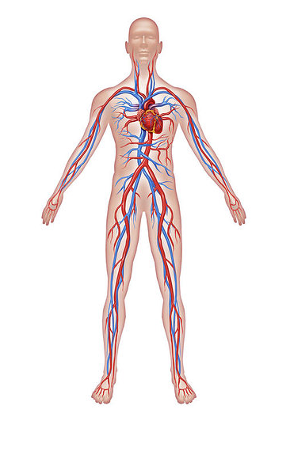
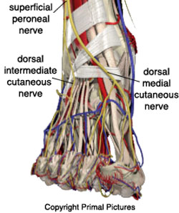
Nicola Sedgwick, BSc(hons) Podiatry,
PgC Medical Ultrasound
Accredited vascular scientist
Podiatry Indications for Vascular Ultrasound assessment
xxxxxxxxx

Slide 2
Vascular Ultrasound
Draw backs
Benefits of ultrasound
Non invasive
No side effects
Relatively comfortable for the patient
Immediate results
Operator dependent
Challenging in patients with obesity
Patient needs to be compliant
Notes:
What we would like you to know about vascular ultrasound

Slide 3
What do you get when you refer to vascular ultrasound?
An ultrasound vascular assessment of either the venous or arterial system with ABPIs for arterial patients and an exercise challenge where required.
Detail of the scan depends on the suspected pathology and what we find throughout the course of the scan
Notes:
Not both sysmtems!
And we want to be your eyes.

Slide 4
The Podiatrist
The gate keeper for patient health
Notes:
What we assume about podiatry
vascular lab should have a podiatrist or two as part of the team refer both ways
Poor compliance and poor attendance so we all need to be gate keepers,
We see pts that have had bypass 3 years ago abroad and have never been followed up, so when apt comes through the door of a medical facility we all need to enforcing the messages about the importance of follow up, following their physicians advice attending dietician appointments physio etc

Slide 5
Indications for arterial duplex
Intermittent claudication
Ischemic rest pain
Gangrene
Ulceration
Diminished pulses
Bounding pulses

Slide 6
Indications for arterial duplex
Non compressible arteries
Considering patient for compression
Reduced ABPI in the podiatry clinic
Post surgery follow up
Known or ? Aneurysm/false aneurysm

Slide 7
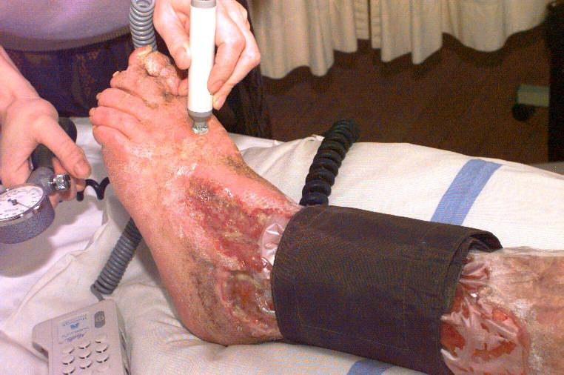
Urgent referral
Critical limb Ischemia. Sudden onset of pain
Chronic
Acute
ABPI <0.3
Notes:
Limb and life threatening
As a result of sudden interruption to flow

Slide 8
Arterial duplex
Three variations of arterial assessment
ABPI
Duplex of PTA and ATA at the ankles
ABPI
Or TCPO2
Limited assessment
CFA, Pop.A and PTA and ATA at the ankle
ABPI

Slide 9
Arterial duplex
Full arterial duplex
CFA to the ankles, scanning the full length of each artery
When needed the iliac and aorta
Noting velocities and waveforms
Length and type of disease
Patent sections of vessel that suitable to use for a bypass

Slide 10
Arterial duplex
ABPI
Simple cheap and useful test
But also operator dependent
Lots of ways to get this wrong and its important that its done correctly.
In the vascular lab we actually visualise the vessels so we can give an indication of the state of the arteries

Slide 11
Arterial assessment
Diagnose as we scan
Adapt the scan to the patients pathology
E.g……
Monophasic CFA
Long occlusion
Triphasic waveforms at the ankle
Aneurysm
DVT

Slide 12
Venous scanning
Two types of Venous scans
?DVT
?Reflux
Important how these scans are done, probably more operator dependent than arterial scans and a problem everywhere getting reliable result of the calf vessels

Slide 13
Indications for venous duplex
DVT
Swelling
Pain
Tenderness
Redness
?source of PE
Notes:
Unilateral symptoms
Bilateral DVT unusual unless pt has cancer bilateral symptoms condsider other causes
Same day scan

Slide 14
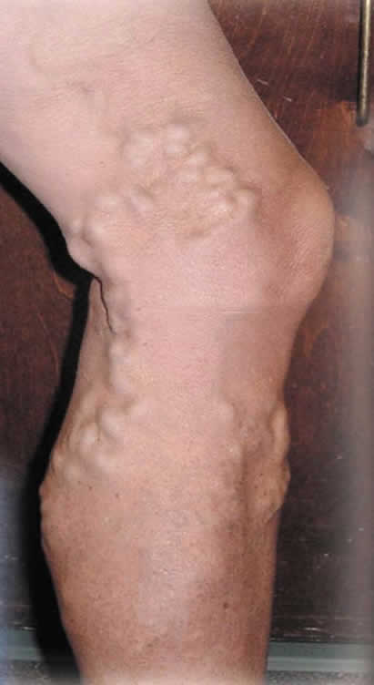
Indications for venous duplex
Varicose Veins
Heavy aching leg
Visible varicosities
Reflux on CW doppler
Telengectasia / spider veins
Hemosiderin staining
Eczema / itchy skin
Thickening skin around the calf

Slide 15
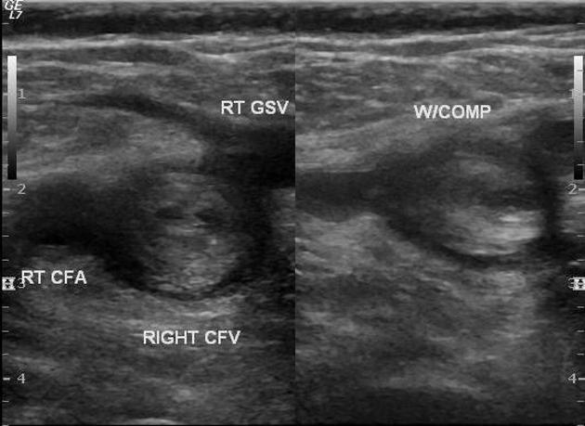
Venous scanning
DVT
The entire deep system from distal EIV to the ankle
Checking for normal competent flow
Compressible vessels
Notes:
Mention thrombophelbitis

Slide 16
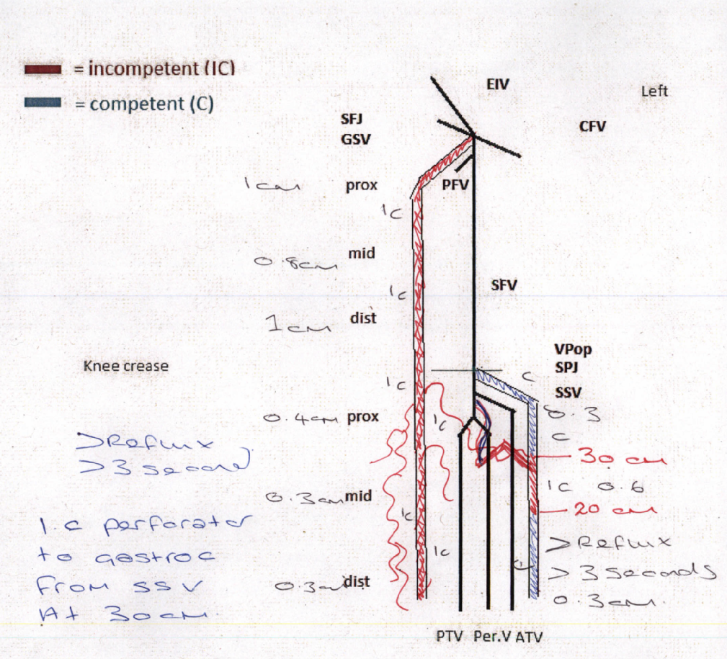
Venous scanning
Varicose veins
Detailed scan of the superficial system and a brief look at the deeps system
The result of the scan providing a plan for surgery and which type of surgery

Slide 17
Podiatry Indications for Vascular Ultrasound
Answering a question that is going to help with decision making on the patient’s care plan
Results that the referring clinician understands
Notes:
Not really to reassure the pt – hopefully not clutching at scores scan everything request.
coming here it wasn’t always the case nephrology example

